Slide 1

قناة الثامن رياضيات شرح وأوراق
https://t.me/mathbook_8
عمل المدرس: مصطفى علَّام

Slide 2
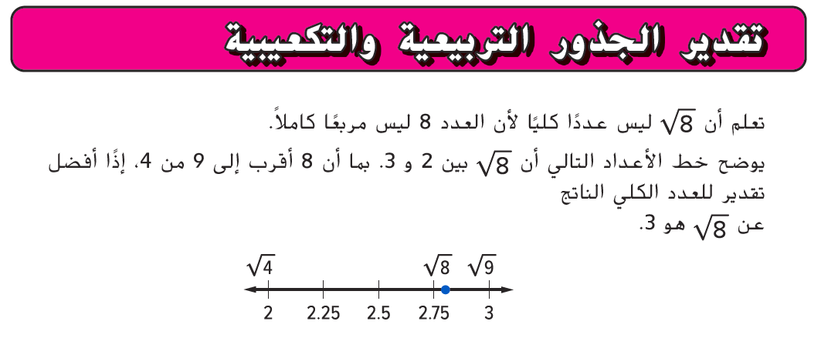

Slide 3
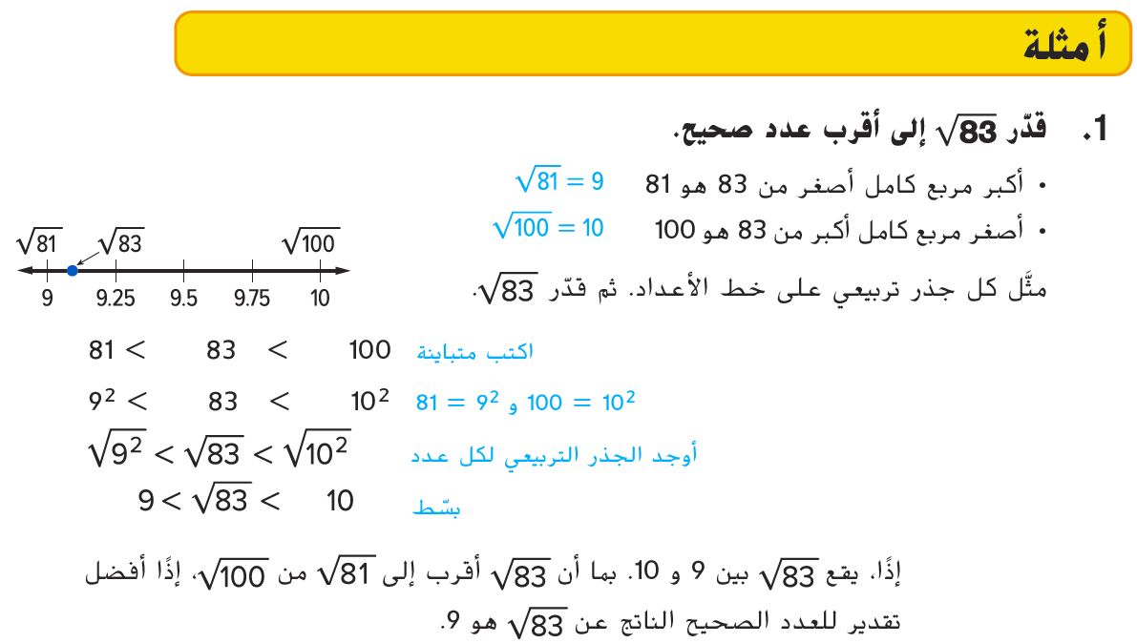

Slide 4
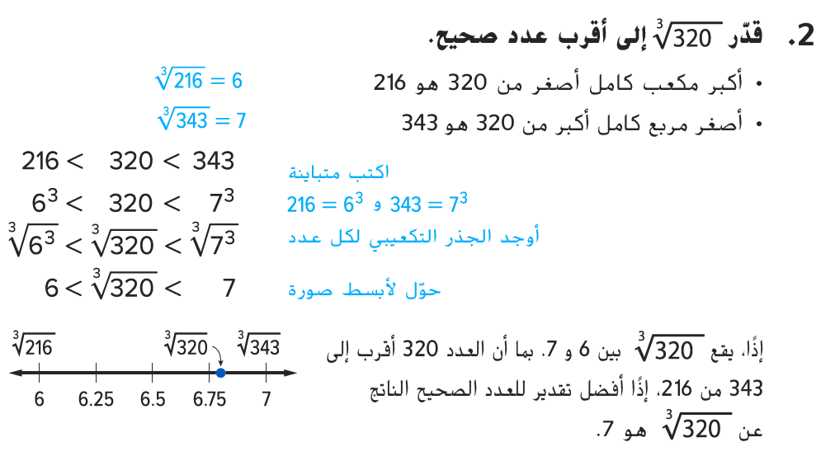

Slide 5
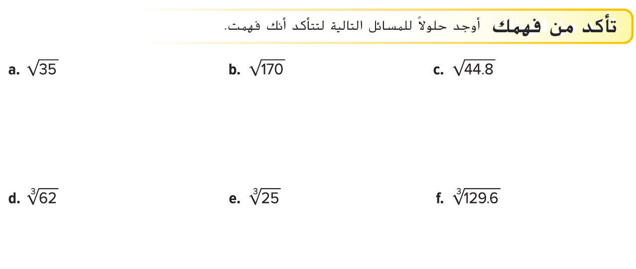
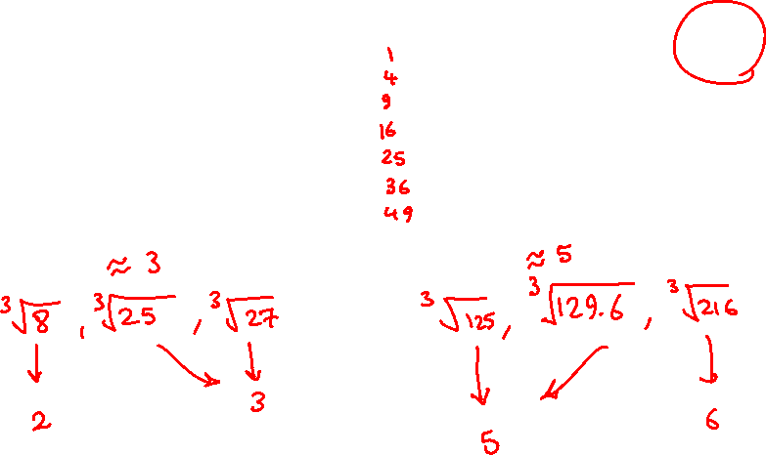
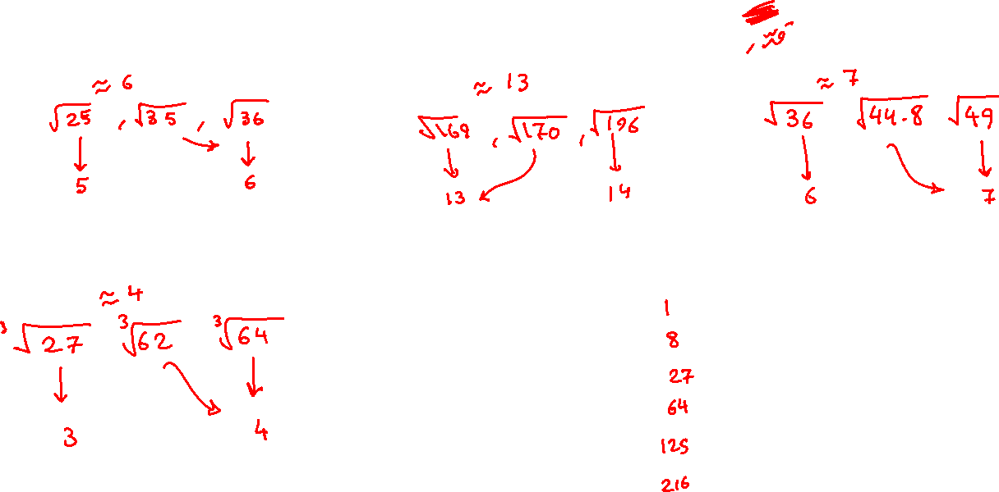

Slide 6
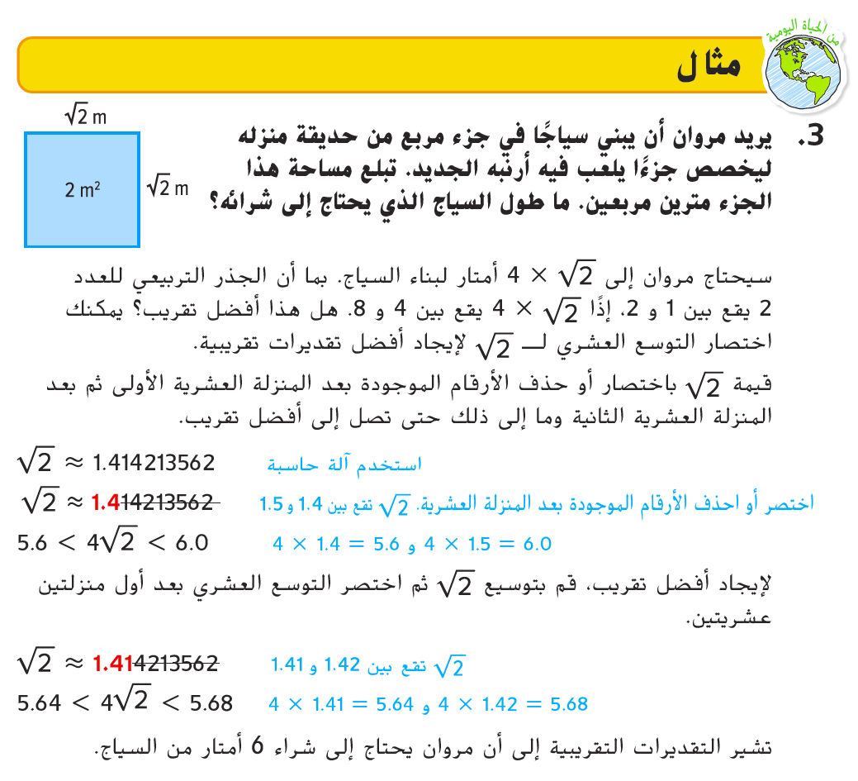

Slide 7
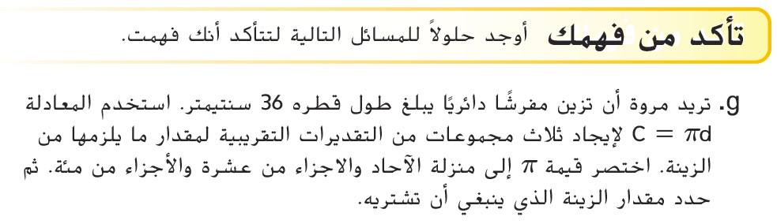
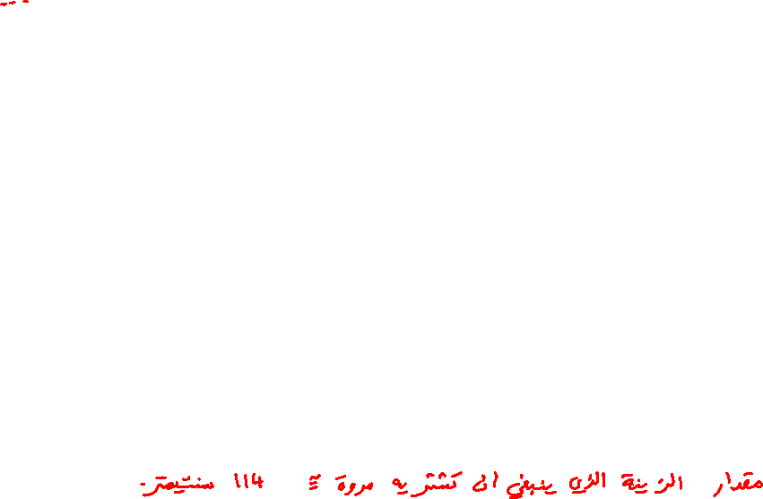
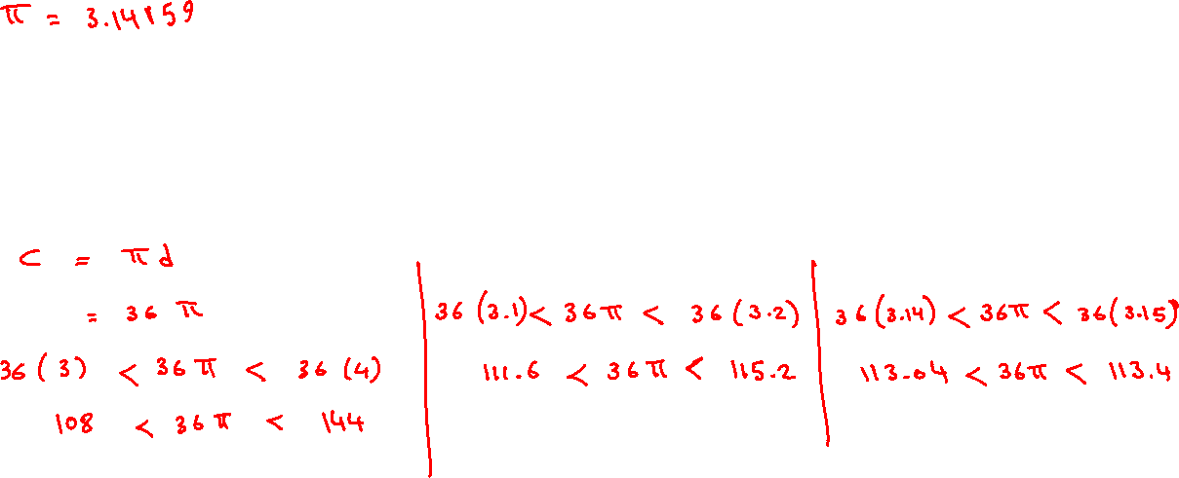
_______________________________________________________________________________________________________________________________________________________________________________________________________________________________________________________________________________________________________________________________________________________________________________________________________________________________________________________________________________________________________________________________________________________________________________________________________________________________________________________________________________________________________________________________________________________________

Slide 8
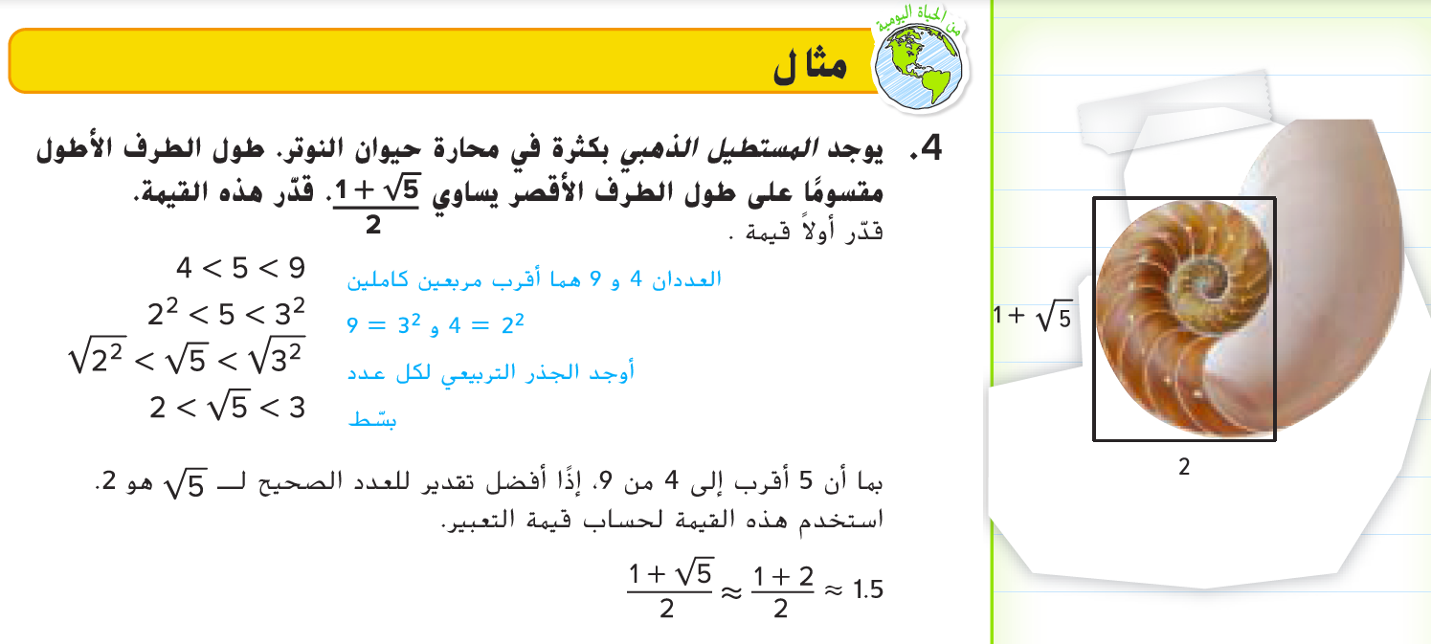

Slide 9
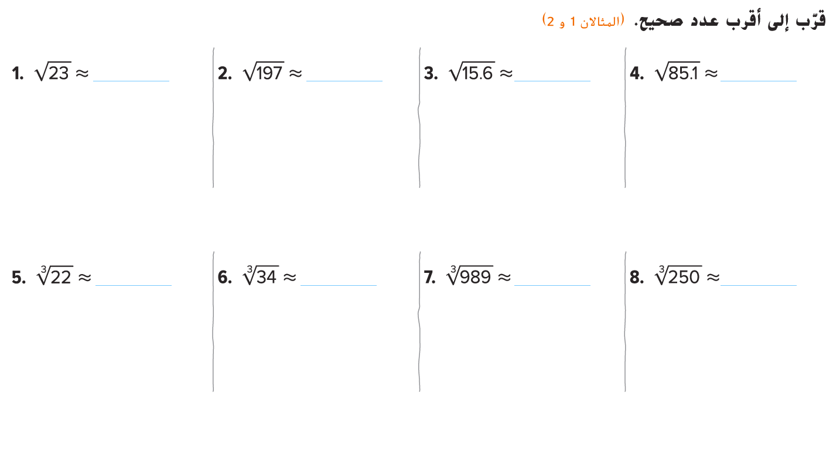
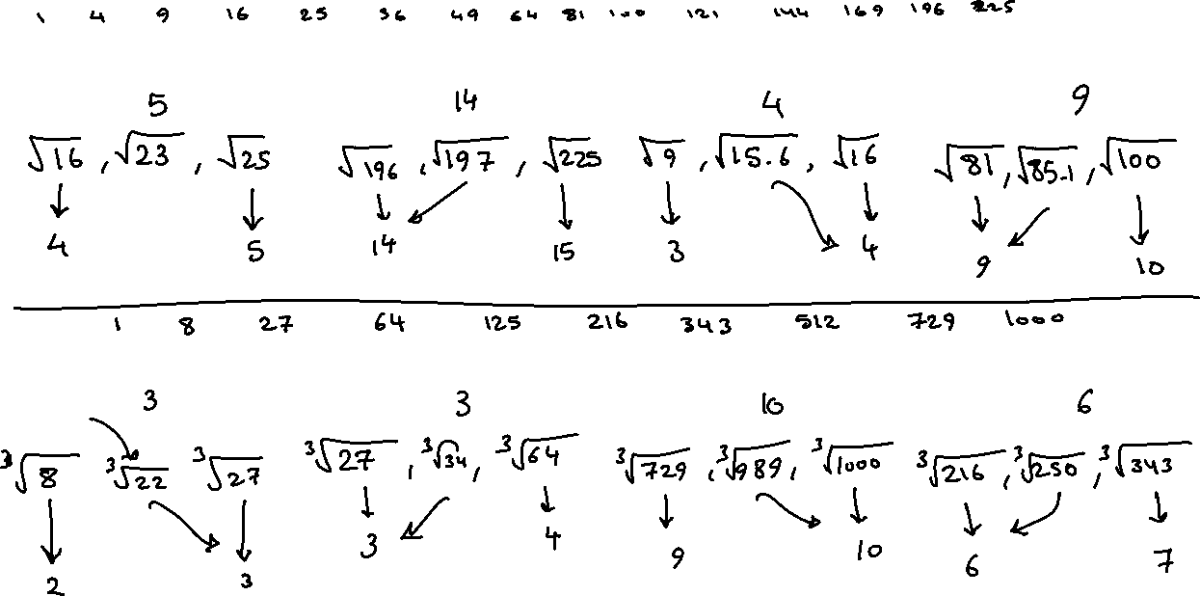

Slide 10
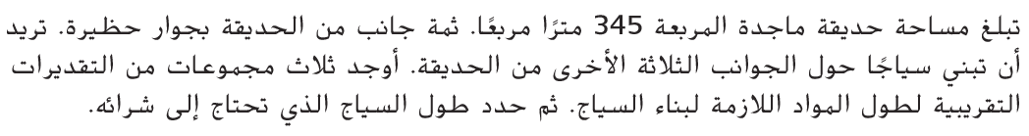
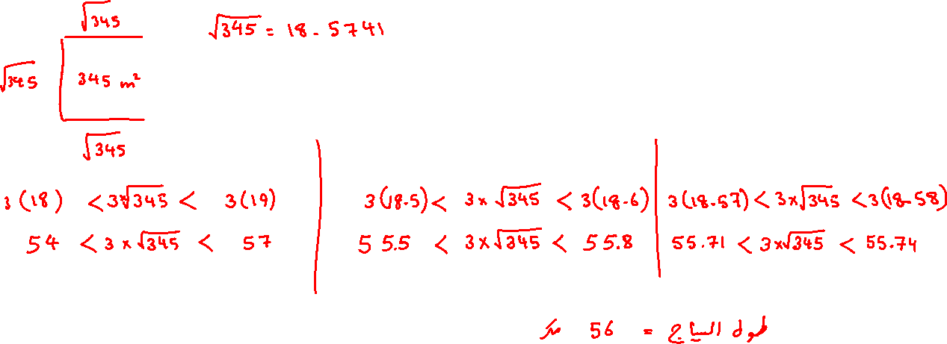
_________________________________________________________________________________________________________________________________________________________________________________________________________________________________________________________________________________________________________________________________________________________________________________________________________________________________________________________________________________________________________________________________________________________________________________________________________________________________________________________________________________________________________________________________________________________________________________________________________________________________________________________________________________________________________________________________________________________________________________

Slide 11
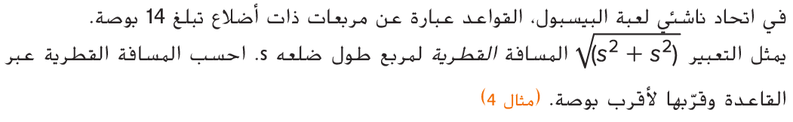
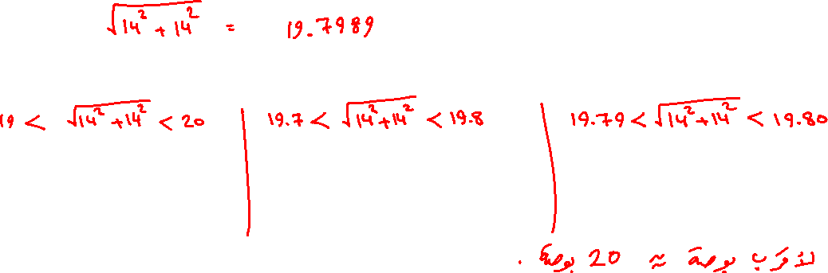
________________________________________________________________________________________________________________________________________________________________________________________________________________________________________________________________________________________________________________________________________________________________________________________________________________________________________________________________________________________________________________________________________________________________________________________________________________________________________________________________________________________________________________________________________________________________________________________________________________________________________________________________________

Slide 12
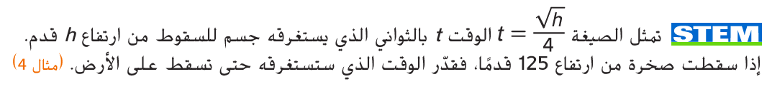
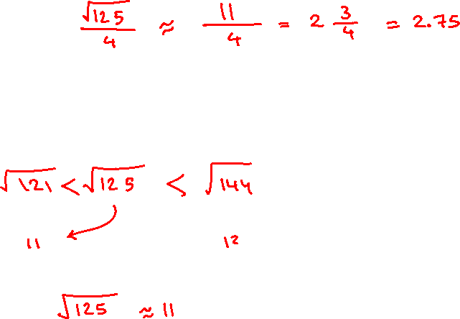
________________________________________________________________________________________________________________________________________________________________________________________________________________________________________________________________________________________________________________________________________________________________________________________________________________________________________________________________________________________________________________________________________________________________________________________________________________________________________________________________________________________________________________________________________________________________________________________________________________________________________________________________________

Slide 13
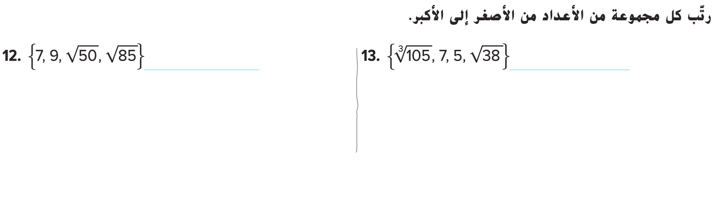
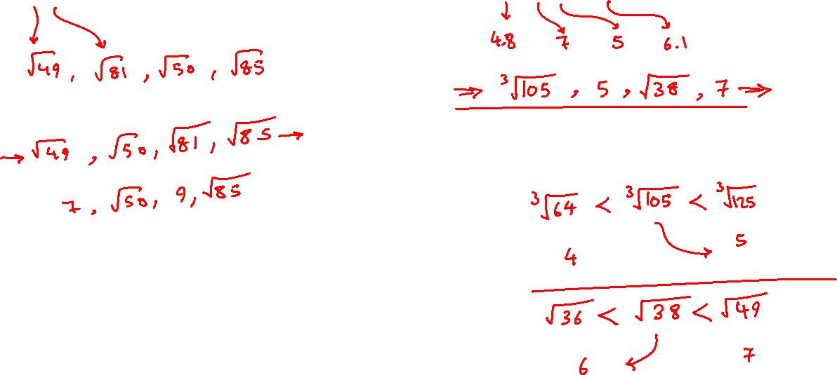

Slide 14
