Slide 1

Unit 10
Lesson 3 – 4: Exploring the Seas
Grade 8

Slide 2
Learning Outcomes
• listen to a discussion and summarise the opinions of the speakers.
• take part in a discussion and express their opinions.

Slide 3
Lesson 3 - Key Words
Wreck: Ruin, crash
Submersible: a small boat designed for exploration under water.
Expedition: a journey taken by a group of people with a particular purpose.
Belongings: a person's movable possessions
Grave: a hole dug in the ground to bury a dead body

Slide 4

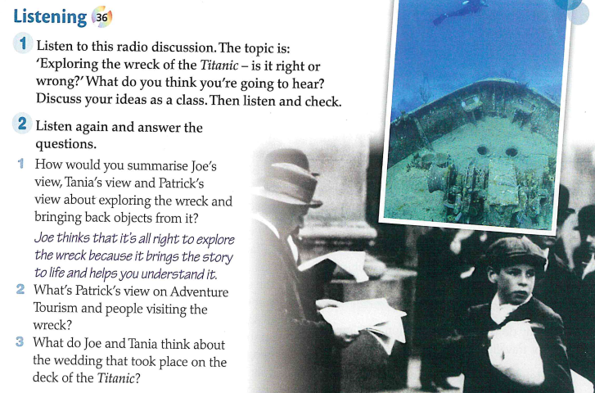

Slide 5
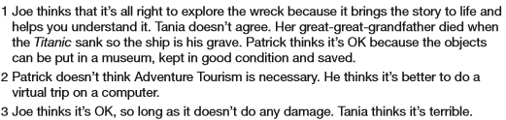
Key Answers

Slide 6
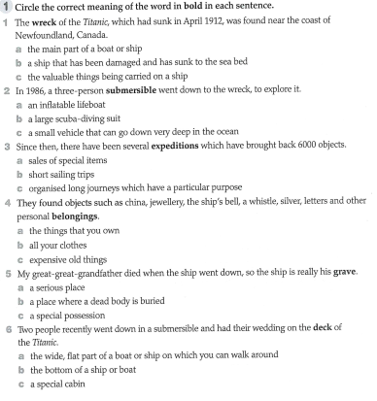
b
c
c

Slide 7
a
b
a

Slide 8
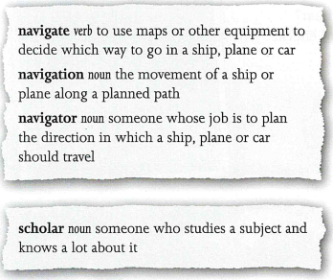
Lesson 4 – Key Words
Navigate
Navigator
Navigation
Scholar

Slide 9
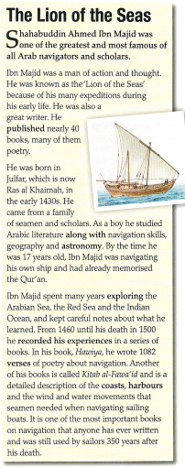

Slide 10

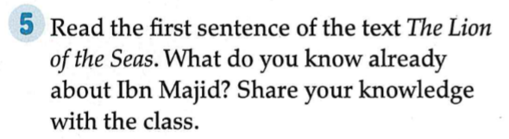

Slide 11
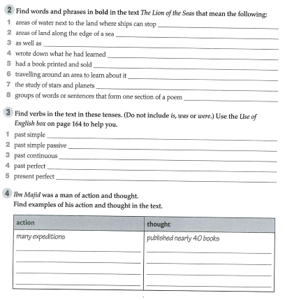
Navigated his own ship at 17
Studied navigation, geography, astronomy, and Arabic literature
Explored the Arabian Sea, the Red Sea and the Indian Ocean
Memorized the Qur’an at an early age
Recorded his experience in a series of books.

Slide 12
Home work

Slide 13
1 harbours;
2 coasts;
3 along with;
4 recorded his experiences;
5 published;
6 exploring;
7 astronomy;
8 verses

Slide 14
Home work

Slide 15
1 published, came from, spent, explored, kept, learned, recorded, wrote, needed
2 was known, was born, was written, was (still) used
3 was navigating
4 had (already) memorised
5 has (ever) written

Slide 16
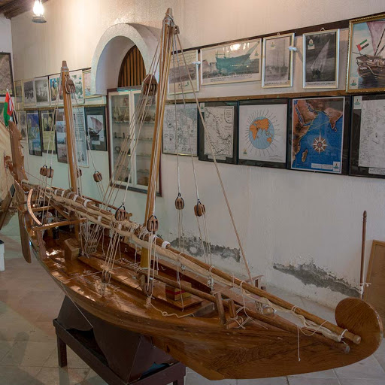
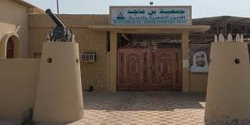
Fun Fact

