Slide 1
Apply Integer Operations

Slide 2
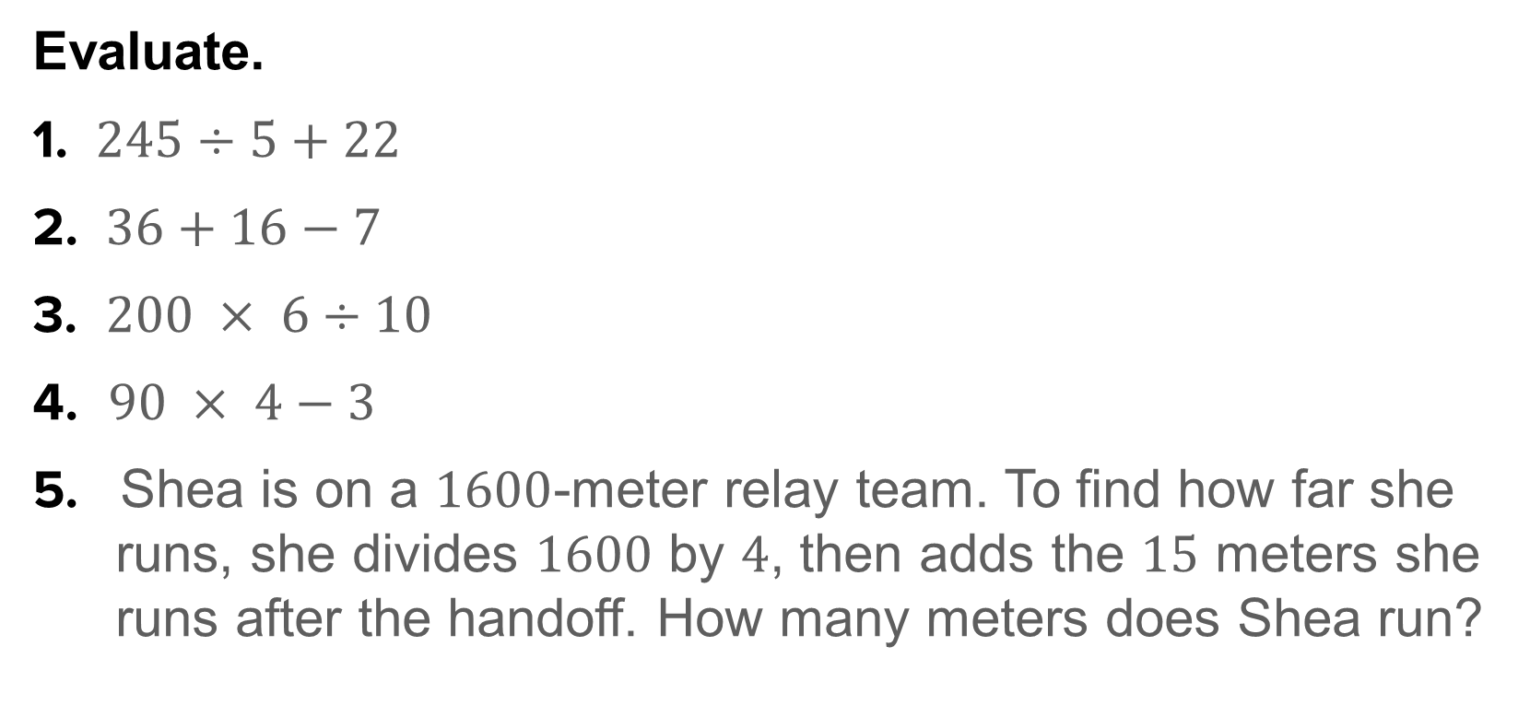
Warm Up
Evaluate.
1. $245÷5+22$
2. $36+16−7$
3. $200 × 6÷10$
4. $90 × 4−3$
5. Shea is on a $1600$-meter relay team. To find how far she runs, she divides $1600$ by $4$, then adds the $15$ meters she runs after the handoff. How many meters does Shea run?

Slide 3
Warm Up
Evaluate.
1. $245÷5+22$
2. $36+16−7$
3. $200 × 6÷10$
4. $90 × 4−3$
5. Shea is on a $1600$-meter relay team. To find how far she runs, she divides $1600$ by $4$, then adds the $15$ meters she runs after the handoff. How many meters does Shea run?
71
45
120
357
415
Notes:
71
45
120
357
415

Slide 4
Standards for Mathematical Content
7.NS.A.1
Apply and extend previous understandings of addition and subtraction to add and subtract rational numbers; represent addition and subtraction on a horizontal or vertical number line diagram.
7.NS.A.1.D
Apply properties of operations as strategies to add and subtract rational numbers.

Slide 5
Standards for Mathematical Content
7.NS.A.2
Apply and extend previous understandings of multiplication and division and of fractions to multiply and divide rational numbers.
7.NS.A.2.C
Apply properties of operations as strategies to multiply and divide rational numbers.
7.NS.A.3
Solve real-world and mathematical problems involving the four operations with rational numbers.

Slide 6
Standards for Mathematical Content
7.EE.B.3
Solve multi-step real-life and mathematical problems posed with positive and negative rational numbers in any form (whole numbers, fractions, and decimals), using tools strategically. Apply properties of operations to calculate with numbers in any form; convert between forms as appropriate; and assess the reasonableness of answers using mental computation and estimation strategies.

Slide 7
Standards for Mathematical Practice
MP3
Construct viable arguments and critique the reasoning of others.
MP6
Attend to precision.
MP7
Look for and make use of structure.

Slide 8
Lesson Goal
Students will solve problems by applying all operations to integers.

Slide 9
Example 1
Order of Integer Operations
Find $−4(3)+(−7).$

Slide 10
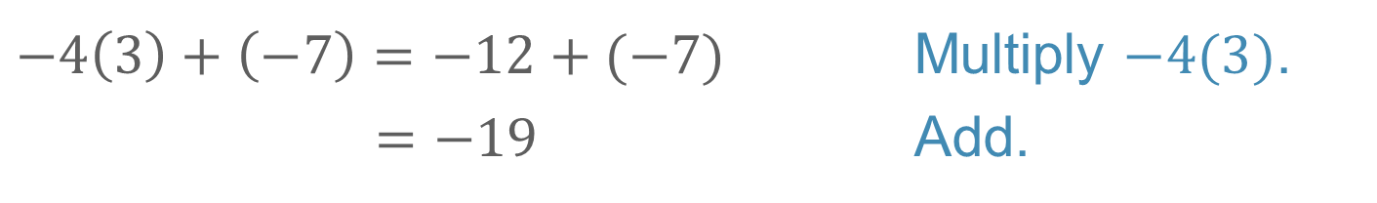
Example 1
Order of Integer Operations
$$−4\left(3\right)+\left(−7\right)=−12+(−7)$$ | Multiply $−4(3)$.
$=−19$ | Add.
So, $−4(3)+(−7)$ is $−19.$

Slide 11
Example 1
Order of Integer Operations
Talk About It!
Why was multiplication performed as the first operation in evaluating the expression?

Slide 12
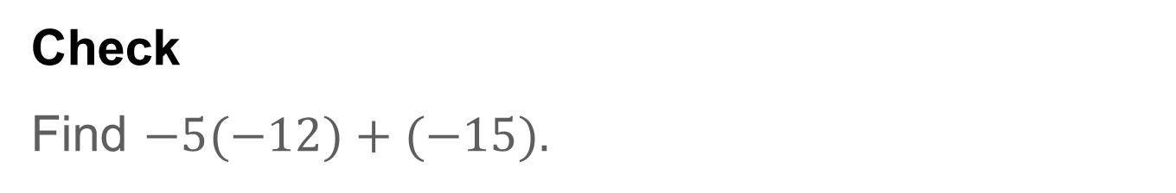
Example 1
Order of Integer Operations
Check
Find $−5(−12)+(−15).$

Slide 13
Example 1
Order of Integer Operations
Check
Find $−5(−12)+(−15).$
45
Notes:
45

Slide 14
Example 2
Order of Integer Operations
Find $−4(−5)(−2)−(−8).$

Slide 15
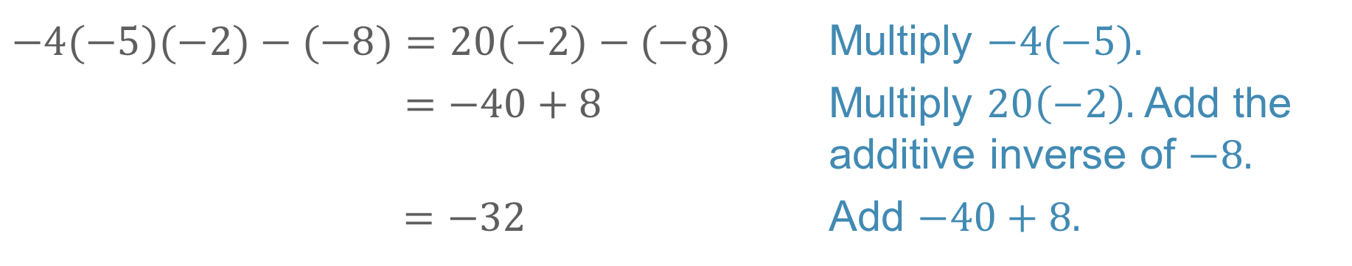
Example 2
Order of Integer Operations
$−4(−5)(−2)−(−8)=20(−2)−(−8)$ | Multiply $−4(−5).$
$$=−40+8$$ | Multiply $20\left(−2\right).$ Add the additive inverse of $−8.$
$=−32$ | Add $−40+8.$
So, $−4(−5)(−2)−(−8)=−32.$

Slide 16
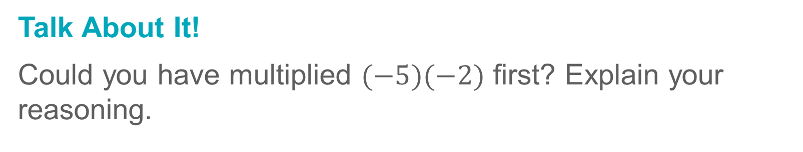
Example 2
Order of Integer Operations
Talk About It!
Could you have multiplied $(−5)(−2)$ first? Explain your reasoning.

Slide 17
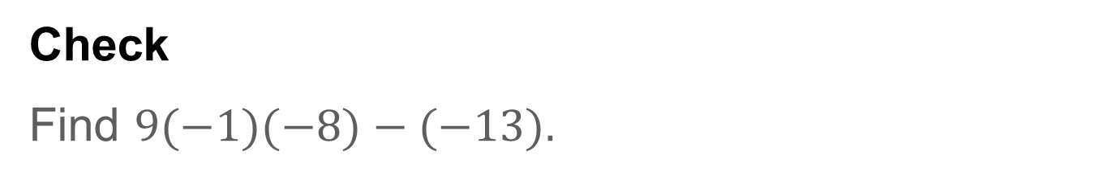
Example 2
Order of Integer Operations
Check
Find $9(−1)(−8)−(−13).$

Slide 18
Example 2
Order of Integer Operations
Check
Find $9(−1)(−8)−(−13).$
85
Notes:
85

Slide 19
Example 3
Order of Integer Operations
Evaluate $\frac{w}{xy}+y−z^{3} if w=36, x=−6, y=−1, and z=−2.$

Slide 20
Example 3
Order of Integer Operations
Think About It!
How would you begin evaluating the expression?

Slide 21
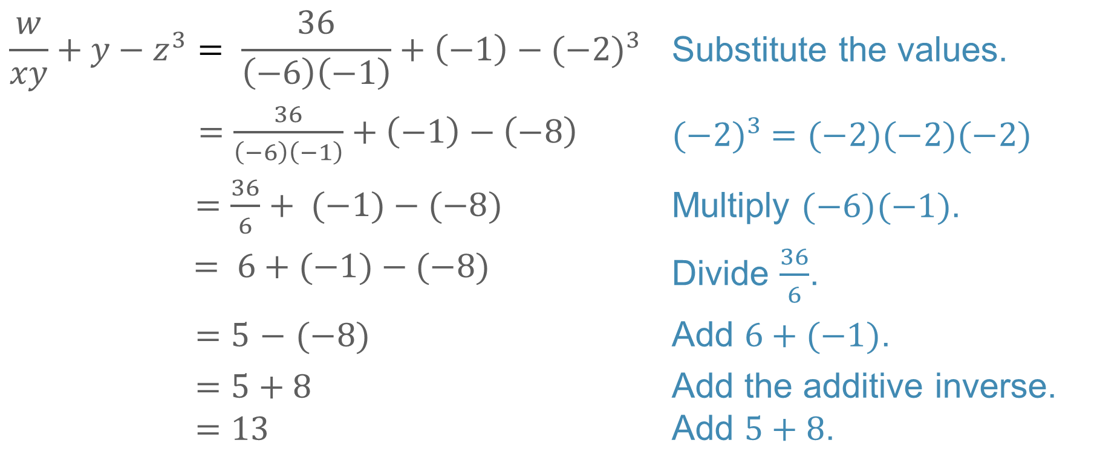
Example 3
Order of Integer Operations
$$\frac{w}{xy}+y−z^{3}= \frac{36}{\left(−6\right)\left(−1\right)}+\left(−1\right)−{(−2)}^{3}$$ | Substitute the values.
$=\frac{36}{\left(−6\right)\left(−1\right)}+\left(−1\right)−\left(−8\right)$ | $${(−2)}^{3} =(−2)(−2)(−2)$$
$=\frac{36}{6}+ (−1)−(−8)$ | Multiply $(−6)(−1)$.
$= 6+(−1)−(−8)$ | Divide $\frac{36}{6}$.
$=5$ $−$ $(−8)$ | Add $6+(−1)$.
$=5+8$ $$=13$$ | Add the additive inverse. Add $5+8$.
So, the value of the expression is 13.

Slide 22
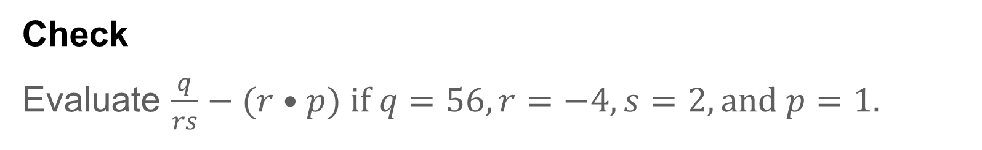
Example 3
Order of Integer Operations
Check
Evaluate $\frac{q}{rs}−(r•p) if q=56, r=−4, s=2, and p=1.$

Slide 23

Example 3
Order of Integer Operations
Check
Evaluate $\frac{q}{rs}−(r•p) if q=56, r=−4, s=2, and p=1.$
$$−3$$
Notes:
$$−3$$

Slide 24
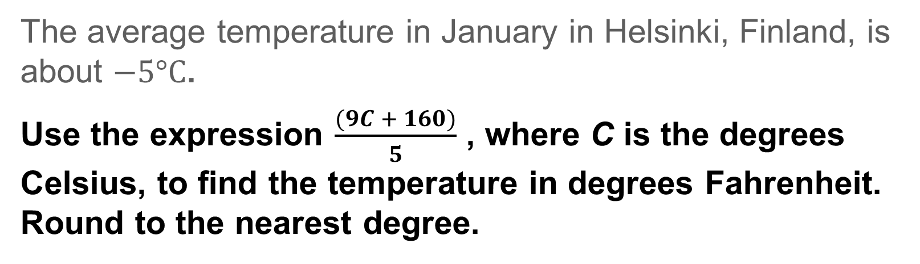
Example 4
Order of Integer Operations
The average temperature in January in Helsinki, Finland, is about $−5°C$.
Use the expression $\frac{(9C + 160)}{5}$ , where C is the degrees Celsius, to find the temperature in degrees Fahrenheit. Round to the nearest degree.

Slide 25
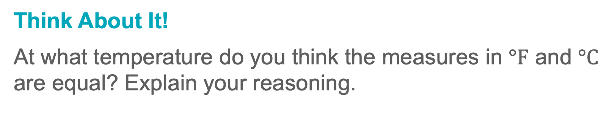
Example 4
Order of Integer Operations
Think About It!
At what temperature do you think the measures in $°F$ and $°C$ are equal? Explain your reasoning.

Slide 26
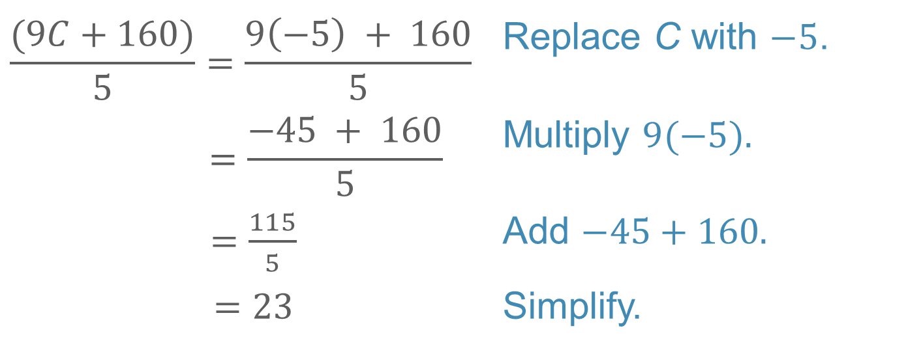
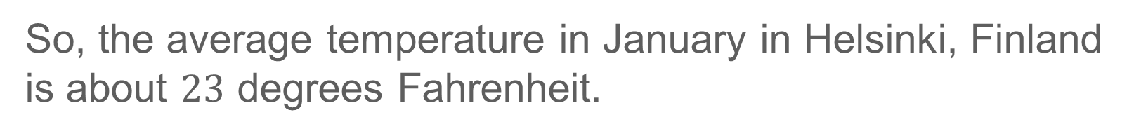
Example 4
Order of Integer Operations
$$\frac{(9C+160)}{5}=\frac{9\left(−5\right) + 160}{5}$$ | Replace C with $−5$.
$$=\frac{−45 + 160}{5}$$ | Multiply $9(−5).$
$=\frac{115}{5}$ | Add $−45+160.$
$=23$ | Simplify.
So, the average temperature in January in Helsinki, Finland is about $23$ degrees Fahrenheit.

Slide 27
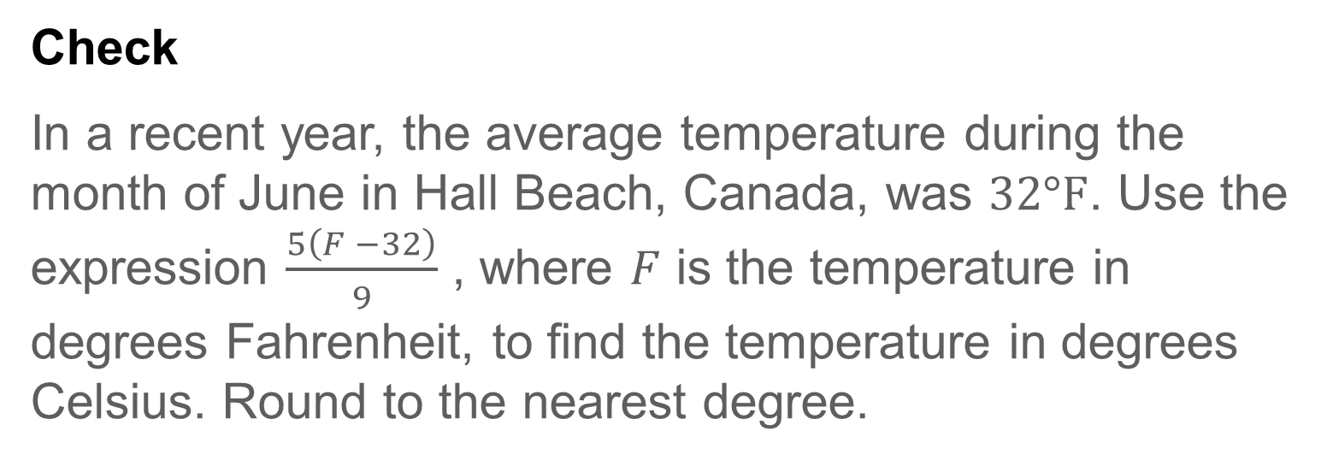
Example 4
Order of Integer Operations
Check
In a recent year, the average temperature during the month of June in Hall Beach, Canada, was $32°F$. Use the expression $\frac{5\left(F −32\right)}{9}$ , where $F$ is the temperature in degrees Fahrenheit, to find the temperature in degrees Celsius. Round to the nearest degree.

Slide 28

Example 4
Order of Integer Operations
Check
In a recent year, the average temperature during the month of June in Hall Beach, Canada, was $32°F$. Use the expression $\frac{5\left(F −32\right)}{9}$ , where $F$ is the temperature in degrees Fahrenheit, to find the temperature in degrees Celsius. Round to the nearest degree.
$$0˚C$$
Notes:
$$0˚C$$

Slide 29
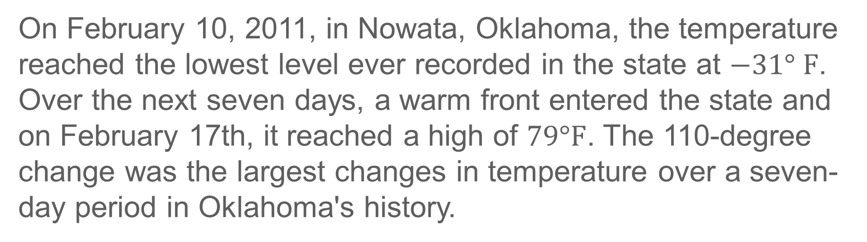
Exit Ticket
On February 10, 2011, in Nowata, Oklahoma, the temperature reached the lowest level ever recorded in the state at $−31° F$. Over the next seven days, a warm front entered the state and on February 17th, it reached a high of $79°F$. The 110-degree change was the largest changes in temperature over a seven-day period in Oklahoma's history.

Slide 30
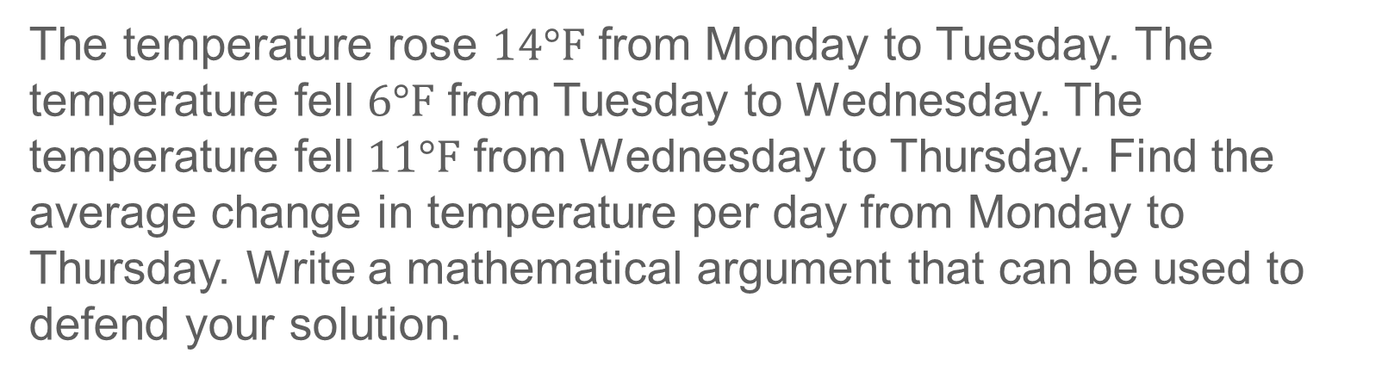
Exit Ticket
The temperature rose $14°F$ from Monday to Tuesday. The temperature fell $6°F$ from Tuesday to Wednesday. The temperature fell $11°F$ from Wednesday to Thursday. Find the average change in temperature per day from Monday to Thursday. Write a mathematical argument that can be used to defend your solution.

Slide 31
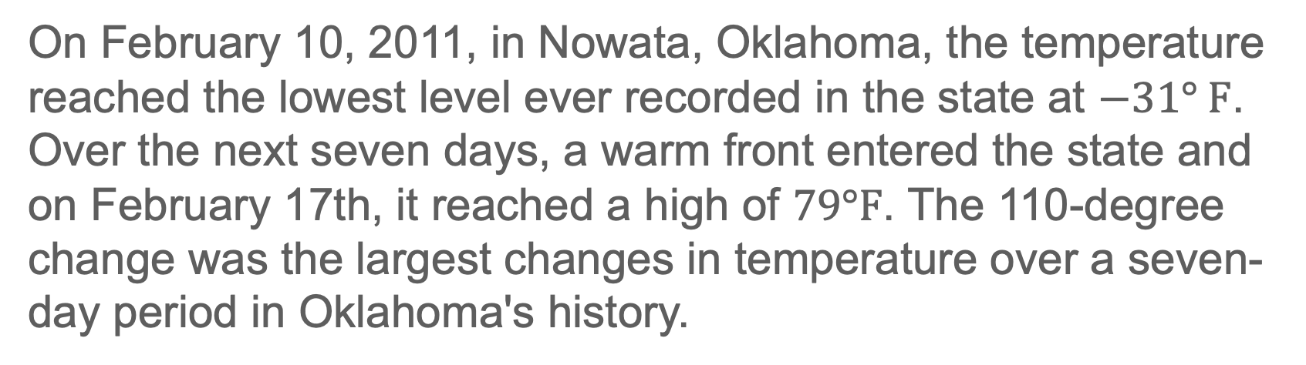
Exit Ticket
On February 10, 2011, in Nowata, Oklahoma, the temperature reached the lowest level ever recorded in the state at $−31° F$. Over the next seven days, a warm front entered the state and on February 17th, it reached a high of $79°F$. The 110-degree change was the largest changes in temperature over a seven-day period in Oklahoma's history.

Slide 32
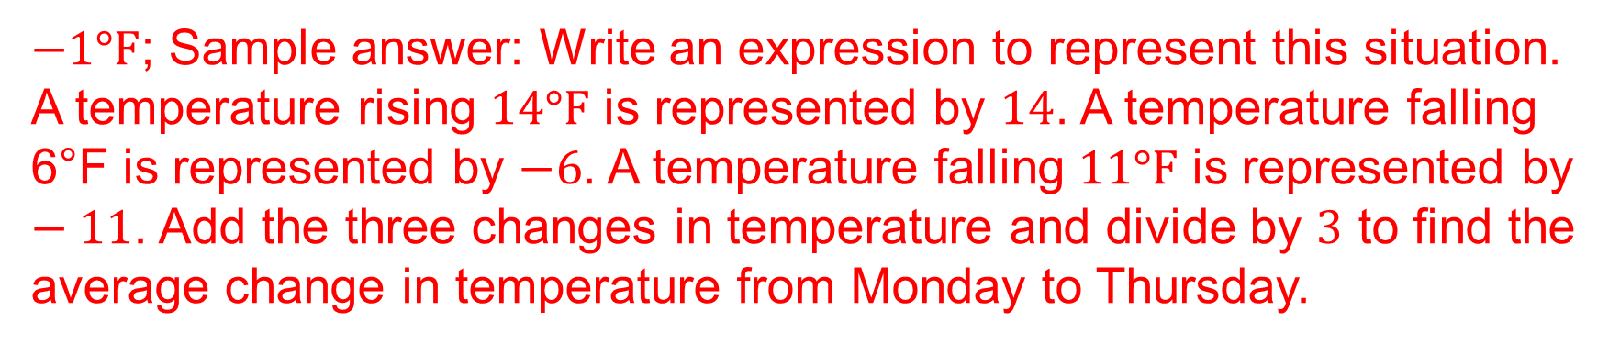
Exit Ticket
The temperature rose $14°F$ from Monday to Tuesday. The temperature fell $6°F$ from Tuesday to Wednesday. The temperature fell $11°F$ from Wednesday to Thursday. Find the average change in temperature per day from Monday to Thursday. Write a mathematical argument that can be used to defend your solution.
$−1°F$; Sample answer: Write an expression to represent this situation. A temperature rising $14°F$ is represented by $14$. A temperature falling 6°F is represented by $−6$. A temperature falling $11°F$ is represented by $−11$. Add the three changes in temperature and divide by $3$ to find the average change in temperature from Monday to Thursday.
Notes:
−1°F; Sample answer: Write an expression to represent this situation. A temperature rising 14°F is represented by 14. A temperature falling 6°F is represented by −6. A temperature falling 11°F is represented by −11. Add the three changes in temperature and divide by 3 to find the average change in temperature from Monday to Thursday.

