Slide 1
Percent Error

Slide 2
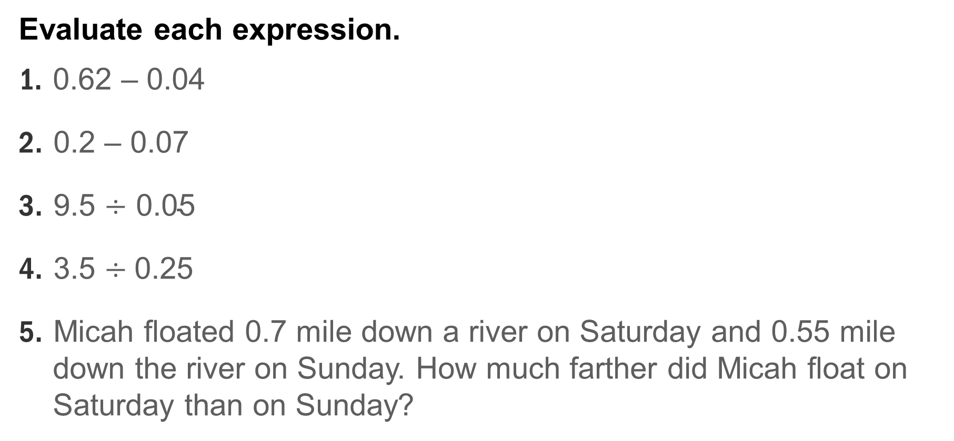
Warm Up
Evaluate each expression.
1. 0.62 – 0.04
2. 0.2 – 0.07
3. $\text{9.5 }\text{÷}\text{ 0.05}$
4. $\text{3.5} \text{÷} \text{0.25}$
5. Micah floated 0.7 mile down a river on Saturday and 0.55 mile
down the river on Sunday. How much farther did Micah float on
Saturday than on Sunday?

Slide 3
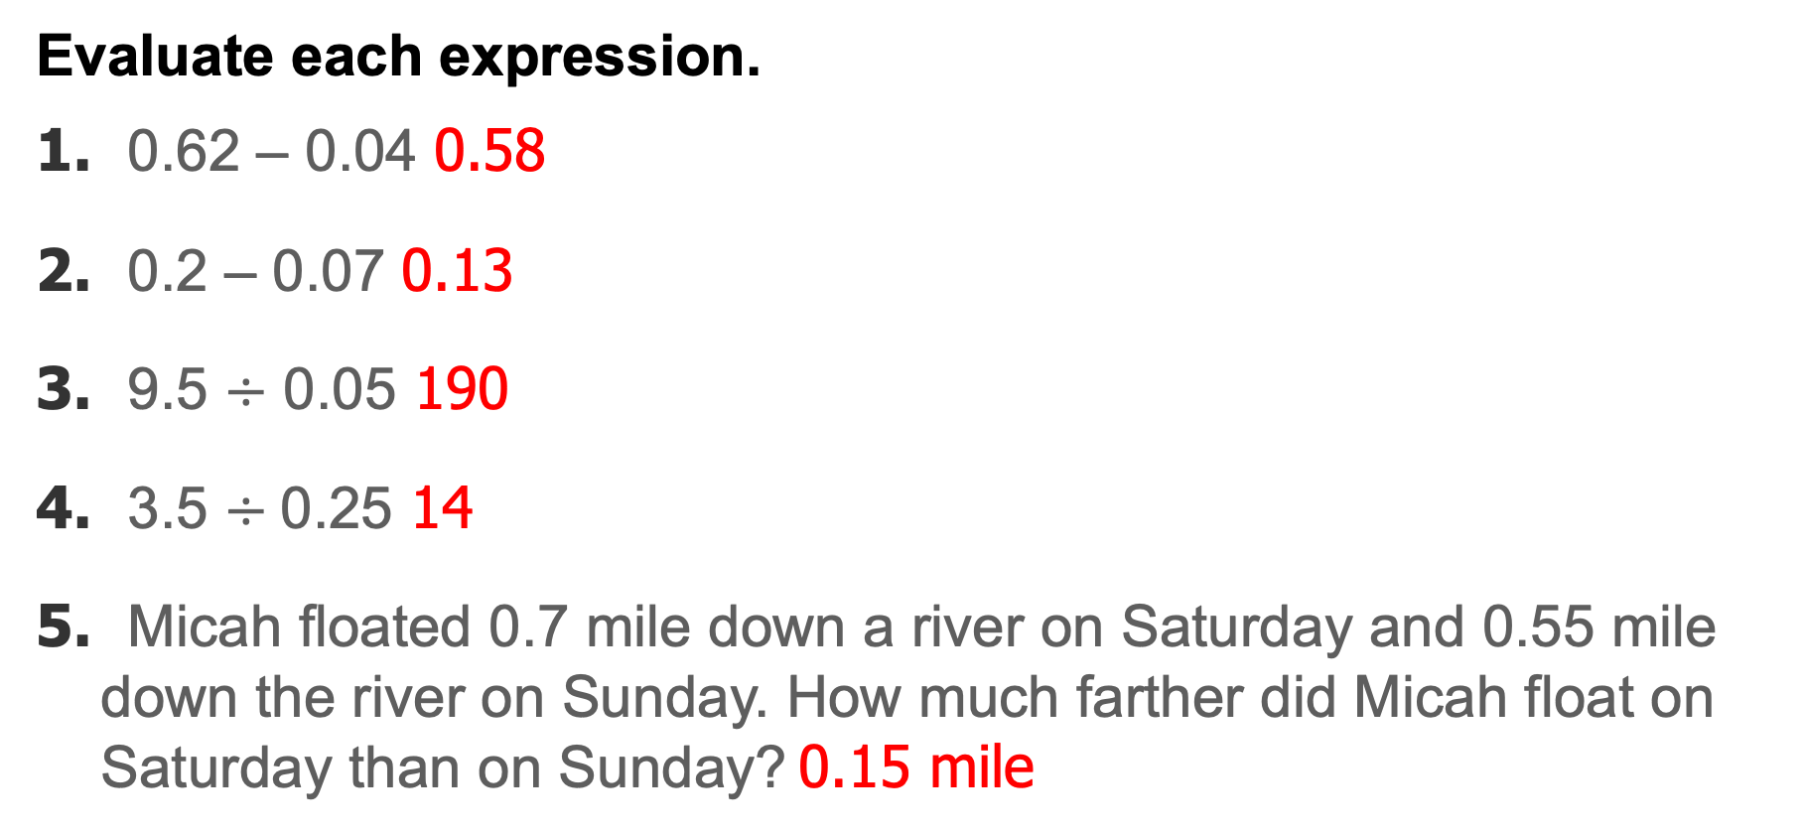
Warm Up
Evaluate each expression.
1. 0.62 – 0.04 0.58
2. 0.2 – 0.07 0.13
3. $\text{9.5 }\text{÷}\text{ 0.05}$ 190
4. $\text{3.5} \text{÷} \text{0.25}$ 14
5. Micah floated 0.7 mile down a river on Saturday and 0.55 mile
down the river on Sunday. How much farther did Micah float on
Saturday than on Sunday? 0.15 mile
Notes:
2.24
0.13
190
14
0.15 mile

Slide 4
Standards for Mathematical Content
7.RP.A.3
Use proportional relationships to solve multistep ratio and percent problems.
7.EE.B.3
Solve multi-step real-life and mathematical problems posed with positive and negative rational numbers in any form (whole numbers, fractions, and decimals), using tools strategically. Apply properties of operations to calculate with numbers in any form; convert between forms as appropriate; and assess the reasonableness of answers using mental computation and estimation strategies.

Slide 5
Standards for Mathematical Practice
MP1
Make sense of problems and persevere in solving them.
MP2
Reason abstractly and quantitatively.
MP3
Construct viable arguments and critique the reasoning of others.

Slide 6
Standards for Mathematical Practice
MP4
Model with mathematics.
MP5
Use appropriate tools strategically.

Slide 7
Lesson Goal
Students will solve problems involving percent error.

Slide 8
Learn
Percent Error
Percent error is a ratio, written as a percent, that compares the inaccuracy of an estimate, or amount of error, to the actual amount.
The amount of error is the positive difference between the estimate and the actual amount. To find the amount of error, subtract the lesser amount from the greater amount.
Suppose 800 people are estimated to attend the high school football game. The actual attendance was 1,000 people. You can use a bar diagram to represent and find the percent of error.

Slide 9
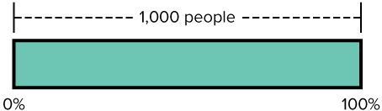
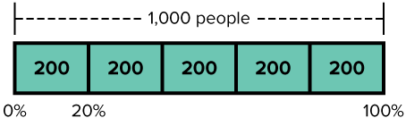
Learn
Percent Error
Draw a bar to represent the actual attendance, 1,000 people. Because this is the whole, label the length of the bar 100%.
The amount of error is 1,000 − 800, or 200 people. Because 1,000 ÷ 200 = 5, divide the bar into 5 equal-size sections of 200.
Each section represents 20% of the whole, 200 people. So, the percent error is 20%.

Slide 10
Learn
Percent Error
Talk About It!
Why do you think it is important to subtract the lesser amount from the greater amount when finding the amount of error?

Slide 11
Example 1
Percent Error
A contractor estimates that it will take him 16 hours to complete a home improvement project. It actually takes him 12.5 hours.
What is the percent error of the contractor’s estimate?

Slide 12
Example 1
Percent Error
Think About It!
Why might a bar diagram not be advantageous to help solve this problem?

Slide 13
Example 1
Percent Error
Step 1 Identify the part and the whole.
actual amount = 12.5 | This is the whole.
estimated amount = 16 | This is the whole plus the part.
amount of error = 16 – 12.5, or 3.5 | This is the part.

Slide 14
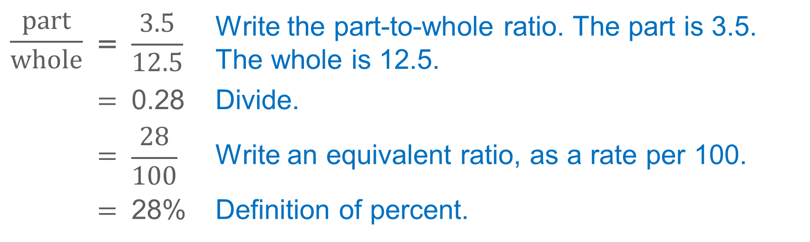
Example 1
Percent Error
Step 2 Find the percent error.
$$\frac{part}{whole}$$ | = | $$\frac{3.5}{12.5}$$ | Write the part-to-whole ratio. The part is 3.5. The whole is 12.5.
 | = | 0.28 | Divide.
 | = | $$\frac{28}{100}$$ | Write an equivalent ratio, as a rate per 100.
 | = | 28% | Definition of percent.
So, the percent error is 28%.

Slide 15
Example 1
Percent Error
Talk About It!
Suppose it actually took the contractor 19.5 hours. What part of solving the problem would stay the same? What part would change?

Slide 16
Example 1
Percent Error
Check
The Ramirez family was going on a trip. Their GPS system estimated that it would take them 4.25 hours to reach their destination. It actually took 5 hours because of stops. Find the percent error of the estimated time.

Slide 17
Example 1
Percent Error
Check
The Ramirez family was going on a trip. Their GPS system estimated that it would take them 4.25 hours to reach their destination. It actually took 5 hours because of stops. Find the percent error of the estimated time.
15%
Notes:
15%

Slide 18

Apply
Sports
A school newspaper estimates that their basketball team will win 23 out of 25 games for the season. After 10 games, they have won 8. If the team continues winning at this rate, what will be the percent error of the newspaper’s estimate once the season is over?

Slide 19
Apply
Sports
Talk About It!
How can you predict the actual number of wins the team has at the end of the season?

Slide 20
Apply
Sports
Check
It is predicted that a softball team will win 35 out of their 50 games for their summer season. After 20 games, they have won 16. If the team continues to win at this rate, what will be the percent error of the prediction once the season is over?

Slide 21
Apply
Sports
Check
It is predicted that a softball team will win 35 out of their 50 games for their summer season. After 20 games, they have won 16. If the team continues to win at this rate, what will be the percent error of the prediction once the season is over?
12.5%
Notes:
12.5%

Slide 22
Pause and Reflect
Explain how ratio and proportional reasoning can be used to solve problems involving percent.

Slide 23
Exit Ticket
A jar has 654 jelly beans. Emily says the jar has 710 jelly beans. Find the percent error of Emily’s estimate. Round to the nearest tenth if necessary. Explain how you found your answer and state whether or not you think Emily’s estimate is close to the actual value.

Slide 24
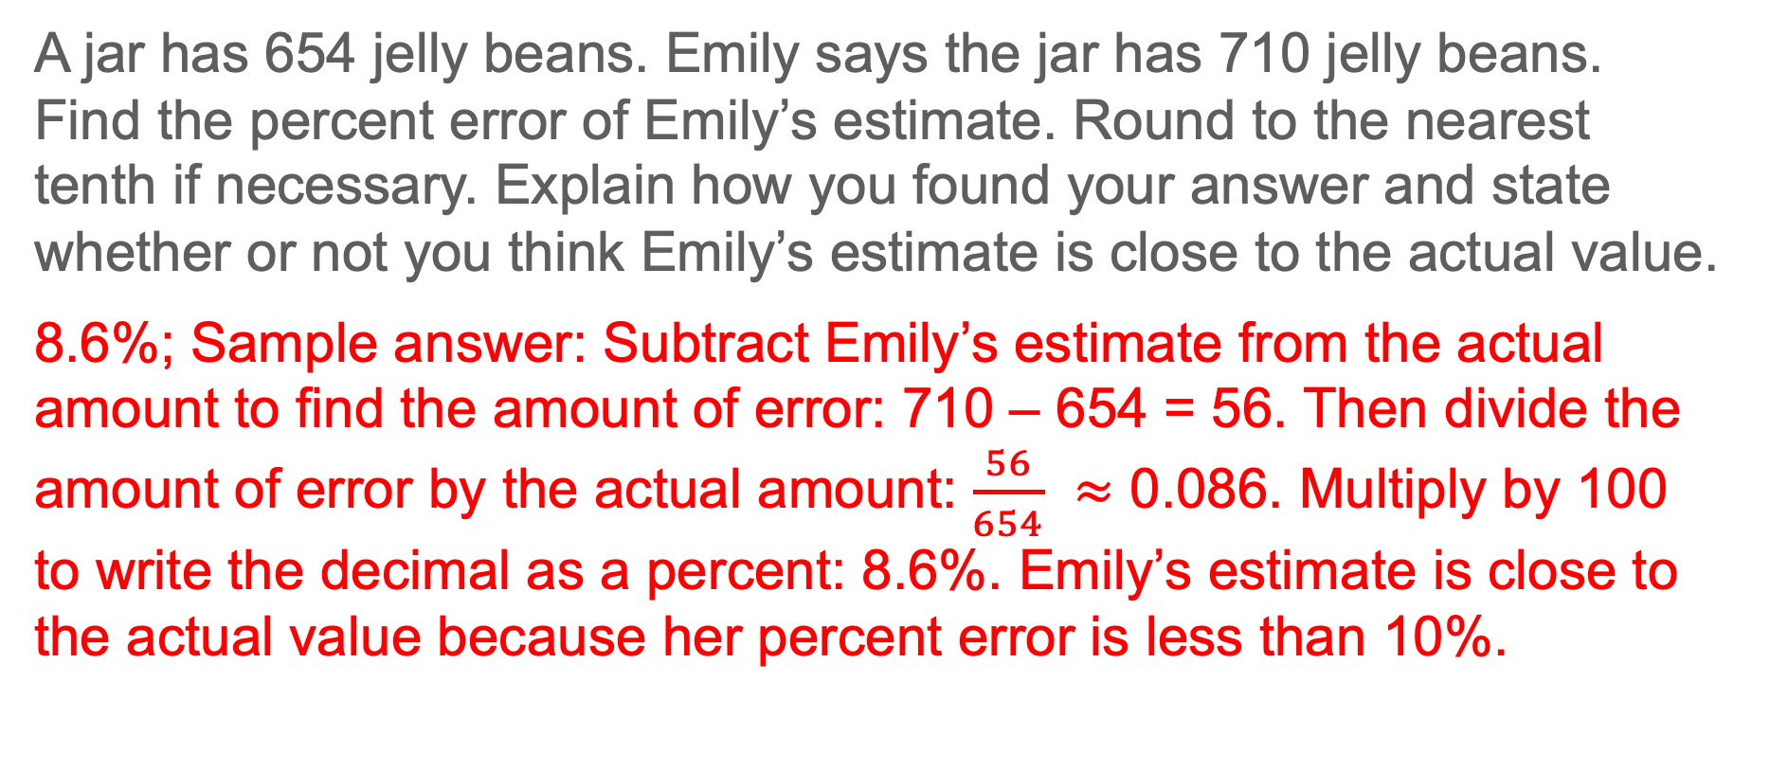
Exit Ticket
A jar has 654 jelly beans. Emily says the jar has 710 jelly beans. Find the percent error of Emily’s estimate. Round to the nearest tenth if necessary. Explain how you found your answer and state whether or not you think Emily’s estimate is close to the actual value.
8.6%; Sample answer: Subtract Emily’s estimate from the actual amount to find the amount of error: 710 – 654 = 56. Then divide the amount of error by the actual amount: $\frac{56}{654}$ ≈ 0.086. Multiply by 100 to write the decimal as a percent: 8.6%. Emily’s estimate is close to the actual value because her percent error is less than 10%.

