Slide 1


Slide 2

I am proud to be living in the
United Arab Emirates.

Slide 3



Slide 4
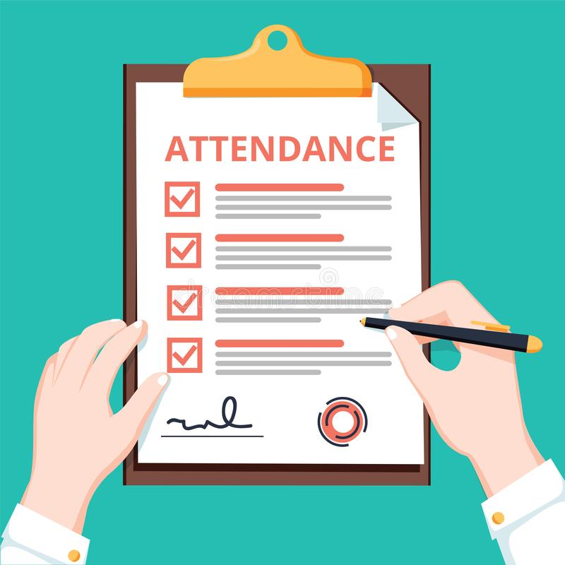
Attendance

Slide 5
Unit 8:
People and numbers
1
2
3

Slide 6
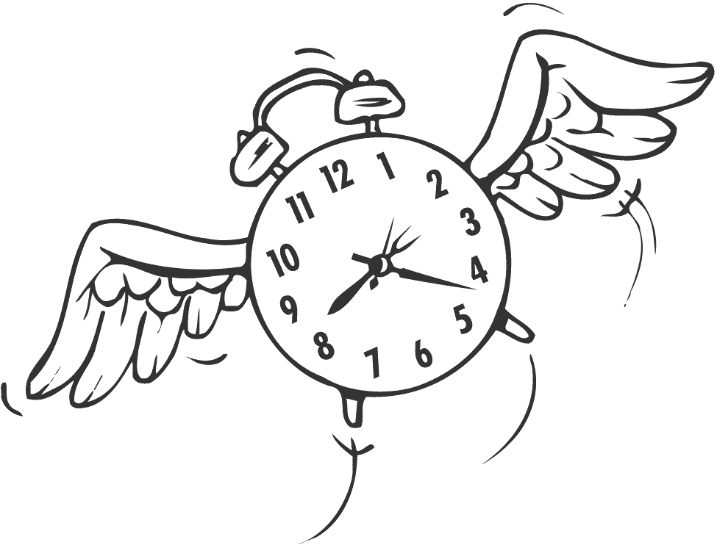
Lesson 1:
How we
spend our time ?

Slide 7
Objectives:
* Recognize the differences use of fractions and percentages.
* Listen for details.

Slide 8
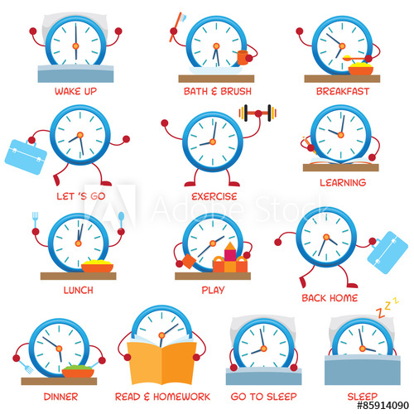
Warming up
How you spend your time ?

Slide 9
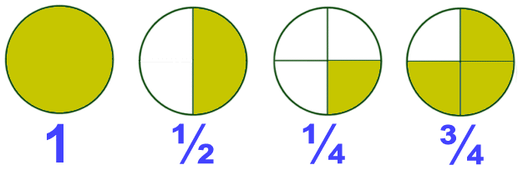
Fractions
half
a quarter
Three quarters

Slide 10
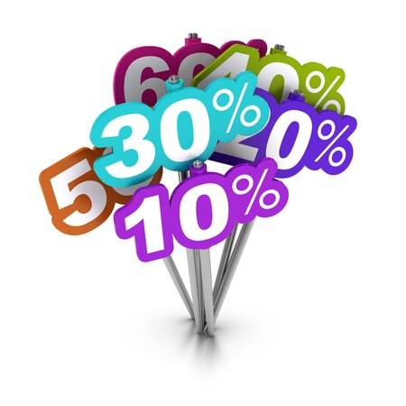
percentages
50% (one half ½)
66.6% (two thirds 2/3)
75% (three quarters ¾)

Slide 11
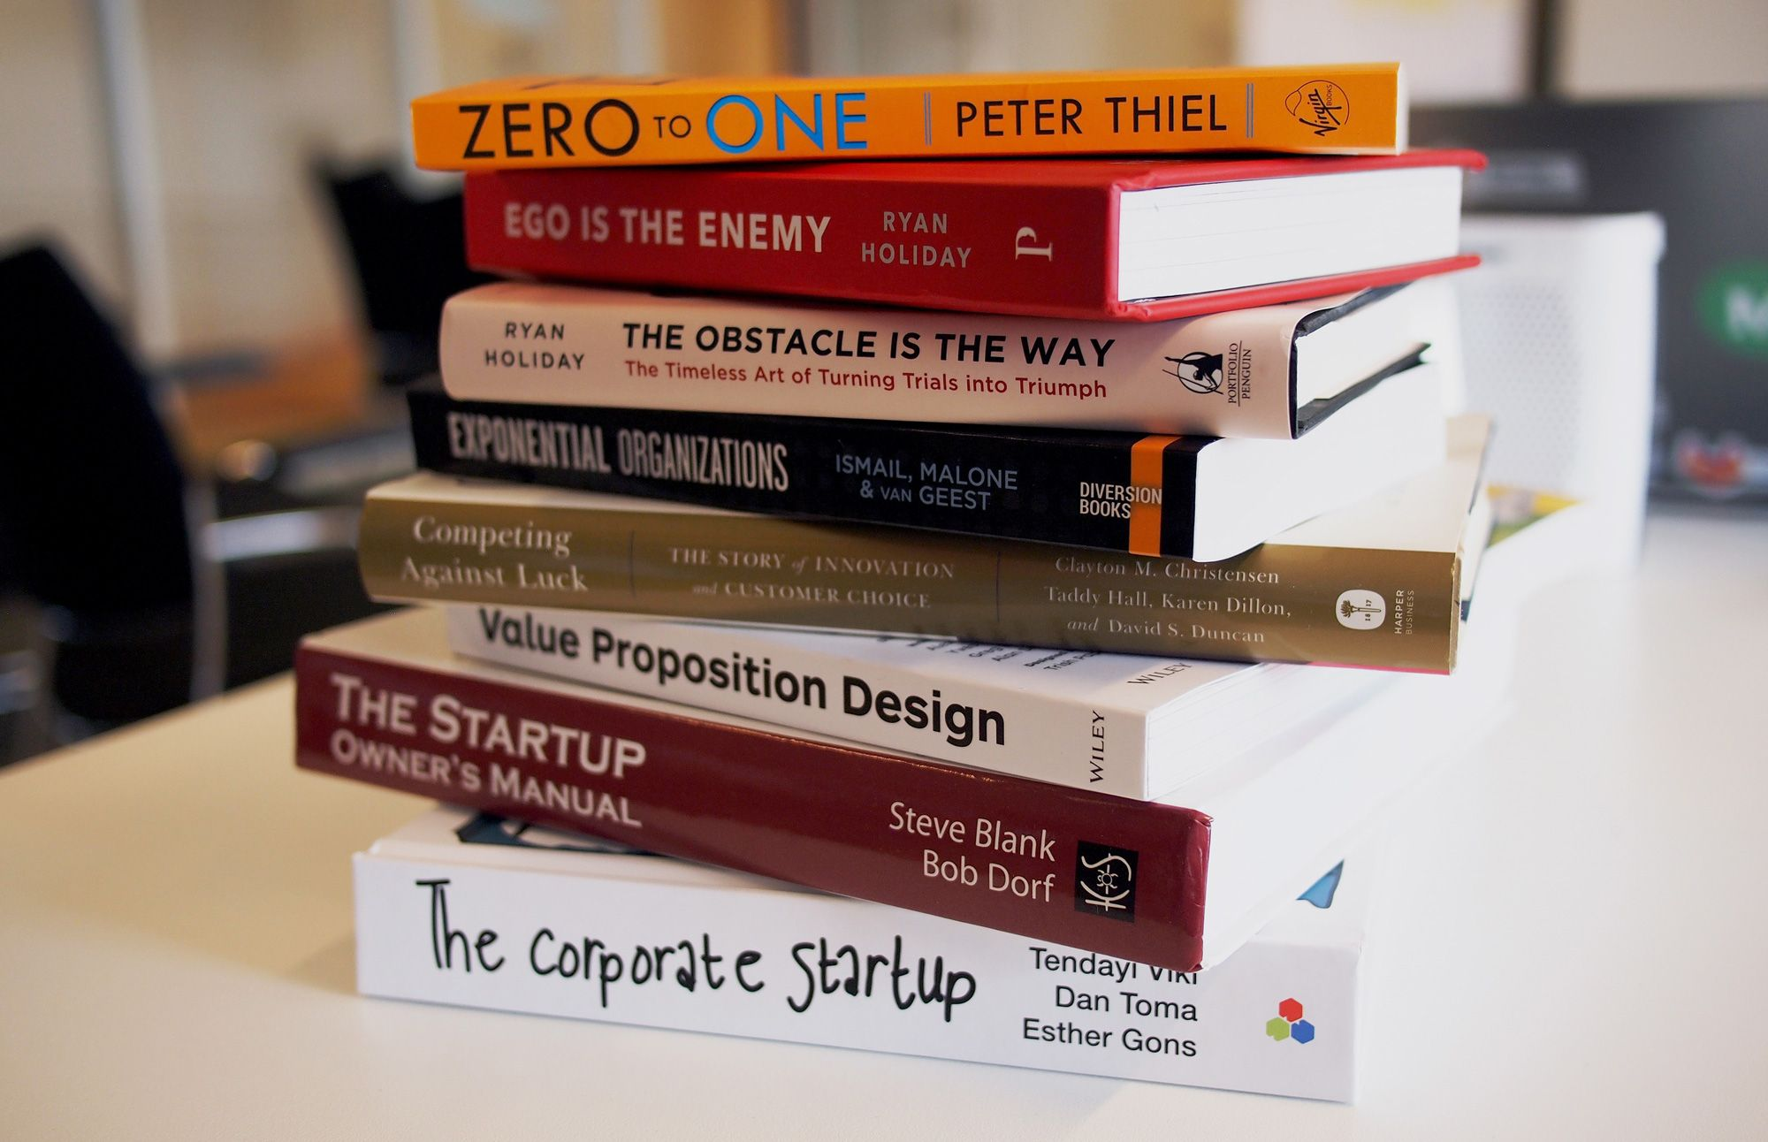
Reading books

Slide 12
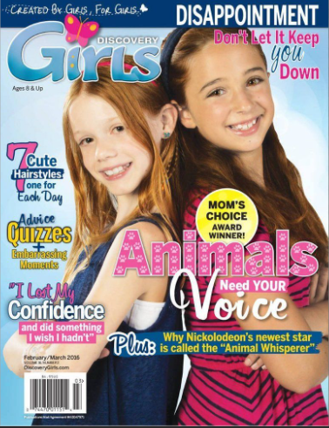
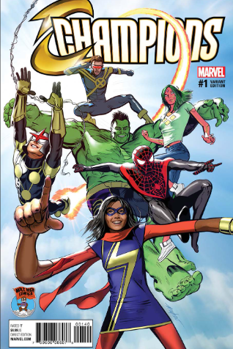
What do you like to read?
magazines
comics

Slide 13
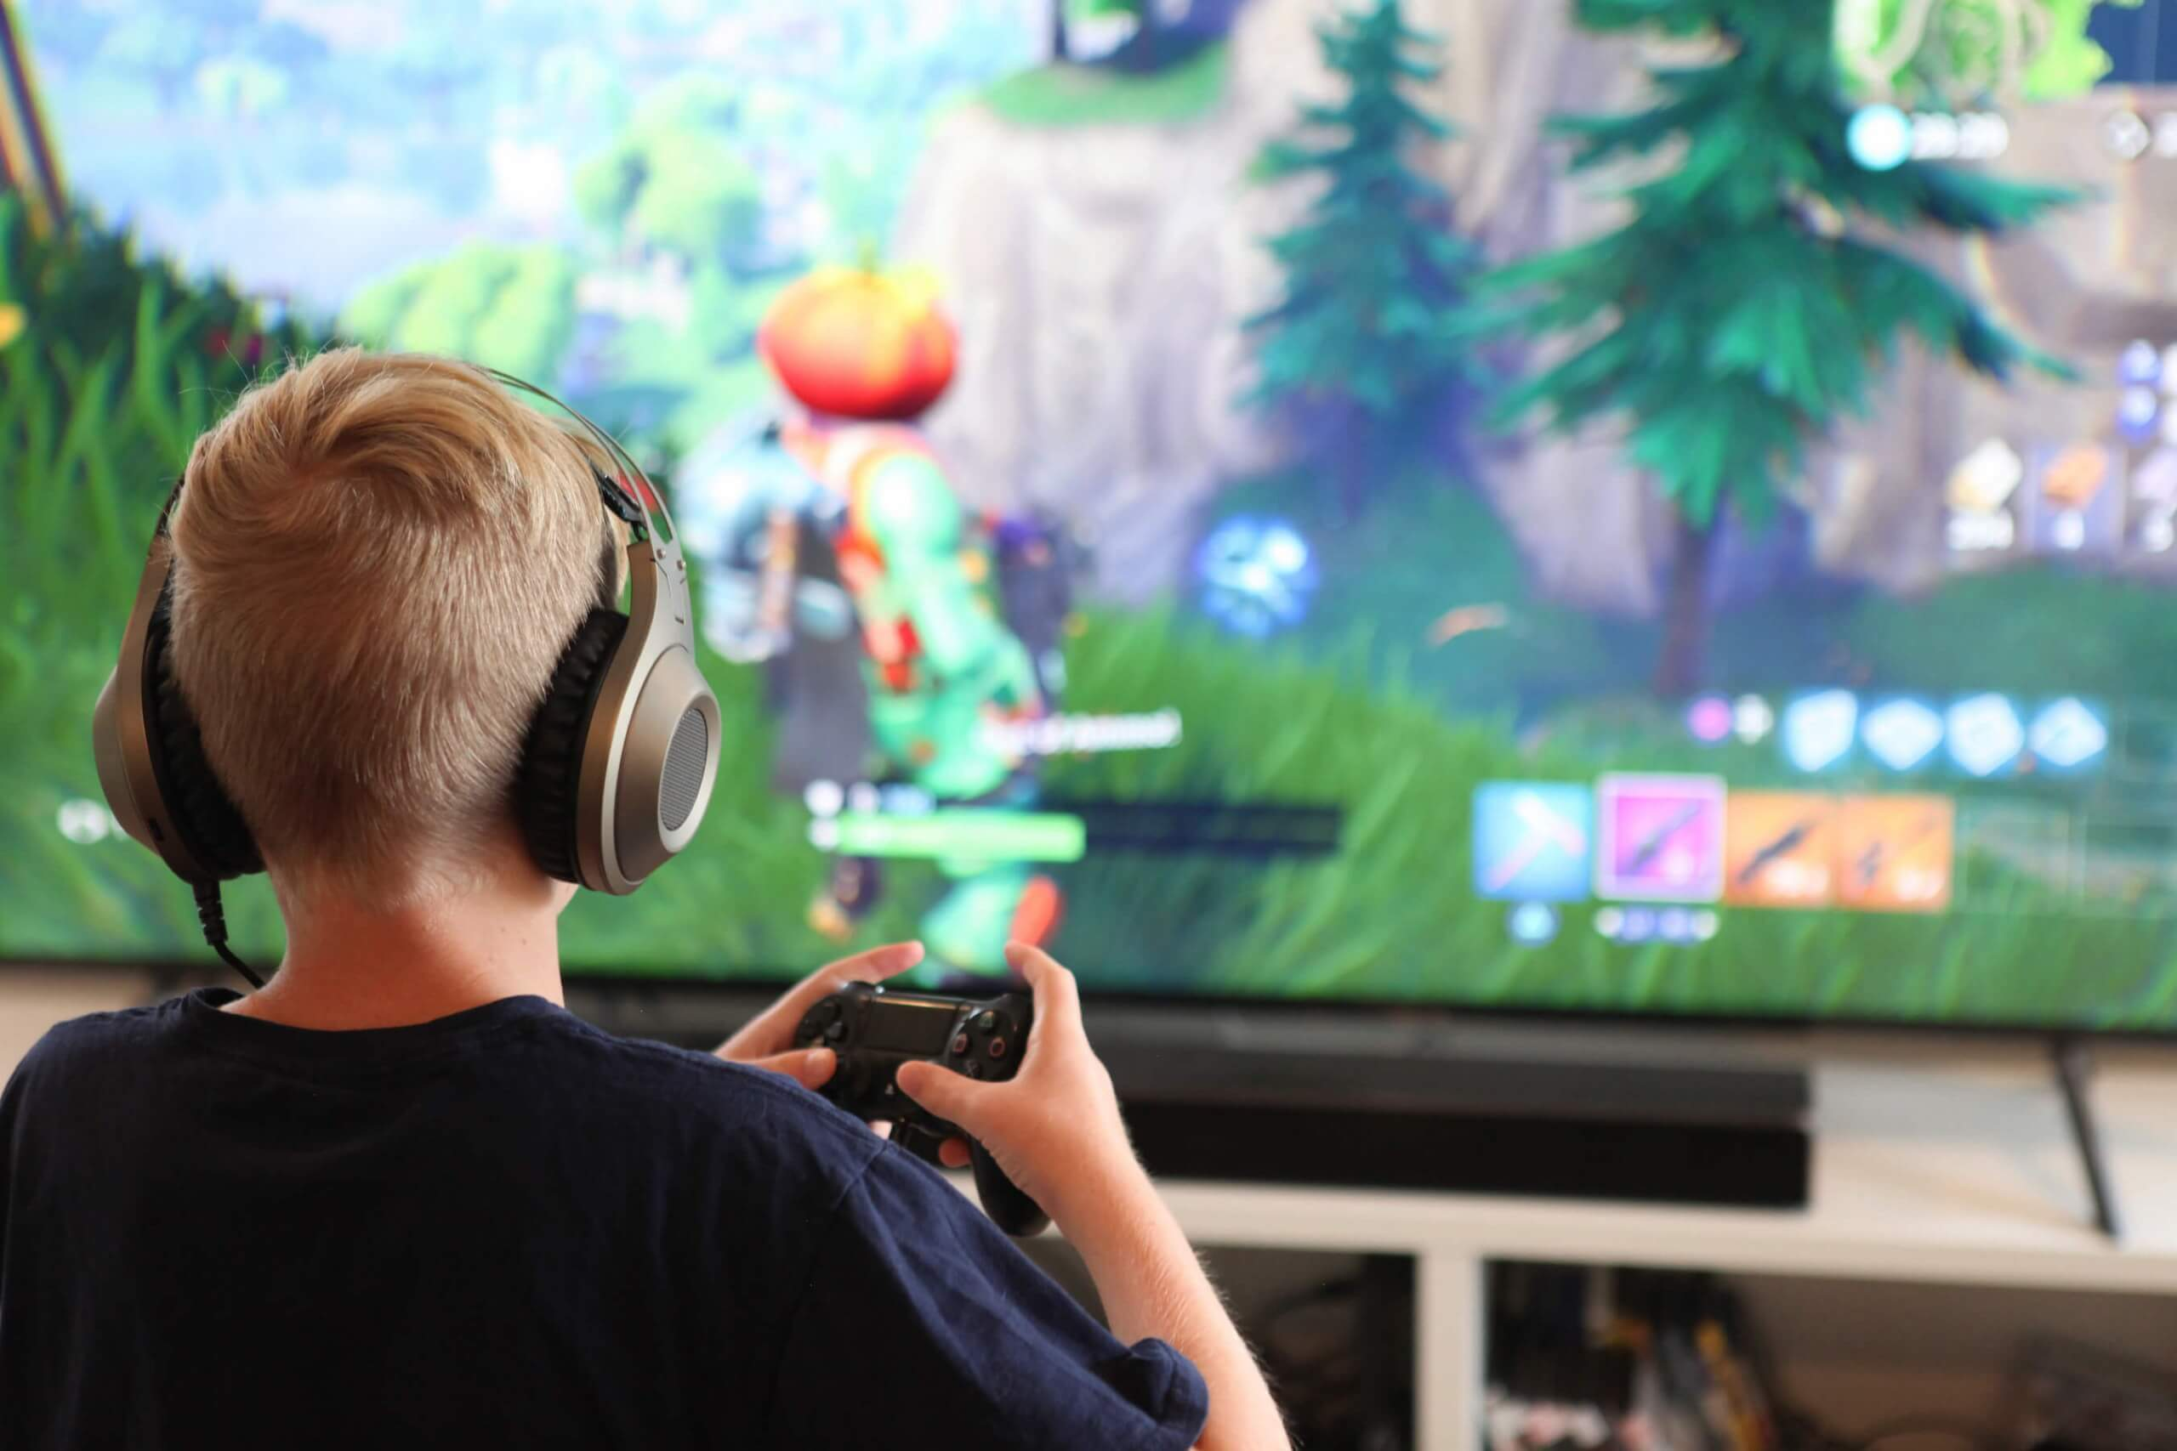
Playing PS

Slide 14
How much time do you spend doing it?

Slide 15
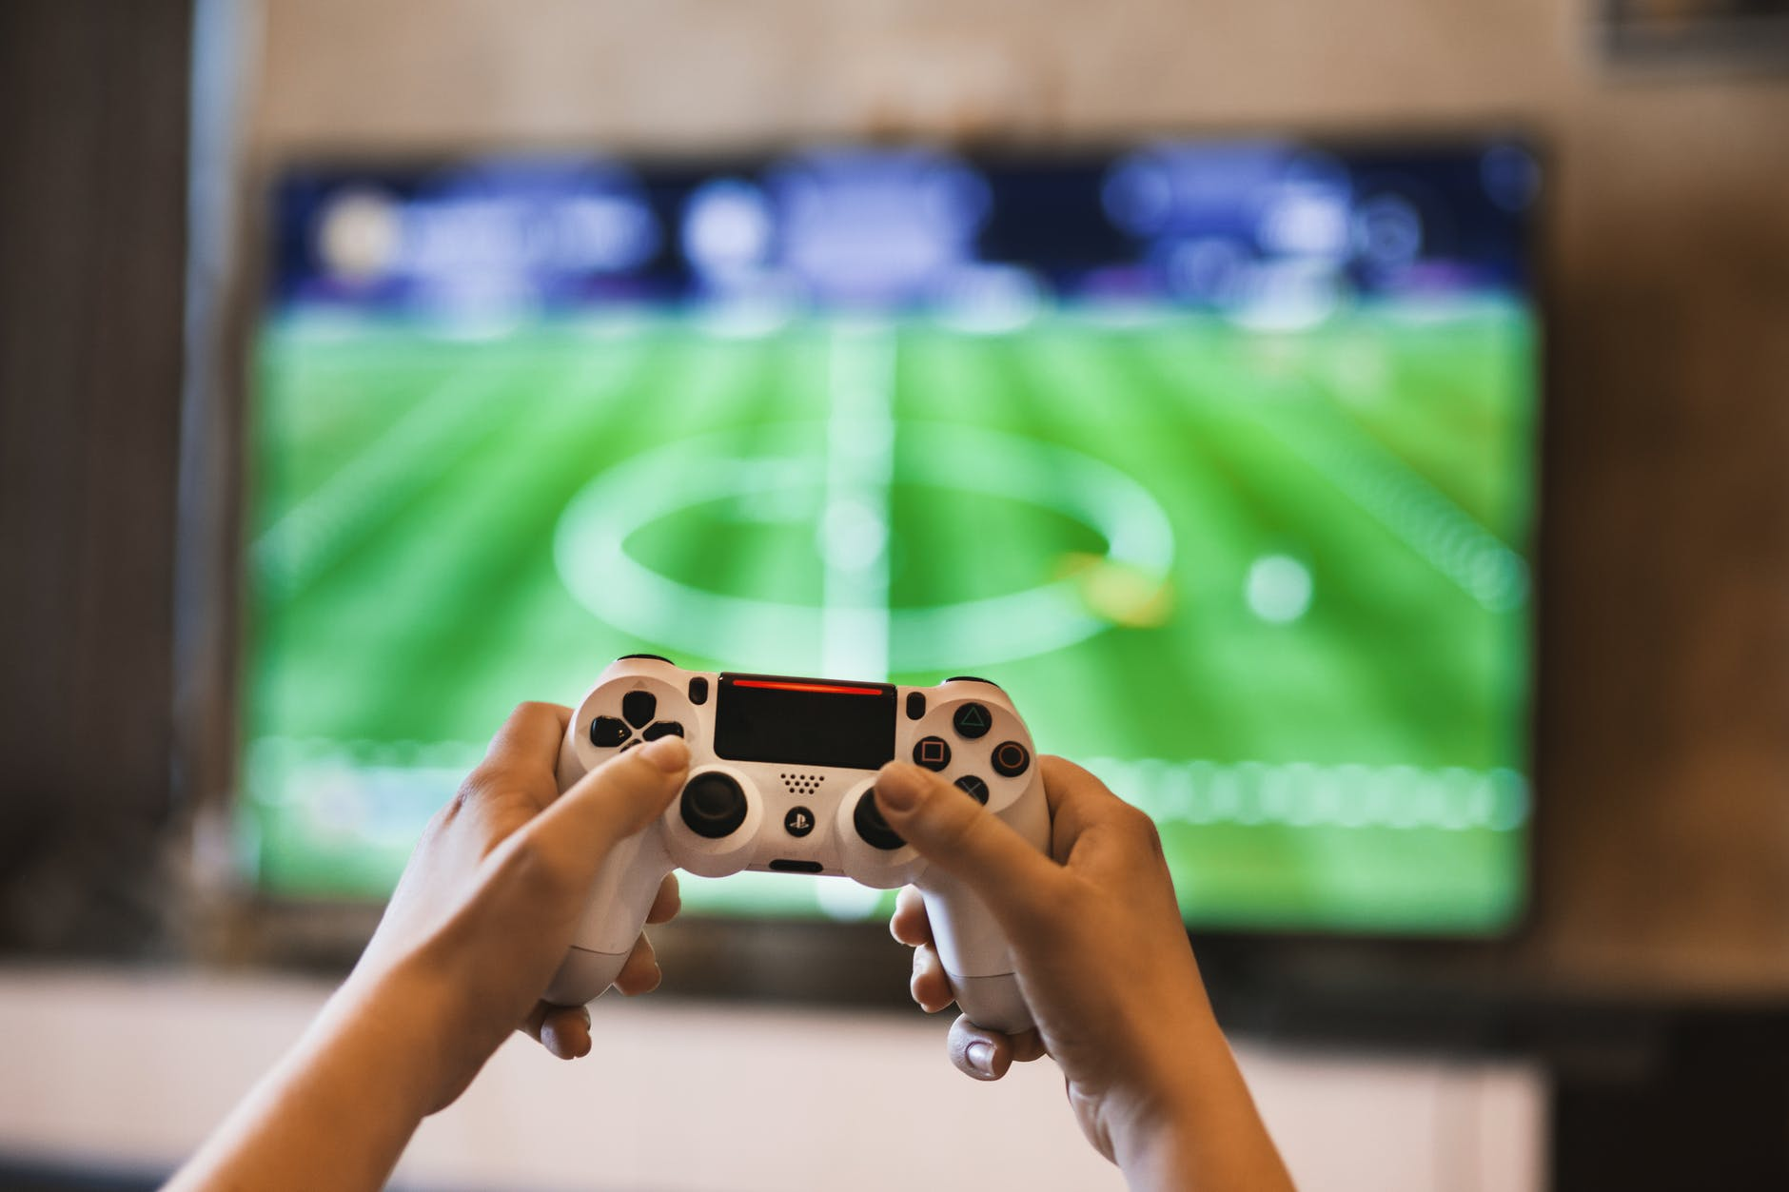
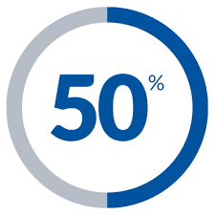

Slide 16

Watching TV

Slide 17
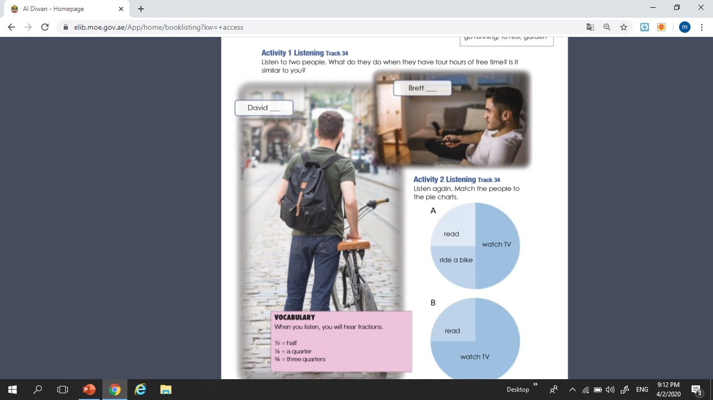

A
B

Slide 18
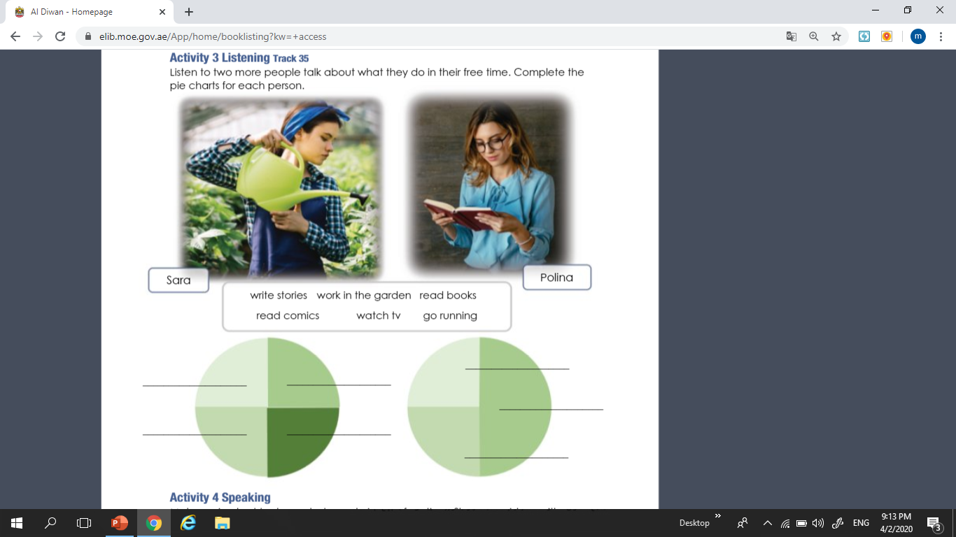
Work in the garden
Write stories
Watch tv
Read books
Read books
Go running
Read comics

Slide 19

H.W
Lessons
105 & 106

Slide 20
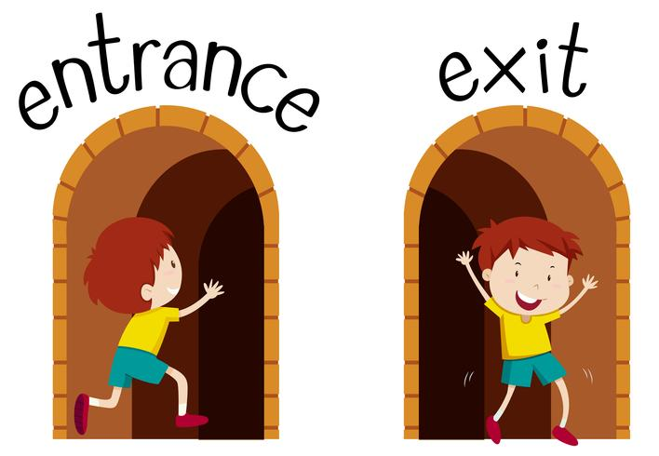
Exit Ticket
Draw your Pie chart that represent how you spend your time .

Slide 21



Self Evaluation
Evaluate your learning for:
Type if you are confused.
Type if you are getting there.
Type if you got it!

