Slide 1
Interest

Slide 2
Warm Up
Multiply.
1. 87 × 0.5 × 15
2. 0.09 × 100 × 18
3. 103 × 8 × 0.4
4. 0.75 × 11 × 2
5. What is the volume, in cubic inches, of an aquarium that is 14.5 inches long, 26 inches wide, and 18.5 inches tall?
Notes:
652.5
162
329.6
16.5
6,974.5 cubic inches

Slide 3
Warm Up
Multiply.
1. 87 × 0.5 × 15 652.5
2. 0.09 × 100 × 18 162
3. 103 × 8 × 0.4 329.6
4. 0.75 × 11 × 2 16.5
5. What is the volume, in cubic inches, of an aquarium that is 14.5 inches long, 26 inches wide, and 18.5 inches tall?
6,974.5 cubic inches
Notes:
652.5
162
329.6
16.5
6,974.5 cubic inches

Slide 4
Standards for Mathematical Content
7.RP.A.3
Use proportional relationships to solve multistep ratio and percent problems.
7.EE.B.3
Solve multi-step real-life and mathematical problems posed with positive and negative rational numbers in any form (whole numbers, fractions, and decimals), using tools strategically. Apply properties of operations to calculate with numbers in any form; convert between forms as appropriate; and assess the reasonableness of answers using mental computation and estimation strategies.

Slide 5
Standards for Mathematical Practice
MP1
Make sense of problems and persevere in solving them.
MP2
Reason abstractly and quantitatively.
MP3
Construct viable arguments and critique the reasoning of others.

Slide 6
Standards for Mathematical Practice
MP4
Model with mathematics.
MP6
Attend to precision.

Slide 7
Lesson Goal
Students will solve problems involving simple interest.

Slide 8
Learn
Simple Interest
If you borrow money or deposit money, the principal is the amount of money borrowed or deposited. Interest is the amount paid or earned for the use of the principal. Simple interest is calculated using specified periods of time.
Percents are used to calculate interest. You can earn interest by letting the bank use the money you deposit in a bank account. You will pay interest if you borrow money from the bank or use a credit card.

Slide 9
Example 1
Find Simple Interest
Magdalena put $580 into a savings account. The account pays 2.5% simple interest each year.
If she neither adds nor withdraws money from the account, how much interest will she earn after 2 years?

Slide 10
Example 1
Find Simple Interest
The period of time is annual or yearly, so t = 2.
The rate is 2.5% or, as a decimal, 0.025.
Use the Interest formula to find the amount of interest Magdalena will earn.

Slide 11
Example 1
Find Simple Interest
I = prt | Interest formula
I = 580 · 0.025 · 2 | The principal is 580, the rate is 0.025, and the time is 2.
I = 29 | Multiply.
So, Magdalena will earn $29 in interest in 2 years.

Slide 12
Example 1
Find Simple Interest
Check
Curtis deposits $550 into a savings account. The account pays 1.75% simple interest on an annual basis. If he does not add or withdraw money from the account, how much interest will he earn after 3 years?

Slide 13
Example 1
Find Simple Interest
Check
Curtis deposits $550 into a savings account. The account pays 1.75% simple interest on an annual basis. If he does not add or withdraw money from the account, how much interest will he earn after 3 years?
$28.88
Notes:
$28.88

Slide 14
Example 2
Find Simple Interest
Suppose Magdalena opens a savings account for only 6 months. She puts $580 in that account and earns 3.5% each year.
How much interest will she earn?

Slide 15
Example 2
Find Simple Interest
Think About It!
What is the simple interest formula? Are you trying to find the interest, principal, rate, or time?

Slide 16
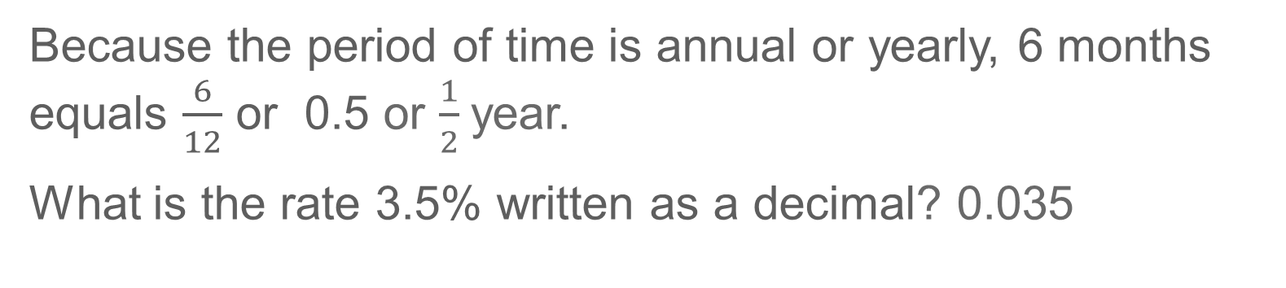
Example 2
Find Simple Interest
Because the period of time is annual or yearly, 6 months equals $\frac{6}{12}$ or 0.5 or $\frac{1}{2}$year.
What is the rate 3.5% written as a decimal? 0.035

Slide 17
Example 2
Find Simple Interest
Talk About It!
How is the process of finding simple interest different when the time is given in months?

Slide 18
Example 2
Find Simple Interest
Use the Interest formula to find the amount of interest Magdalena will earn.
I = prt | Interest formula
I = 580 · 0.035 · 0.5 | The principal is 580, the rate is 0.035, and the time is 0.5.
I = 10.15 | Multiply.
So, Magdalena will earn $10.15 in interest in 6 months.

Slide 19
Example 2
Find Simple Interest
Check
Carrie invests $430 into a savings account. The account pays 2.5% simple interest on an annual basis. If she does not add or withdraw money from the account, how much interest will she earn after 15 months?

Slide 20
Example 2
Find Simple Interest
Check
Carrie invests $430 into a savings account. The account pays 2.5% simple interest on an annual basis. If she does not add or withdraw money from the account, how much interest will she earn after 15 months?
$13.44
Notes:
$13.44

Slide 21
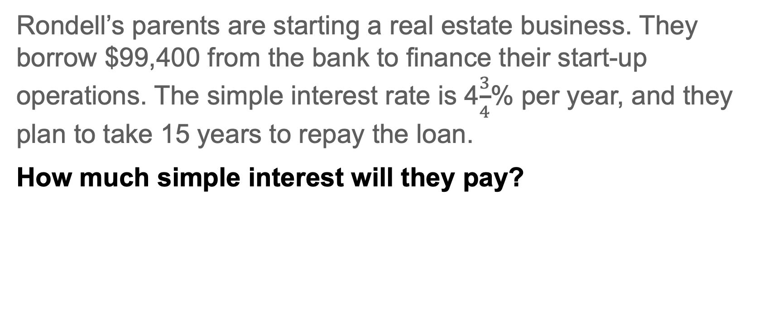
Example 3
Find Simple Interest
Rondell’s parents are starting a real estate business. They borrow $99,400 from the bank to finance their start-up operations. The simple interest rate is 4$\frac{3}{4}$% per year, and they plan to take 15 years to repay the loan.
How much simple interest will they pay?

Slide 22
Example 3
Find Simple Interest
Think About It!
How would you begin solving the problem?

Slide 23
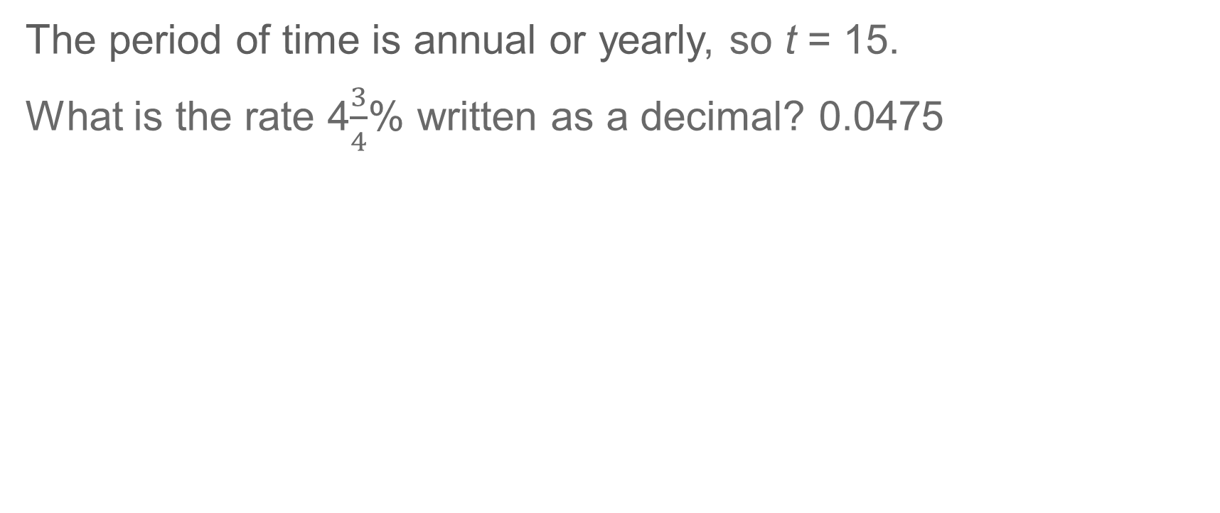
Example 3
Find Simple Interest
The period of time is annual or yearly, so t = 15.
What is the rate 4$\frac{3}{4}$% written as a decimal? 0.0475

Slide 24
Example 3
Find Simple Interest
Use the Interest formula to find the amount of interest they will pay.
I = prt | Interest formula
I = 99,400 · 0.0475 · 15 | The principal is 99,400, the rate is 0.0475, and the time is 15.
I = 70,822.50 | Multiply.
So, Rondell's parents will pay $70,822.50 in interest on the loan.

Slide 25
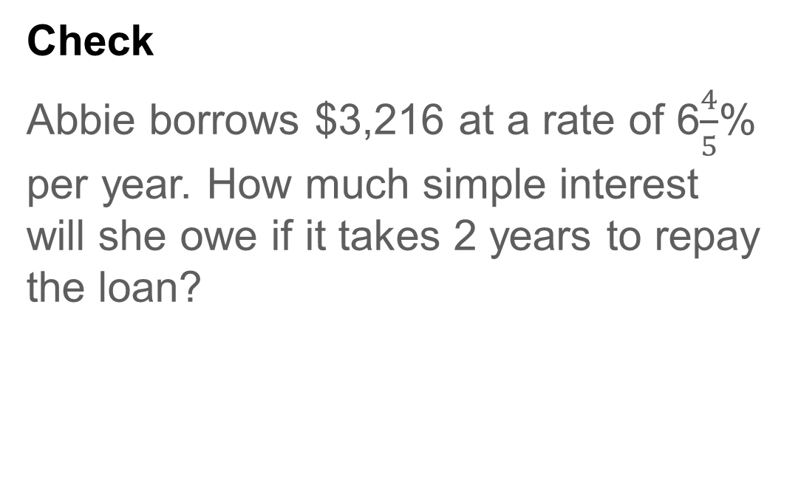
Example 3
Find Simple Interest
Check
Abbie borrows $3,216 at a rate of 6$\frac{4}{5}$% per year. How much simple interest will she owe if it takes 2 years to repay the loan?

Slide 26
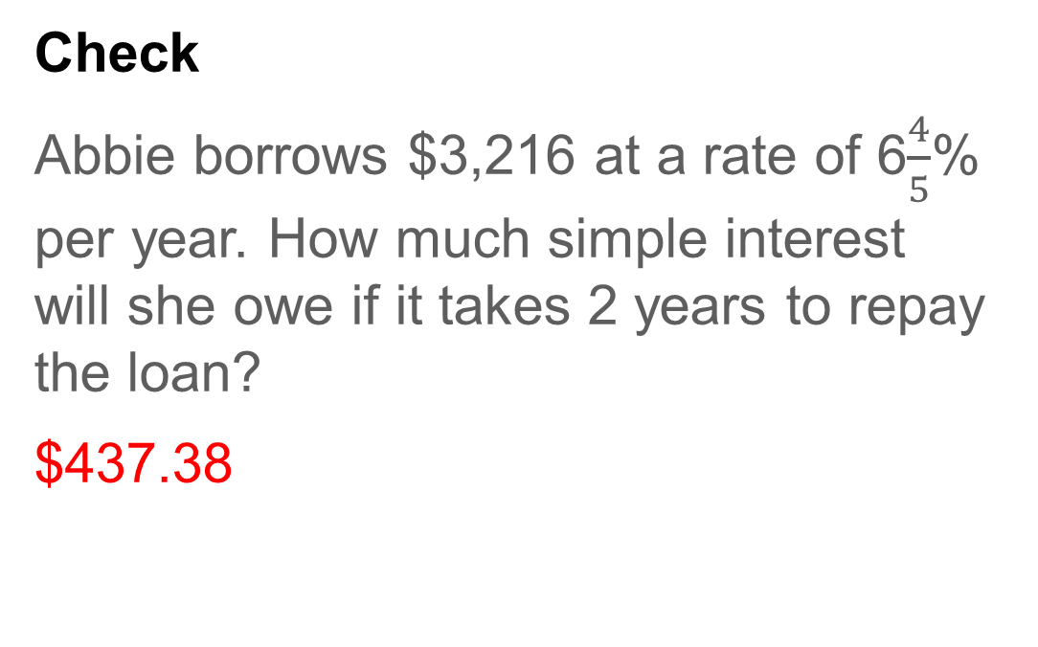
Example 3
Find Simple Interest
Check
Abbie borrows $3,216 at a rate of 6$\frac{4}{5}$% per year. How much simple interest will she owe if it takes 2 years to repay the loan?
$437.38
Notes:
$437.38

Slide 27
Pause and Reflect
Why is it important to pay off loans as soon as possible?

Slide 28
Apply
Car Shopping
Alex is buying a car that costs $18,000. The tax rate is 7%, and he plans to make a down payment of $2,000. The sales tax is added to the price of the car before the down payment is made. He is considering a five-year loan with a simple interest rate of 6.2% each year. What will be his monthly payment?

Slide 29
Apply
Car Shopping
Talk About It!
How can the amount of a down payment affect the monthly payment?

Slide 30
Apply
Car Shopping
Check
Donte is buying a car that costs $8,000. He is deciding between a
3-year loan and a 4-year loan. Use the rates in the table to determine how much money he will save if he chooses the 3-year loan instead of the 4-year loan.
Time (y) | Simple Interest Rate (%)
3 | 2.25
4 | 2.5
5 | 3

Slide 31
Apply
Car Shopping
Check
Donte is buying a car that costs $8,000. He is deciding between a
3-year loan and a 4-year loan. Use the rates in the table to determine how much money he will save if he chooses the 3-year loan instead of the 4-year loan.
$260
Time (y) | Simple Interest Rate (%)
3 | 2.25
4 | 2.5
5 | 3
Notes:
$260

Slide 32
Pause and Reflect
Have you ever wondered when you might use the concepts you learn in math class? What are some everyday scenarios in which you might use what you learned today?

Slide 33
Exit Ticket
Simar is deciding between two accounts to deposit money. Account A pays 2.25% annual interest if the deposit is $600 for one year. Account B pays 2.5% annual interest if the deposit is $800 for one year. Which account will pay more to deposit Simar's money over the course of a year? Write a mathematical argument that can be used to defend your solution.
Notes:
Account B; Sample answer: Use the simple interest formula. For Account A, the interest earned is 600 multiplied by 0.0225 multiplied by 1. The interest earned is $13.50. For Account B, the interest earned is 800 multiplied by 0.025 multiplied by 1. The interest earned is $20. So, Account B earns more interest over the course of one year.

Slide 34
Exit Ticket
Simar is deciding between two accounts to deposit money. Account A pays 2.25% annual interest if the deposit is $600 for one year. Account B pays 2.5% annual interest if the deposit is $800 for one year. Which account will pay more to deposit Simar's money over the course of a year? Write a mathematical argument that can be used to defend your solution.
Account B; Sample answer: Use the simple interest formula. For Account A, the interest earned is 600 multiplied by 0.0225, multiplied by 1. The interest earned is $13.50. For Account B, the interest earned is 800 multiplied by 0.025, multiplied by 1. The interest earned is $20. So, Account B earns more interest over the course of one year.
Notes:
Account B; Sample answer: Use the simple interest formula. For Account A, the interest earned is 600 multiplied by 0.0225 multiplied by 1. The interest earned is $13.50. For Account B, the interest earned is 800 multiplied by 0.025 multiplied by 1. The interest earned is $20. So, Account B earns more interest over the course of one year.

