Slide 1
PBLA
Grade 7
2024 - 2025

Slide 2
Page 12-13
1
Expressions
The rate of data transmissions
from hope probe back to earth

Slide 3
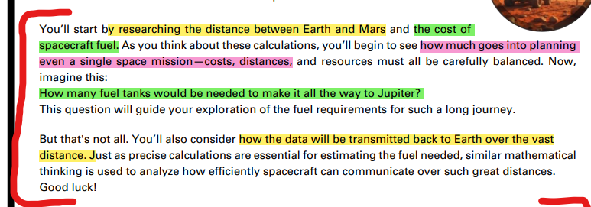
Page 12
Research :
………………………………….…….….…..
………………………………….…….….…..

Slide 4
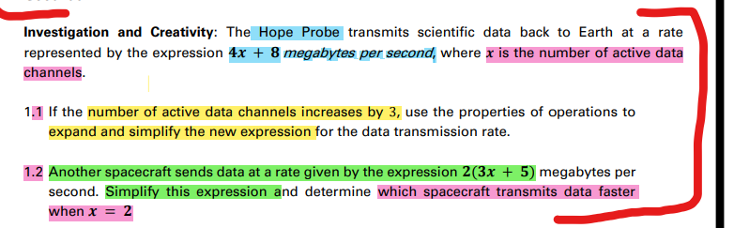



P 12
1.2
Hope Prope Another space craft :
2(3x+5)
4x+8 Simplify : …………………….
If x=2 If x=2
………………….….. ……………………………..
Which space craft transmits the data faster ?
…………………………………………………………………………………………
…………………………………………………………………………………………
1.1
Hope Probe :
4x+8
X increased by 3
…………………………………..….…..
………………………………….…….….…..

Slide 5
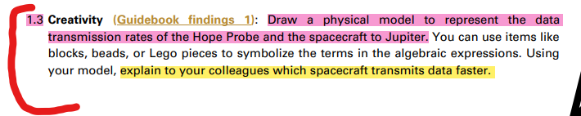
P. 12 , 13
x
x
x
x
1
1
1.3
Modeling
1
Hope Probe
4x+8
Another space craft
………………………….

Slide 6
Page 14-15
2
Re-writing Expressions
The hope probe uses solar Panel
to generate energy
Student will calculate the energy from solar panel
given the number of optimal sunlight hours

Slide 7
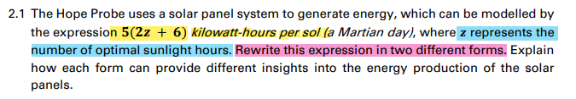


P. 14 , 15
Rewrite this expression
5(2z+6) 5(2z+6)
…………….. ………………
Explain: Explain:
…………….. ………………

Slide 8
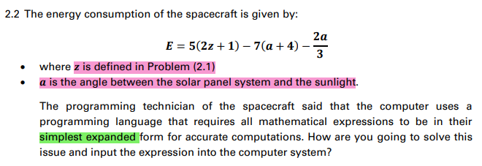






P. 14 , 15
Simplify the expressions :

Slide 9
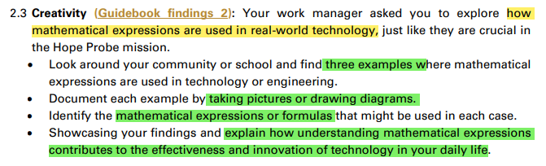
P. 14 , 15
Example 1 :
……………………………………….
………………………………………..
Formula
…………………….
Example 2 :
……………………………………….
………………………………………..
Formula
…………………….
Example 3 :
……………………………………….
………………………………………..
Formula
…………………….
Pictures
Pictures
Pictures

Slide 10
Page 16-17
3
Re-writing Expressions

Slide 11
Objectives:
Search and Learn about the distance between Earth and
other planets
and the amount of spacecraft fuel needed .

Slide 12
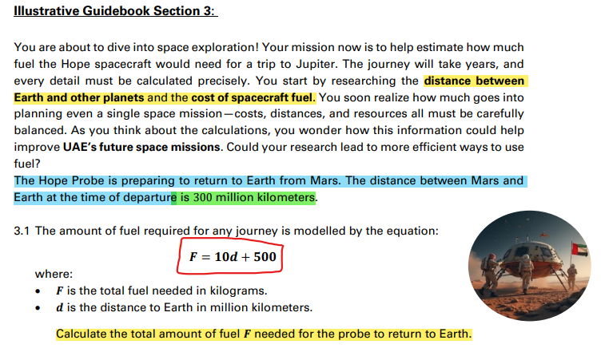
Page 14
P. 16 , 17

Slide 13
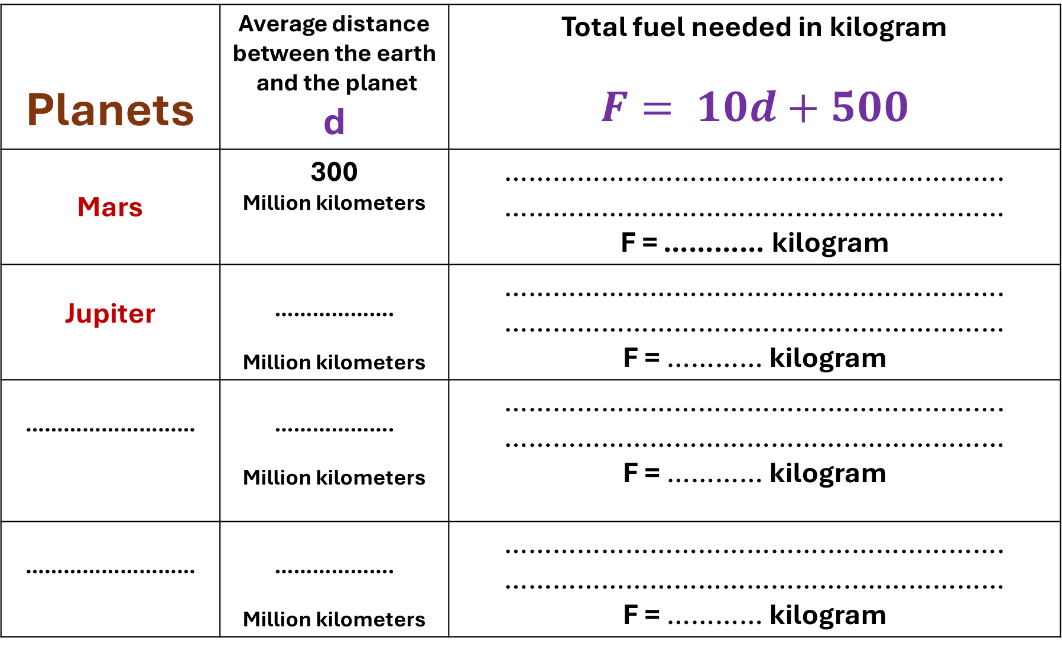
Planets | Average distance between the earth and the planet d | Total fuel needed in kilogram $$F= 10d+500$$
Mars | 300 Million kilometers | ………………………………….…………………. ……………………………………..……………… F = ………… kilogram
Jupiter | ………………. Million kilometers | ………………………………….…………………. ……………………………………..……………… F = ………… kilogram
……………………… | ………………. Million kilometers | ………………………………….…………………. ……………………………………..……………… F = ………… kilogram
……………………… | ………………. Million kilometers | ………………………………….…………………. ……………………………………..……………… F = ………… kilogram

Slide 14
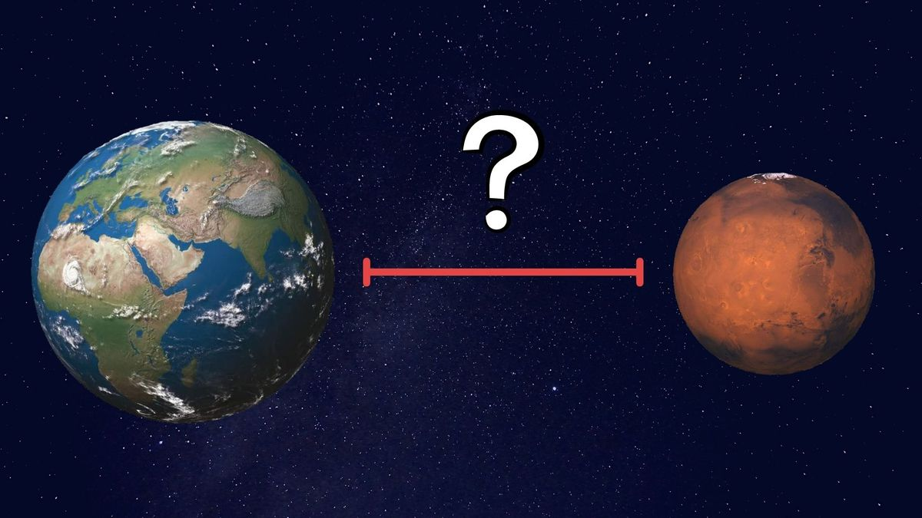
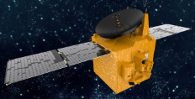
Hope probe
D= 300 million kilometers
F= 3500 kilograms

Slide 15
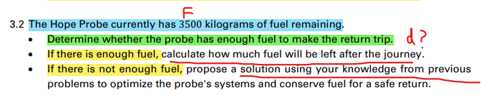
P. 16 , 17
Hope probe has F = 3500 kilograms of fuel remaining.
Is the fuel enough to complete the return trip to earth from mars ? …………
How much fuel left ?
………………………….
If the fuel is not enough to return
Find solutions ?
…………………………….

Slide 16
Hope probe
D= 300 million kilometers
F= 3500 kilograms

Slide 17

Distance between Earth and Jupiter ?
………………… million kilometers
F = ………………
kilograms
…………………………………………………………………………………………………………………………………………………… …………………………………………………………………………………………………………………………………………………… ……………………………………………………………………………………………………………………………………………………
P. 16 , 17

Slide 18

Advanced Students only
4
Extension Investigation and Creativity

Slide 19
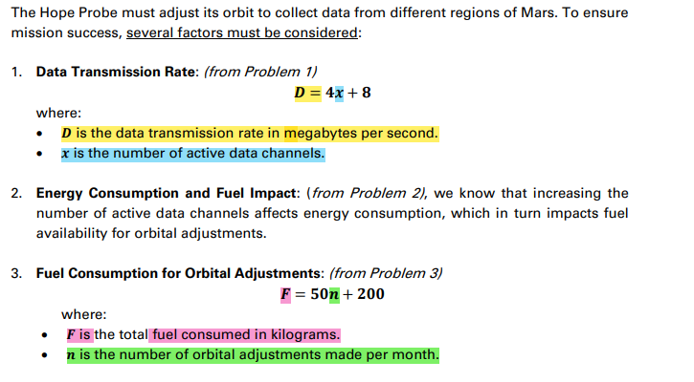
P. 18 , 19

Slide 20

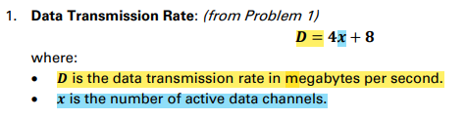
P. 18 , 19
D = 60 megabytes per second
X ? ………………………………………………………………………………………………………………………………………………………………………… …………………………………………………………………………………………………………………………………………………………………………

Slide 21
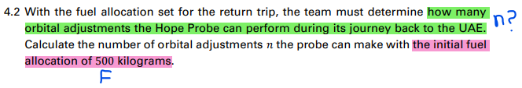
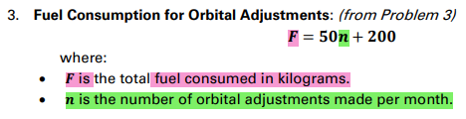
F = 500 Kilograms
n ? ………………………………………………………………………………………………………………………………………………………………………… …………………………………………………………………………………………………………………………………………………………………………
P. 18 , 19

Slide 22
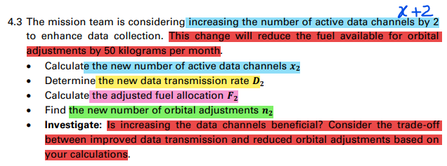

P. 18 , 19

Slide 23
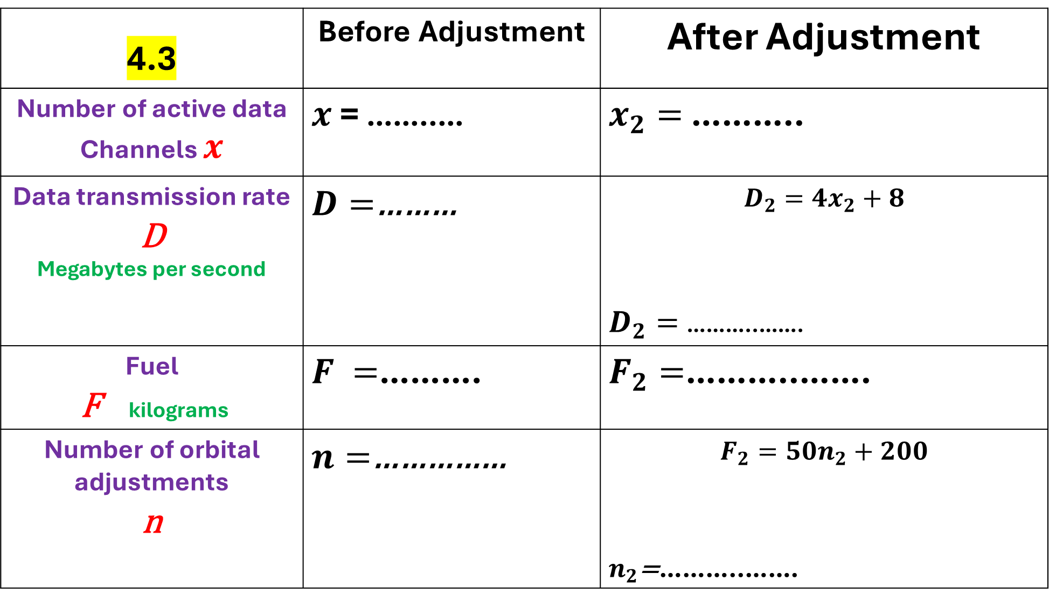
4.3 | Before Adjustment | After Adjustment
Number of active data Channels $x$ | $x$ = ……..… | $x_{2}=$ ………..
Data transmission rate D Megabytes per second | $D=$……… | $$D_{2}=4x_{2}+8$$ $D_{2}=$ ………..…….
Fuel F kilograms | $F =$………. | $F_{2}=$………..…….
Number of orbital adjustments n | $n=$…………… | $$F_{2}=50n_{2}+200$$ $n_{2}$=………..…….

Slide 24

4.3
……………………………………………………………………………………………………………………………………………………………….
……………………………………………………………………………………………………………………………………………………………….
……………………………………………………………………………………………………………………………………………………………….
……………………………………………………………………………………………………………………………………………………………….
……………………………………………………………………………………………………………………………………………………………….
……………………………………………………………………………………………………………………………………………………………….
……………………………………………………………………………………………………………………………………………………………….
……………………………………………………………………………………………………………………………………………………………….

