Slide 1
Divide Integers

Slide 2
Warm Up
1. A building is 75 feet tall. It is 3 times as tall as the building next to it. How tall is the building next to it?
2. Grant had 56 trading cards. He divided them into 4 equal groups. How many cards were in each group?
3. Laura did 112 pull-ups this week. If she did the same number of pullups on each of the 7 days, how many pull-ups did she do each day?

Slide 3
Warm Up
1. A building is 75 feet tall. It is 3 times as tall as the building next to it. How tall is the building next to it?
2. Grant had 56 trading cards. He divided them into 4 equal groups. How many cards were in each group?
3. Laura did 112 pull-ups this week. If she did the same number of pullups on each of the 7 days, how many pull-ups did she do each day?
25 feet
14
16
Notes:
25 feet
14
16

Slide 4
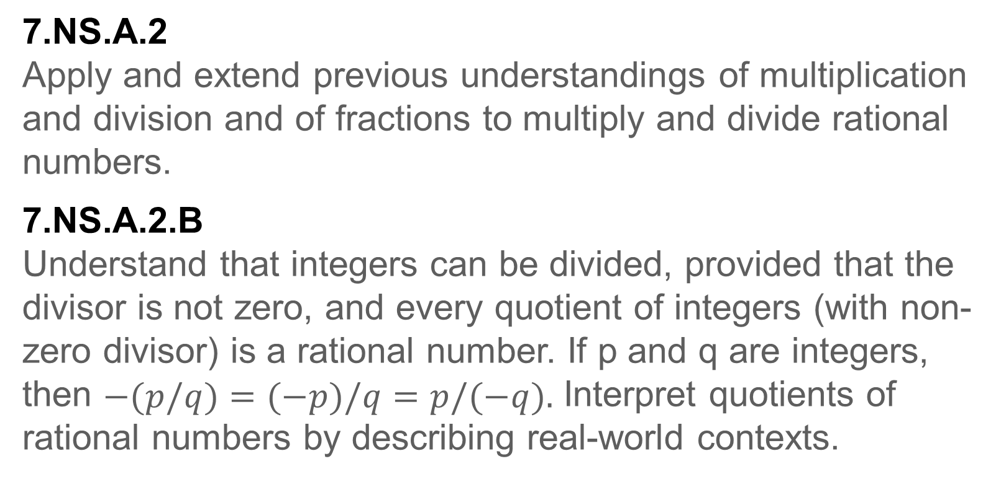
Standards for Mathematical Content
7.NS.A.2
Apply and extend previous understandings of multiplication and division and of fractions to multiply and divide rational numbers.
7.NS.A.2.B
Understand that integers can be divided, provided that the divisor is not zero, and every quotient of integers (with non-zero divisor) is a rational number. If p and q are integers, then $−(p/q)=(−p)/q=p/(−q).$ Interpret quotients of rational numbers by describing real-world contexts.

Slide 5
Standards for Mathematical Content
7.NS.A.2.C
Apply properties of operations as strategies to multiply and divide rational numbers.
7.NS.A.1.D
Apply properties of operations as strategies to add and subtract rational numbers.

Slide 6
Standards for Mathematical Content
7.EE.B.3
Solve multi-step real-life and mathematical problems posed with positive and negative rational numbers in any form (whole numbers, fractions, and decimals), using tools strategically. Apply properties of operations to calculate with numbers in any form; convert between forms as appropriate; and assess the reasonableness of answers using mental computation and estimation strategies.
7.NS.A.3
Solve real-world and mathematical problems involving the four operations with rational numbers.

Slide 7
Standards for Mathematical Practice
MP1
Make sense of problems and persevere in solving them.
MP3
Construct viable arguments and critique the reasoning of others.
MP4
Model with mathematics.
MP5
Use appropriate tools strategically.
MP6
Attend to precision.

Slide 8
Lesson Goal
Students will solve problems dividing integers.

Slide 9
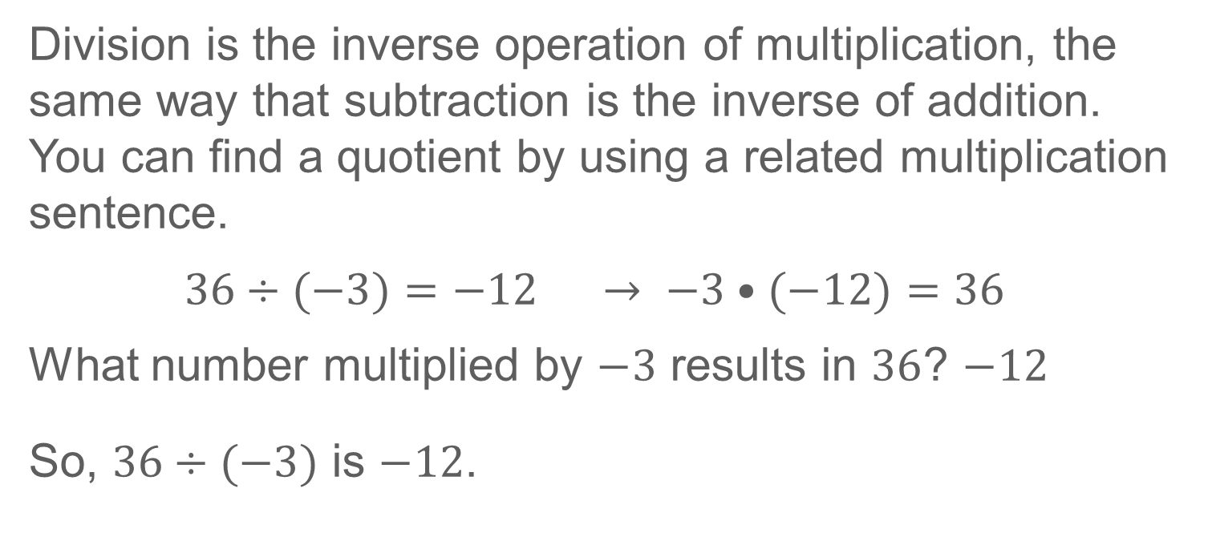
Learn
Divide Integers with Different Signs
Division is the inverse operation of multiplication, the same way that subtraction is the inverse of addition. You can find a quotient by using a related multiplication sentence.
$36÷(−3)=−12$ $→ −3•(−12)=36$
What number multiplied by $−3$ results in $36$? $−12$
So, $36÷(−3)$ is $−12$.

Slide 10
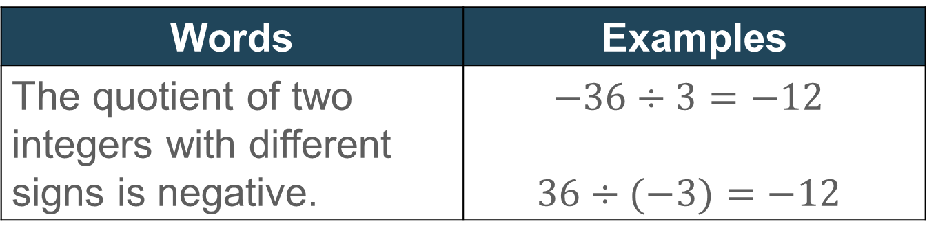
Learn
Divide Integers with Different Signs
The table shows the rules for dividing integers with different signs.
Words | Examples
The quotient of two integers with different signs is negative. | $−36÷3=−12$ $$36÷(−3)=−12$$

Slide 11

Learn
Divide Integers with Different Signs
Talk About It!
What do you think is the quotient of $−36÷3$? Explain
your reasoning.

Slide 12

Example 1
Divide Integers with Different Signs
Find $90÷(−10).$

Slide 13
Example 1
Divide Integers with Different Signs
Talk About It!
Predict the sign of the quotient.

Slide 14

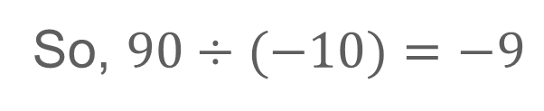
Example 1
Divide Integers with Different Signs
$$90÷(−10)=−9$$
The signs of the integers are different. The quotient is negative.
So, $90÷(−10)=−9$

Slide 15
Example 2
Divide Integers with Different Signs
Talk About It!
A friend stated that the quotient was positive. How can you use multiplication to show that the quotient is negative?

Slide 16

Example 1
Divide Integers with Different Signs
Check
Find $72÷(−9).$

Slide 17

Example 1
Divide Integers with Different Signs
Check
Find $72÷(−9).$
$$−8$$
Notes:
$$−8$$

Slide 18
Example 2
Divide Integers with Different Signs
The best underwater divers can dive almost 380 feet in four minutes, using only a rope as they descend.
At this rate, what integer represents the change, in feet, of a diver’s position after one minute?

Slide 19

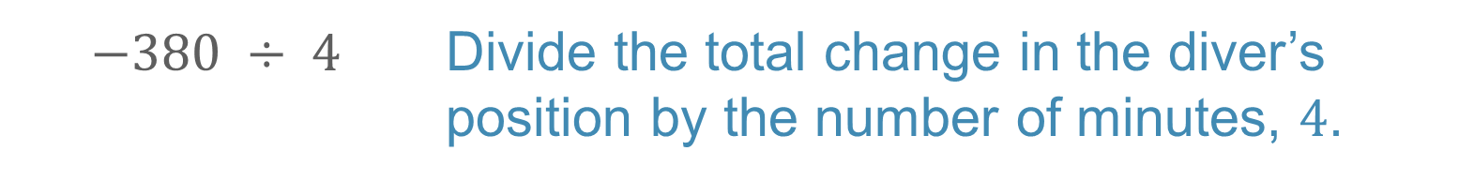
Example 2
Divide Integers with Different Signs
Step 1 Identify the distance descended.
What integer represents the change, in feet, in the diver's position after four minutes?
$$−380$$
Step 2 Write the division expression.
$$−380 ÷ 4$$ | Divide the total change in the diver’s position by the number of minutes, $4$.

Slide 20
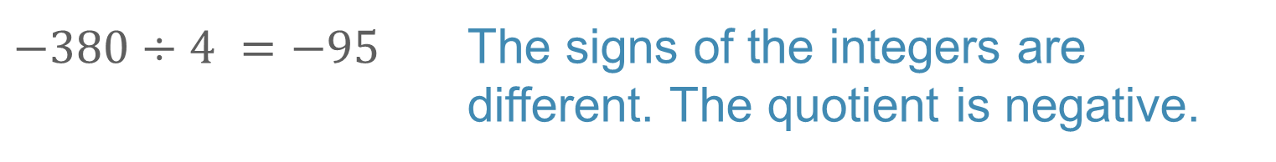


Example 2
Divide Integers with Different Signs
Step 3 Divide $−380$ by $4$ to find the change after one minute.
$$−380÷4 =−95$$ | The signs of the integers are different. The quotient is negative.
So, the integer $−95$represents the change in the diver's position, in feet, after one minute.

Slide 21
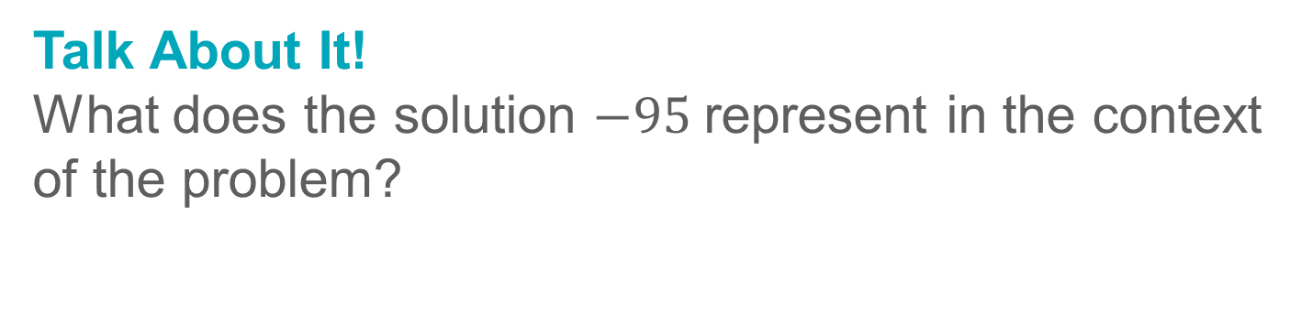
Example 2
Divide Integers with Different Signs
Talk About It!
What does the solution $−95$represent in the context of the problem?

Slide 22
Example 2
Divide Integers with Different Signs
Check
A neighbor is improving his dogʼs fitness level by working on agility training. Before beginning the training regiment, the dog weighed 65 pounds. After nine weeks of training, the dog weighed 47 pounds. What integer represents the change in weight that the dog averaged, in pounds per week, over the nine weeks?

Slide 23
Example 2
Divide Integers with Different Signs
Check
A neighbor is improving his dogʼs fitness level by working on agility training. Before beginning the training regiment, the dog weighed 65 pounds. After nine weeks of training, the dog weighed 47 pounds. What integer represents the change in weight that the dog averaged, in pounds per week, over the nine weeks?
−2
Notes:
−2

Slide 24

Learn
Divide Integers with the Same Sign
Division is the inverse operation of multiplication. You can find a quotient by finding a related multiplication sentence.
positive quotient
$−20÷(−4)=5$ → | $$−4 (5)=−20$$

Slide 25
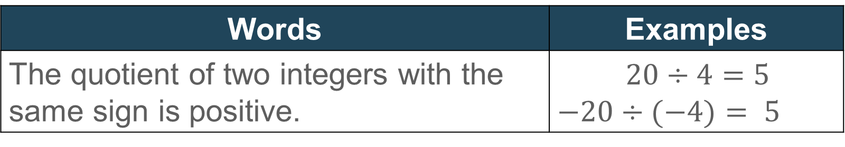
Learn
Divide Integers with the Same Sign
The table shows the rules for dividing integers with the same sign.
Words | Examples
The quotient of two integers with the same sign is positive. | $20÷4=5$ $−20÷(−4)= 5$

Slide 26
Example 2
Divide Integers with Different Signs
Talk About It!
How are division and multiplication of integers similar? How are they different?

Slide 27

Example 3
Divide Integers with the Same Sign
Find $−30÷(−6).$

Slide 28


Example 3
Divide Integers with the Same Sign
$$−30÷(−6)=5$$
The signs of the integers are the same. The quotient is positive.
$$So, −30÷(−6)=5.$$

Slide 29

Example 3
Divide Integers with the Same Sign
Check
Find $−84÷(−12)$.

Slide 30
Example 3
Divide Integers with the Same Sign
Check
Find $−84÷(−12)$.
7
Notes:
7

Slide 31
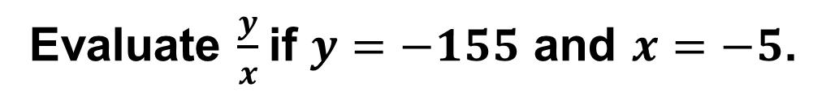
Example 4
Divide Integers with the Same Sign
Evaluate $\frac{y}{x}$if $y=−155$ and $x=−5$.

Slide 32



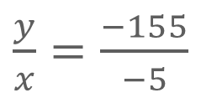
Example 4
Divide Integers with the Same Sign
$\frac{y}{x}=\frac{−155}{−5}$
Replace $y$ with $−155$ and $x$ with $−5$.
$=−155÷(−5)$
Write as a division sentence.
$$=31$$
The signs of the integers are the same. The quotient is positive.
So, the value of the expression is 31.

Slide 33

Example 4
Divide Integers with the Same Sign
Check
Evaluate $\frac{y}{x}$ if $y=−162 and x=−6$.

Slide 34
Example 4
Divide Integers with the Same Sign
Check
Evaluate $\frac{y}{x}$ if $y=−162 and x=−6$.
27
Notes:
27

Slide 35
Pause and Reflect
Compare and contrast how to predict the sign of the integer when adding or subtracting, and when multiplying or dividing.

Slide 36
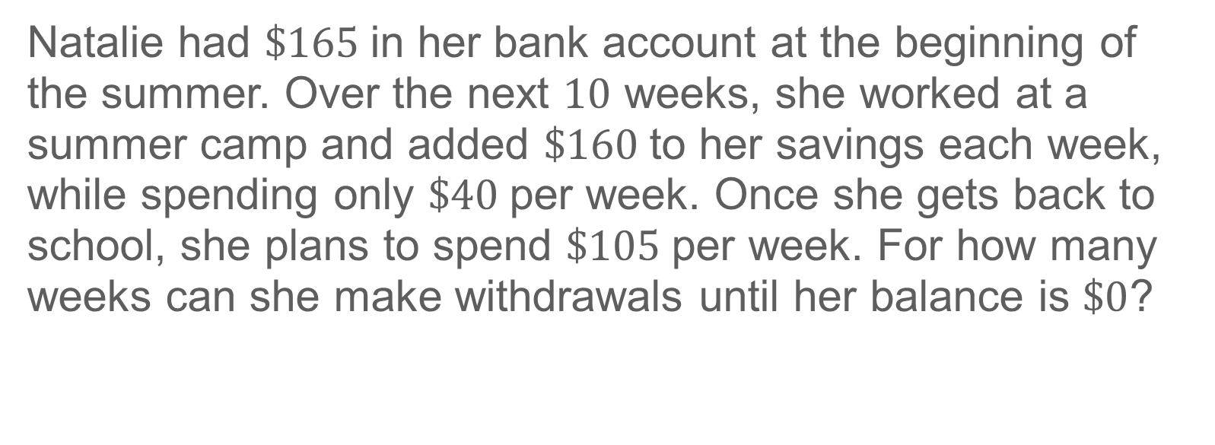
Apply
Personal Finance
Natalie had $\$165$in her bank account at the beginning of the summer. Over the next $10$ weeks, she worked at a summer camp and added $\$160$to her savings each week, while spending only $\$40$per week. Once she gets back to school, she plans to spend $\$105$per week. For how many weeks can she make withdrawals until her balance is $\$0$?

Slide 37
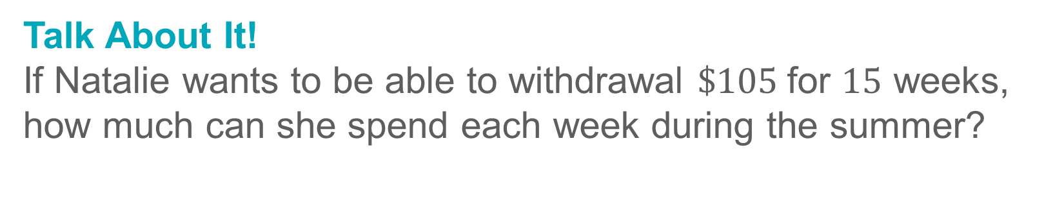
Apply
Personal Finance
Talk About It!
If Natalie wants to be able to withdrawal $\$105$for $15$ weeks, how much can she spend each week during the summer?

Slide 38
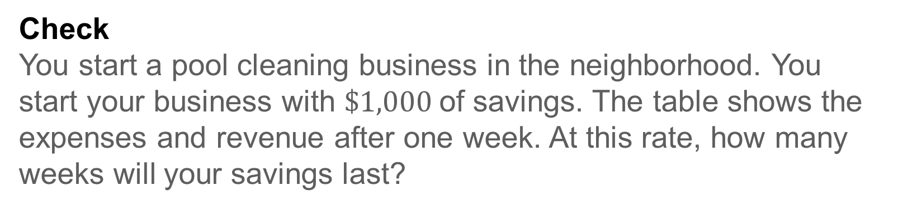
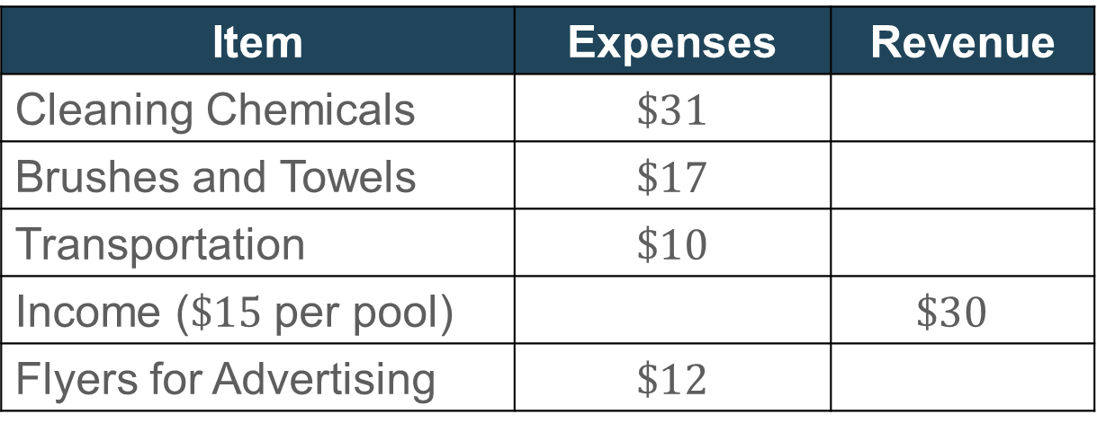
Apply
Personal Finance
Check
You start a pool cleaning business in the neighborhood. You start your business with $\$1,000$of savings. The table shows the expenses and revenue after one week. At this rate, how many weeks will your savings last?
Item | Expenses | Revenue
Cleaning Chemicals | $\$31$
Brushes and Towels | $\$17$
Transportation | $\$10$
Income ($\$15$ per pool) |  | $$\$30$$
Flyers for Advertising | $\$12$

Slide 39
Apply
Personal Finance
Check
You start a pool cleaning business in the neighborhood. You start your business with $\$1,000$of savings. The table shows the expenses and revenue after one week. At this rate, how many weeks will your savings last?
Item | Expenses | Revenue
Cleaning Chemicals | $\$31$
Brushes and Towels | $\$17$
Transportation | $\$10$
Income ($\$15$ per pool) |  | $$\$30$$
Flyers for Advertising | $\$12$
25 weeks
Notes:
25 weeks

Slide 40
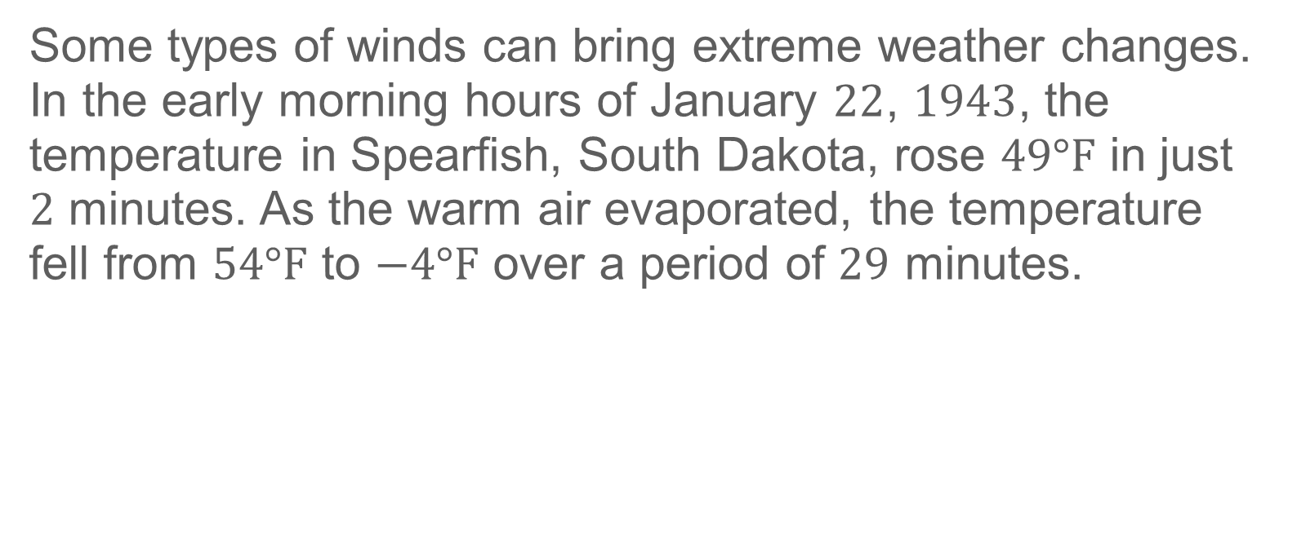
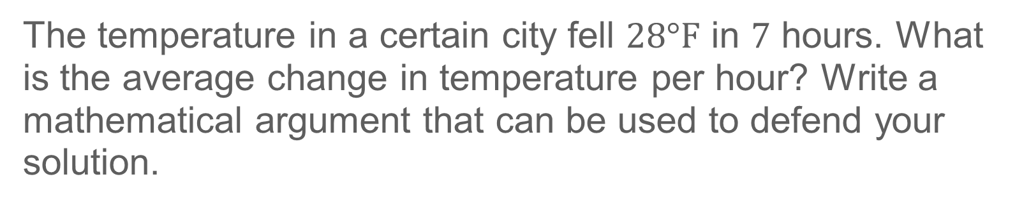
Exit Ticket
Some types of winds can bring extreme weather changes. In the early morning hours of January $22$, $1943$, the temperature in Spearfish, South Dakota, rose $49°F$ in just $2$ minutes. As the warm air evaporated, the temperature fell from $54°F$ to $−4°F$ over a period of $29$ minutes.
The temperature in a certain city fell $28°F$ in $7$ hours. What is the average change in temperature per hour? Write a mathematical argument that can be used to defend your solution.

Slide 41
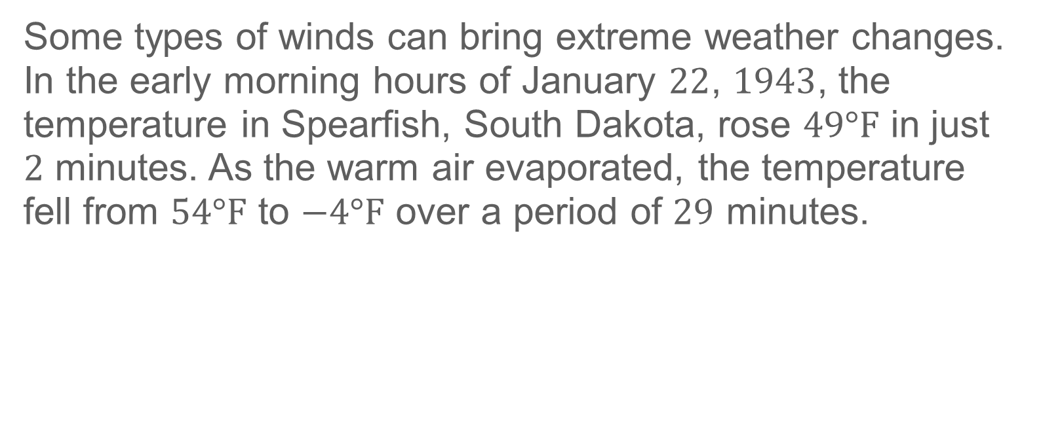
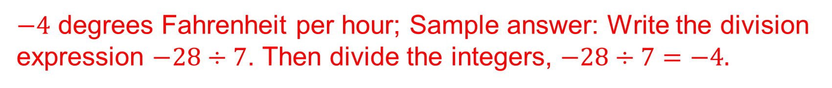
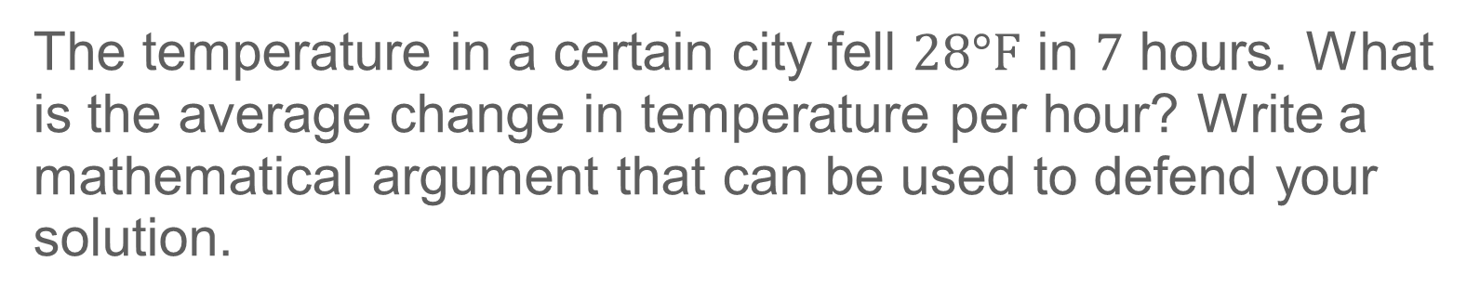
Exit Ticket
Some types of winds can bring extreme weather changes. In the early morning hours of January $22$, $1943$, the temperature in Spearfish, South Dakota, rose $49°F$ in just $2$ minutes. As the warm air evaporated, the temperature fell from $54°F$ to $−4°F$ over a period of $29$ minutes.
The temperature in a certain city fell $28°F$ in $7$ hours. What is the average change in temperature per hour? Write a mathematical argument that can be used to defend your solution.
$−4$ degrees Fahrenheit per hour; Sample answer: Write the division expression $−28÷7$. Then divide the integers, $−28÷7=−4.$
Notes:
$−4$ degrees Fahrenheit per hour; Sample answer: Write the division expression $−28÷7$. Then divide the integers, $−28÷7=−4.$

