Slide 1

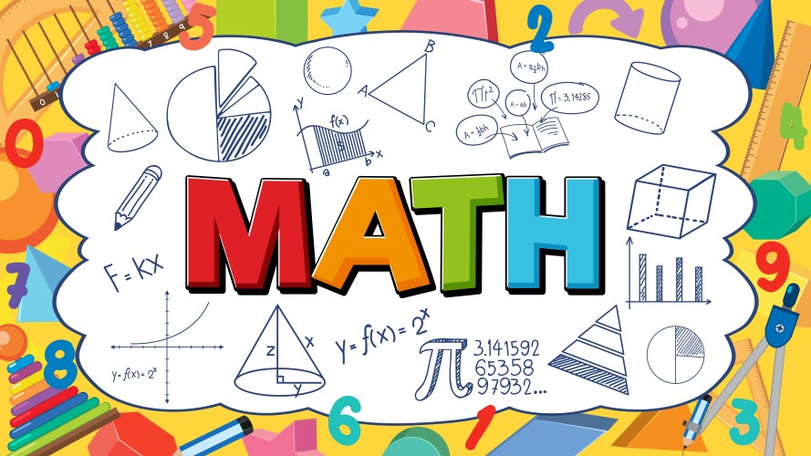
Gayathi Common School(2065)
EOT Answers
Grade 7 Reveal
2025-26T1
Principal : Ms.Moza AlMansoori Grade : 7 Teacher: Ms Lija Xavier

Slide 2
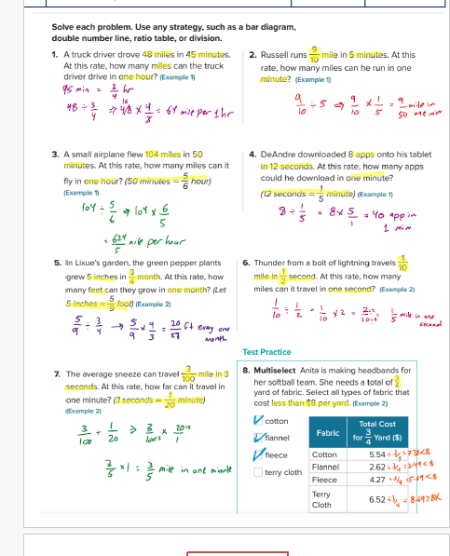
Gayathi Common School(2065)
Page 11
Principal : Ms.Moza AlMansoori Grade : 7 Teacher: Ms Lija Xavier

Slide 3
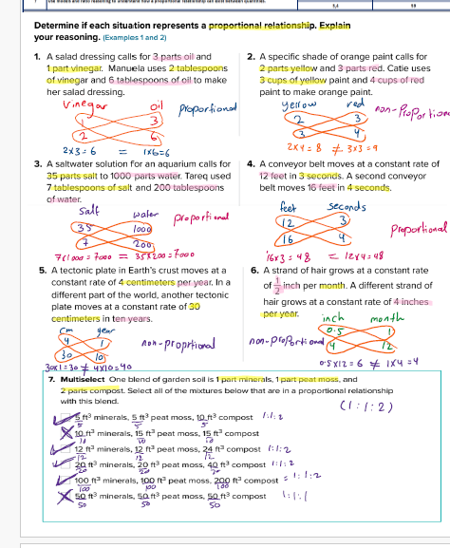
Gayathi Common School(2065)
Page 19
Principal : Ms.Moza AlMansoori Grade : 7 Teacher: Ms Lija Xavier

Slide 4
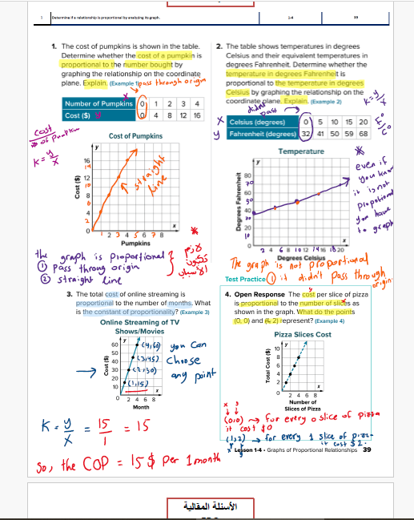
Gayathi Common School(2065)
Page 39
Principal : Ms.Moza AlMansoori Grade : 7 Teacher: Ms Lija Xavier

Slide 5
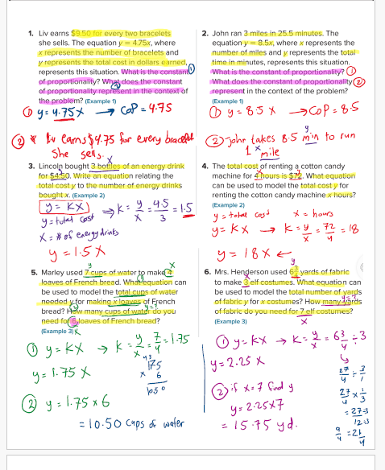
Gayathi Common School(2065)
Page 47
Principal : Ms.Moza AlMansoori Grade : 7 Teacher: Ms Lija Xavier

Slide 6
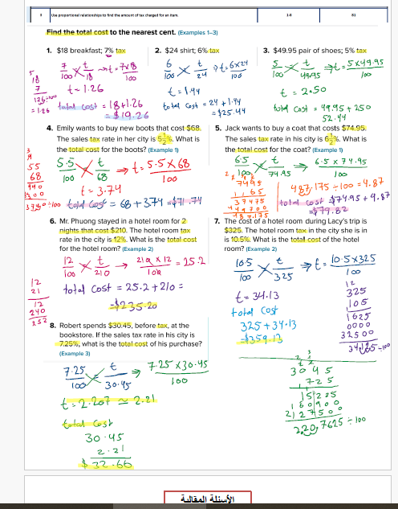
Gayathi Common School(2065)
Page 81
Principal : Ms.Moza AlMansoori Grade : 7 Teacher: Ms Lija Xavier

Slide 7
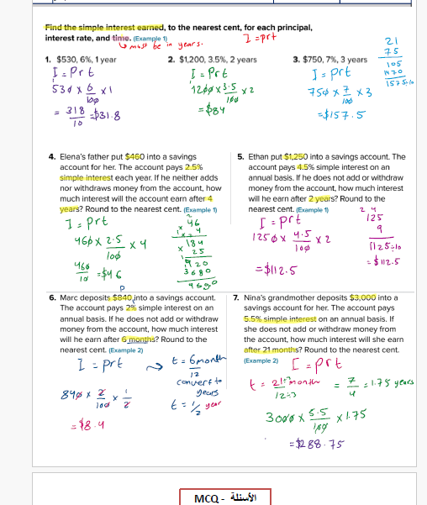
Gayathi Common School(2065)
Page 105
Principal : Ms.Moza AlMansoori Grade : 7 Teacher: Ms Lija Xavier

Slide 8
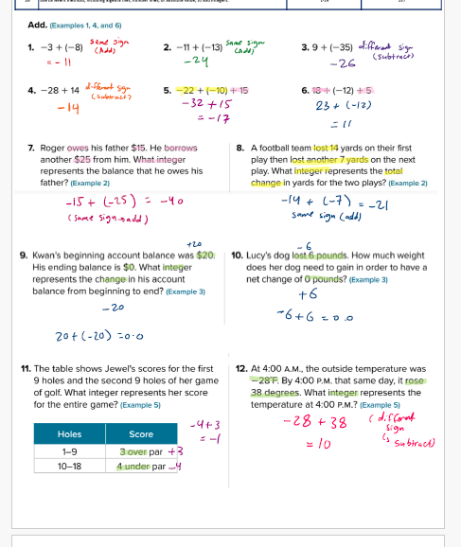
Gayathi Common School(2065)
Page 137
Principal : Ms.Moza AlMansoori Grade : 7 Teacher: Ms Lija Xavier

Slide 9
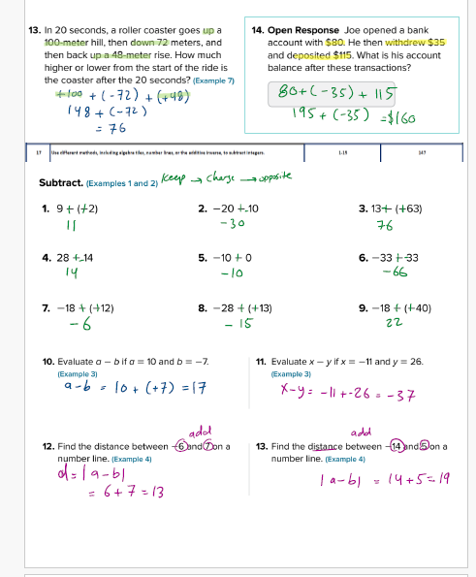
Gayathi Common School(2065)
Page 147
Principal : Ms.Moza AlMansoori Grade : 7 Teacher: Ms Lija Xavier

Slide 10
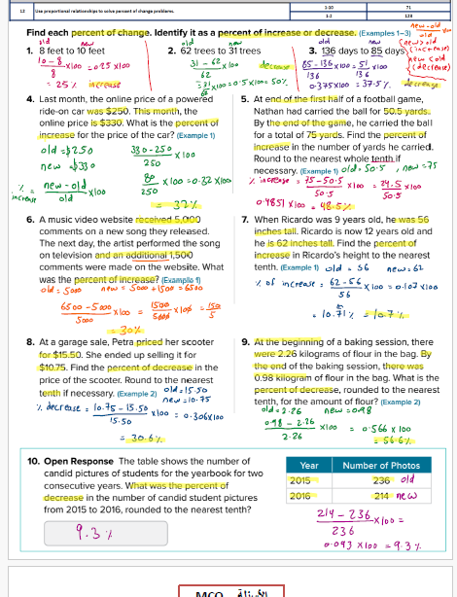
Gayathi Common School(2065)
Page 71
Principal : Ms.Moza AlMansoori Grade : 7 Teacher: Ms Lija Xavier

Slide 11
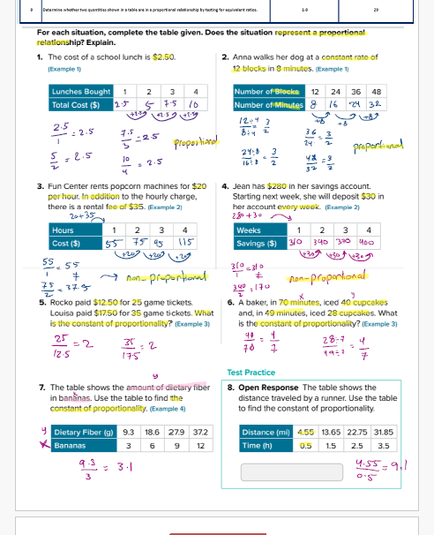
Gayathi Common School(2065)
Page 29
Principal : Ms.Moza AlMansoori Grade : 7 Teacher: Ms Lija Xavier

Slide 12
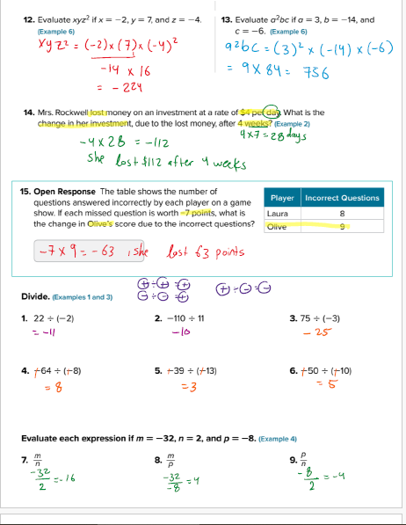
Gayathi Common School(2065)
Page 157
Page 165
Principal : Ms.Moza AlMansoori Grade : 7 Teacher: Ms Lija Xavier

Slide 13
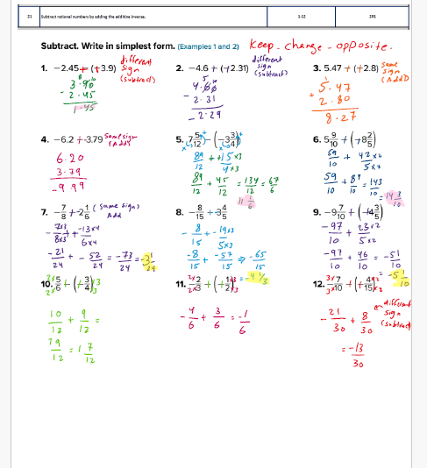
Gayathi Common School(2065)
Page 201
Principal : Ms.Moza AlMansoori Grade : 7 Teacher: Ms Lija Xavier

Slide 14
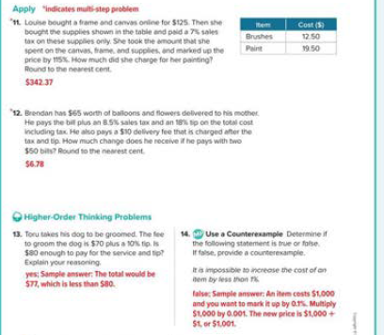
Page 90

Slide 15
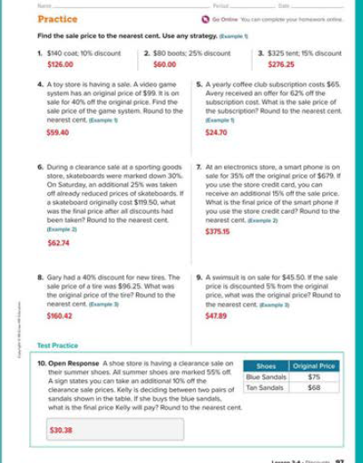
Page 97

Slide 16
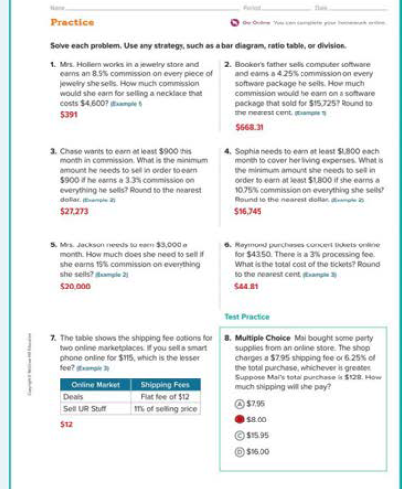
Page 113

Slide 17
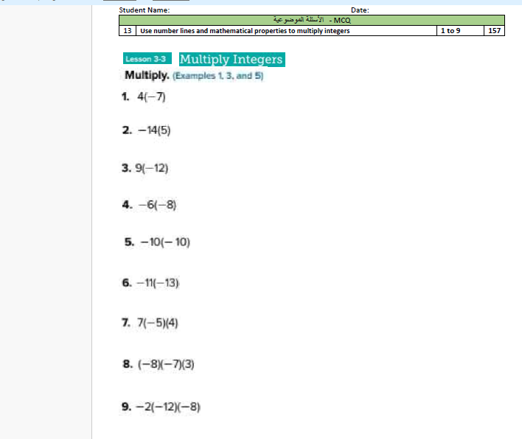










Page 157

Slide 18
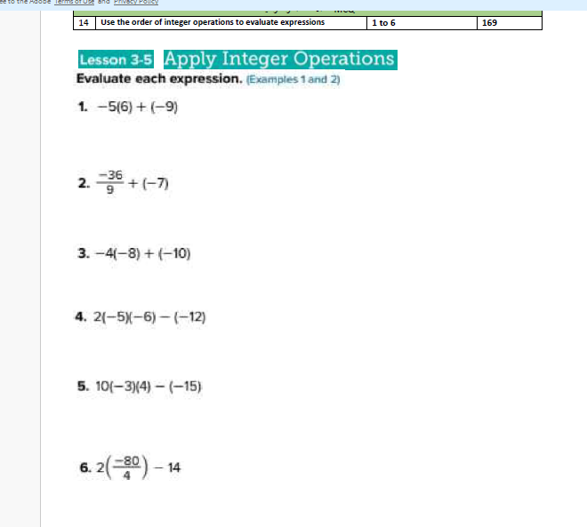
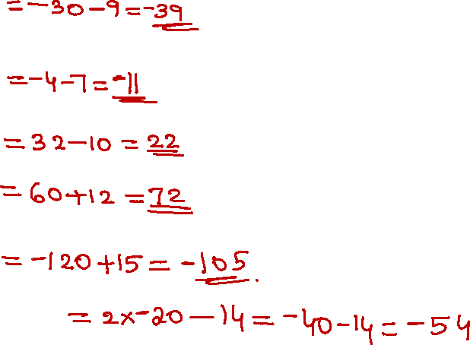
Page 169

Slide 19
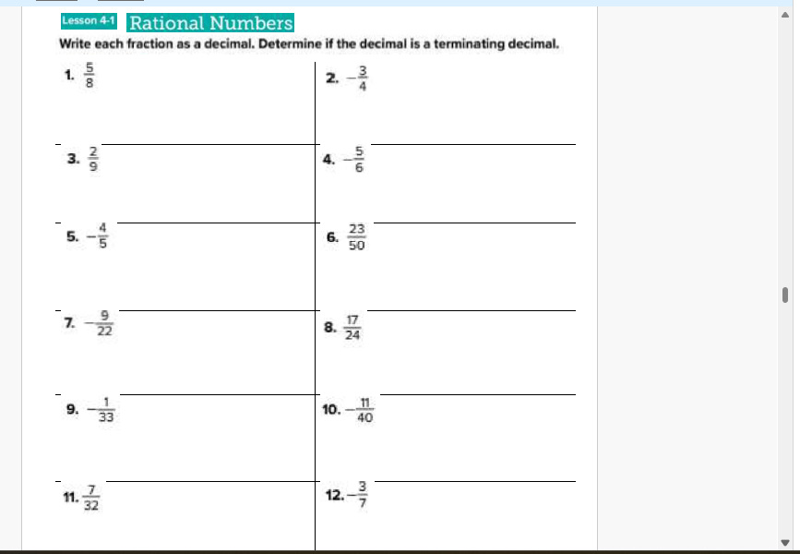
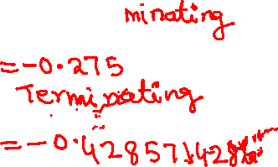
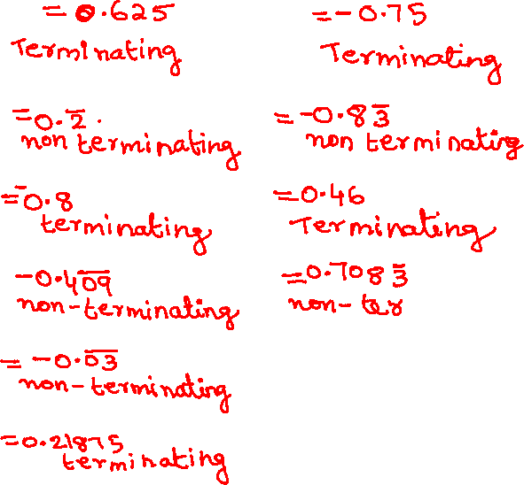
Page 183

Slide 20
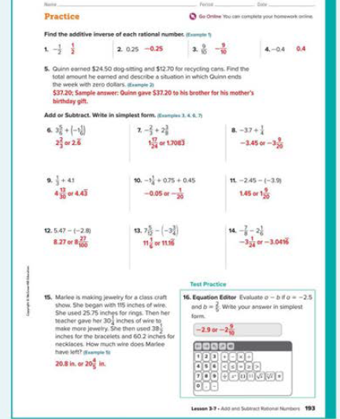
Page 195

Slide 21
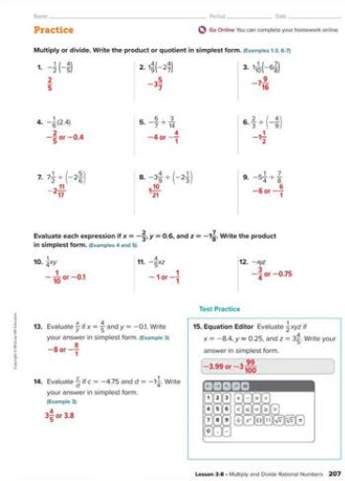
Page 211

Slide 22
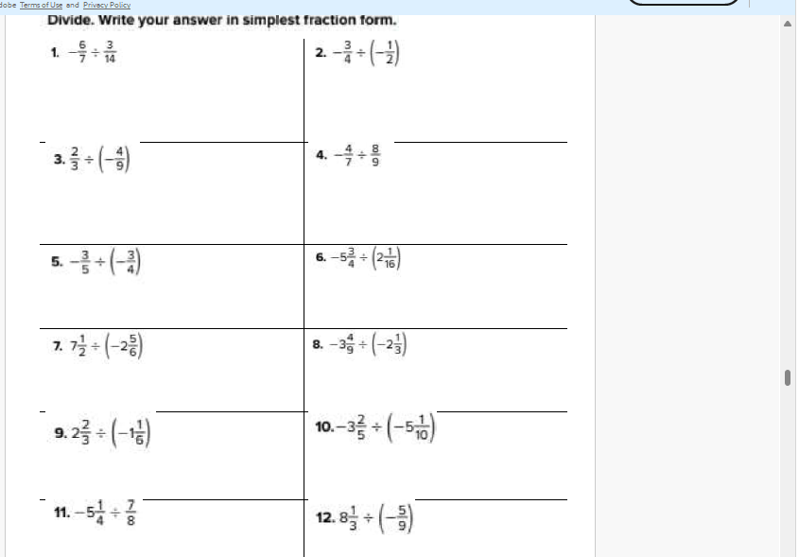
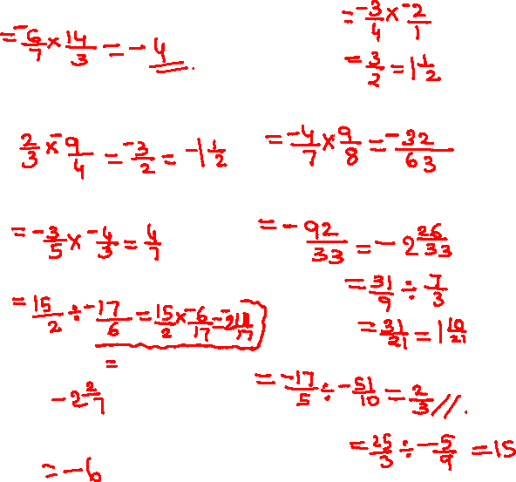
Page 219

Slide 23
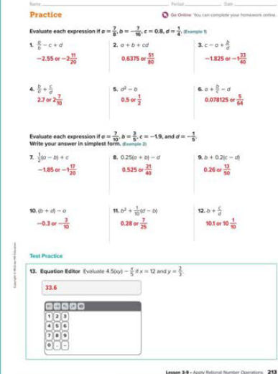
Page 225

Slide 24
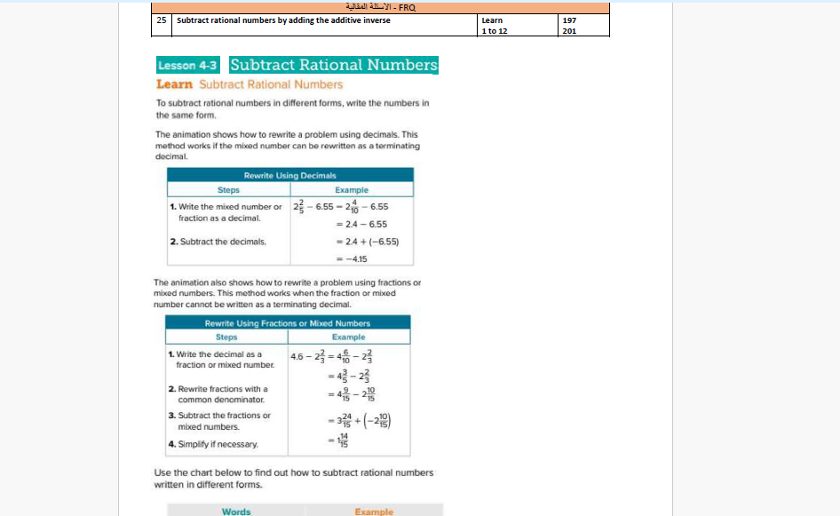
Page 197

Slide 25
Gayathi Common School(2065)
Thank You
Principal : Ms.Moza AlMansoori Grade : 7 Teacher: Ms Lija Xavier

