Slide 1

English Term 3 Coverage
Level 4.1
Term 3 2021-2022

Slide 2

Contents:
Coverage
Preparation - grammar
Level 4.1
Term 3 Academic Year 2021-2022

Slide 3
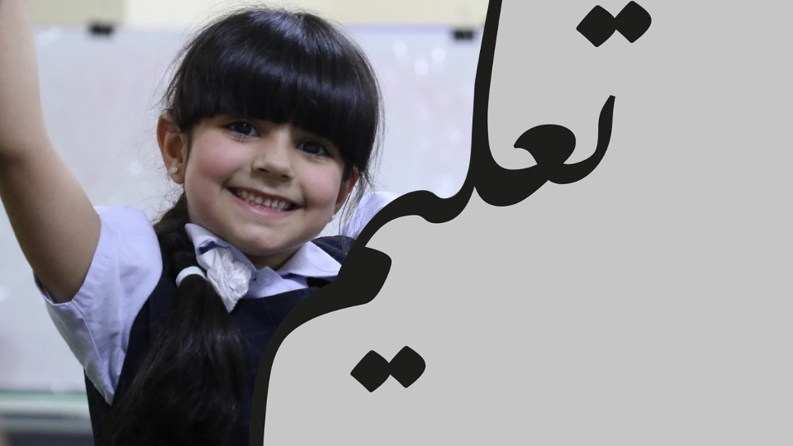
Term 3 Coverage

Slide 4
Term 3 Coverage
Topic(s): People and places
Lexis | Grammar | Functional Language
expeditions, cultures | Modals: present modals Adjectives: position Adverb: time Pronouns: object | Asking and giving permission Describing people Describing places Asking and giving directions Making arrangements Expressing interest

Slide 5

Term 3: Preparation - Grammar

Slide 6

I must do my homework. We have to eat dinner now. I don’t have to watch this film.
Grammatical structure | Modals: present modals (must / have to) subject + modal + main verb
Usage | A modal adds meaning to the main verb in a sentence. In this case, it is a modal of obligation that expresses a firm obligation. The action is a rule and there is no other choice.
Meaning | must / have to – it is a rule to do the action must not – it is a rule to not do the action do not have to – there is a choice to do the action or not
Other examples | I mustn’t forget my water bottle. You must / have to stop when the traffic lights are red. They do not have to go to school today.

Slide 7
The hotel seemed nice. It had a big, blue pool. Noisy children were playing in the cool water.
Grammatical structure | Adjectives: position adjective + noun subject + sensing verb + adjective
Usage | An adjective can come before the noun it describes. Adjectives can also come after the noun if a sensing verb (e.g. look, feel, seem, taste, smell) is used between the noun and adjective.
Meaning | They were happy with the place they stayed in while on vacation. The pool was a large size and the colour blue. The children who were playing in it were very loud.
Other examples | The food smelled delicious. There were many interesting things to see. Is it a good school?

Slide 8
Earlier, I went home. I stayed there all afternoon. I always stay at home on Friday afternoons.
Grammatical structure | Adverbs of time To point out a fact: subject + verb + object + adverb To point out the time: adverb, + subject + verb + object How often: subject + adverb + verb + object
Usage | Adverbs of time are used to tell us when (earlier, soon, next month, in 2018), for how long (all afternoon, since 2020, for hours) and how often (always, daily, never) an action happened. The word order depends on whether the speaker wants to highlight the action or the time it happened.
Meaning | At a time before we are speaking, I travelled home. I was at home for a long time in the afternoon. It is my habit to be home on Fridays.
Other examples | Usually, we go to school on Mondays. She will be on holiday soon. They never swim at the weekend.

Slide 9
Have a look at this. My family did that last June.
Grammatical structure | Pronouns: object pronouns (that, this) subject + verb + that/this
Usage | An object pronoun takes the place of an object in the sentence when it is clear what it refers to, usually because it has already been mentioned. This and that can be used as object pronouns in a sentence in place of a noun and indicate distance in time or place from the speaker. This is used when the object is close to the speaker and that is used when it is far away. In this case, the speaker uses this to show the listener something that is physically close to them. In the next sentence, the speaker uses that to show distance in time between them and the activity.
Meaning | She is showing something to a friend that is close by. My family did an activity a long time ago.
Other examples | I don’t like that. Did you see this? Oh, I didn’t know that!

Slide 10
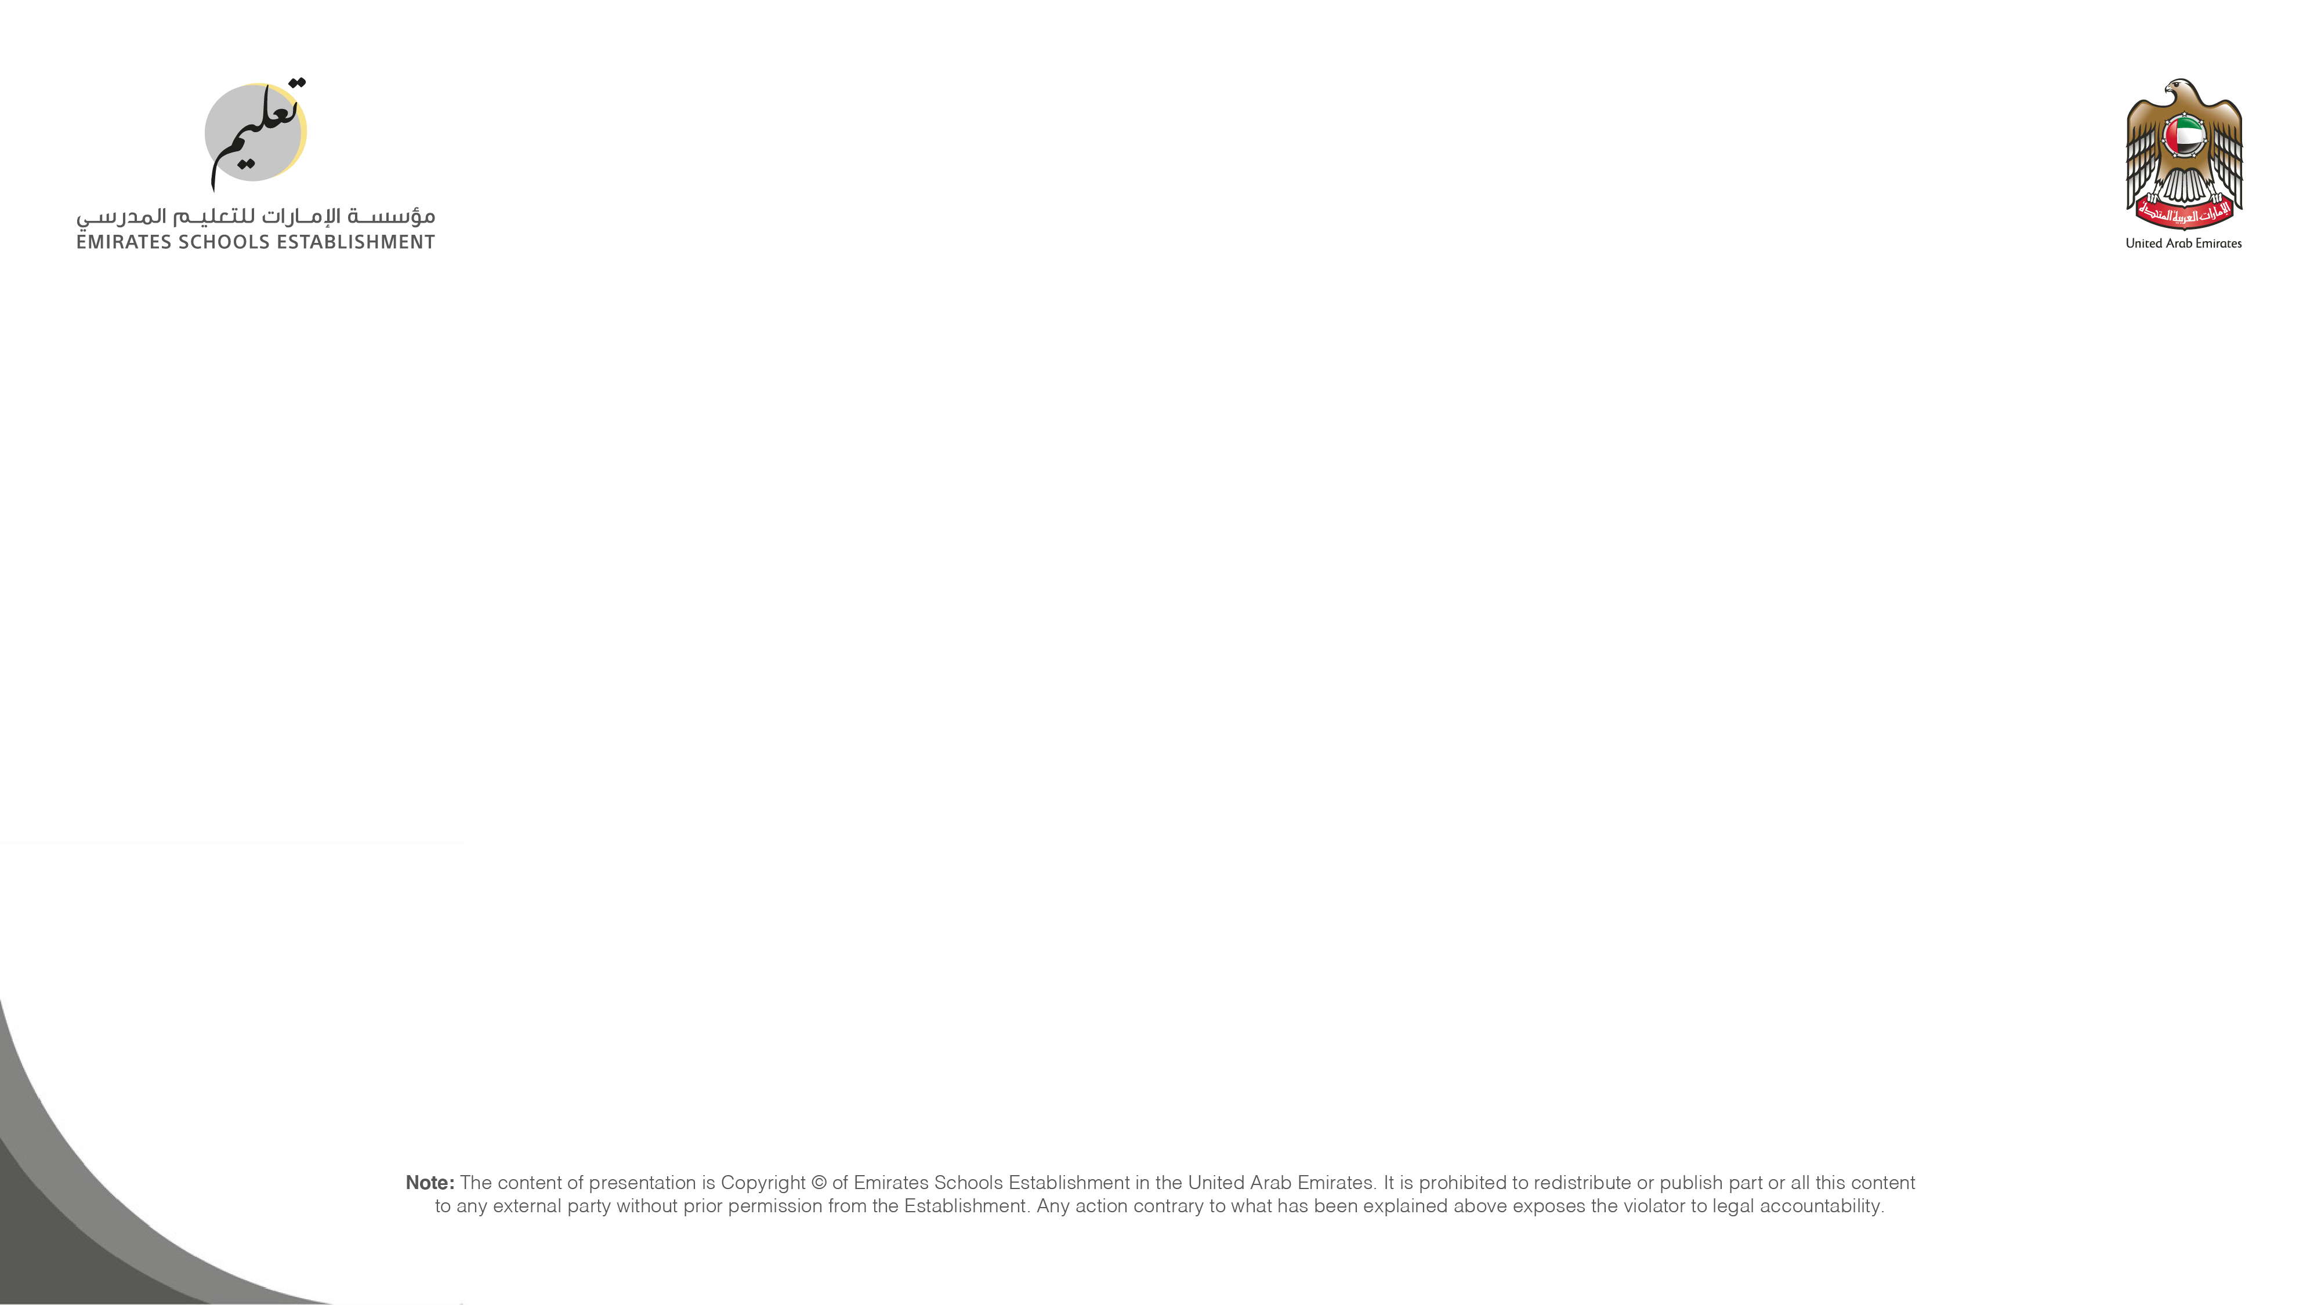


Follow us
ese.ae
Ese_ae

