Slide 1
Commission and Fees

Slide 2
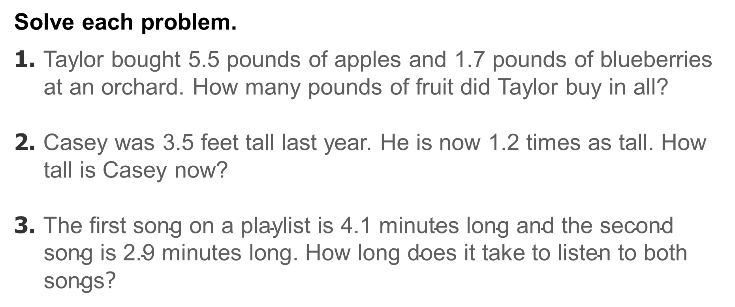
Warm Up
Solve each problem.
1. Taylor bought 5.5 pounds of apples and 1.7 pounds of blueberries at an orchard. How many pounds of fruit did Taylor buy in all?
2. Casey was 3.5 feet tall last year. He is now 1.2 times as tall. How tall is Casey now?
3. $\text{The} \text{first} \text{song} \text{on} \text{a} \text{playlist} \text{is}\text{ 4.1 }\text{minutes} \text{long} \text{and} \text{the} \text{second} \text{song} \text{is}\text{ 2.9 }\text{minutes} \text{long}$. $\text{How} \text{long} \text{does} \text{it} \text{take} \text{to} \text{listen} \text{to} \text{both} \text{songs}$?

Slide 3
Warm Up
Solve each problem.
1. Taylor bought 5.5 pounds of apples and 1.7 pounds of blueberries at an orchard. How many pounds of fruit did Taylor buy in all?
2. Casey was 3.5 feet tall last year. He is now 1.2 times as tall. How tall is Casey now?
3. $\text{The} \text{first} \text{song} \text{on} \text{a} \text{playlist} \text{is}\text{ 4.1 }\text{minutes} \text{long} \text{and} \text{the} \text{second} \text{song} \text{is}\text{ 2.9 }\text{minutes} \text{long}$. $\text{How} \text{long} \text{does} \text{it} \text{take} \text{to} \text{listen} \text{to} \text{both} \text{songs}$?
7.2 pounds
4.2 feet
7.0 minutes
Notes:
7.2 pounds
4.2 feet
7.0 minutes

Slide 4
Standards for Mathematical Content
7.RP.A.3
Use proportional relationships to solve multistep ratio and percent problems.
7.EE.A.2
Understand that rewriting an expression in different forms in a problem context can shed light on the problem and how the quantities in it are related.

Slide 5
Standards for Mathematical Content
7.EE.B.3
Solve multi-step real-life and mathematical problems posed with positive and negative rational numbers in any form (whole numbers, fractions, and decimals), using tools strategically. Apply properties of operations to calculate with numbers in any form; convert between forms as appropriate; and assess the reasonableness of answers using mental computation and estimation strategies.

Slide 6
Standards for Mathematical Practice
MP1
Make sense of problems and persevere in solving them.
MP2
Reason abstractly and quantitatively.
MP3
Construct viable arguments and critique the reasoning of others.

Slide 7
Standards for Mathematical Practice
MP4
Model with mathematics.
MP6
Attend to precision.

Slide 8
Lesson Goal
Students will solve problems involving commission and fees.

Slide 9
Learn
Commission and Fees
The following are four ways in which people are paid.
Hourly | These employees are paid a set amount each hour, such as $15 per hour.
Salary | These employees are paid a set amount, no matter how many hours they work, such as $45,000 per year.
Commission Only | These employees are paid only a percent of the amount that they sell.
Salary plus Commission | These employees are paid a small base salary, plus a percent of the amount that they sell.

Slide 10
Learn
Commission and Fees
Some employees, such as realtors, car salespeople, and stockbrokers, are paid a percent of the amount that they sell. This payment is called a commission.
If you pay a commission to a person or business, you are paying a fee. A fee is a payment for a service. It can be a fixed amount, a percent of the charge, or both.
A realtor may earn 5% commission on the sale of a home. Suppose the realtor sells a house for $140,000. You can use equivalent ratios, and the percentage written as a rate per 100, to determine the amount of commission. Let c represent the amount of commission.

Slide 11
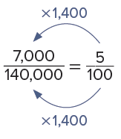
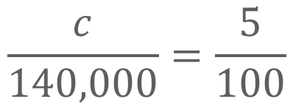
Learn
Commission and Fees
amount of commission
price of house
$$\frac{c}{140,000}=\frac{5}{100}$$
Percent
Because 100 × 1,400 is 140,000, multiply 5 by 1,400 to find c.

Slide 12
Learn
Commission and Fees
The amount of commission is $7,000. This means the real estate agent will be paid $7,000 for selling a $140,000 home.

Slide 13
Example 1
Find Commission
Angie works in a jewelry store and earns a 6.25% commission on every piece of jewelry she sells.
How much commission does she earn for selling a ring that costs $1,300?

Slide 14
Example 1
Find Commission
Think About It!
What is a good estimate for the solution? Explain how
you calculated the estimate.

Slide 15
Example 1
Find Commission
Method 1 Use ratio reasoning.
Write a proportion and solve using ratio reasoning. Let c represent the amount of commission.

Slide 16
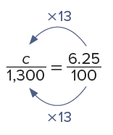
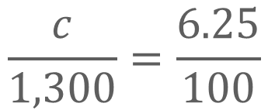
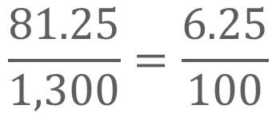
Example 1
Find Commission
amount of commission
cost of ring
$$\frac{c}{1,300}=\frac{6.25}{100}$$
Percent
Because 100 × 13 = 1,300, multiply 6.25 by 13 to find the value of c.
$$\frac{81.25}{1,300}=\frac{6.25}{100}$$
6.25 × 13 = 81.25,
so, c = 81.25.

Slide 17
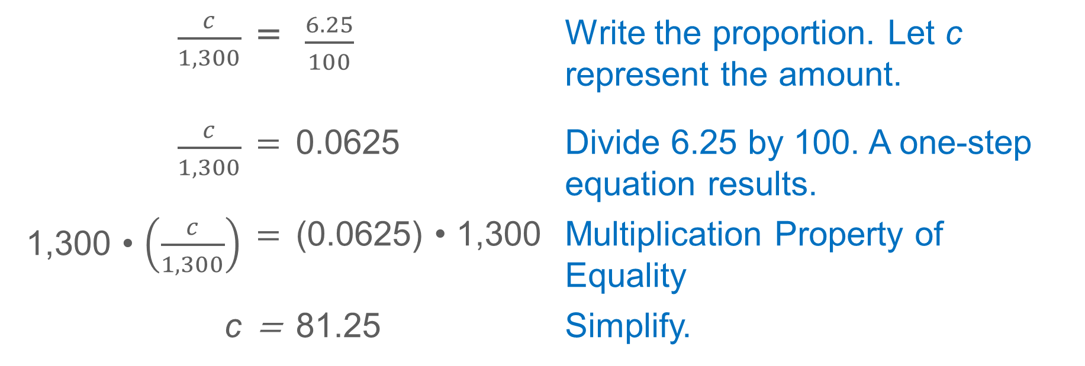
Example 1
Find Commission
Method 2 Use properties of operations.
$\frac{c}{1,300}$ | = | $\frac{6.25}{100}$ | Write the proportion. Let c represent the amount.
$\frac{c}{1,300}$ | = | 0.0625 | Divide 6.25 by 100. A one-step equation results.
1,300 • $\left(\frac{c}{1,300}\right)$ | = | (0.0625) • 1,300 | Multiplication Property of Equality
c | = | 81.25 | Simplify.
So, using either method, the amount of commission is $81.25.

Slide 18
Example 1
Find Commission
Talk About It!
How does your answer compare to your estimate?

Slide 19
Example 1
Find Commission
Check
Nathan sells jewelry and earns a 9.75% commission on every piece he sells. How much commission would he earn on a bracelet that sold for $220? Use any strategy.

Slide 20
Example 1
Find Commission
Check
Nathan sells jewelry and earns a 9.75% commission on every piece he sells. How much commission would he earn on a bracelet that sold for $220? Use any strategy.
$21.45
Notes:
$21.45

Slide 21
Example 2
Find the Amount of Sales
Caleb needs to earn $1,200 each month to cover his living expenses. He earns an 8% commission on everything he sells.
What is the minimum amount he needs to sell in order to earn $1,200?

Slide 22
Example 2
Find the Amount of Sales
Think About It!
Do you need to find the part, the percent, or the whole?

Slide 23
Example 2
Find the Amount of Sales
Write a proportion. Then solve using ratio reasoning. Let a represent the amount he needs to sell.

Slide 24
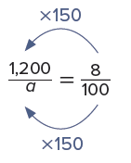
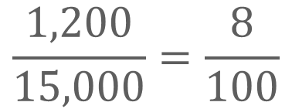
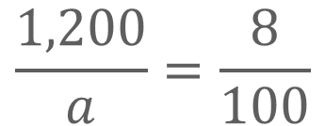
Example 2
Find the Amount of Sales
amount of commission
amount of sales
$$\frac{1,200}{a}=\frac{8}{100}$$
Percent
Because 8 × 150 = 1,200, multiply 100 by 150 to find
the value of a.
$$\frac{1,200}{15,000}=\frac{8}{100}$$
100 × 150 = 15,000,
so, a = 15,000.

Slide 25
Example 2
Find the Amount of Sales
So, Caleb needs to sell $15,000 to earn $1,200 in commission.

Slide 26
Example 2
Find the Amount of Sales
Talk About It!
How do you know your answer is reasonable?

Slide 27
Example 2
Find the Amount of Sales
Check
Quentin wants to earn at least $945 this month in commission. What is the minimum amount he needs to sell if he earns a 5.25% commission?
Notes:
$18,000

Slide 28
Example 2
Find the Amount of Sales
Check
Quentin wants to earn at least $945 this month in commission. What is the minimum amount he needs to sell if he earns a 5.25% commission?
$18,000
Notes:
$18,000

Slide 29
Pause and Reflect
Did you make any errors when completing the Check exercise? What can you do to make sure you don’t repeat the errors in the future?

Slide 30
Example 3
Fees
Sybrina bought some paper supplies from an online retailer. The retailer charges a $6.95 shipping fee or 8% of the total purchase, whichever is greater.
If Sybrina's total purchase is $85.50, how much shipping will she pay?

Slide 31
Example 3
Fees
Think About It!
What is a good estimate for an 8% shipping fee? Explain how you calculated the estimate.

Slide 32
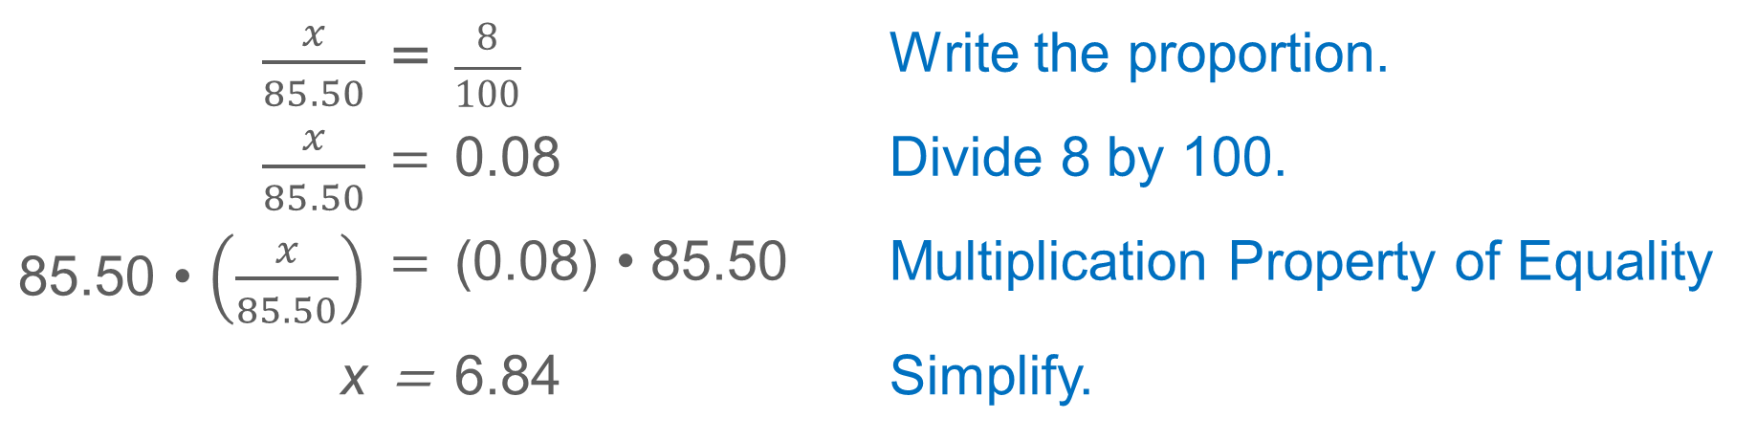
Example 3
Fees
Step 1 Find the percent of the total purchase.
Because the shipping fee may be 8% of the total purchase, find 8% of $85.50.
Write a proportion and solve using the properties of operations. Let x represent the potential shipping fee.
$\frac{x}{85.50}$ | = | $$\frac{8}{100}$$ | Write the proportion.
$\frac{x}{85.50}$ | = | 0.08 | Divide 8 by 100.
85.50 • $\left(\frac{x}{85.50}\right)$ | = | (0.08) • 85.50 | Multiplication Property of Equality
x | = | 6.84 | Simplify.

Slide 33
Example 3
Fees
Step 2 Compare the two fees.
The 8% shipping fee of $6.84 is less than the $6.95 shipping fee. Sybrina must pay the greater amount.
So, Sybrina will pay $6.95 in shipping fees.

Slide 34
Example 3
Fees
Talk About It!
How can you solve the problem another way?

Slide 35
Example 3
Fees
Check
Tickets for a concert are sold by online ticket resellers. One company charges a fee of 4% of the ticket price. Another company charges a flat fee of $2.50. The ticket you want to buy costs $60.50. If you buy the ticket online, which is the lesser fee?

Slide 36
Example 3
Fees
Check
Tickets for a concert are sold by online ticket resellers. One company charges a fee of 4% of the ticket price. Another company charges a flat fee of $2.50. The ticket you want to buy costs $60.50. If you buy the ticket online, which is the lesser fee?
$2.42
Notes:
$2.42

Slide 37

Apply
Personal Finance
David is starting a new job in sales. He can choose to earn only a 10% commission on sales each month, or earn a monthly base salary of $1,500 with a 3% commission on sales over $7,500. Which pay method would earn him more money if he has an average sales of $16,000 each month?

Slide 38
Apply
Personal Finance
Talk About It!
How do you determine a 3% commission on sales over $7,500?

Slide 39
Apply
Personal Finance
Check
Kelly has a job in sales that pays only a commission of 24% of her total monthly sales. She is offered a new job with a monthly salary of $3,750 with a commission of 9.5% on her total monthly sales over $12,500. If she estimates her total monthly sales will average $20,000, which statement is correct?
A. The new job will pay more because she would earn $4,462.50, and her current job only pays $4,220.
B. The new job will pay more because she would earn $4,742.75, and her current job only pays $4,220.
C. Her current job will pay more because she will earn $4,800, and the new job would only pay $4,462.50.
D. Her current job will pay more because she will earn $4,800, and the new job would only pay $4,742.75.

Slide 40
Apply
Personal Finance
Check
Kelly has a job in sales that pays only a commission of 24% of her total monthly sales. She is offered a new job with a monthly salary of $3,750 with a commission of 9.5% on her total monthly sales over $12,500. If she estimates her total monthly sales will average $20,000, which statement is correct?
A. The new job will pay more because she would earn $4,462.50, and her current job only pays $4,220.
B. The new job will pay more because she would earn $4,742.75, and her current job only pays $4,220.
C. Her current job will pay more because she will earn $4,800, and the new job would only pay $4,462.50.
D. Her current job will pay more because she will earn $4,800, and the new job would only pay $4,742.75.
C
Notes:
C

Slide 41
Pause and Reflect
How are parts and wholes represented in fees and commissions? Give examples to support your answer.

Slide 42
Exit Ticket
Suppose you are offered a job that pays a base salary of $300 plus 5% commission on sales per week. Explain how to determine your weekly pay.

Slide 43
Exit Ticket
Suppose you are offered a job that pays a base salary of $300 plus 5% commission on sales per week. Explain how to determine your weekly pay.
Sample answer: Multiply the amount in sales by 5%, or 0.05. Then add the base salary of $300.

