Slide 1
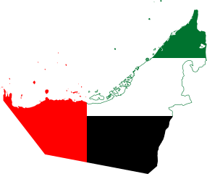
I am proud to be living in the United Arab Emirates.

Slide 2
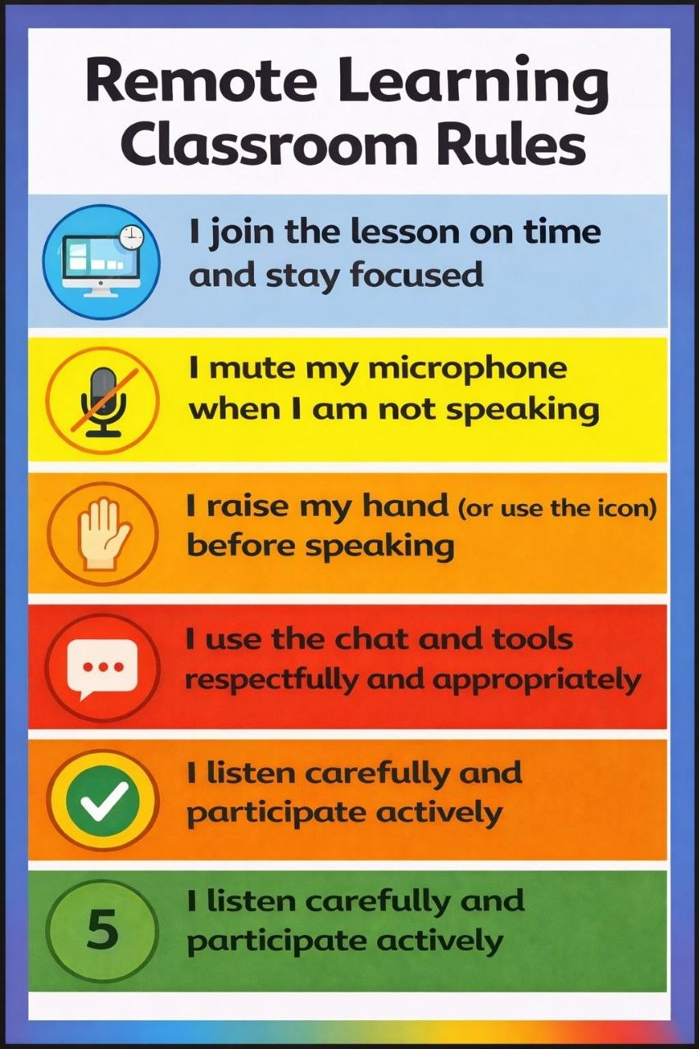

Slide 3
Unit 8:People and Numbers
Lesson 2:
At the Weekend

Slide 4





























Objectives
2
-to introduce the new vocabulary words
-to identify the main ideas in a reading passage
-to identify the details in a reading passage.
-to speak about what you do at the weekend.

Slide 5


Warm Up:
-What is your favorite thing to do at the weekend?
3
-How much do you spend doing it?

Slide 6


















1. Vocabulary
Let’s learn the vocabulary words first.

Slide 7

















Percent
5

Slide 8

Internet
6

Slide 9
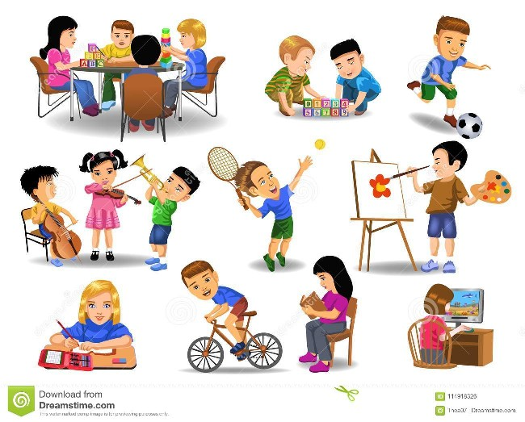
Activities
7

Slide 10
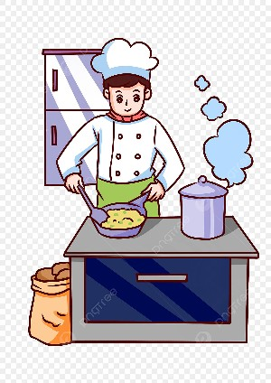
Cooking
8

Slide 11
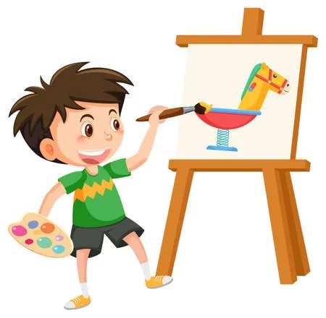
Painting
9

Slide 12
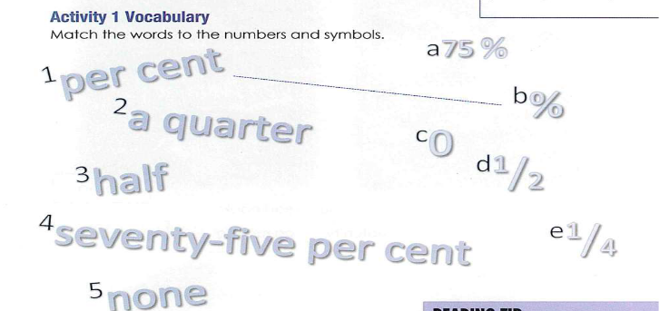
Activity 1 (Vocabulary)
10

Slide 13
Activity 1 (Vocabulary)
11

Slide 14
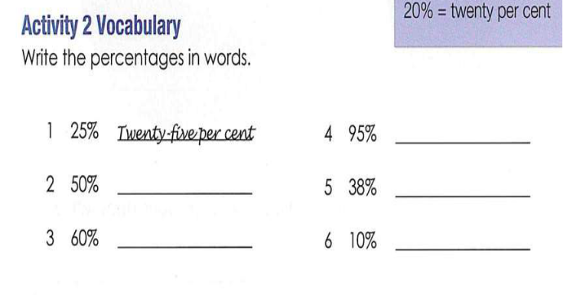
Activity 2 Vocabulary
12
Ninety five percent
Fifty percent
Thirty eight percent
Sixty percent
Ten percent

Slide 15
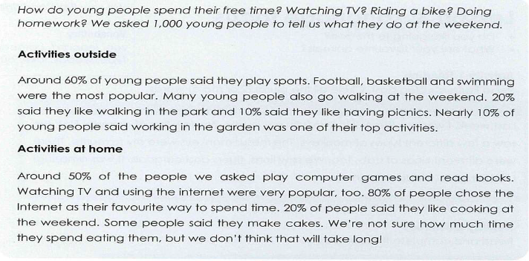
Read the article. What is it about? School - Free time Sports
13
-

Slide 16

Activity 3 (Reading)
14

Slide 17
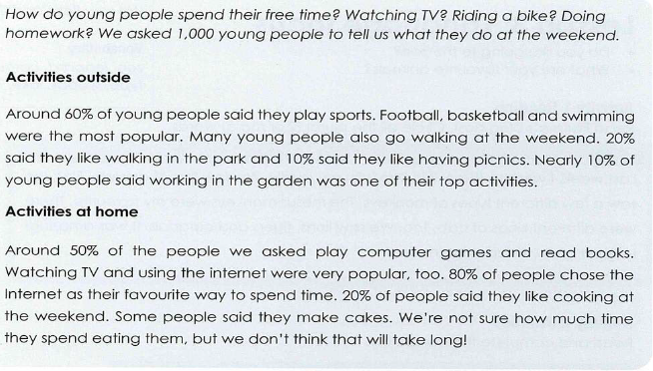
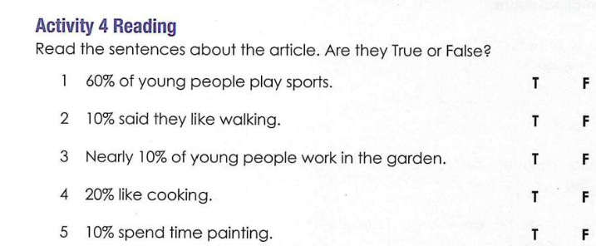

Activity 3 (Reading)
15

Slide 18
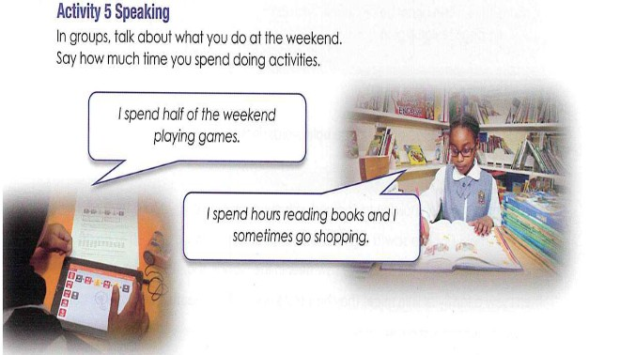
Activity 5 -Speaking
16

Slide 19
Answer liveworksheets
https://www.liveworksheets.com/worksheet/en/english-language/338423

Slide 20

18
Thanks!
Any questions?

Slide 21



Self Evaluation
Evaluate your learning for:
Type if you are confused.
Type if you are getting there.
Type if you got it!

