Slide 1
Equations of Proportional Relationships

Slide 2
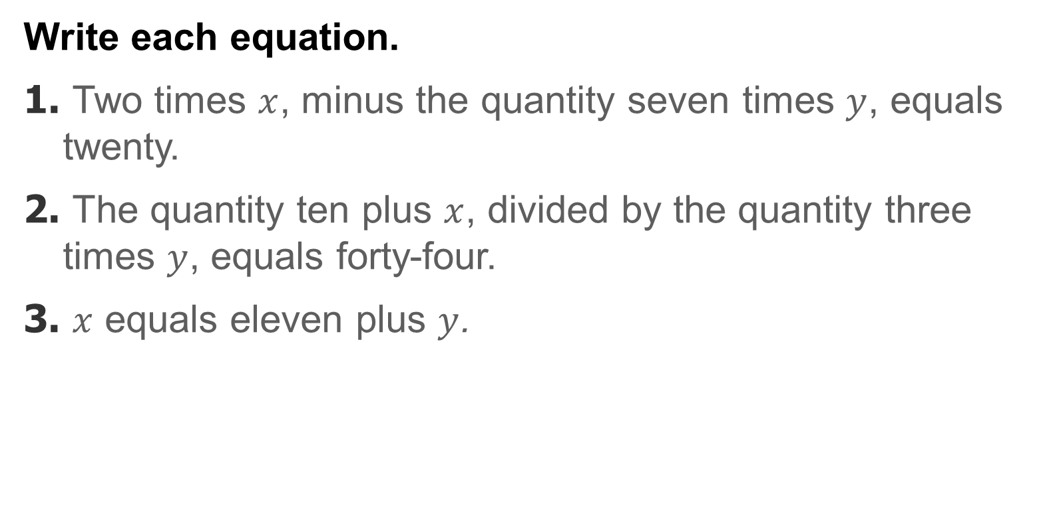
Warm Up
Write each equation.
1. Two times $x$, minus the quantity seven times $y$, equals twenty.
2. The quantity ten plus $x$, divided by the quantity three times $y$, equals forty-four.
3. $x$ equals eleven plus $y$.

Slide 3
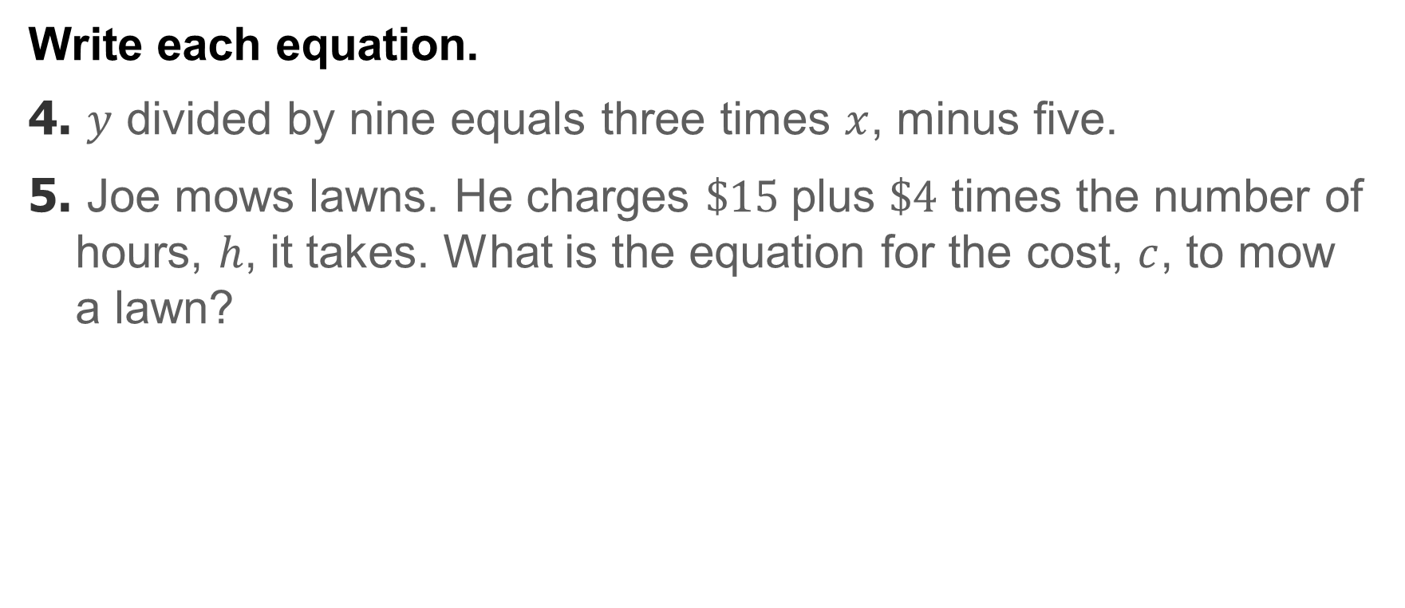
Warm Up
Write each equation.
4. $y$ divided by nine equals three times $x$, minus five.
5. Joe mows lawns. He charges $\$15$plus $\$4$ times the number of hours, $h$, it takes. What is the equation for the cost, $c$, to mow a lawn?

Slide 4
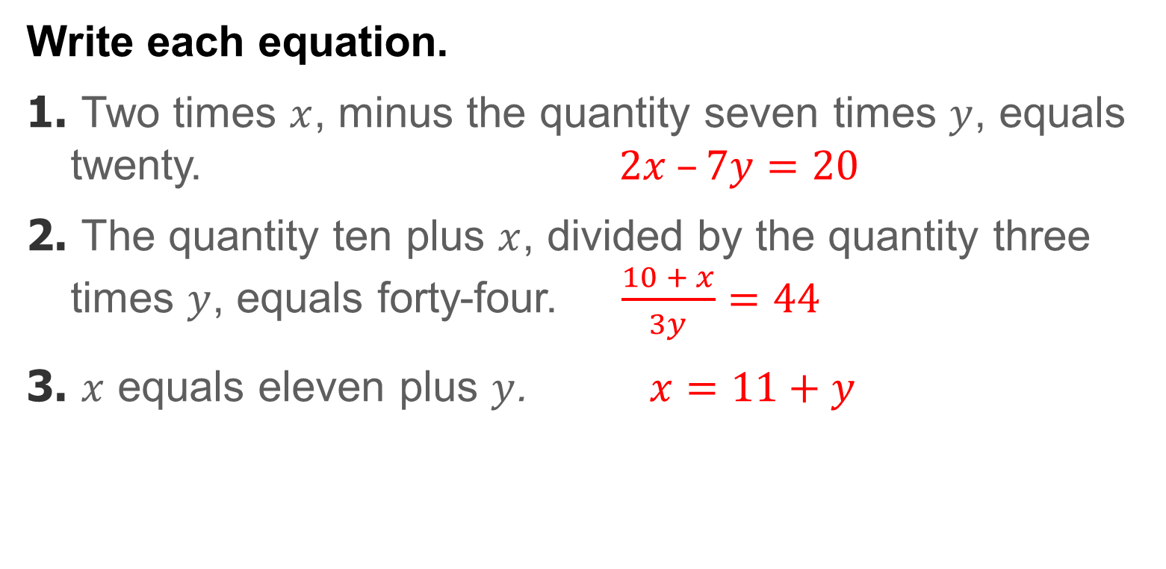
Warm Up
Write each equation.
1. Two times $x$, minus the quantity seven times $y$, equals twenty. $2x –7y=20$
2. The quantity ten plus $x$, divided by the quantity three times $y$, equals forty-four. $\frac{10 + x}{3y}=44$
3. $x$ equals eleven plus $y$. $x=11+y$
Notes:
1. $2x –7y=20$
2. . $\frac{10 + x}{3y}=44$
3. $x=11+y$

Slide 5
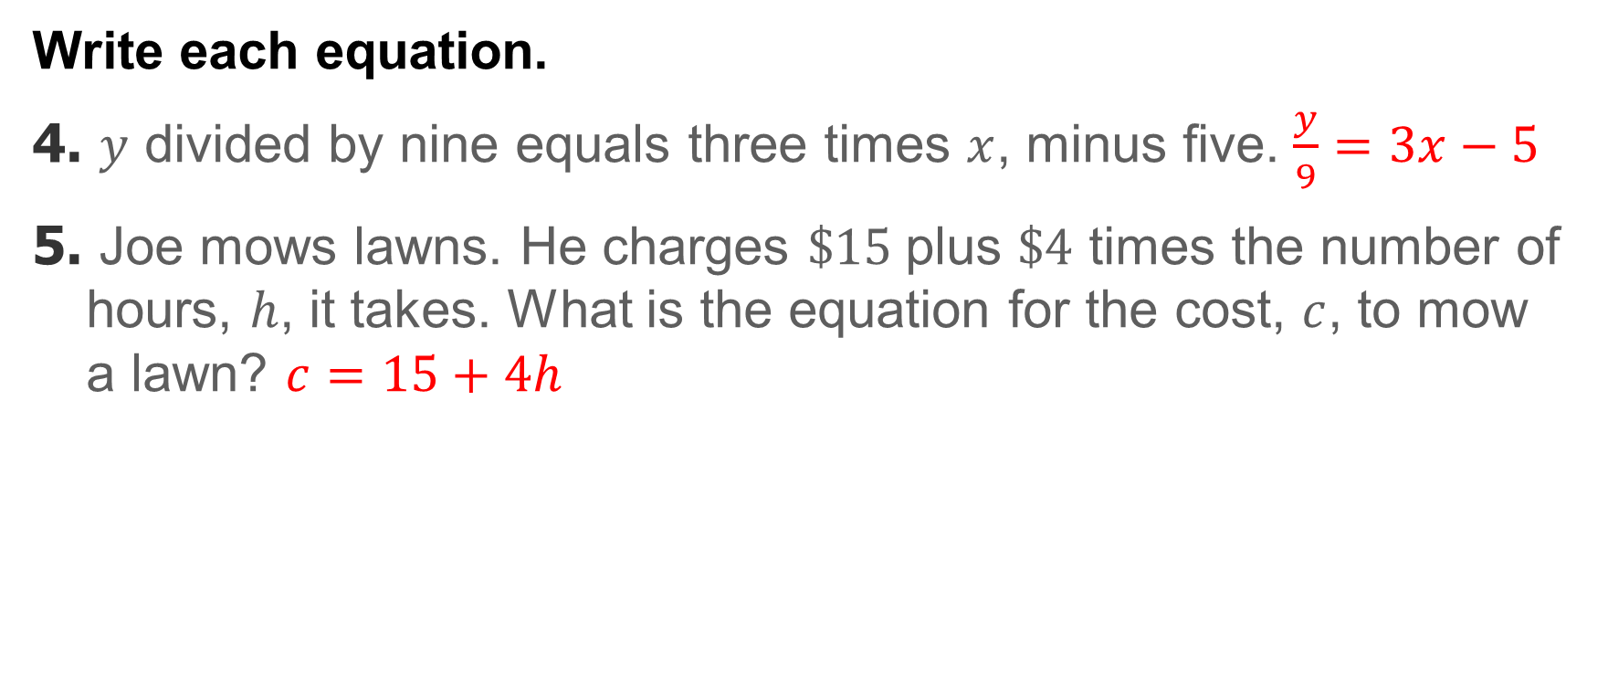
Warm Up
Write each equation.
4. $y$ divided by nine equals three times $x$, minus five. $\frac{y}{9}=3x−5$
5. Joe mows lawns. He charges $\$15$plus $\$4$ times the number of hours, $h$, it takes. What is the equation for the cost, $c$, to mow a lawn? $c=15+4h$
Notes:
4. $\frac{y}{9}=3x−5$
5. $c=15+4h$

Slide 6
Standards for Mathematical Content
7.RP.A.2
Recognize and represent proportional relationships between quantities.
7.RP.A.2.B
Identify the constant of proportionality (unit rate) in tables, graphs, equations, diagrams, and verbal descriptions of proportional relationships.
7.RP.A.2.C
Represent proportional relationships by equations.

Slide 7
Standards for Mathematical Practice
MP1
Make sense of problems and persevere in solving them.
MP2
Reason abstractly and quantitatively.
MP3
Construct viable arguments and critique the reasoning of others.
MP4
Model with mathematics.

Slide 8
Standards for Mathematical Practice
MP5
Use appropriate tools strategically.
MP6
Attend to precision.

Slide 9
Lesson Goal
Students will write equations to represent proportional relationships.

Slide 10
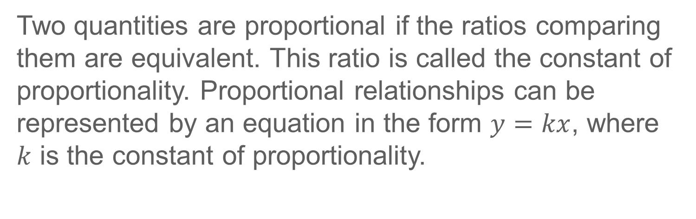
Learn
Identify the Constant of Proportionality in Equations
Two quantities are proportional if the ratios comparing them are equivalent. This ratio is called the constant of proportionality. Proportional relationships can be represented by an equation in the form $y=kx$, where $k$ is the constant of proportionality.

Slide 11
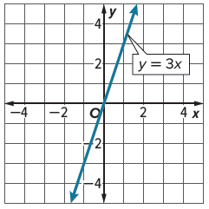
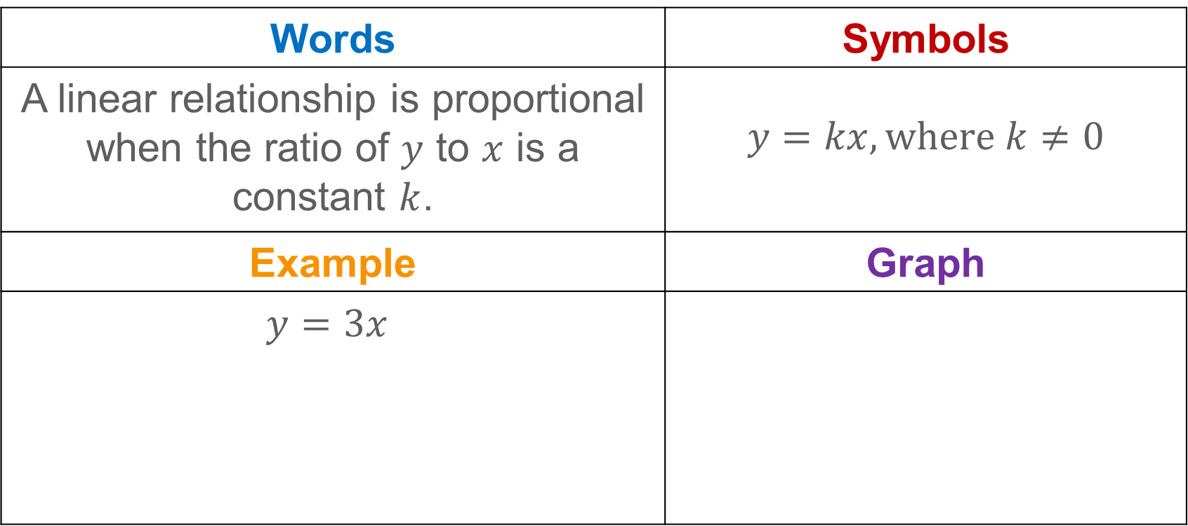
Learn
Identify the Constant of Proportionality in Equations
Words | Symbols
A linear relationship is proportional when the ratio of $y$ to $x$ is a constant $k$. | $$y=kx, where k≠0$$
Example | Graph
$$y=3x$$

Slide 12

Learn
Identify the Constant of Proportionality in Equations
Talk About It!
Can you write an equation in the form $y=kx$ for a line that does not pass through the origin? Explain.

Slide 13
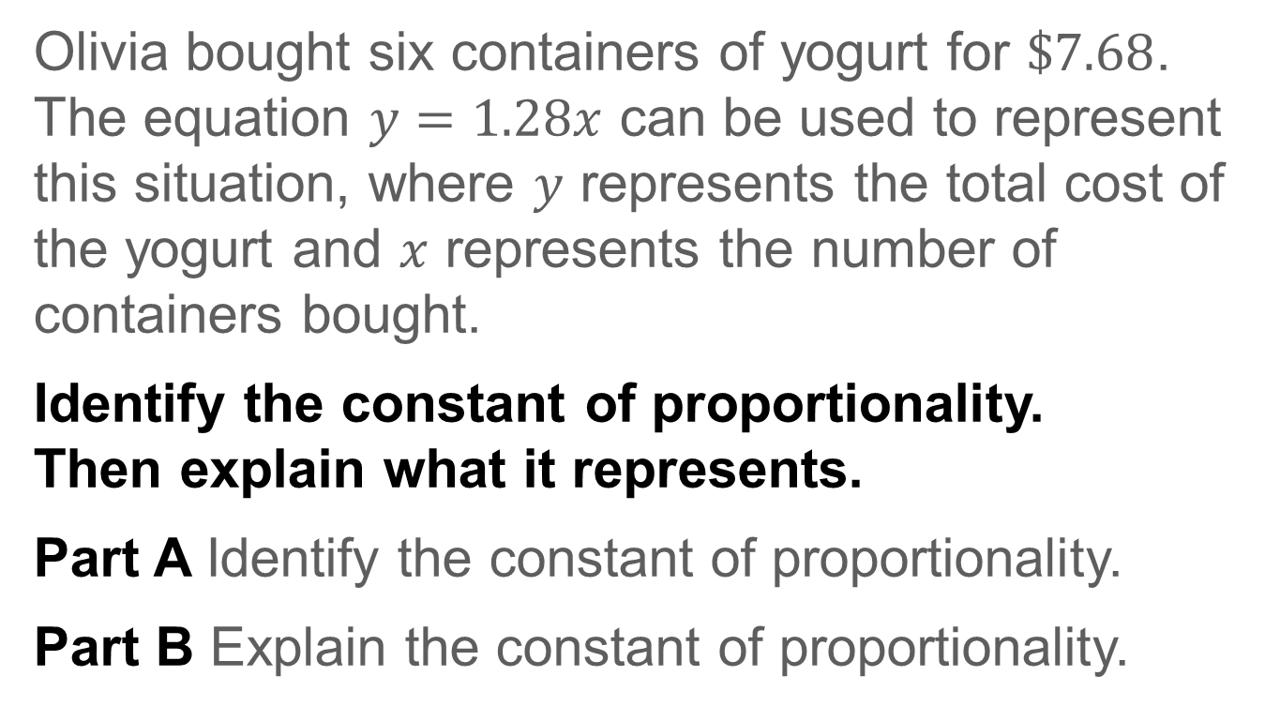
Example 1
Identify the Constant of Proportionality in Equations
Olivia bought six containers of yogurt for $\$7.68$. The equation $y=1.28x$ can be used to represent this situation, where $y$ represents the total cost of the yogurt and $x$ represents the number of containers bought.
Identify the constant of proportionality.
Then explain what it represents.
Part A Identify the constant of proportionality.
Part B Explain the constant of proportionality.

Slide 14
Example 1
Identify the Constant of Proportionality in Equations
Think About It!
How would you begin solving the problem?

Slide 15
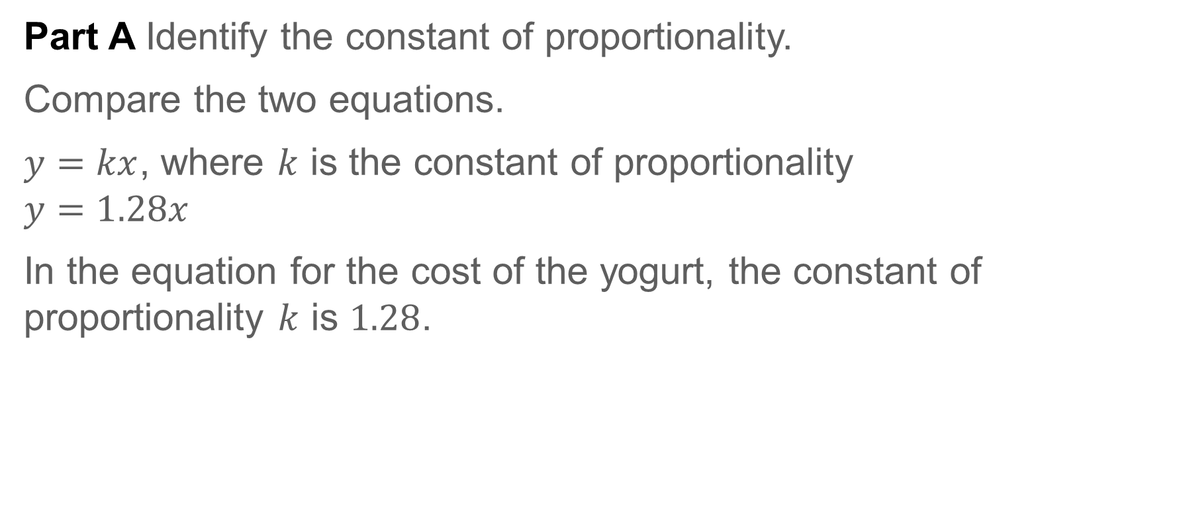
Example 1
Identify the Constant of Proportionality in Equations
Part A Identify the constant of proportionality.
Compare the two equations.
$y=kx$, where $k$ is the constant of proportionality
$$y=1.28x$$
In the equation for the cost of the yogurt, the constant of proportionality $k$ is $1.28$.

Slide 16
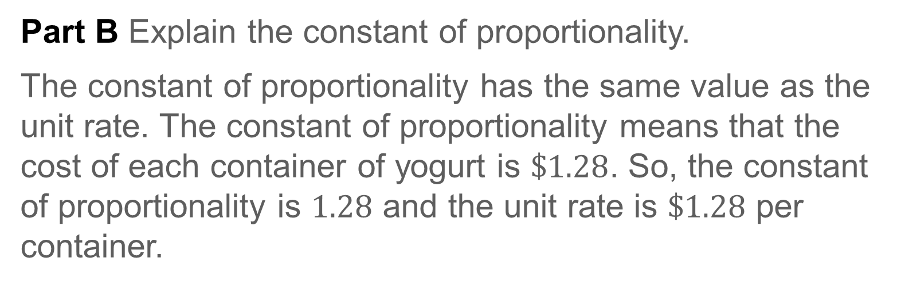
Example 1
Identify the Constant of Proportionality in Equations
Part B Explain the constant of proportionality.
The constant of proportionality has the same value as the unit rate. The constant of proportionality means that the cost of each container of yogurt is $\$1.28$. So, the constant of proportionality is $1.28$ and the unit rate is $\$1.28$ per container.

Slide 17
Example 1
Identify the Constant of Proportionality in Equations
Talk About It!
How much would Olivia pay for 10 yogurts at this same rate?

Slide 18
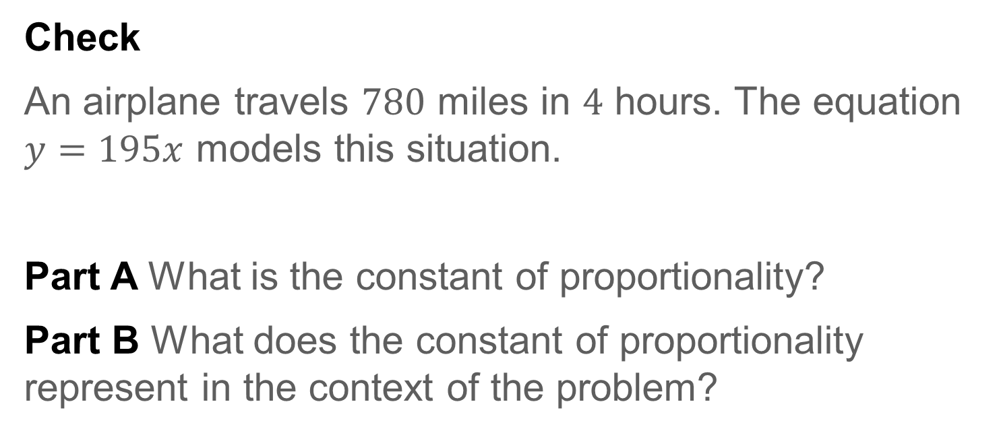
Example 1
Identify the Constant of Proportionality in Equations
Check
An airplane travels $780$ miles in $4$ hours. The equation $y=195x$ models this situation.
Part A What is the constant of proportionality?
Part B What does the constant of proportionality represent in the context of the problem?

Slide 19
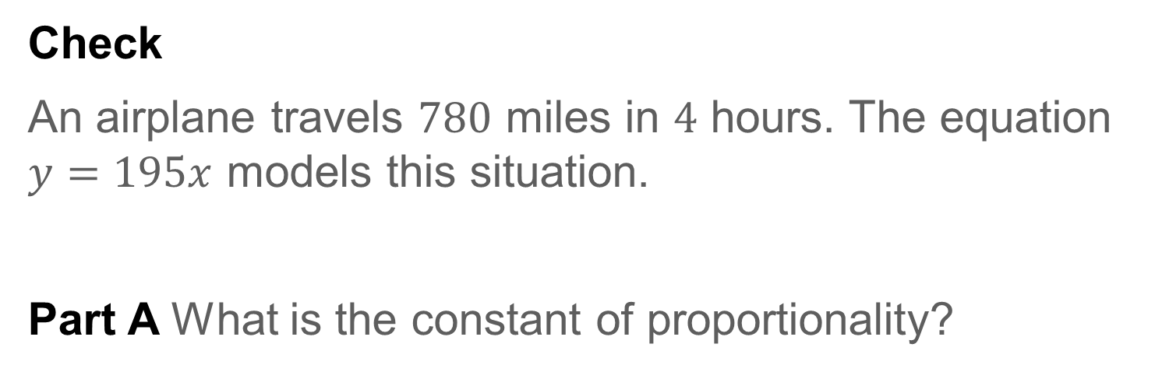
Example 1
Identify the Constant of Proportionality in Equations
Check
An airplane travels $780$ miles in $4$ hours. The equation $y=195x$ models this situation.
Part A What is the constant of proportionality?
195
Notes:
195

Slide 20
Example 1
Identify the Constant of Proportionality in Equations
Check
Part B What does the constant of proportionality represent in the context of the problem?
A An airplane travels 390 miles per hour.
B An airplane travels 1 mile per 4 hours.
C An airplane travels 1 mile per 585 hours.
D An airplane travels 195 miles per hour.

Slide 21
Example 1
Identify the Constant of Proportionality in Equations
Check
Part B What does the constant of proportionality represent in the context of the problem?
A An airplane travels 390 miles per hour.
B An airplane travels 1 mile per 4 hours.
C An airplane travels 1 mile per 585 hours.
D An airplane travels 195 miles per hour. D
Notes:
D

Slide 22
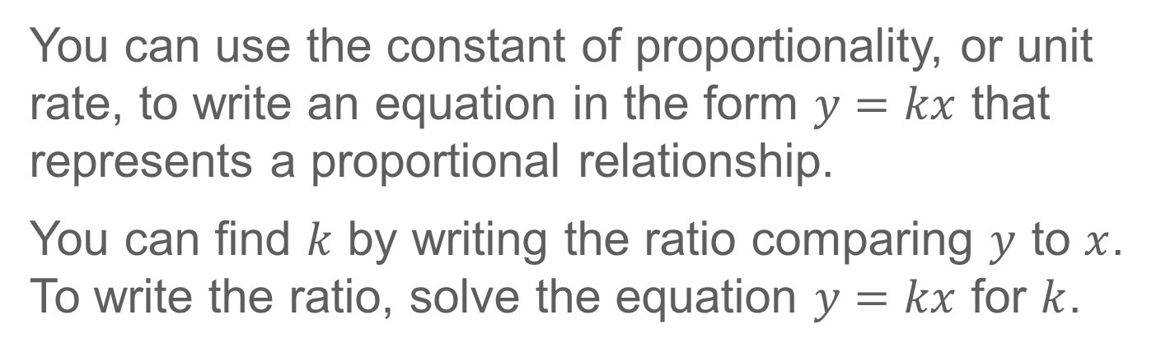
Learn
Proportional Relationships and Equations
You can use the constant of proportionality, or unit rate, to write an equation in the form $y=kx$ that represents a proportional relationship.
You can find $k$ by writing the ratio comparing $y$ to $x$. To write the ratio, solve the equation $y=kx$ for $k$.
Notes:
D

Slide 23
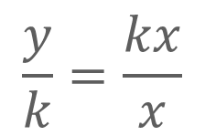


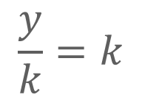
Learn
Proportional Relationships and Equations
$y=kx$
Write the equation.
$$\frac{y}{k}=\frac{kx}{x}$$
Divide each side by $x$.
$$\frac{y}{k}=k$$
Simplify.
The constant of proportionality is the ratio $\frac{y}{k}$ where $x≠0$.

Slide 24
Learn
Proportional Relationships and Equations
Talk About It!
What is the equation for a proportional relationship where the constant of proportionality is 3.25?

Slide 25

Example 2
Proportional Relationships and Equations
Jaycee bought 8 gallons of gas for $\$31.12.$
Write an equation relating the total cost y to the number of gallons of gas x if it is a proportional relationship.

Slide 26
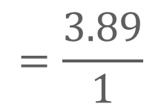
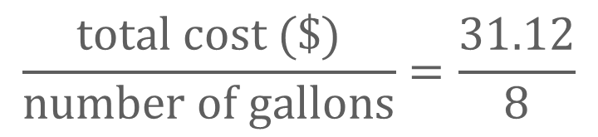

Example 2
Proportional Relationships and Equations
Step 1 Find the constant of proportionality between cost and gallons.
$$\frac{total cost (\$)}{number of gallons}=\frac{31.12}{8}$$
$$=\frac{3.89}{1}$$
The constant of proportionality is $3.89$

Slide 27

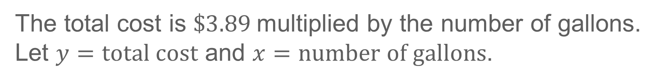
Example 2
Proportional Relationships and Equations
Step 2 Write the equation.
The total cost is $\$3.89$multiplied by the number of gallons. Let $y=total cost$ and $x=number of gallons$.
So, the total cost for any number of gallons can be found using the equation $y=3.89x$.

Slide 28
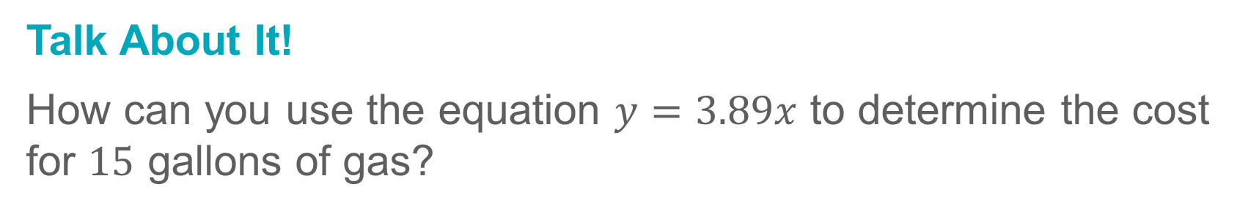
Example 2
Proportional Relationships and Equations
Talk About It!
How can you use the equation $y=3.89x$ to determine the cost for $15$ gallons of gas?

Slide 29
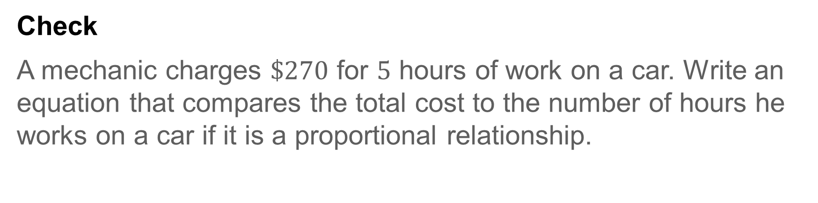
Example 2
Proportional Relationships and Equations
Check
A mechanic charges $\$270$ for $5$ hours of work on a car. Write an equation that compares the total cost to the number of hours he works on a car if it is a proportional relationship.

Slide 30

Example 2
Proportional Relationships and Equations
Check
A mechanic charges $\$270$ for $5$ hours of work on a car. Write an equation that compares the total cost to the number of hours he works on a car if it is a proportional relationship.
$$y=54x$$
Notes:
$$y=54x$$

Slide 31
Example 3
Proportional Relationships and Equations
The perimeter of a square is proportional to the length of one side. A square with 10-inch sides has a perimeter of 40 inches.
Write an equation relating the perimeter of the square to its side length. Then find the perimeter of a square with a 6-inch side.
Part A Write an equation.
Part B Use the equation to find the perimeter of a square with a side length of 6 inches.

Slide 32
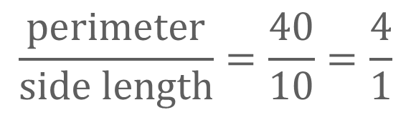
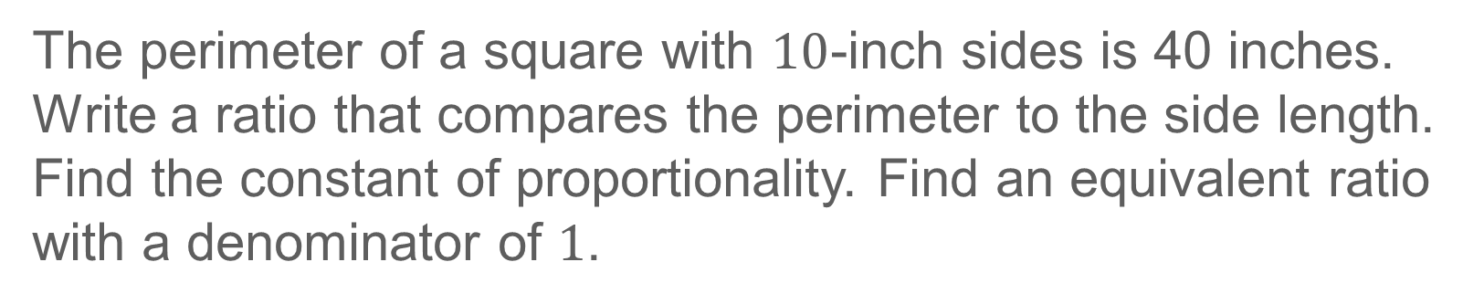
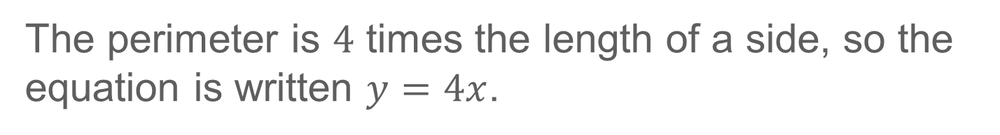
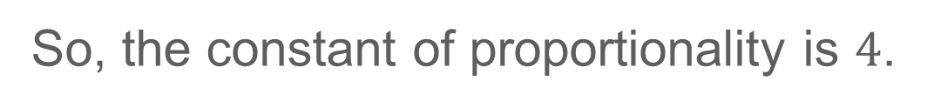
Example 3
Proportional Relationships and Equations
Part A Write an equation.
The perimeter of a square with $10$-inch sides is 40 inches. Write a ratio that compares the perimeter to the side length. Find the constant of proportionality. Find an equivalent ratio with a denominator of $1$.
$$\frac{perimeter}{side length}=\frac{40}{10}=\frac{4}{1}$$
So, the constant of proportionality is $4$.
The perimeter is $4$ times the length of a side, so the equation is written $y=4x$.

Slide 33





Example 3
Proportional Relationships and Equations
Part B Use the equation to find the perimeter of a square with a side length of $6$ inches.
$$y=4x$$
Write the equation.
$$y=4(6)$$
Replace $x$ with $6$.
$$y=24$$
Multiply.
So, the perimeter of a square with sides of $6$ inches is $24$ inches.

Slide 34
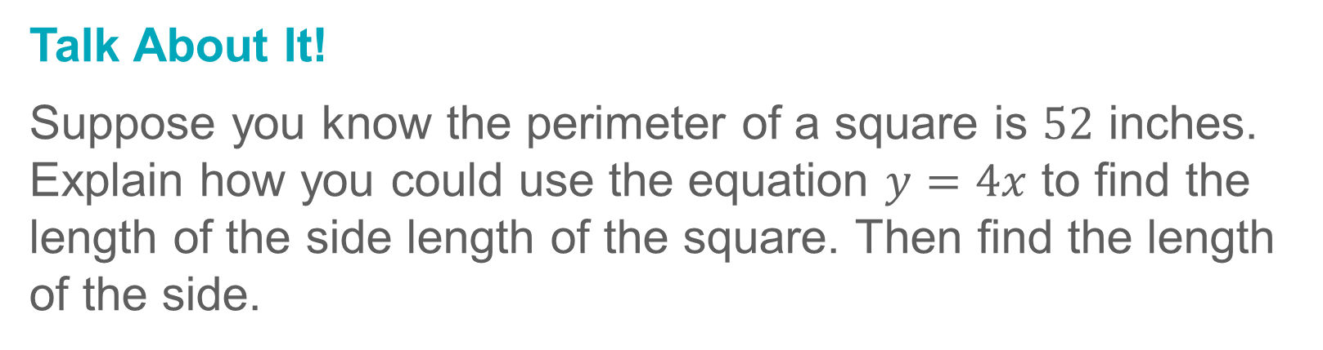
Example 3
Proportional Relationships and Equations
Talk About It!
Suppose you know the perimeter of a square is $52$ inches. Explain how you could use the equation $y=4x$ to find the length of the side length of the square. Then find the length of the side.

Slide 35
Example 3
Proportional Relationships and Equations
Check
Jack is in charge of the 120,000-gallon community swimming pool. Each spring, he drains the pool in order to clean it. When finished, he refills the pool with fresh water. Jack can fill the pool with 500 gallons of water in 5 minutes.
Part A
Write an equation that represents the relationship between the total number of gallons y and the number of minutes spent filling the pool x.

Slide 36

Example 3
Proportional Relationships and Equations
Check
Jack is in charge of the 120,000-gallon community swimming pool. Each spring, he drains the pool in order to clean it. When finished, he refills the pool with fresh water. Jack can fill the pool with 500 gallons of water in 5 minutes.
Part A
Write an equation that represents the relationship between the total number of gallons y and the number of minutes spent filling the pool x.
$$y=100x$$
Notes:
$$y=100x$$

Slide 37
Example 3
Proportional Relationships and Equations
Check
Part B
How long will it take to become completely filled?

Slide 38
Example 3
Proportional Relationships and Equations
Check
Part B
How long will it take to become completely filled?
1,200 minutes
Notes:
1,200 minutes

Slide 39
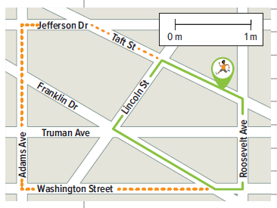
Apply
Running
Hugo can run 4 miles in
25 minutes. How many more miles can Hugo run in 90 minutes than in 25 minutes? Assume the relationship is proportional and he runs at a constant rate.

Slide 40
Apply
Running
Talk About It!
Can you always assume that Hugo runs at a constant rate for any amount of time predicted? Explain your reasoning.

Slide 41
Apply
Running
Check
Emily can ride her bike 15 kilometers in 45 minutes. How many more kilometers can she bike in two hours than in 45 minutes? Assume the relationship is proportional and she always bikes at the same rate.

Slide 42
Apply
Running
Check
Emily can ride her bike 15 kilometers in 45 minutes. How many more kilometers can she bike in two hours than in 45 minutes? Assume the relationship is proportional and she always bikes at the same rate.
25 km
Notes:
25 km

Slide 43
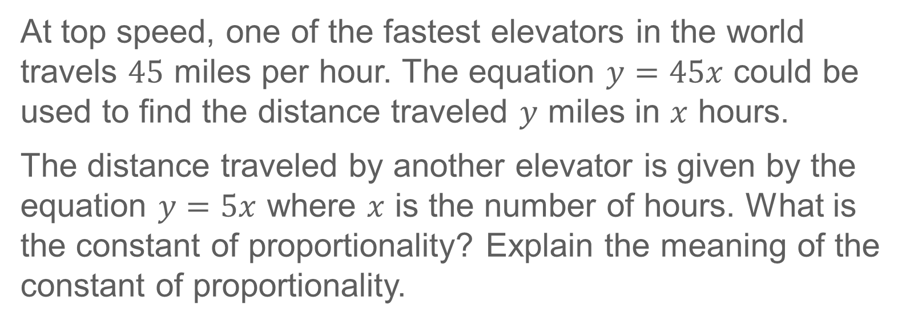
Exit Ticket
At top speed, one of the fastest elevators in the world travels $45$ miles per hour. The equation $y=45x$ could be used to find the distance traveled $y$ miles in $x$ hours.
The distance traveled by another elevator is given by the equation $y=5x$ where $x$ is the number of hours. What is the constant of proportionality? Explain the meaning of the constant of proportionality.

Slide 44
Exit Ticket
At top speed, one of the fastest elevators in the world travels $45$ miles per hour. The equation $y=45x$ could be used to find the distance traveled $y$ miles in $x$ hours.
The distance traveled by another elevator is given by the equation $y=5x$ where $x$ is the number of hours. What is the constant of proportionality? Explain the meaning of the constant of proportionality.
5; Sample answer: The constant of proportionality is the speed the elevator travels in miles per hour. So, the elevator travels at a speed of 5 miles per hour.
Notes:
5; Sample answer: The constant of proportionality is the speed the elevator travels in miles per hour. So, the elevator travels at a speed of 5 miles per hour.

