Slide 1
Lesson 4

Slide 2
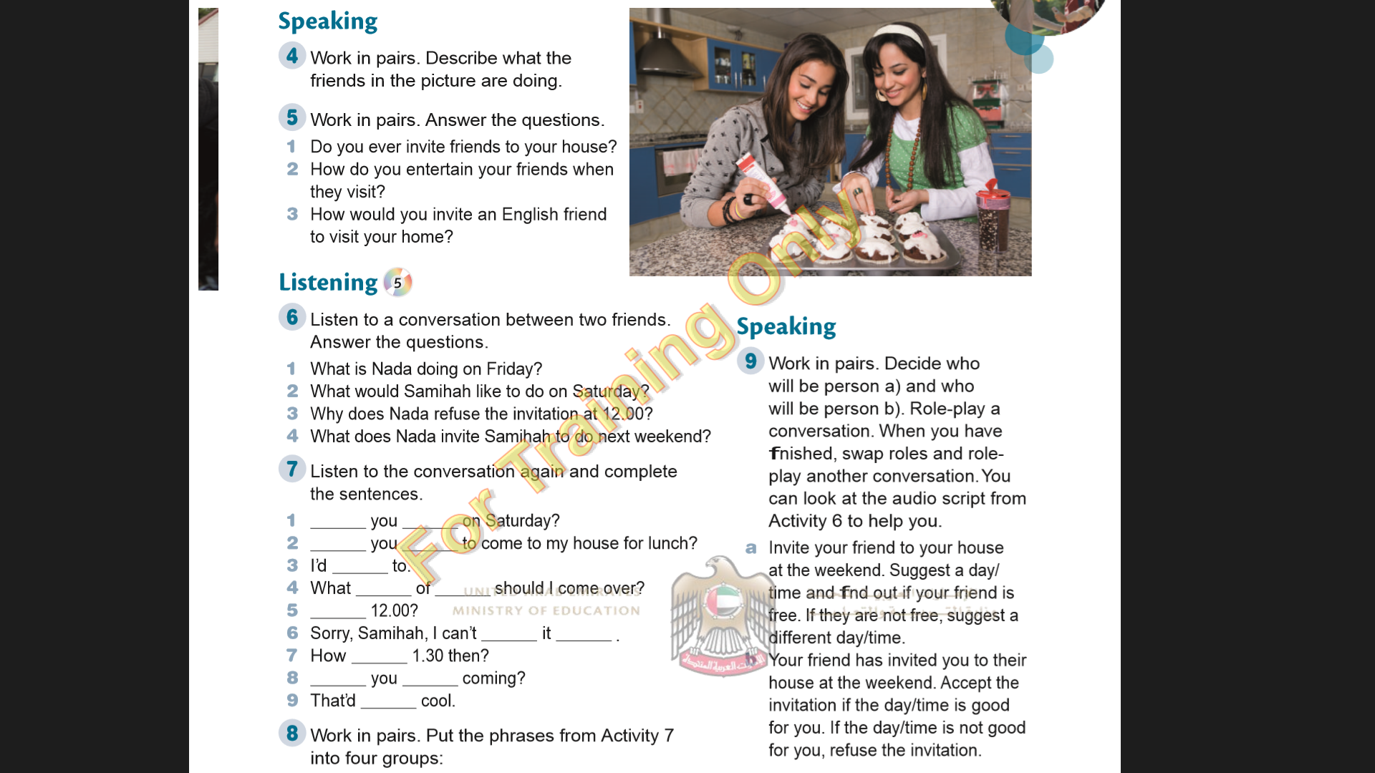

Slide 3

1 She is going to the desert with her family.
2 She would like Nada to come to her house for lunch.
3 Because she can’t make that time.
4 To go to the desert with her and her family.

Slide 4
Are
free
Would
like
love
sort
time
About
make
then
about
Do
fancy
be

Slide 5
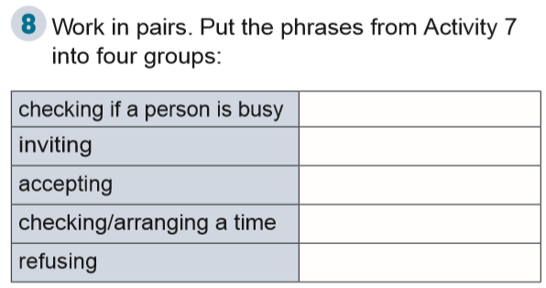
1
2 - 8
3 - 9
4 - 5 - 7
6

Slide 6
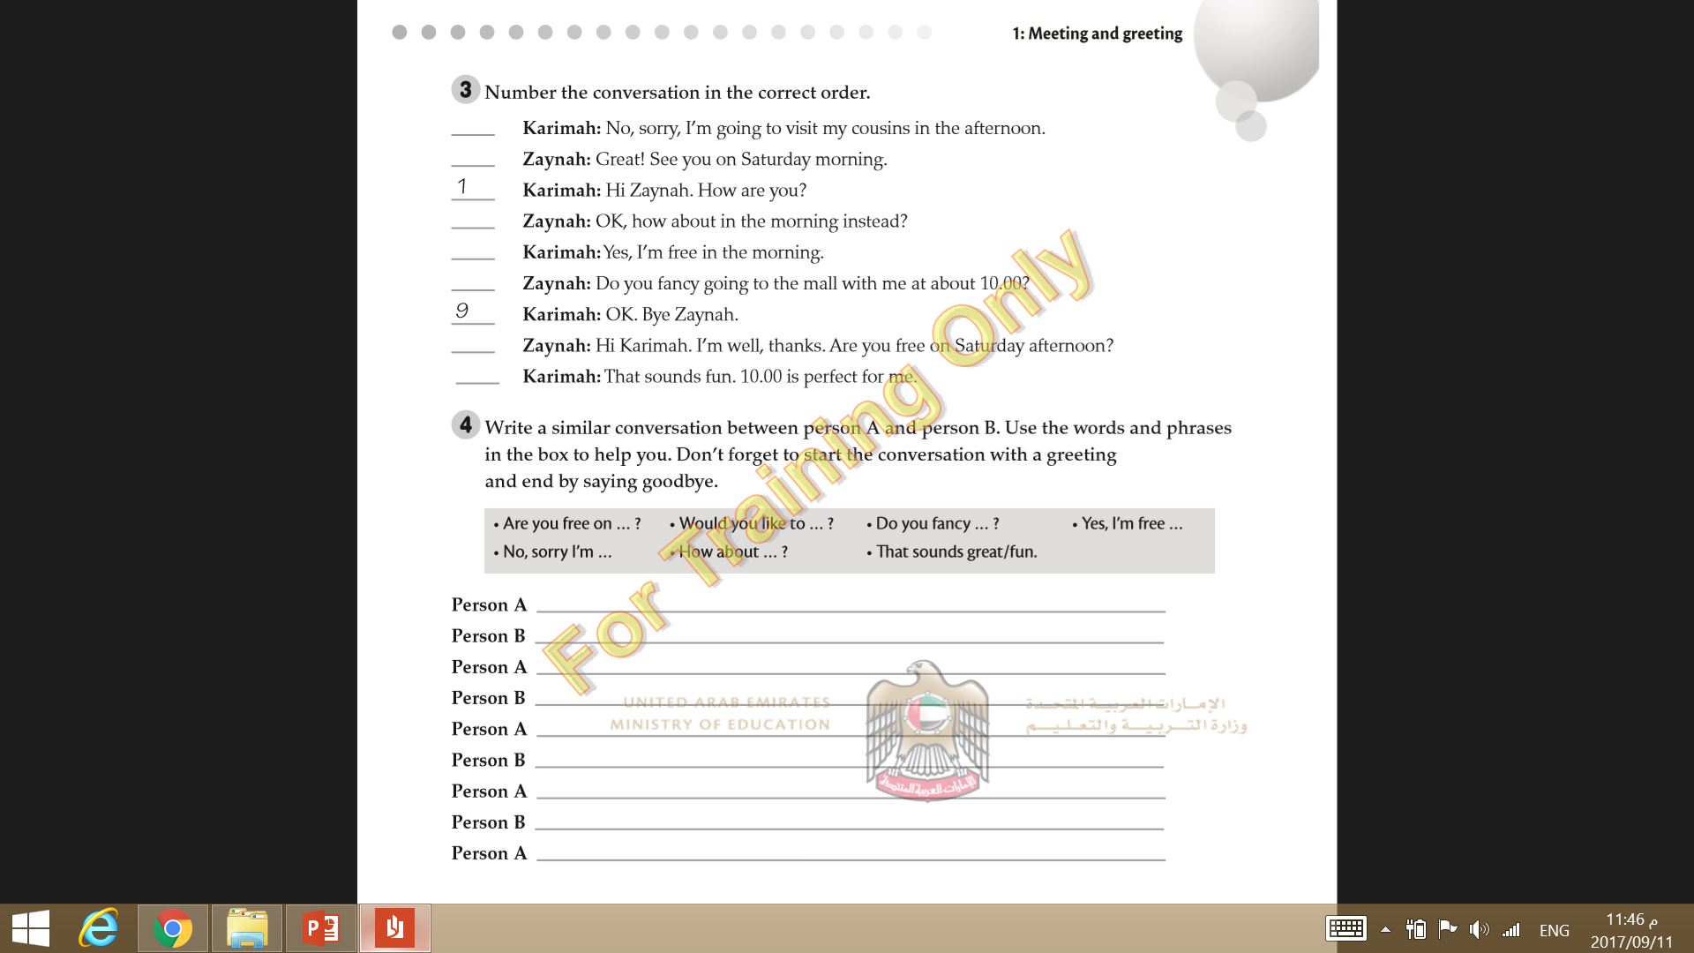
3
8
4
5
6
2
7

