Slide 1
Unit 8:
All living things
Lessons 12–13 Fiction

Slide 2
Learning objectives:
Speaking: To discuss the background to the text.
Reading: To read a fiction text from War Horse by Michael Morpurgo.
Writing: To answer comprehension questions about the text.

Slide 3
Key vocabulary:
Intrigued
Smooth
Rub
Dab
Raw
hay
Bucket
Stable
stroke

Slide 4
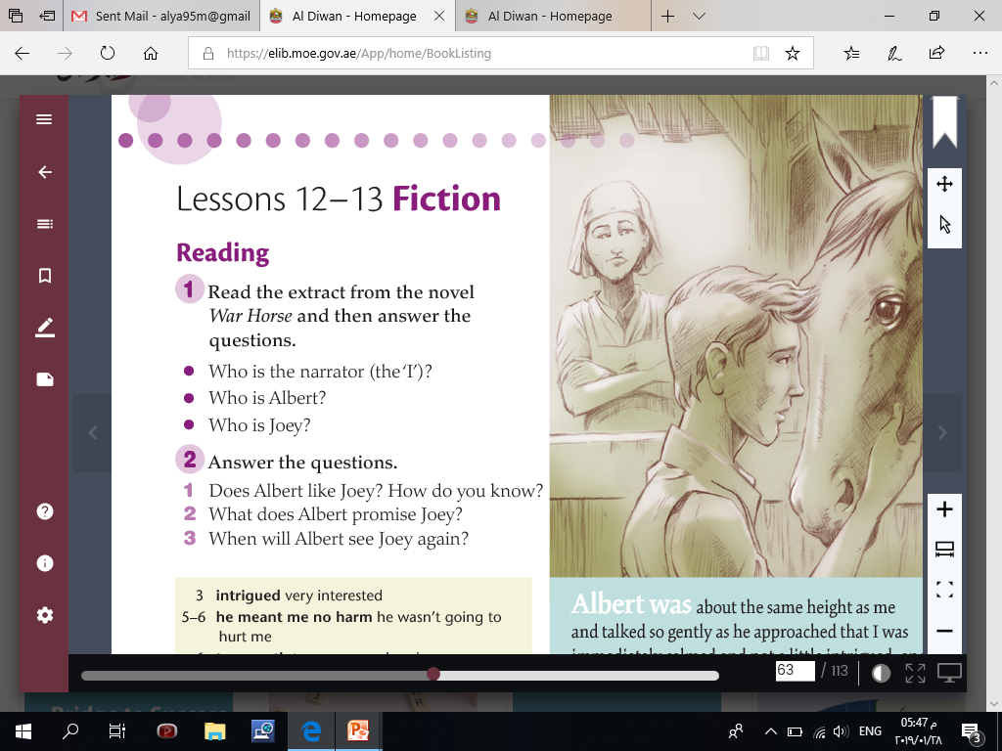
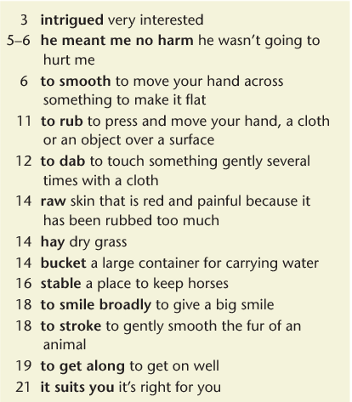
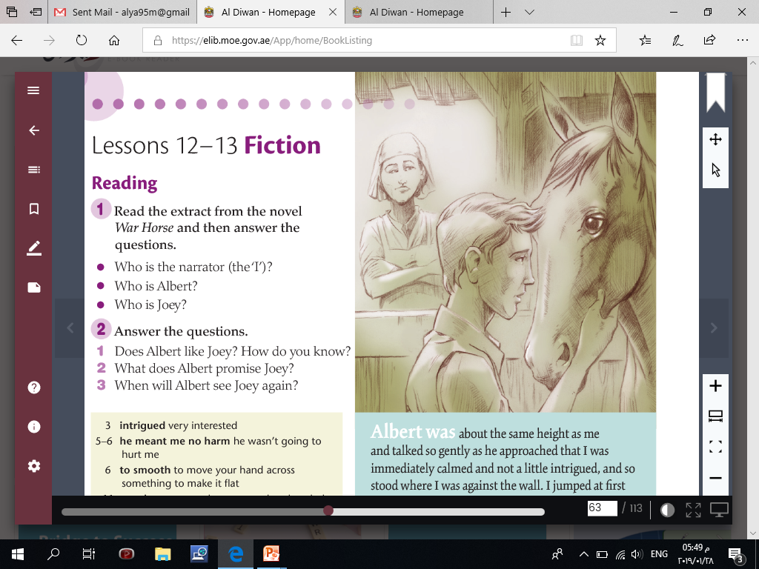
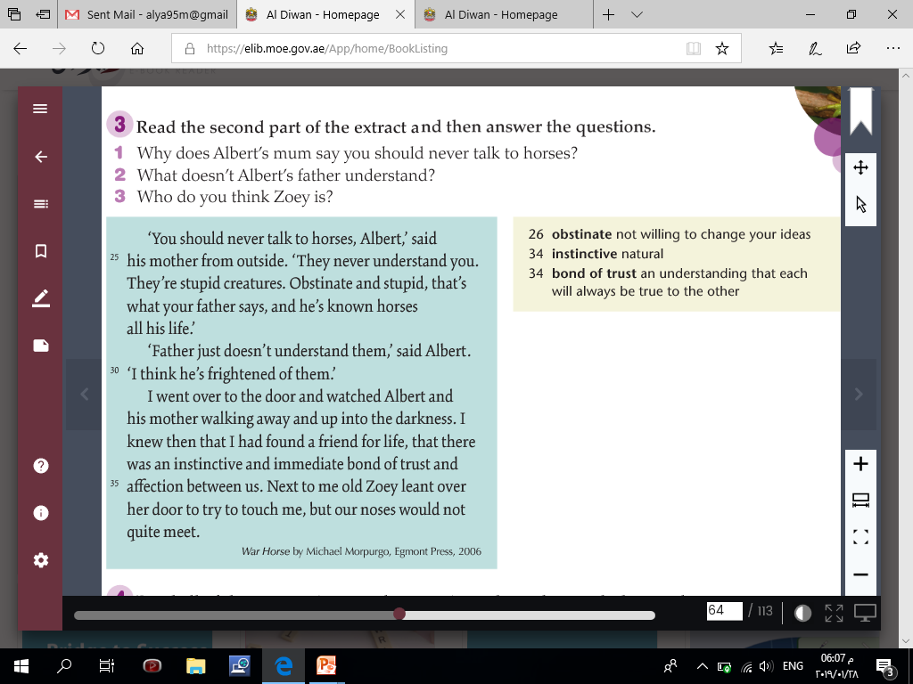

Slide 5
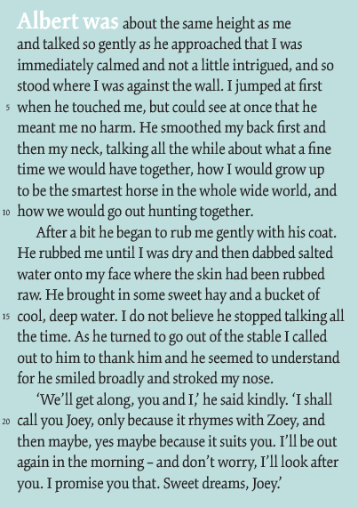

Slide 6
1 The narrator is the horse
2 Albert is the boy owner of the horse
3 Joey is the horse
1 Yes, Joey does like Albert. There are lots of examples in the text. For example, He talks gently, he means no harm, smoothes Joey’s back and talks to him of things they will do together to calm him down. He rubs him down and dabs his raw skin and gives him food and drink. He also speaks kindly to him, gives him a name and wishes him sweet dreams;
2 Albert promises Joey that he will look after him
3 Albert says he will see Joey again in the morning.

Slide 7
1 Albert’s mum says you should never talk to horses, because she thinks they are stupid and obstinate and they can’t understand you
2 Albert’s father doesn’t understand horses
3 The extract doesn’t tell us who Zoey is, but we can guess she is a horse as she and Joey try to touch noses and Zoey is presumably in a stable too.

Slide 8
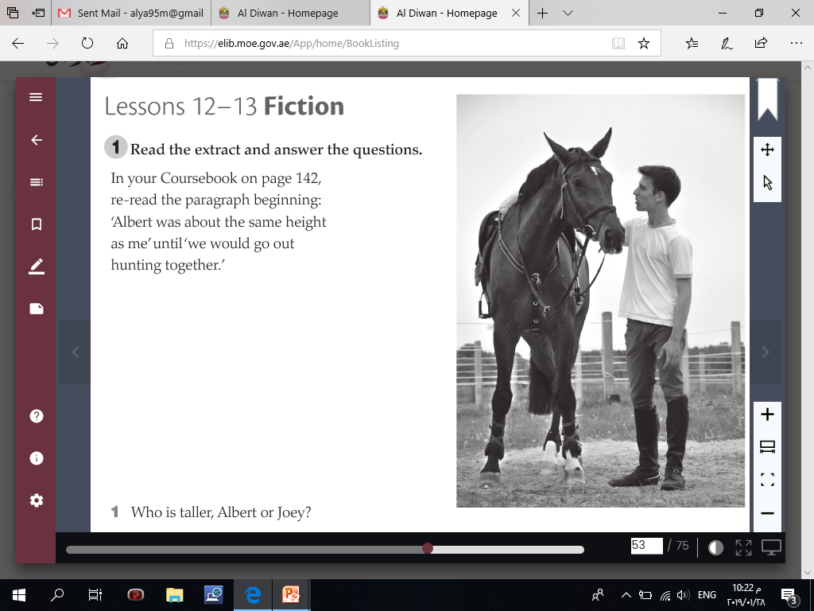
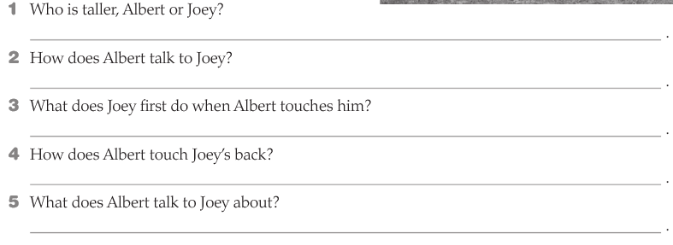
1 Albert and Joey are the same height.
2 Albert talks to Joey gently.
3 Joey jumps at first when Albert touches him.
4 Albert smoothes Joey’s back.
5 Albert tells Joey that they will have a fine time together, how he would grow up to be the smartest horse in the world and how they would go hunting together.

Slide 9
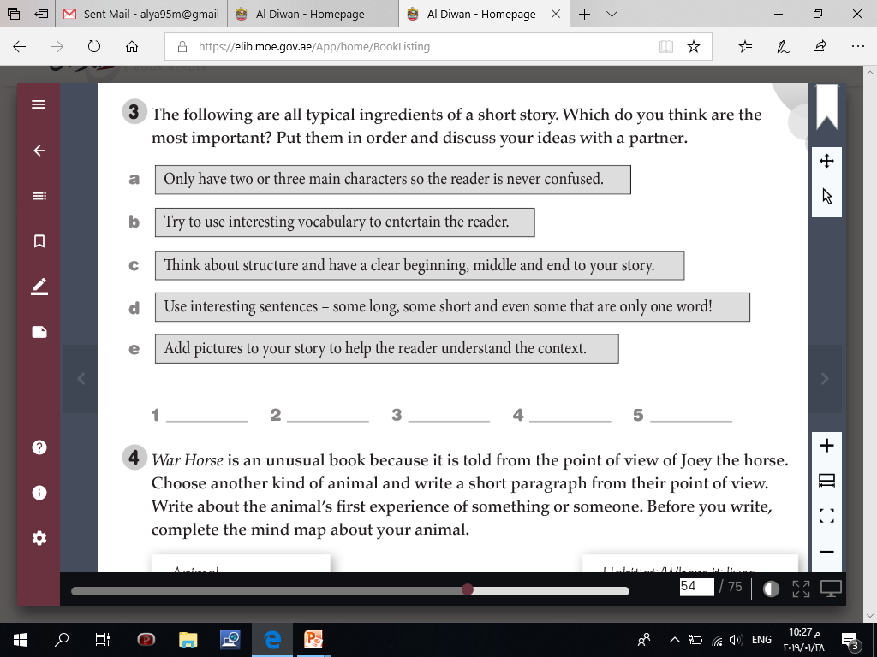

Slide 10
