Slide 1
Multiply Rational Numbers

Slide 2
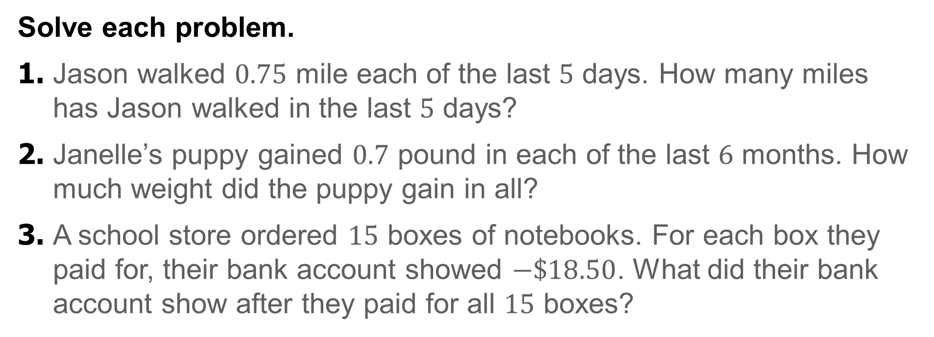
Warm Up
Solve each problem.
1. Jason walked $0.75$ mile each of the last $5$ days. How many miles has Jason walked in the last $5$ days?
2. Janelle’s puppy gained $0.7$ pound in each of the last $6$ months. How much weight did the puppy gain in all?
3. A school store ordered $15$ boxes of notebooks. For each box they paid for, their bank account showed $−\$18.50$. What did their bank account show after they paid for all $15$ boxes?

Slide 3
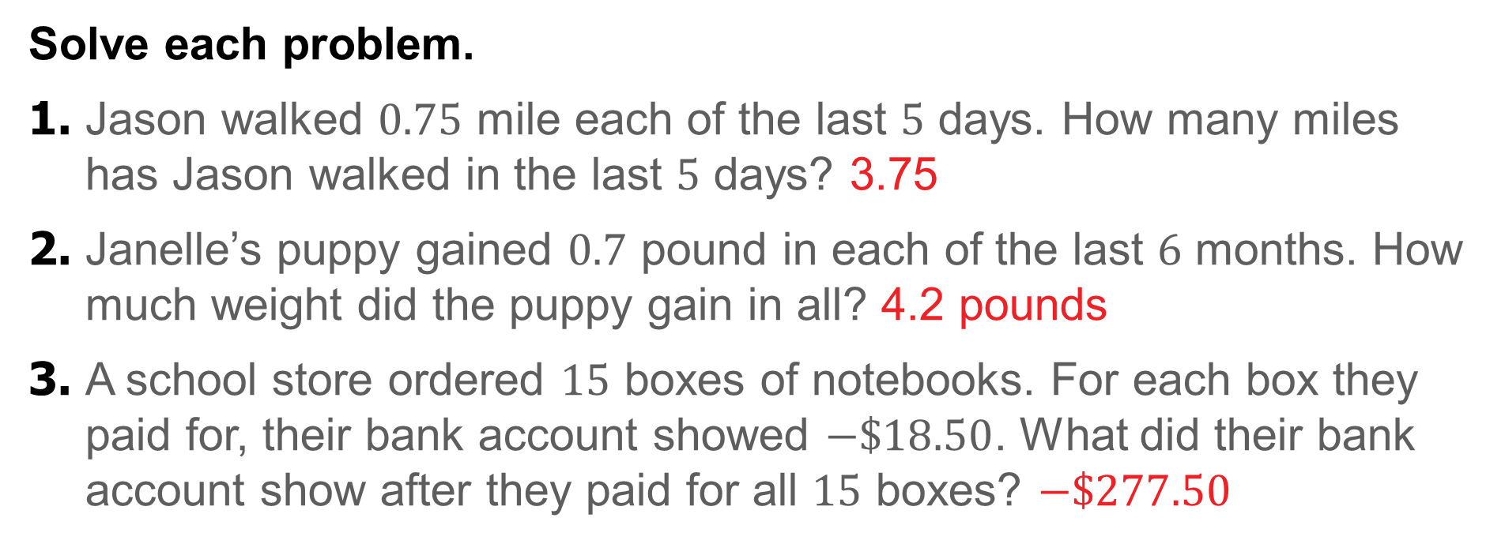
Warm Up
Solve each problem.
1. Jason walked $0.75$ mile each of the last $5$ days. How many miles has Jason walked in the last $5$ days? 3.75
2. Janelle’s puppy gained $0.7$ pound in each of the last $6$ months. How much weight did the puppy gain in all? 4.2 pounds
3. A school store ordered $15$ boxes of notebooks. For each box they paid for, their bank account showed $−\$18.50$. What did their bank account show after they paid for all $15$ boxes? $−\$277.50$
Notes:
3.75
4.2 pounds
−$277.50

Slide 4
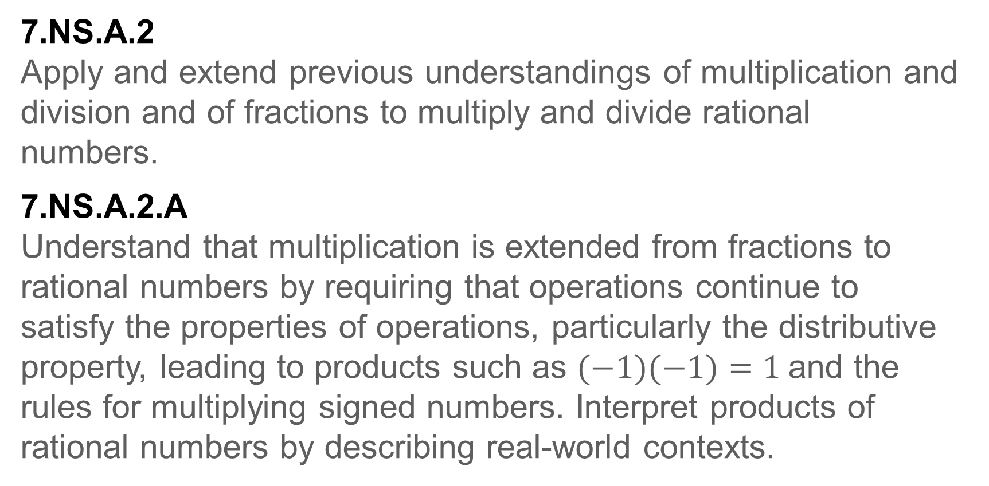
Standards for Mathematical Content
7.NS.A.2
Apply and extend previous understandings of multiplication and division and of fractions to multiply and divide rational numbers.
7.NS.A.2.A
Understand that multiplication is extended from fractions to rational numbers by requiring that operations continue to satisfy the properties of operations, particularly the distributive property, leading to products such as $(−1)(−1)=1$and the rules for multiplying signed numbers. Interpret products of rational numbers by describing real-world contexts.

Slide 5
Standards for Mathematical Content
7.NS.A.2.C
Apply properties of operations as strategies to multiply and divide rational numbers.
7.NS.A.3
Solve real-world and mathematical problems involving the four operations with rational numbers.
7.NS.A.1.D
Apply properties of operations as strategies to add and subtract rational numbers.

Slide 6
Standards for Mathematical Content
7.EE.B.3
Solve multi-step real-life and mathematical problems posed with positive and negative rational numbers in any form (whole numbers, fractions, and decimals), using tools strategically. Apply properties of operations to calculate with numbers in any form; convert between forms as appropriate; and assess the reasonableness of answers using mental computation and estimation strategies.

Slide 7
Standards for Mathematical Practice
MP1
Make sense of problems and persevere in solving them.
MP3
Construct viable arguments and critique the reasoning of others.
MP4
Model with mathematics.
MP6
Attend to precision.
MP7
Look for and make use of structure.

Slide 8
Lesson Goal
Students will apply understanding of multiplication to rational numbers, and use the order of operations to solve real-world problems.

Slide 9
Learn
Multiply Rational Numbers
The rules for integers apply to positive and negative rational numbers.
State whether the product of each expression will be positive or negative using your knowledge of multiplying integers.

Slide 10
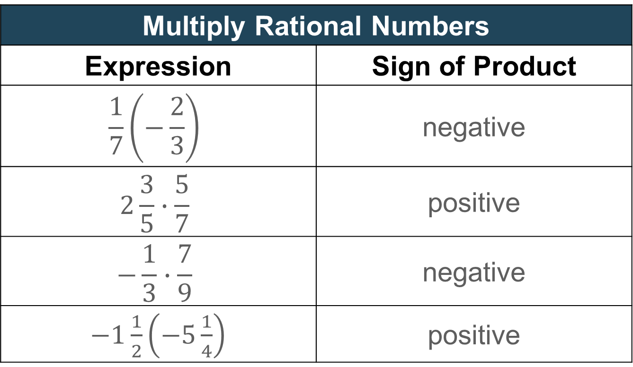
Learn
Multiply Rational Numbers
Multiply Rational Numbers
Expression | Sign of Product
$$\frac{1}{7}\left(−\frac{2}{3}\right)$$ | negative
$$2\frac{3}{5}∙\frac{5}{7}$$ | positive
$$−\frac{1}{3}∙\frac{7}{9}$$ | negative
$−1\frac{1}{2}\left(−5\frac{1}{4}\right)$ | positive

Slide 11

Example 1
Multiply Rational Numbers
Find $−\frac{3}{4}\left(−\frac{7}{9}\right)$. Write in simplest form.

Slide 12
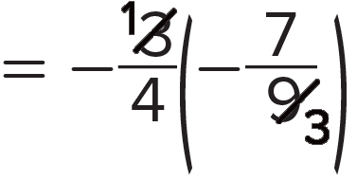
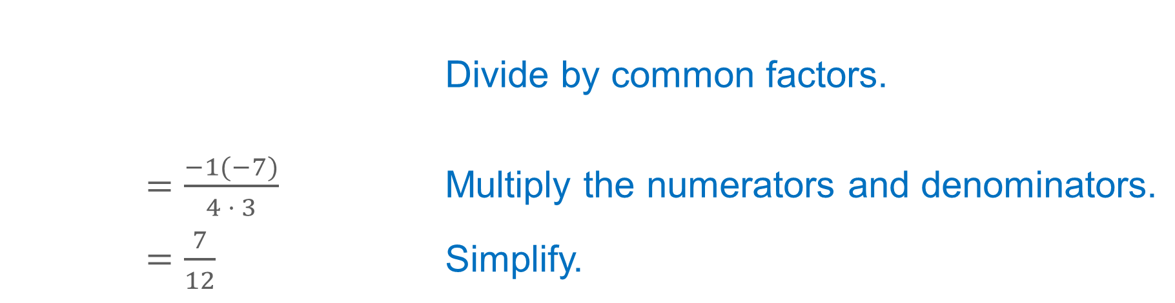
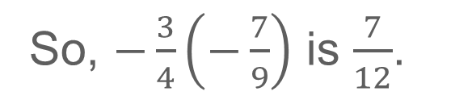
Example 1
Multiply Rational Numbers
 | Divide by common factors.
$=\frac{−1(−7)}{4 · 3}$ | Multiply the numerators and denominators.
$=\frac{7}{12}$ | Simplify.
So, $−\frac{3}{4}\left(−\frac{7}{9}\right)$ is $\frac{7}{12}$.

Slide 13
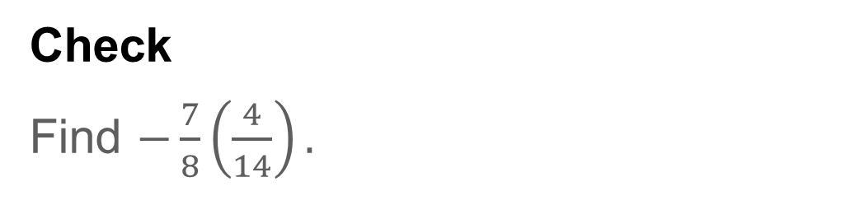
Example 1
Multiply Rational Numbers
Check
Find $−\frac{7}{8}\left(\frac{4}{14}\right).$

Slide 14
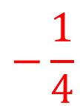
Example 1
Multiply Rational Numbers
Check
Find $−\frac{7}{8}\left(\frac{4}{14}\right).$
$$−\frac{1}{4}$$
Notes:
$$−\frac{1}{4}$$

Slide 15
Example 2
Multiply Rational Numbers
Find $−3\frac{1}{5}\left(1\frac{1}{14}\right)$. Write in simplest form.

Slide 16
Example 2
Multiply Rational Numbers
Think About It!
Before you begin to multiply the rational numbers, what do you need to do?

Slide 17

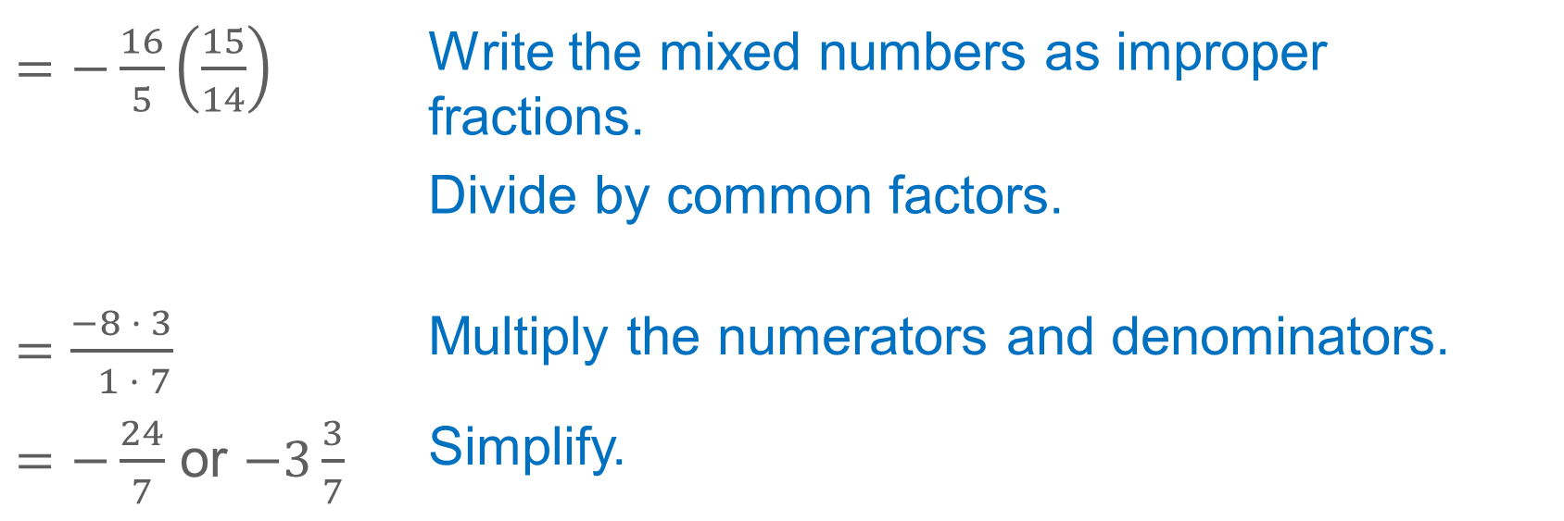
Example 2
Multiply Rational Numbers
$=−\frac{16}{5}\left(\frac{15}{14}\right)$ | Write the mixed numbers as improper fractions.
 | Divide by common factors.
$=\frac{−8 · 3}{ 1 · 7}$ | Multiply the numerators and denominators.
$=−\frac{24}{7}$ or $−3\frac{3}{7}$ | Simplify.
So, the product of $−3\frac{1}{5}\left(1\frac{1}{14}\right)$ is $−\frac{24}{7}$ or $−3\frac{3}{7}$.

Slide 18
Example 2
Multiply Rational Numbers
Talk About It!
How would the steps be different if you did not simplify the rational numbers before multiplying?

Slide 19
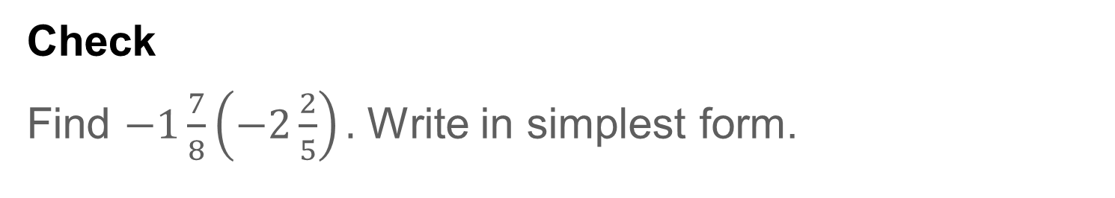
Example 2
Multiply Rational Numbers
Check
Find $−1\frac{7}{8}\left(−2\frac{2}{5}\right).$ Write in simplest form.

Slide 20
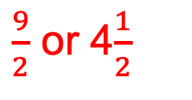
Example 2
Multiply Rational Numbers
Check
Find $−1\frac{7}{8}\left(−2\frac{2}{5}\right).$ Write in simplest form.
$\frac{9}{2}$ or 4$\frac{1}{2}$
Notes:
$\frac{9}{2}$ or 4$\frac{1}{2}$

Slide 21
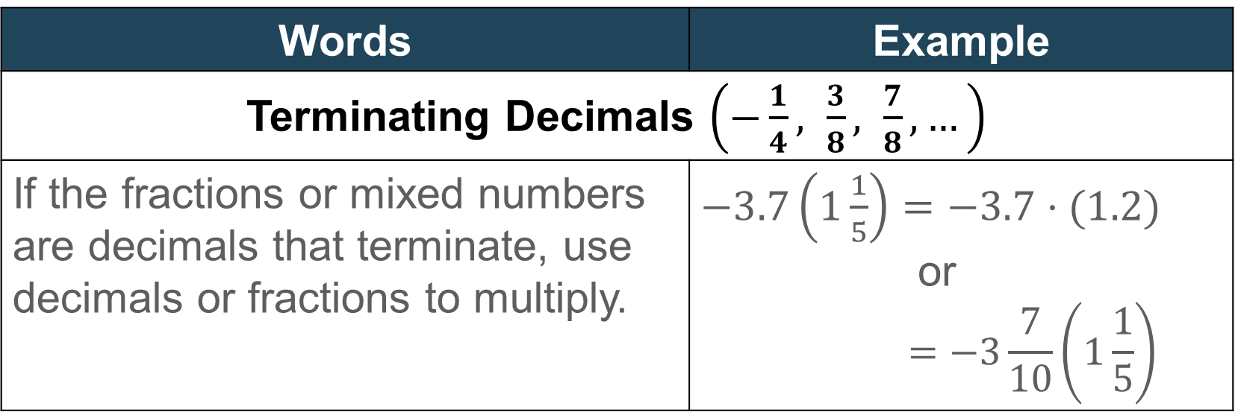
Learn
Multiply Rational Numbers
When multiplying rational numbers written in different forms, write the factors in the same form.
Words | Example
Terminating Decimals $\left(−\frac{1}{4}, \frac{3}{8}, \frac{7}{8},…\right)$
If the fractions or mixed numbers are decimals that terminate, use decimals or fractions to multiply. | $−3.7\left(1\frac{1}{5}\right)=−3.7·(1.2)$ or $$=−3\frac{7}{10}\left(1\frac{1}{5}\right)$$

Slide 22
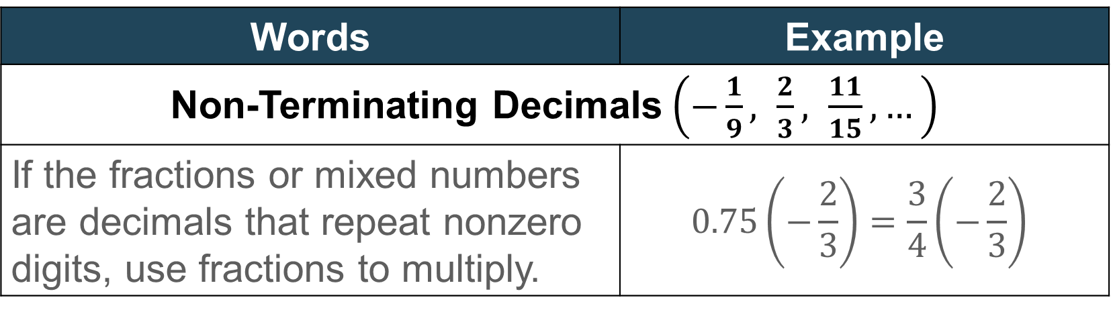
Learn
Multiply Rational Numbers
Words | Example
Non-Terminating Decimals$\left(−\frac{1}{9}, \frac{2}{3}, \frac{11}{15},…\right)$
If the fractions or mixed numbers are decimals that repeat nonzero digits, use fractions to multiply. | $$0.75\left(−\frac{2}{3}\right)=\frac{3}{4}\left(−\frac{2}{3}\right)$$

Slide 23
Pause and Reflect
Create a graphic organizer that will help you understand how to determine if a fraction or mixed number is a terminating or non-terminating decimal.

Slide 24
Example 3
Multiply Rational Numbers
Find $\frac{1}{3}(−2.75)$. Write in simplest form.

Slide 25
Example 3
Multiply Rational Numbers
Think About It!
Will you write both numbers as fractions or as decimals?

Slide 26
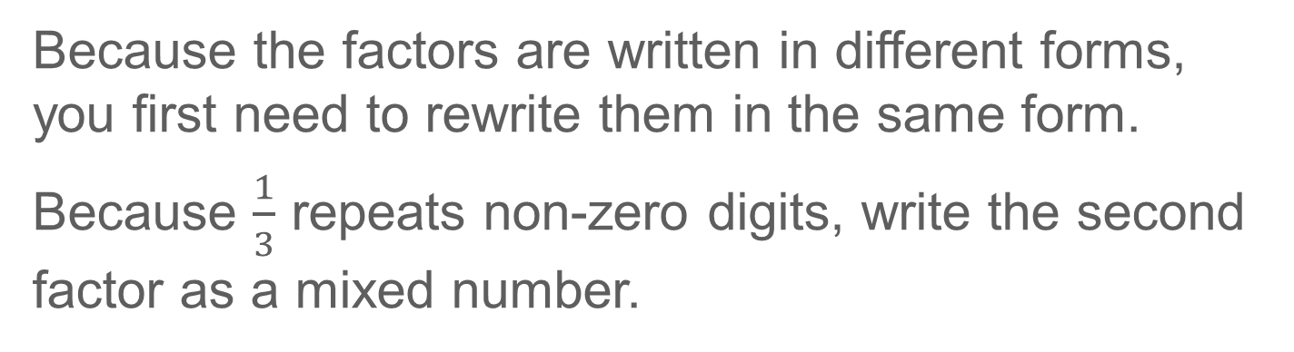
Example 3
Multiply Rational Numbers
Because the factors are written in different forms, you first need to rewrite them in the same form.
Because $\frac{1}{3}$ repeats non-zero digits, write the second factor as a mixed number.

Slide 27
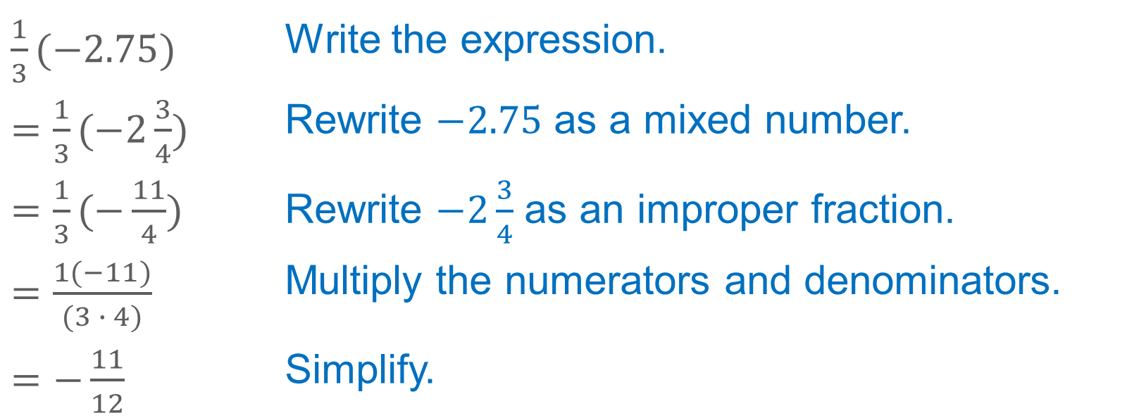
Example 3
Multiply Rational Numbers
$\frac{1}{3}(−2.75)$ | Write the expression.
$=\frac{1}{3}(−2\frac{3}{4})$ | Rewrite $−2.75$ as a mixed number.
$=\frac{1}{3}(−\frac{11}{4})$ | Rewrite $−2\frac{3}{4}$ as an improper fraction.
$=\frac{1(−11)}{(3 ∙ 4)}$ | Multiply the numerators and denominators.
$=−\frac{11}{12}$ | Simplify.
So, the product of $\frac{1}{3}(−2.75)$ is $−\frac{11}{12}$.

Slide 28
Example 3
Multiply Rational Numbers
Talk About It!
Is it possible to find the product without writing the numbers in the same form? Explain.

Slide 29
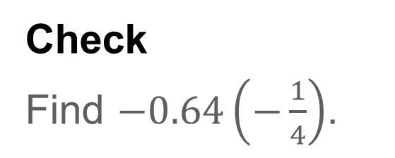
Example 3
Multiply Rational Numbers
Check
Find $−0.64\left(−\frac{1}{4}\right)$.

Slide 30
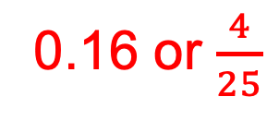
Example 3
Multiply Rational Numbers
Check
Find $−0.64\left(−\frac{1}{4}\right)$.
0.16 or $\frac{4}{25}$
Notes:
0.16 or $\frac{4}{25}$

Slide 31
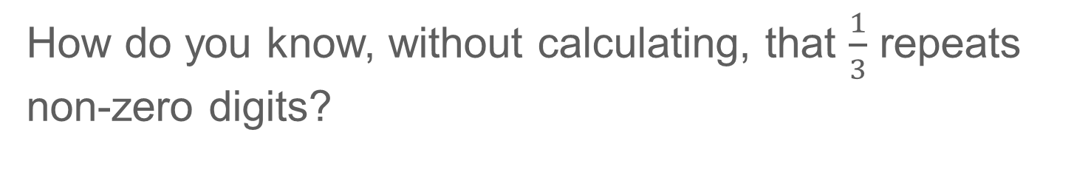
Pause and Reflect
How do you know, without calculating, that $\frac{1}{3}$ repeats non-zero digits?

Slide 32
Example 4
Multiply Rational Numbers
Evaluate $\frac{1}{2}$ $ab$ if $a=1\frac{3}{7}$ and $b$ $=−\frac{4}{9}$.

Slide 33

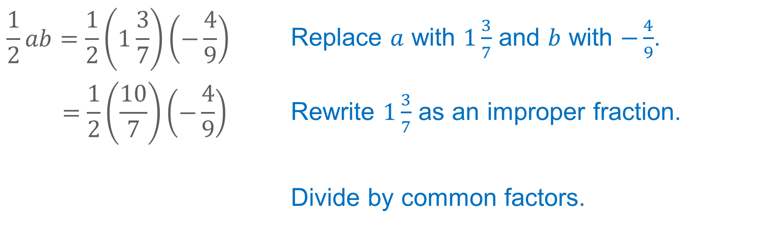
Example 4
Multiply Rational Numbers
$$\frac{1}{2}ab=\frac{1}{2}\left(1\frac{3}{7}\right)\left(−\frac{4}{9}\right)$$ | Replace $a$ with $1\frac{3}{7}$ and $b$ with $−\frac{4}{9}$.
$$=\frac{1}{2}\left(\frac{10}{7}\right)\left(−\frac{4}{9}\right)$$ | Rewrite $1\frac{3}{7}$ as an improper fraction.
 | Divide by common factors.

Slide 34
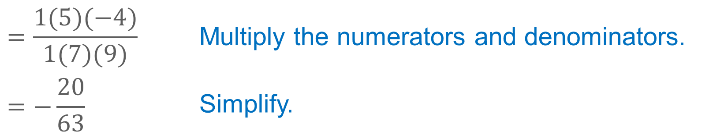
Example 4
Multiply Rational Numbers
$$=\frac{1(5)(−4)}{1(7)(9)}$$ | Multiply the numerators and denominators.
$$=−\frac{20}{63}$$ | Simplify.
So, the value of $\frac{1}{2}ab$ when $a=1\frac{3}{7}$ and $b=−\frac{4}{9}$ is $−\frac{20}{63}$.

Slide 35
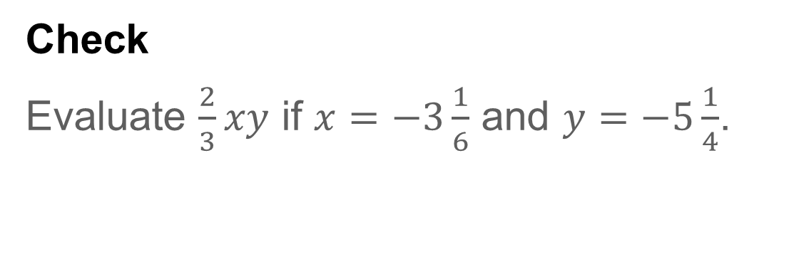
Example 4
Multiply Rational Numbers
Check
Evaluate $\frac{2}{3}xy$ if $x=−3\frac{1}{6}$ and $y=−5\frac{1}{4}$.

Slide 36
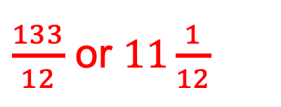
Example 4
Multiply Rational Numbers
Check
Evaluate $\frac{2}{3}xy$ if $x=−3\frac{1}{6}$ and $y=−5\frac{1}{4}$.
$\frac{133}{12}$ or $11\frac{1}{12}$
Notes:
$\frac{133}{12}$ or 11$\frac{1}{12}$

Slide 37
Pause and Reflect
When multiplying rational numbers, why is it beneficial to divide by common factors?

Slide 38
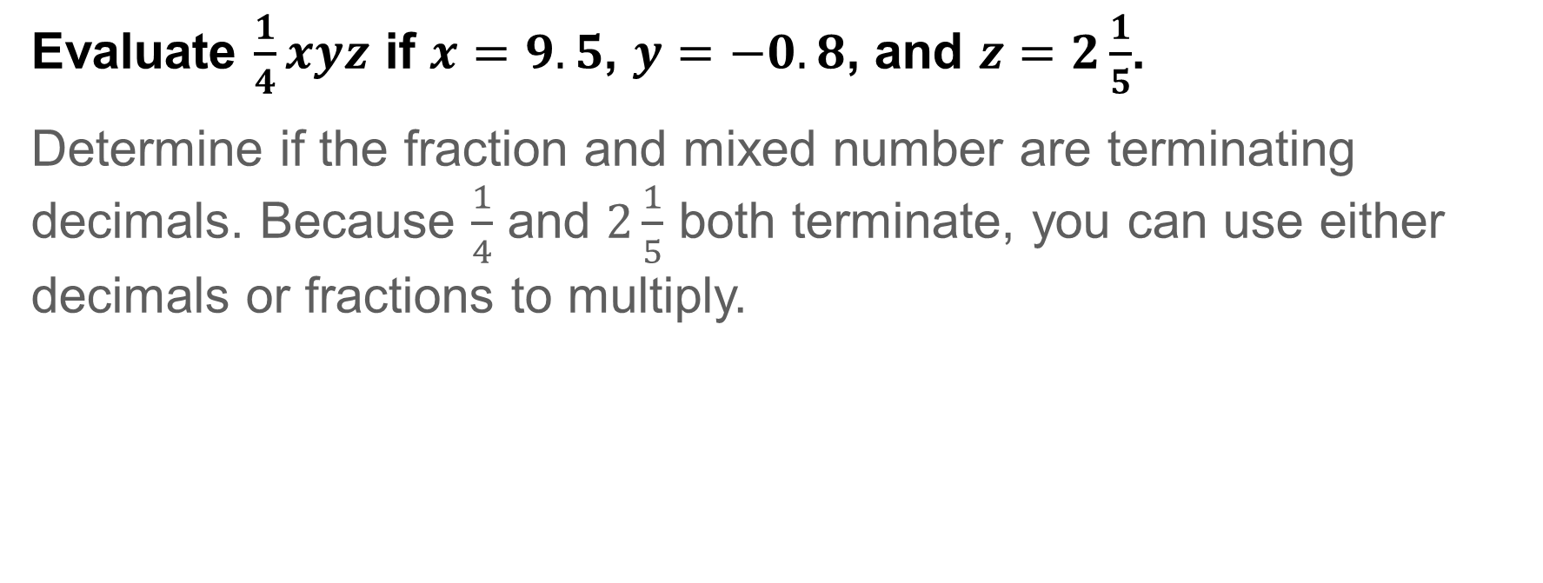
Example 5
Multiply Rational Numbers
Evaluate $\frac{1}{4}xyz$ if $x=9.5$, $y=−0.8$, and $z=2\frac{1}{5}$.
Determine if the fraction and mixed number are terminating decimals. Because $\frac{1}{4}$ and $2\frac{1}{5}$ both terminate, you can use either decimals or fractions to multiply.

Slide 39
Example 5
Multiply Rational Numbers
Think About It!
What is the sign of the product of the four numbers?

Slide 40

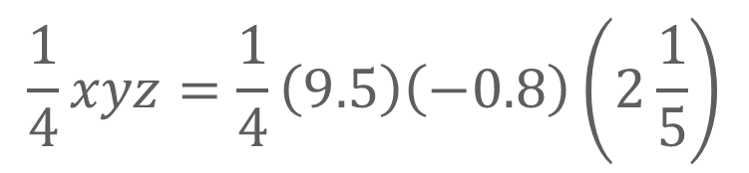
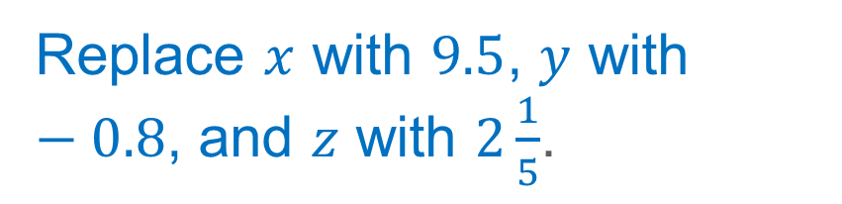
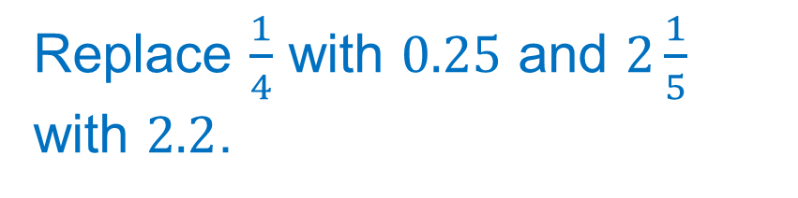

Example 5
Multiply Rational Numbers
$$\frac{1}{4}xyz=\frac{1}{4}\left(9.5\right)\left(−0.8\right)\left(2\frac{1}{5}\right)$$
Replace $x$ with $9.5$, $y$ with $−0.8$, and $z$ with $2\frac{1}{5}$.
$$=0.25(9.5)(−0.8)(2.2)$$
Replace $\frac{1}{4}$ with $0.25$ and $2\frac{1}{5}$ with $2.2$.
$$=−4.18$$
Simplify.
So, the value of $\frac{1}{4}xyz$when $x=9.5, y=−0.8$, and $z=2\frac{1}{5}$ is $−4.18$.

Slide 41
Example 5
Multiply Rational Numbers
Talk About It!
How would your answer compare if you had multiplied using fractions rather than decimals?

Slide 42
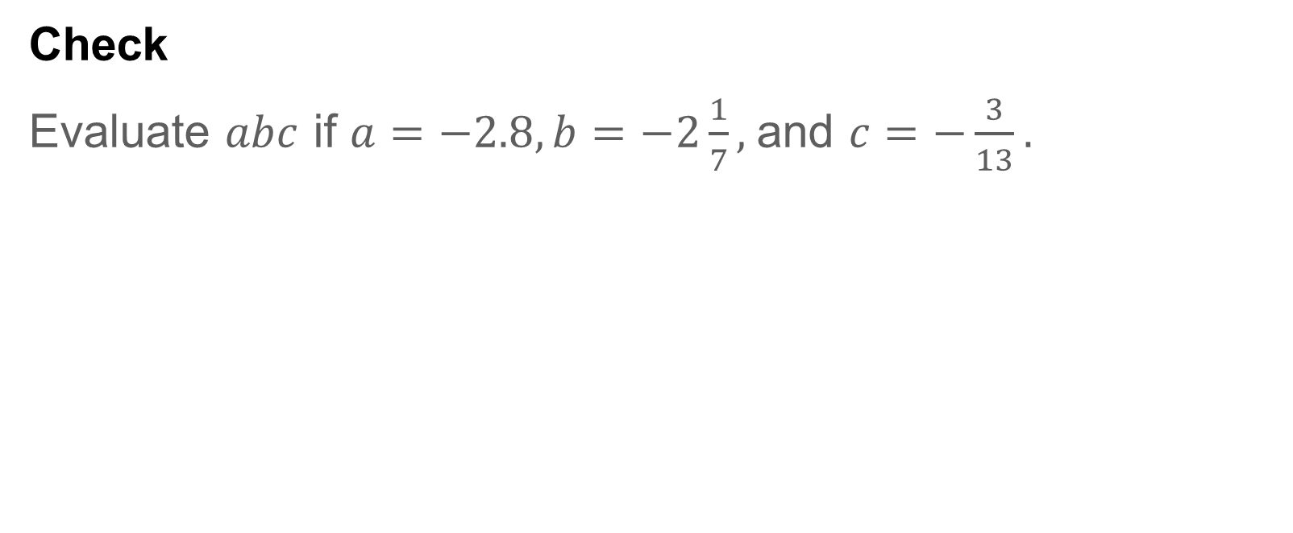
Example 5
Multiply Rational Numbers
Check
Evaluate $abc$ if $a=−2.8, b=−2\frac{1}{7},$and $c=−\frac{3}{13}.$

Slide 43

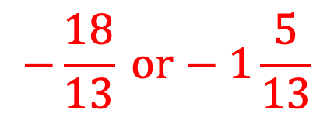
Example 5
Multiply Rational Numbers
Check
Evaluate abc if $a=−2.8, b=−2\frac{1}{7},$and $c=−\frac{3}{13}.$
$$−\frac{18}{13} or−1\frac{5}{13}$$
Notes:
$$−\frac{18}{13} or−1\frac{5}{13}$$

Slide 44
Pause and Reflect
How can you use estimation to check your work?

Slide 45
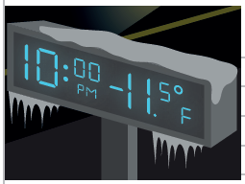
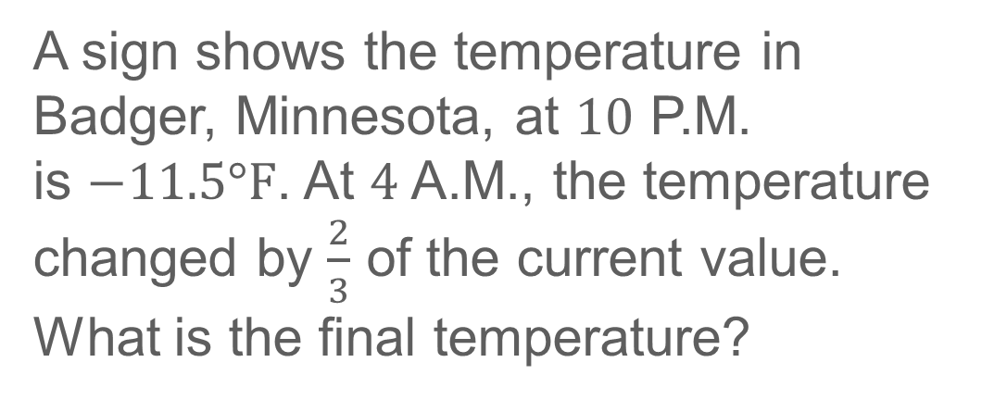
Apply
Temperature
A sign shows the temperature in Badger, Minnesota, at $10$ P.M.
is $−11.5°F$. At $4$ A.M., the temperature changed by $\frac{2}{3}$ of the current value. What is the final temperature?

Slide 46
Apply
Temperature
Talk About It!
Is the final temperature warmer or colder than the original temperature? Explain.

Slide 47
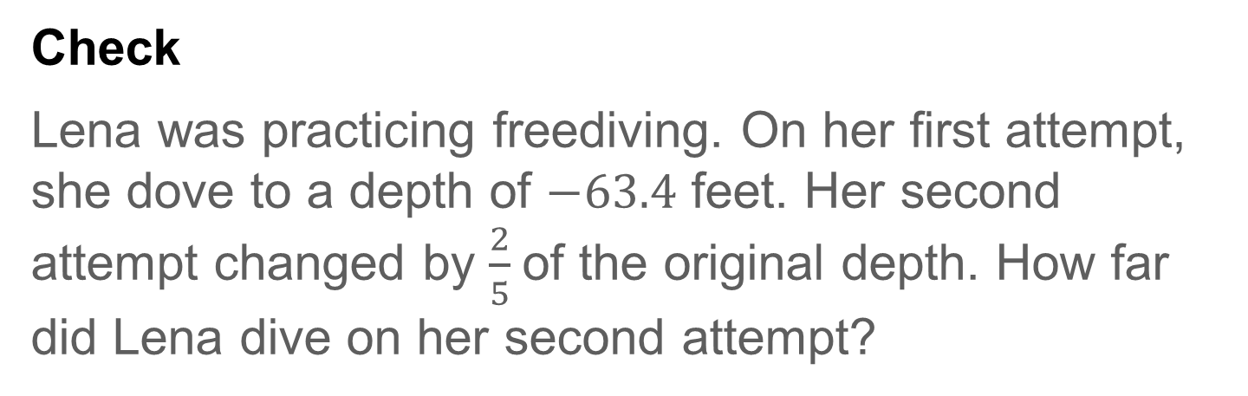
Apply
Temperature
Check
Lena was practicing freediving. On her first attempt, she dove to a depth of $−63.4$ feet. Her second attempt changed by $\frac{2}{5}$of the original depth. How far did Lena dive on her second attempt?

Slide 48

Apply
Temperature
Check
Lena was practicing freediving. On her first attempt, she dove to a depth of $−63.4$ feet. Her second attempt changed by $\frac{2}{5}$of the original depth. How far did Lena dive on her second attempt?
$$−88.76 ft$$
Notes:
$$−88.76 ft$$

Slide 49
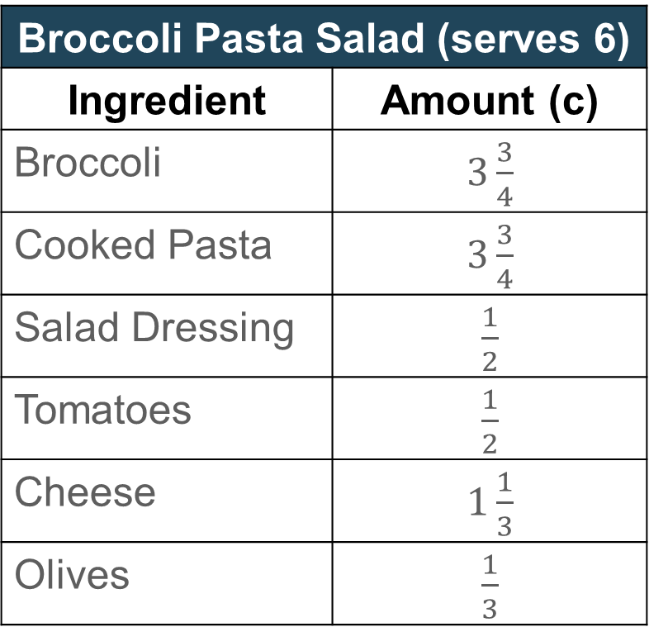
Exit Ticket
Have you ever used a recipe to make your favorite dish? The recipe shown serves six people. You are hosting a picnic with
15 people attending.
Broccoli Pasta Salad (serves 6)
Ingredient | Amount (c)
Broccoli | $3\frac{3}{4}$
Cooked Pasta | $3\frac{3}{4}$
Salad Dressing | $\frac{1}{2}$
Tomatoes | $\frac{1}{2}$
Cheese | $1\frac{1}{3}$
Olives | $\frac{1}{3}$

Slide 50
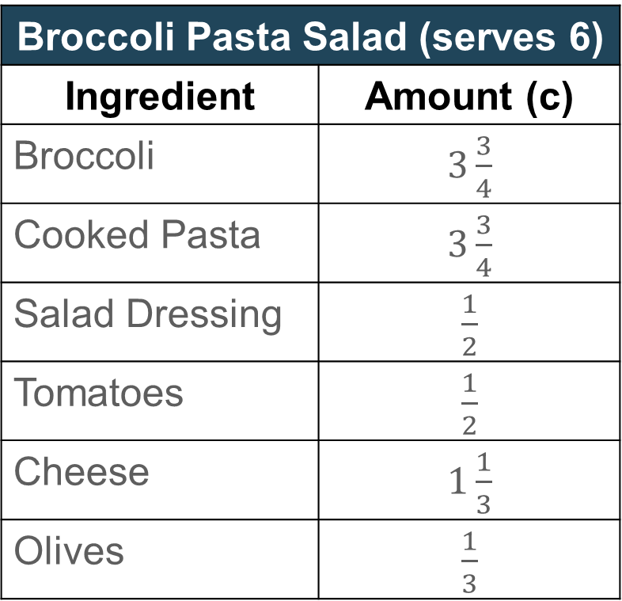
Exit Ticket
If you want to triple the recipe, explain how to find the amount of cooked pasta you will need.
Broccoli Pasta Salad (serves 6)
Ingredient | Amount (c)
Broccoli | $3\frac{3}{4}$
Cooked Pasta | $3\frac{3}{4}$
Salad Dressing | $\frac{1}{2}$
Tomatoes | $\frac{1}{2}$
Cheese | $1\frac{1}{3}$
Olives | $\frac{1}{3}$

Slide 51

Exit Ticket
Have you ever used a recipe to make your favorite dish? The recipe shown serves six people. You are hosting a picnic with
15 people attending.
Broccoli Pasta Salad (serves 6)
Ingredient | Amount (c)
Broccoli | $3\frac{3}{4}$
Cooked Pasta | $3\frac{3}{4}$
Salad Dressing | $\frac{1}{2}$
Tomatoes | $\frac{1}{2}$
Cheese | $1\frac{1}{3}$
Olives | $\frac{1}{3}$

Slide 52
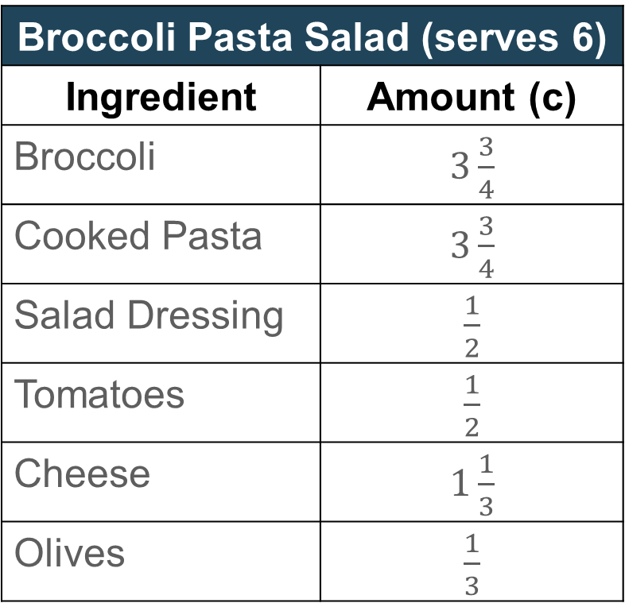
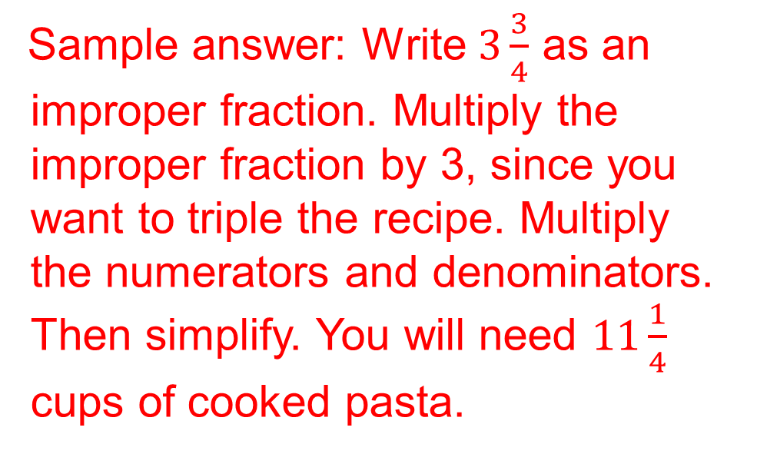
Exit Ticket
If you want to triple the recipe, explain how to find the amount of cooked pasta you will need.
Broccoli Pasta Salad (serves 6)
Ingredient | Amount (c)
Broccoli | $3\frac{3}{4}$
Cooked Pasta | $3\frac{3}{4}$
Salad Dressing | $\frac{1}{2}$
Tomatoes | $\frac{1}{2}$
Cheese | $1\frac{1}{3}$
Olives | $\frac{1}{3}$
Sample answer: Write $3\frac{3}{4}$ as an improper fraction. Multiply the improper fraction by 3, since you want to triple the recipe. Multiply the numerators and denominators. Then simplify. You will need $11\frac{1}{4}$ cups of cooked pasta.
Notes:
Sample answer: Write $3\frac{3}{4}$ as an improper fraction. Multiply the improper fraction by 3, since you want to triple the recipe. Multiply the numerators and denominators. Then simplify. You will need $11\frac{1}{4}$ cups of cooked pasta.

