Slide 1
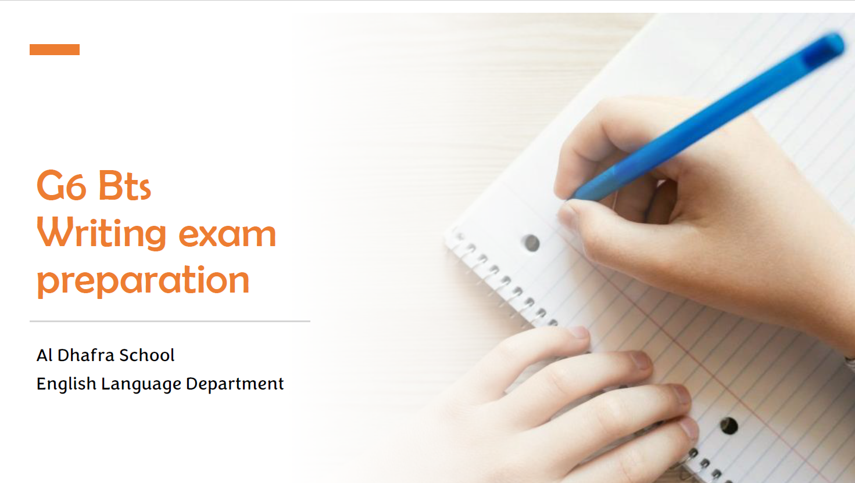
الفرع المدرسي الأول
مدرسة أم العلاء للتعليم الأساسي ح 2
Done by :
Shamsah Alyileili

Slide 2
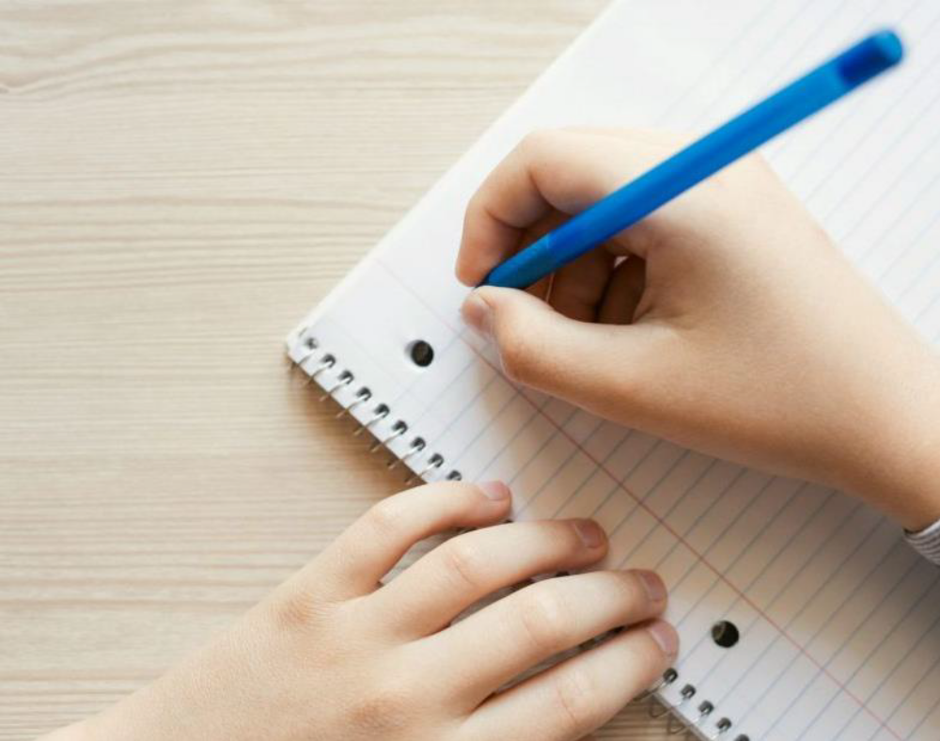
The objective:
To practice writing for specific topic.
Second term 2023 exam

Slide 3
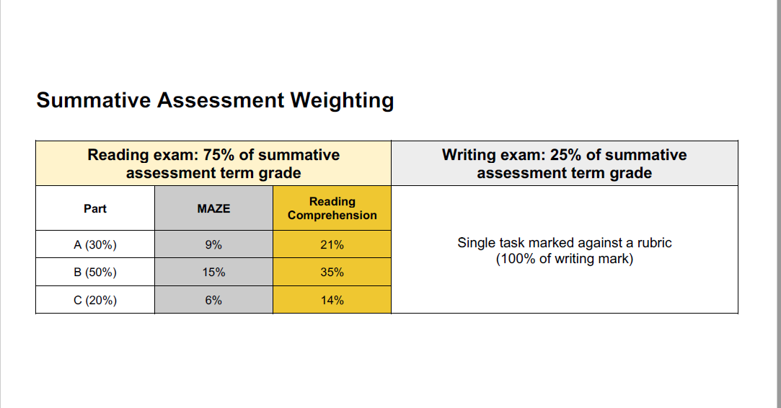

Slide 4
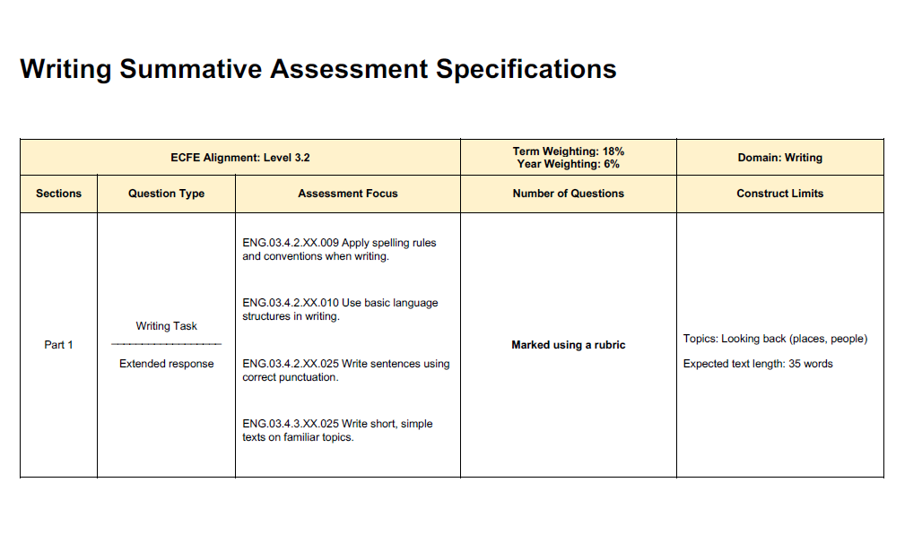
Writing :
Topics: Looking back ( places, people)
Expected text length : 35 works ( 6 sentences)

Slide 5
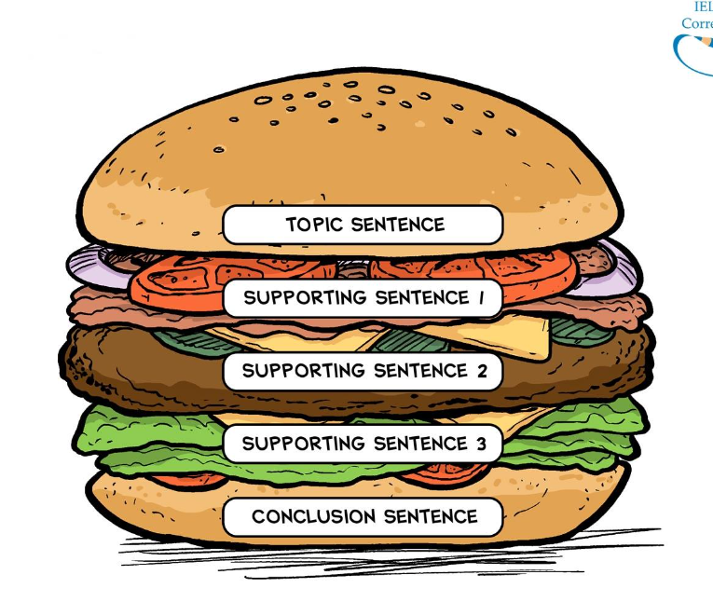
What is this ?
It is a sandwich.
2) Why do we use this for writing?
To write full paragraph.

Slide 6
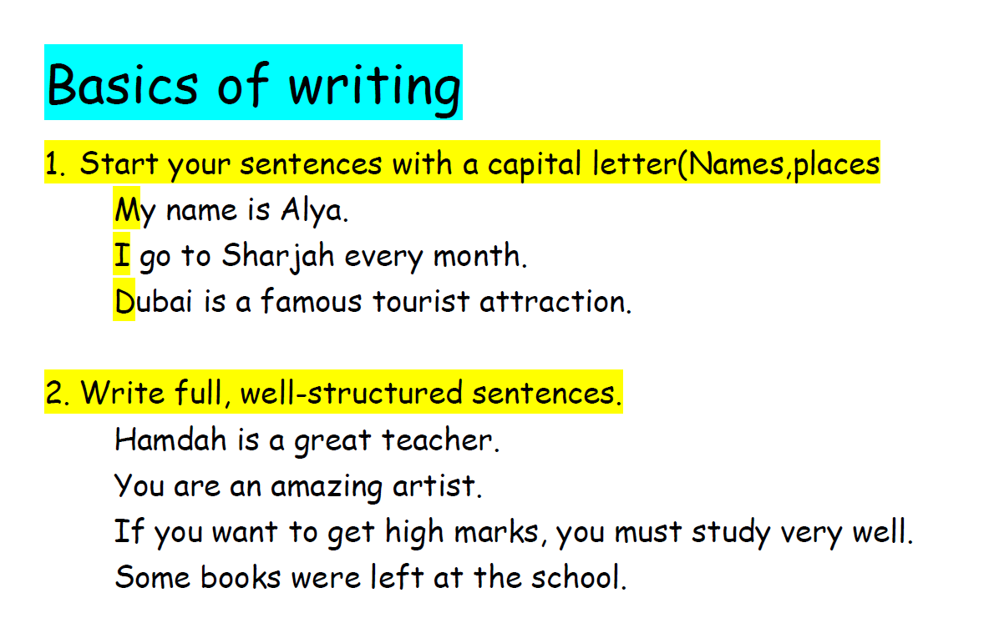

Slide 7
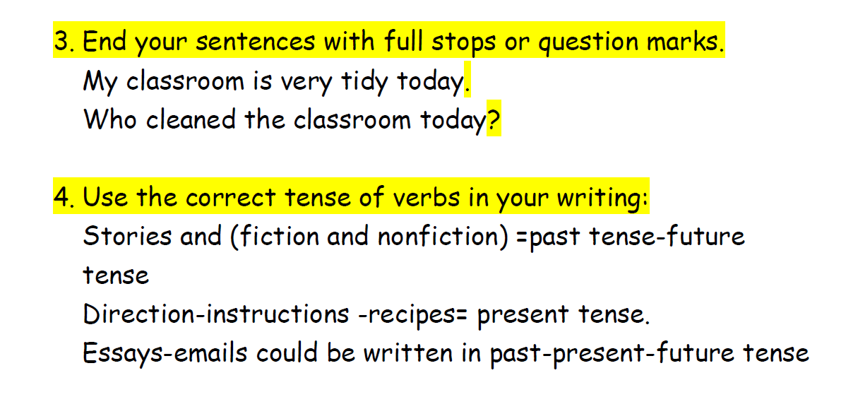

Slide 8
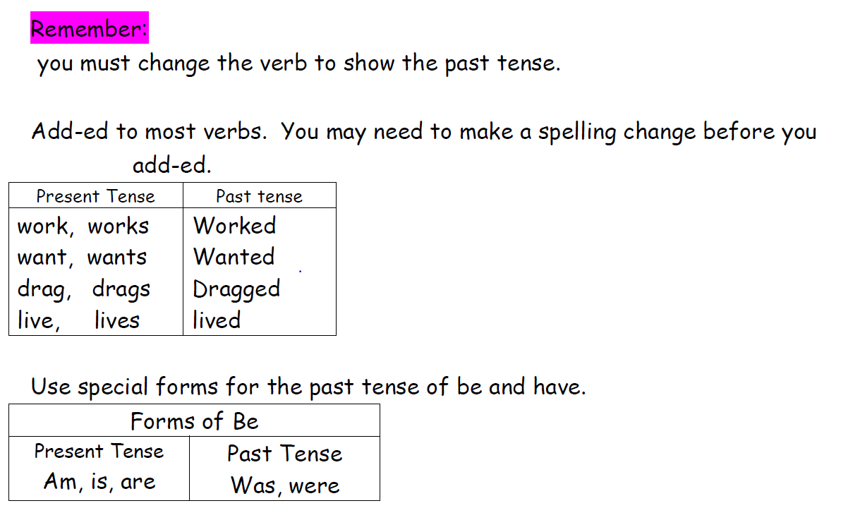

Slide 9
Let’s write a paragraph about person’s job?
1) What was the job? Who had this job?
Ahmed was a vet
2) Where did he/ she work?
He worked at the clinic and sometimes he went to the farms.
3) What was his/her personal qualities?
He was hardworking, brave, patient and calm.
4) What did he/she need for this job?
He should know science and math. Also, he should know about medicine.
5) What did she wear?
He wore veterinary uniform.

Slide 10
person’s job
Ahmed was a vet. He worked at the clinic and sometimes he went to the farms. He was hardworking, brave, patient and calm. He should know science and math. Also, he should know about medicine. He wore veterinary uniform.

Slide 11
Let’s write a paragraph about special place?
What was the place? Where was it?
Dubai Miracle Garden in Dubai
2) Who went with you?
I went there with my family.
3)When did you go there?
We went last week.
4) What did you do there?
I saw many awesome flowers. Also, I saw beautiful butterflies. When I felt tired, I sat in a wonderful café.
5) How did you feel?
I enjoyed my time very well.

Slide 12
Special place
Dubai Miracle Garden in Dubai. I went there with my family. We went last week. I saw many awesome flowers. Also, I saw beautiful butterflies. When I felt tired, I sat in a wonderful café. I enjoyed my time very well.

Slide 13
Let’s write a paragraph about your Special person?
Who was the special person?
H.H. Shaik Zayed Bin Sultan was the special person.
2) What was his personal qualities?
He was hardworking, brave, patient, confident and kind.
3) What did he love?
He loved horse riding and falconry. Also, he loved plants.
4) What did he do?
He changed the desert to the green land. Moreover, He united the UAE.
5) How do you feel when you hear his name?
I feel very proud because I love him. Also, I will follow his steps.

Slide 14
Special person
H.H. Shaik Zayed Bin Sultan was the special person. He was hardworking, brave, patient, confident and kind. He loved horse riding and falconry. Also, he loved plants. He changed the desert to the green land. Moreover, He united the UAE. I feel very proud because I love him. Also, I will follow his steps.

Slide 15
Thank you
Good luck

