Slide 1




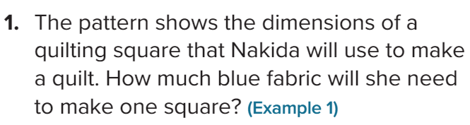
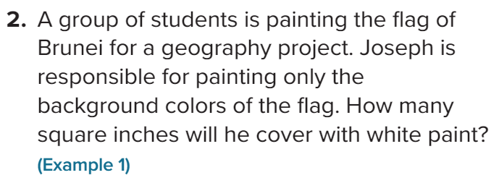
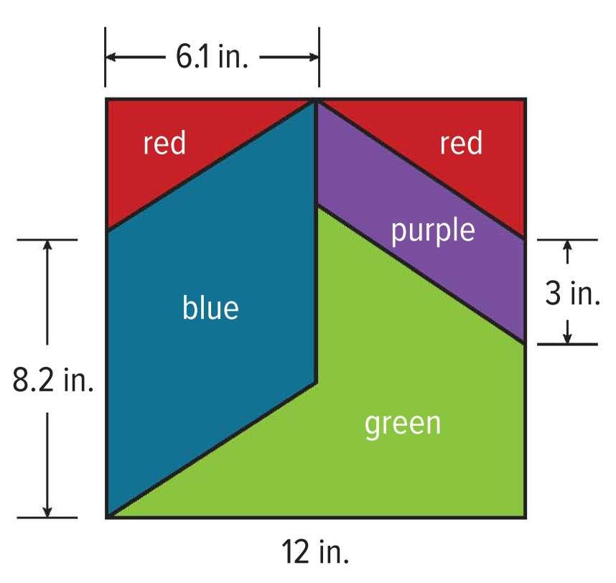
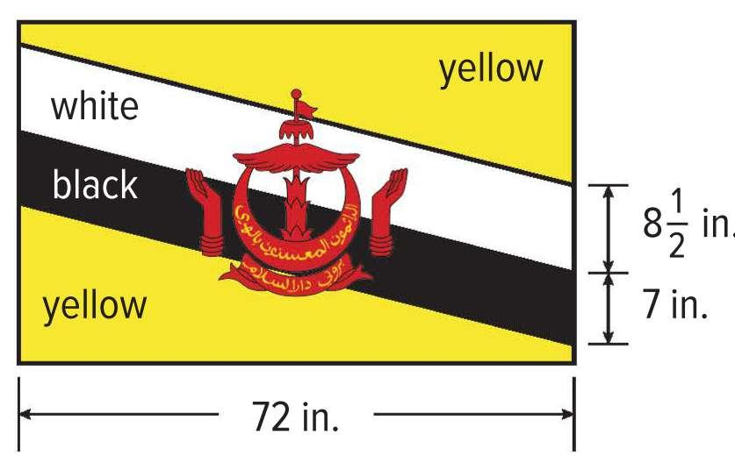
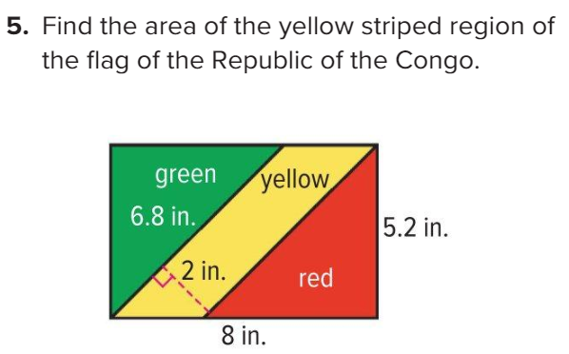
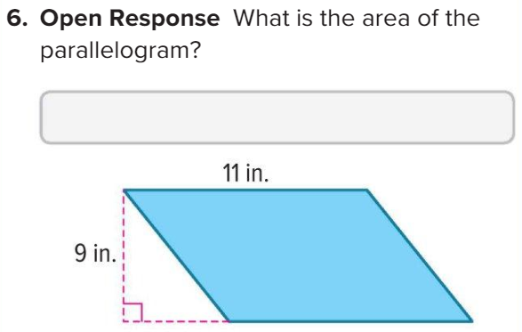
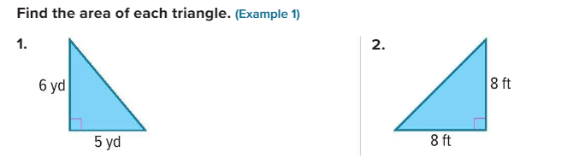
EoT3-Coverae-Grade 6-General
Part-1
M8L1 – Area of Parallelograms | Exercise (1,2, 5,6) | Page:441
……………..……
……………..……
…………..………
……………..……
…………..………
……………..………………………..
……………..……
……………..……
…………..………
……………..……
…………..………
……………..………………………..
……………..……
……………..……
…………..………
……………..……
…………..………
……………..………………………..
M8L2 – Area of Triangles | Exercise (1,2, 3,4) | Page:449
……………..……
……………..……
…………..………
……………..……
…………..………
……………..………………………..
……………..……
……………..……
…………..………
……………..……
…………..………
……………..………………………..

Slide 2
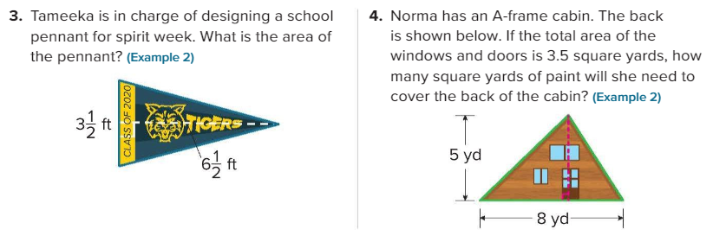
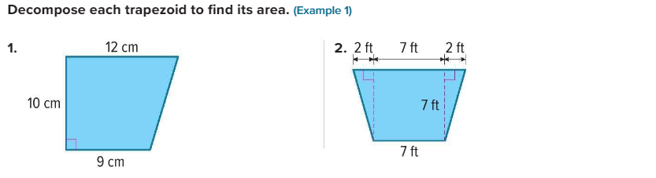
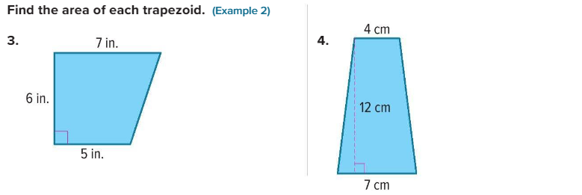
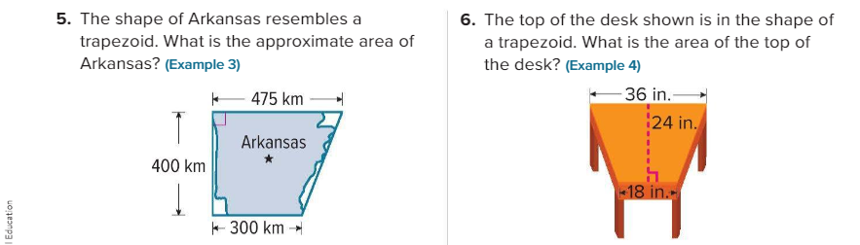
……………..……………………………………..……
…………..………………………………………..……
…………..……………………..………………………………………………………………………………….
……………..……………………………………..……
…………..………………………………………..……
M8L3 – Area of Trapezoids | Exercise (1,2, 3,4,5,6,7,8) | Page:461
……………..……
……………..……
…………..………
……………..……
…………..………
……………..………………………..
…………………….……..……
…………………….……..……
…………………….…..………
…………………….……..……
…………………….…..………
………….…..…………………………………………………...
…………………….……..……
…………………….……..……
…………………….…..………
…………………….……..……
…………………….…..………
………….…..…………………………………………………...
…………………….……..……
…………………….……..……
…………………….…..………
…………………….……..……
…………………….…..………
………….…..…………………………………………………...
…………………….……..………………………….……..………………………….…..…………………………….……..………………………….…..………………….…..………………………………………………….
…………………….……..………………………….……..………………………….…..…………………………….……..………………………….…..………………….…..………………….……………………………….

Slide 3
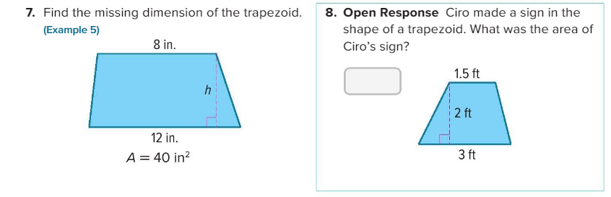
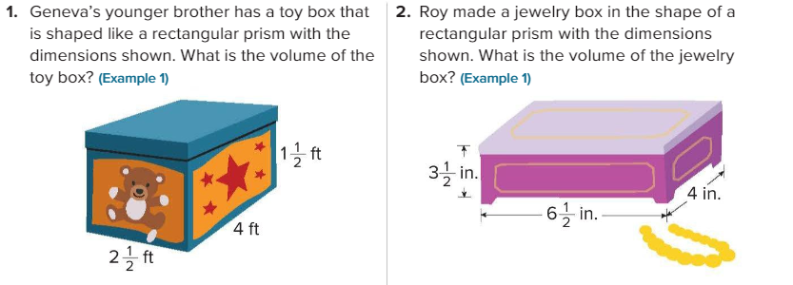
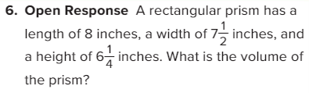
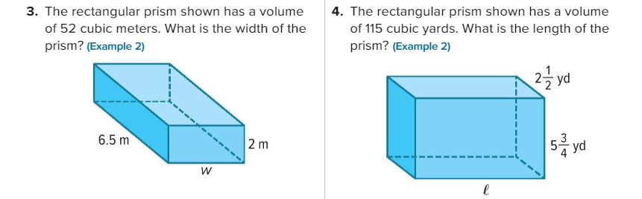
……………..……
……………..……
…………..………
……………..……
…………..………
……………..………………………..
……………..……
……………..……
…………..………
……………..……
…………..………
……………..………………………..
M9L1 – Volume of Rectangular Prisms | Exercise (1,2, 6) | Page:493
……………..……………………………………..……
…………..………………………………………..……
……………..……………………………………..……
…………..………………………………………..……
……………..……………………………………..……
…………..………………………………………..……
……………..……………………………………..……
…………..………………………………………..……
M9L1 – Volume of Rectangular Prisms | Exercise (3,4, 5) | Page:493

Slide 4
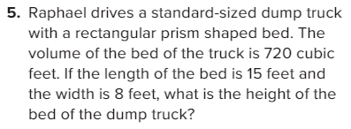
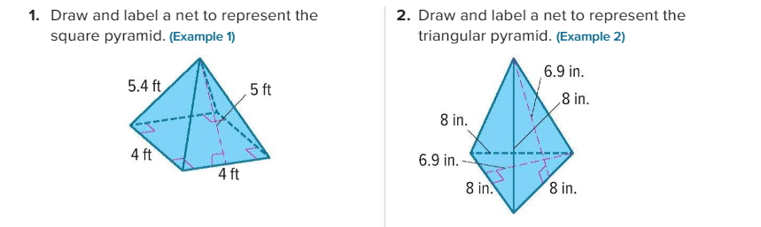
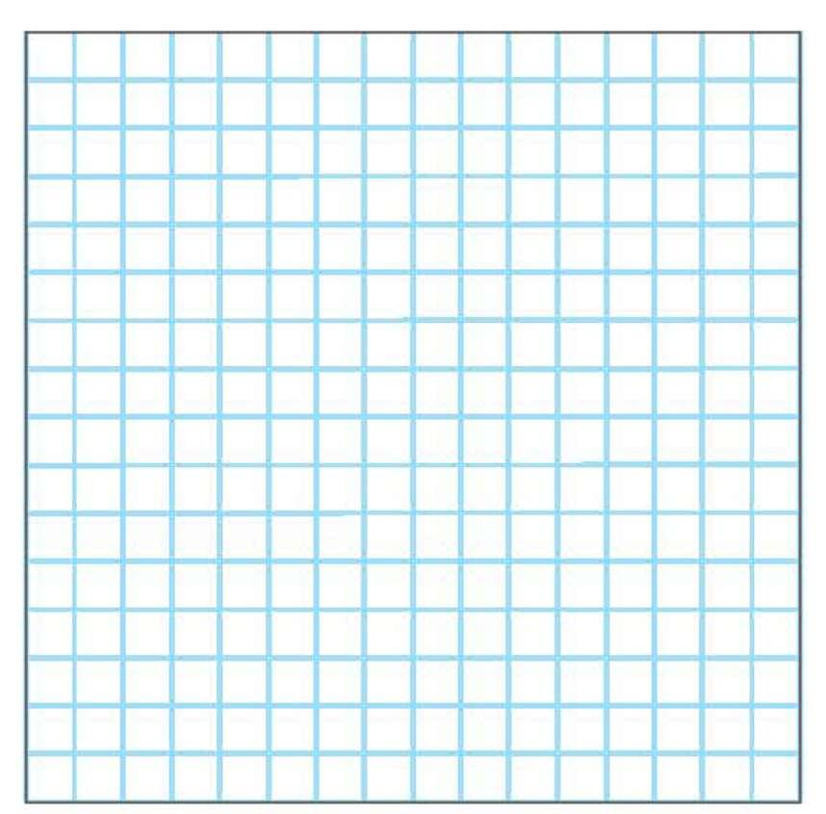
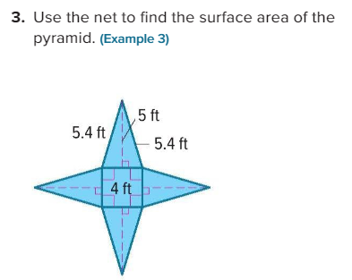
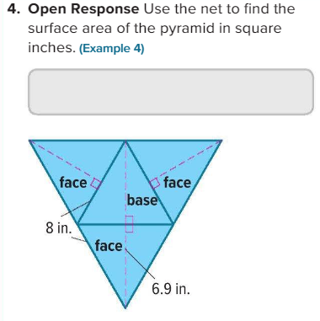
……………..……………………………………..……
…………..………………………………………..……
……………..……………………………………..……
…………..………………………………………..……
M9L4 – Surface Area of Pyramids (Part 1 + Part 2) | Exercise (1,2,3,4) | Page:529

Slide 5
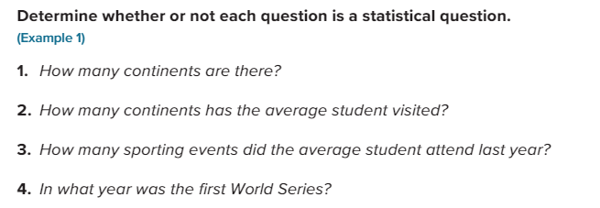
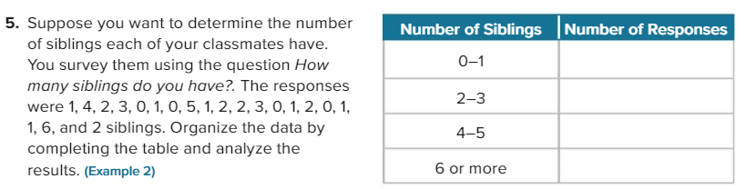
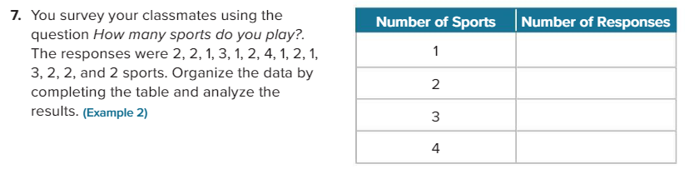
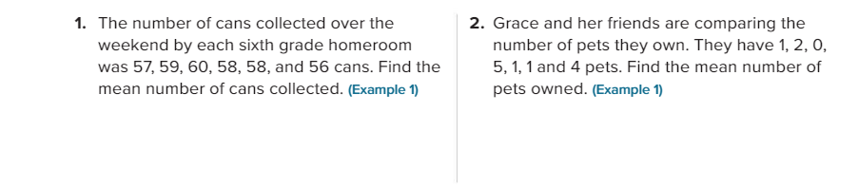
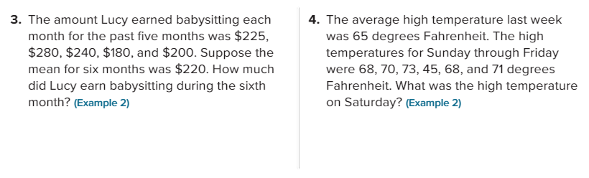
M10L1 – Statistical Questions | Exercise (1,2,3,4,5,6,7) | Page:541
……………..……………………………………..……
…………..………………………………………..……
……………..……………………………………..……
…………..………………………………………..……
M10L3 – Measures of Center | Exercise (1,2,3,4,5,6,7,8) | Page:559
……………..……………………………………..……
…………..………………………………………..……
……………..……………………………………..……
…………..………………………………………..……
Part 1
Part2
Part 1
Part2
……………..……………………………………..……
…………..………………………………………..……
……………..……………………………………..……
…………..………………………………………..……

Slide 6
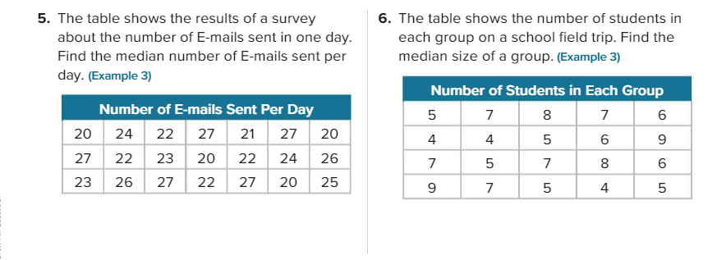
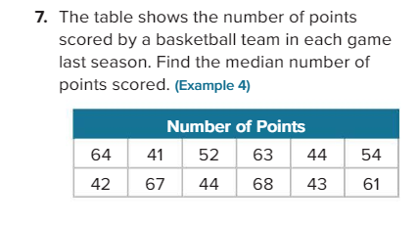
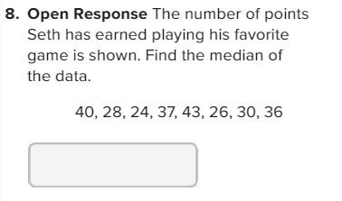
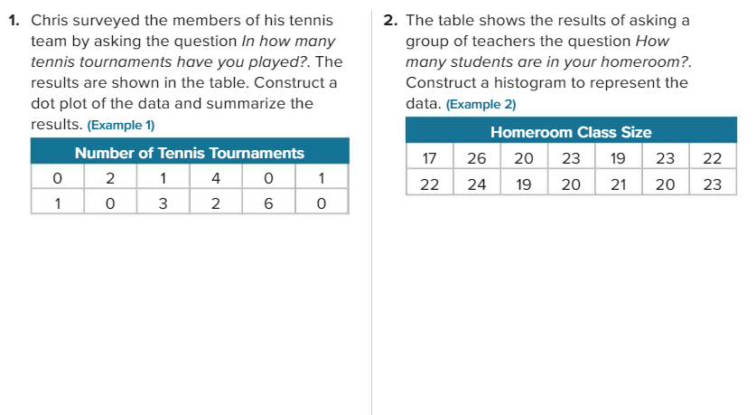
Part 1
Part2
Part 1
Part2
……………..……………………………………..……
…………..………………………………………..……
……………..……………………………………..……
…………..………………………………………..……
……………..……………………………………..……
…………..………………………………………..……
……………..……………………………………..……
…………..………………………………………..……
M10L2 – Dot Plots and Histograms | Exercise (1,2,3,4) | Page:547

Slide 7
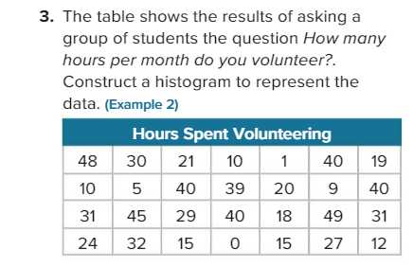
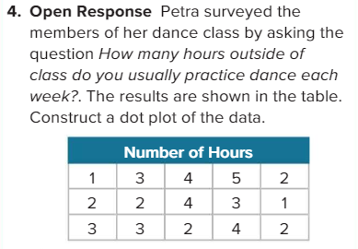
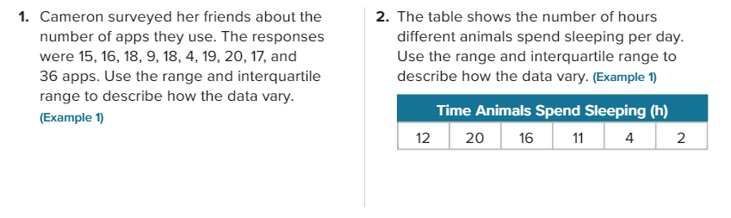
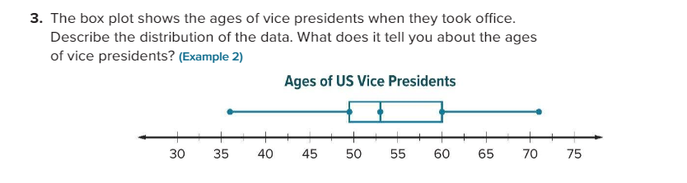
M10L4 – Interquartile Range and Box Plots (Part 1 + Part 2) | Exercise (1,2,3,4) | Page:567

Slide 8
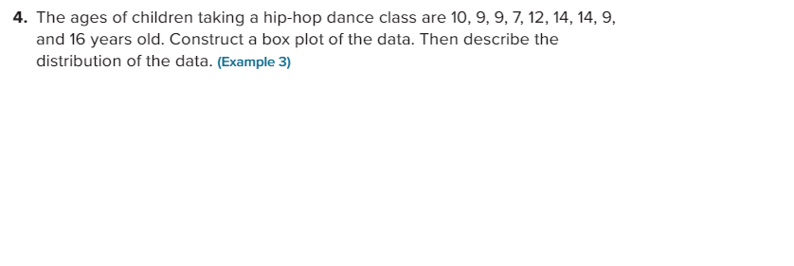
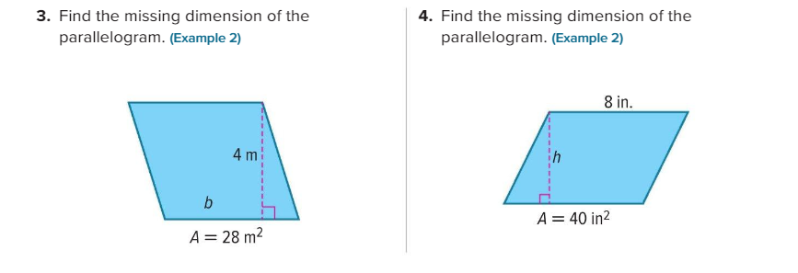
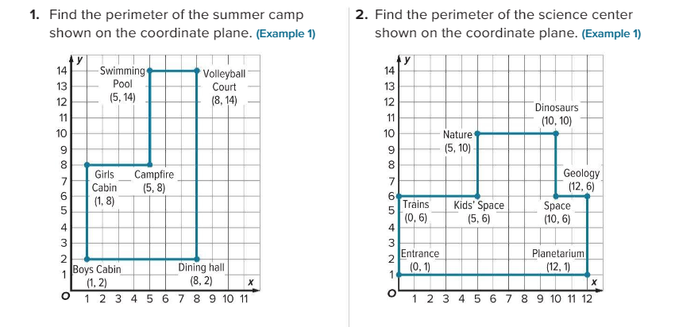
Part-2
M8L1 – Area of Parallelograms | Exercise (3,4) | Page:441
M8L5 – Polygons on the Coordinate Plane | Exercise (1,2,3,4,5,6) | Page:477

Slide 9
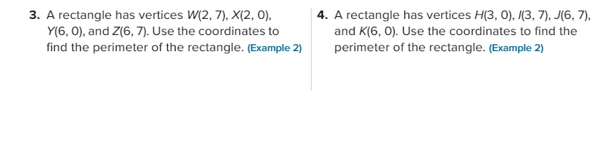

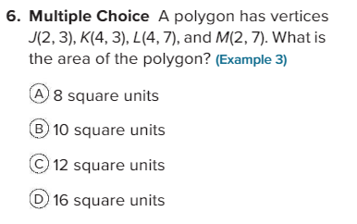
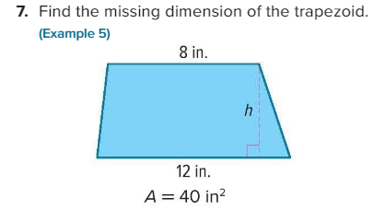
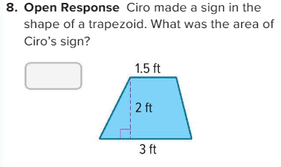
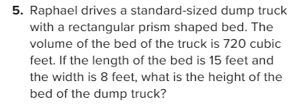
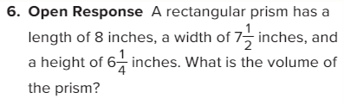
M8L3 – Area of Trapezoids | Exercise (7,8) | Page:461
M9L1 – Volume of Rectangular Prisms | Exercise ( 5,6) | Page:493

Slide 10
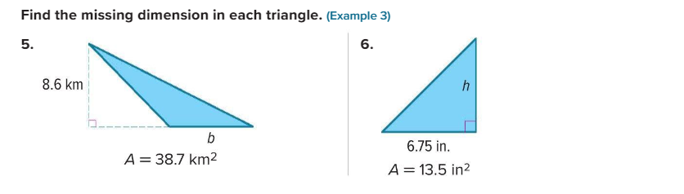
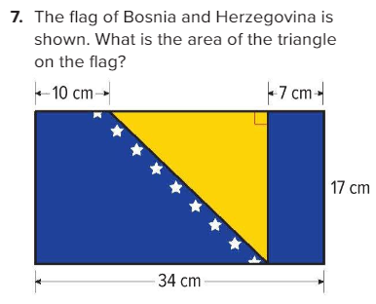
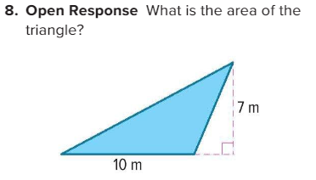
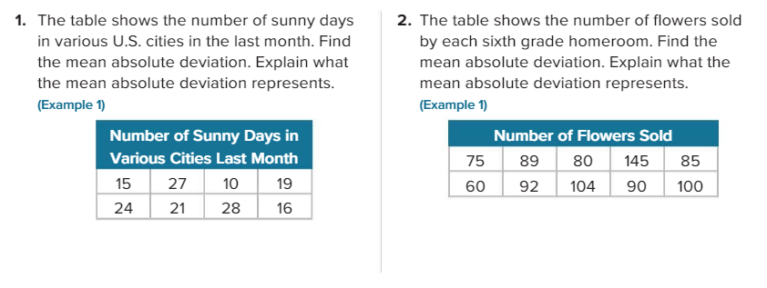
M8L2 – Area of Triangles | Exercise (5,6,7,8) | Page:449
M10L5 – Mean Absolute Deviation | Exercise (1-4) | Page:573

Slide 11
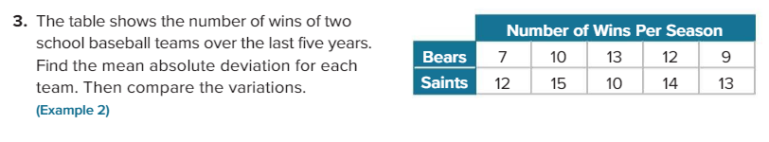
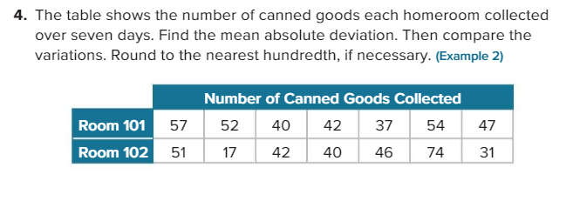

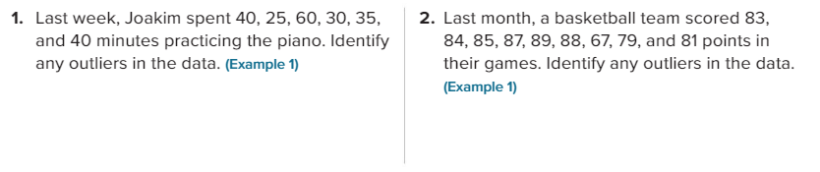
M10L4 – Interquartile Range and Box Plots | Exercise (5) | Page:567
M10L6 – Outliers | Exercise (1,2,3,4,5,6) | Page:581

Slide 12
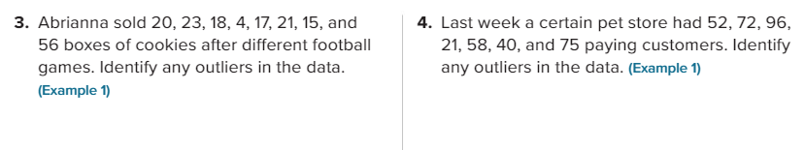


Part-3
M8L4 – Area of Regular Polygons | Exercise (1,2,3) | Page:467

Slide 13



M9L3 – Surface Area of Triangular Prisms | Exercise (1,2,3) | Page:515

Slide 14



