Slide 1
English Language
Coverage, Grammar and Functional Language Teaching Resource
Level 3.1
Term 1
2024 - 2025

Slide 2
INDEX
03
06
08
15
How to use this resource
Assessment Coverage
Preparation - Grammar
Preparation – Functional language

Slide 3
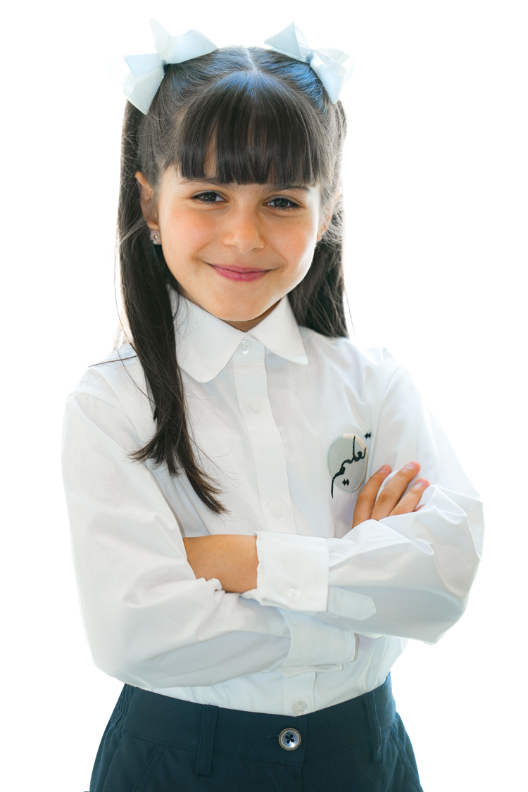
How to use this resource

Slide 4

The Coverage, Grammar and Functional Language Teaching Resource
The slides within this resource, although detailed, are designed as a starting point for teachers. You can:
construct lessons around the language points explored in them.
use the slides individually as a resource within a lesson.
incorporate them gradually in lessons throughout the term (rather than the whole PowerPoint at once).
combine functional language and grammar slides which overlap.
Ensure that students have been exposed to all the language points in the coverage ahead of their end of term exam.

Slide 5

Within this document, you will find information about:
the coverage for this term.
the lexis families that assessments will contain.
particular grammatical and functional language points that will be tested in the exams.
In the preparation sections, you will find examples and explanations for the grammatical and functional language points that will be assessed this term.
The grammar preparation sections contain:
an example sentence.
an explanation of the meaning of the example sentence.
the specific grammatical structure used within the example sentence.
links to further resources.
an explanation of the circumstances under which the structure is used.
more example sentences.
In the functional language preparation section, there are examples and explanation of how the functional language is used, as well as relevant associated grammar points.

Slide 6

Term 1 Assessment Coverage

Slide 7
Topic(s): Food and drink, animals, sports and leisure activities.
ECFE Grammar | Prerequisite Grammar | GSE Grammar | Functional Language
Present time: present simple | Can use the correct form of 'be' with singular and plural nouns. (24) | Can make affirmative statements using the present simple without time reference. (26) Can use the present simple to refer to daily routines. (26) Can make negative statements using the present simple. (26) Can use the present simple to refer to likes, dislikes and opinions. (27) | Comparing and contrasting Expressing likes and dislikes Describing habits, routines, tasks and jobs.
Comparatives | Can make basic statements with subject + verb + object. (24) | Can use short regular (-er) and irregular comparatives.
Present time: present continuous | Can use subject pronouns with the correct form of the verb 'be' in the simple present. (24) | Can tell when to use the present simple and when to use the present continuous. (29)

Slide 8

Term 1 preparation: Grammar

Slide 9
I play football every Sunday.
Checking questions | What happens on Sunday?
Grammatical structure | Present simple subject + present verb* (+ object) * add –s for he, she, it
Usage | We can use the present simple tense when we talk about current routines, facts and likes / dislikes.
Other examples | He eats his breakfast every morning. I paint pictures in my free time. We like to walk to school.

Slide 10
A giraffe is taller than a rabbit.
Checking questions | What is tall – a giraffe or a rabbit?
Grammatical structure | Adjectives: comparatives Short adjectives: (be) + (adjective)–er + than For “good”: (be) + better + than For “bad”: (be) + worse + than
Usage | Comparatives are used to say how people or things are different.
Other examples | Alia is shorter than Rawan. I think peppers are worse than tomatoes. The beach is better than the park.

Slide 11
What are you doing? I am watching TV.
Checking questions | Where is TV here?
Grammatical structure | Present continuous subject + am/is/are + verb +ing (+ object)
Usage | We can use present continuous to talk about actions in progress right now.
Other examples | They are walking. He is drawing a picture. She isn’t reading a book.
Present

Slide 12
Term 1 preparation:
Functional language

Slide 13
It is hot in the desert but cold in the mountains. I am taller than my brother. A tiger has stripes but a lion does not have them.
Functional language point | Comparing and contrasting
Associated grammar | Adjectives, comparatives, noun phrases

Slide 14
I like learning about animals. I enjoy playing sports. We love travelling. I don’t like drinking milk.
Functional language point | Expressing likes and dislikes
Associated grammar | Present simple, adjectives, noun phrases

Slide 15
My brother drinks coffee every morning. I get the bus to school every day. I always go swimming on Tuesdays. What do you do at the weekend?
Functional language point | Describing habits, routines, tasks and jobs.
Associated grammar | Verbs, simple present, time phrases.

Slide 16
Thank you

