Slide 1

English Term 3 Coverage
Level 3.2
Term 3 2021-2022

Slide 2

Contents:
Coverage
Preparation - grammar
Level 3.2
Term 3 Academic Year 2021-2022

Slide 3
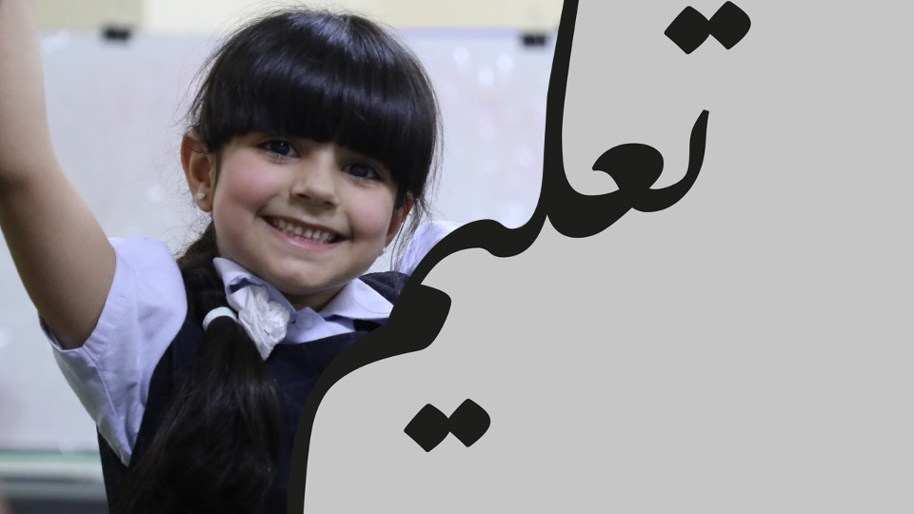
Term 3 Coverage

Slide 4
Term 3 Coverage
Topic(s): Animals
Lexis | Grammar | Functional Language
deserts, rainforests, oceans | Verb forms: gerunds Preposition: time Adverbs: frequency | Expressing likes and dislikes Describing places Describing objects Expressing opinion Asking for and giving advice Talking about time periods

Slide 5

Term 3: Preparation - Grammar

Slide 6

Swimming is fun.
Grammatical Structure | gerund - the –ing form of a verb
Usage | A gerund is the –ing form of a verb that behaves like a noun. They can be the subject as well as the object in the sentence. Gerunds can be used as the object after some verbs such as ‘like / hate / love’.
Meaning | In the above example, the person enjoys swimming.
Other examples | I love shopping. They like camping. She hates watching TV.

Slide 7
I will visit you on Monday.
Grammatical Structure | Prepositions of time subject + verb + object + preposition of time
Usage | We use prepositions of time to talk about when an action or event happens. at: can be used for clock times and specific times. in: can be used for months, years, centuries and even longer times. on: can be used for dates and days.
Meaning | The person is visiting a friend on Monday.
Other examples | We go to the park on Friday. I have dinner at 8:00 pm. My birthday is in July.

Slide 8
We take a vacation yearly.
Grammatical Structure | adverb of frequency subject + adverb + main verb or subject + to be + adverb or subject + verb + object + adverb of definite frequency
Usage | An adverb of frequency describes how often an action happens. Common adverbs of frequency include always, ever, never, often, sometimes and usually. Adverbs of definite frequency include daily, weekly, every minute, once and twice.
Meaning | We take a vacation once a year.
Other examples | She always tells the truth. He is never on time. I go to school daily.

Slide 9



Follow us
ese.ae
Ese_ae

