Slide 1

Grade 5 Access
Reading End of Term Exam
Term 1
2022 - 2023

Slide 2

Contents
Lexis
Grammar
Sample Questions
This Photo by Unknown Author is licensed under CC BY

Slide 3
Key Lexis
family | path
parents | garden
cousin | swimming pool
husband | weather
grandmother | mountains
robot | beautiful
celebrity | favourite
house | volleyball
bedroom | coffee
balcony | cook

Slide 4

family
a group of people such as a mother, father and children

Slide 5


parents
parent
parent
a mother and father

Slide 6


cousin
Parent
Cousin
Cousin
Parent
Me
Grandparents
your aunt or uncle’s child

Slide 7

husband
husband
a man who is married

Slide 8

grandmother
the mother of your mother or father

Slide 9

robot
a machine that can do some of the same
things as a person

Slide 10

celebrity
a famous person
Limousine, Red Carpet, created by upklyak, Freepik.com

Slide 11
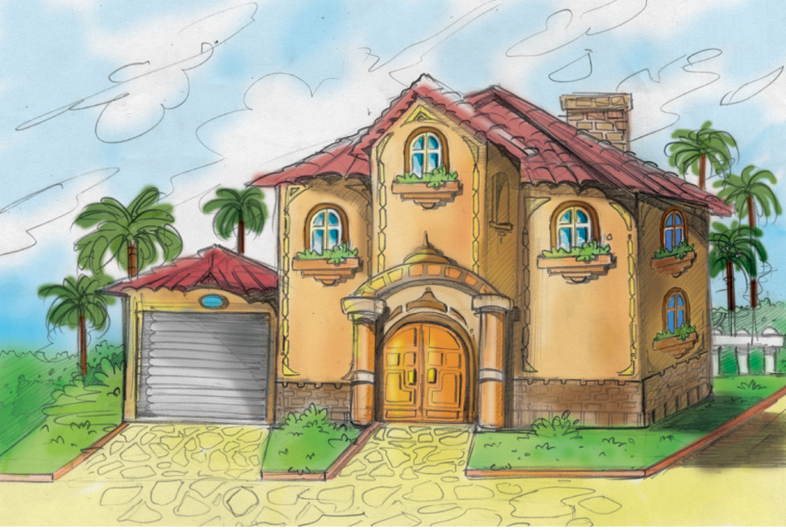
house
a place to live

Slide 12
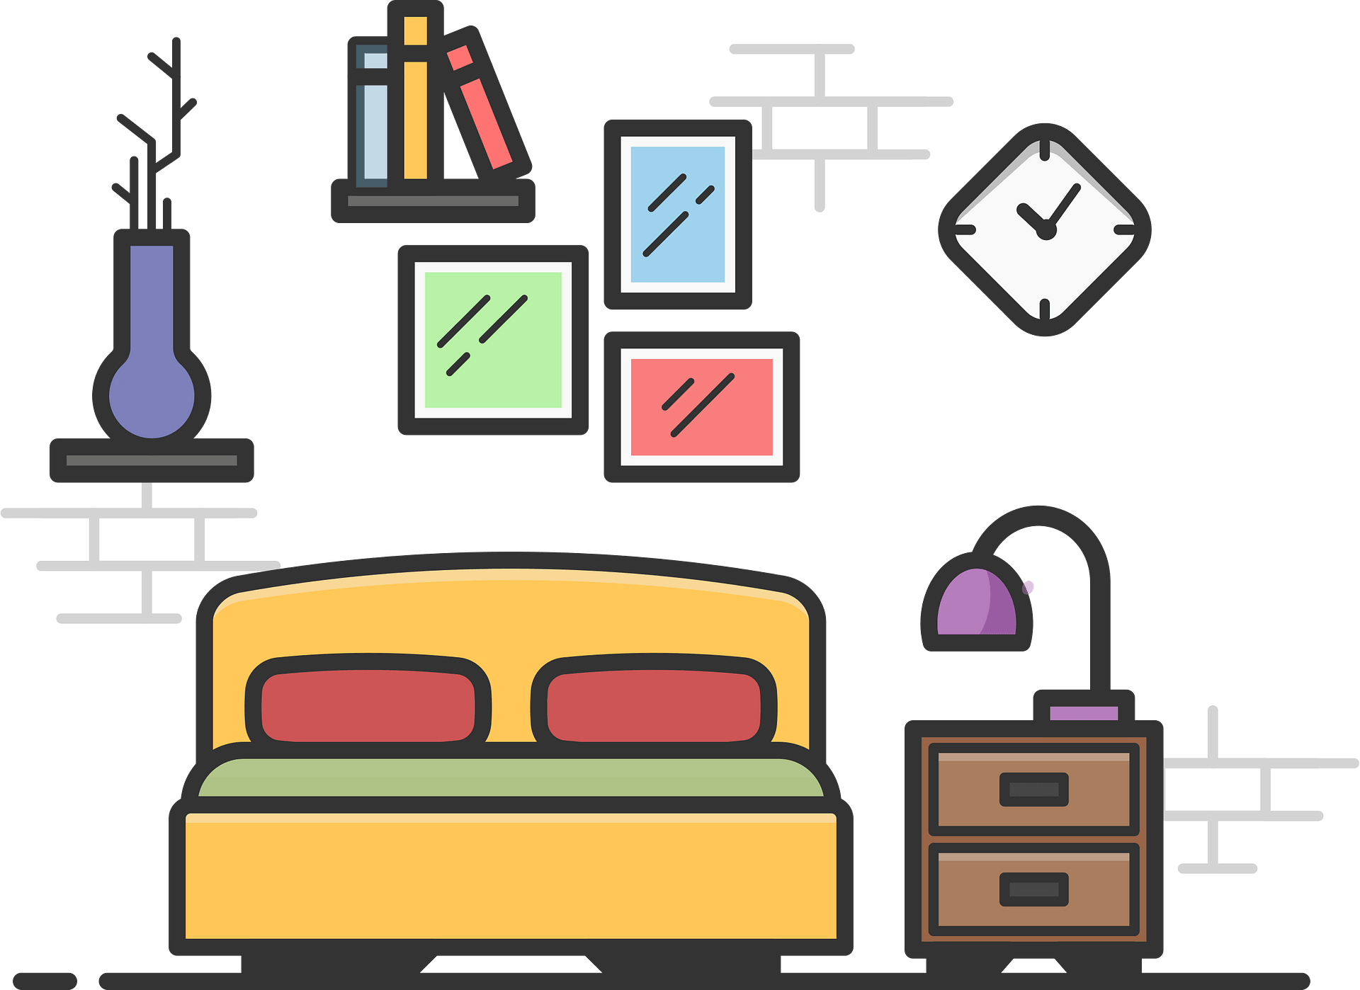
bedroom
a room for sleeping

Slide 13
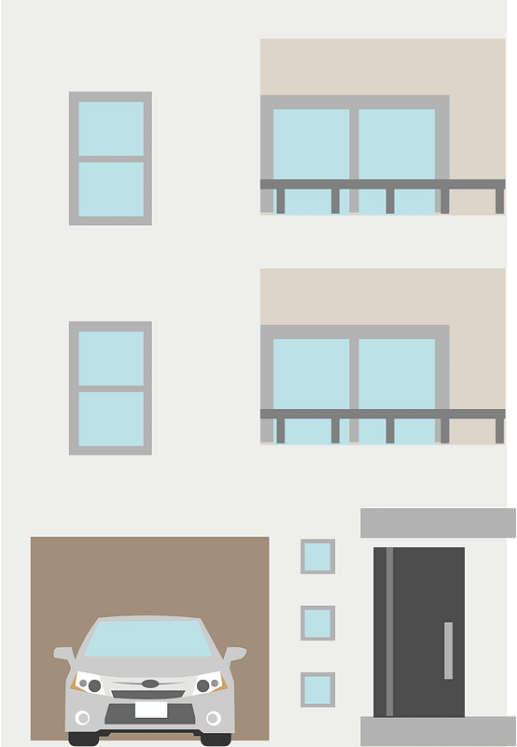
balcony
balcony
an area joined to the outside of a flat or house

Slide 14

path
a road between one place and another,
used for walking

Slide 15

garden
an area of land used for growing flowers
and other plants

Slide 16
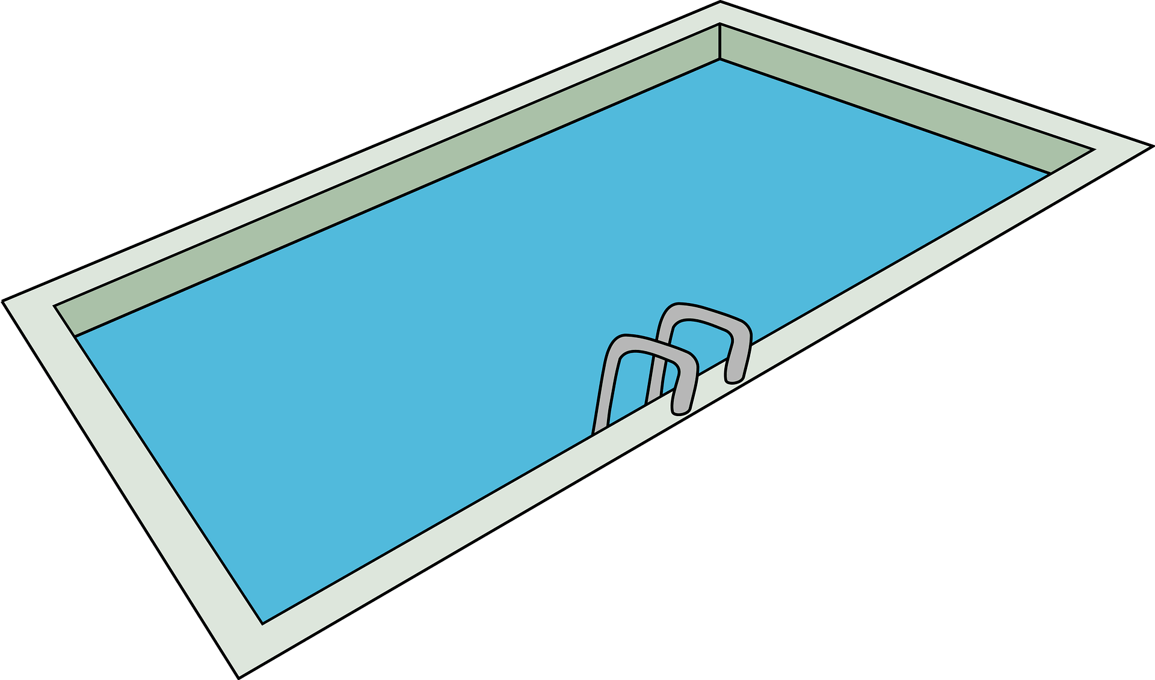
swimming pool
a man-made area of water

Slide 17



weather
what the sky and air are like
such as sunny, windy, rainy

Slide 18

mountains
land which is taller than a hill

Slide 19

beautiful
very nice to look at

Slide 20



favourite
to like something the best

Slide 21
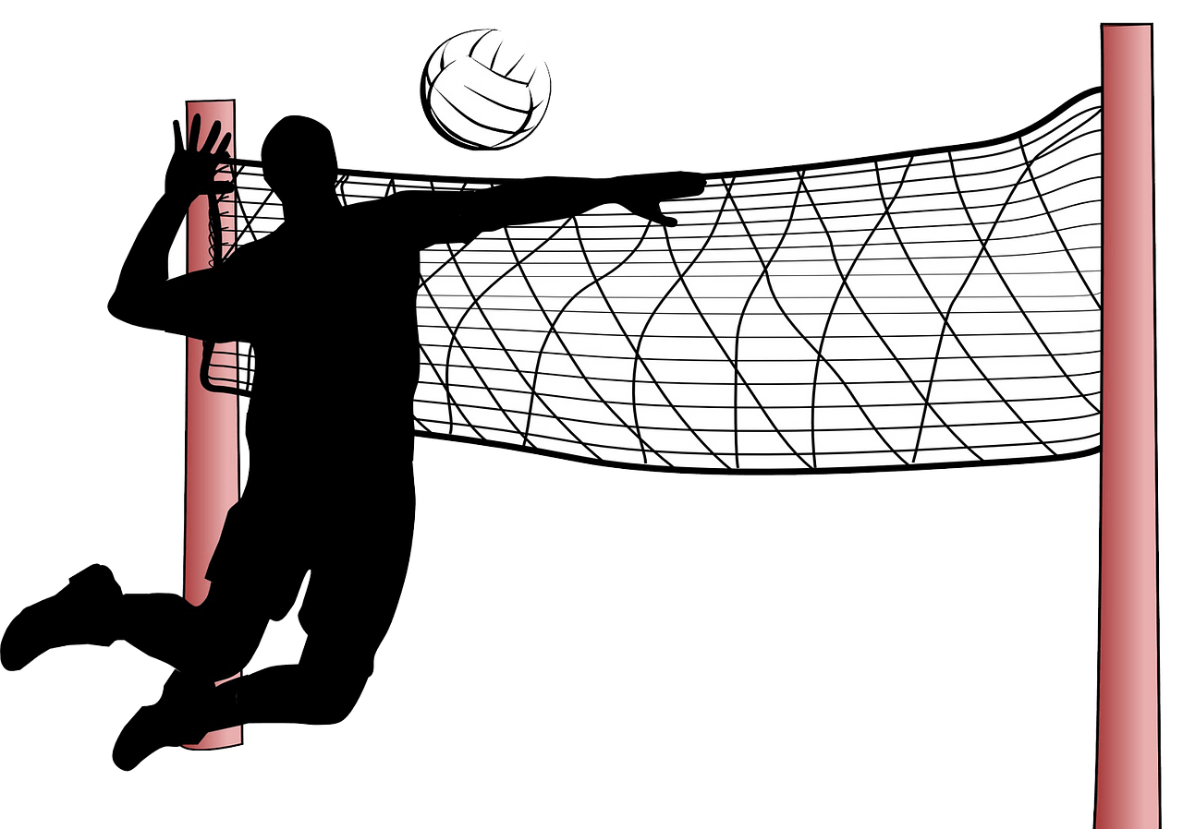
volleyball
a game where people use their hands
to hit a ball over a high net

Slide 22
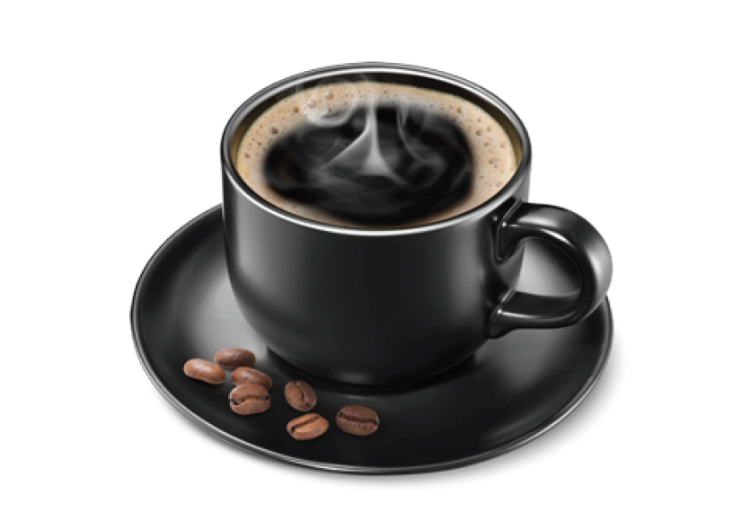
coffee
a kind of drink

Slide 23

cook
to use heat to make food

Slide 24
Key Grammar
NELCF Code | Grammatical structure
G.16.1 | Pronouns (personal / subject pronouns)
G.9.4 | Nouns (possessive’s’)
G.13.1 | Present Time (present simple (including verb ‘to be’)

Slide 25
My mom is in the kitchen. She is cooking. My brother plays football. He is very fast! I have three houses. They are big.
Grammatical structure | Pronouns (personal / subject pronouns)
Usage | Use personal / subject pronouns to replace a person, place or thing.
Other examples | My name is Latifah. I like to ride horses. My family likes the beach. We go there when it is hot. I like to go to the café. It is next to the sports shop.

Slide 26
My father’s cars are fast. My hat is in Salma’s room. The Burj Khalifa’s windows are made from glass.
Grammatical structure | Nouns (possessive ‘s’)
Usage | Use possessive nouns to show that something belongs to the subject.
Other examples | The dog’s bone is in the grass. The student’s books are on the desk.

Slide 27
I feel tired. I play football every day. I live in a flat. The pictures are next to the table.
Grammatical structure | Present time (present simple, including the verb ‘to be’)
Usage | Use the present simple to describe habits and routines and to give facts about things.
Other examples | Alia has two aunts and four cousins. She is not going to school today. I am six years old. I would like to be on your team.

Slide 28
Sample Reading Multiple Choice Questions
Hi, I’m Khaled. I live in England. My cousins are from India. Last year, we met for a holiday in the UAE and went to the mountains.
Where do Khaled’s cousins live?
  India
  the UAE
  England

Slide 29
Sample Reading Multiple Choice Questions
Saif follows a path when walking to school. His sister Anna goes by metro and his brother takes the bus.
2. How does Saif’s sister
get to school?
  follows a path
  takes a bus
  uses the metro

Slide 30
Sample Matching Questions
3. Elephants, tigers and giraffes I see. I don’t want any of them to scare me. Long hair, short hair, curly hair too! I like to visit here. What about you?
4. When the weather is hot, we go for a swim. We go at 7 o’clock when it is sunny. We see boats and play on the sand dunes. It is very funny.
A. A Trip to the Beach
B. A Trip to the Zoo

Slide 31
Sample MAZE
My 5. ( brother / aunt / uncle ) Leila is a teacher. She has a big 6. ( classroom / bedroom / dining room ) at the 7. ( bank / university / police station ). Her 8. ( student / student’s / students ) are from England.

Slide 32
Sample Question Answers
1. A
2. C
3. B
4. A
5. aunt
6. classroom
7. university
8. students

