Slide 1


EOT 3 EXAM COVERAGE

Slide 2

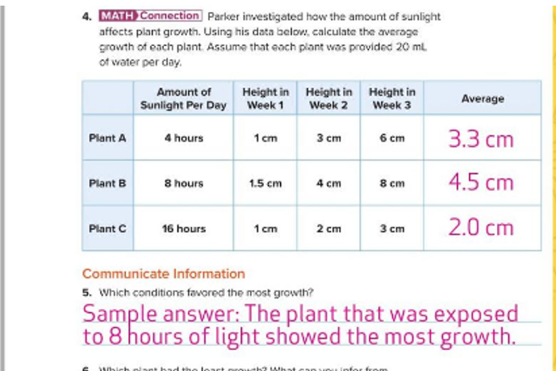

Slide 3
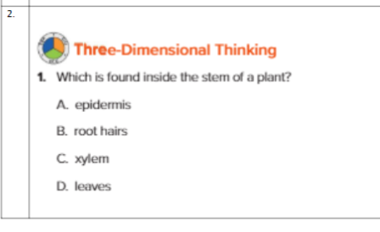

Slide 4



Slide 5
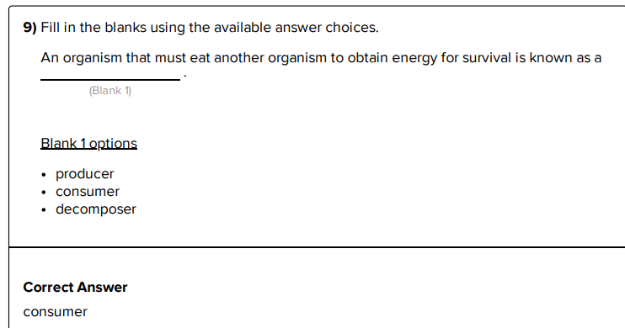

Slide 6
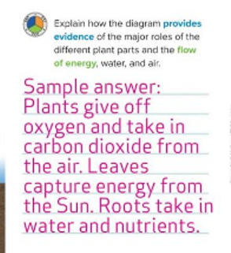

Slide 7
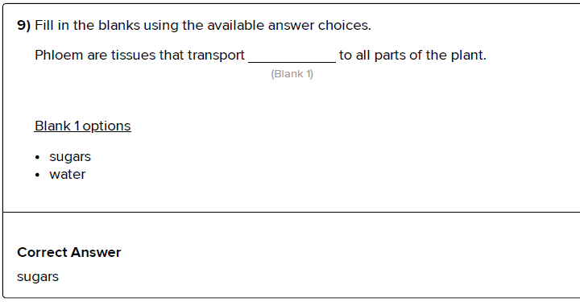

Slide 8
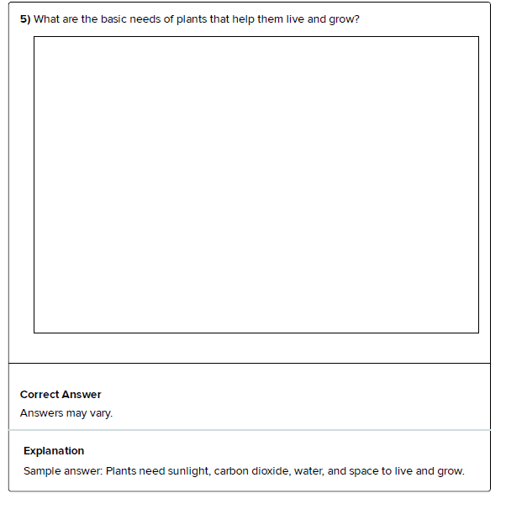

Slide 9
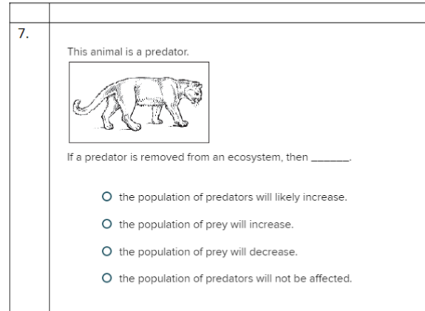

Slide 10
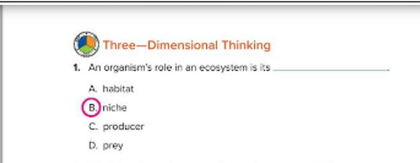

Slide 11


Slide 12

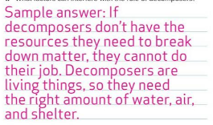

Slide 13


Green plants takes in sunlight , carbon dioxide, and water from environment. It makes food in the leaves in the form of sugar. This food is consumed by other organisms in the food chain of ecosystem when they eat plant.

Slide 14
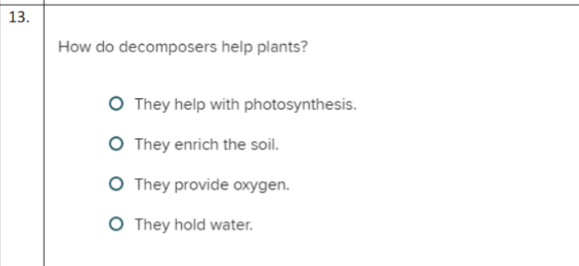

Slide 15
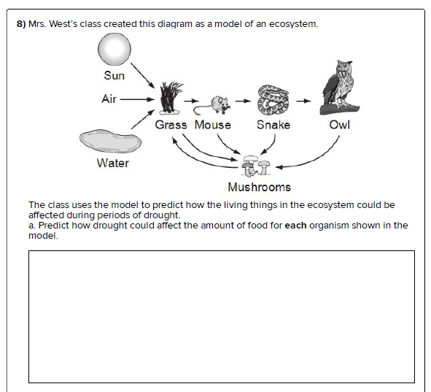
Drought can have a negative affect on food chain. In absence of water plants (grass) cannot make food for itself and will eventually die. As a result, all other consumers ( including primary, secondary and even decomposers) will also die in the food chain.

Slide 16
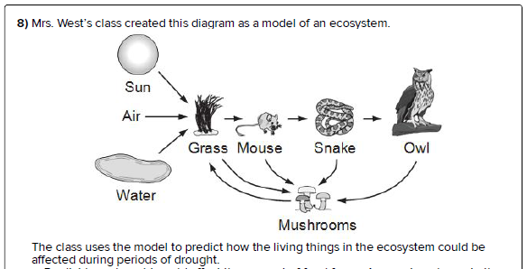
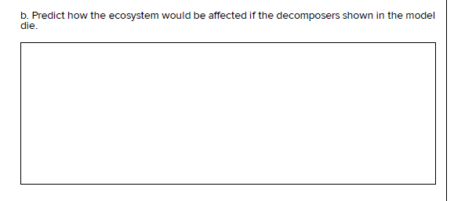
If the decomposers ( mushrooms) die in the food chain, then the dead bodies of plants and animals will not be decayed, and the nutrients will not be recycled in ecosystem

Slide 17
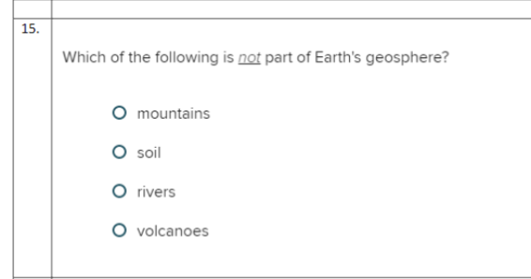

Slide 18
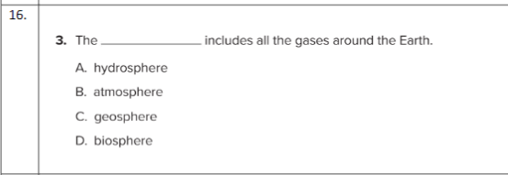

Slide 19
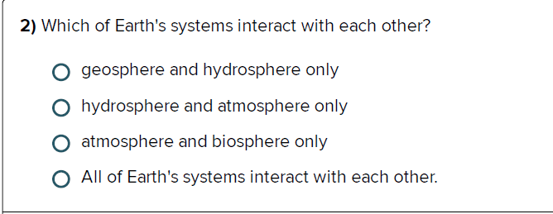
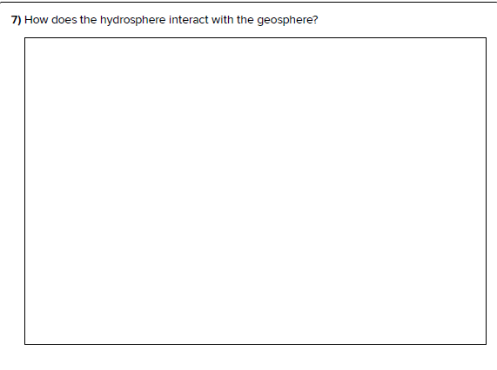


Slide 20
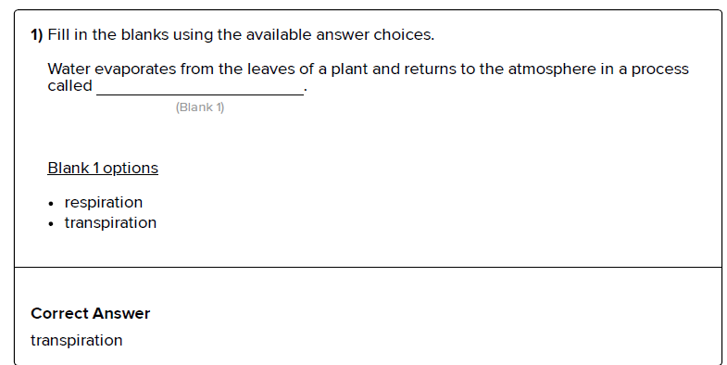

Slide 21
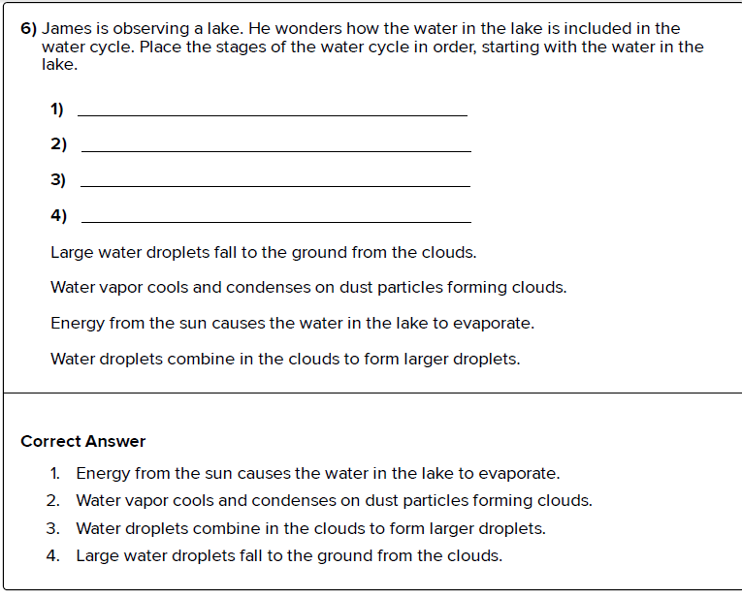

Slide 22


Slide 23
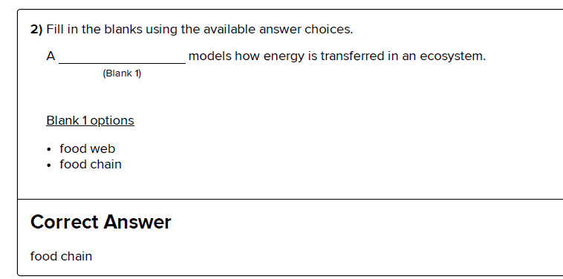

Slide 24


Slide 25
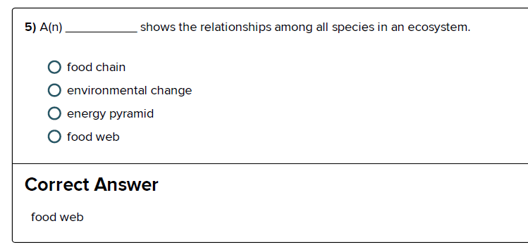

Slide 26
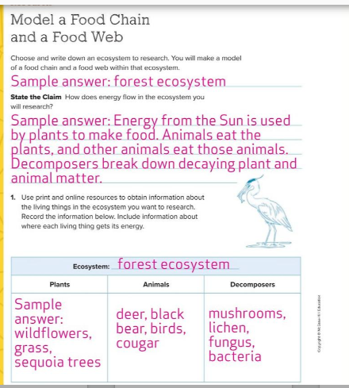

Slide 27
