Slide 1

​Class index​
Class welcome
Class & safety rules ​
Daily Math routine
Outcomes
Starter
Lesson explanation
Main Activity
work evaluation​
Plenary question
Enrichment activity
Welcome to Math’s
Class Grade 4
Ms. Mariam Alnaqbi

Slide 2


​Class index​
Class welcome
Class & safety rules ​
Daily Math routine
Outcomes
Starter
Lesson explanation
Main Activity
work evaluation​
Plenary question
Enrichment activity

Slide 3


​Class index​
Class welcome
Class & safety rules ​
Daily Math routine
Outcomes
Starter
Lesson explanation
Main Activity
work evaluation​
Plenary question
Enrichment activity

Slide 4

​Class index​
Class welcome
Class & safety rules ​
Daily Math routine
Outcomes
Starter
Lesson explanation
Main Activity
work evaluation​
Plenary question
Enrichment activity

Slide 5

​Class index​
Class welcome
Class & safety rules ​
Daily Math routine
Outcomes
Starter
Lesson explanation
Main Activity
work evaluation​
Plenary question
Enrichment activity

Slide 6

​Class index​
Class welcome
Class & safety rules ​
Daily Math routine
Outcomes
Starter
Lesson explanation
Real Word Problem
Differentiation​
Plenary + HOT question
Enrichment activity
Lesson 13-7 : Solve Problems using a perimeter formula
Objectives :

Slide 7

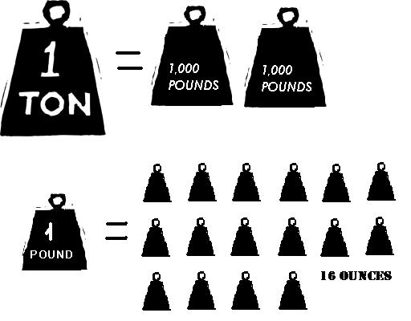
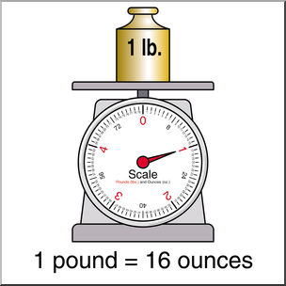
​Class index​
Class welcome
Class & safety rules ​
Daily Math routine
Outcomes
Starter
Lesson explanation
Real Word Problem
Differentiation​
Plenary + HOT question
Enrichment activity
Vocabulary

Slide 8
​Class index​
Class welcome
Class & safety rules ​
Daily Math routine
Outcomes
Starter
Lesson explanation
Real Word Problem
Differentiation​
Plenary + HOT question
Enrichment activity
Book Page:187

Slide 9
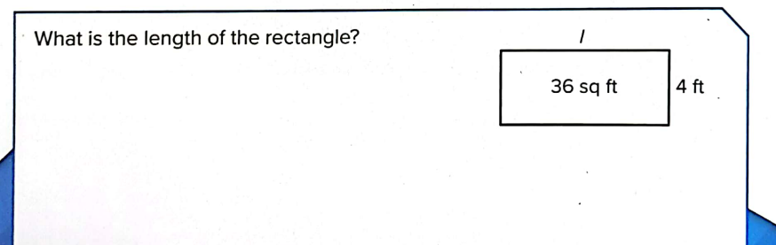
​Class index​
Class welcome
Class & safety rules ​
Daily Math routine
Outcomes
Starter
Lesson explanation
Real Word Problem
Differentiation​
Plenary + HOT question
Enrichment activity
Book Page:192

Slide 10
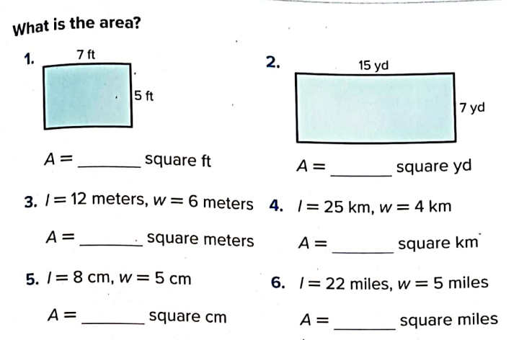
​Class index​
Class welcome
Class & safety rules ​
Daily Math routine
Outcomes
Starter
Lesson explanation
Real Word Problem
Differentiation​
Plenary + HOT question
Enrichment activity
Book Page:193

Slide 11
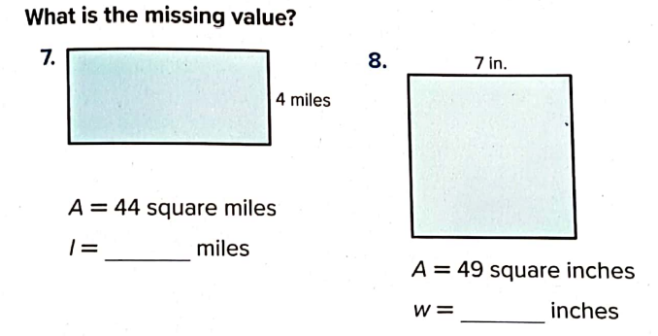
​Class index​
Class welcome
Class & safety rules ​
Daily Math routine
Outcomes
Starter
Lesson explanation
Real Word Problem
Differentiation​
Plenary + HOT question
Enrichment activity
Book Page:193

Slide 12
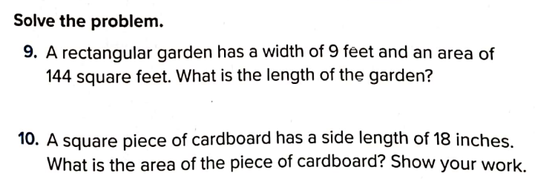
​Class index​
Class welcome
Class & safety rules ​
Daily Math routine
Outcomes
Starter
Lesson explanation
Real Word Problem
Differentiation​
Plenary + HOT question
Enrichment activity
Book Page:193

Slide 13
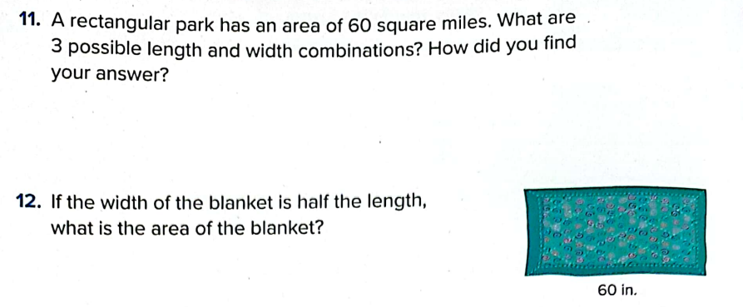
​Class index​
Class welcome
Class & safety rules ​
Daily Math routine
Outcomes
Starter
Lesson explanation
Real Word Problem
Differentiation​
Plenary + HOT question
Enrichment activity
Book Page:194

Slide 14
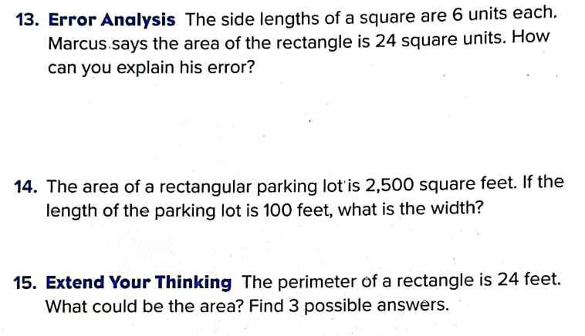
​Class index​
Class welcome
Class & safety rules ​
Daily Math routine
Outcomes
Starter
Lesson explanation
Real Word Problem
Differentiation​
Plenary + HOT question
Enrichment activity
Book Page:194

Slide 15
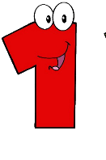


​Class index​
Class welcome
Class & safety rules ​
Daily Math routine
Outcomes
Starter
Lesson explanation
Real Word Problem
Differentiation​
Plenary + HOT question
Enrichment activity
Self Assessment
I can do it and teach it to someone
I can do it but not teach it
I need to practice it more
I didn’t get it

Slide 16

​Class index​
Class welcome
Class & safety rules ​
Daily Math routine
Outcomes
Starter
Lesson explanation
Real Word Problem
Differentiation​
Plenary + HOT question
Enrichment activity
For enrichment you can solve this activities

