Slide 1

Bridge to Success 4 Reading End of Term Exam
Support Materials
Term 3
2021 - 2022

Slide 2

Contents
Lexis
Grammar
Sample Questions
This Photo by Unknown Author is licensed under CC BY

Slide 3
Key Lexis
grandparents | helpful
sister | dangerous
brother | café
mother | school
father | skateboarding
cousin | football
inventor | swimming
robot | baseball
firefighter | sweep the floor
big, huge, enormous | do the dishes
small, tiny | make the bed

Slide 4
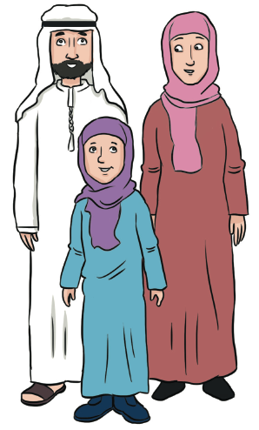
father and mother
Your father and your mother are your parents.

Slide 5
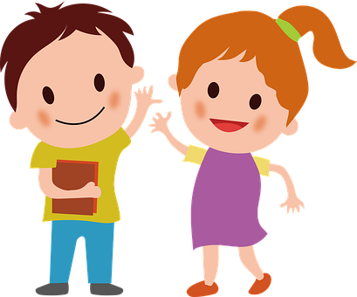
brother and sister
Brothers and sisters are children
who have the same parents.

Slide 6
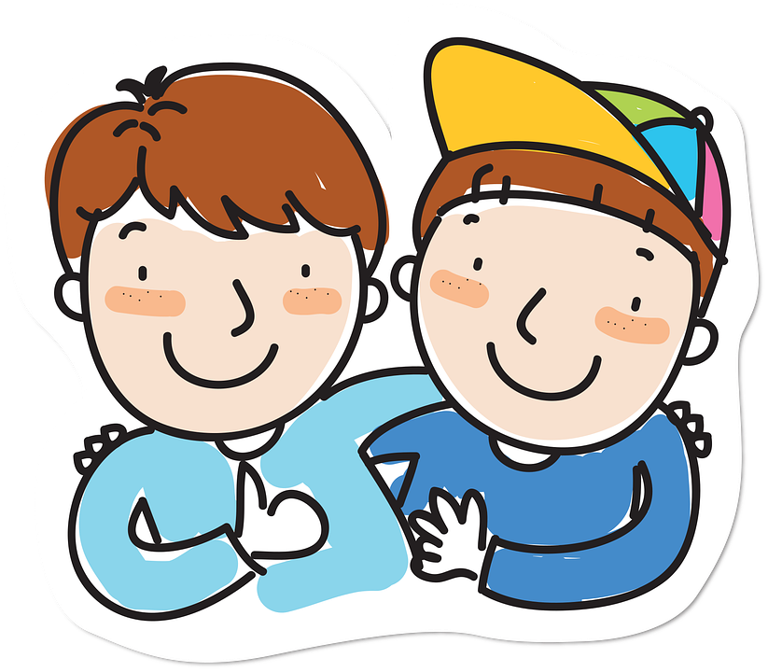
cousins
the children of your aunt or uncle

Slide 7
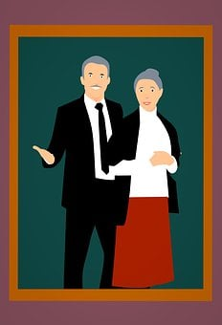
grandparents
your father’s or your mother’s parents

Slide 8
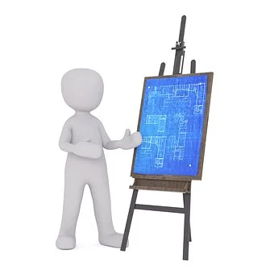
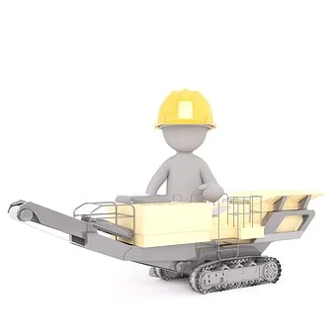
inventor
a person who creates new things that can help people

Slide 9

robot
A thing that can move, do things and sometimes talk.

Slide 10
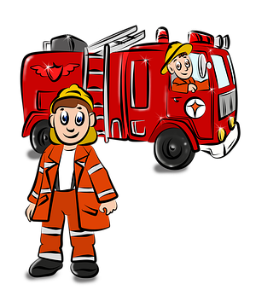
firefighter
a person who saves people from burning buildings

Slide 11

This ball is small.
This ball is big.

Slide 12
This ball is huge.
This ball is enormous.
This ball is tiny.

Slide 13

helpful
A helpful person often does things for others.

Slide 14
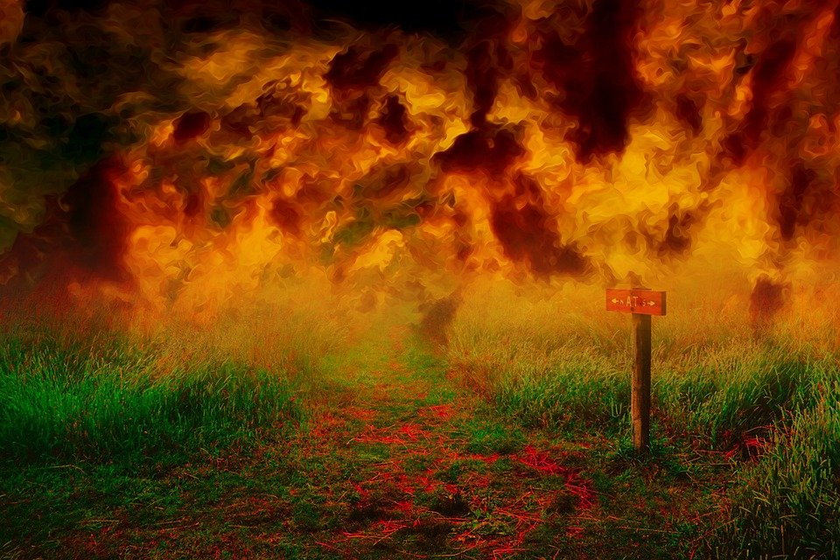
dangerous
In dangerous places people can be hurt.

Slide 15

school
a place where you go every day to study

Slide 16
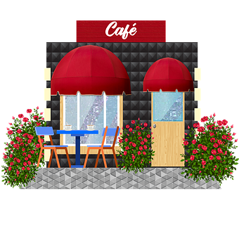
café
a place where you can have some coffee, tea or cake

Slide 17
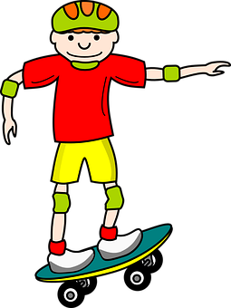
skateboarding
a sport in which you ride on a skateboard

Slide 18
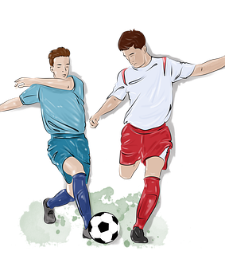
football
a sport in which you kick a ball with your foot

Slide 19

baseball
a sport in which you hit the ball with a bat

Slide 20

swimming
a sport that you do in water

Slide 21
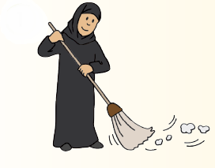
sweep the floor
to clean the floor with a broom

Slide 22
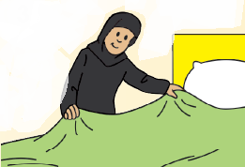
make the bed
to make your bed tidy

Slide 23
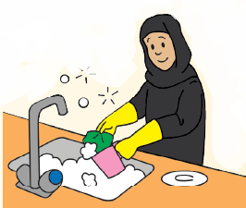
do the dishes
to clean the plates and cups with water and soap

Slide 24
Key Grammar
NELCF Code | Grammatical structure
G.13.1 | Present time: present simple (including the verb ‘to be’)
G.14.2 | Past time: past simple (including the verb ‘to be’)
G.2.3 | Adverbs (frequency)
G.15.1 | Future time: simple future (will and shall)

Slide 25
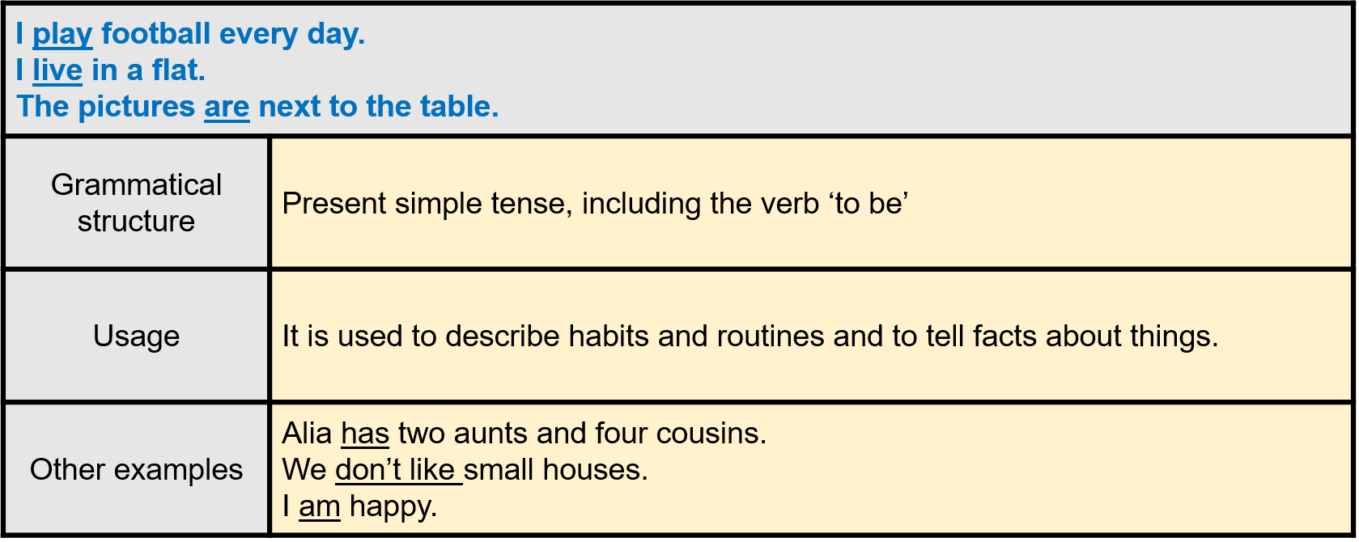

Slide 26
We were at home last night. I went to school yesterday. I saw a camel in the desert.
Grammatical structure | Past time: past simple (including the verb ‘to be’)
Usage | We use it to talk about actions that happened in the past.
Other examples | We played with our cousins. She wasn’t at school yesterday. They didn’t do homework.

Slide 27
My brother never eats chocolate ice-cream. Fatima always helps her mother after school. We usually have pancakes for breakfast.
Grammatical structure | Adverbs (frequency)
Usage | They are used to describe how often people repeat certain actions.
Other examples | Ali usually plays tennis, but sometimes he plays football, too. I often go to a café with my sister. My brothers sometimes watch TV in the evening.

Slide 28
I will play football tomorrow. I shall go shopping next week. The park will open at 9 o’clock.
Grammatical structure | Future time; simple future (will and shall)
Usage | It is used to describe intentions and events that happen in the future.
Other examples | Alia will visit her aunts and cousins this afternoon. We shall buy ice cream for the party. I will be happy when I finish my exam.

Slide 29
Sample Reading Multiple Choice Questions
Read the texts and choose the correct answer A, B or C. There is one example.
Aisha wakes up at 6 AM every day. She eats breakfast at 7 AM and goes to school at 8 AM.
What time does Aisha eat breakfast?
  at 6 AM
  at 7 AM
  at 8 AM
Notes:
Answer: 7 AM

Slide 30
In the morning, Aisha gets dressed and eats pancakes for breakfast. She doesn’t like bread or eggs.
2. Aisha eats ________ for breakfast.
  eggs
  bread
  pancakes
Notes:
Answer: C

Slide 31
Sample Matching Questions
Read the titles. Draw a line to the correct text. Each title can only be used once.
Aisha lives with her family in Ajman. She has three older brothers and five younger sisters. They like to play together.
Rashid likes playing football very much. He usually plays football with his brothers. He never plays football at school.
3. Playing Football
4. Aisha’s Family

Slide 32
Sample MAZE
Read the text and choose the correct word(s) to complete the sentences.
My sister’s name is Alia. She 5. (am / is / are) ten years old. She likes to 6. (play / go / do) swimming. She is 7. (angry / sad / friendly), so she has many friends.

Slide 33
Sample MAZE: answers
My sister’s name is Alia. She 5. (am / is / are) ten years old. She 6. (wakes / catches / goes) up early every day. She is 7. (angry / sad / friendly), so she has many friends.

