Slide 1

Bridge to Success 4
Reading End of Term Exam
Term 1
2022 - 2023

Slide 2

Contents
Lexis
Grammar
Sample Questions
This Photo by Unknown Author is licensed under CC BY

Slide 3
Key Lexis
family | mountains
parents | wolves
sister and brother | classroom
impolite / polite | coloured pencils
mammal | glue
desert | scissors
camel | cut out
hump | climb
camping trip | carry

Slide 4
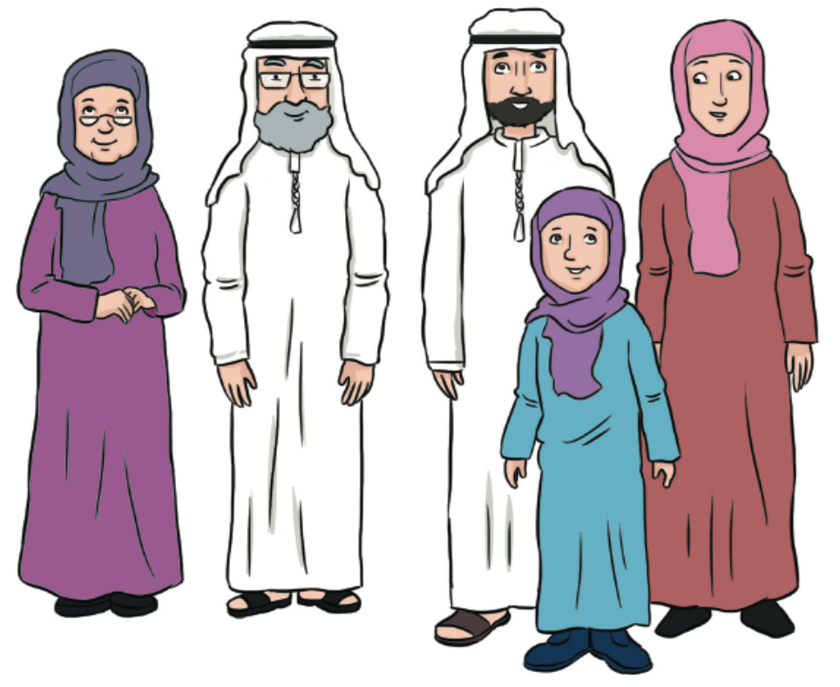
family
Your family are the people who are closest to you.

Slide 5
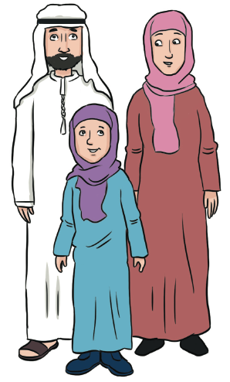
parents
your father and your mother

Slide 6
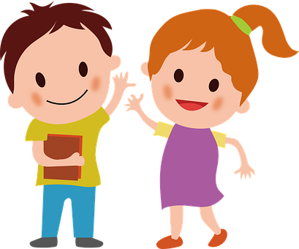
brother and sister
Brothers and sisters are children
who have the same parents.

Slide 7
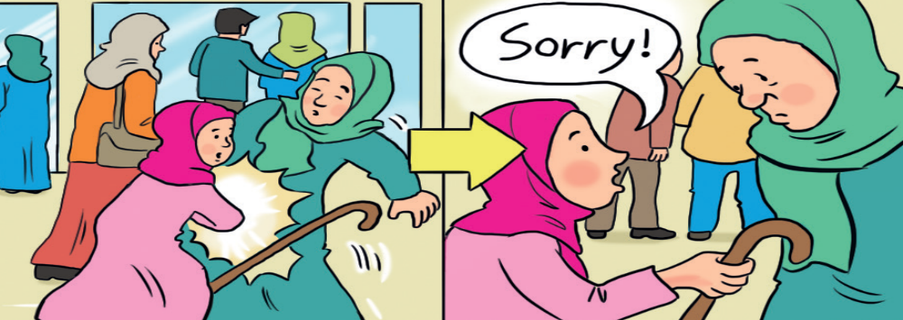
impolite / polite
Impolite people are not nice and don’t say “sorry” or “thank you.”
Polite people are kind and say “sorry” and “thank you.”

Slide 8

mammal
a warm-blooded animal with fur or hair on its skin and a skeleton inside its body

Slide 9
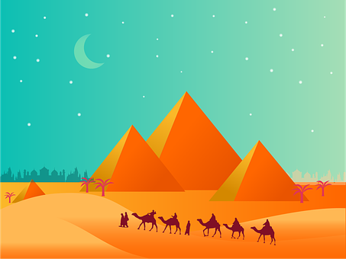
desert
a very hot place with a lot of sand. It is difficult to find water there

Slide 10
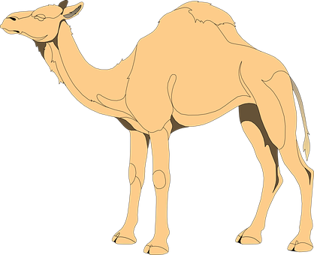
camel
an animal that can spend a lot of time in the
desert without drinking water

Slide 11
hump
It is the part of the camel’s body that is on its back.
It is made of fat.

Slide 12
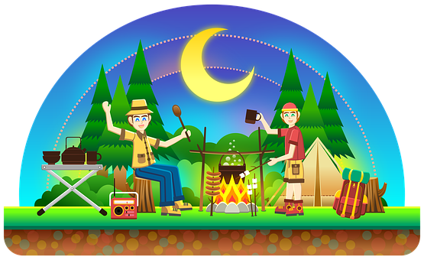
camping trip
when you travel and sleep in a tent

Slide 13
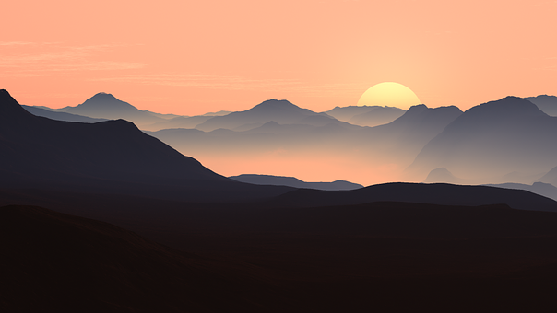
mountains
an area with high land that goes up and down

Slide 14
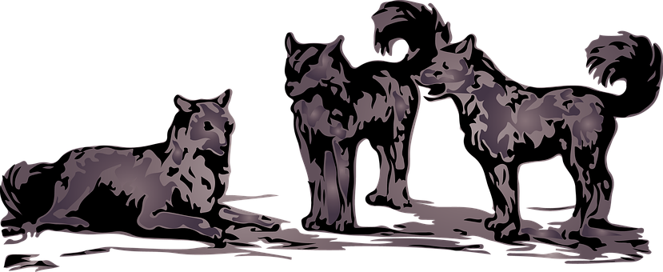
wolves
They are animals that lived in the desert in the UAE.
They look like dogs.

Slide 15
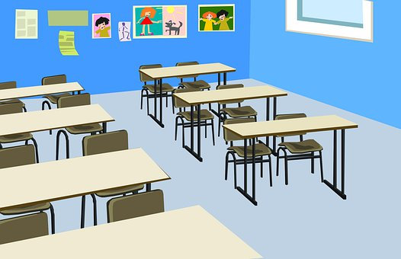
classroom
a room in a school where you learn together
with your teacher and your classmates

Slide 16

coloured pencils
pencils that you use to draw and colour pictures

Slide 17

glue
used to stick two things together

Slide 18

scissors
used to cut by opening and closing them

Slide 19
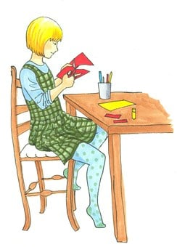
cut out
to cut paper into different shapes

Slide 20
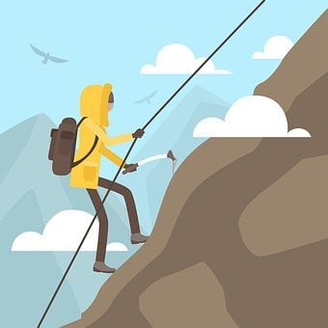
climb
to move up a mountain, up the stairs, up a tree, etc.

Slide 21
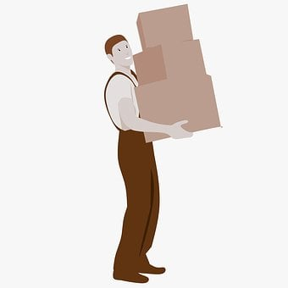
carry
to lift and move things to a different place

Slide 22
Key Grammar
NELCF Code | Grammatical structure
G.13.2 | Present time (present continuous)
G.14.2 | Past time (past simple including the verb ‘to be’)
G.12.1 | Prepositions (place)
G.16.1 | Pronouns (personal / subject pronouns)
G.16.2 | Pronouns (object pronouns)
G.2.3 | Adverbs (frequency)

Slide 23
They are carrying boxes to the table. Some girls are drawing. He is climbing the wall.
Grammatical structure | Present time (present continuous)
Usage | It is used to describe what somebody is doing at the time of speaking.
Other examples | Alia is helping her mother. We aren’t watching TV, we are studying. I am reading a book.

Slide 24
We were at home last night. I went to school yesterday. I saw a camel in the desert.
Grammatical structure | Past time (past simple including the verb ‘to be’)
Usage | Used to talk about actions that happened in the past.
Other examples | We played with our cousins. She wasn’t at school yesterday. They didn’t do homework.

Slide 25
I am behind the table. Sarah’s house is near the school. The teacher is in front of the class. The pictures are next to the table.
Grammatical structure | Prepositions (place)
Usage | Used to describe where people and things are.
Other examples | The ball is under the chair. My bed is between the wall and the wall. The book is on the desk.

Slide 26
My book is blue. → It is blue. My brothers are at school. → They are at school. Laila is kind. → She is kind.
Grammatical structure | Pronouns (personal / subject pronouns)
Usage | Used in place of the proper noun or noun to show who performs the action.
Other examples | Is the elephant big? → Is it big? Ali is sad. → He is sad. Amna and Aisha like apples. → They like apples.

Slide 27
I like this book. → I like it. My mother is giving the children breakfast. → My mother is giving them breakfast. He saw the girl on the street. → He saw her on the street.
Grammatical structure | Pronouns (object pronouns)
Usage | Used in place of a proper noun or a noun to describe who or what is acted upon by the subject of the sentence.
Other examples | Can you ask Ahmed? → Can you ask him? My brother is doing homework. → My brother is doing it. I know Aisha. → I know her. I will call my mother and father. → I will call them.

Slide 28
My brother never eats chocolate ice-cream. Fatima always helps her mother after school. We usually have pancakes for breakfast.
Grammatical structure | Adverbs (frequency)
Usage | Used to describe how often people repeat certain actions.
Other examples | Ali usually plays tennis, but sometimes he plays football too. I often go to a café with my sister. My brothers sometimes watch TV in the evening.

Slide 29
Sample Reading Multiple Choice Questions
Where do Hanan’s grandparents live?
  Dubai
  Abu Dhabi
  Ras al Khaimah
Hanan lives in Ras al Khaimah. She sometimes goes with her family to Abu Dhabi, but they usually go to Dubai to visit her grandparents.

Slide 30
Sample Reading Multiple Choice Questions
2. What is Eman doing?
  cutting
  sticking
  colouring
Haneen is cutting out pictures and sticking them to the poster. Eman isn’t sticking the pictures because she has no glue. She is colouring them.

Slide 31
Sample Matching Questions
3. Ali went camping with his family. It was hot and sunny. Their tents were next to sand dunes. They saw an oryx.
4. Hoor lives with her parents and her grandparents. She has five brothers and five sisters. She likes spending time with them.
A. A Big Family
B. A Trip to the Desert

Slide 32
Sample MAZE
Ahmed and his friends 5. ( am / is / are ) doing activities at school. Ahmed is 6. ( passing / climbing / carrying ) up a ladder and his friend Rashid is tying a 7. ( rope / road / read ). Ali and Yousef want to cut out some pictures, so Mohammed is sharing 8. ( pencils / papers / scissors ) with them.

Slide 33
Sample Question Answers
1. A
2. C
3. B
4. A
5. are
6. climbing
7. rope
8. scissors

