Slide 1
QUESTION 1:What are the basic needs of plants? Select all that apply
A- Shelter
B- Air
C- Sugar
D- Water
E- Space

Slide 2
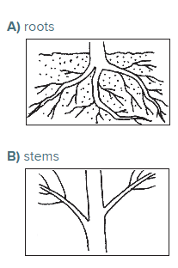
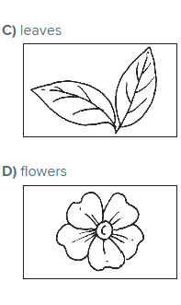
QUESTION 2 – Which part of the plant makes most of the plant’s food?

Slide 3
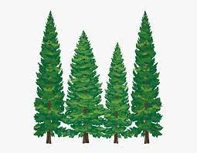
QUESTION 3
Pine Trees can reproduce with_______that produce pollen or a sticky liquid that captures pollen
A-Cones
B- Stamens

Slide 4
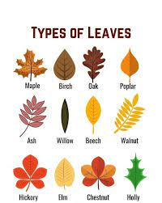
QUESTION 4: Why do plants found in hot, dry areas often have smaller leaves than plants found in warm, wet areas?
A)Smaller leaves allow plants to grow in smaller spaces.
B)smaller leaves limit the amount of transpiration that occurs.
C)Smaller leaves help plants to take in more water through transpiration.
D)Smaller leaves allow plants to give off more water through transpiration.

Slide 5
QUESTION 5: Which plant part plays the biggest role in supporting the plant?
A)stem
B)leaf
C)seed
D) flower

Slide 6
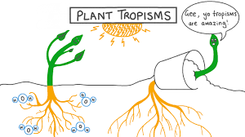
QUESTION 6:
Which is true about tropisms?
A)They are a plant part
B)they are a stimulus
C) they help plants get what they need
D)they are where plants make food

Slide 7
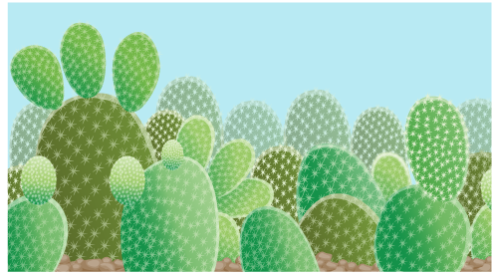
QUESTION 7
Which is an adaptation used by this plant to survive in a hot, dry environment?
A)thick stems to hold water
B)deep roots to soak up the rain
C)flat surface that faces the sun
D)white thorns to attract animals
A

Slide 8

QUESTION 8:
Flowers contain structures that are responsible for which process?
A)germination
B)reproduction
C)respiration
D)transpiration
B

Slide 9
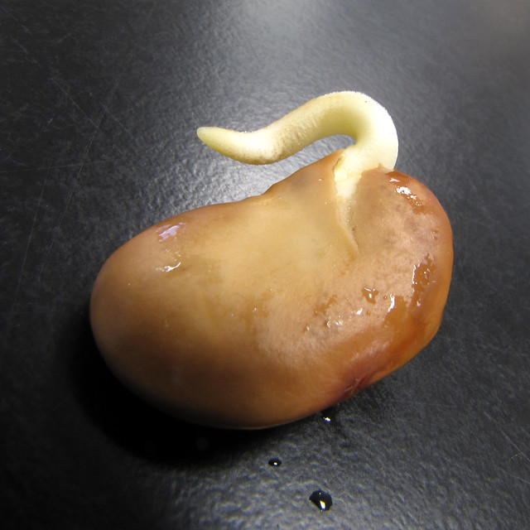
QUESTION 9
What is the function of the seed coat?
A)It protects the new plant
B)it contains food
C)it attracts animals
D)it performs respiration
A

Slide 10
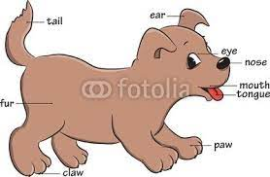
Lesson Check: Structures and Functions of Animals

Slide 11
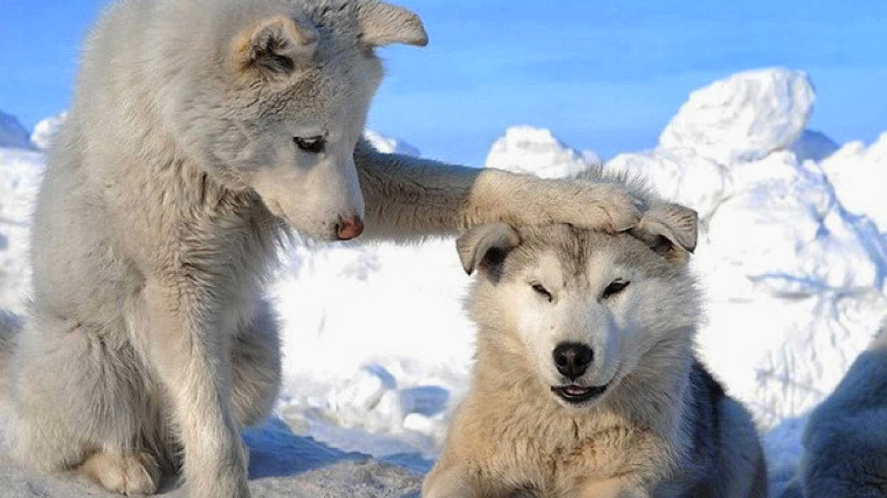
QUESTION 1
Which of the following is an internal structure in animals?
A) )fur
B)lungs
C)scales
D)claws
B

Slide 12
QUESTION 2
Which feature is not used to help animals stay safe?
A)strong jaws
B)lungs
C)shells
D)scales
B

Slide 13
QUESTION 3
Which of the following is a structural adaptation used to help animals move?
A)lungs
B)fur
C)wings
D)gills
C

Slide 14
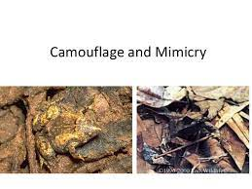
QUESTION 4
The brown coat of a deer helps it blend in with its wooded environment. This adaptation is called
A- Camouflage
B- Mimicry
A

Slide 15
Question 5
Which is not an example of how internal structures function to support an animal's survival?
A)The brain process information.
B)Teeth help animals chew food.
C)The heart pumps blood.
D)The stomach digests food.
B

Slide 16
QUESTION 6
Which are internal structures of an animal? Select all that apply.
A)brain
B)beak
C)heart
D)teeth
A-C

Slide 17
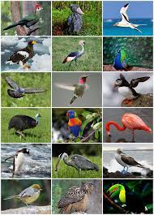
QUESTION 7
Which feature do all birds have in common?
A)powerful claws
B)strong beaks
C)feathers
D)teeth
C

Slide 18
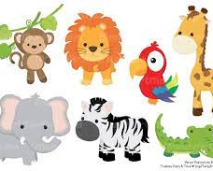
Lesson Check: Information Processing in Animals

Slide 19
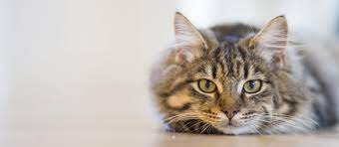
QUESTION 1
Cats have a strong sense of smell and rely on it for important activities. How might the cat's sense of smell help it survive?
A)The scent of a mouse causing it to hunt
B)The shape of a mouse causing it to hunt.
C)The shape of a dog causing it to hunt.
D)The scent of a dog causing it to hunt.
C

Slide 20
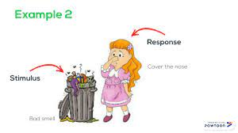
QUESTION 2
Something in the environment that causes a living thing to respond is a
A)Stimulus
B)Reaction
A

Slide 21
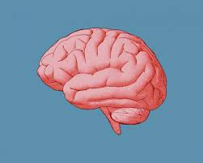
QUESTION 3
The brain is part of which system?
A) circulatory system
B)central nervous system
C)peripheral nervous system
D)digestive system
B

Slide 22
QUESTION 4
Which of the following is not true about an animal that damages its eyes?
A)If the animal is a predator, it might have a more difficult time hunting with worse vision.
B)An animal that loses some or all of its vision will not have any disadvantages surviving compared to a healthy animal.
C)If the animal is a prey animal, it could be prevented from seeing when a predator is approaching.
D)The animal might rely more on its sense of smell and hearing to make up for its lost vision.
B

Slide 23
QUESTION 5
Which are directly connected to the peripheral nerves?
A)Skin, Teeth, Ears
B)Nose, teeth, Mouth
C)Skin, Tongue, Nose
D)teeth, Nose, Skin
C

Slide 24
QUESTION 6
Abigail is conducting research on the nervous system. She has found that an animal's response is coordinated by the central nervous system.
Which statement helps Abigail explain how the body reacts to a stimulus?
A) Sensory organs are not part of the nervous system.
B)Different sensory receptors can detect different types of stimulus from the environment.
C)All animals have the same reaction to a stimulus.
D)Peripheral nerves are part of the central nervous system and send messages to the brain.
B

Slide 25

QUESTION 7
A_____is a quick reaction that happens without a message from the nervous system.
A)Reflex
B)Stimulation
A

Slide 26
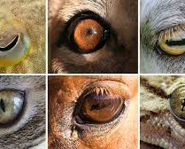
Lesson Check: Role of Animals’ Eyes

Slide 27
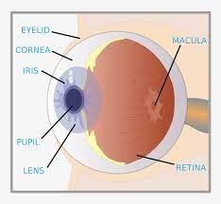
QUESTION 1
Which structure is at the back of the human eye where light through the lens is focused?
A)cornea
B)pupil
C)retina
D)rod
C

Slide 28
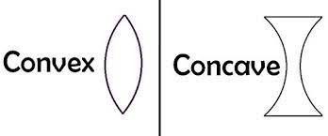
QUESTION 2
A ______ lens is thinner in the middle and always makes objects look smaller.
A) concave
B)convex
C)translucent
D)Opaque
A

Slide 29
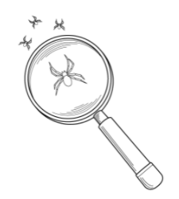
QUESTION 3
The magnifying glass is a_________ lens that causes the image to appear bigger up close.
A)Concave
B)Convex
B

Slide 30
QUESTION 4
Why is Maria able to see more objects in a dark room when a light shines through a clear plastic bag than when a light shines through a brown paper bag?
A)More light is reflected into Maria's eyes when it shines through the clear plastic bag.
B)More light is scattered into Maria's eyes when it shines through the clear plastic bag.
C)More light is refracted into Maria's eyes when it shines through the clear plastic bag.
D)More light is transferred into Maria's eyes when it shines through the clear plastic bag.
C

Slide 31
QUESTION 5
Light enters through_____. The _______sends signals to the brain to be interpreted as images.
A)Retina, Cornea
B) Cornea, Retina
C

Slide 32
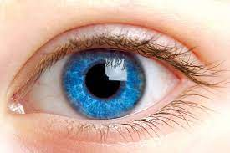
QUESTION 6
Farrah injured one of her eyes while playing in a sandbox. Since her injury, her vision is very blurry. Which statement possibly explains why the blurriness is occurring?
A)Her eye is not focusing light properly.
B)Her eye is absorbing too much light.
C)Her eye is reflecting too much light.
D)Her eye is blocking some light.
A

Slide 33
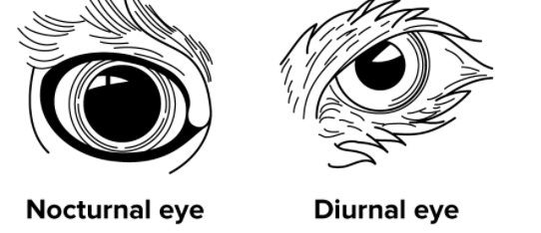
QUESTION 7
Nocturnal animals can see better at night because their_____is dilated and allows more light to reach the back of the eye.
A)Retina
B)Pupil
B

Slide 34
QUESTION 8
Which statement helps explain the position of eyes on predators?
A)Forward-facing eyes allow predators to detect prey approaching from the sides.
B)Sideways-facing eyes allow predators to have a wider field of view to locate prey.
C)Sideways-facing eyes allow predators to see prey at night.
D)Forward-facing eyes allow predators to judge the distance and depth of objects.
C

Slide 35

Lesson Check: Information Transfer

Slide 36
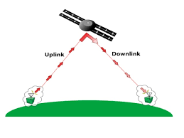
QUESTION 1
A signal, such as a phone call, that is sent to a communications satellite by radio waves is called a/an
A)Uplink
B)Downlink
A

Slide 37
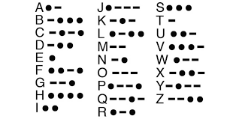
QUESTION 2
__________is a code in which letters are represented by a combination of short and long signals with light or sound.
A)Morse code
B)Binary Code
C)Coding
D)Signals
A

Slide 38

QUESTION 3
______ can be used to transmit information.
A)Heat
B)Patterns
C)Senses
D) Digital
B

Slide 39
QUESTION 4
Select all of the answer choices that demonstrate energy being transferred by sound.
A)a flashlight being turned on
B)a balloon popping
C)the siren blaring on a fire engine
D)knocking on someone's door
E)riding a bus instead of driving
F)the dinging bell on a microwave
G)conserving water
H)a car engine moving a car
Write your answer on your whiteboard.
B,C,D,F

Slide 40
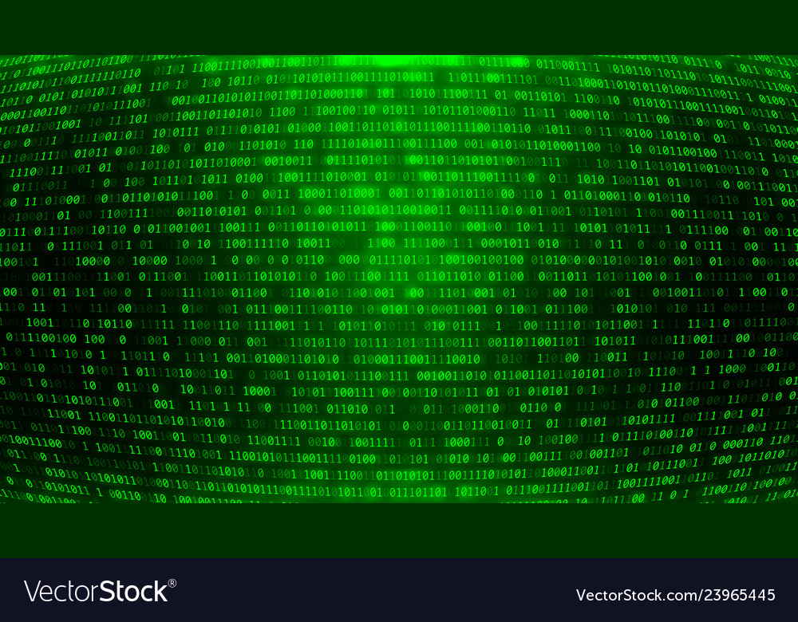
QUESTION 5
Computers use ______code to transmit information.
A)Coding
B) Binary code
B

Slide 41
QUESTION 6
Which of the following was not used to transmit information using Morse Code?
A) a telegraph
B)a flashlight
C)pencil and paper
D)a sundial
D

Slide 42
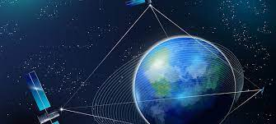
QUESTION 7
Communication satellites use ______ sent by a transmitting station to transmit signals over long distances.
A) microwaves
B)polar waves
C)light
D)radio waves
D

Slide 43
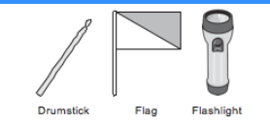
QUESTION 8
Mario and Rachel live on opposite sides of a busy street. They are learning how to use the tools shown to send messages to each other.
Which tool can Mario use to send Rachel a message?
B, C
A | B | C | D-ALL

Slide 44
Module Pretest: Information Processing and Transfer

Slide 45
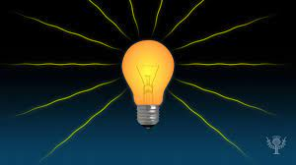
QUESTION 1
Light is a form of energy that ______.
A)does work
B)lets you see
C)you can hear
B

Slide 46
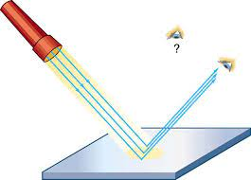
QUESTION 2
We see objects when , _______
bounces off of the surface of the object.
A)Light
B) Sound
A

Slide 47
QUESTION 3
Which of the following can be used to transmit information using Morse Code? Select all that apply.
A) Flags
B)A sundial
C)A flashlight
D)A telegraph
C,D

Slide 48

QUESTION 5
How high or low a sound is can be described by its
A) Sound
B)Volume
C)Pitch
D)Tone
C

Slide 49
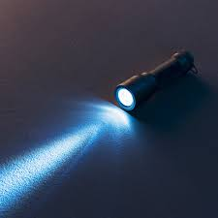
QUESTION 6
You walk into a very dark room. What would happen if you turn on a flashlight?
A)I would be able to see objects that are shiny.
B)I would be able to see objects that are illuminated by the beam of light.
C)I would be able to see objects that are opaque.
D)I would be able to see bright colored objects.
B

Slide 50
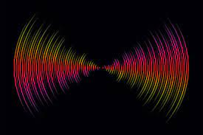
QUESTION 7
Sound energy travels in _____
A) microwaves
B)Waves
C)Beams
D)Pulses
B

Slide 51
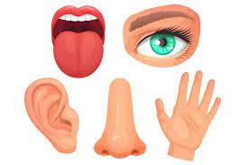
QUESTION 8
Animals use _____organs to gather information from outside the body.
A) Sound
B)Taste
C)Sensory
C

Slide 52
Module Pretest: Structures and Functions of Living Things

Slide 53
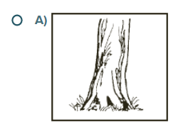
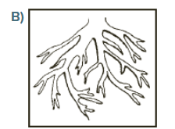
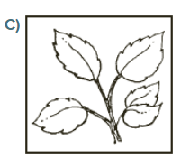
QUESTION 1
Which part helps a plant get water?

Slide 54
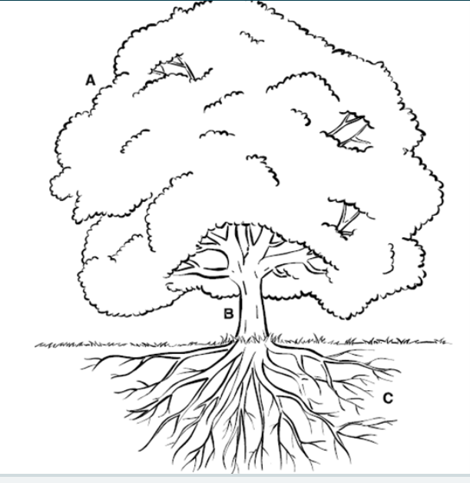
QUESTION 2
What is the function of Part A?
A)taking in sunlight
B)taking in water
C)searching for nutrients

Slide 55
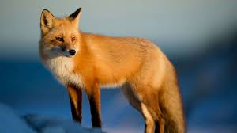
QUESTION 3
An fox can use its______to catch its prey.
A) Teeth
B)Ears

Slide 56
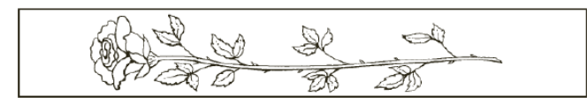
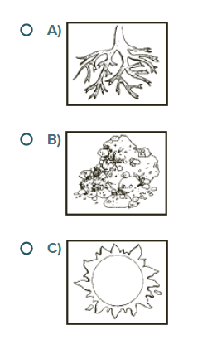
QUESTION 5
Which part of the plant is missing?

Slide 57
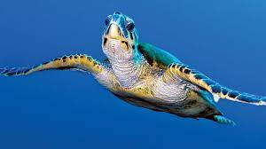
QUESTION 6
What does a turtle need to live?
A)food only
B)food, water, air, and shelter
C)food and air
B

Slide 58
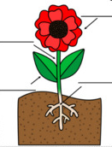
QUESTION 7
________take in water and nutrients from the soil.
A) Branches
B)Roots
C)Leaves
D)Flowers
B

Slide 59
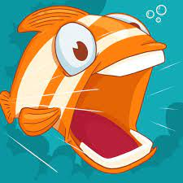
QUESTION 8
What body part does a fish use to breathe?
A) Eyes
B)Lungs
C)Gills
C

Slide 60
QUESTION 9
Why do bears have sharp claws?
A)to help them smell their food
B)to help them catch their food
C)to help them see their food
B

