Slide 1

Emirates Schools Establishment Assessment Unit
Bridge to Success 3
English Listening End of Term Exam
Term 2 2022
Term 2 Academic Year 2021-2022

Slide 2

Emirates Schools Establishment Assessment Unit
Contents:
Part 1: Preparation - Vocabulary
Part 2: Preparation- Grammar and Functional language.

Slide 3
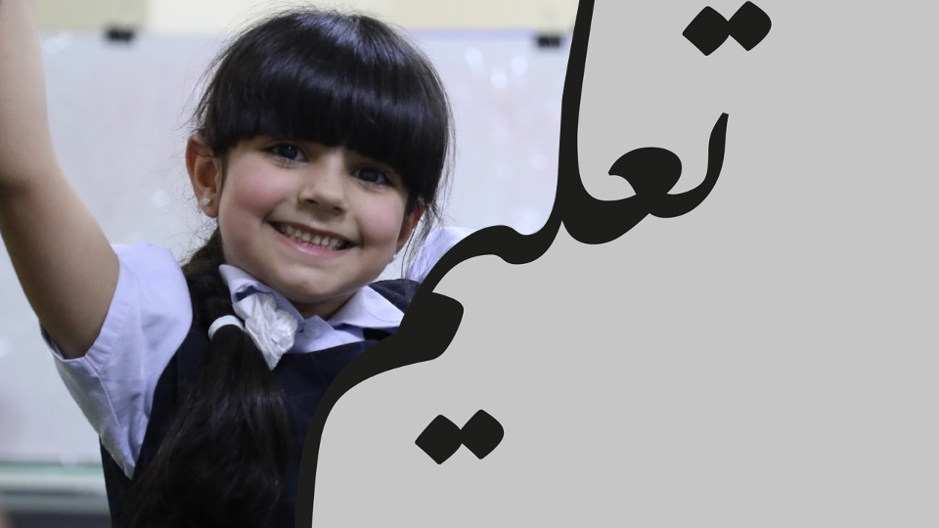
Part 1: Preparation – Vocabulary.
Learn these words for the listening task.

Slide 4

Centimeter
A measurement of length

Slide 5
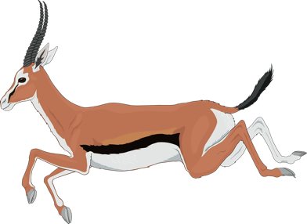
Antelope
An animal with horns, a long neck and long legs

Slide 6
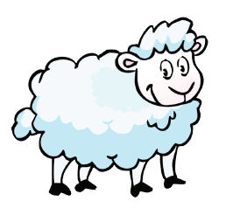
Sheep
A farm animal with soft, curly hair

Slide 7

Butterfly
An insect with four large wings

Slide 8
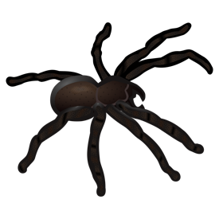
Spider
An arachnid with 8 legs.

Slide 9

Ant
An insect with 6 legs.

Slide 10

Bee
An insect with wings that makes honey.

Slide 11

Fly
An insect with wings

Slide 12

Litter
Things that go into a bin

Slide 13
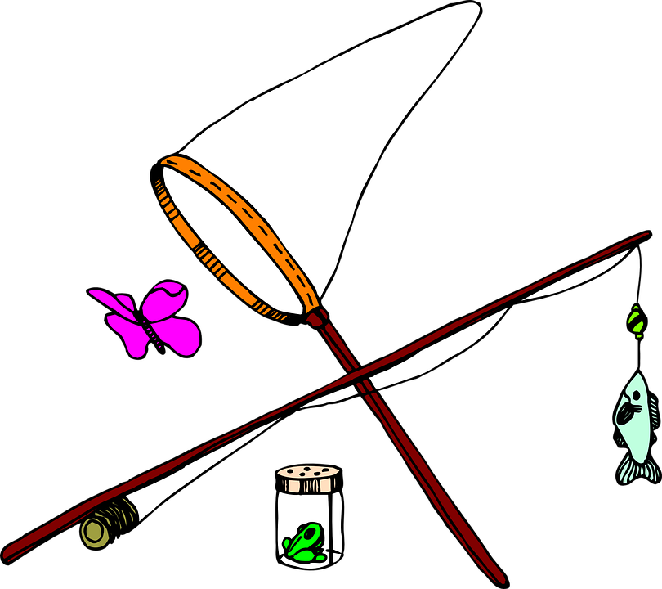
Catch
To get hold of something

Slide 14

Branch
A part of a tree

Slide 15

Leaves
A green part of a tree

Slide 16

Water plants
To pour water over plants to help them grow

Slide 17

Grass
Tall green leaves

Slide 18

Seconds
A measurement of time
60 seconds in one minute

Slide 19
Minutes
A measurement of time
60 minutes in one hour

Slide 20
Hour
A measurement of time
24 hours in one day

Slide 21
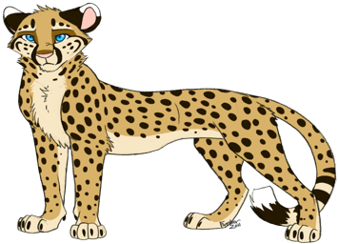
Leopard
An animal that can run quickly

Slide 22

Alligator
An animal that has sharp teeth

Slide 23
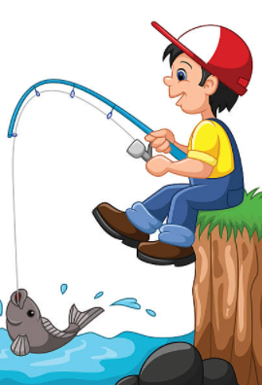
Fishing
To catch fish

Slide 24
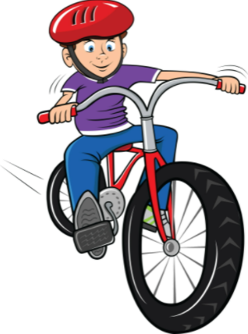
Cycling
To ride a bike

Slide 25

Bin
A place to put waste

Slide 26

Paper
Something to write on

Slide 27

Plant
Something that has a stem and leaves

Slide 28
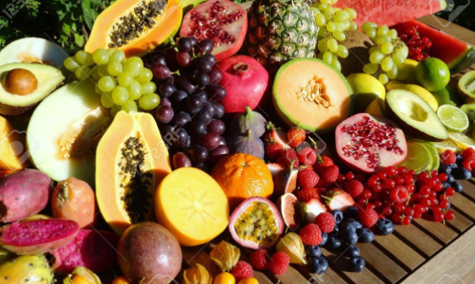
Fruit
Something that grows on a tree and you can eat

Slide 29

Wood
The hard part of a tree or branch

Slide 30

Beetle
An insect with wings and sometimes spots

Slide 31
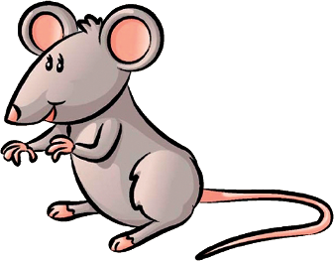
Mouse
A small animal with big ears and a long tail

Slide 32

Worm
An animal with no arms or legs

Slide 33
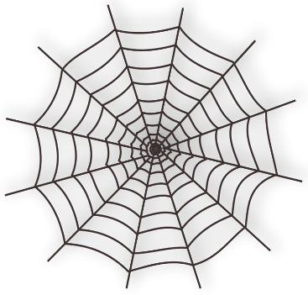
Web
Something that a spider makes

Slide 34
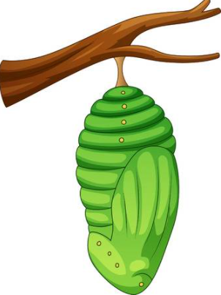
Cocoon
Something that a caterpillar makes

Slide 35
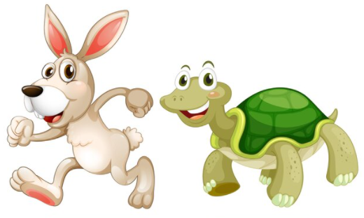
Slow
Not fast

Slide 36
Fast
To move quickly

Slide 37
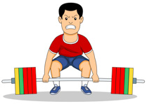
Heavy
To weigh a lot

Slide 38

Light
To weigh a little

Slide 39
Part 2: Preparation – Grammar

Slide 40
Key Grammar
NELCF Code | Grammatical structure
G.4.3 | Clauses and Phrases: Imperatives
G.7.5 | Determiners: Quantifiers
G.17.2 | Questions: Wh questions

Slide 41
Go and play outside. Put that in the bin. Sit down.
Grammatical structure​ | Clauses and Phrases: Imperatives
Usage​ | Words that give a command.
Other examples​ | Put that butterfly down. Stand over there. Get your fishing net.

Slide 42
She ate some bread. There are many people here. There are a lot of butterflies.
Grammatical structure​ | Determiners: Quantifiers
Usage​ | Words that show the amount of something.
Other examples​ | I have some sweets. I can see many dogs. There are a lot of leaves.

Slide 43
Where is the book? The book is under the chair. What is your name? My name is Aisha Who is your teacher? My teacher is Mr. Jones
Grammatical structure | wh - questions
Usage | They are used to ask questions. What – for things Where – for places Who – for people Why – for reasons When – for time
Other examples | What shape is it? It is round. When is English class today? English class is at 10 o’clock. Why do you like reading books? I like reading books because I can learn many things.

Slide 44
Key Functional Language
NELCF Code | Functional Language Topic
FL.7 | Describing objects
FL.4 | Using numbers to express amount, quantity, number and time

Slide 45
Describing objects (measurememt)
Lexis | Centimeters, meters, fruit, leaves, paper, wood
Examples | The snake is 3 meters long. The butterfly is 4 centimeters. My finger is 3 centimeters long. This tree has fruit. The plane is made out of paper. The leaves fell from the tree. The man cut the wood.

Slide 46
Using numbers to express amount, quantity, number and time
Lexis | Five,ten, twenty, thirty, forty, fifty, sixty, seventy, eighty, ninety, one hundred
Examples | The snake is two meters long. The butterfly is four centimeters. The tree is 10 meters high. I can catch five flies.

Slide 47


Well Done!

Slide 48



Follow us
ese.ae
Ese_ae

