Slide 1

Bridge to Success 4
Reading and Writing End of Term Exam
Term 3
2022 - 2023

Slide 2

Contents
Lexis
Grammar
Sample Questions
This Photo by Unknown Author is licensed under CC BY

Slide 3
Key Lexis
robot | grandpa
scientist | playground
inventor | classroom
to measure | football
tiny | diving
enormous | horse riding
helpful | to mop the floors
to look after | to do the washing up
to grow up | to make the bed
strong | brave

Slide 4
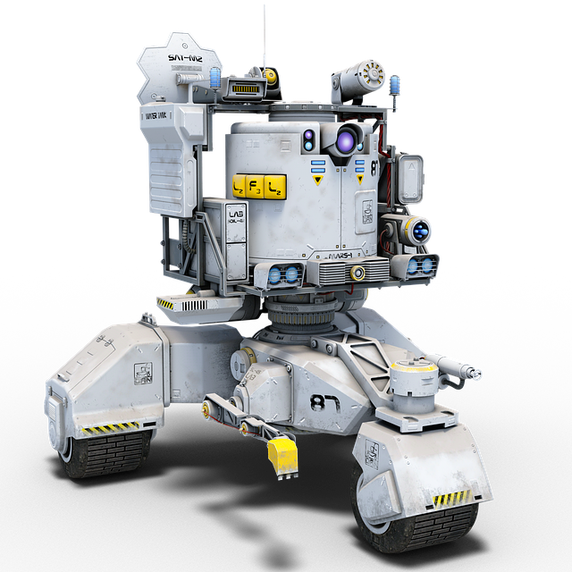
robot
a machine that can move and do things for people

Slide 5
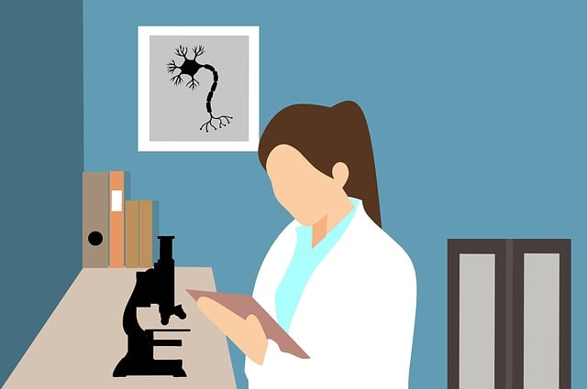
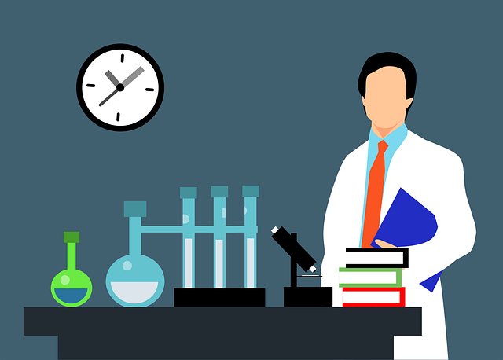
scientist
a person whose job is to learn new things about science

Slide 6
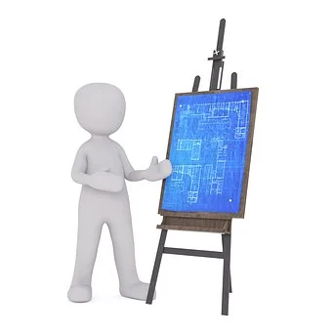
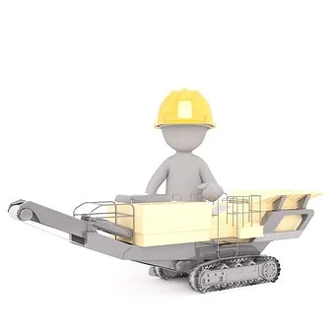
inventor
a person that creates new things that can help people

Slide 7
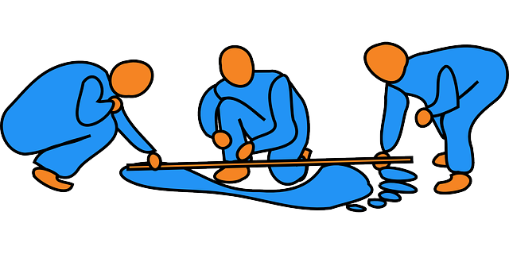
to measure
to check how big, heavy or long something is

Slide 8

tiny / enormous
This ball is tiny.
This ball is enormous.

Slide 9

strong
a person or thing that has a lot of power

Slide 10
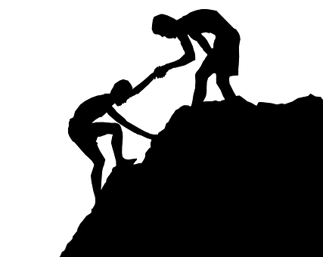
helpful
a helpful person often does things for others

Slide 11
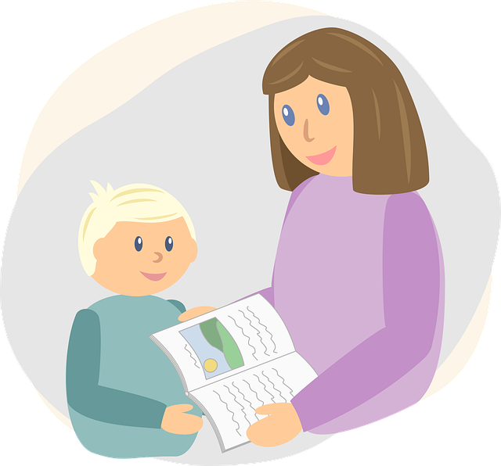
to look after somebody
to spend time with someone and make sure they have everything they need

Slide 12

to grow up
A child grows up and becomes an adult.

Slide 13
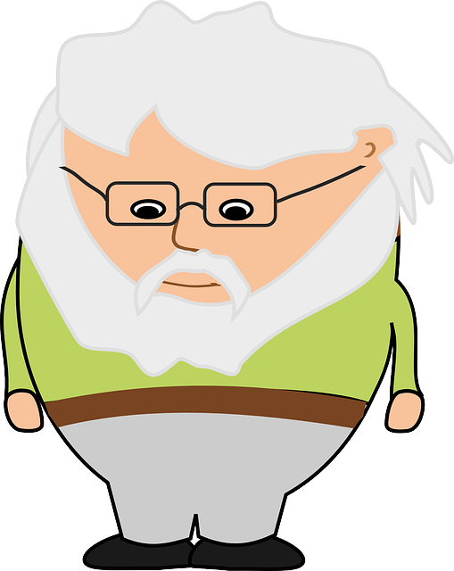
grandpa
your mother’s or father’s father

Slide 14
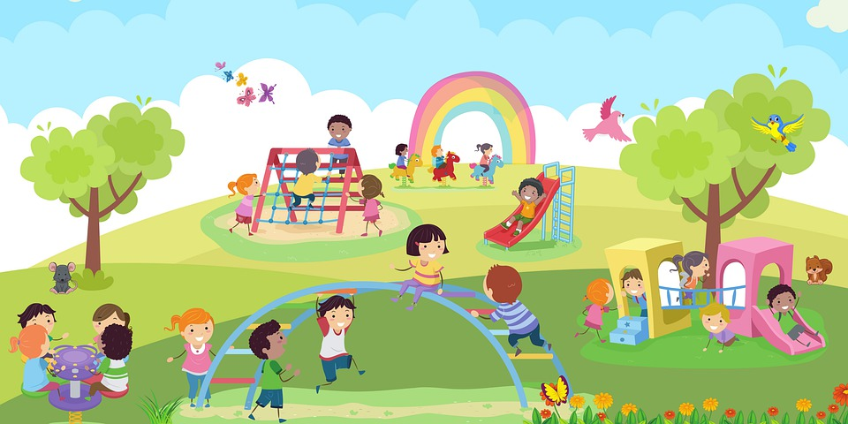
playground
space outside where you can play

Slide 15
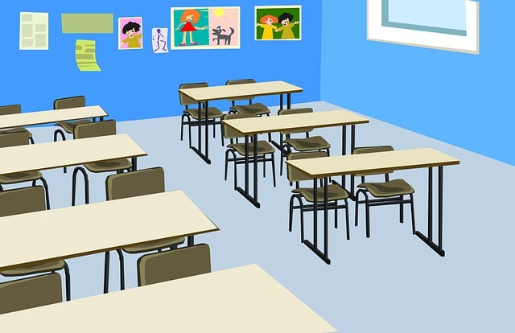
classroom
a room at school where you study

Slide 16
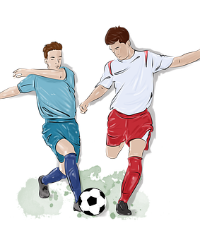
football
a sport in which you kick a ball with your leg

Slide 17
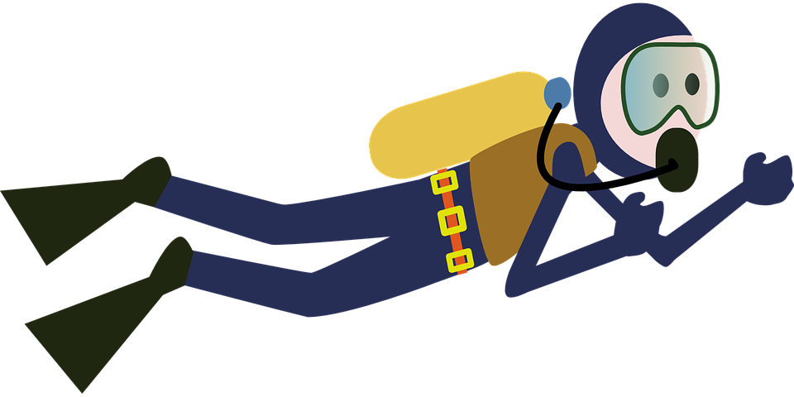
diving
a sport in which you swim underwater

Slide 18
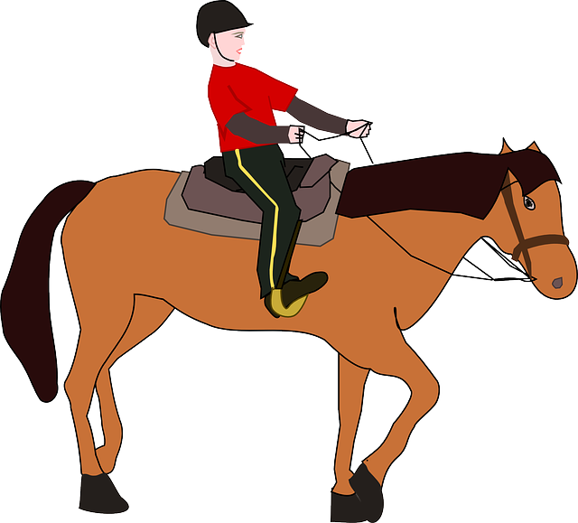
horse riding
a sport in which you ride on the back of a horse

Slide 19
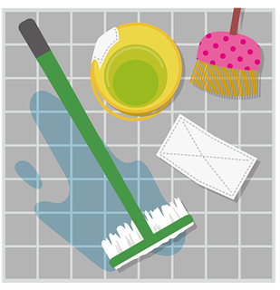
to mop the floors
to clean the floor with a mop, soap and water

Slide 20
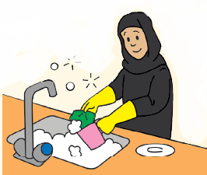
to do the washing up
to clean the dishes with soap and water

Slide 21
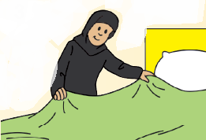
to make the bed
to make your bed tidy in the morning

Slide 22
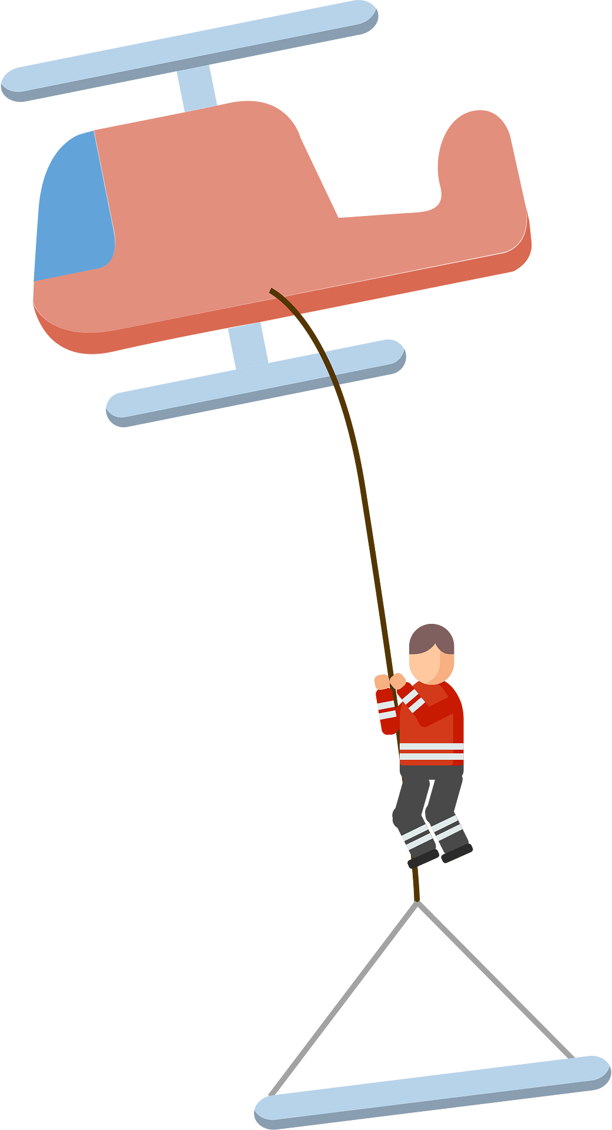
brave
when you are not frightened by something dangerous

Slide 23
Key Grammar
NELCF Code | Grammatical structure
G.13.1 | Present time: present simple (including the verb ‘to be’)
G.2.3 | Adverbs (frequency)
G.15.1 | Future time: simple future “will” and “shall”

Slide 24
I play football every day. I live in a flat. The pictures are on the table.
Grammatical structure | Present simple tense, including the verb “to be”
Usage | It is used to describe habits and routines and to tell facts about things.
Other examples | Alia has four cousins. We don’t like big schools. Does he play football often?

Slide 25
My brother never eats chocolate ice-cream. Fatima always helps her mother after school. We usually have pancakes for breakfast.
Grammatical structure | Adverbs (frequency)
Usage | They are used to describe how often people repeat certain actions.
Other examples | Ali usually plays tennis, but sometimes he plays football, too. I often go to a café with my sister. My brothers sometimes watch TV in the evening.

Slide 26
Ali will be a scientist when he grows up. I shall talk to you later. We won’t go swimming today because it is too cold.
Grammatical structure | Future simple tense “will” and “shall”
Usage | It is used to describe the actions that are likely to happen in the future.
Other examples | Will you give me this book when you finish reading it? Aisha will watch TV after school.

Slide 27
Sample Questions
1. Look at the picture and finish the word.
 | r o _ _ _

Slide 28
Sample Questions
2. Choose the correct sentence A or B, that matches the picture. .
 | A. They often play football. B. They often play baseball.

Slide 29
Sample Questions
3. Read the text and answer the questions. Choose a, b or c or write your answer on the line.
Adel and Khalid like sports. Adel’s favourite sport is baseball, but he sometimes plays tennis with Khalid. Khalid likes playing tennis very much, but his favourite sport is football.
What is Adel’s favourite sport?
tennis
football
baseball

Slide 30
Sample Questions
4. Read the text and answer the questions. Choose a, b or c or write your answer on the line.
Adel and Khalid like sports. Adel’s favourite sport is baseball, but he sometimes plays tennis with Khalid. Khalid likes playing tennis very much, but his favourite sport is football.
Khalid and Adel play ______ together.

Slide 31
Sample Questions
5. Read the text and choose the correct word(s) to complete the sentences. .
Manal and Fatima always 5. (help / helps / helping) their mother after school. Manal does the 6. ( dishes / washing / mopping ) up and Fatima 7. (closes / sweeps / lays) the floors.

Slide 32
Sample Questions
8. Read the story. Answer the questions by writing complete sentences.
Adel and Khalid like sports. Adel’s favourite sport is baseball, but he sometimes plays tennis with Khalid. Khalid likes playing tennis very much, but his favourite sport is football.
What sports do you like playing with your friends?
_______________________________________________________________________________________________________________________________________________________________

Slide 33
Sample Reading Question Answers
1. robot
2. A
3. C
4. tennis
5. help
6. washing
7. sweeps
8. student’s own answer

Slide 34
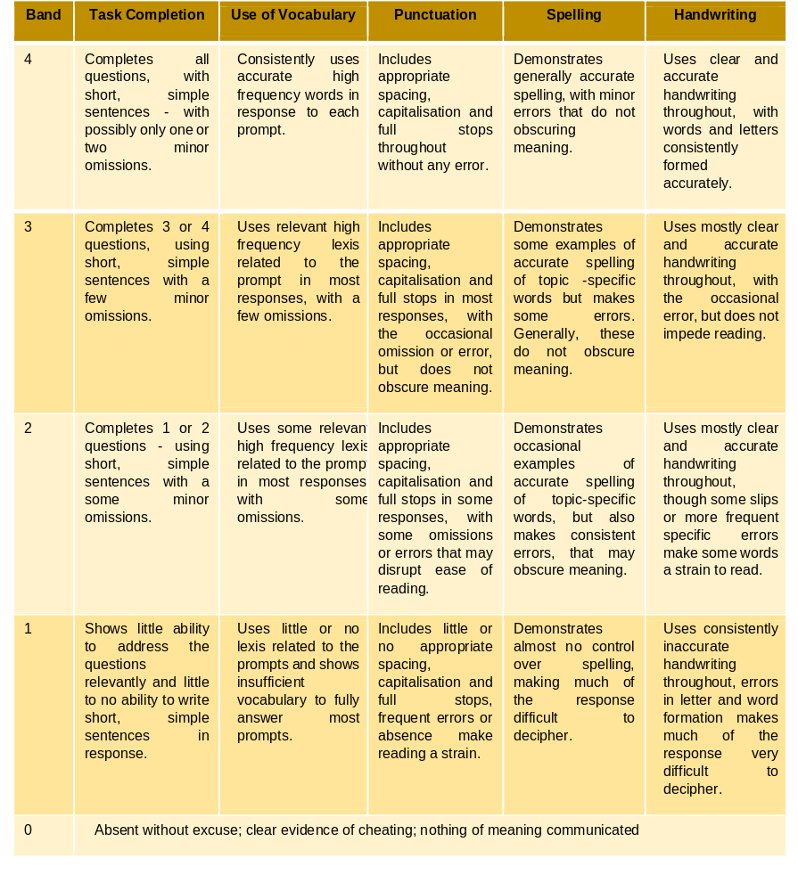
Writing Rubric

