Slide 1
English Language
Coverage, Grammar and Functional Language Teaching Resource
Grade 4
Level 2.1
Term 3
2024 - 2025

Slide 2
INDEX
03
06
08
15
How to use this resource
Assessment Coverage
Preparation - Grammar
Preparation – Functional language

Slide 3
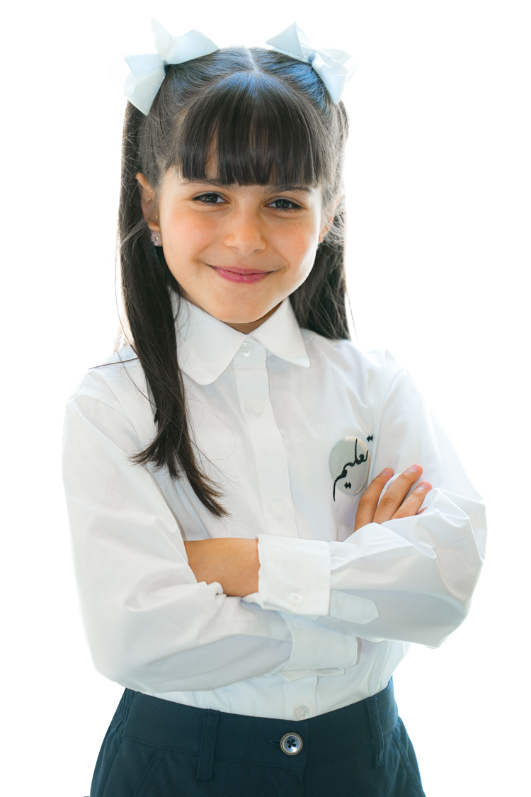
How to use this resource

Slide 4

The Coverage, Grammar and Functional Language Teaching Resource
The slides within this resource, although detailed, are designed as a starting point for teachers. You can:
construct lessons around the language points explored in them.
use the slides individually as a resource within a lesson.
incorporate them gradually in lessons throughout the term (rather than the whole PowerPoint at once).
combine functional language and grammar slides which overlap.
Ensure that students have been exposed to all the language points in the coverage ahead of their end of term exam.

Slide 5
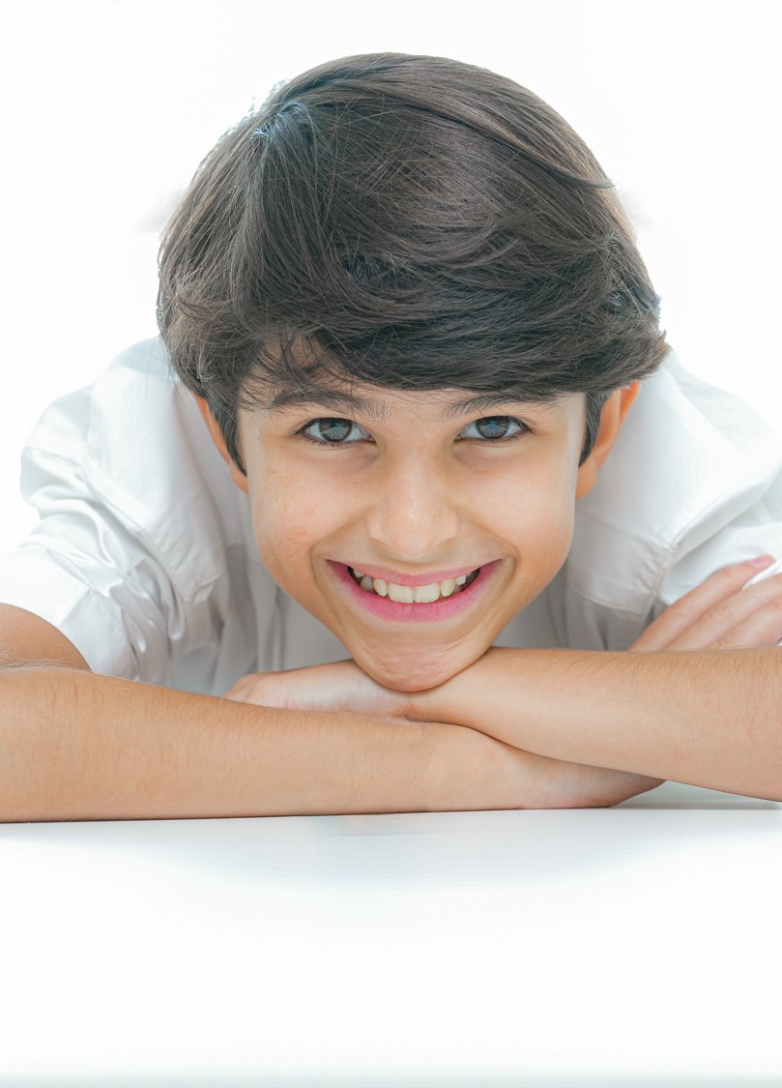
Within this document, you will find information about:
the coverage for this term.
the lexis families that assessments will contain.
particular grammatical and functional language points that will be tested in the exams.
In the preparation sections, you will find examples and explanations for the grammatical and functional language points that will be assessed this term.
The grammar preparation sections contain:
an example sentence.
sample concept checking questions.
the specific grammatical structure used within the example sentence.
links to further resources.
an explanation of the circumstances under which the structure is used.
more example sentences.
In the functional language preparation section, there are examples and explanation of how the functional language is used, as well as relevant associated grammar points.

Slide 6

Term 3 Assessment Coverage

Slide 7
Topic(s): Daily routine, places, animals.
ECFE Grammar | GSE Grammar | Functional Language
Modals: present modals | ‘can’ to refer to ability in the present (29) | Describing objects Expressing likes and dislikes Describing habits, routines, tasks and jobs.
Prepositions: time | prepositions ('on' or 'at') with various common time expressions (33)
Prepositions: place | prepositions of place with nouns and noun phrases (26)

Slide 8

Term 3 preparation: Grammar

Slide 9
Alia can swim. Alia’s sister can’t swim.
Checking questions | Does Alia know how to swim? Does Alia’s sister know how to swim?
Grammatical structure | 'can' to refer to ability in the present subject + can (n’t) + base verb (bare infinitive)
Usage | We use “can” to say someone knows how to do something or is able to do it. We use ‘can’t’ to say someone is not able to do something.
Other examples | The cat can jump. I can run fast. She can speak Arabic. I can’t ride a horse. Can you swim?

Slide 10
Miriam goes to the park at 1 p.m.
Checking questions | Does Mariam go the the park at 1:10 pm? Does she go at a specific time? What word tells us the time is exact and not near that time?
Grammatical structure | Prepositions: time preposition of time + time expression
Usage | We use prepositions of time to talk about when an action or event happens. at: clock times and specific times in: months, years and even longer times on: dates and days
Other examples | I have dinner at 8:00 pm. My birthday is in July. We go to the park on Friday.

Slide 11
The book is on the table.
Checking questions | Where is the book? Is the book touching the table? Is the book under the table? What word tells us where the book is?
Grammatical structure | Prepositions: place subject + verb + preposition of place + noun/noun phrase
Usage | Prepositions of place are used to say where someone or something is. at: a point or place (school, the bus stop) in: inside something (a box, a room) on: on the surface (a table, the wall)
Other examples | The children are at the park. The fish are in the river. The breakfast is on the table.

Slide 12
Term 3 preparation:
Functional language

Slide 13
The earth is big. The cat is small. The picture is beautiful.
Functional language point | Describing objects
Associated grammar | adjectives, noun phrases

Slide 14
I like animals. I enjoy sports. We love travelling. I don’t like homework.
Functional language point | Expressing likes and dislikes
Associated grammar | verbs, noun phrases

Slide 15
They go to the park. I go to the beach. We eat breakfast at 7 a.m. We feed the birds.
Functional language point | Describing habits, routines, tasks and jobs
Associated grammar | verbs, noun phrases

Slide 16
Thank you

