Slide 1

Emirates Schools Establishment Assessment Unit
Cycle 1 Bridge to Success 4
English Listening Task
Term 2 2021
Level 2.2
Term 2 Academic Year 2021-2022

Slide 2

Emirates Schools Establishment Assessment Unit
Contents:
Part 1: Preparation – Vocabulary
Part 2: Preparation – Grammar
Part 3: Listening Task
Level 2.2
Term 2 Academic Year 2021-2022

Slide 3
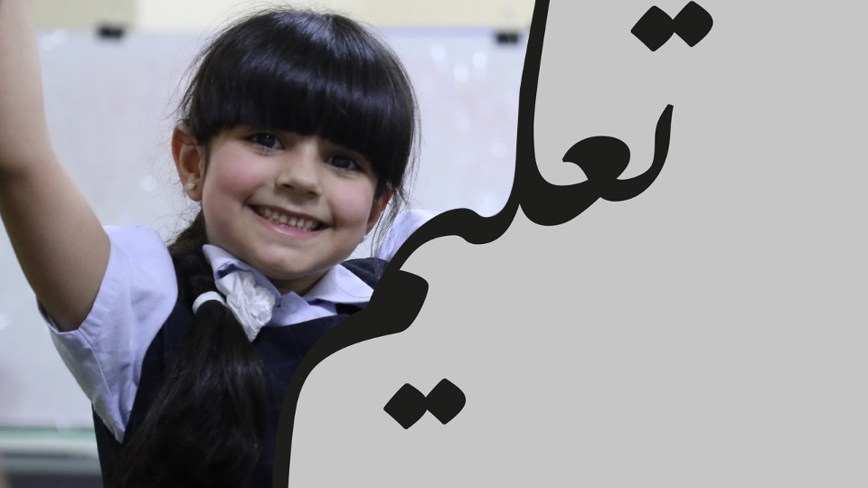
Part 1: Preparation – Vocabulary.
Learn these words for the listening task.

Slide 4
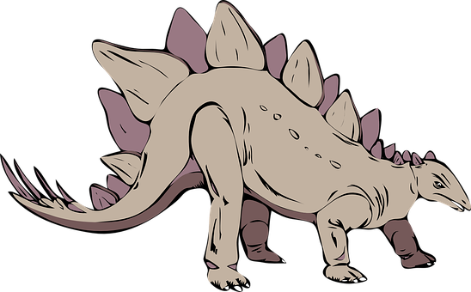
dinosaurs a group of animals that lived a very long time ago

Slide 5
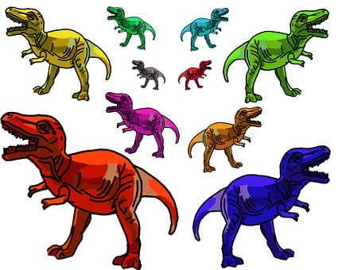
size it tells you how big or how small something is

Slide 6

teeth a part of your body that cuts food into small pieces

Slide 7

horn a part of an animal’s body that grows from their head

Slide 8
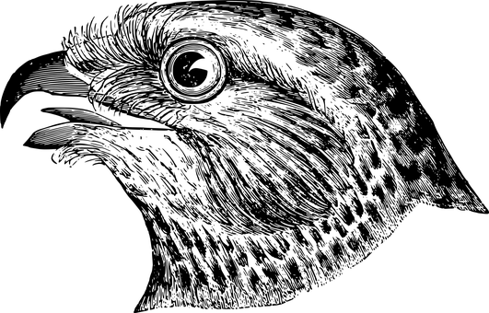
beak the mouth of a bird

Slide 9

to climb to go up a mountain, the stairs, a tree

Slide 10

strong having a lot of power

Slide 11

fast able to move quickly

Slide 12
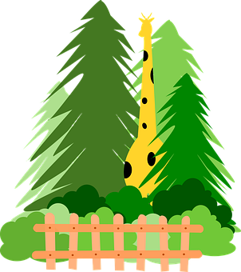
tall higher than other people, animals

Slide 13
sixty five
65

Slide 14
two hundred and twenty
220

Slide 15
three hundred and fifty
350

Slide 16

flower the colourful part of a plant

Slide 17

bug a small animal that sometimes lives in flowers

Slide 18

centre the middle of something

Slide 19

spots lots of circles together

Slide 20

stripes long colourful lines

Slide 21
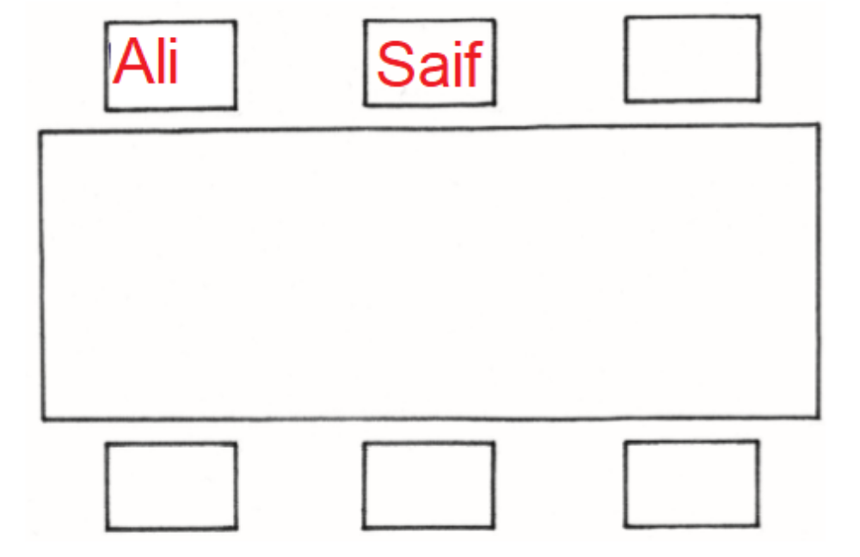
next to
Ali is next to Saif

Slide 22
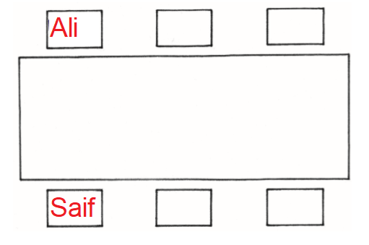
opposite
Ali is opposite Saif

Slide 23
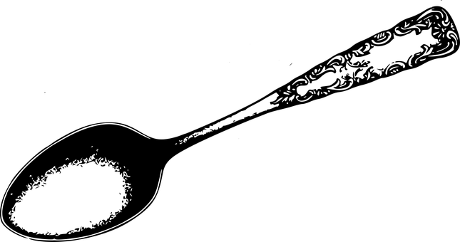
spoon you use it to eat soup or ice cream

Slide 24

cup you drink from it

Slide 25
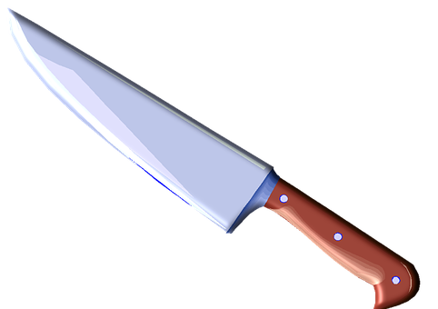
knife you cut food with it

Slide 26

plate you put food on it

Slide 27
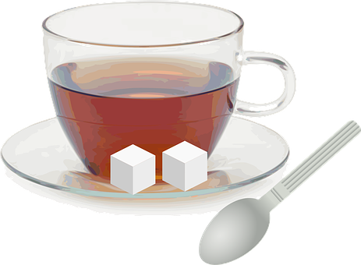
with that has something
a cup with a spoon

Slide 28

without that doesn’t have something
a cup without a spoon

Slide 29
Part 2: Preparation – Grammar
Learn this grammar for the listening task.

Slide 30
Key Grammar
NELCF Code | Grammatical structure
G.14.1 | Past time; past simple
G.16.2 | Pronouns; object pronouns
G.17.2 | Questions; wh- questions

Slide 31
I played football yesterday. The children didn’t eat any cake last week. We were very happy last Friday.
Grammatical structure | Past time; past simple
Usage | It is used to describe actions and states that started and finished in the past.
Other examples | My grandfather lived in Dubai when he was a little boy. Mariam wasn’t at school yesterday. My father spoke to my teacher four days ago.

Slide 32
His sister gave him a cup. Aisha meets her every day . My parents love me.
Grammatical structure | Pronouns; object pronouns
Usage | It is used to describe the person who receives the action of the verb.
Other examples | The teacher can see me. Please give it to them. Aisha’s friends will visit her.

Slide 33
Where is the book? The book is under the chair. What is your name? My name is Aisha Who is your teacher? My teacher is Mr. Jones
Grammatical structure | wh - questions
Usage | They are used to ask questions. What – for things Where – for places Who – for people Why – for reasons When – for time
Other examples | When is English class today? English class is at 10 o’clock Why do you like reading books? I like reading books because I can learn many things.

Slide 34

Part 3: Listening Task.

Slide 35

Part 1. Listen and choose True or False.
Example: Aisha is happy.
True False

Slide 36


Well Done!

Slide 37
Part 2.
Listen and choose the correct answer A, B or C.
Example: How old is Ahmed?
4
5
6

