Slide 1

​Class index​
Class welcome
Class & safety rules ​
Daily Math routine
Outcomes
Starter
Lesson explanation
Main Activity
work evaluation​
Plenary question
Enrichment activity
Welcome to Math’s
Class Grade 4
Ms. Mariam Alnaqbi

Slide 2


​Class index​
Class welcome
Class & safety rules ​
Daily Math routine
Outcomes
Starter
Lesson explanation
Main Activity
work evaluation​
Plenary question
Enrichment activity

Slide 3


​Class index​
Class welcome
Class & safety rules ​
Daily Math routine
Outcomes
Starter
Lesson explanation
Main Activity
work evaluation​
Plenary question
Enrichment activity

Slide 4

​Class index​
Class welcome
Class & safety rules ​
Daily Math routine
Outcomes
Starter
Lesson explanation
Main Activity
work evaluation​
Plenary question
Enrichment activity

Slide 5
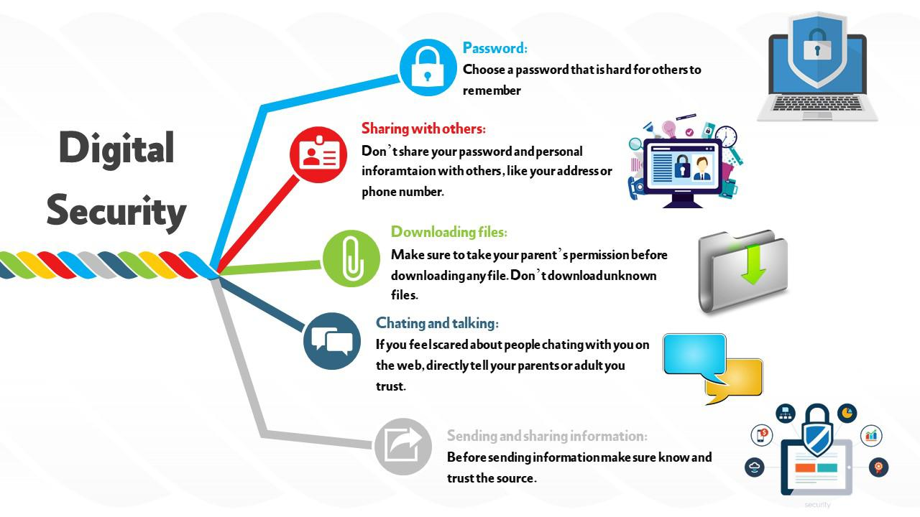
​Class index​
Class welcome
Class & safety rules ​
Daily Math routine
Outcomes
Starter
Lesson explanation
Main Activity
work evaluation​
Plenary question
Enrichment activity

Slide 6

Basic facts
Multiply 2 digit by 1 digit
18
x 9
45
x 6
62
x 7

Slide 7


Math book
page 235

Slide 8

Learning Objectives
I can represent problems involving unknown angle measures using an equation.

Slide 9
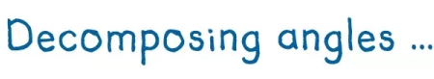
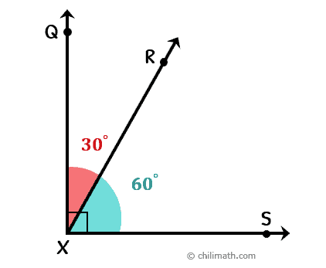
Vocabulary
30º + 60º = 90º

Slide 10
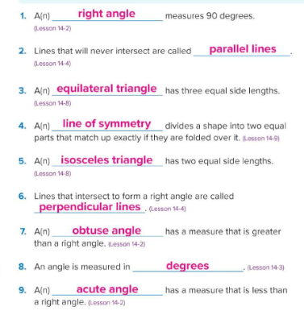
Page 257

Slide 11
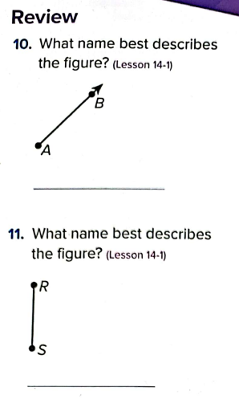
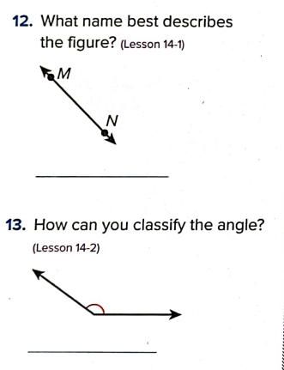
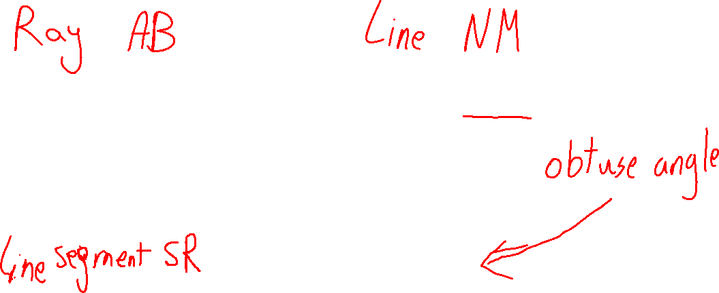
Page 258

Slide 12
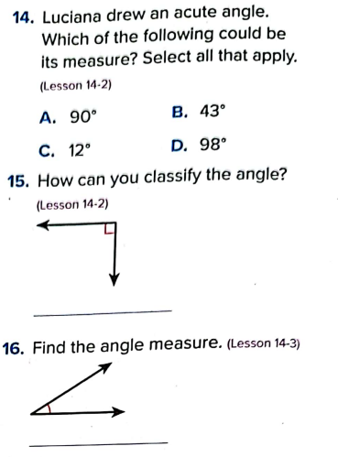
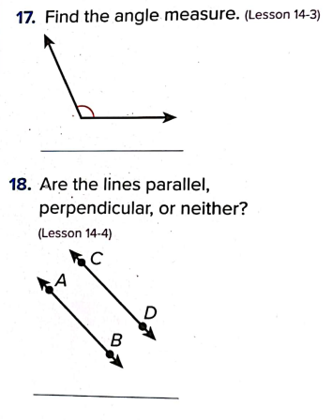
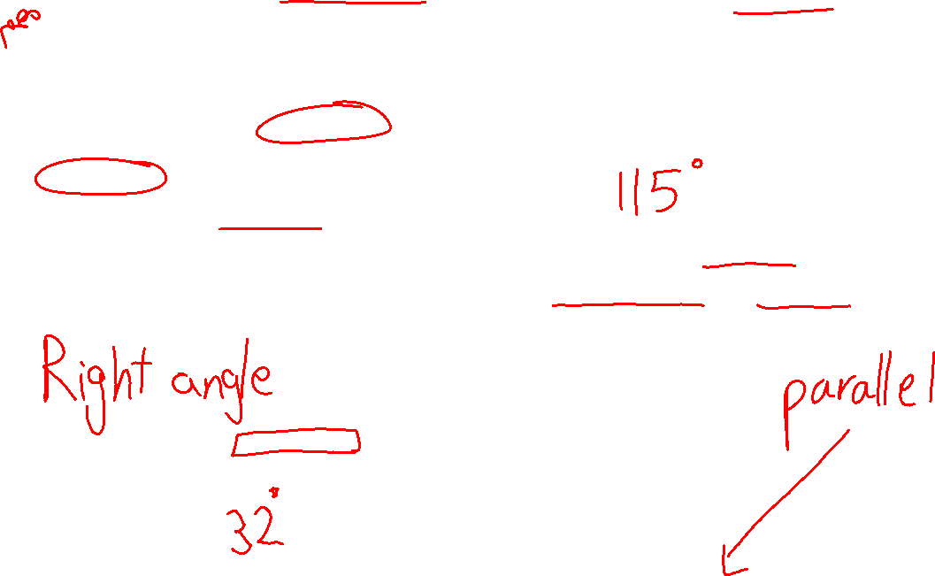
Page 258

Slide 13
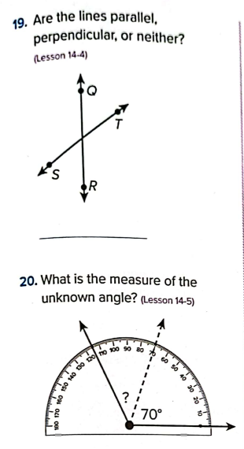
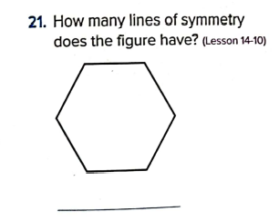
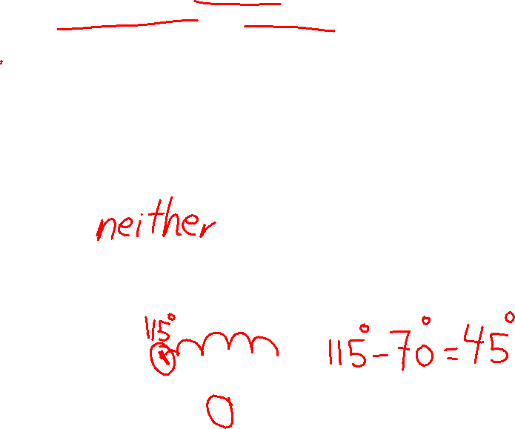
Page 259

Slide 14
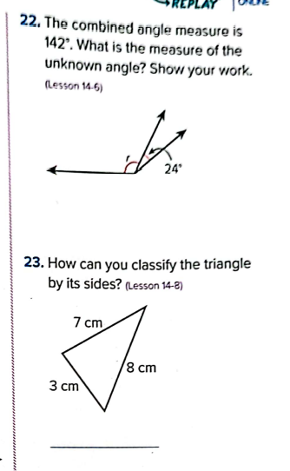
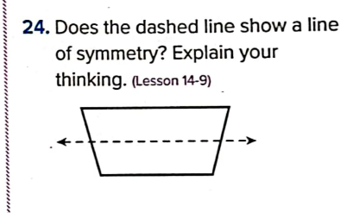
Page 259

Slide 15











Self Assessment! I understand!
I can do It!
I am getting there
I need more help

Slide 16

THANK YOU! Goodbye!

