Slide 1

Bridge to Success 3
Reading End of Term Exam
Term 1
2022 - 2023

Slide 2

Contents
Lexis
Grammar
Sample Questions
This Photo by Unknown Author is licensed under CC BY

Slide 3
Key Lexis
library | thin
whisper | old
class | body
computer | clap
skipping rope | talk
teacher | flap
firefighter | parrot
mall | tiger
shops | cloud
city | shine

Slide 4
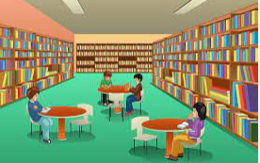
library
a place with lots of books

Slide 5

whisper
to talk quietly

Slide 6

class
a room in a school where children learn

Slide 7

computer
a machine used for finding information

Slide 8
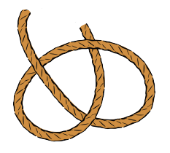
skipping rope
a toy used for jumping

Slide 9

teacher
someone who works in a school and
helps people to learn

Slide 10
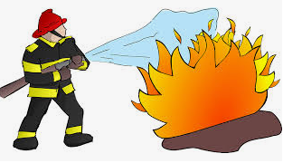
firefighter
a person who puts out fires

Slide 11
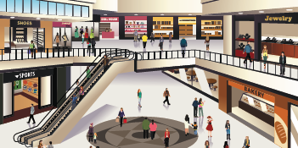
mall
a place to shop

Slide 12

shops
places that sell things

Slide 13

city
a place to live where there are lots of streets, buildings and people

Slide 14
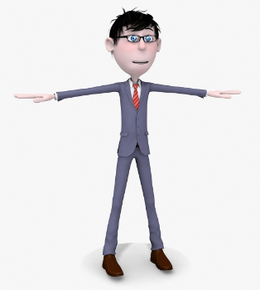
thin
skinny, not thick or fat

Slide 15
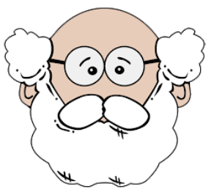
old
someone that has lived for a long time

Slide 16

body
head, shoulders, knees, toes, hands, nose, feet, tummy, fingers, leg, arm

Slide 17

clap
to hit your hands together

Slide 18

talk
to say words

Slide 19

flap
to move up and down

Slide 20

parrot
a kind of bird

Slide 21

tiger
a big cat

Slide 22

cloud
the part of the sky that is made up of tiny drops of water

Slide 23

shine
to light up

Slide 24
Key Grammar
NELCF Code | Grammatical structure
G.16.4 | Pronouns (possessive pronouns)
G.6.1 | Conjunctions (coordinating)
G.17.2 | Questions (wh-questions)

Slide 25
The fiction books are yours and the non-fiction books are theirs. The lunchbox that is on the table is not his. It is hers.
Grammatical structure | Pronouns; possessive pronouns
Usage | They are used to show what belongs to someone.
Other examples | The red jacket is mine. These toys are ours. We play with them every day.

Slide 26
She went outside and she read her book. The planets are rocky and cloudy. At night, I can see the stars but I can’t see the sun.
Grammatical structure | Conjunctions (coordinating)
Usage | Used to join two words or sentences. and – used to add things but – used for contrast or – to give an alternative
Other examples | Do you want to have dinner or do you want to go shopping? I love football but I don’t like tennis. Deserts can be hot or they can be cold.

Slide 27
Where is the book? The book is under the chair. What is your name? My name is Aisha. Who is your teacher? My teacher is Mr. Jones.
Grammatical structure | wh - questions
Usage | They are used to ask questions. What – for things Where – for places Who – for people Why – for reasons When – for time
Other examples | When is English class today? English class is at 10 o’clock. Why do you like reading books? I like reading books because I can learn many things. Where are you going? I am going to the supermarket.

Slide 28
Sample Reading Multiple Choice Questions
At the zoo, there is a turtle sitting on a rock. The ducks are swimming in the pond and the penguins are playing by the river.
Where are the ducks?
  in the pond
  by the river

Slide 29
Sample Reading Multiple Choice Questions
Layla likes watching TV and her brother Saif likes riding his bike. They both like using the computer but they don’t like shopping.
2. What does Layla’s
brother like to do?
  watch TV
  use a computer

Slide 30
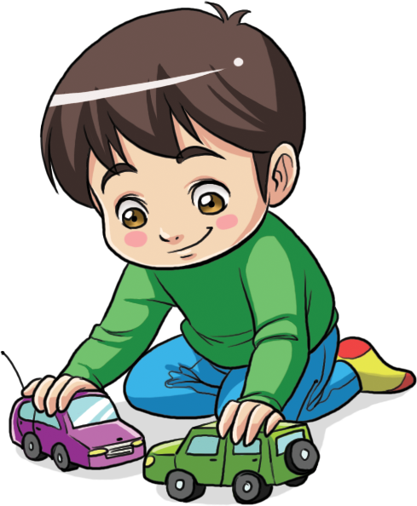

Sample Matching Questions
3. If you’re happy and you know it, clap your hands!
4. Malik moves his toys by rolling them along the floor.
A.
B.

Slide 31
Sample MAZE
My 5. ( aunt / uncle ) Mohammed is a firefighter. He wears a 6. ( uniform / ladder ) and has a 7. ( tractor / fire engine ). He works at the 8. ( fire station / library ).

Slide 32
Sample Question Answers
1. A
2. B
3. B
4. A
5. uncle
6. uniform
7. fire engine
8. fire station

