Slide 1

BTS3
Level 2.1
End of Term Grammar & functional language review

Slide 2
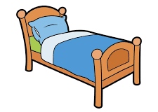

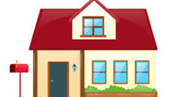

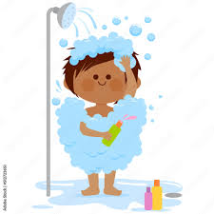
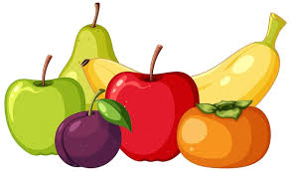
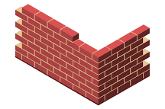
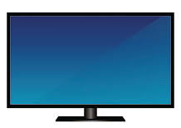
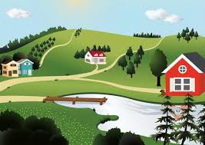

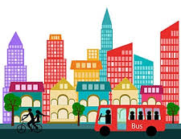
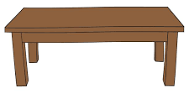

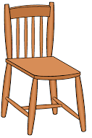
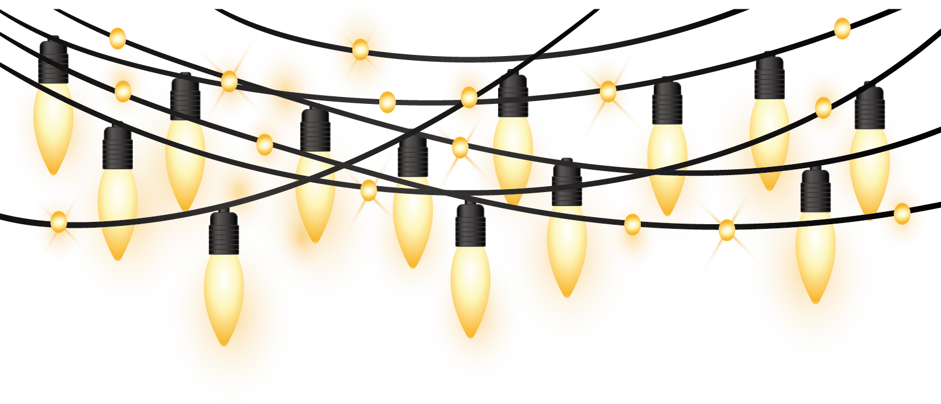
Vocabulary
house |  |  | bed |  |  | shopping
bird |  |  | shower |  |  | fruit
wall |  |  | TV |  |  | country
door |  |  | table |  |  | city
window |  |  | chair |  |  | lights

Slide 3
Grammar
G.13.1 Present Time (present simple (including verb 'to be’)) << click the link for online practice
Meaning Present simple tense indicates a present state, something that happens regularly, and general truths. For example: I am at school (now). I usually wake up at 6 o’clock. Water boils at 100 degrees Celsius.
Present Simple I / you / we / they = verb He / She / It = verb + s | Verb “to be” Singular = is Plural = are
Positive | Question | Negative
I work You work He works She works It works We work You work They work | Do I work? Do you work? Does he work? Does she work? Does it work? Do we work? Do you work? Do they work? | I do not work. You do not work. He does not work. She does not work. It does not work. We do not work. You do not work. They do not work.
Positive | Questions | Negative
I am a student. You are a student. He/she is a student. It is a book. We are students. You are students. They are students. | Am I a student? Are you a student? Is he/she a student? Is it a book? Are we students? Are you students? Are they students? | I am not a student. You are not a student. He/she is not a student. It is not a book. We are not students. You are not students. They are not students.

Slide 4
Grammar
G.13.1 Present Time (present simple (including verb 'to be’)) << click the link for online practice
Practice: 1. I (am / are / is) a student. 2. Do you (go / goes / going) to school? 3. (Do / Does / Is) he study mathematics? 4. It (am / are / is) fast. 5. What sports do you (play / played / plays)? 6. Where (am / are / is) you from?

Slide 5
Grammar
G.14.1 Past Time (past simple (including verb 'to be’)) << click the link for online practice
Meaning Past simple is used to describe actions that started and finished in the past. For example: Notice when we use did, the verb is in the present form. Did you worked? Incorrect Did you work? Correct For negative sentences, we can contract do not/does not. I didn’t work. |  | There are no rules for irregular verbs, they just need to be learned and remembered. For example:
Past Simple Regular = verb + ed Irregular = change the spelling | Verb “to be” Singular (I, it, she, he) = was Plural (we, you, they) = were
Present | Past | Present | Past
do | did | speak | spoke
go | went | eat | ate
see | saw | drink | drank
have | had | meet | met
get | got
Positive | Question | Negative
I worked. You worked. He worked. She worked. It worked. We worked. You worked. They worked. | Did I work? Did you work? Did he work? Did she work? Did it work? Did we work? Did you work? Did they work? | I did not work. You did not work. He did not work. She did not work. It did not work. We did not work. You did not work. They did not work.
Positive | Questions | Negative
I was a student. You were a student. He/she was a student. It was hot yesterday. We were students. You were students. They were students. | Was I asleep? Were you asleep? Was he/she asleep? Was it hot yesterday? Were we asleep? Were you asleep? Were they asleep? | I was not a student. You were not a student. He/she was not a student. It was not a book. We were not students. You were not students. They were not students.

Slide 6
Grammar
G.14.1 Past Time (past simple (including verb 'to be’)) << click the link for online practice
Practice: 1. I (am / is / was) busy yesterday. 2. Did you (go / was / went) to school? 3. (Did / Do / Is) he study before the exam? 4. They (is / was / were) very tired. 5. What sports did you (play / played / plays)? 6. I (bought / buy / buying) a new phone last week. 7. He (wasn’t / were / weren’t) at work yesterday.

Slide 7
Grammar
G.2.1 Adverbs (manner) << click the link for online practice
Meaning An adverb of manner tells us how something happens. For example: He drives fastly. [incorrect] / He drives fast. [correct] She works hardly*. [incorrect] / She works hard. [correct] He arrives lately* to work. [incorrect] / He arrives late to work. [correct] Form: Adverbs of manner normally come after the main verb or after the object. |  | There are also irregular adverbs. Here are some common ones.
Regular adverbs of manner cannot be put between a verb and its direct object. Therefore, the adverb must be put either before the verb or at the end of the clause. • He ate greedily the entire pizza. [incorrect] • He ate the entire pizza greedily. [correct] • He greedily ate the entire pizza. [correct] | Irregular adverbs of manner can come after the verb (if there is no object) or after the object. He well played the piano. [incorrect] He played well. [correct] He played the piano well. [correct]
Adjective | Adverb
good | well
fast | fast
late | late
early | early
hard | hard
Rule | Example | Adverb
Add -ly to most adjectives to create an adverb. | loud | loudly
Replace the -y with -ily for adjectives ending in -y. | happy | happily
Replace the -le with -ly for adjectives ending in -le. | terrible | terribly

Slide 8
Grammar
G.2.1 Adverbs (manner) << click the link for online practice
Practice: The student opened the door (quieten / quietly / quit). The boy ran (quick / quicker / quickly) after the football. 3. Aisha talks (happier / happily / happy) with her friends. 4. Her father spoke (lazier / lazily / lazy) because he was tired. 5. The teacher entered the classroom (sudden / suddenly / suddenness).

Slide 9
Grammar
G.12.2 Prepositions (time) << click the link for online practice
Meaning Prepositions of time are words which show when something happens:
We use ‘in’ to talk about parts of the day (not night), months, years, centuries, seasons, and longer periods of time: I have a meeting in the afternoon. I was born in June. The UAE was founded in 1971. The Industrial Revolution started in the 18th century. The weather is a lot better in winter. It happened in the past. | We use ‘on’ to talk about days of the week, days + parts of days, dates, and special days: The working week in Europe starts on Monday. We have a meeting on Wednesday afternoon. I started this job on 23rd April, 2019. We’re going out on my birthday.
We use ‘at’ to talk about clock times, and with ‘the weekend’* and ‘night’: I will meet you at 7pm. What are you doing at the weekend? I don’t like driving at night. | We can also use ‘for + a length of time or special occasions’ to say how long something happens, and ‘during + noun/noun phrase’ to say when something happens. We walked for three hours. I’m going to Lebanon for Eid. We walked during the afternoon.

Slide 10
Grammar
G.12.2 Prepositions (time) << click the link for online practice
Practice: Complete the text with in, at or on. Remember to use the correct punctuation. My friend’s name is Salem. He is an engineer for an international company. ( ) the mornings, he usually gets up ( ) 6 am. This is only ( ) weekdays because ( ) the weekend he gets up much later. ( ) Sundays and Thursdays he works in the office, so he gets home ( ) about 5 pm. ( ) the other days he visits different sites in the UAE, so he usually gets home late ( ) the evenings.
in
at
on
at
On
at
On
in

Slide 11
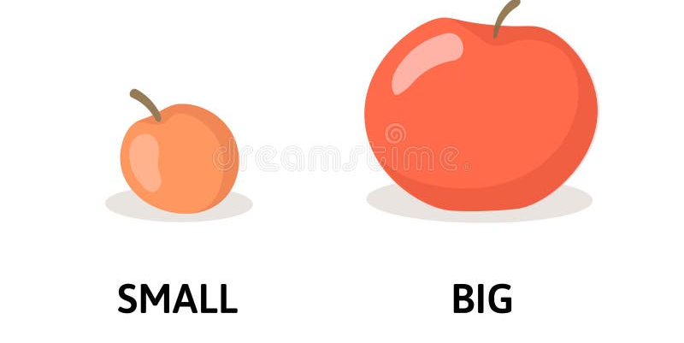
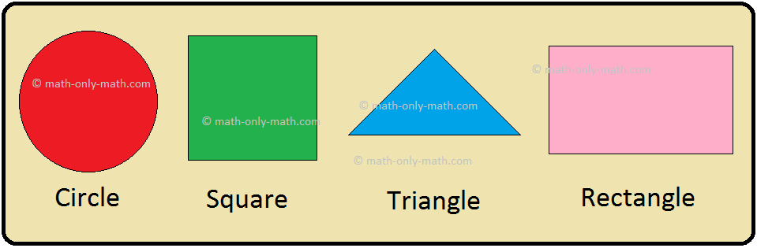
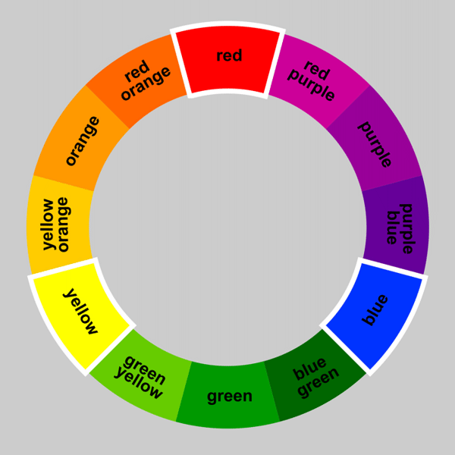
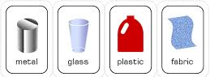
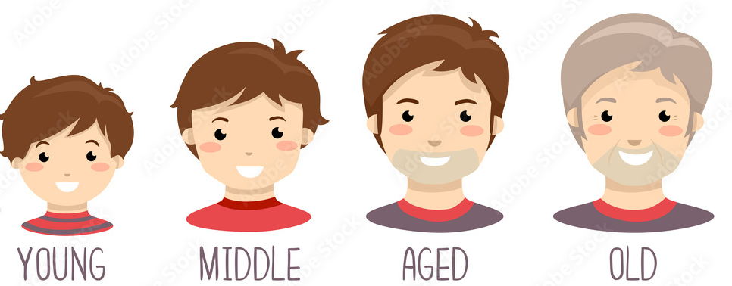
Functional Language
FL.7 Describing objects << click the link for online practice
Describing an object: When we describe an object we talk about different things like:
Its size: It is long. It is very large. | Its shape: It is round. It is square.
Its colour: It is yellow. It is red. | What it is made of: It is made of metal. It is made of glass.
Its age: It was invented in the 19th century. It is quite old. | What it is used for: It is used to heat water. It is used for keeping food fresh.

Slide 12
Functional Language
FL.7 Describing objects << click the link for online practice
Practice: Match the questions with their correct answer When was it invented? What is it used for? How does it work? What is it famous for? What is it made of? What does it look like? | It is famous for changing modern transport. Metal and wood. Heating water. By turning a lever. A long time ago! Like a tube.

Slide 13
Functional Language
FL.7 Describing objects << click the link for online practice
Practice: 1. It is used for (heat / heating / heats) water. 2. We use it to (open / opening/ opens) cans of food. 3. It (look / looking / looks) like a balloon. 4. It is made (do / of / on) wood. 5. It works (as / by / in) turning a handle.

Slide 14
Functional Language
FL.8 Expressing preference << click the link for online practice
Meaning Expressing preference is when you talk about something you like or want more at a given point in time, either right now or in the future. When expressing preference there are many phrases that can be used:
My favourite What is your favourite sport? My favourite sport is tennis. | I like Which do you like? I like the green one the most. I’d like the green one.
I’d prefer Which one do you prefer? I’d prefer to go early. What is your preference? I prefer the green one. | I’d rather Which one would you rather have/do? I’d rather go to the cinema.
I’ll go for Which one do you fancy? I’ll go for the green one. | This is more my kind of thing. I’d opt for the green one. Given the choice I’d choose the green one. I’m inclined to choose the green one.

Slide 15
Functional Language
FL.8 Expressing preference << click the link for online practice
Practice: What is your preference, the morning or afternoon? Would you rather have tea of coffee? Would you prefer to eat your breakfast in the restaurant or in your room? What type of room would you like? | I’ll go for a coffee, please. I’d prefer to eat in the restaurant. I would like one with a view of the ocean. I’d rather go in the afternoon.

Slide 16
Functional Language
FL.9 Describing habits, routines, tasks, and jobs<< click the link for online practice
Meaning Describing habits and routines means talking about things we do regularly, or did regularly, in the past or the present. When expressing habits, routines tasks & jobs there are many phrases that can be used:
Asking about habits and routines What do you usually do at the weekend? How often do you clean your room? How many times a week/a month do you clean your room? | Asking about tasks and jobs What jobs/tasks/chores do you do around the home/at work? What is your job? What do you do? What is your profession/occupation? What do you do for a living? What are you responsible for?
Describing habits and routines I usually go to the beach. I always/often/sometimes/never go to the beach. I go to the beach every day. I go to the beach once/twice/three times a week/a month/a year. I go to the beach now and then. I rarely/seldom/hardly ever/barely go to the beach. I go to the beach every other day/week/month/year. | Describing tasks and jobs I am a teacher/an engineer/an accountant. I work for a global company. I have my own business. I am responsible for creating marketing campaigns. My responsibility is to create marketing campaigns. I am responsible for my team of three people. I am responsible to the head of marketing.

Slide 17
Functional Language
FL.9 Describing habits, routines, tasks, and jobs<< click the link for online practice
Practice:
a. How often do you clean your room? | I am an engineer.
b. What do you do?
c. What do you like?
a. How do you do? | About once a week.
b. How often do you clean your room?
c. What do you usually do at the weekend?
a. Do you have any brothers and sisters? | I often visit my family.
b. How are you?
c. What do you do at the weekend?

Slide 18
Functional Language
FL.9 Describing habits, routines, tasks, and jobs<< click the link for online practice
Practice: Put the words into order of frequency. Start with 'Always' at the top.
Often | Always
Always | Usually
Never | Often
Hardly ever | Sometimes
Usually | Hardly ever
sometimes | Never

Slide 19
Functional Language
FL.16 Expressing opinion<< click the link for online practice
Meaning Expressing opinion is the act of saying what you think or showing how you feel using words. When opinion there are many phrases that can be used:
I think that is the right decision. I believe that is the right decision. My opinion is that is the right decision. In my opinion, that is the right decision. I’m sure that is the right decision. I feel that is the right decision. I guess that is the right decision. I strongly believe that is the right decision. To be honest, that is the right decision. I reckon that is the right decision. | From my point of view, that is the right decision. From my perspective, that is the right decision. As far as I’m concerned, that is the right decision. The way I see it, that is the right decision. To my mind, that is the right decision. I am of the opinion that it is the right decision. I can’t help thinking/feeling that it is the right decision. I’m absolutely certain that it is the right decision. Without a doubt, it is the right decision. Frankly, it is the right decision.

Slide 20
Functional Language
FL.16 Expressing opinion<< click the link for online practice
Practice:
honest | doubt | mind | opinion | concerned | reckon
Ali: In my , TV is a good thing. You can learn so much from TV! Jassim: Well, to my , it is better to play sport than watch TV. Ali: That’s true. But to be , it is too hot to play outside right now. Jassim: Oh yes, without a , it is too hot right now. Ali: As far as I’m , it’s ok to watch TV when it is this hot outside! Jassim: I you’re right, Ali!
----------
-------
------
-------
------
----------

Slide 21
Functional Language
FL.16 Expressing opinion<< click the link for online practice
Practice:
(At / In / On) my opinion, football is the best sport.
To (be / bee / beeing) honest, it’s a great idea.
(For / From / Of) my point of view, this is the wrong decision.
As (far / farm / for) as I’m concerned, it’s the right choice.
(To / Too / Two) my mind, winter is the best season.
I can’t (help / helped / helping) thinking that this is the wrong choice.

