Slide 1
English Language
Coverage, Grammar and Functional Language Teaching Resource
Grade 3
Level 2.1
Term 3
2024 - 2025

Slide 2
INDEX
03
06
08
15
How to use this resource
Assessment Coverage
Preparation - Grammar
Preparation – Functional language

Slide 3
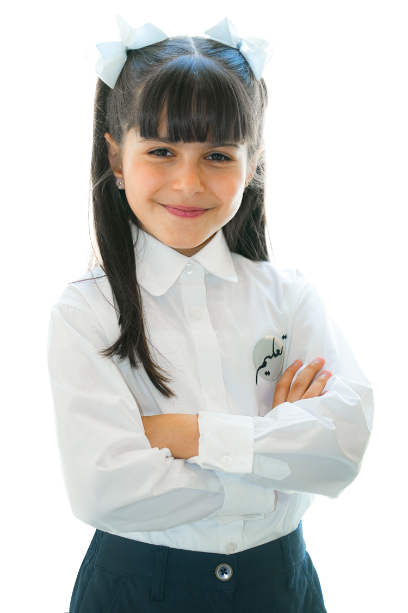
How to use this resource

Slide 4

The Coverage, Grammar and Functional Language Teaching Resource
The slides within this resource, although detailed, are designed as a starting point for teachers. You can:
construct lessons around the language points explored in them.
use the slides individually as a resource within a lesson.
incorporate them gradually in lessons throughout the term (rather than the whole PowerPoint at once).
combine functional language and grammar slides which overlap.
Ensure that students have been exposed to all the language points in the coverage ahead of their end of term exam.

Slide 5

Within this document, you will find information about:
the coverage for this term.
the lexis families that assessments will contain.
particular grammatical and functional language points that will be tested in the exams.
In the preparation sections, you will find examples and explanations for the grammatical and functional language points that will be assessed this term.
The grammar preparation sections contain:
an example sentence.
sample concept checking questions.
the specific grammatical structure used within the example sentence.
links to further resources.
an explanation of the circumstances under which the structure is used.
more example sentences.
In the functional language preparation section, there are examples and explanation of how the functional language is used, as well as relevant associated grammar points.

Slide 6

Term 3 Assessment Coverage

Slide 7
Topic(s): Home and household items, animals, places.
ECFE Grammar | GSE Grammar | Functional Language
Prepositions: time | prepositions ('on' or 'at') with various common time expressions (33) | Describing objects Expressing opinion Describing habits, routines, tasks and jobs
Adjectives: position | adjectives placed in the correct position (before nouns) (31)
Present time: past simple | affirmative statements using common regular past simple forms (30)

Slide 8

Term 3 preparation: Grammar

Slide 9
Miriam goes to the park at 1 p.m.
Checking questions | Does Mariam go the the park at 1:10 pm? Does she go at a specific time? What word tells us the time is exact and not near that time?
Grammatical structure | prepositions of time preposition of time + time expression
Usage | We use prepositions of time to talk about when an action or event happens. at: clock times and specific times in: months, years and even longer times on: dates and days
Other examples | I have dinner at 8:00 pm. My birthday is in July. We go to the park on Friday.

Slide 10
I live in a big house.
Checking questions | Does the speaker live in a flat? Where does the speaker live? What word tells you more about the house? Where does the word come in the sentence?
Grammatical structure | Adjectives: position adjective + noun
Usage | We use adjectives to tell us more about nouns. Adjectives can be placed before the noun in a sentence.
Other examples | I have a blue chair. She sees a small rabbit. He sits under an old tree.

Slide 11
Hamid played on the computer.
Checking questions | Is Hamid playing on the computer now? Has he finished playing?
Grammatical structure | Present time: past simple subject + verb -ed + object
Usage | We use past simple to describe actions that started and finished in the past. We can make past simple sentences with regular past verbs by adding –ed to the infinitive (base form of the verb).
Other examples | They visited the park. I cleaned my room. I brushed my teeth and walked to school.

Slide 12
Term 3 preparation:
Functional language

Slide 13
She reads a red book. It has brown eyes. I have a big ball.
Functional language point | Describing objects
Associated grammar | adjectives, nouns

Slide 14
I enjoy the beach. I like school. I don’t like cats.
Functional language point | Expressing Opinion
Associated grammar | verbs, nouns, pronouns

Slide 15
They go to the park. I go to the beach. We drive to the city.
Functional language point | Describing habits, routines, tasks and jobs
Associated grammar | verbs, nouns, present simple

Slide 16
Thank you

