Slide 1


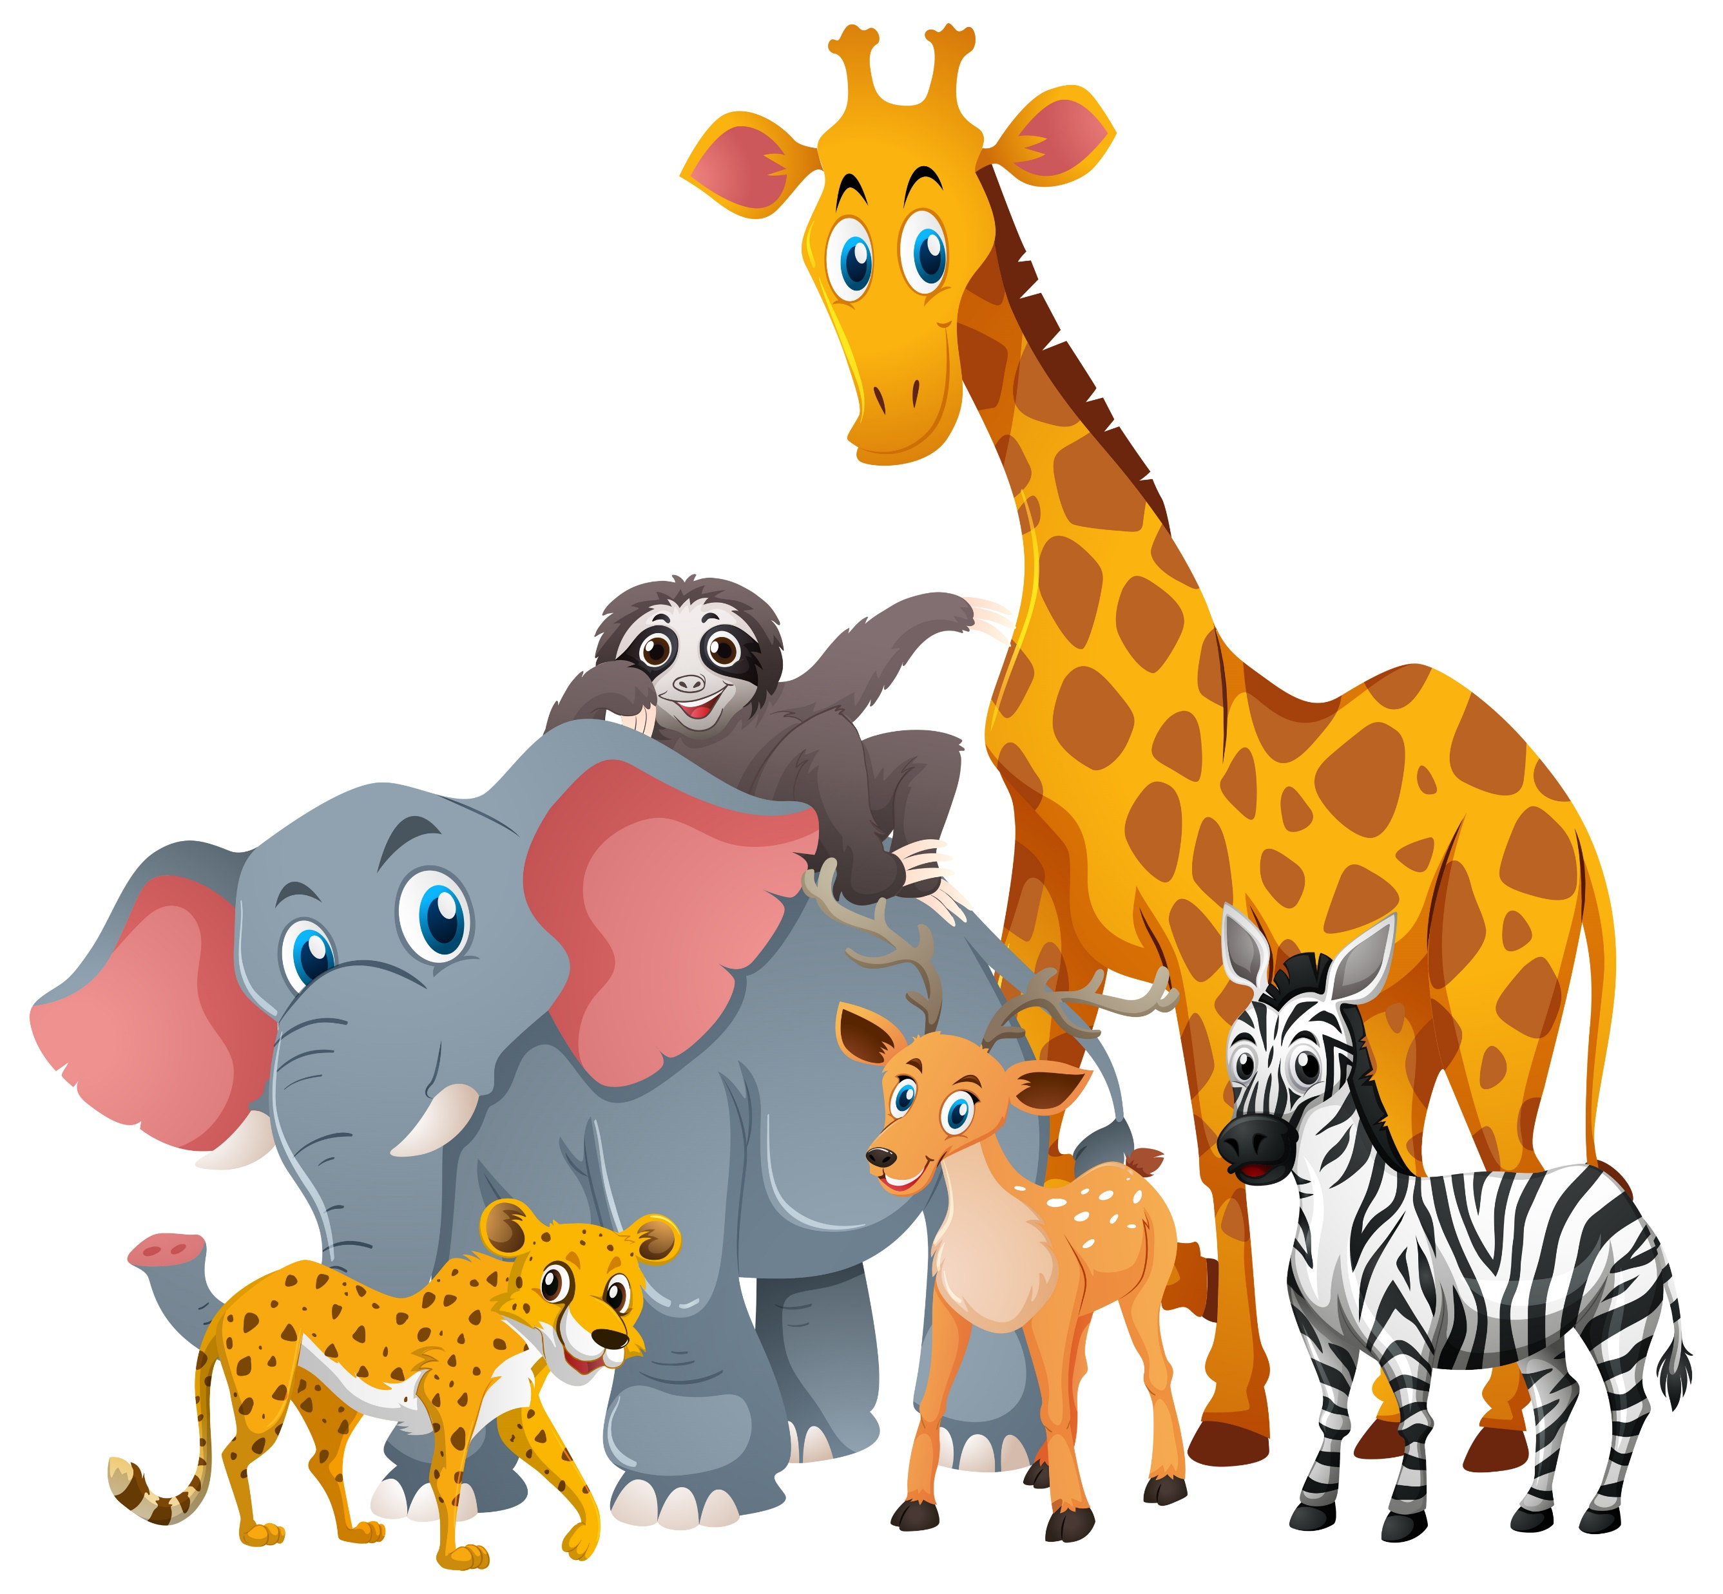

Name : ________________________________________________________
1
Grade : ________________
2025-2026

Slide 2
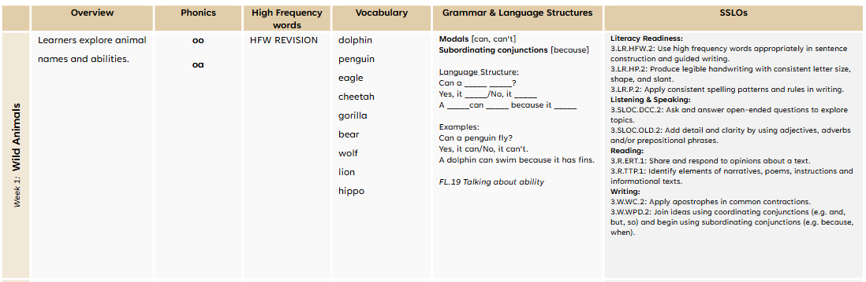
Learning outcomes –week 1
2

Slide 3
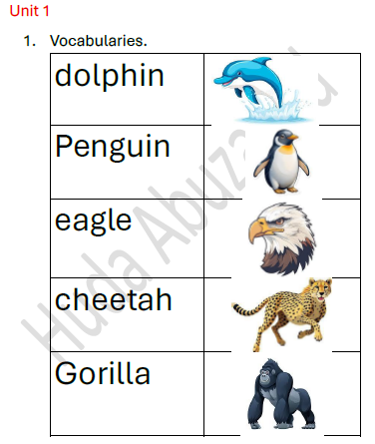
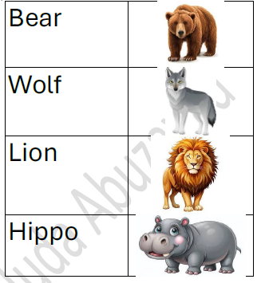
Week 1 – Wild Animals ( Vocabulary )
كلمات الأسبوع الأول \ أرجو مراجعة الكلمات مع الطلاب ومعرفة معنى الكلمات
Let’s read !
3

Slide 4
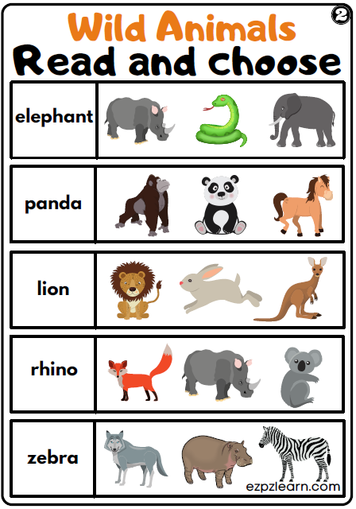
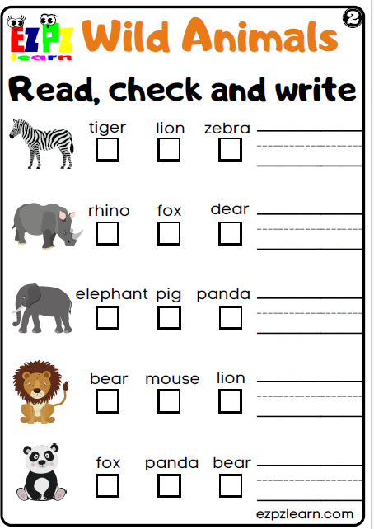
Let’s read !
Let’s write !
4

Slide 5
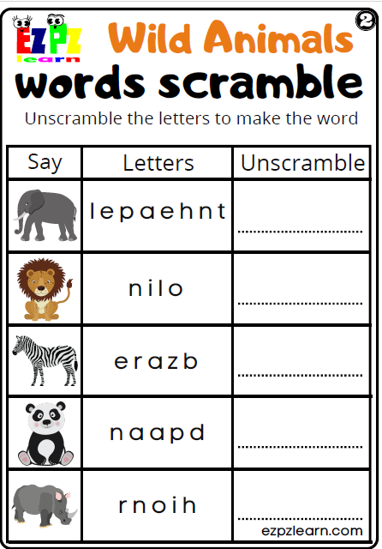
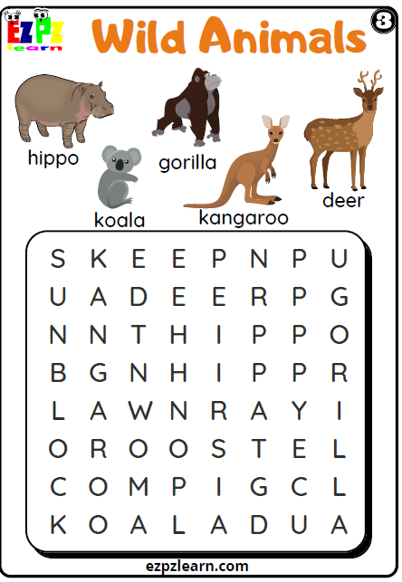
Let’s practice !
5

Slide 6
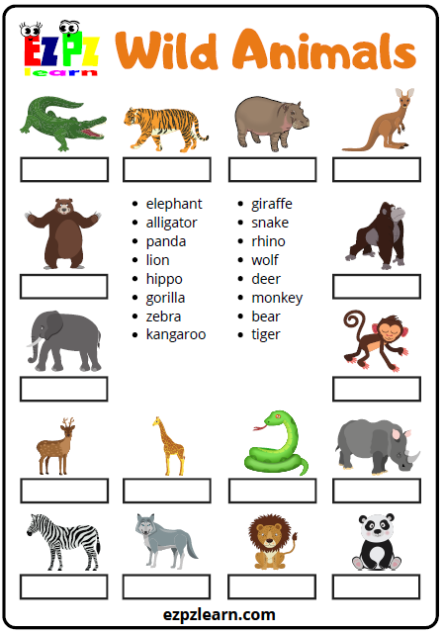
Let’s write !
6

Slide 7
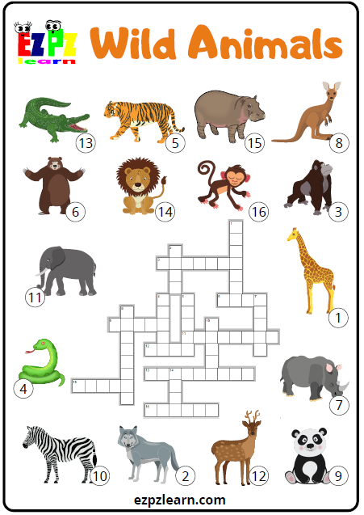
Let’s learn & have fun !
7

Slide 8

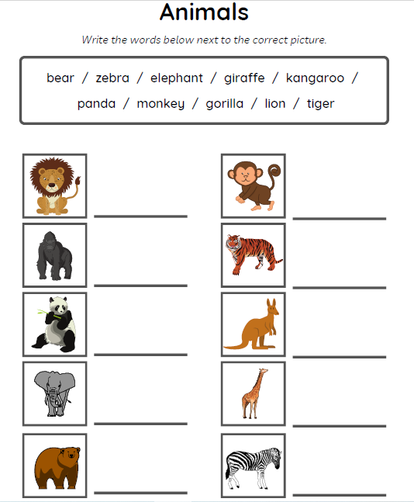
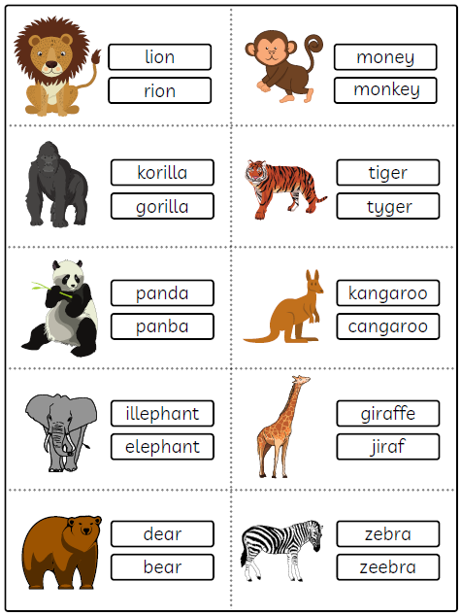
Let’s read !
Let’s write !
8

Slide 9
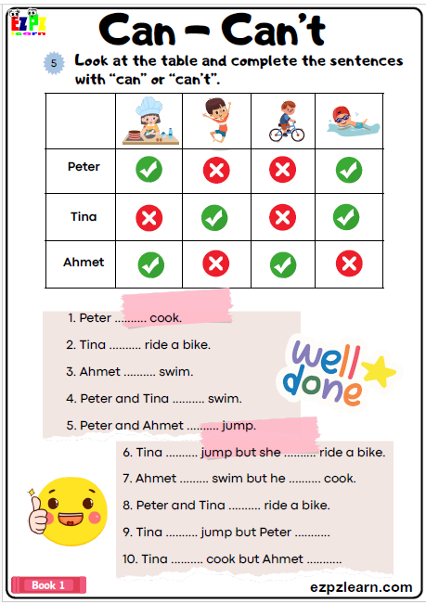


9

Slide 10

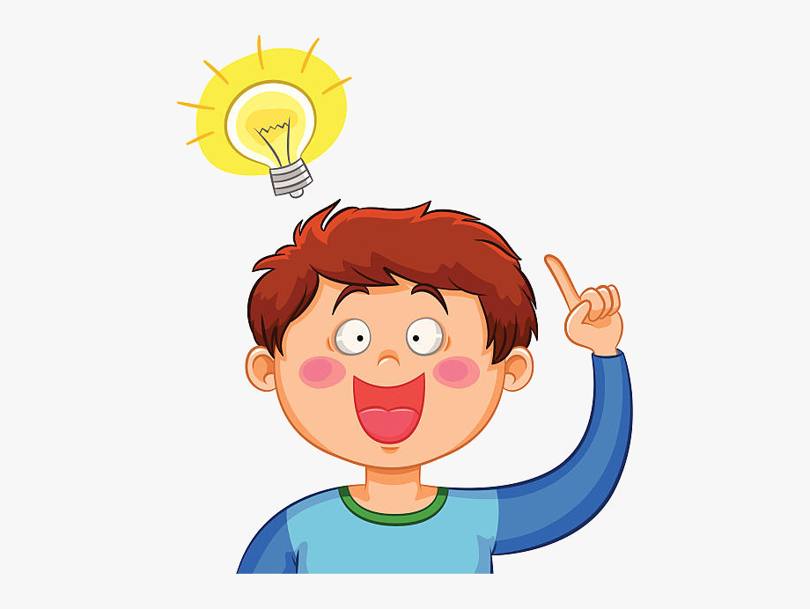
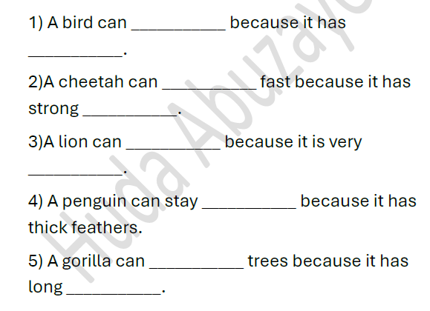
Let’s think ???
10

Slide 11
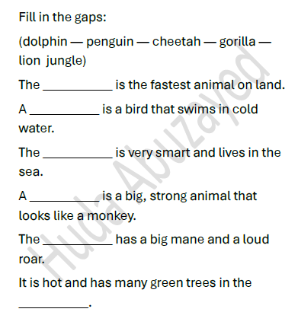
Let’s think ???
11

Slide 12
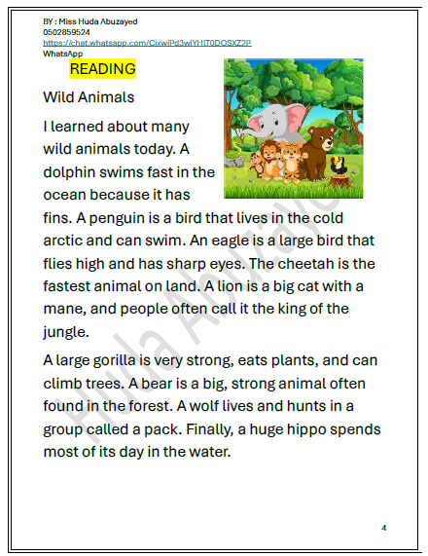
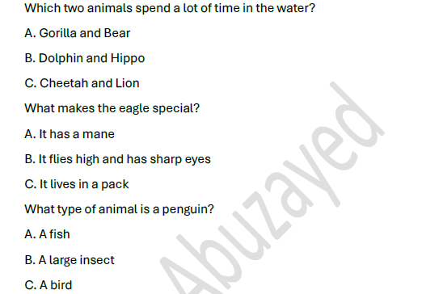
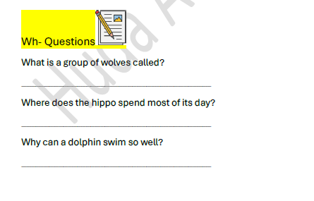
1
2
3
12

Slide 13
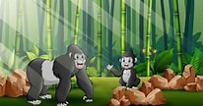
Writing
Let’s write !
Look at the picture ,then write a sentence using the two words:
( penguin – swim)
_____________________________________________
(Lion / fly)
_____________________________________________
(Gorilla / trees)
_____________________________________________
13

Slide 14
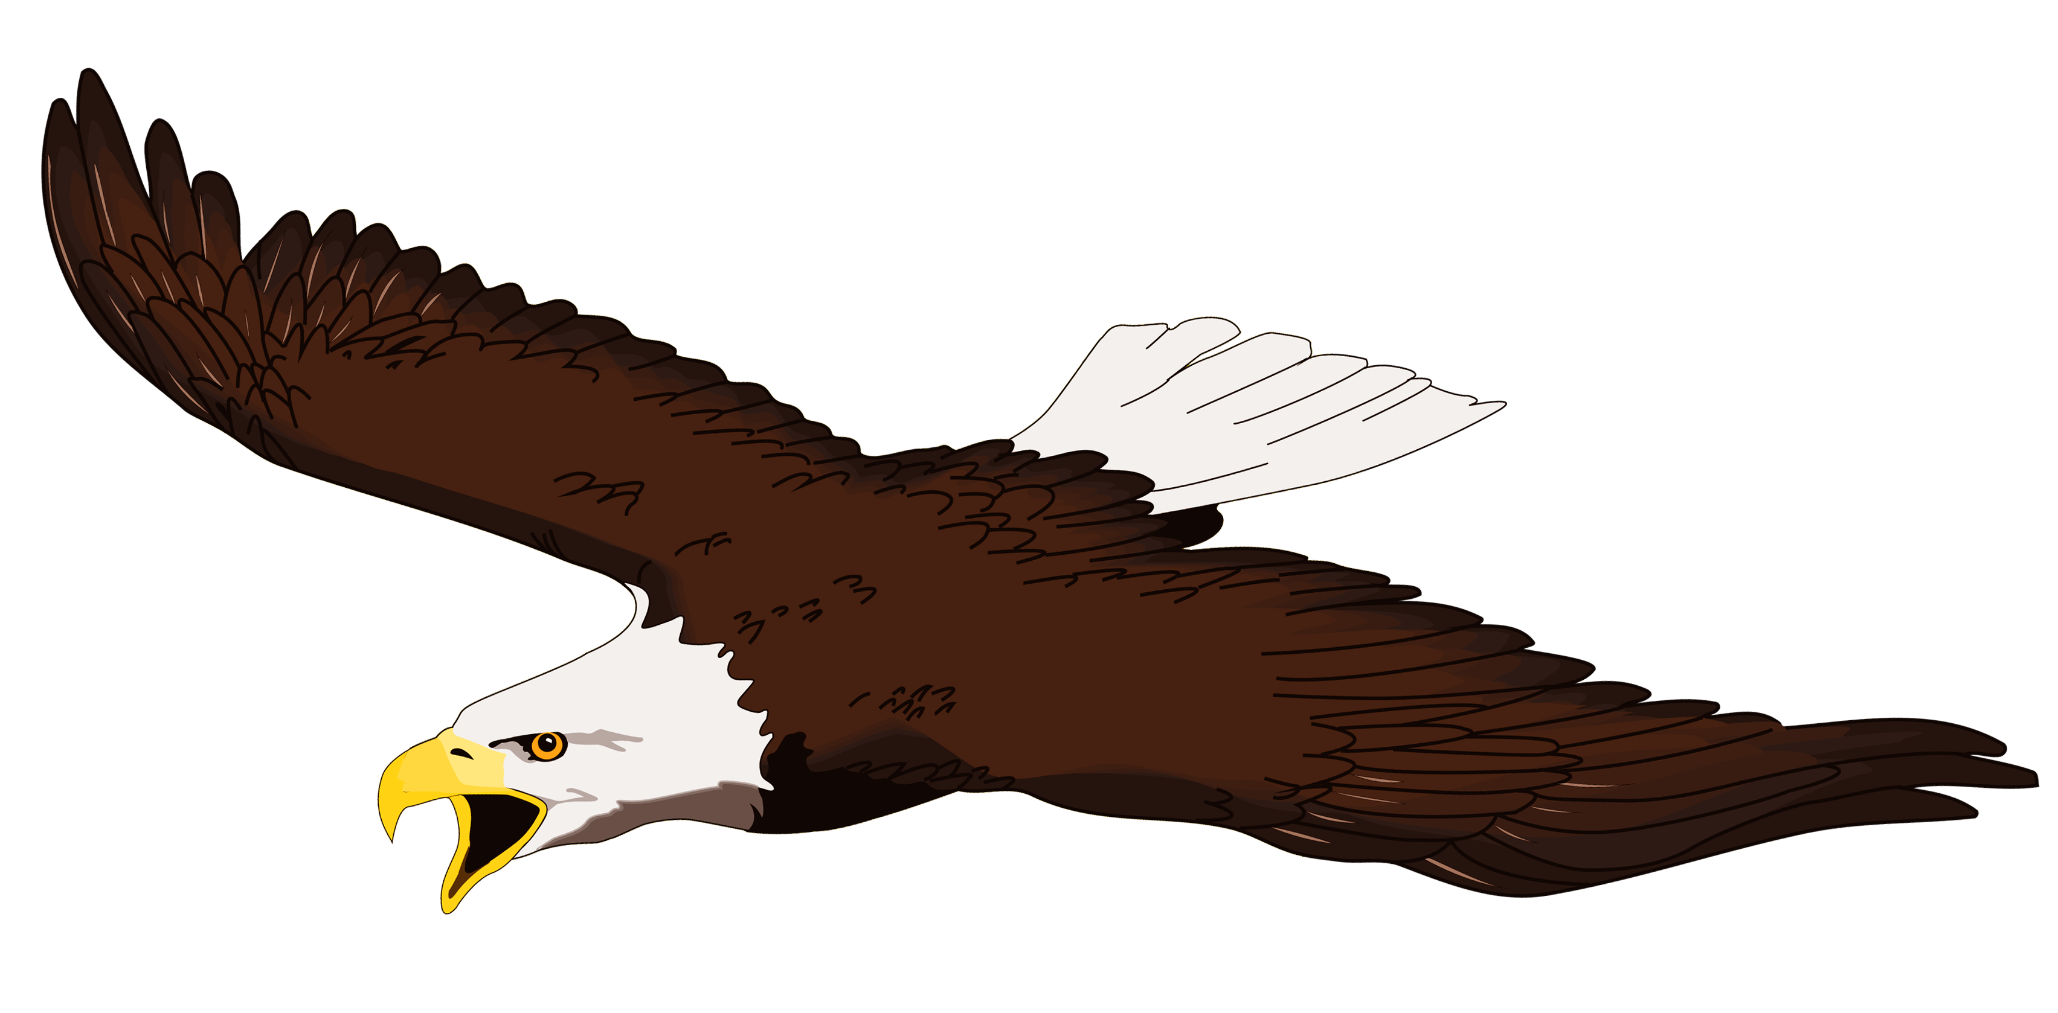

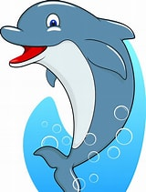
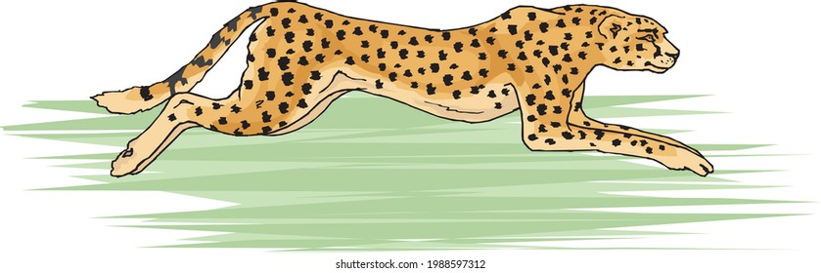
Handwriting:
Read the following sentences and then copy them with nice handwriting:-
Let’s read & copy!
1- An eagle has sharp eyes and it can fly high.
2- A dolphin can swim fast because it has fins.
3- The cheetah is the fastest animal on land .
14

