Slide 1


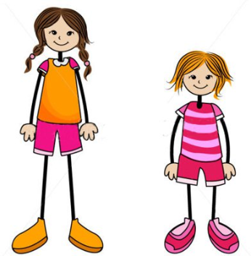

Listening test
الجزء الأول كل جزء 5 اسئلة
Look at the pictures Listen and choose True or false ? .
الجزء الثاني كل جزء 5 اسئلة Look at the pictures Listen and choose the correct answer A or B ?
.

Slide 2


Example:
True / False
Notes:
false

Slide 3


Have a go at a True or False Question!
1. True / False
2. Khalid saw a giraffe at the zoo. True / False
Notes:
False
False

Slide 4
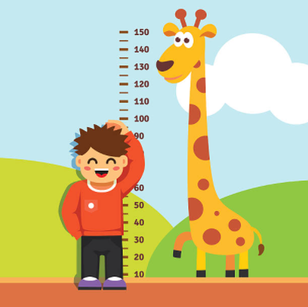
How tall is Saif?
Example:
A. seventy metres
B. a hundred centimetres
Notes:
b. a hundred centimeters

Slide 5
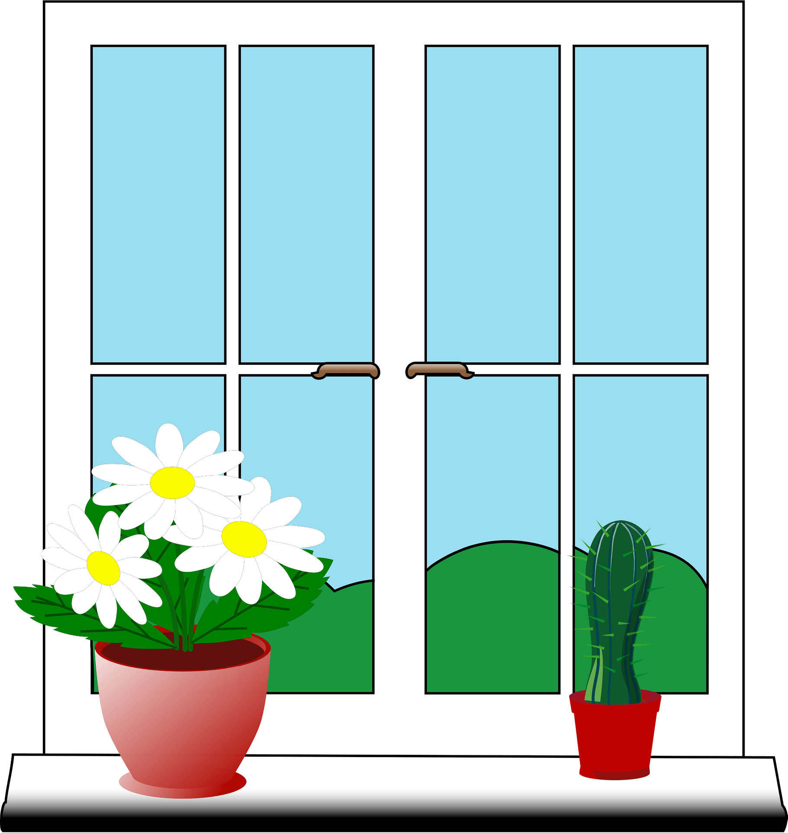
Have a go at a Multiple Choice Question!
Where are the flowers?
A. next to the window
B. next to the door
2. When does Abdulaziz eat breakfast on Saturday?
A. 8 o’clock
B. 9 o’clock
C. 10 o’clock
Notes:
A
B

