Slide 1


Grade 3
Writing Programme
Task 2

Slide 2
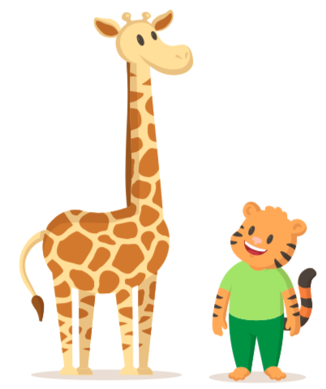
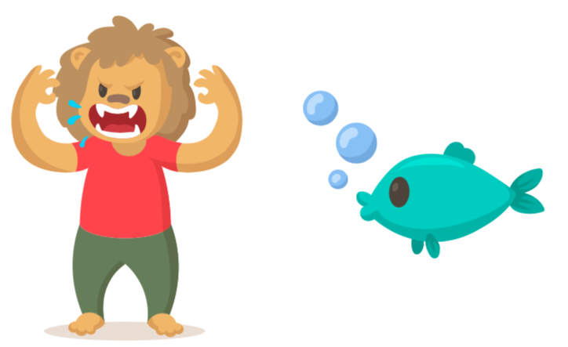
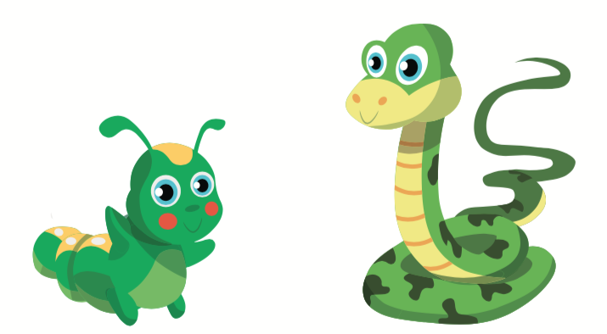
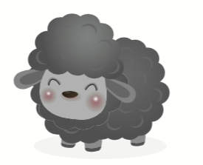
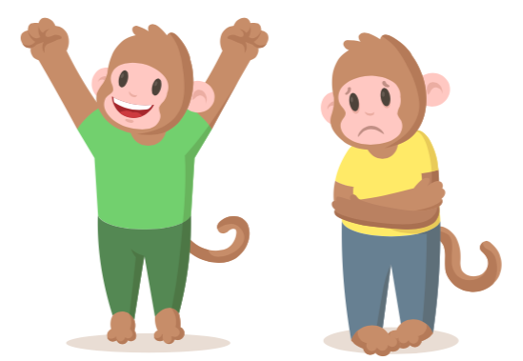
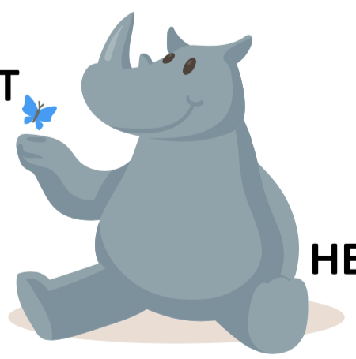
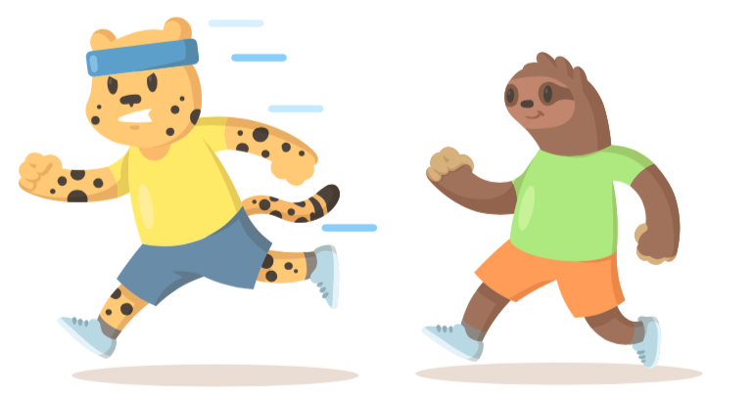
Activity 1 Brainstorm
Choose a pair of adjectives for each picture.
heavy
light
tall
short
scary
cute
long
short
fast
slow

Slide 3
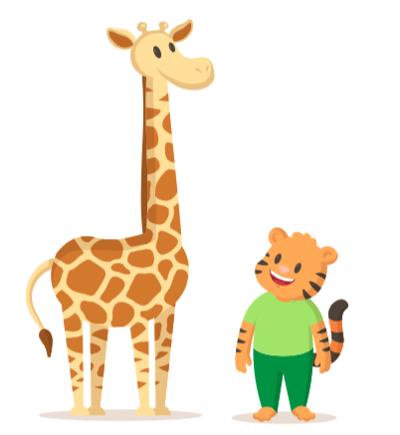
Activity 2 Comparatives
Complete the sentences using comparatives.
When the adjective has one syllable | tall - taller
When the adjective has consonant + vowel + consonant | big - bigger
When the adjective ends in -e | cute - cuter
When the adjective ends in -y | happy - happier
The giraffe is ______________.
The tiger is ______________.
___________________________________.
___________________________________.

Slide 4
Activity 3 Superlatives
Complete the sentences using superlatives.
When the adjective has one syllable | tall – tallest
When the adjective has consonant + vowel + consonant | big - biggest
When the adjective ends in -e | cute - cutest
When the adjective ends in -y | happy - happiest
The lion is the ______________.
The sheep is the ______________.
___________________________________.
___________________________________.

Slide 5
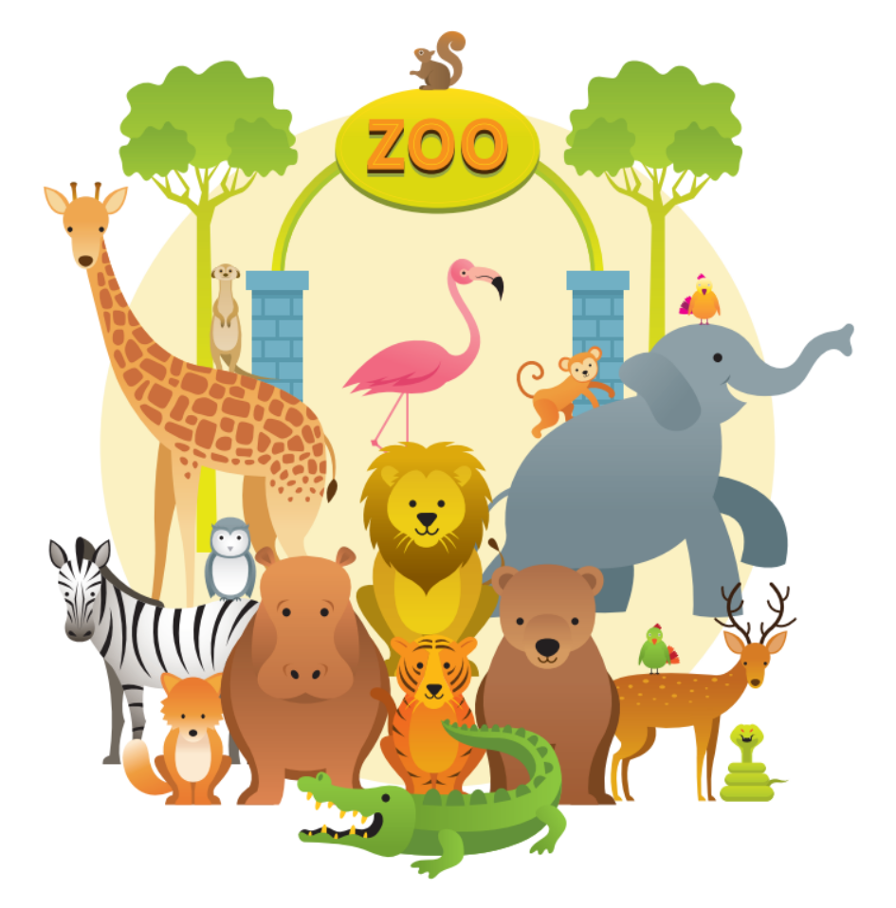
Activity 4 Discussion
Talk about the animals in the picture. Then, answer the questions.
1. Which animals are bigger than the monkey?
2. Which animals are lighter than the tiger?
3. Which animal is the cutest?
4. Which animal is the scariest?

Slide 6
Activity 5 Write Sentences
Write about the picture using comparatives and superlatives.
Use the adjectives in the box.
loud greedy quiet strong

