Slide 1

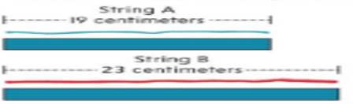
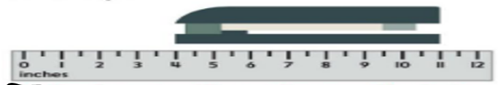
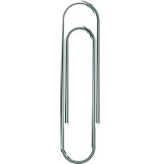
Math Quiz 2
Name: Class:
1:The length of the pencil is …………….inches.(2points)
5: How much string A is longer than string B? ( 2points)
2:The length of the brush is ………….Centimeters.(2points)
3:The length of the stapler is .………..Inches.(2 points)
6:1 Meter = Centimeters ( 2points)
7:1 Feet = Inches ( 2points)
8:1 yard = Inches (2points)
9:
(4Points)
4:A paper clip is about : (2points)
1 Inch 1 Foot 1 yard

