Slide 1
Skill check Revision
Monday 25-10-2021

Slide 2
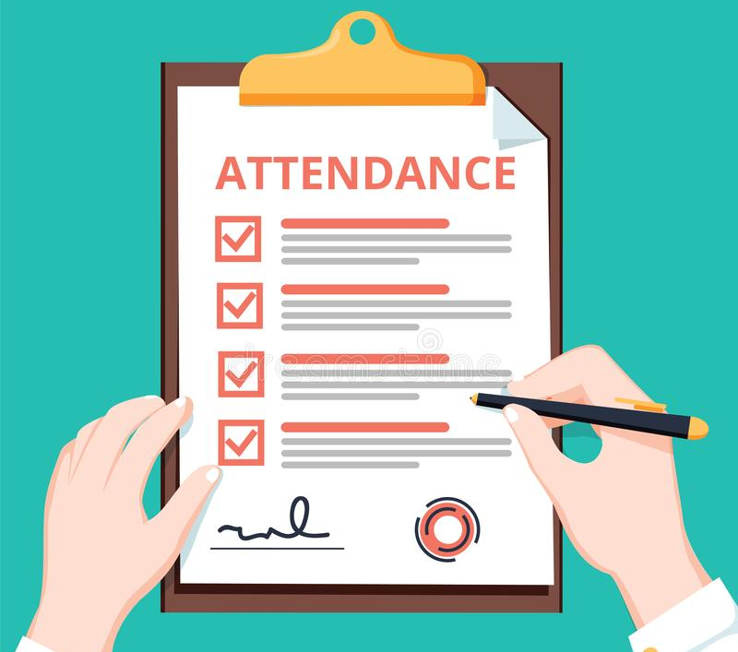

Slide 3
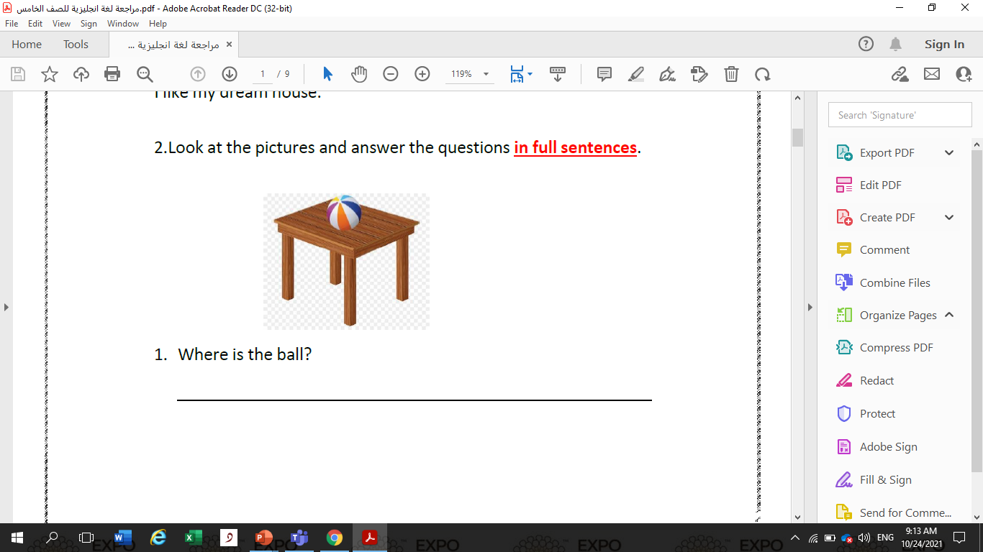
The ball is on the table .

Slide 4
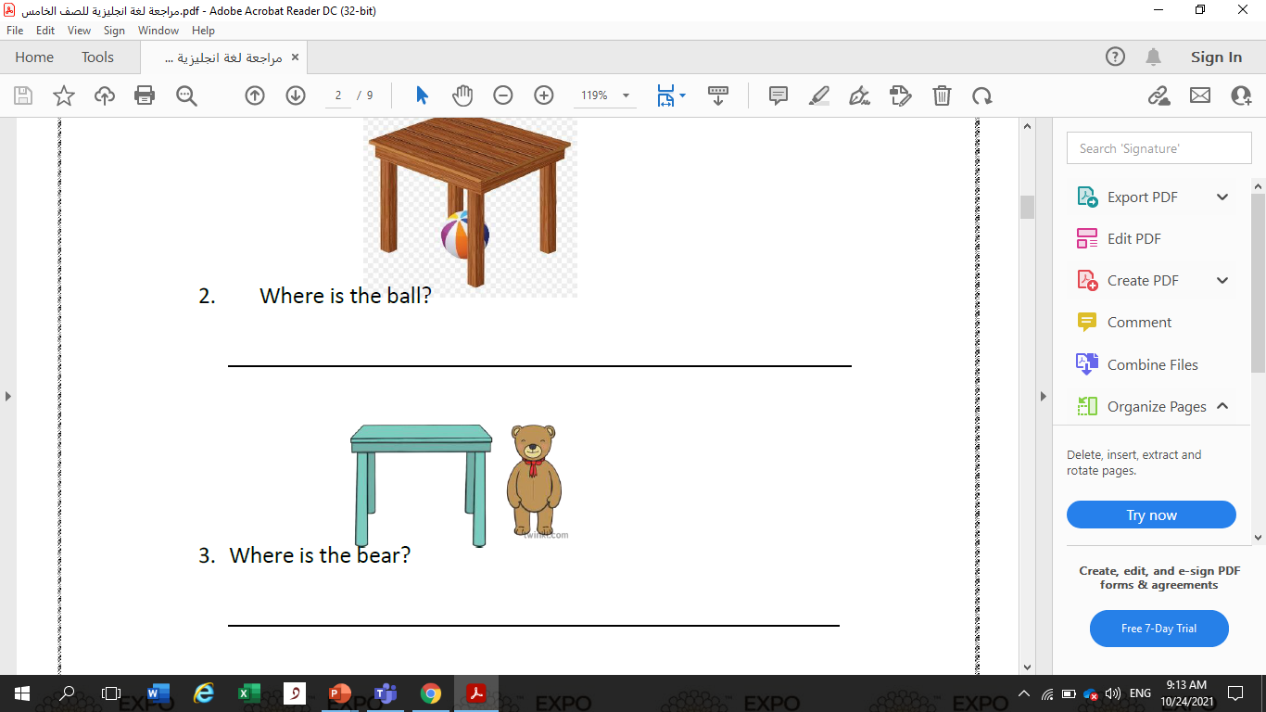
The ball is under the table .
The bear is next to the table .

Slide 5
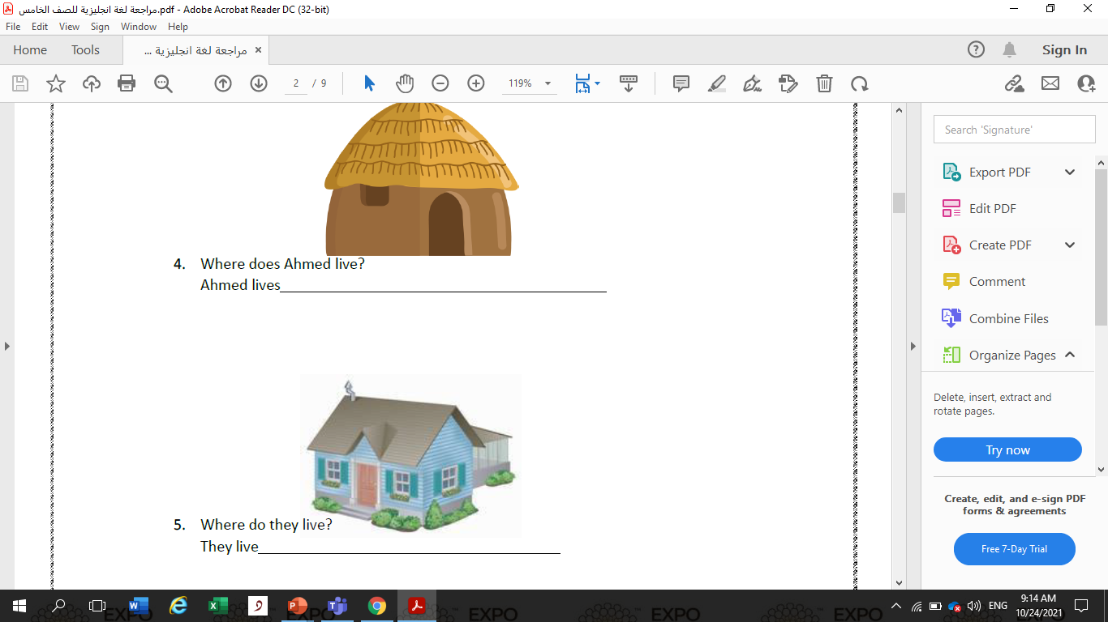
in a hut .
in a villa .

Slide 6
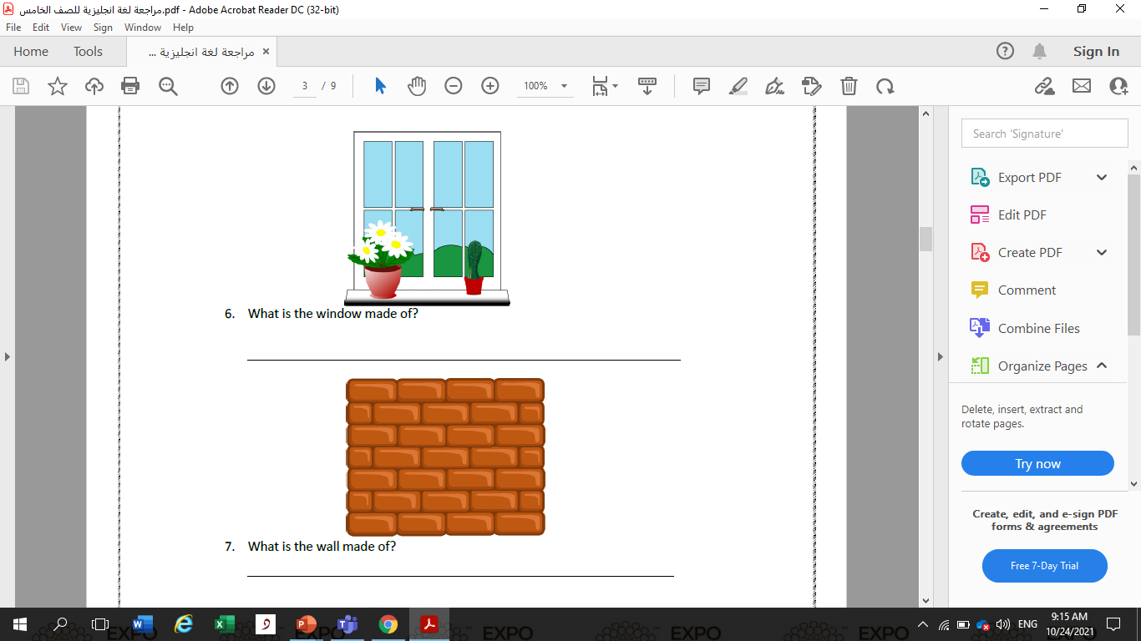
The window is made of glass .
The wall is made of stone .

Slide 7
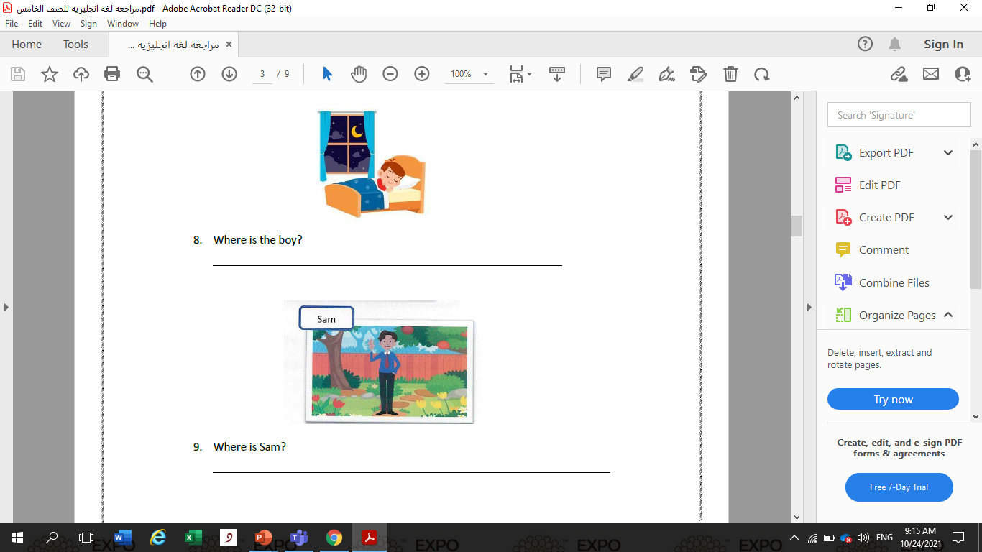
The boy is in the bedroom .
Sam is in the garden .

Slide 8
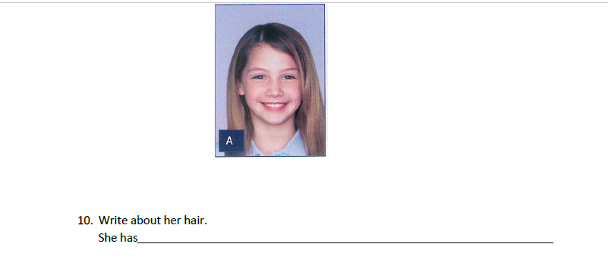
Long blonde hair .

Slide 9
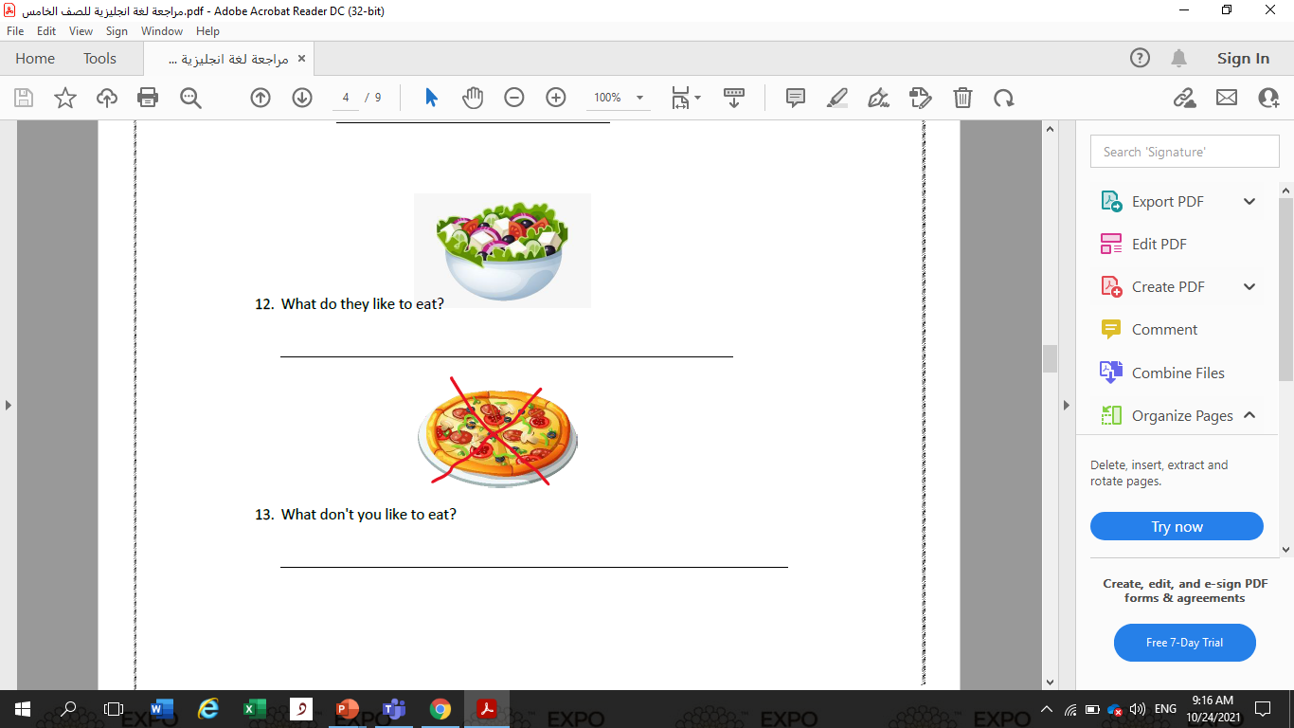
They likr to eat salad .
They don’t like to eat pizza .

Slide 10
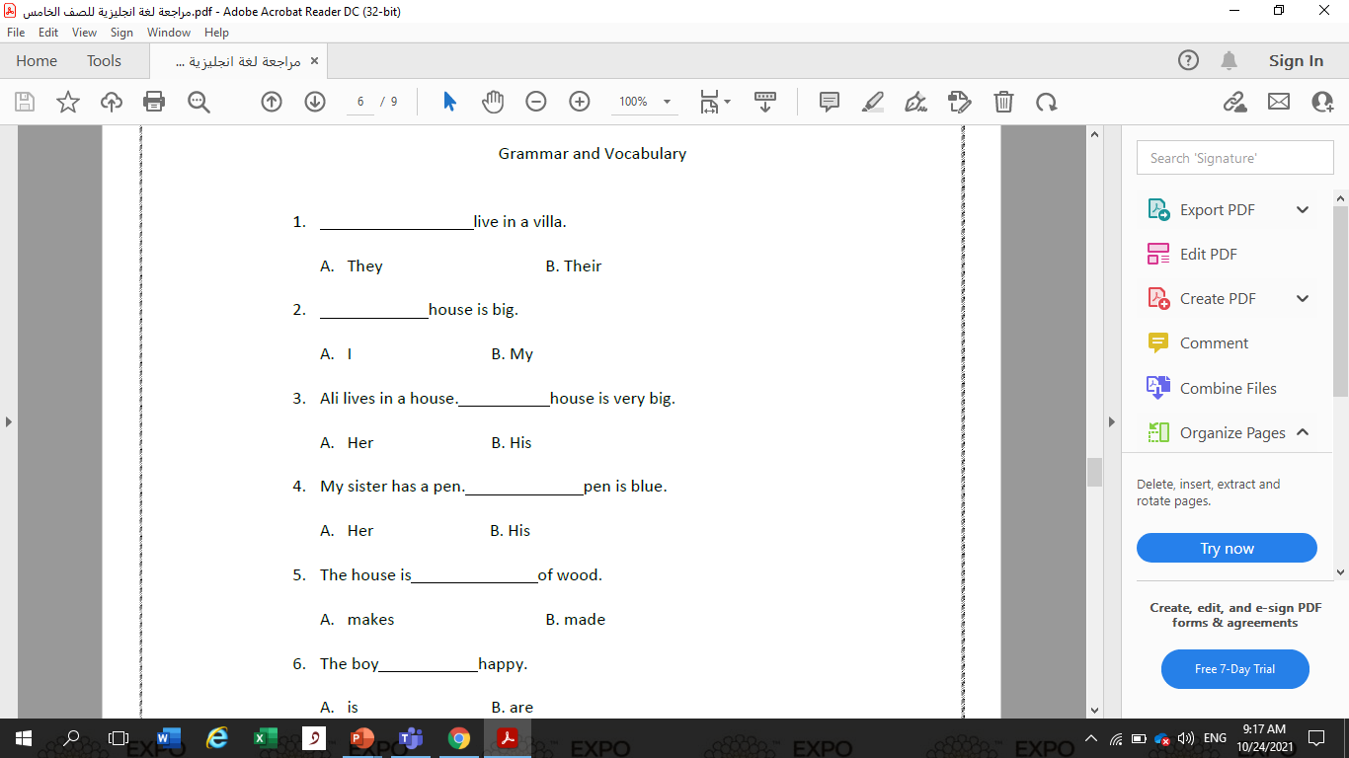


Slide 11
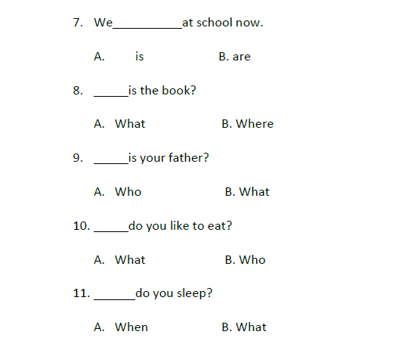

Slide 12


Slide 13
