Slide 1
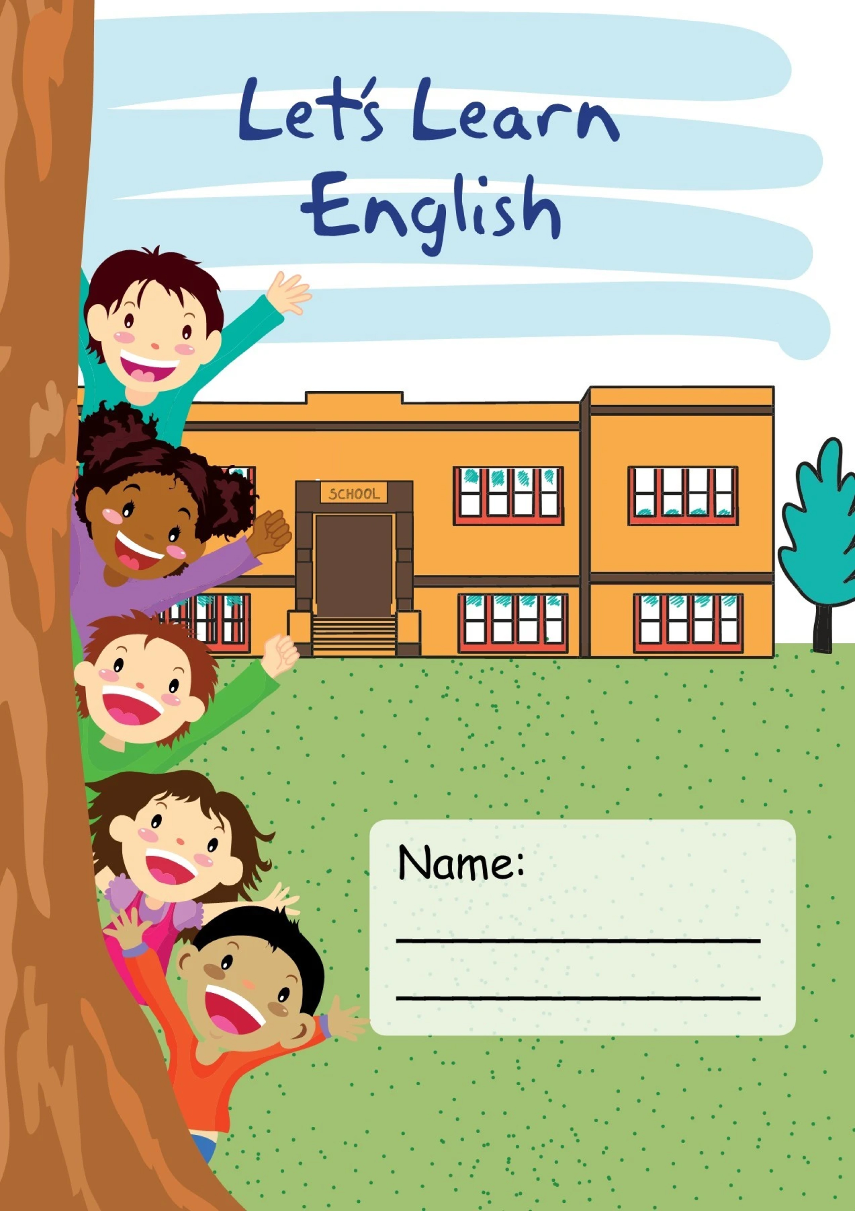

Slide 2
WEEK 1
الكلمات المطلوبة للحفظ قراءة وكتابة
للصف الثاني – الفصل الدراسي الأول
WEEK 2
WEEK 3
New
Happy
Lesson
School
Classroom
Back pack
Computer
example
Morning
Afternoon
Evening
Start
Finish
Break
Play
Before
After
English
Math
Art
Music
Sport
Write
Favorite
Fun
Difficult

Slide 3
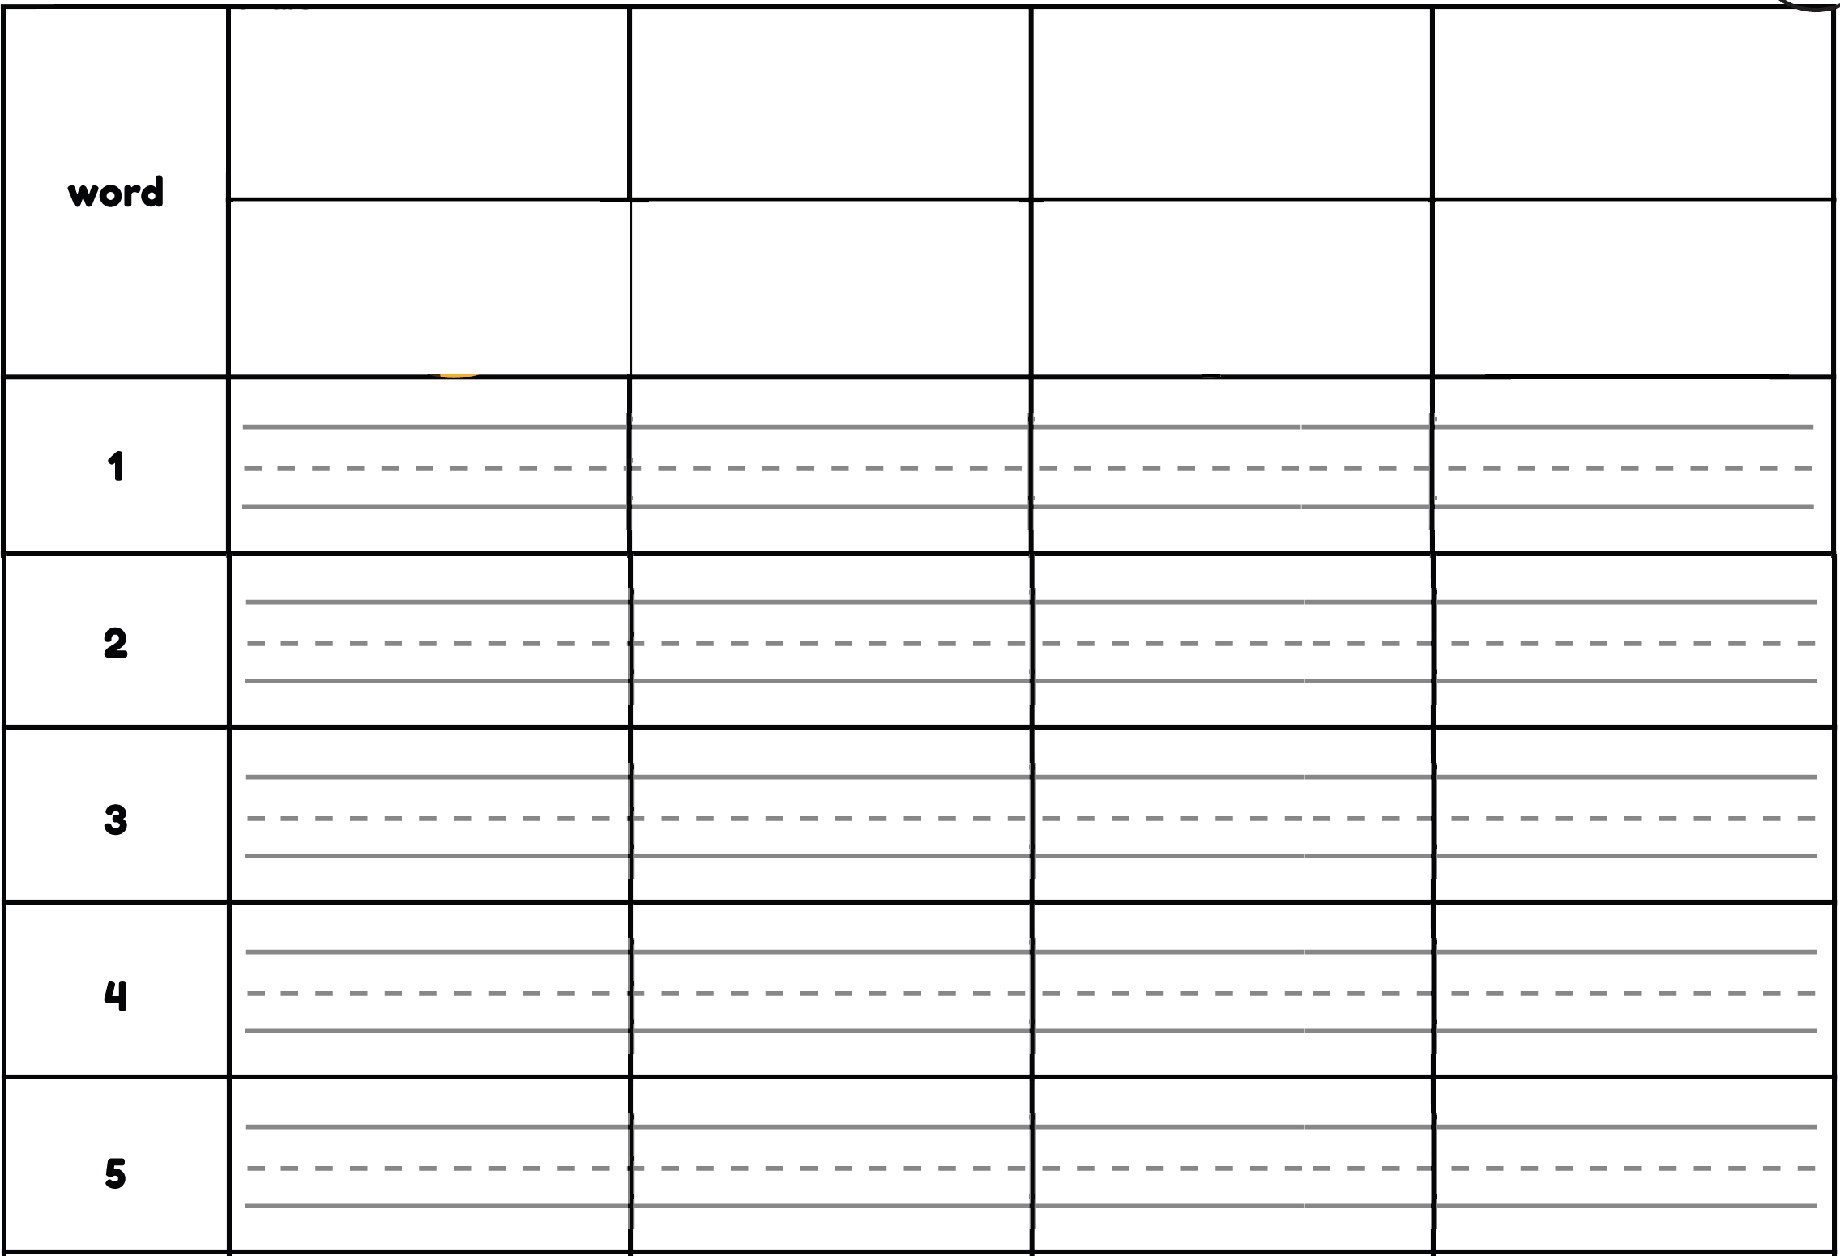


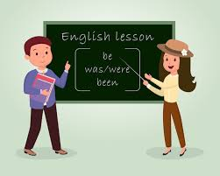

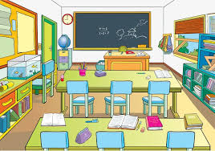


WEEK 1
New
Happy
Lesson
School
Classroom
Back pack
Computer
example

Slide 4
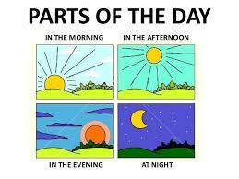
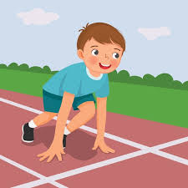
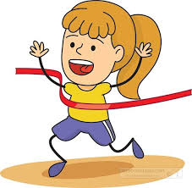
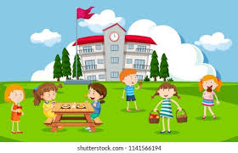
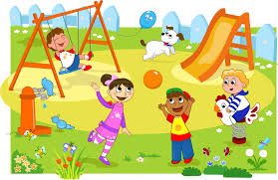

WEEK 2
Morning
Afternoon
Evening
Start
Finish
Break
Play
Before/ After

Slide 5





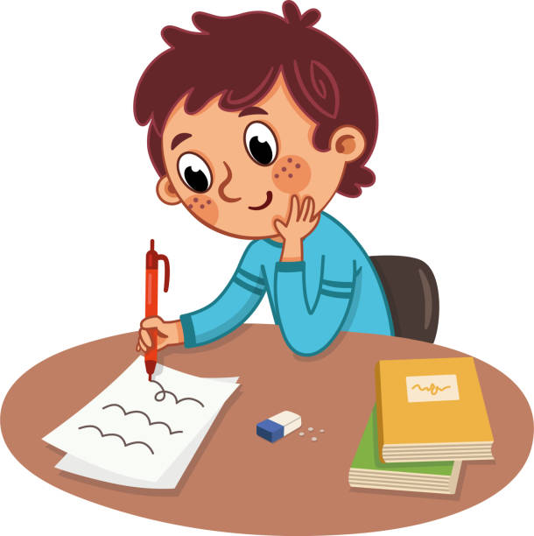


WEEK 3
English
Math
Art
Music
Sport
Write
Favorite
Fun

Slide 6

WEEK 3
Difficult

Slide 7
الكلمات المطلوبة للحفظ قراءة وكتابة
للصف الثاني – الفصل الدراسي الأول
WEEK 4
WEEK 5
WEEK 6
Tall
Short
Young
Old
Beautiful
Hair
Eyes
Different
Trousers
Dress
Boots
Shorts
Wear
Favourite
Cold
hot
Aunt
Uncle
Cousin
Grandparent
Family tree
Who
How many
Their

Slide 8
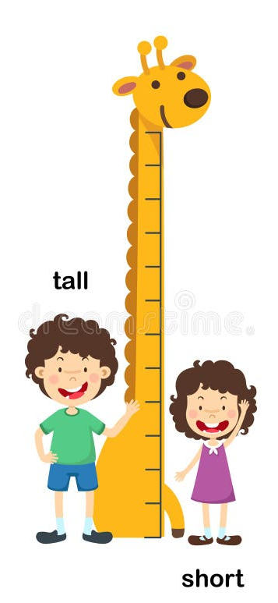
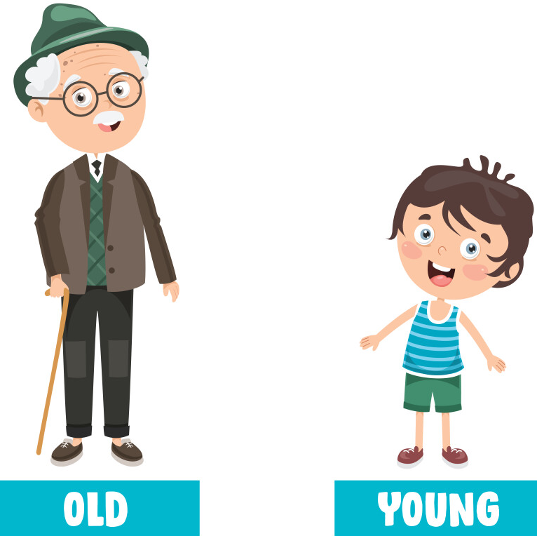




WEEK 4
Tall
Short
Young
Old
Beautiful
Hair
Eyes
Different

Slide 9
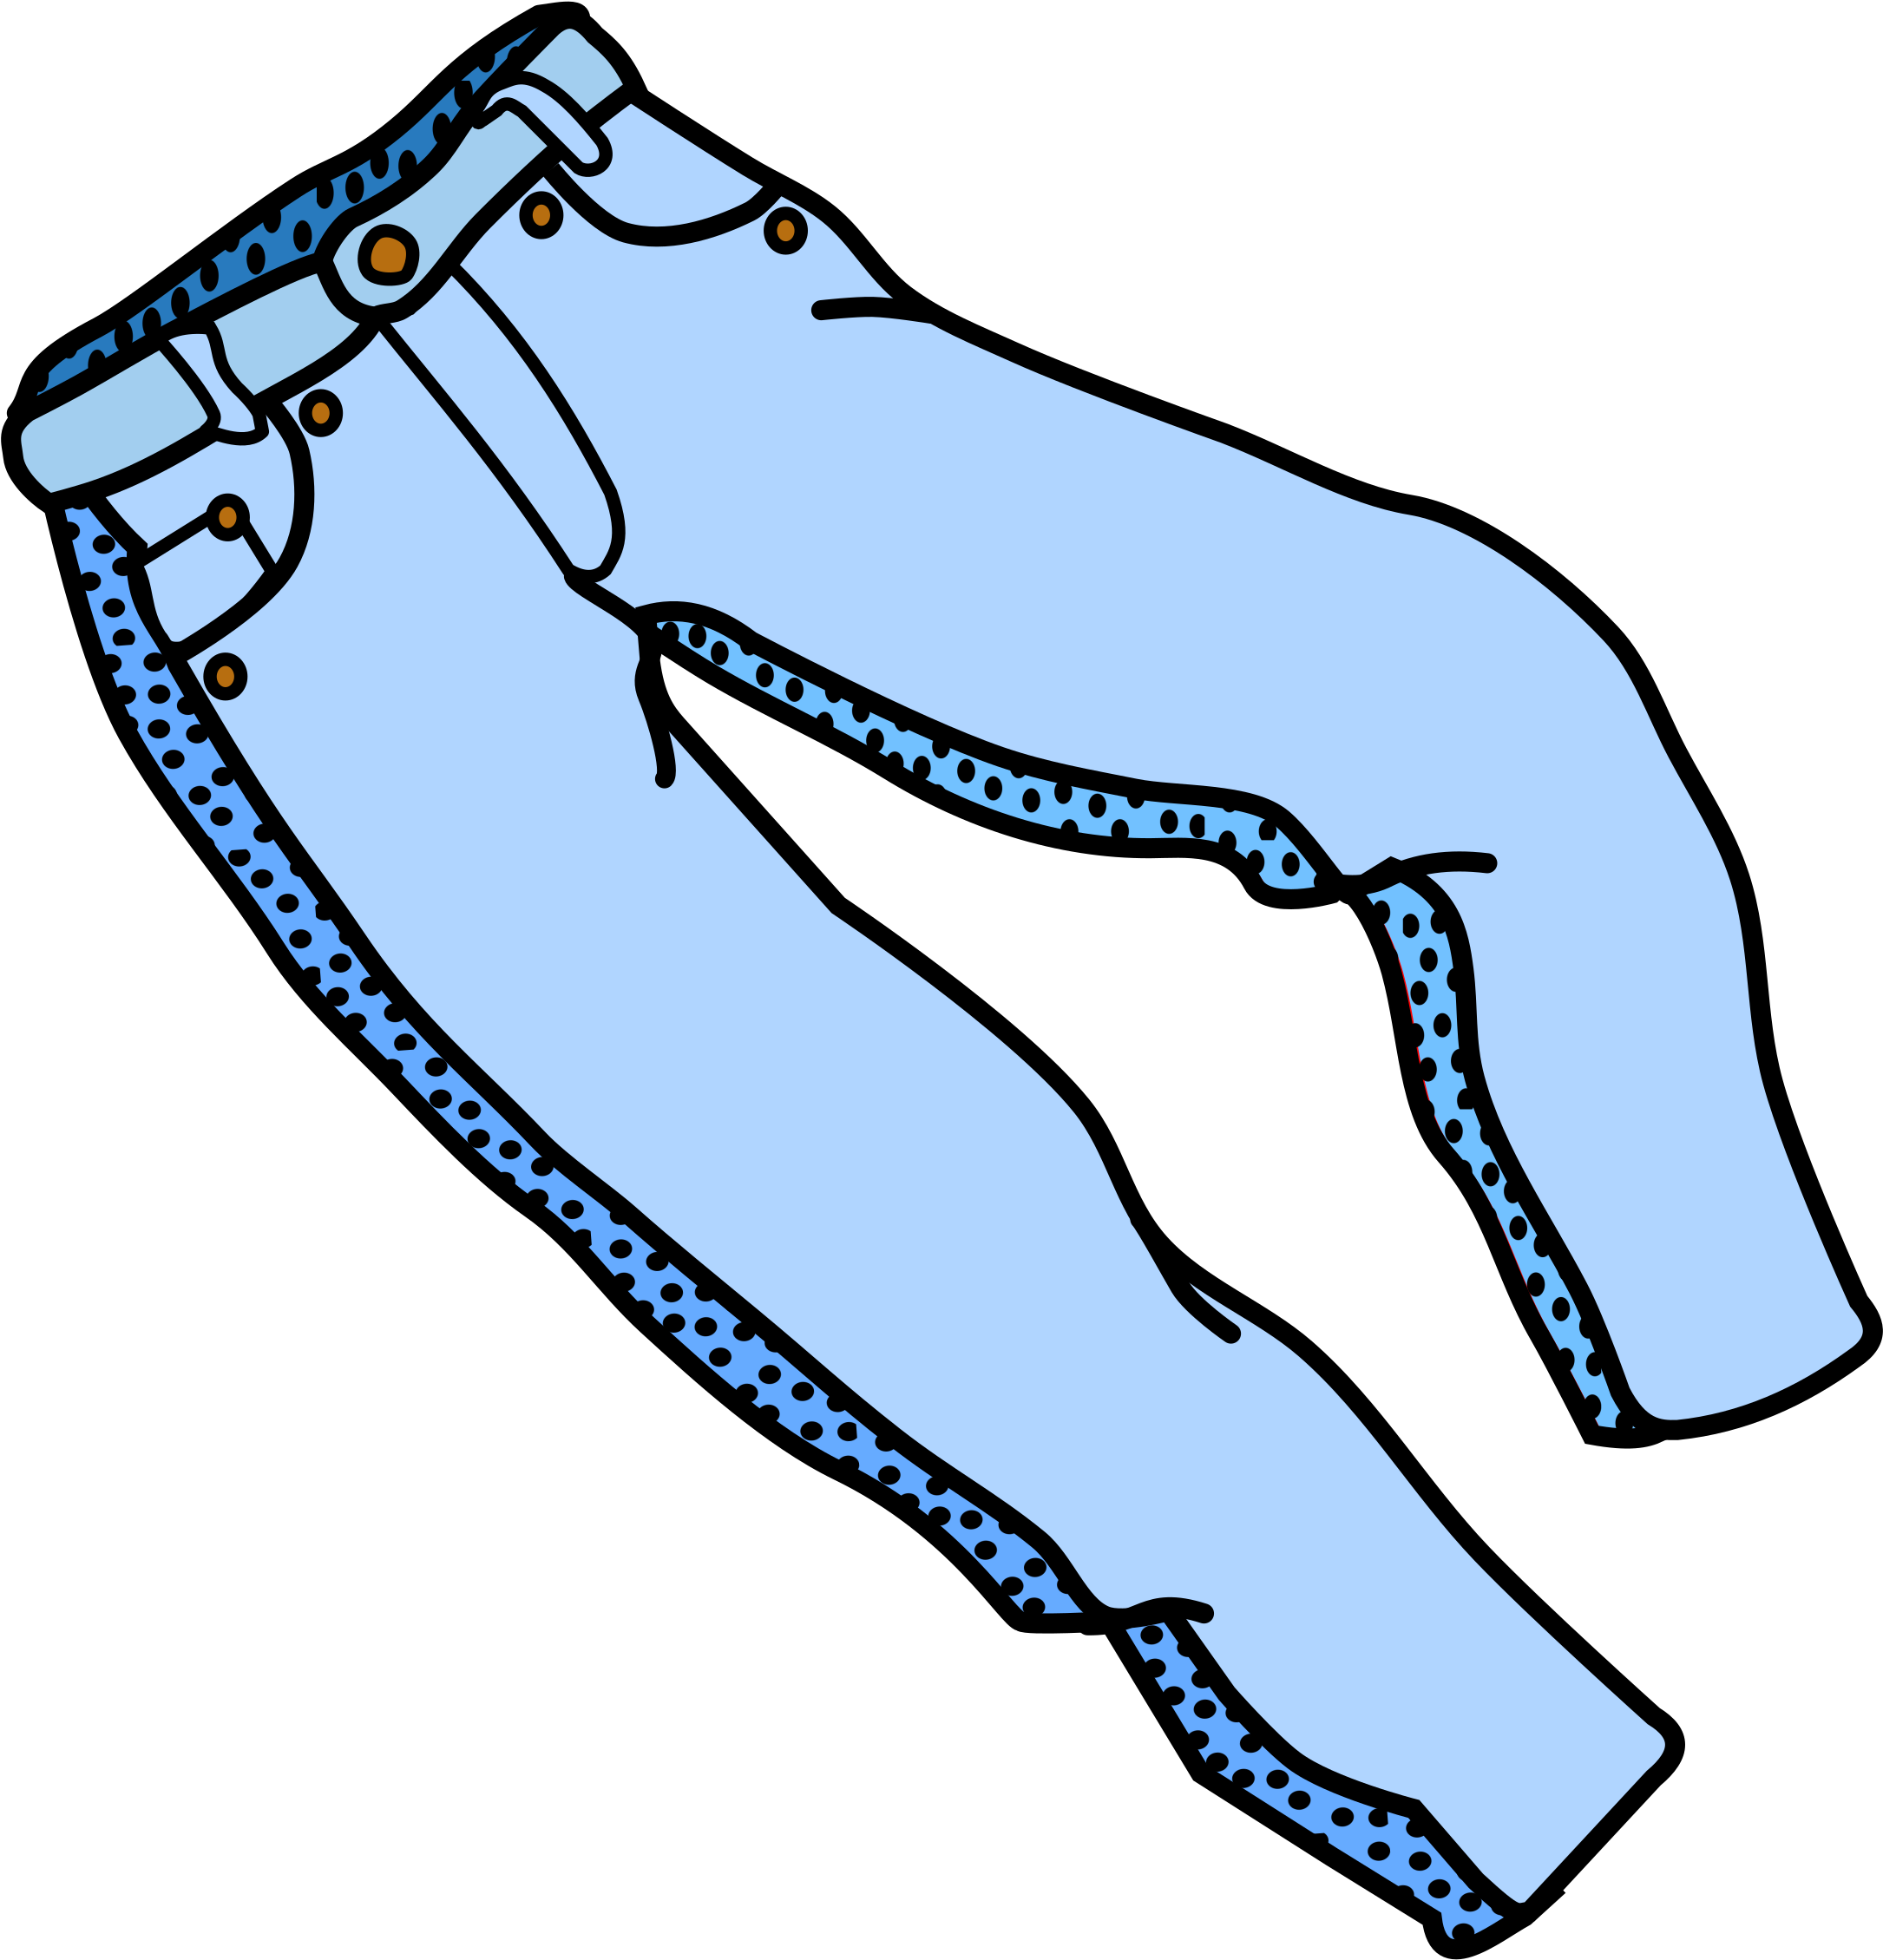
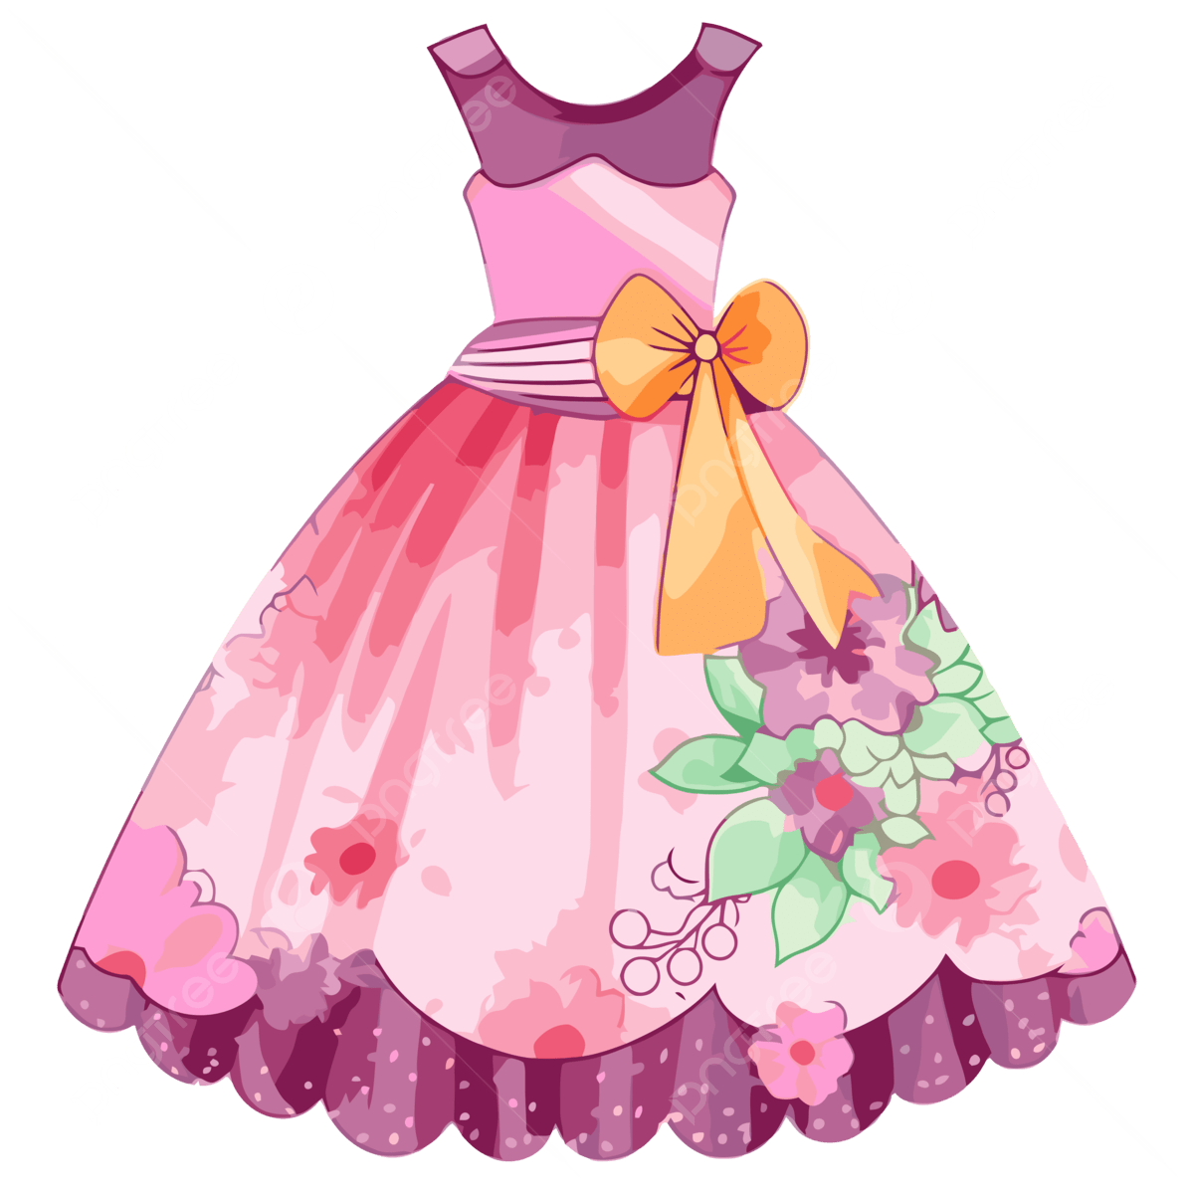
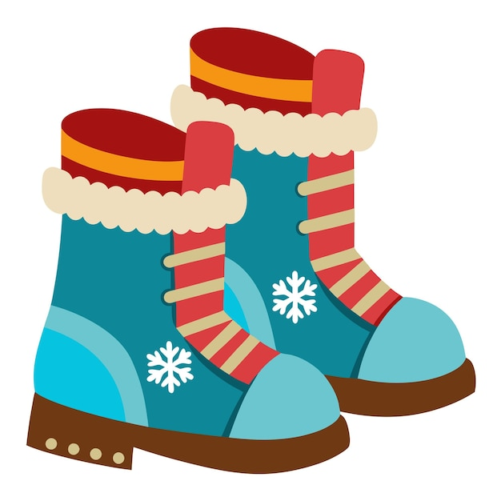

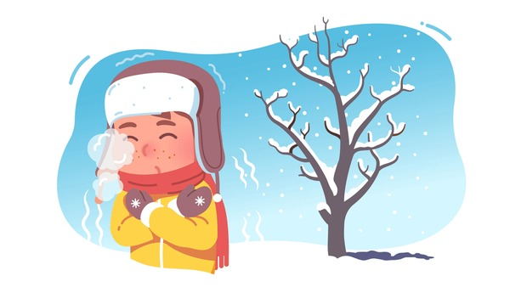
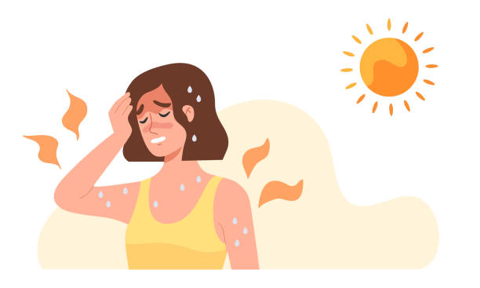
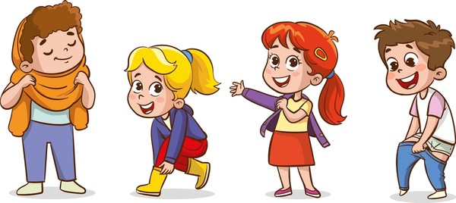
WEEK 5
Trousers
Dress
Boots
Shorts
Wear
Favourite
Cold
hot

Slide 10
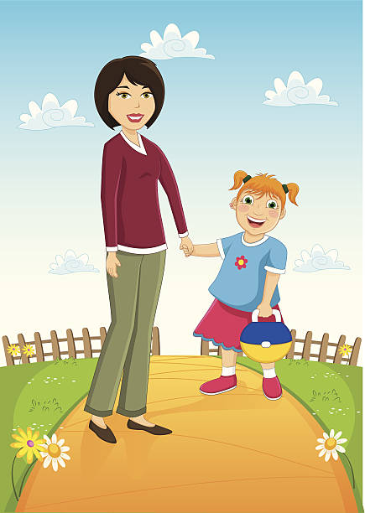

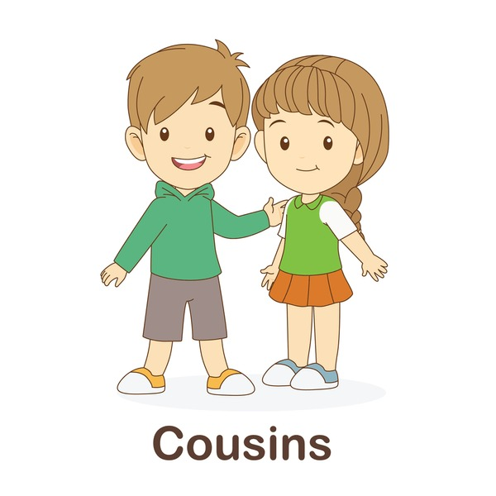
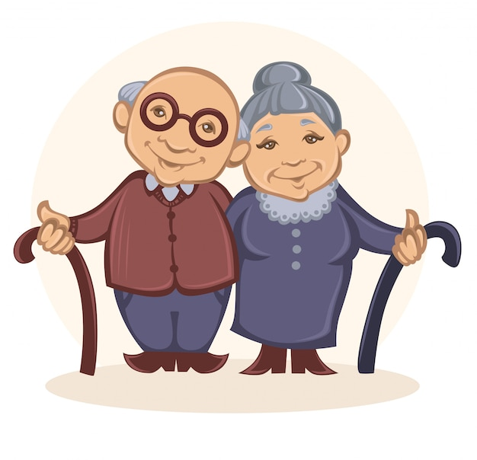
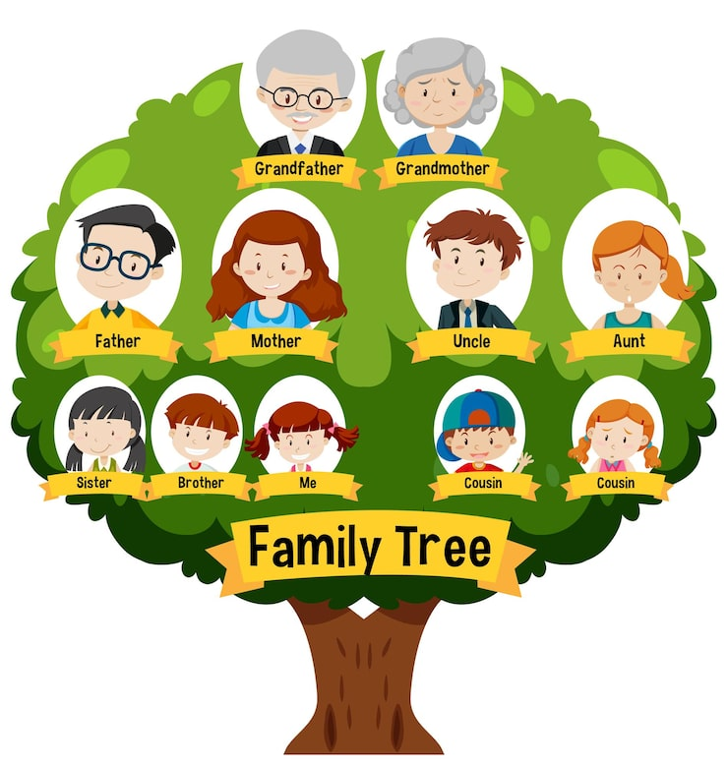

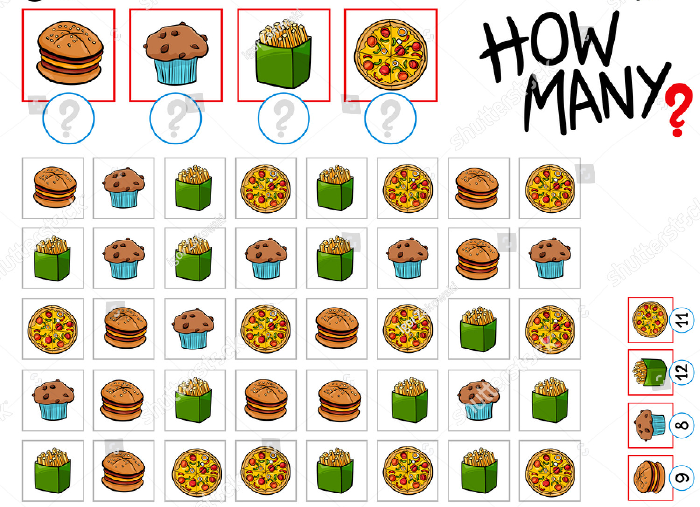

WEEK 6
Aunt
Uncle
Cousin
Grandparent
Family tree
Who
How many
Their

Slide 11
WEEK 7
الكلمات المطلوبة للحفظ قراءة وكتابة
للصف الثاني – الفصل الدراسي الأول
WEEK 8
WEEK 9
Visit
Help
Cook
Clean
Watch TV
Talk
Yesterday
Tomorrow
Garden
Wall
Floor
Roof
Upstairs
Downstairs
Next to
Between
Armchair
Sofa
Mirror
Picture
Clock
Television
Cupboard
Behind

Slide 12
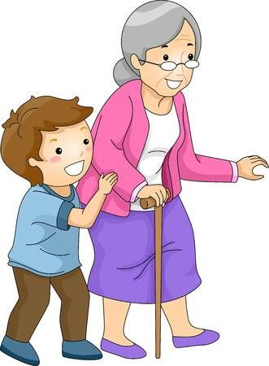
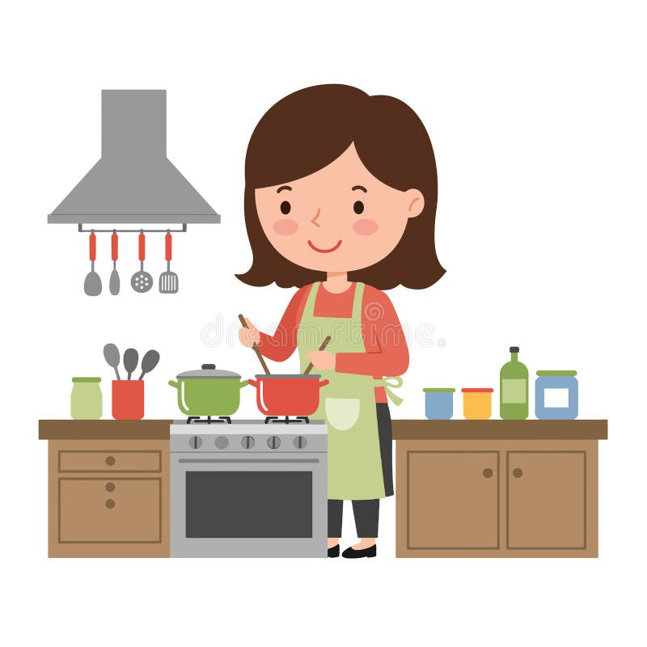
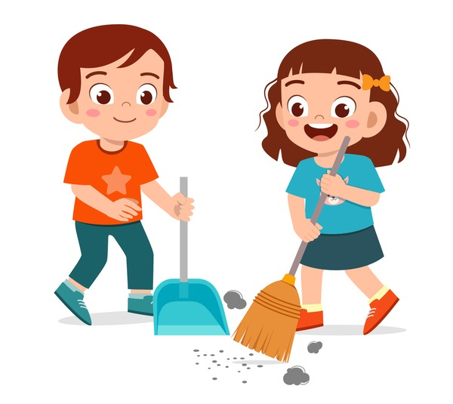

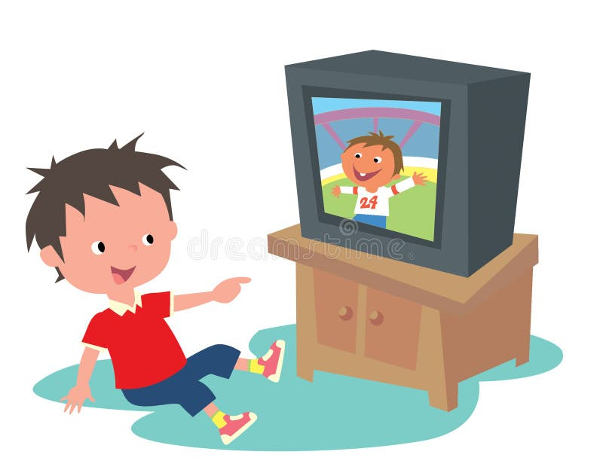

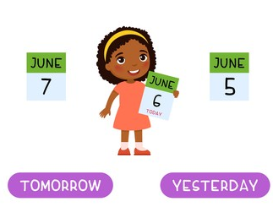
WEEK 7
Visit
Help
Cook
Clean
Watch TV
Talk
Yesterday
Tomorrow

Slide 13

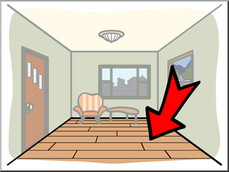
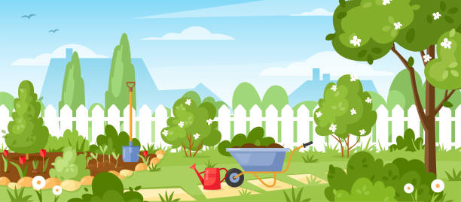

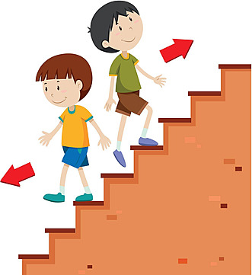

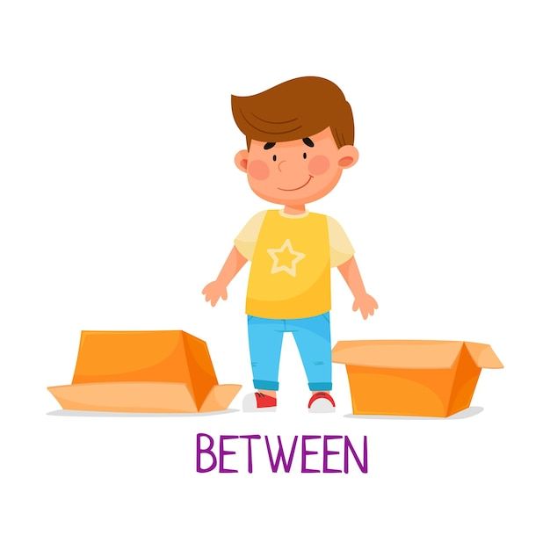
WEEK 8
Garden
Wall
Floor
Roof
Upstairs
Downstairs
Next to
Between

Slide 14



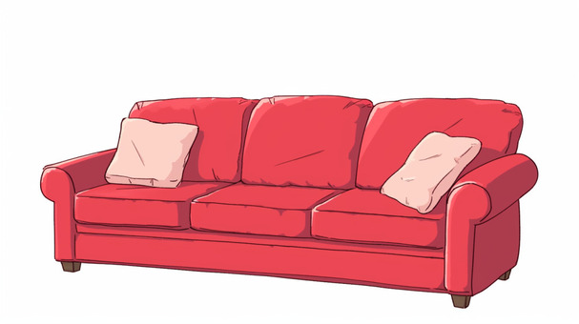



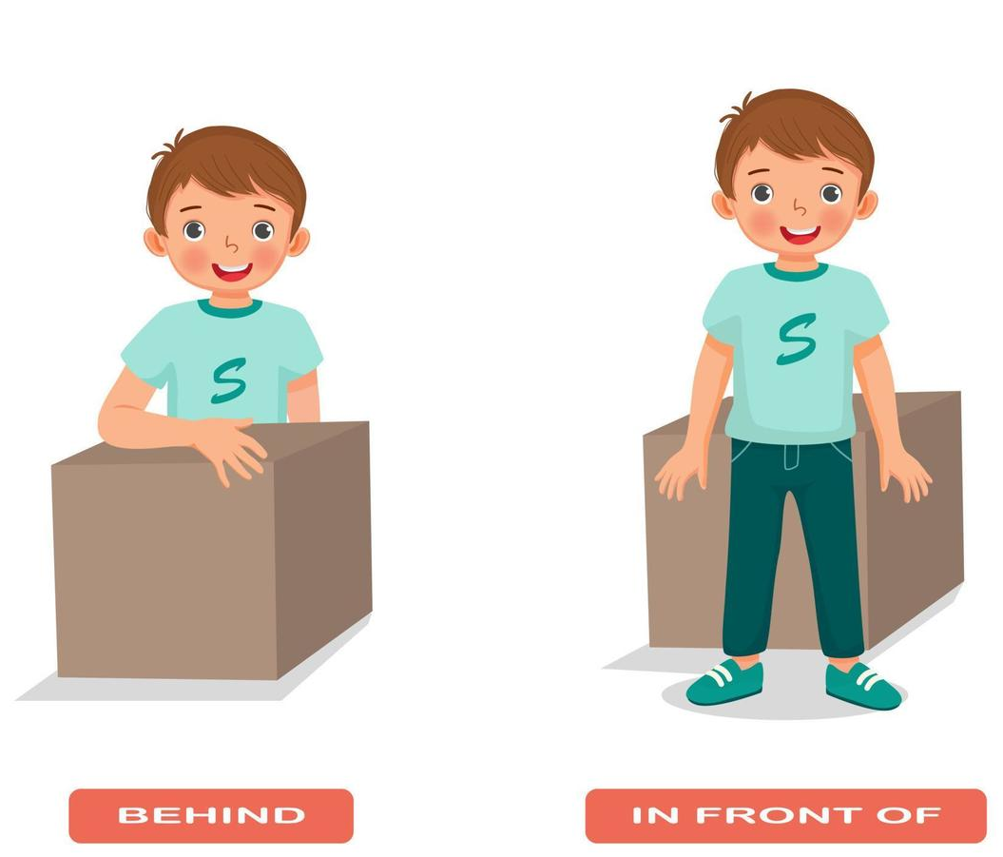
WEEK 9
Armchair
Sofa
Mirror
Picture
Clock
Television
Cupboard
Behind

