Slide 1


Dear Parents
Warm greetings to you all!!!
Please use this PowerPoint to prepare your child for
the listening assessment the 8th May 2023.

Slide 2

2022-2023
Trimester 3
Grade 2
ENGLISH
Continuous Assessment 1: Listening

Slide 3






W
ASSESSMENT RULES
You should…
Put your hand up if you have a question
Try your best
Speak clearly when it’s your turn
Remember! 50 points for camera on!!!
Remember…
No copying
No calling out

Slide 4


Part 1: Listen and circle
Yes or No.

Slide 5
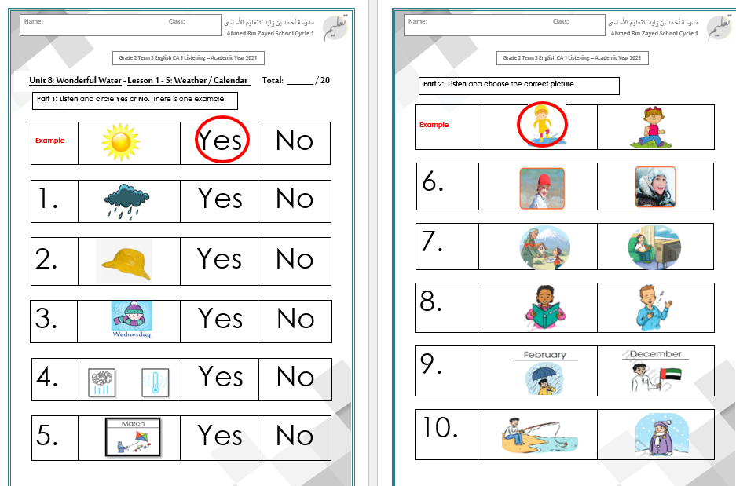
Part 1: Listen and circle
Yes or No.

Slide 6
Part 1: Listen and circle
Yes or No.

Slide 7
Part 1: Listen and circle
Yes or No.

Slide 8
Part 1: Listen and circle
Yes or No.

Slide 9
Part 1: Listen and circle
Yes or No.

Slide 10
Part 2: Listen and choose
the correct picture.

Slide 11
Part 2: Listen and choose
the correct picture.

Slide 12
Part 2: Listen and choose
the correct picture.

Slide 13
Part 2: Listen and choose
the correct picture.

Slide 14
Part 2: Listen and choose
the correct picture.

Slide 15
Part 2: Listen and choose
the correct picture.

Slide 16
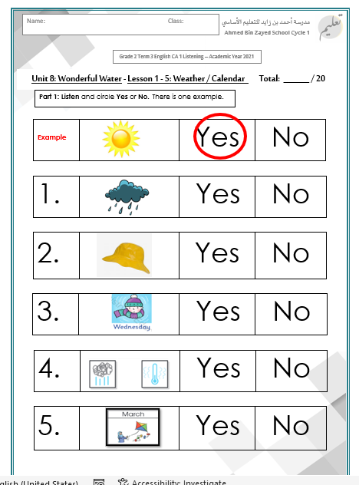
Part 1: Answers

Slide 17
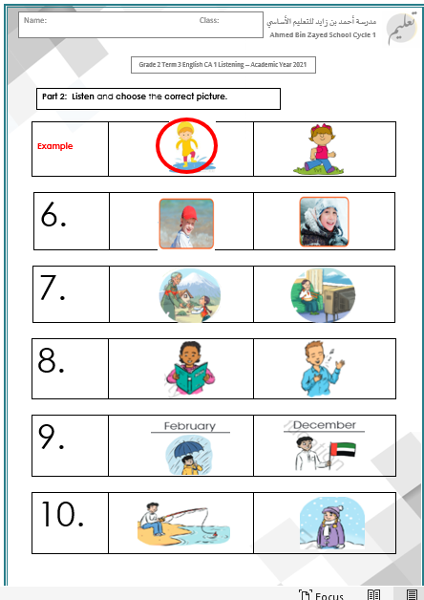
Part 2: Answers

Slide 18


