Slide 1
Unit 5 travel & tourism CB answers G12 General Term 2
Snapchat : Seniorss17 Telegram: @iiorrignal Instagram:Seniors.19

Slide 2
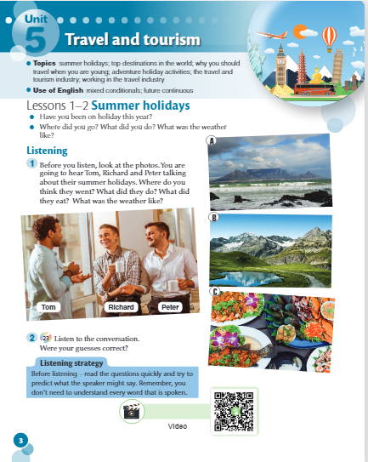

Slide 3
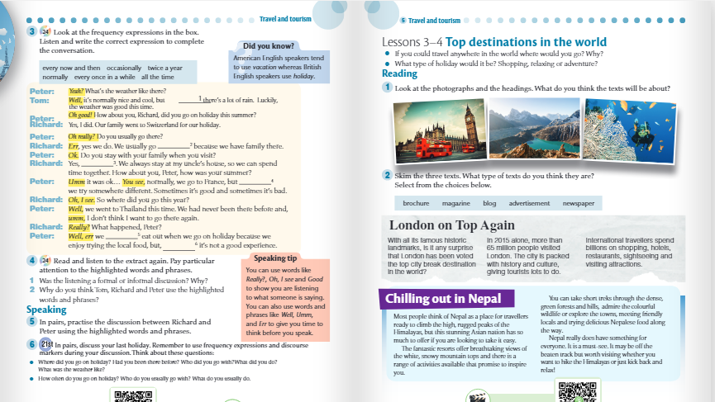
occasionally
twice a year
all the time
every now and then
newspaper
normally
Every once in a while
magazine

Slide 4
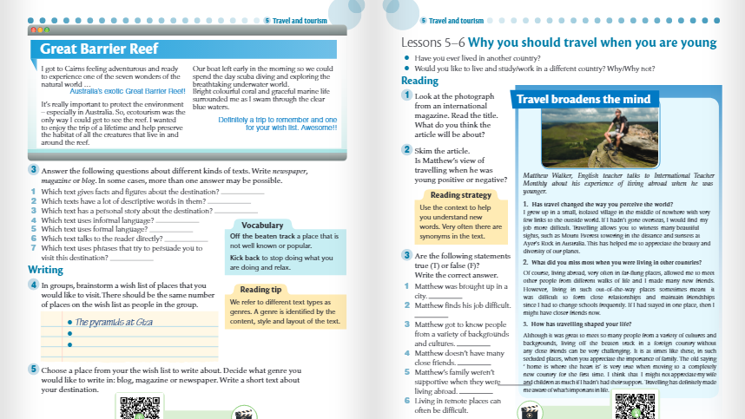
blog
Newspaper
Magazine
Blog
Blog
Newspaper
Magazine
Magazine
F
F
T
T
F
T

Slide 5
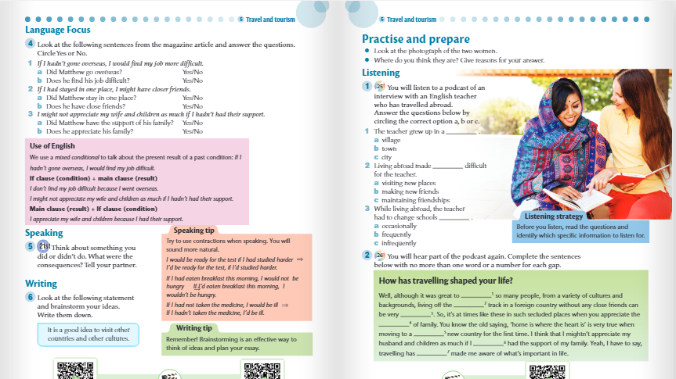
1a Yes;
1b No;
2a No;
2b No;
3a Yes;
3b Yes
1 A
2 C
3 B
meet
beaten
challenging
importance
completely
hadn’t
definitely

Slide 6
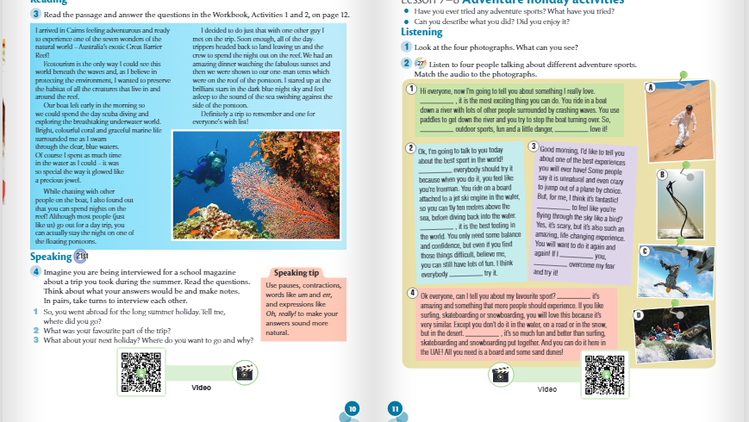
For me
D
if you like
you will
I think
Wouldn’t you like
In my opinion
were
I’d
should
B
C
I think
In my opinion
A

Slide 7
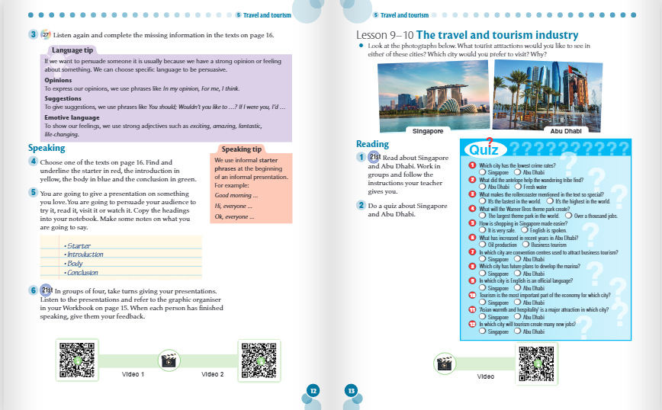

Slide 8
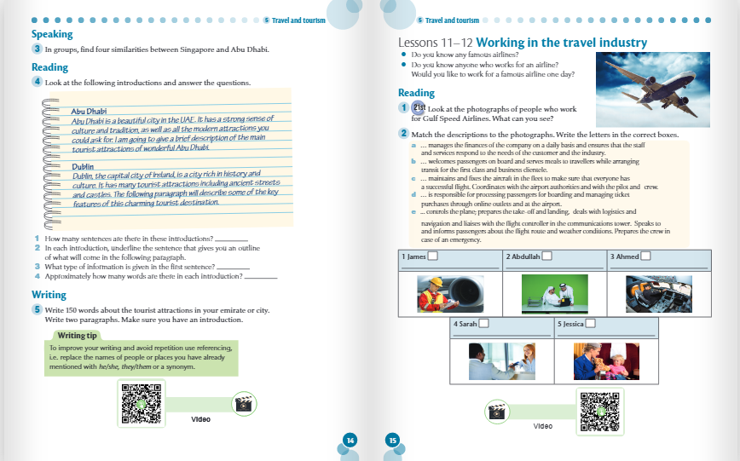
3
The third/last sentence
C
A
E
A general overview and facts about the topic
Engineering officer
Finance manager
Pilot (Captain)
Approximately 50 words
D
B
Check-in and sales assistant
Cabin crew

Slide 9
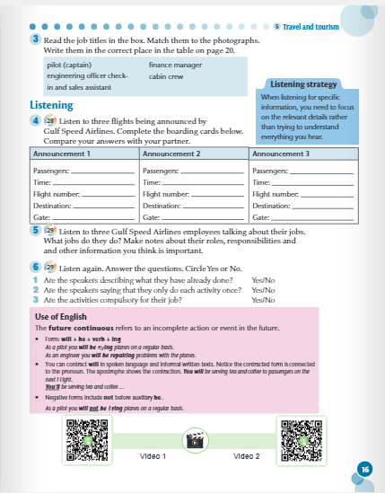
Mark Underwood
Ladies and gentlemen
22h50,
23h00,
07h30,
78643,
00983,
78394,
London,
Bali,
Singapore,
37
50
not applicable
1 No;
2 No
3 Yes

