Slide 1
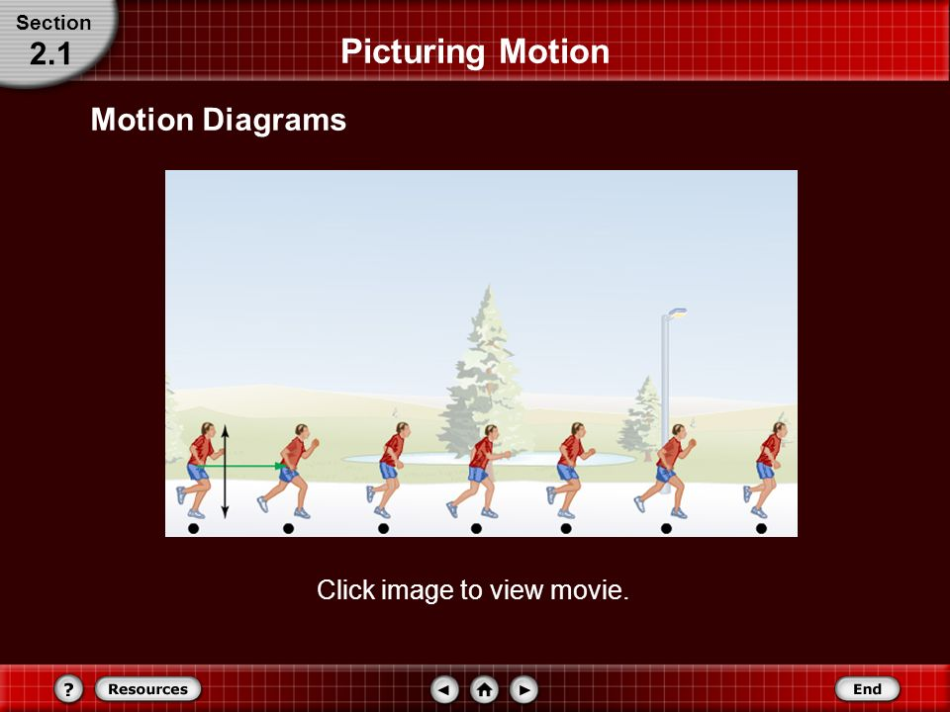
Chapter 2
Representing motion
Section 1
Picturing motion

Slide 2
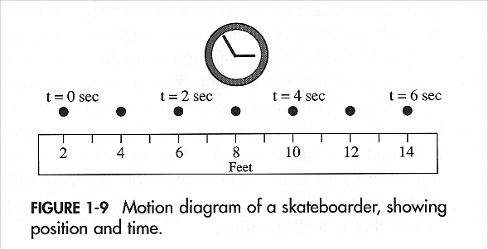
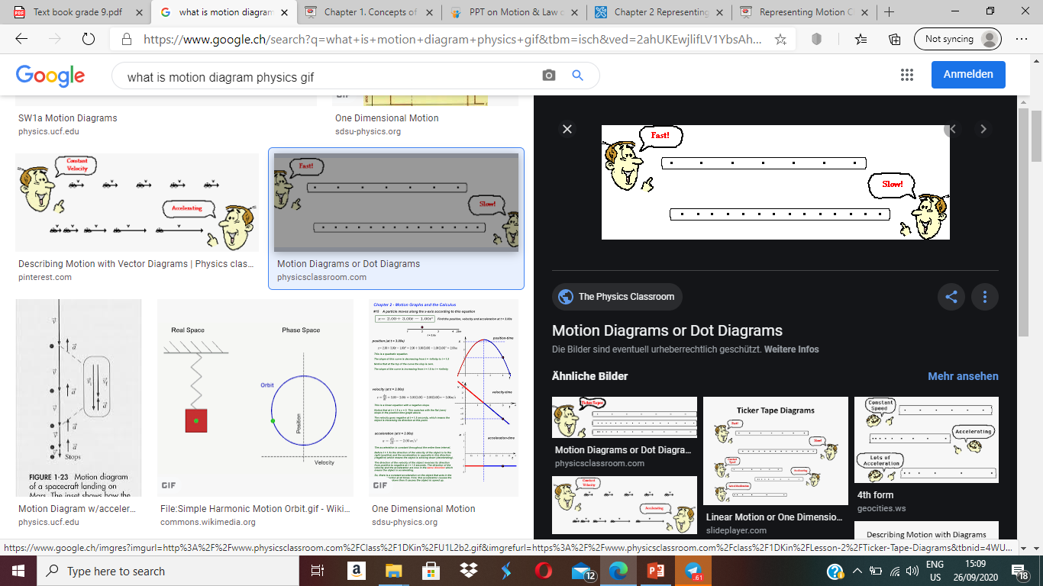
MAINIDEA
You can use motion diagrams to show how an object’s position changes over time.

Slide 3

Picturing motion
When studying moving object its useful to understand their motion by picturing how that motion would look

Slide 4
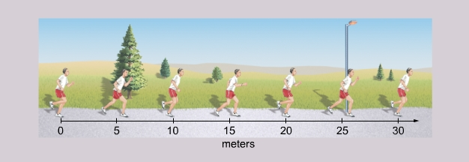
Learning objective
Use motion diagrams to show how an object position changes
Draw motion diagram to describe motion
Develop a particle model to represent a moving object

Slide 5
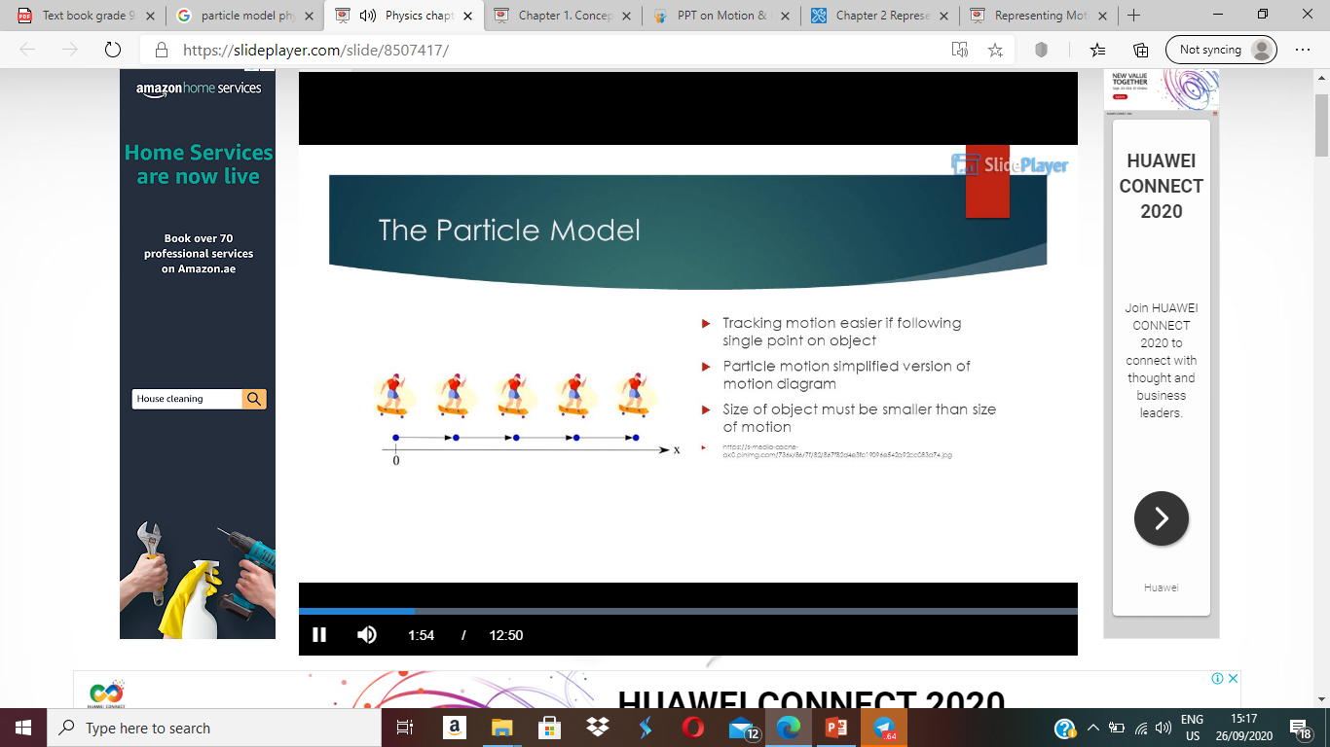
New vocabulary
is change in position of an objects
Motion
motion diagram
A series of images showing the positions of a moving object
at equal time intervals
particle model
is change in position of an objects

Slide 6
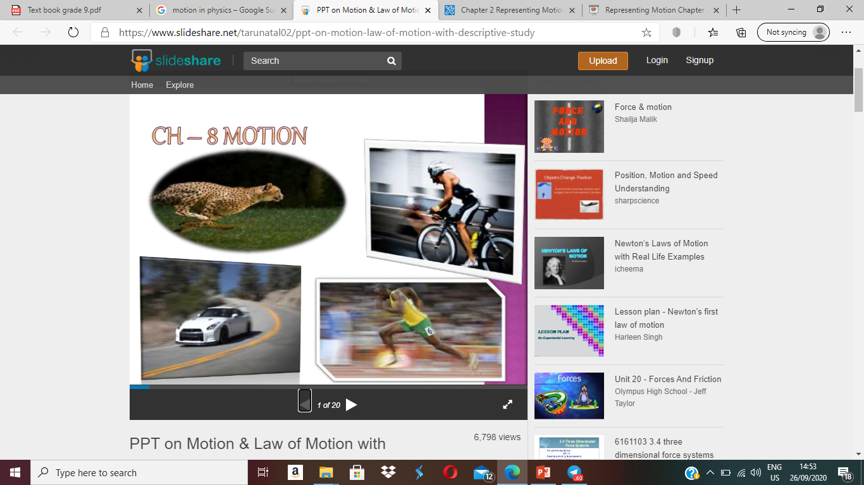
What is motion ?
In physics, the motion is the change in position of an object with respect to its surroundings in a given interval of time

Slide 7
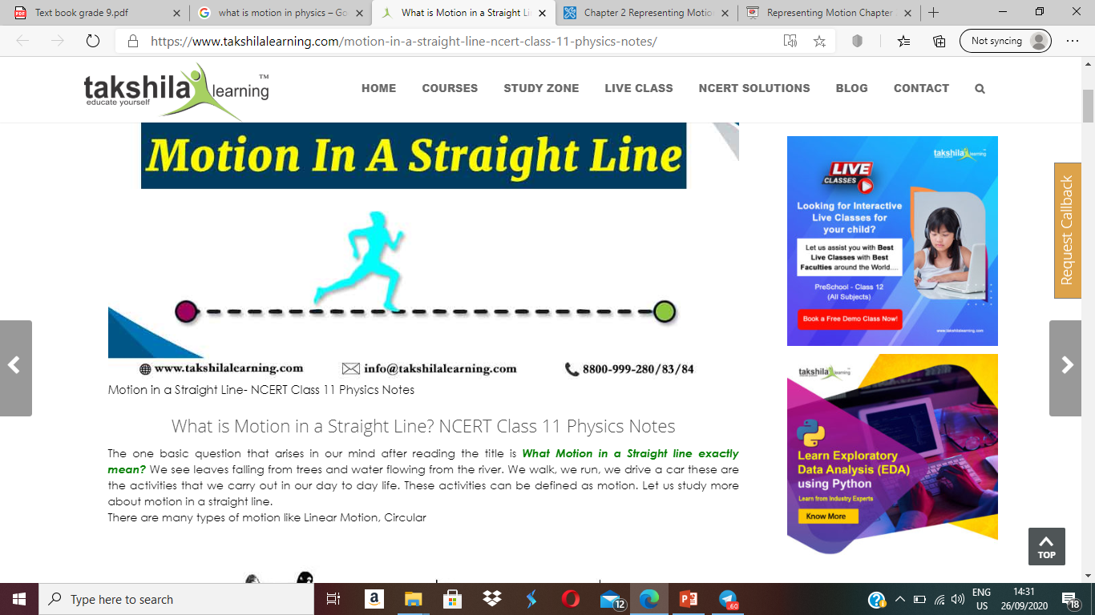
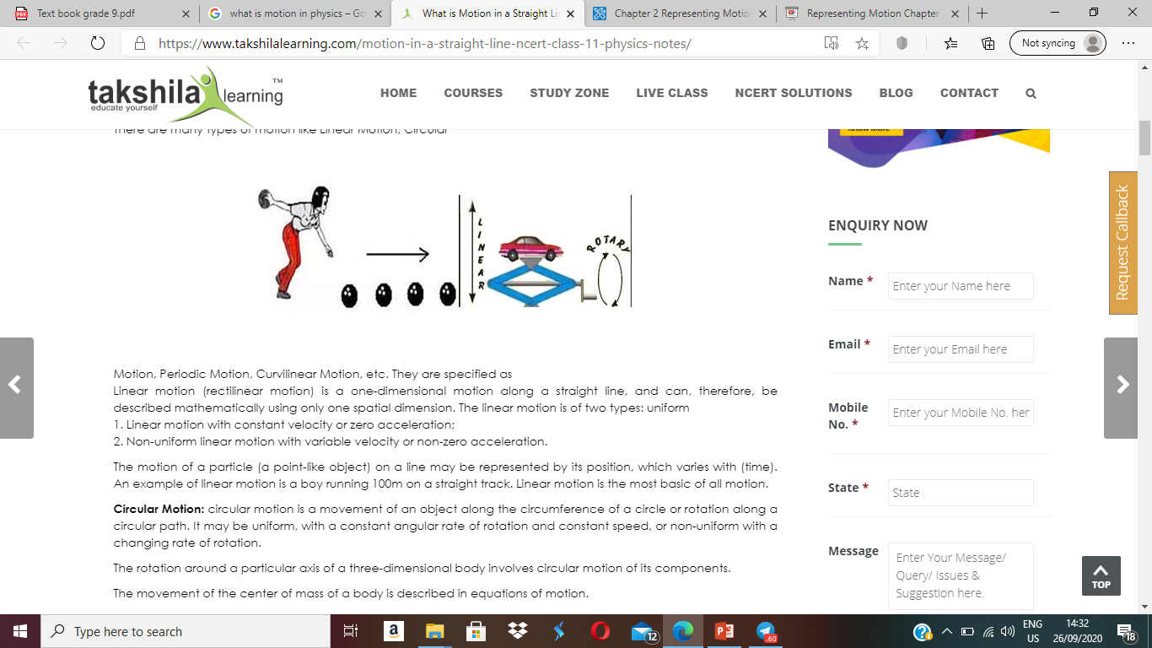
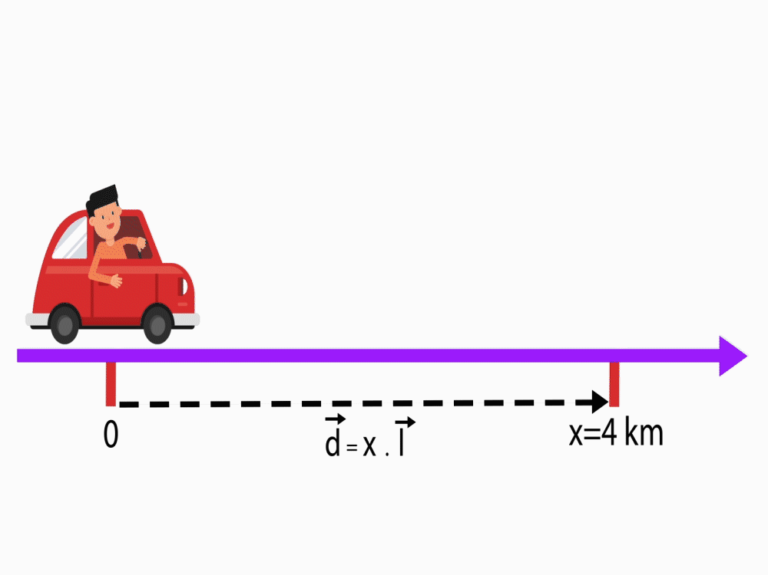
A straight line motion which is an object follows a path directly between tow points without turning left or right

Slide 8

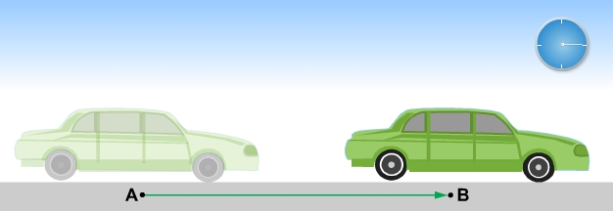
The motion is a description of place and time.
TIME
place
Time
PLACE

Slide 9




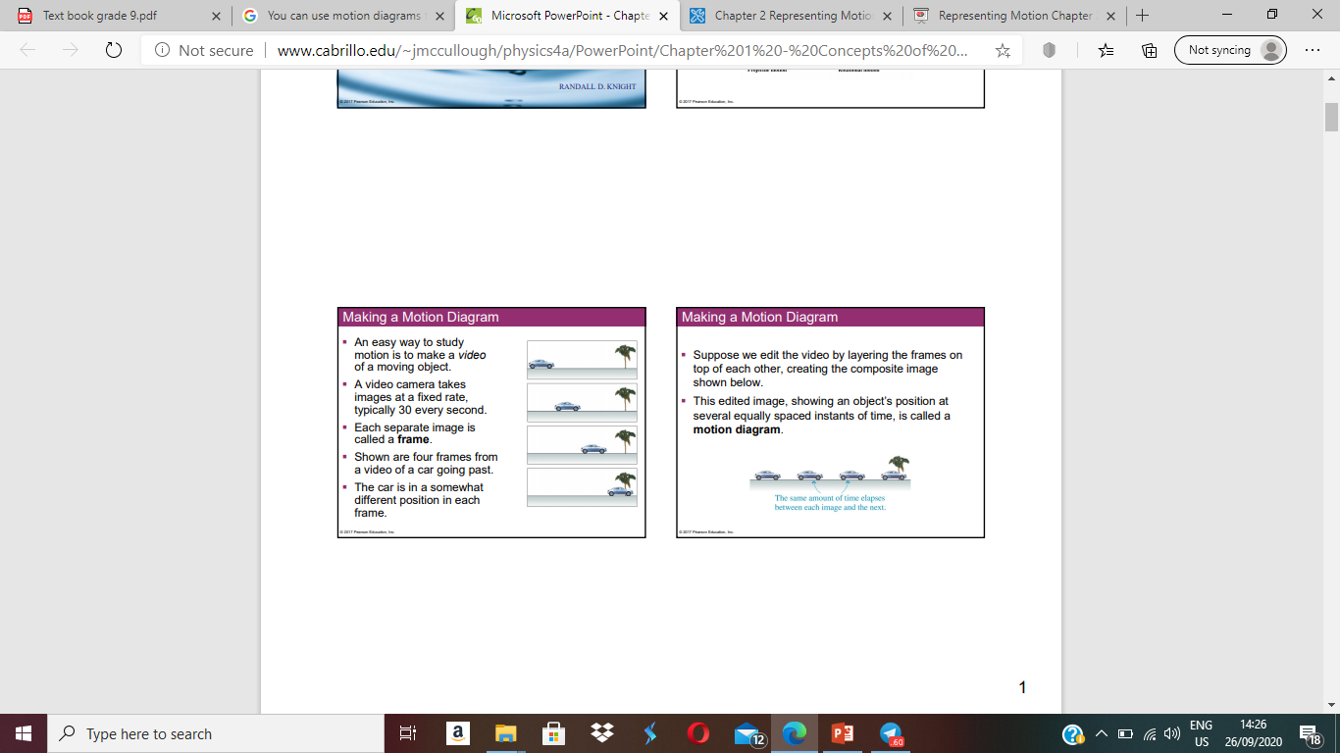
Motion Diagrams
Series of images showing the positions of a moving object at equal time intervals.
An easy way to study motion

Slide 10
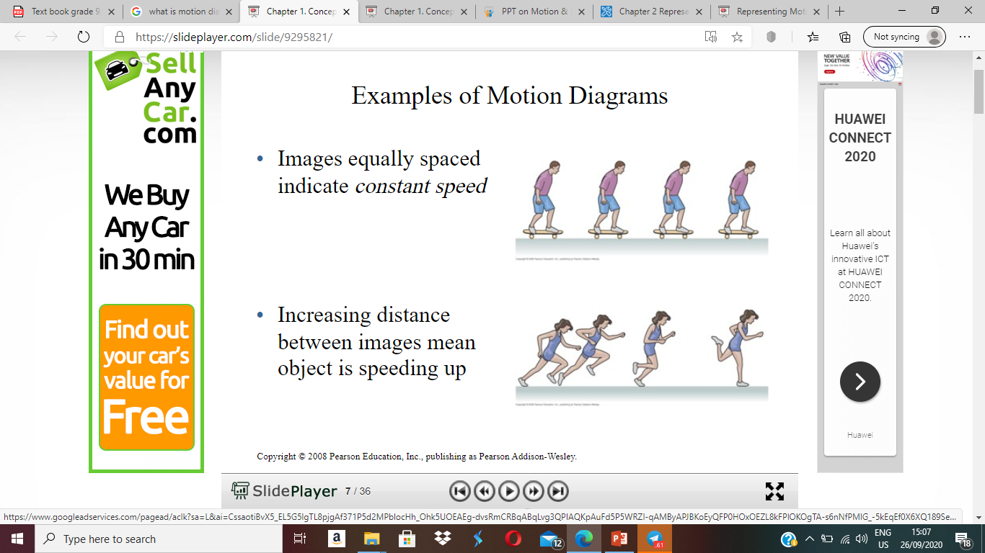
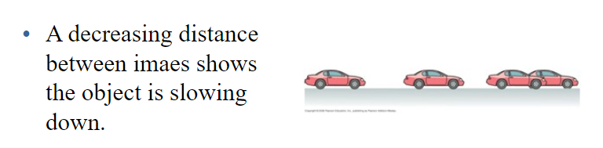

Slide 11
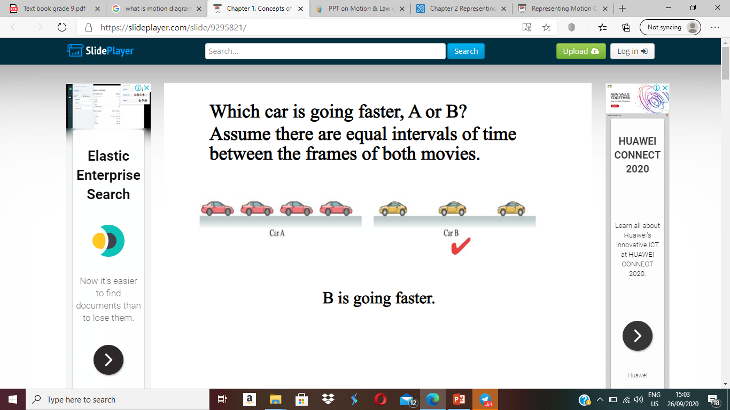


Slide 12
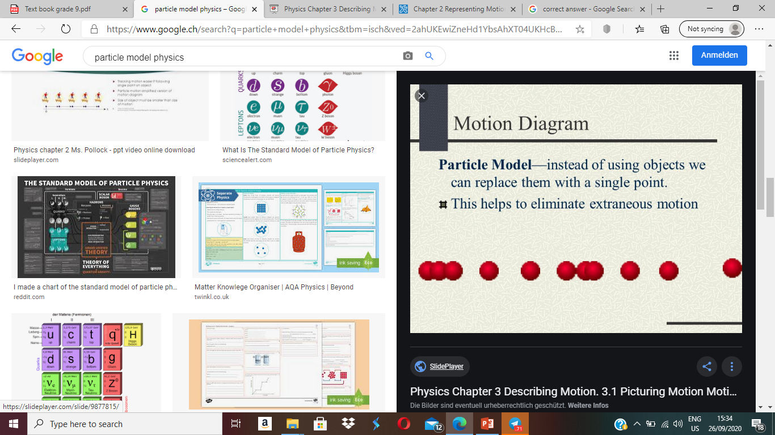
particle model
simplified version of a motion diagram in which moving object is replaced by a series of single points.

Slide 13
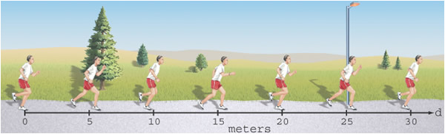
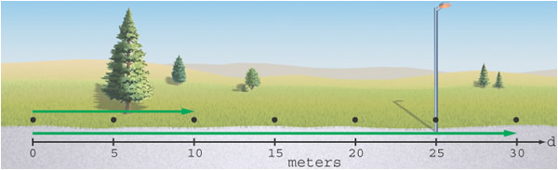

Slide 14
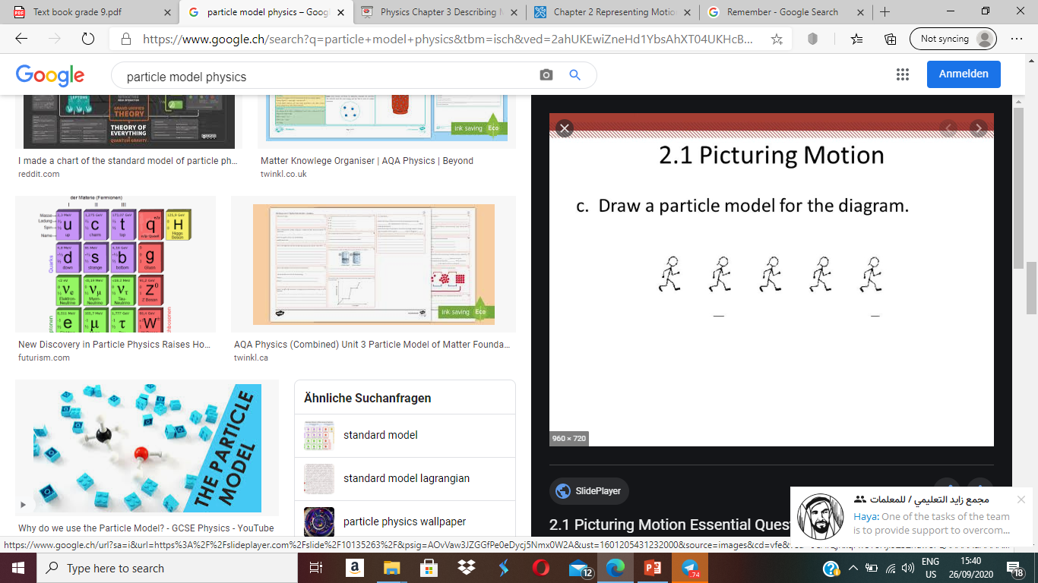

Slide 15
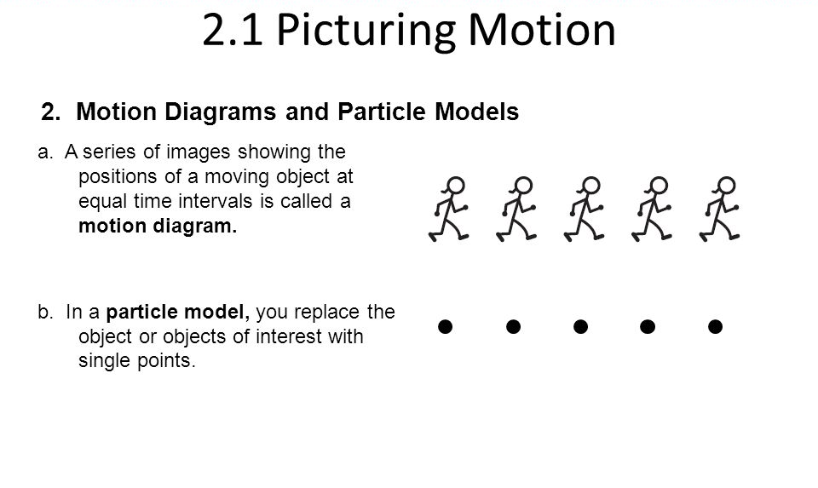

Remember

Slide 16
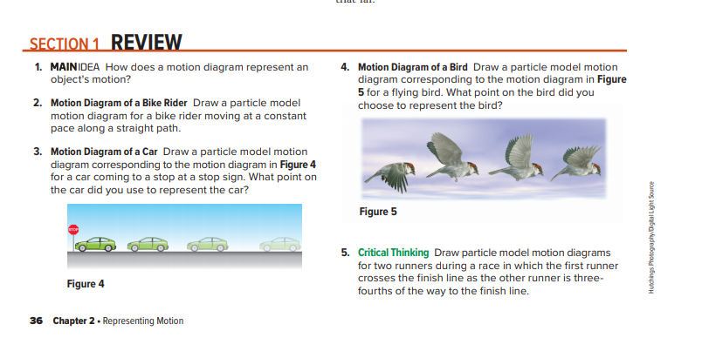

Slide 17
Section Review
1-How do motion diagrams represent motion?
a motion diagram shows the position of an object successive equal times.
2-how can you use a particle model to represent a moving object?
in a particle model diagram an objects position at successive times is represented by a series of dots spacing between dots indicate wether the object is moving faster or slower.

Slide 18
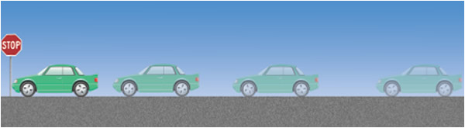
3- Draw a particle model motion diagram

Slide 19

4- Draw a particle model motion diagram
•
•
•
•

Slide 20

SECTION2.1
Which statement describes best the motion diagram of an object in motion?
A. a graph of the time data on a horizontal axis and the position on a vertical axis
B. a series of images showing the positions of a moving object at equal time intervals
C. a diagram in which the object in motion is replaced by a series of single points
a diagram that tells us the location of the zero point of the object in motion and the direction in which the object is moving
B

Slide 21

SECTION2.1
Section Check
What is the purpose of drawing a motion diagram or a particle model?
A. to calculate the speed of the object in motion
B. to calculate the distance covered by the object in a particular time
C. to check whether an object is in motion
to calculate the instantaneous velocity of the object in motion
C

Slide 22



