Slide 1

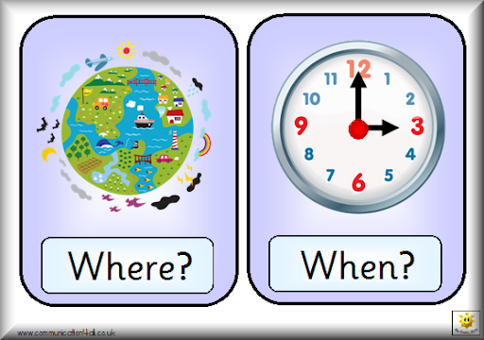
CHAPTER 2
REPRESENTING MOTION
SECTION 2

Slide 2
CHAPTER 2
REPRESENTING MOTION
SECTION 2
OBJECTIVES
To make students able to understand about the concept of
motion and types of motion.
To make students able to understand about motion diagram.
At the end of the lesson, students will able to know about
particle model of motion.

Slide 3
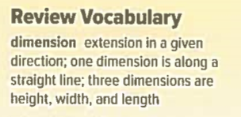
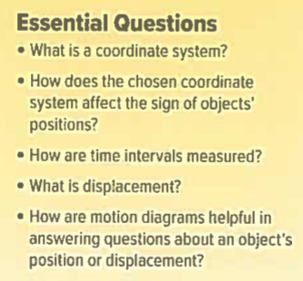
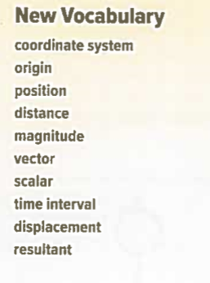

CHAPTER 2
REPRESENTING MOTION
SECTION 2
NEXT :
VIDEO ON CARTESIAN COORDINATE SYSYETM

Slide 4

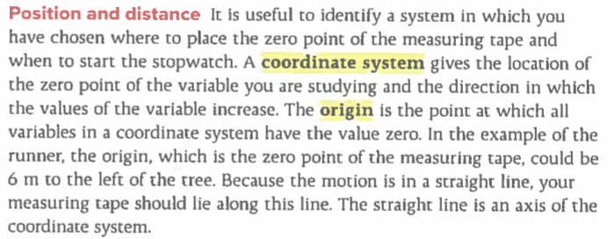

Slide 5

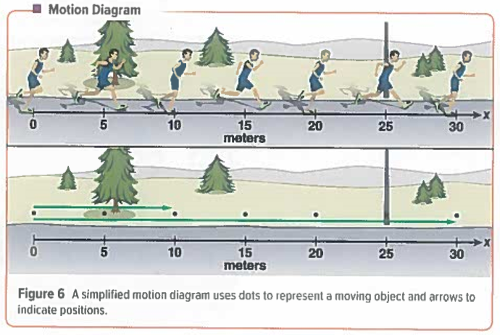

Slide 6

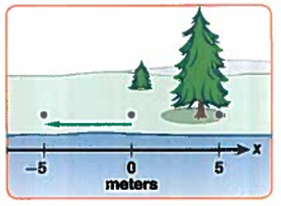
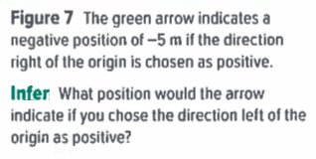
NEXT :
VIDEO ON VECTORS AND SCALARS

Slide 7
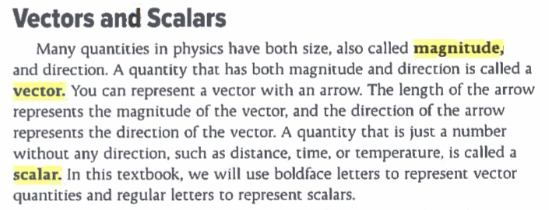


Slide 8

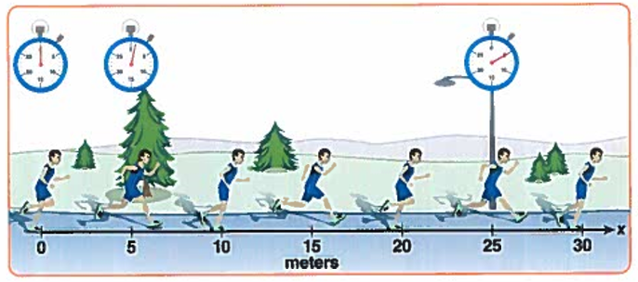

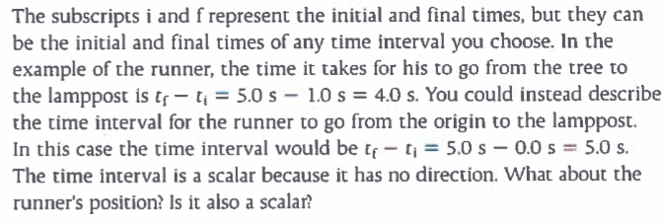


Slide 9


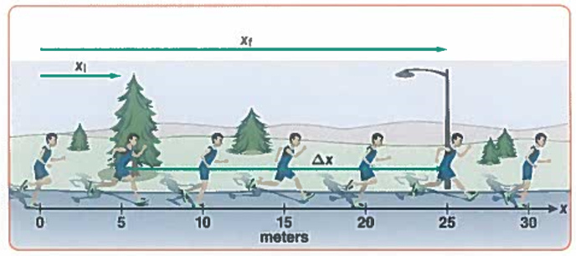
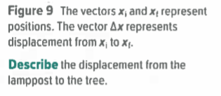

Slide 10


Slide 11



NEXT :
VIDEO ON DISTANCE AND DISPLACEMENT

Slide 12


Slide 13

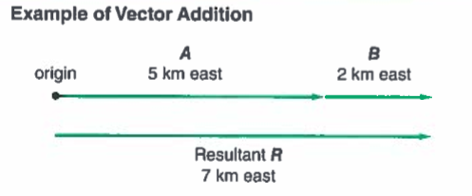
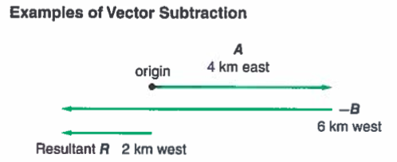



Slide 14



Slide 15
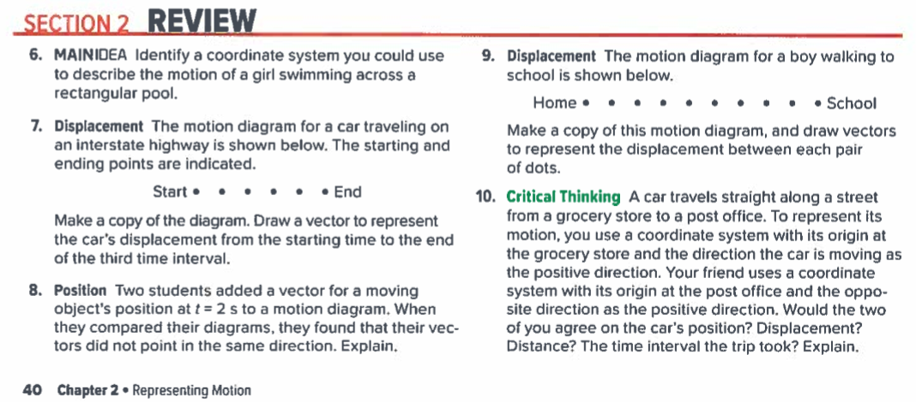

Slide 16



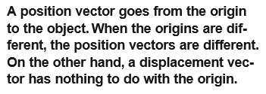
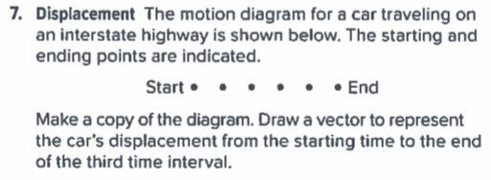



Cartesian co-ordinate system

Slide 17
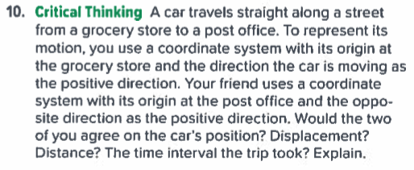
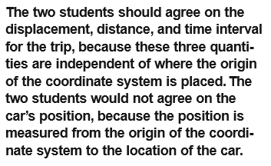

Slide 18


END OF SECTION 2 : WHERE AND WHEN ?
NEXT : SECTION 3 : POSITION-TIME GRAPH

