Slide 1



Representing Motion
2.3
Position-Time Graphs

Slide 2
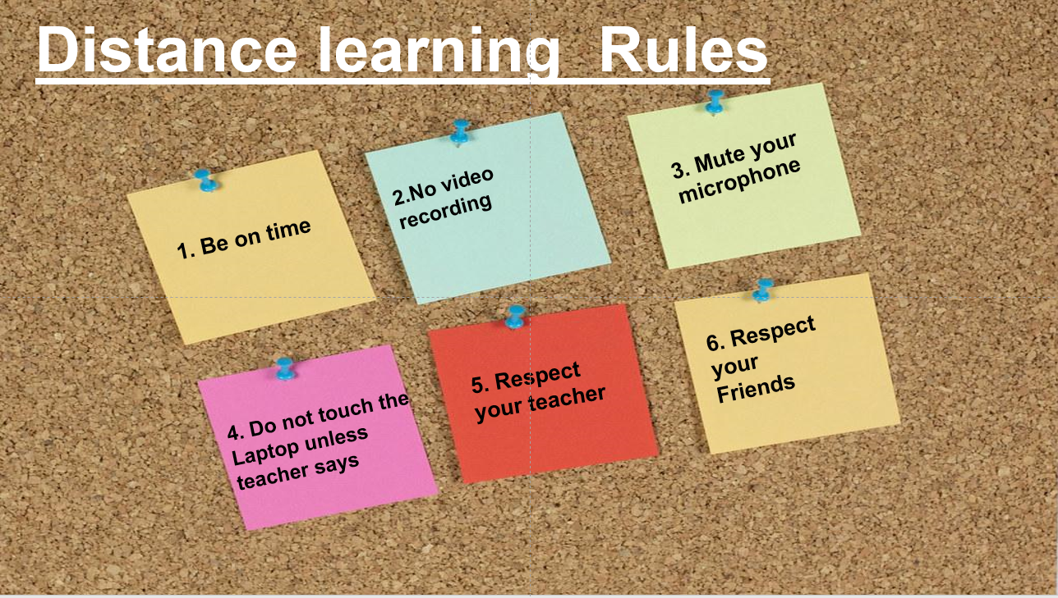

Slide 3

Welcome to Our Distance Learning Session

Slide 4




2 Mins
Once I call your name , just say
YES or comment in the chat

Slide 5


Main Idea
You can use position-time graphs to determine an object’s position at a certain time.

Slide 6

Essential Questions
• What information do position-time graphs provide?
• How can you use a position-time graph to interpret an object’s position or displacement?
• What are the purposes of equivalent representations of an object’s motion?

Slide 7
Learning objectives:
Plot data to get position-time graph.
Estimate time and position using position-time graph.
Analyze position-time graph.

Slide 8
Key words and expressions:
Review vocabulary
intersection:
a point where lines meet and cross
New vocabulary
position-time graph
instantaneous position

Slide 9






Brain in gear
Q: Name four ways to represent motion. Use each method to describe an everyday example of motion?

Slide 10
Check your answers:
Q: Name four ways to represent motion. Use each method to describe an everyday example of motion?
  Words
  Motion diagrams
  Data tables
  Position-time graphs

Slide 11
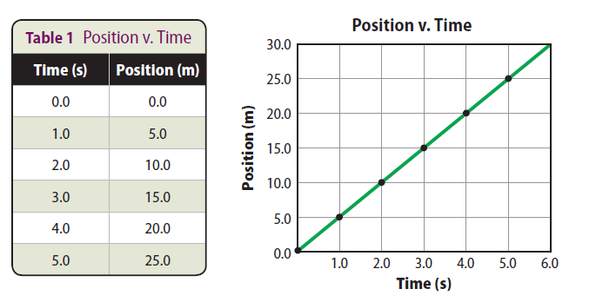
Learning Objectives:
1. Plot data to get position-time graph.
2. Estimate time and position using position-time graph.
3. Analyze position-time graph.
Plotting data:
In a position-time graph, the time data is plotted on a horizontal axis and the position data is plotted on a vertical axis.
To draw this graph, first plot the runner’s positions. Then, draw a line that best fits the points.

Slide 12
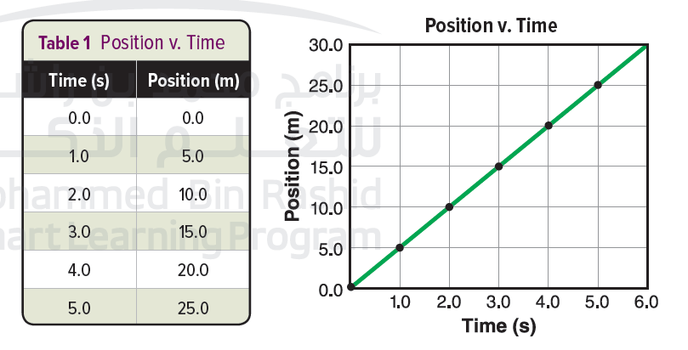
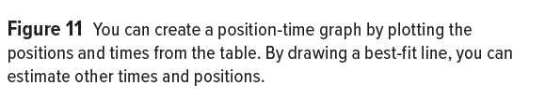

Slide 13


Learning Objectives
1. Plot data to get position-time graph.
2. Estimate time and position using position-time graph
3. Analyze position-time graph.

Slide 14

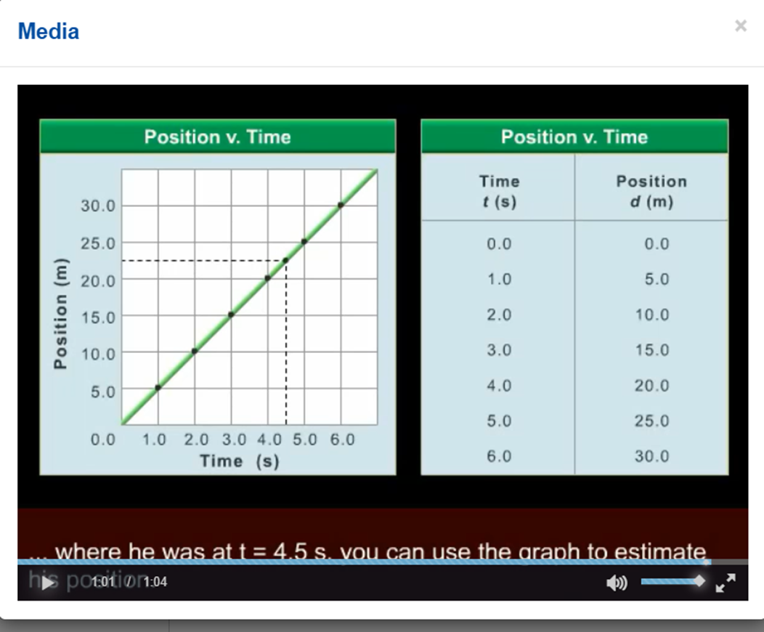
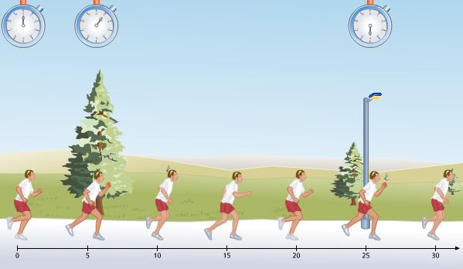

Finding Positions
Lets watch the following animation

Slide 15
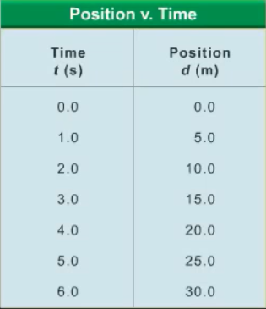
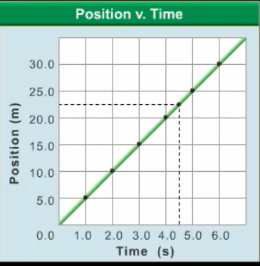
Graphs of an object’s position and time contain useful information about an object’s position at various times.
you can use the graph to estimate the time or his position.
Estimating time and position

Slide 16

Learning Objectives:
1. Plot data to get position-time graph.
2. Estimate time and position using position-time graph.
3. Analyze position-time graph.
Critical thinking
Explain Why is the line on the graph sloped even though it describes motion along a flat path??
Textbook Page 41

Slide 17
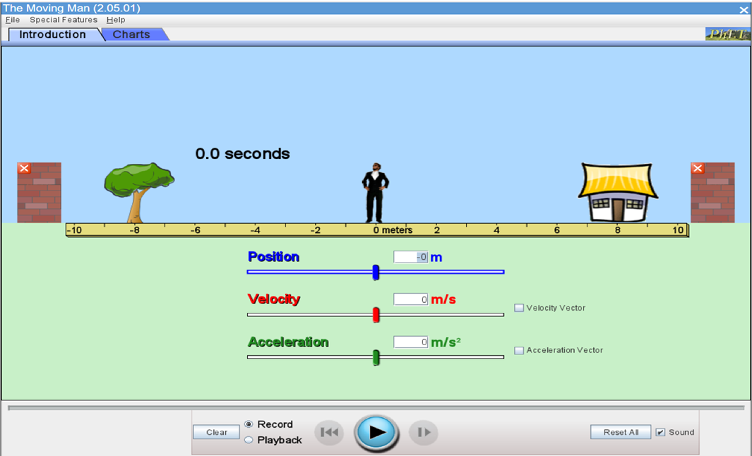
https://phet.colorado.edu/sims/cheerpj/moving-man/latest/moving-man.html?simulation=moving-man
Use the online simulator to observe the relation between the position and the time.
Lets watch this simulation
Position-time graph

Slide 18
https://phet.colorado.edu/sims/cheerpj/moving-man/latest/moving-man.html?simulation=moving-man after watching this simulation: which variable will be on X-axis and which variable on
Y-axis?
Lets watch this simulation
Position-time graph

Slide 19
Learning Objectives
1. Plot data to get position-time graph.
2. Estimate time and position using position-time graph
3. Analyze position-time graph.

Slide 20
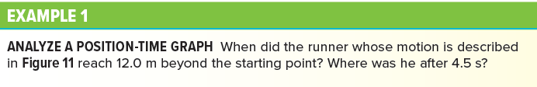
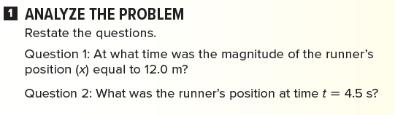
Learning Objectives:
1. Plot data to get position-time graph.
2. Estimate time and position using position-time graph
3. Analyze position-time graph.

Slide 21
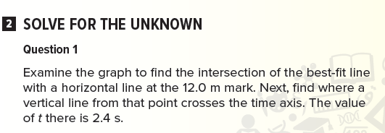
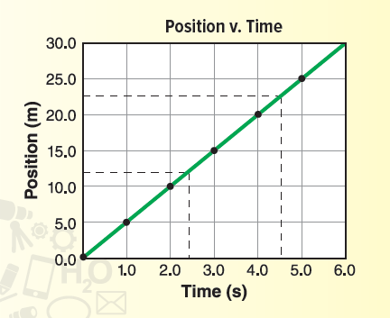
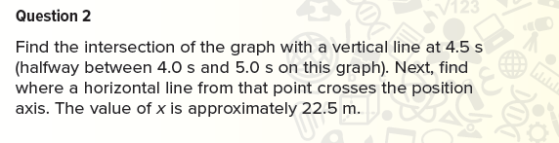

Slide 22
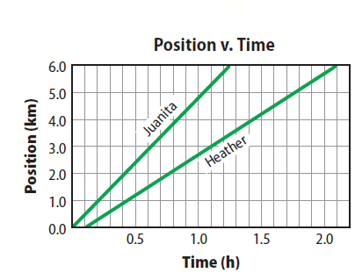
Finding Positions
Problem
Where was Juanita at time t = 0.5 h?
At what time was the magnitude of Heather’s position equal to 2.0 km?
Response
At 0.5 h, Juanita is a position with a magnitude of 2.5 km.
Heather is at 2.0 km at a time of
t = 0.8 h.

Slide 23
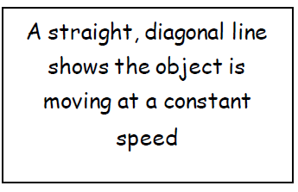
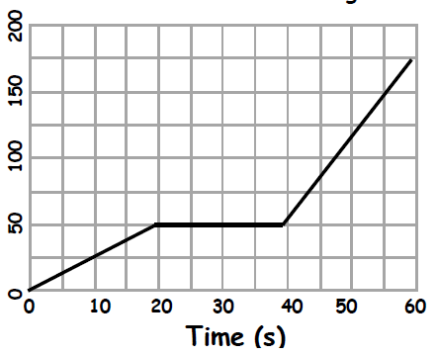
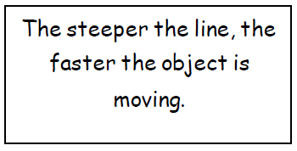

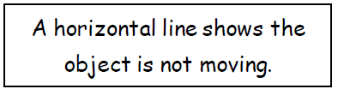
Position -Time Graphs
Distance-time graphs are used to show how far something travels in a certain amount of time.

Slide 24
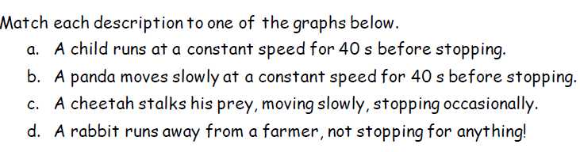

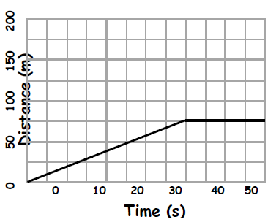
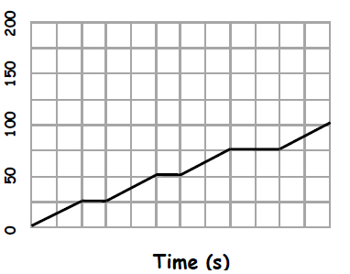
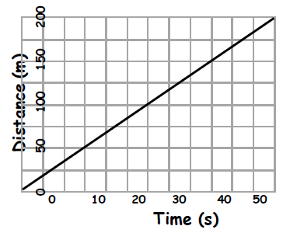
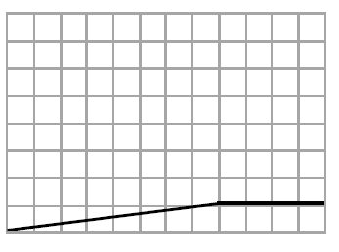
Activity

Slide 25

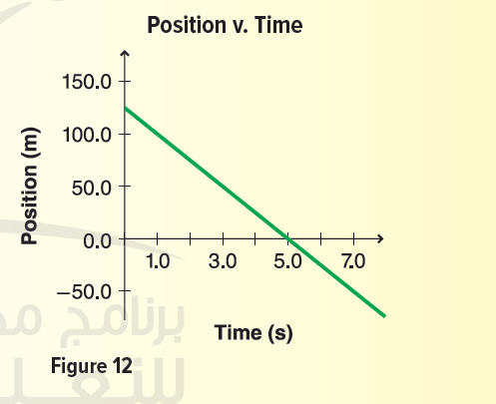

Application
Text book page 42

Slide 26
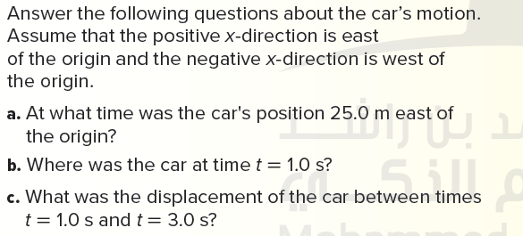

Application
Text book page 42

Slide 27

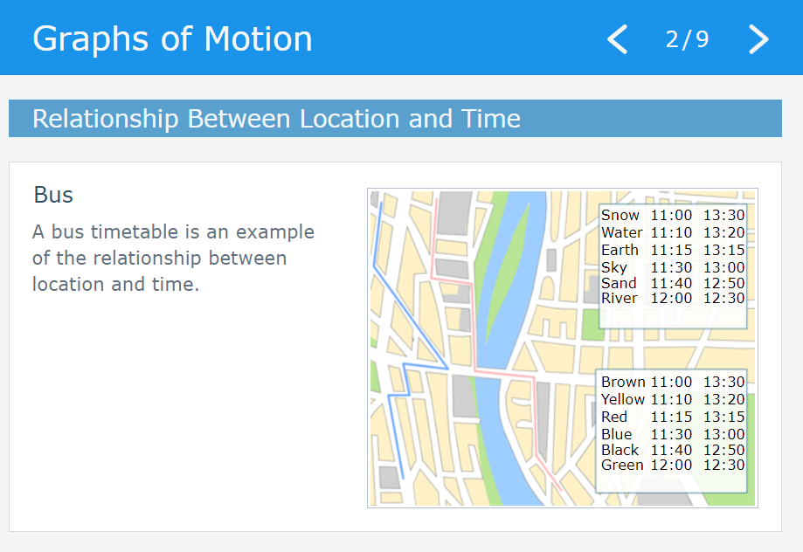

FOR MORE PRACTICING: https://edushare.moe.gov.ae/Uploads/Resources/74b411b4-a3a6-4fda-b7f8-58ce7374a1ff/6262019/index.html
EDUSHARE LINK

Slide 28



Quiz time
https://quizizz.com/admin/quiz/5f72324eee4115001bc5506c/position-time-graph-review

Slide 29


Learning Objectives:
1. Plot data to get position-time graph.
2. Estimate time and position
using position-time graph.
3. Analyze position-time graph.

Slide 30
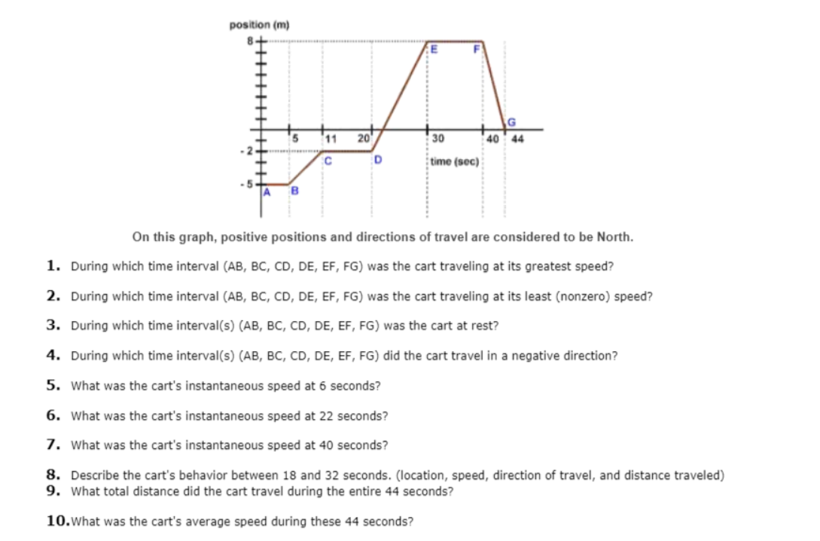


H.W
https://app.classkick.com/#/login/GJ9O4T
Learning Objectives:
1. Plot data to get position-time graph.
2. Estimate time and position using position-time graph
3. Analyze position-time graph.

Slide 31
Representing Motion
2.3
Position-Time Graphs

Slide 32

Essential Questions
• What information do position-time graphs provide?
• How can you use a position-time graph to interpret an object’s position or displacement?
• What are the purposes of equivalent representations of an object’s motion?

Slide 33
Learning objectives:
Identify the instantaneous position.
List different ways to describe motion
Discuss the multiple objects on the position-time graph

Slide 34
Key words and expressions:
Review vocabulary
intersection:
a point where lines meet and cross
New vocabulary
position-time graph
instantaneous position

Slide 35
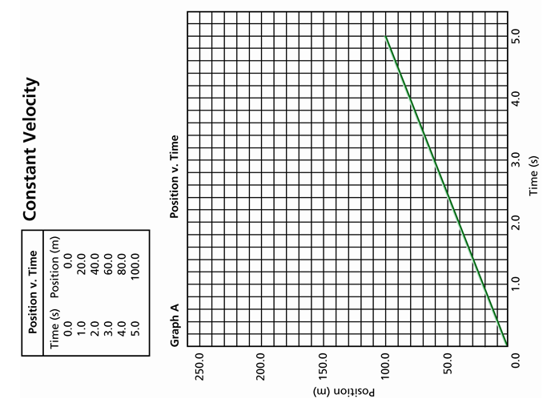
Quick review

Slide 36

Learning Objectives:
1. Identify the instantaneous position.
2. List different ways to describe motion
3. Discuss the multiple objects on the position-time graph
Instantaneous position:
The position at a particular position.
It is called simply position.
Text book page 43

Slide 37
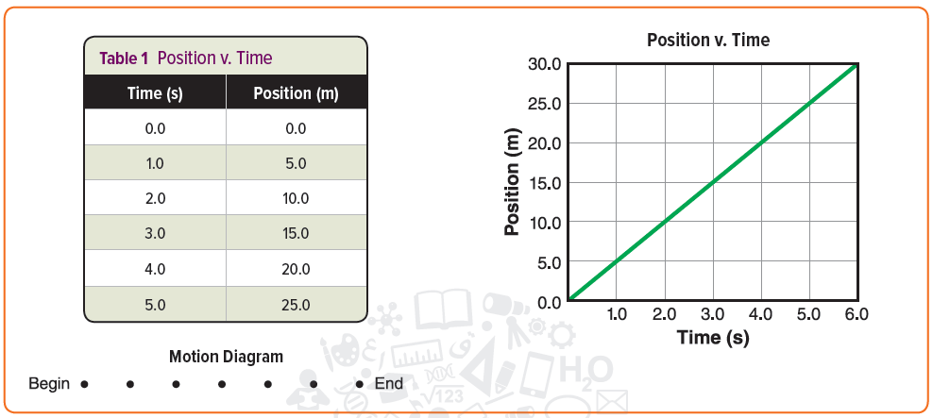
Equivalent Representations:
We can describe motion using different ways:
Words
pictures
motion diagrams
particle models
data tables
position-time graphs
Learning Objectives:
1. Identify the instantaneous position.
2. List different ways to describe motion
3. Discuss the multiple objects on the position-time graph
Text book page 43

Slide 38
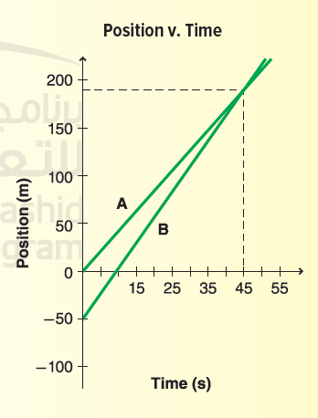
Multiple objects on a position-time graph:
Learning Objectives:
1. Identify the instantaneous position.
2. List different ways to describe motion
3. Discuss the multiple objects on the position-time graph
A position-time graph for two different runners is shown in the figure.
At what time are the two runners at the same position? What is their position at this time?
You can evaluate these questions by identifying the point on the position-time graph at which the lines representing the two runners’ motions intersect.
Text book page 44

Slide 39
The intersection of two lines

Slide 40
Multiple objects on a position-time graph:
Learning Objectives:
1. Identify the instantaneous position.
2. List different ways to describe motion
3. Discuss the multiple objects on the position-time graph
The intersection of two lines
on a position-time graph tells you when objects have the same position, but not necessarily that they will collide
What does the slope of the line on a position-time graph tell you?
we use the slope of a line on a position-time graph to determine the velocity of an object.
Text book page 44

Slide 41
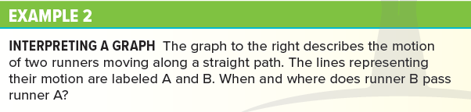

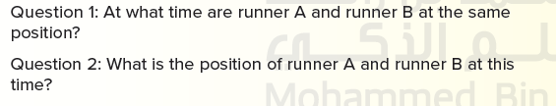
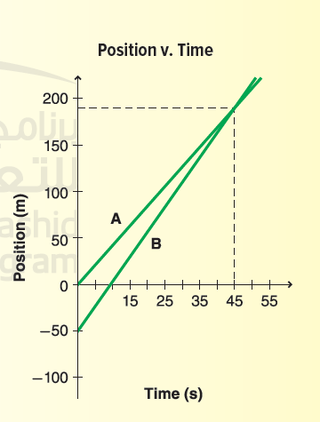

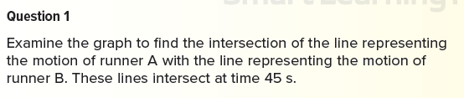
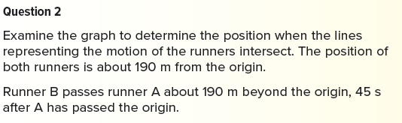
Text book page 44

Slide 42
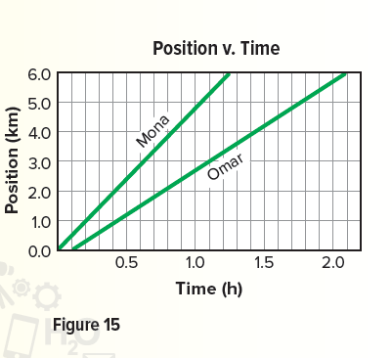
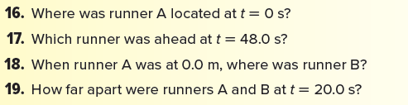
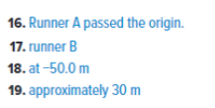
Application
Text book page 45

Slide 43
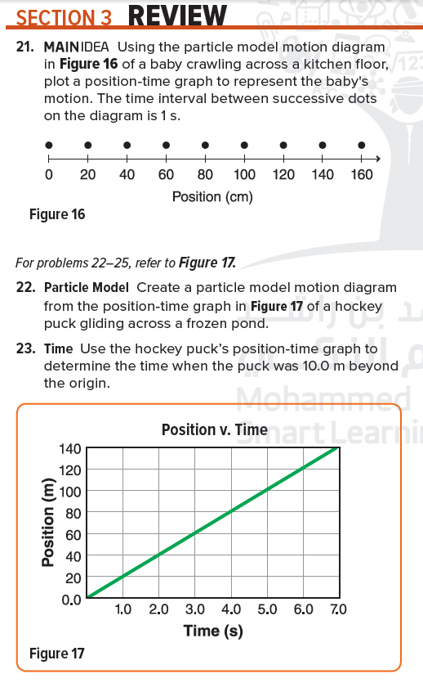
H.W
Learning Objectives:
1. Identify the instantaneous position.
2. List different ways to describe motion
3. Discuss the multiple objects on the position-time graph

Slide 44


