Slide 1
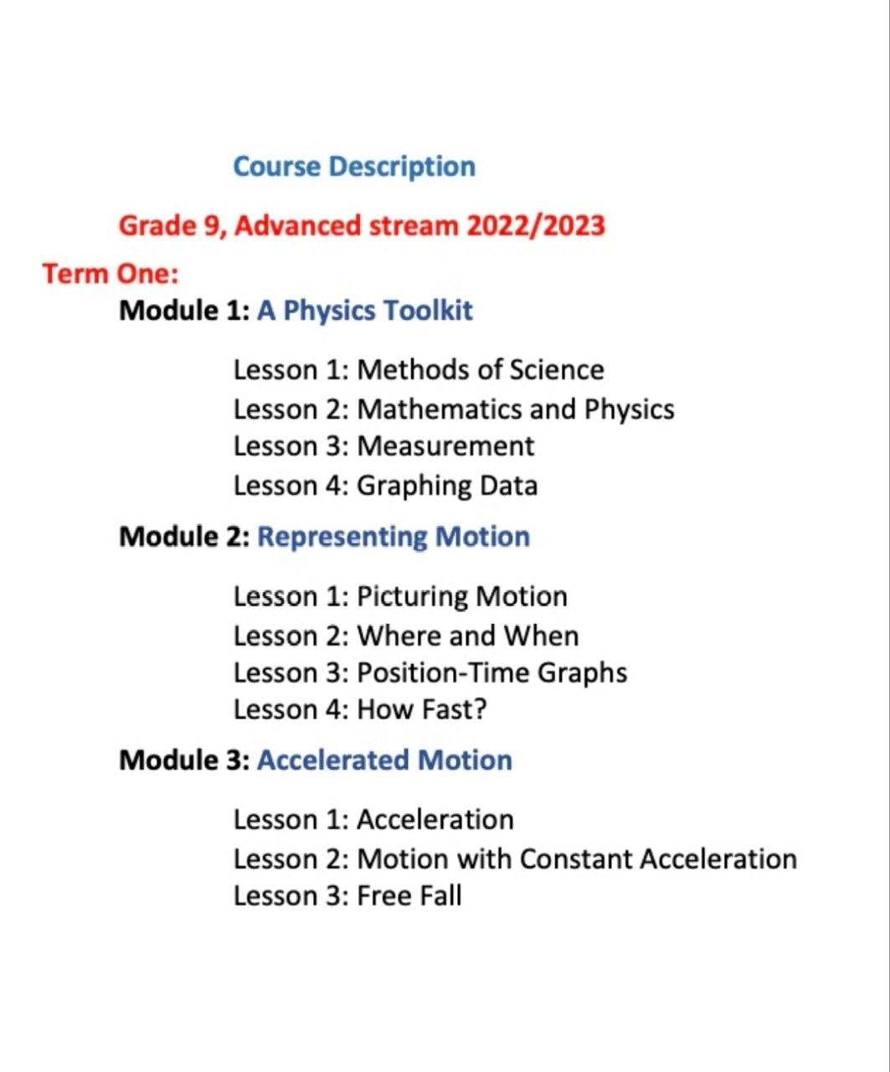

Unit3 : accelerated motion
Unit 1 : methods of science

Slide 2

Section 2.1 picturing motion
Lesson objectives:
Define motion with constant acceleration
Use the velocity – time graph to find displacement

Slide 3
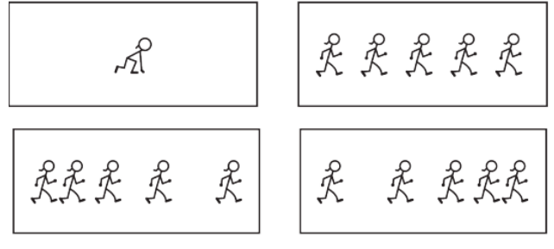
Section 3.2 motion with constant acceleration
Constant acceleration
The velocity increases by 5 m/s every second
This increase is constant ( الزيادة ثابتة).
The acceleration is constant
The velocity decreases by 5 m/s every second
This decrease is constant ( النقصان ثابت).
The acceleration is constant
V=0
V=5
V=10
V=15
V=20
V=20
V=15
V=10
V=5
V=0

Slide 4
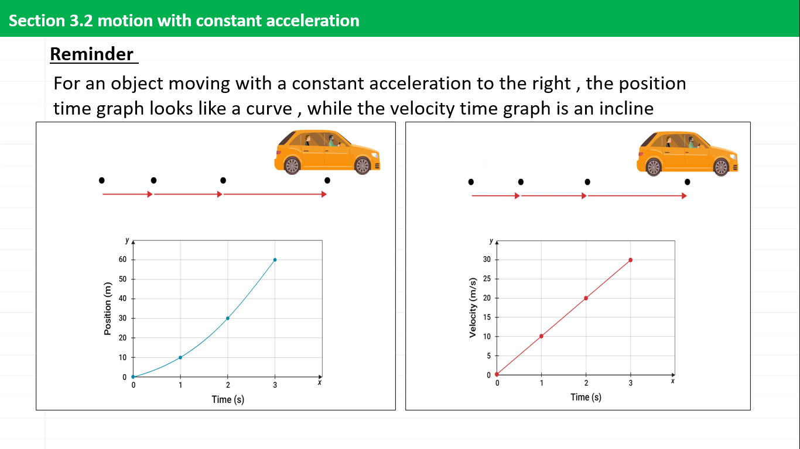
Section 3.2 motion with constant acceleration
Constant acceleration
Motion with constant acceleration: a type of motion where the object experiences a constant increase or decrease in its velocity
For an object moving with a constant acceleration to the right , the position time graph looks like a curve , while the velocity time graph is an incline

Slide 5


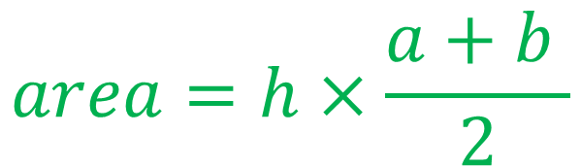
Section 3.2 motion with constant acceleration
Connection to math
Area
triangle
rectangle
Trapezoid
$$area=\frac{1}{2}×base×height$$
$$area=h×\frac{a+b }{2}$$
$$area=length ×width$$

Slide 6


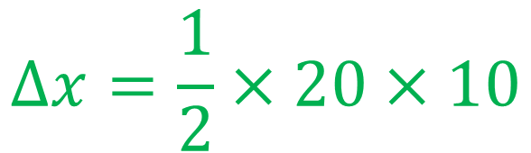
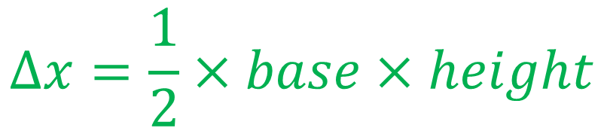
Section 3.2 motion with constant acceleration
Displacement from a velocity time graph
velocity (m/s)
To find the displacement from a velocity time graph , we find the area under the curve
Example :
What is the displacement of the object during the first 20 s of its motion?
20
15
10
5
$$∆x=area under the curve$$
Time (s)
$$∆x=\frac{1}{2}×base×height$$
10 20 30 40 50
-5
$$∆x=\frac{1}{2}×20×10$$
$$=100 m$$
-10

Slide 7
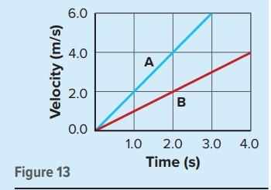
Section 3.2 motion with constant acceleration
Displacement frm a velocity time graph
20. The graph describes the motion of two bicyclists, Akiko and Brian, who start from rest and travel north, increasing their speed with a constant acceleration. What was the total displacement of each bicyclist during the time shown for each?

Slide 8
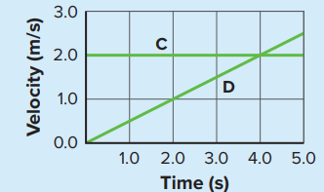





Section 3.2 motion with constant acceleration
Displacement frm a velocity time graph
21. The motion of Carlos is described by the velocity time graph. What is the total displacement during the first 4.0 s interval?

Slide 9
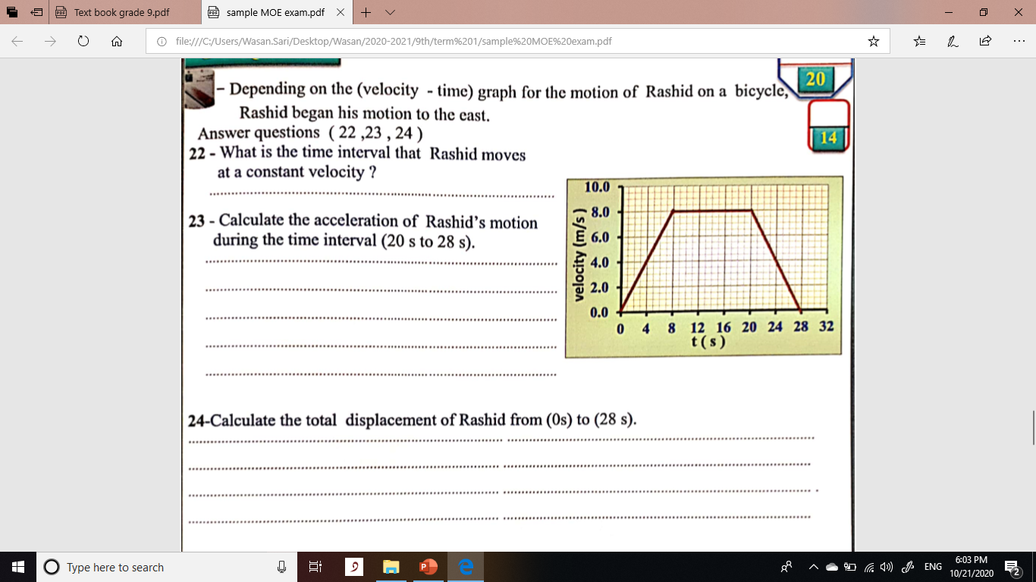
Section 3.2 motion with constant acceleration
Displacement frm a velocity time graph

Slide 10
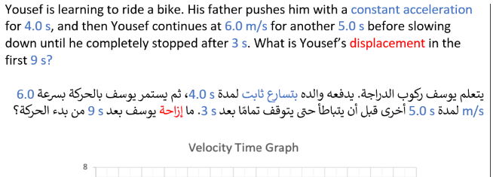
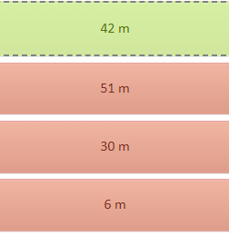
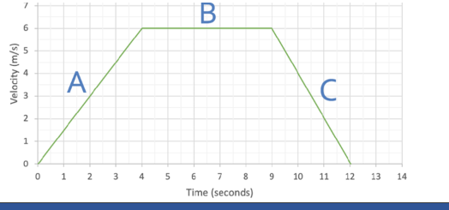
Section 3.2 motion with constant acceleration
Displacement from a velocity time graph

Slide 11
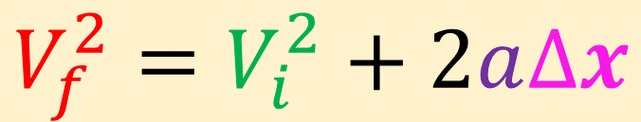
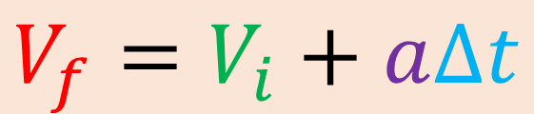
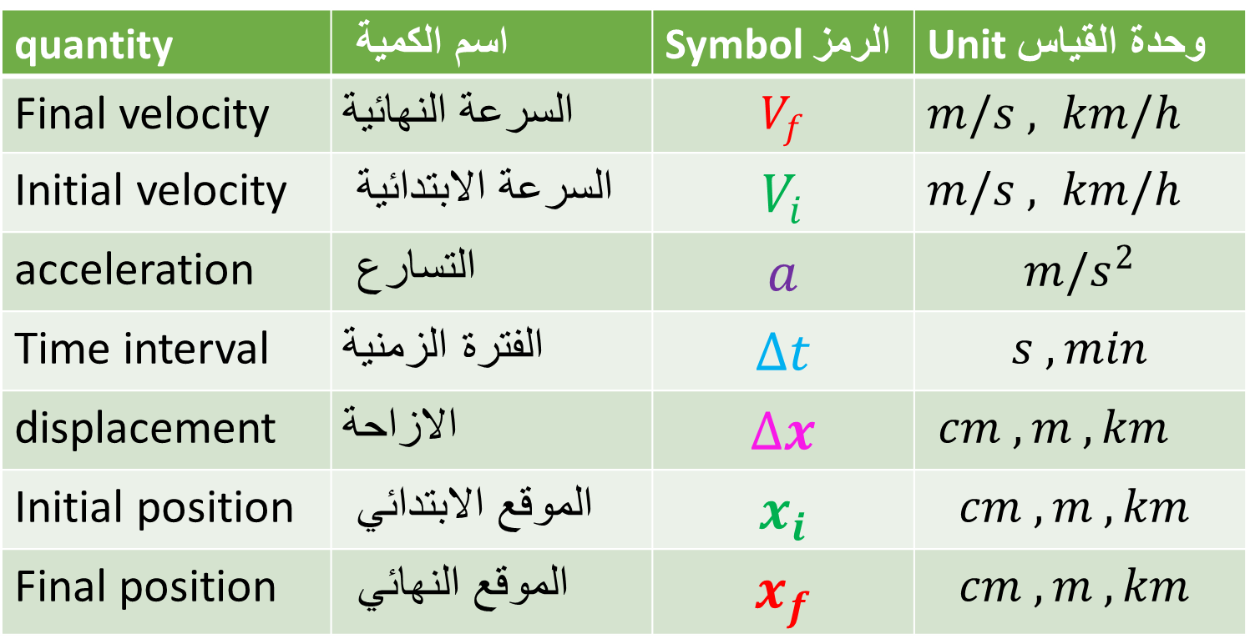
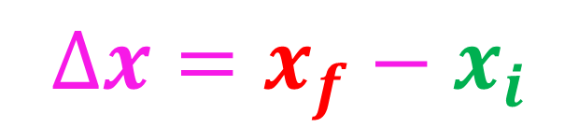
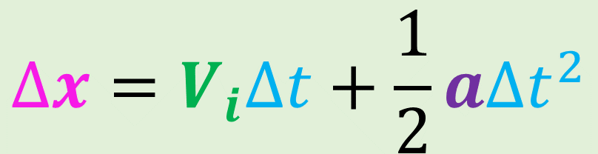
Section 3.2 motion with constant acceleration
Motion with constant acceleration equations
When the acceleration is constant , 3 equations can be used to solve for different unknowns
$$V_{f}=V_{i}+a∆t$$
quantity | اسم الكمية | Symbol الرمز | Unit وحدة القياس
Final velocity | السرعة النهائية | $$V_{f}$$ | $m/s$ $, km/h$
Initial velocity | السرعة الابتدائية | $$V_{i}$$ | $m/s$ $, km/h$
acceleration | التسارع | $$a$$ | $$m/s^{2}$$
Time interval | الفترة الزمنية | $$∆t$$ | $$s , min$$
displacement | الازاحة | $$∆x$$ | $cm , m , km$
Initial position | الموقع الابتدائي | $$x_{i}$$ | $$cm , m , km$$
Final position | الموقع النهائي | $$x_{f}$$ | $$cm , m , km$$
$$V_{f}^{2}=V_{i}^{2}+2a∆x$$
$$∆x=V_{i}∆t+\frac{1}{2}a∆t^{2}$$
$$∆x=x_{f}−x_{i}$$

Slide 12
Section 3.2 motion with constant acceleration
Motion with constant acceleration equations
When the acceleration is constant , 3 equations can be used to solve for different unknowns
To solve problems :
Write the knowns and unknowns in symbols , sketch the problem.
Make sure the units are unified. (one unit for distance and one unit for time)
Choose the suitable equation
  The equation must have the unknown
  The other quantities in the equation must be known.
Substitute and solve for the unknown.
$$V_{f}=V_{i}+a∆t$$
$$V_{f}^{2}=V_{i}^{2}+2a∆x$$
$$∆x=V_{i}∆t+\frac{1}{2}a∆t^{2}$$
$$∆x=x_{f}−x_{i}$$

Slide 13
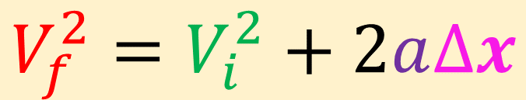
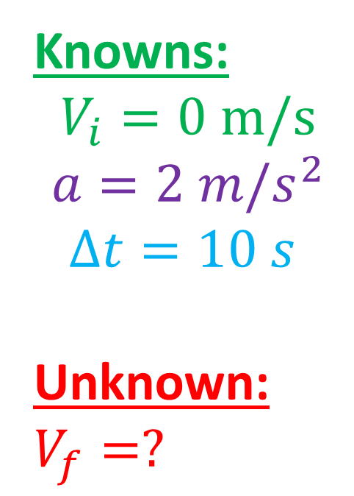



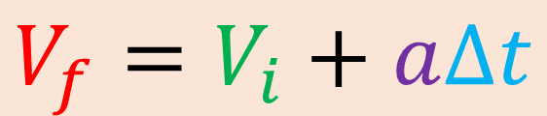




Section 3.2 motion with constant acceleration
Motion with constant acceleration equations
example : if you have this list of knowns , which equation will you use to find the unknown?
$$1.$$
$$V_{f}=V_{i}+a∆t$$
Knowns:
$$V_{i}=0 m/s$$
$$a=2 m/s^{2}$$
$$∆t=10 s$$
Unknown:
$$V_{f}=?$$
$$2.$$
$$V_{f}^{2}=V_{i}^{2}+2a∆x$$
$$∆x=V_{i}∆t+\frac{1}{2}a∆t^{2}$$
$$3.$$
  The equation must have the unknown
  The other quantities in the equation must be known.

Slide 14
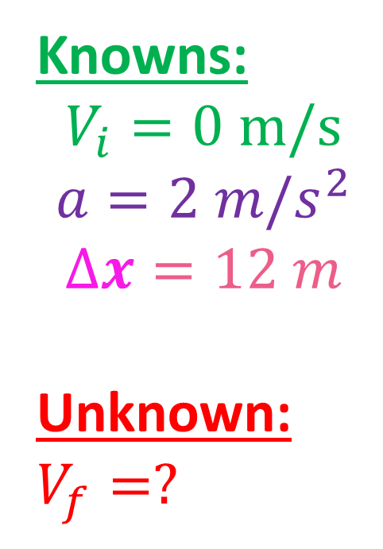
Section 3.2 motion with constant acceleration
Motion with constant acceleration equations
example : if you have this list of knowns , which equation will you use to find the unknown?
$$1.$$
$$V_{f}=V_{i}+a∆t$$
Knowns:
$$V_{i}=0 m/s$$
$$a=2 m/s^{2}$$
$$∆x=12 m$$
Unknown:
$$V_{f}=?$$
$$2.$$
$$V_{f}^{2}=V_{i}^{2}+2a∆x$$
$$∆x=V_{i}∆t+\frac{1}{2}a∆t^{2}$$
$$3.$$
  The equation must have the unknown
  The other quantities in the equation must be known.

Slide 15
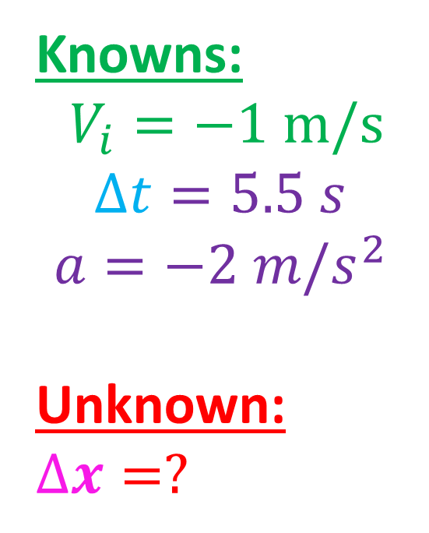
Section 3.2 motion with constant acceleration
Motion with constant acceleration equations
example : if you have this list of knowns , which equation will you use to find the unknown?
$$1.$$
$$V_{f}=V_{i}+a∆t$$
Knowns:
$$V_{i}=−1 m/s$$
$$∆t=5.5 s$$
$$a=−2 m/s^{2}$$
Unknown:
$$∆x=?$$
$$2.$$
$$V_{f}^{2}=V_{i}^{2}+2a∆x$$
$$∆x=V_{i}∆t+\frac{1}{2}a∆t^{2}$$
$$3.$$
  The equation must have the unknown
  The other quantities in the equation must be known.

Slide 16
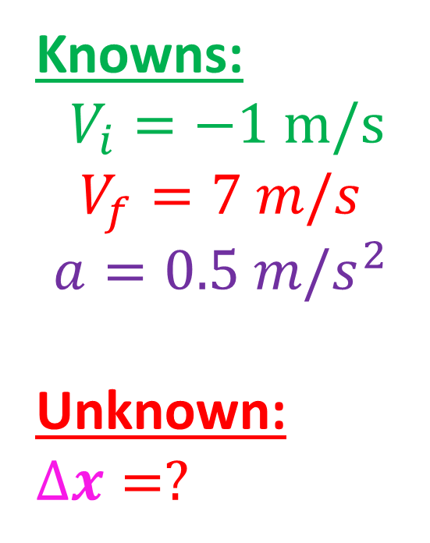
Section 3.2 motion with constant acceleration
Motion with constant acceleration equations
example : if you have this list of knowns , which equation will you use to find the unknown?
$$1.$$
$$V_{f}=V_{i}+a∆t$$
Knowns:
$$V_{i}=−1 m/s$$
$$V_{f}=7 m/s$$
$$a=0.5 m/s^{2}$$
Unknown:
$$∆x=?$$
$$2.$$
$$V_{f}^{2}=V_{i}^{2}+2a∆x$$
$$∆x=V_{i}∆t+\frac{1}{2}a∆t^{2}$$
$$3.$$
  The equation must have the unknown
  The other quantities in the equation must be known.

Slide 17
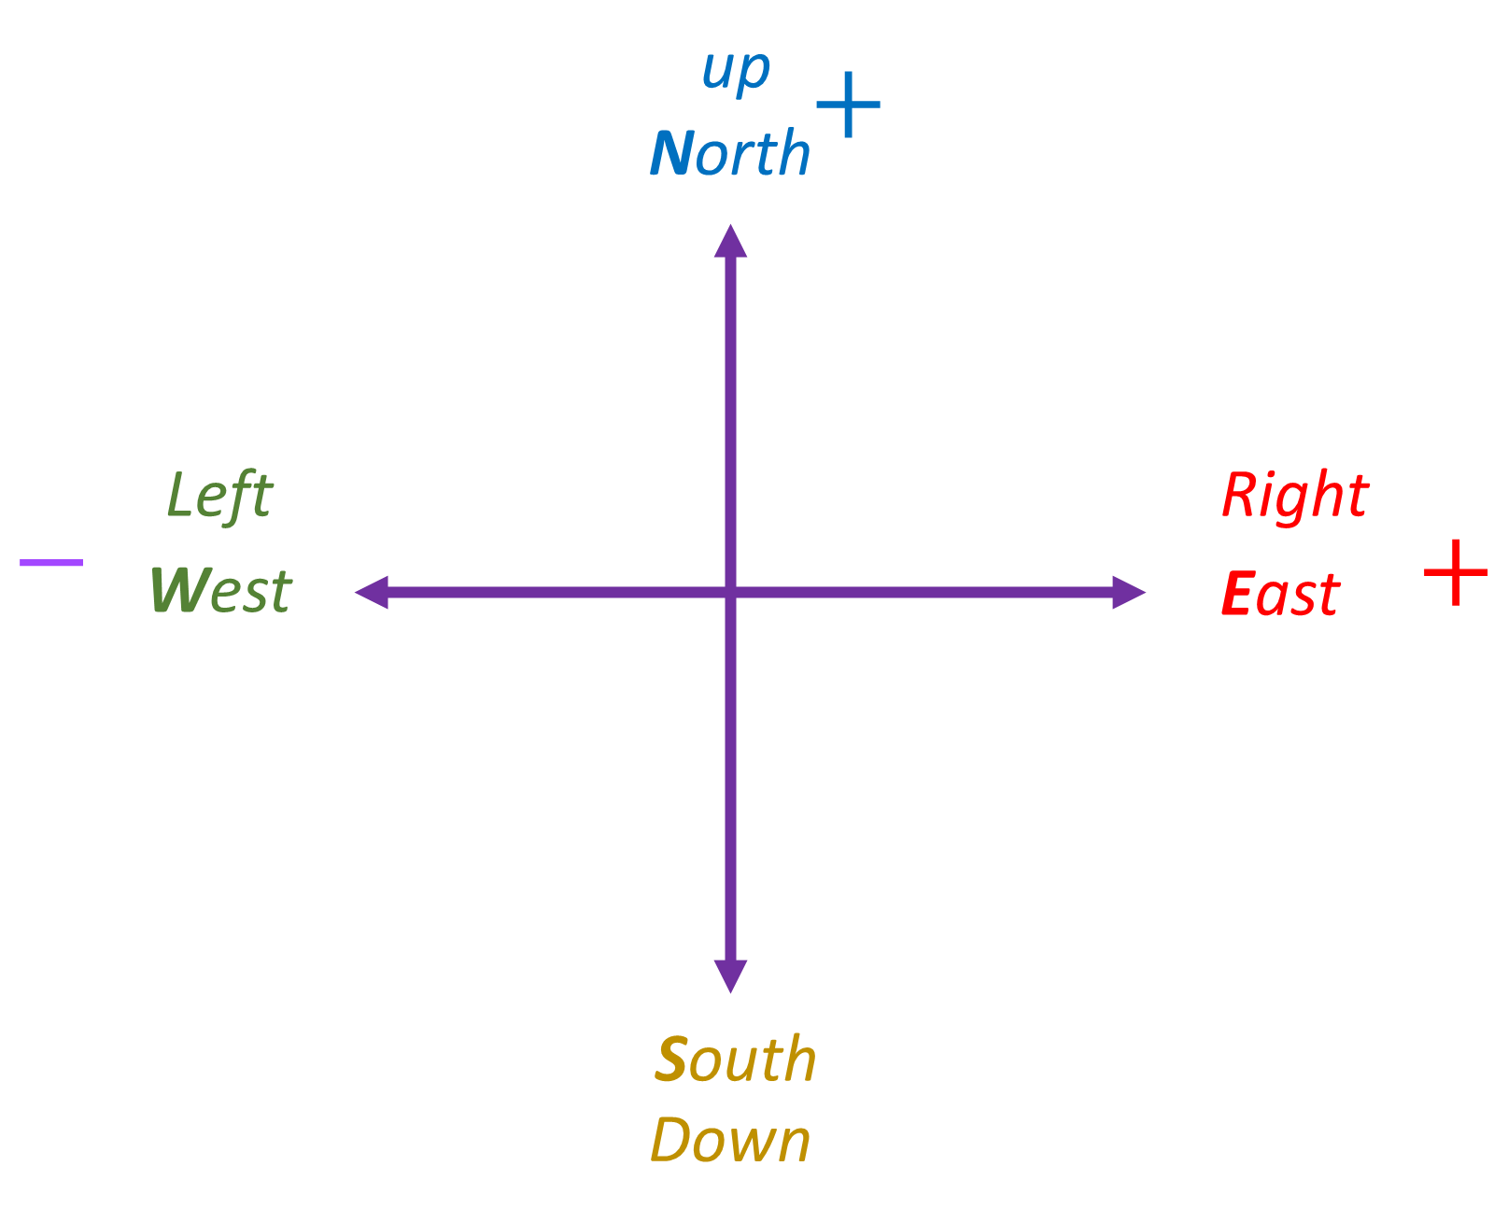
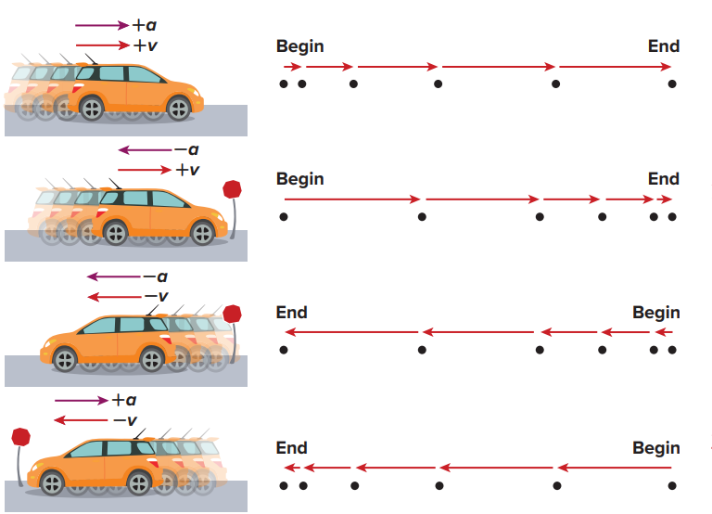
Section 3.2 motion with constant acceleration
Don’t forget !!!!!!!!!!!!!!!!!!!
If the object is accelerating, a same sign of v.
If the object is decelerating, a opposite sign of v

Slide 18
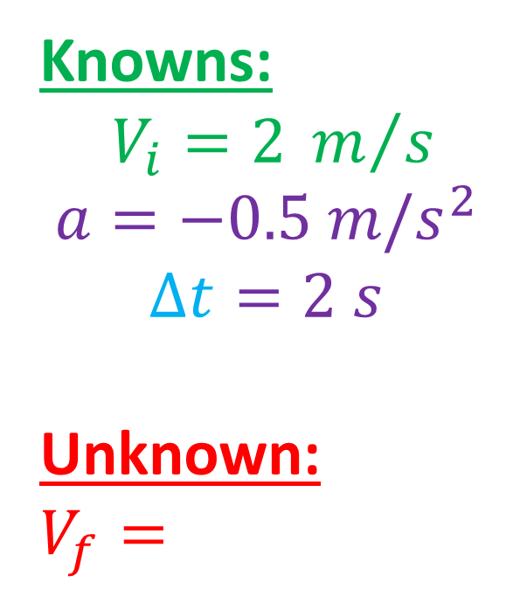
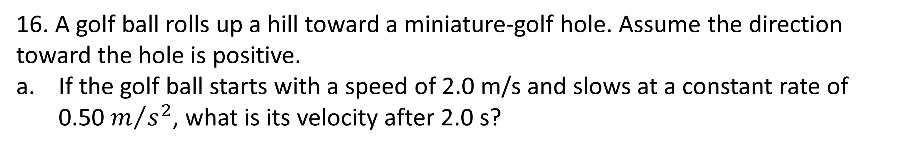



Section 3.2 motion with constant acceleration
Motion with constant acceleration equations
16. A golf ball rolls up a hill toward a miniature-golf hole. Assume the direction toward the hole is positive.
If the golf ball starts with a speed of 2.0 m/s and slows at a constant rate of 0.50 $m/{s^{2}}$, what is its velocity after 2.0 s?
Knowns:
$$V_{i}=2 m/s$$
$$a=−0.5 m/s^{2}$$
$$∆t=2 s$$
Unknown:
$$V_{f}=$$
$$V_{f}=V_{i}+a∆t$$
$$V_{f}=2+−0.5×2$$
$$V_{f}=1 m/s$$

Slide 19
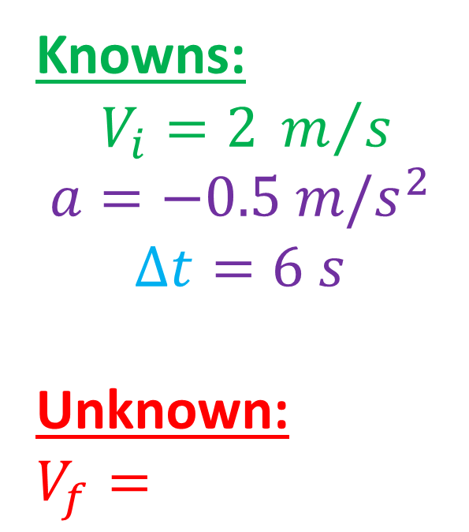


Section 3.2 motion with constant acceleration
Motion with constant acceleration equations
16. A golf ball rolls up a hill toward a miniature-golf hole. Assume the direction toward the hole is positive.
What is the golf ball’s velocity if the constant acceleration continues for 6.0 s?
Knowns:
$$V_{i}=2 m/s$$
$$a=−0.5 m/s^{2}$$
$$∆t=6 s$$
Unknown:
$$V_{f}=$$
$$V_{f}=V_{i}+a∆t$$
$$V_{f}=2+−0.5×6$$
$$V_{f}=−1 m/s$$

Slide 20

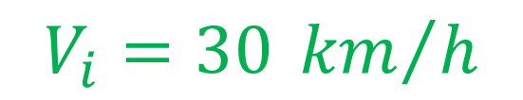
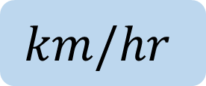






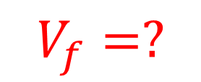
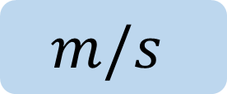


Section 3.2 motion with constant acceleration
Motion with constant acceleration equations
17. A bus traveling 30.0 km/h east has a constant increase in speed of 1.5 $m/s^{2}$What is its velocity 6.8 s later?
$$V_{f}=V_{i}+a∆t$$
Knowns:
Unknown:
$$V_{i}=30 {km}/h$$
$$×0.28=8.4 m/s$$
$$V_{f}=8.4+1.5×6.8$$
$$a=1.5m/s^{2}$$
$$V_{f}=18.6 m/s$$
$$∆t=6.8 s$$
$$V_{f}=?$$
$$×0.28$$
$$km/hr$$
$$m/s$$
$$3.6×$$

Slide 21






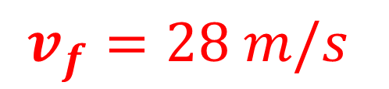
Section 3.2 motion with constant acceleration
Motion with constant acceleration equations
18. If a car accelerates from rest at a constant rate of 5.5 $m/s^{2}$north, how long will it take for the car to reach a velocity of 28 m/s north?
Knowns:
Unknown:
$$V_{i}=0 m/s$$
$$V_{f}=V_{i}+a∆t$$
$$a=5.5m/s^{2}$$
$$v_{f}=28 m/s$$
$28=0+5.5×$ $∆t$
$$∆t=5.09 s$$
$$∆t=?$$

Slide 22


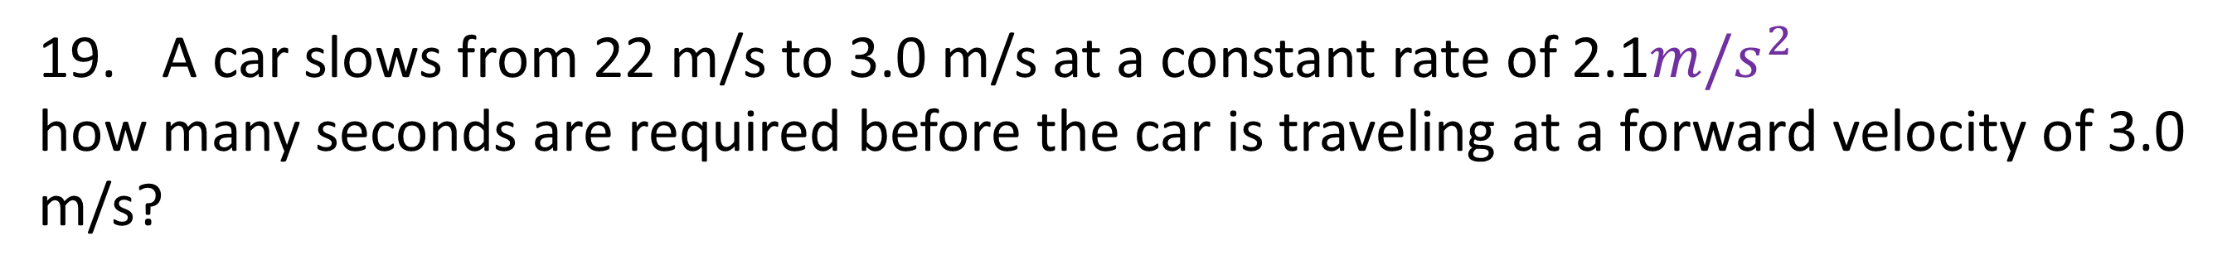


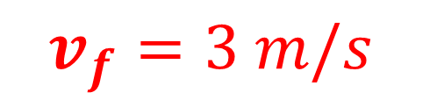
Section 3.2 motion with constant acceleration
Motion with constant acceleration equations
19. A car slows from 22 m/s to 3.0 m/s at a constant rate of 2.1$m/s^{2}$
how many seconds are required before the car is traveling at a forward velocity of 3.0 m/s?
Knowns:
Unknown:
$$V_{i}=22 m/s$$
$$V_{f}=V_{i}+a∆t$$
$$v_{f}=3 m/s$$
$$a=−2.1 m/s^{2}$$
$3=22+−2.1×$ $∆t$
$$∆t=9.04 s$$
$$∆t=?$$

Slide 23
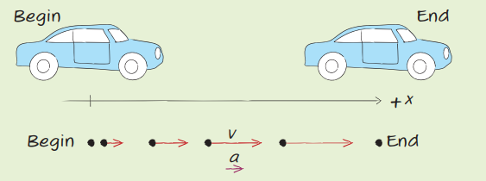
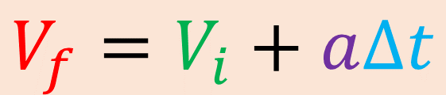










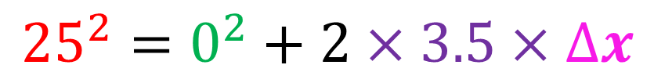






Section 3.2 motion with constant acceleration
Motion with constant acceleration equations
Knowns:
Unknown:
$$v_{i}=0 m/s$$
$$V_{f}^{2}=V_{i}^{2}+2a∆x$$
$$a=3.5 m/s^{2}$$
$$v_{f}=25 m/s$$
$${25}^{2}=0^{2}+2×3.5×∆x$$
$$1.$$
$$V_{f}=V_{i}+a∆t$$
$$625=7×∆x$$
$$∆x= ?$$
$$7$$
$$7$$
$$2.$$
$$V_{f}^{2}=V_{i}^{2}+2a∆x$$
$$89.2 m =∆x$$
$$∆x=V_{i}∆t+\frac{1}{2}a∆t^{2}$$
$$3.$$

Slide 24
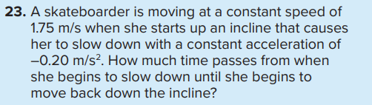
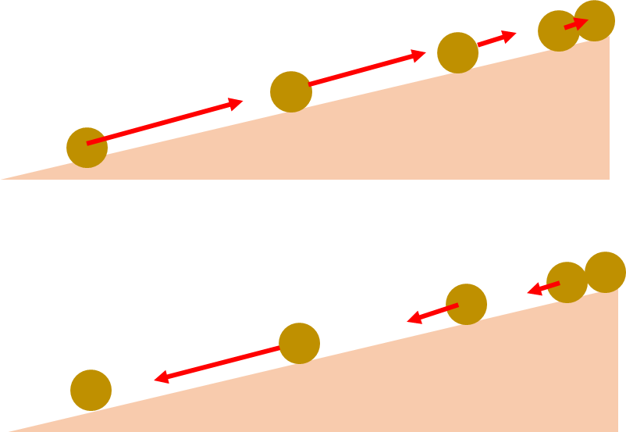
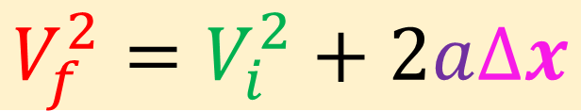


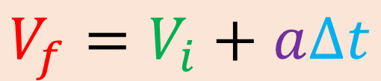







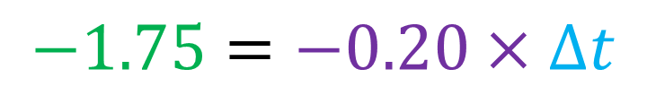





Section 3.2 motion with constant acceleration
Knowns:
Unknown:
$$v_{i}=1.75 m/s$$
$$V_{f}=V_{i}+a∆t$$
$$a=−0.20 m/s^{2}$$
$$1.$$
$$V_{f}=V_{i}+a∆t$$
$$0=1.75+−0.20×∆t$$
$$v_{f}=0 m/s$$
$$−1.75=−0.20×∆t$$
$$V_{f}^{2}=V_{i}^{2}+2a∆x$$
$$2.$$
$$−0.20$$
$$−0.20$$
$$∆t= ?$$
$$8.75 s=∆t$$
$$∆x=V_{i}∆t+\frac{1}{2}a∆t^{2}$$
$$3.$$

Slide 25







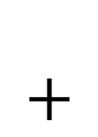
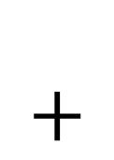
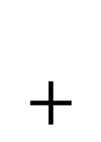
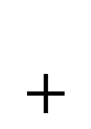
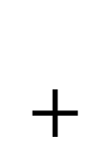


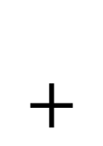
Section 3.2 motion with constant acceleration
Connection to real life
Cupcake recipe:
Ingredients:
Flour
Oil
Sugar
Milk
eggs
Whipped cream
Can I still make cupcake?
Yes ! , I can prepare whipped cream with some of the ingredients on the side , then use it to make cupcake
$$+$$
$$=$$
$$+$$
$$+$$
$$+$$
$$+$$
$$=$$
$$+$$

Slide 26



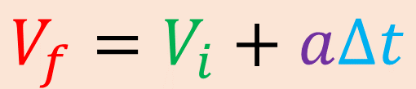

















Section 3.2 motion with constant acceleration
Knowns:
Unknown:
$$a=??$$
$$1.$$
$$V_{f}=V_{i}+a∆t$$
$$v_{i}=44 m/s$$
$$a=\frac{v_{f}−v_{i}}{∆t}$$
$$=\frac{22−44}{11}$$
$$=−2m/s^{2}$$
$$V_{f}^{2}=V_{i}^{2}+2a∆x$$
$$v_{f}=22 m/s$$
$$2.$$
$$∆t=11s$$
$$∆x=V_{i}∆t+\frac{1}{2}a∆t^{2}$$
$$a=−2m/s^{2}$$
$$∆x=V_{i}∆t+\frac{1}{2}a∆t^{2}$$
$$3.$$
$$∆x=44×11+\frac{1}{2}×−2×{11}^{2}$$
$$∆x=??$$
Since the $a$ is in all equations , we must find it first then use one of the equations to find $∆x$
$$∆x=363 m$$

Slide 27





























Section 3.2 motion with constant acceleration
Knowns:
Unknown:
$$a=??$$
$$1.$$
$$V_{f}=V_{i}+a∆t$$
$$v_{i}=15 m/s$$
$$V_{f}^{2}=V_{i}^{2}+2a∆x$$
$$625−225=250×a$$
$$v_{f}=25 m/s$$
$${25}^{2}={15}^{2}+2×a×125$$
$$400=250×a$$
$$2.$$
$$V_{f}^{2}=V_{i}^{2}+2a∆x$$
$$250$$
$$250$$
$$∆x=125 m$$
$$625=225+250×a$$
$$a=1.6m/s^{2}$$
$$a=1.6m/s^{2}$$
$$∆x=V_{i}∆t+\frac{1}{2}a∆t^{2}$$
$$3.$$
$$V_{f}=V_{i}+a∆t$$
$$10=1.6×∆t$$
$$∆t= ??$$
$$25=15+1.6×∆t$$
$$1.6$$
$$1.6$$
Since the $a$ is in all equations , we must find it first then use one of the equations to find $∆t$
We use the second equation to find $a$
$$25−15=1.6×∆t$$
$$∆t=6.25 s$$

Slide 28

Section 3.2 motion with constant acceleration

Slide 29



























Section 3.2 motion with constant acceleration
Knowns:
Unknown:
constant velocity
deceleration
$$v_{i}=25 m/s$$
react
$${∆t}_{react}=0.45 s$$
$${∆x}_{1}$$
$${∆x}_{2}$$
$$a=−8.5 m/s^{2}$$
$$v=25 m/s$$
$$v_{i}=25 m/s$$
$$∆t=0.45 s$$
$$v_{f}=0 m/s$$
$$a=−8.5 m/s^{2}$$
$$v_{f}=0 m/s$$
$$v = \frac{{∆x}_{1}}{∆t}$$
$$∆t×$$
$$×∆t$$
$$V_{f}^{2}=V_{i}^{2}+2a{∆x}_{2}$$
$${∆x}_{total} = ???$$
$${∆x}_{1}=v×∆t$$
$$0^{2}={25}^{2}+2×−8.5×{∆x}_{2}$$
$${∆x}_{1}=25×0.45$$
$$−625=−17×{∆x}_{2}$$
$$−17$$
$$−17$$
$${∆x}_{1}=11.45 m$$
$${∆x}_{2}=36.76 m$$
$${∆x}_{total} =11.45+36.76=48.2 m$$

Slide 30





















Section 3.2 motion with constant acceleration
Knowns:
Unknown:
$$v_{i}=0 m/s$$
$$a=2 m/s^{2}$$
$$v_{f}=18 m/s$$
$${∆x}_{1}$$
acceleration
$${∆x}_{2}$$
$$v=18 m/s$$
$$V_{f}^{2}=V_{i}^{2}+2a{∆x}_{1}$$
constant velocity
$∆t=1 min$
$$×60s$$
$${18}^{2}=0^{2}+2×2×{∆x}_{1}$$
$${∆x}_{2}=v×∆t$$
$$∆t=60 s$$
$$324=4×{∆x}_{1}$$
$${∆x}_{2}=18×60$$
$$4$$
$$4$$
$${∆x}_{total} = ???$$
$${∆x}_{1}=81 m$$
$${∆x}_{2}=1080 m$$
$${∆x}_{total} =81+1080=1161 m$$

Slide 31

Section 3.2 motion with constant acceleration

Slide 32

Section 3.2 motion with constant acceleration

Slide 33
Section 3.2 motion with constant acceleration

Slide 34












Section 3.2 motion with constant acceleration
Known:
Unknown:
$$∆x=V_{i}∆t+\frac{1}{2}a∆t^{2}$$
$$v_{i}=0 m/s$$
$$a=3 m/s^{2}$$
$$∆x=0×30+\frac{1}{2}×3×{30}^{2}$$
$$∆t=30 s$$
$$∆x=1350 m$$
$$∆x= ???$$
$$v_{f}=???$$
$$V_{f}=V_{i}+a∆t$$
$$V_{f}=0+3×30$$
$$V_{f}=90 m/s$$

Slide 35

Section 3.2 motion with constant acceleration

Slide 36

Section 3.2 motion with constant acceleration

Slide 37

Section 3.2 motion with constant acceleration

Slide 38

Section 3.2 motion with constant acceleration

Slide 39

Section 3.2 motion with constant acceleration

Slide 40

Section 3.2 motion with constant acceleration

Slide 41

Section 2.1 picturing motion
Lesson objectives:
Analyze velocity time graphs for uniform and nonuniform motion.
Define and Calculate acceleration
Find the average acceleration from a velocity –time graph.
Find the direction of acceleration from a motion diagram.
Find the instantaneous acceleration from a velocity time graph.

