Slide 1


1-2 Mathematics and Physics

Slide 2

Learning Objectives
By the end of this lesson :
Students will be able to relate mathematics to physics
Students will be able to know the SI units
Students will be able to apply dimensional analysis

Slide 3

Key Vocabulary
SI Units
Derived Units
Dimensional Analysis
Conversion Factors
Significant Figures

Slide 4
Mathematics in physics
Equations are important tools for modeling observations and for making predictions.
Equations are one way of representing relationships between measurement.
Physicists rely on theories and experiments with numerical results to support their conclusions.

Slide 5
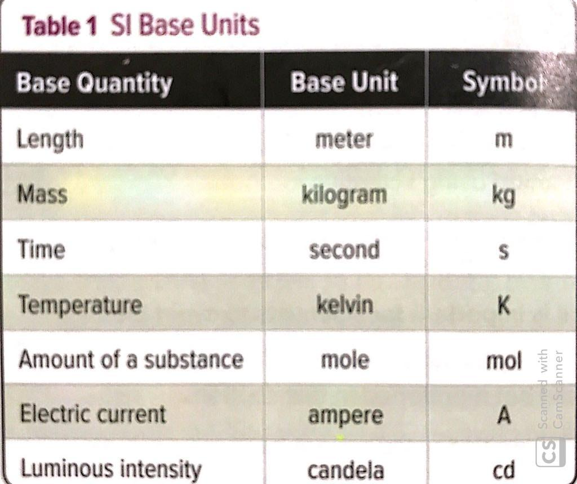
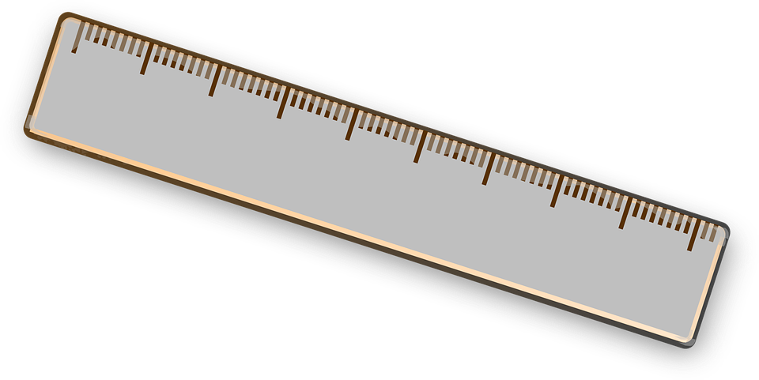
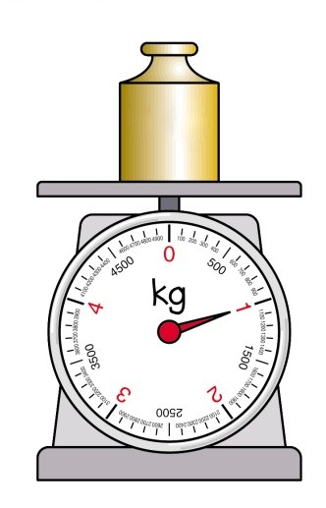


SI Units
The SI base units are seven units of measure defined by the International System of Units as the basic set from which all other SI units can be derived
Derived units are created by combing the base units in various ways .
Derived units are given special names.

Slide 6
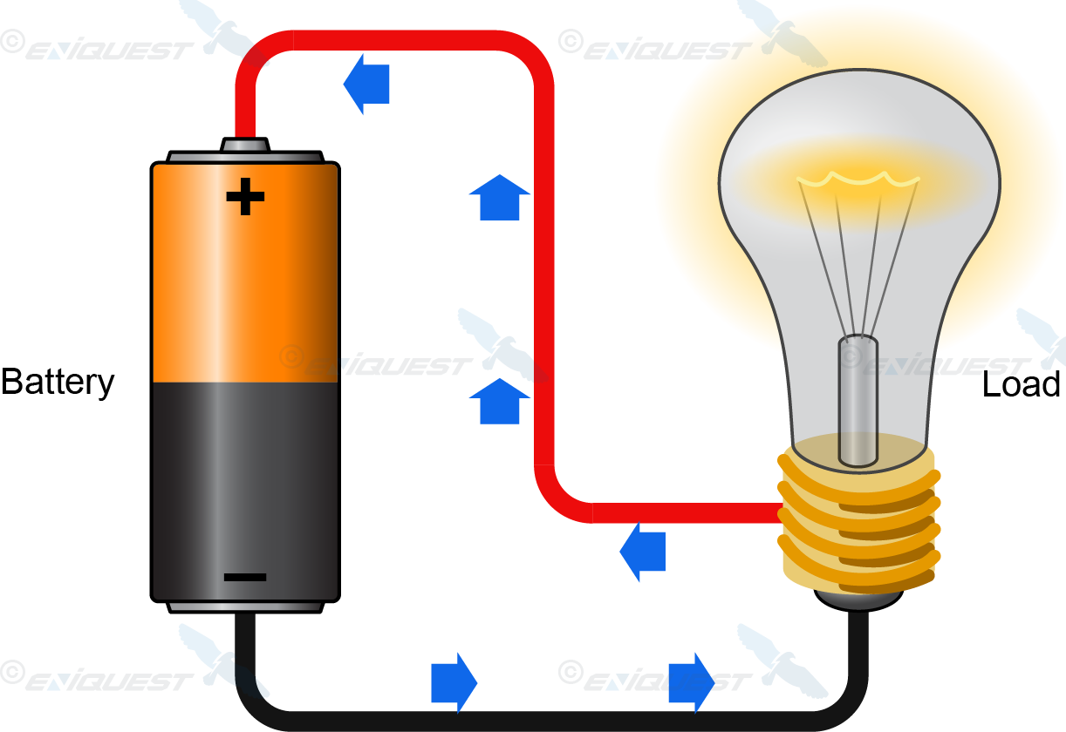
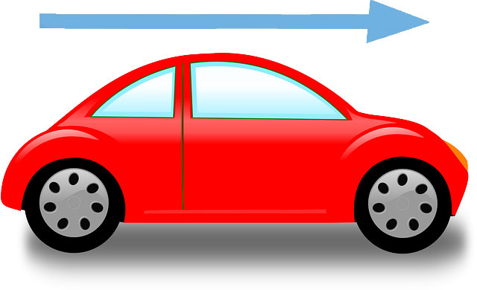
Derived Units
Electric Charge : Measure in Ampere-Seconds ( A*s) , which also called Coulombs ( C )
Derived units are created by combing the base units in various ways .
Derived units are given special names.
Velocity : Measure in meters per seconds ( m/s )

Slide 7
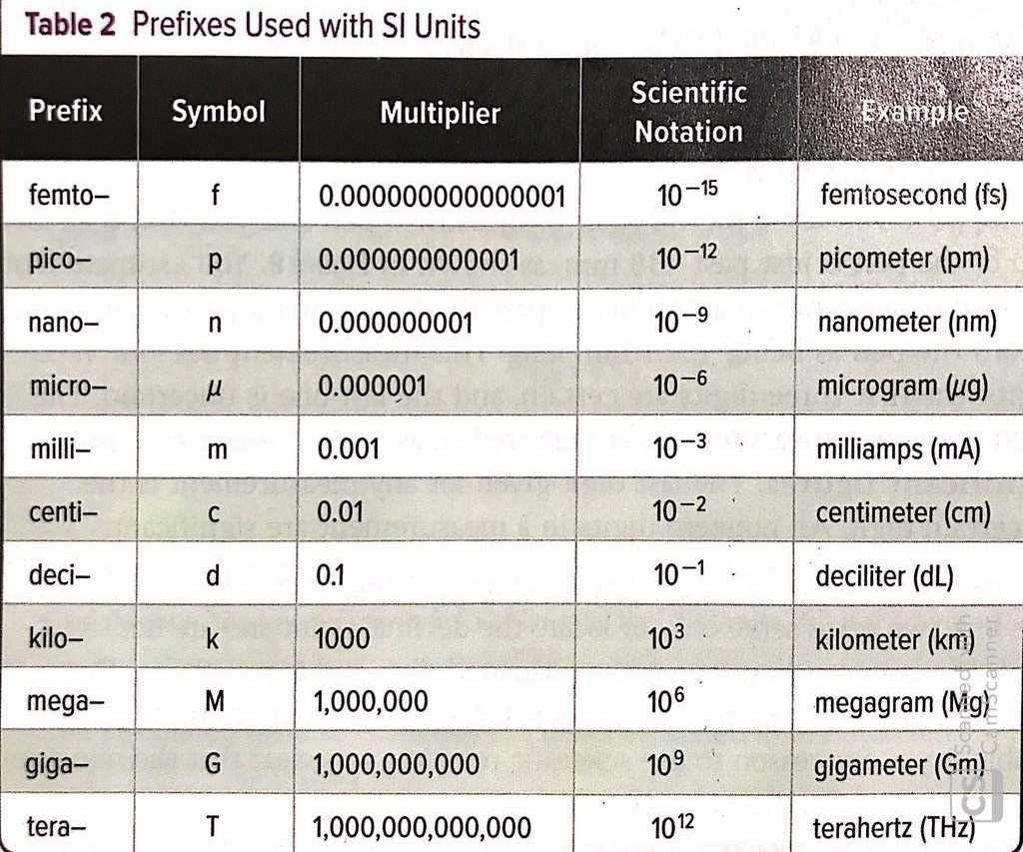

Prefixes
Prefixes are used to change SI base units by powers of 10
Derived units are created by combing the base units in various ways .
Derived units are given special names.

Slide 8
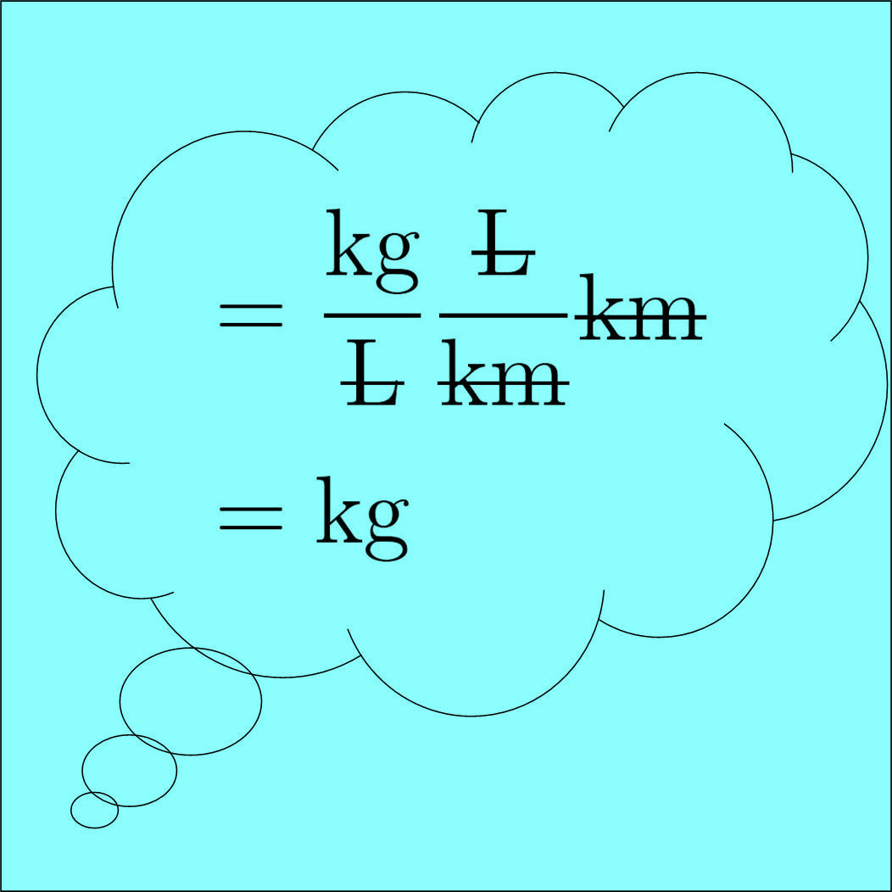
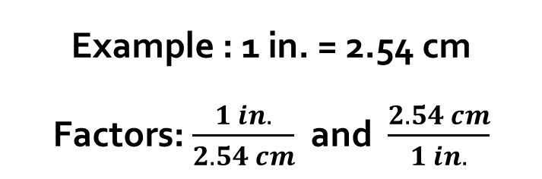
Dimensional Analysis
The method of treating the units as algebraic quantities that can be canceled
Dimensional Analysis also used in choosing conversion factors.
A conversion factor is a multiplier equal to 1.
Conversion Factors
Fractions in which the numerator and denominator are EQUAL quantities expressed in different units.

Slide 9
Conversion Factors
How Do We Multiply By 1
If the same thing is on the top and the bottom of a fraction,
λ
= 1
λ
Then they cancel out… and become 1
Dimensional Analysis also used in choosing conversion factors.
A conversion factor is a multiplier equal to 1.

Slide 10
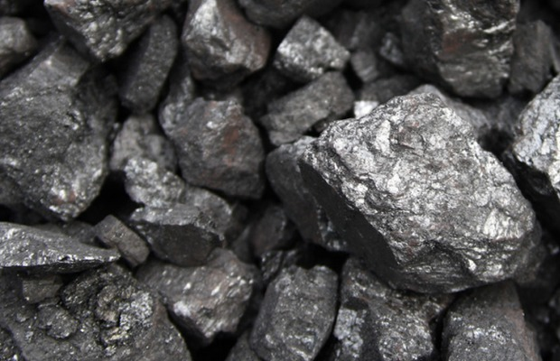
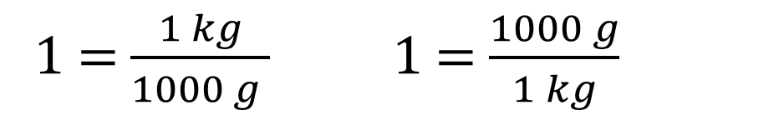
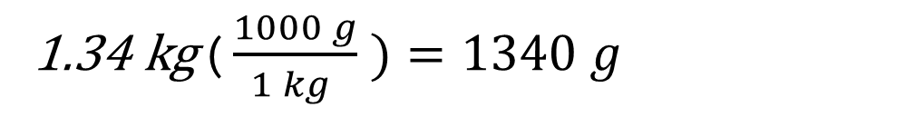
Convert 1.34 kg of iron ore to grams
Example 1
1 Kg = 1000 g
Choose a conversion factors that will make the initial units cancel, leaving the answer in the desired units.

Slide 11
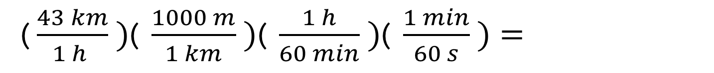
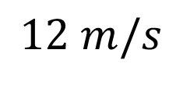
Example 2
Convert 43 km/h to m/s
Choose a conversion factors that will make the initial units cancel, leaving the answer in the desired units.
1 Km= 1000 m
1 h = 60 min
1 min = 60 sec

Slide 12
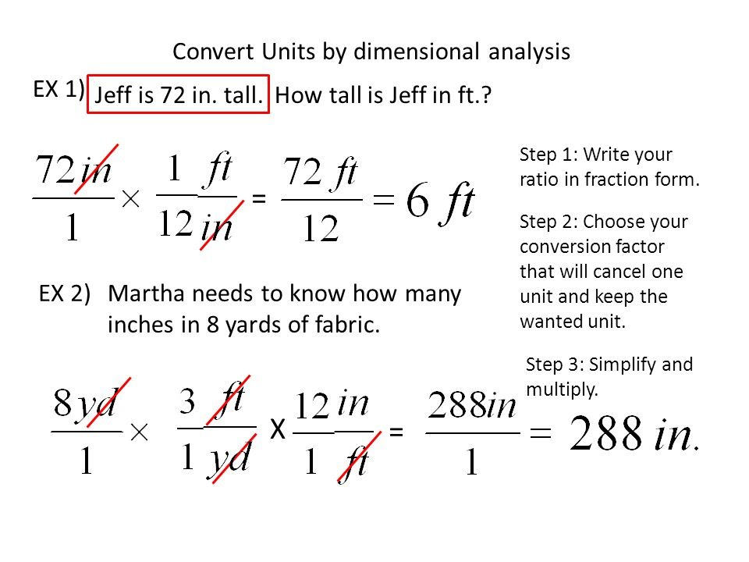
Example 3
Jeff is 72 inch in tall. How tall is Jeff in feet
1 ft = 12 in
1 yd = 3 ft
Sara needs to know how many inches in 8 yards
Example 4

Slide 13
Learning Objectives
By the end of this lesson :
Students will be able to count Significant Figures
Students will be able to solve problems using a three step process

Slide 14
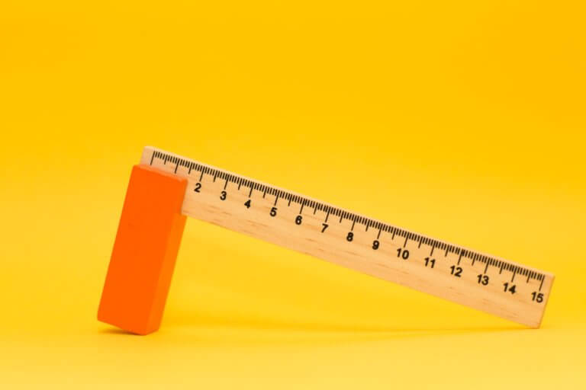
Significant Figures
Is a figure or a digit that contributes to how accurately something can be measured.
The numbers in a measurement that actually mean something.
The more significant figures are available to us when measuring , the more exact the measurement will be.

Slide 15
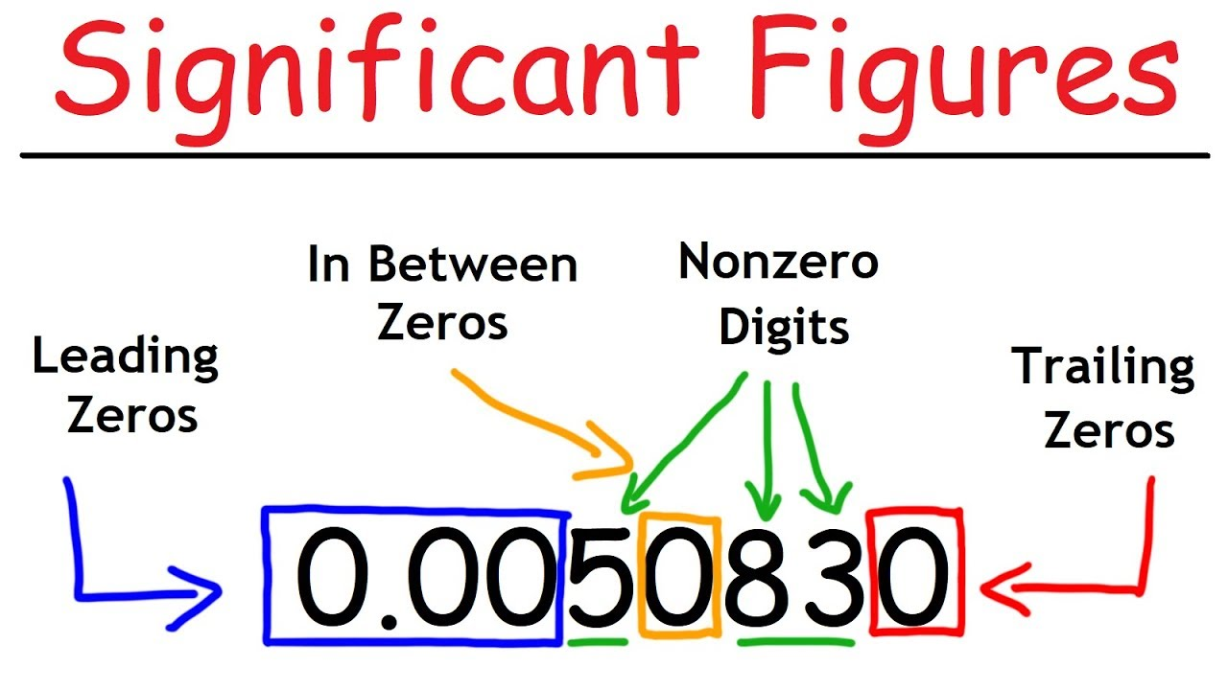
Counting Significant Figures
1) All Non Zero Digits Are Significant ( 1- 9 )
1.5 has 2 Significant Figures.
26981 has 5 Significant Figures.
2) Interior (Sandwich) Zeros (Between Two Digits) Are Significant
1.05 has 3 Significant Figures.
1023 has 4 Significant Figures.

Slide 16
3) Trailing Zeros After A Decimal Point Are Significant
1.050 has 4 Significant Figures.
4) Leading Zeros (On The Left Of A Number) Are NOT Significant.
0.001050 has 4 Significant Figures.
5) Zeros That Do Nothing But Set The Decimal Point (To The Right Of A Number) Are NOT Significant:
542,000 has 3 Significant Figures
Notes:
Some of you may say its length is 6.75 cm. Some may say it is 6.74 cm or 6.76 cm. We are quite
certain that the length is somewhere between 6.7 cm and 6.8 cm. The third (last) digit is a reasonable
guess. In other words, we can only estimate to the nearest hundredth of a centimeter. There is an
uncertainty of at least 0.01cm.

Slide 18


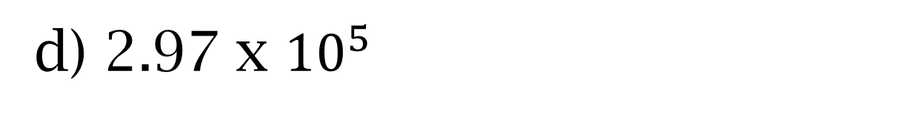
How many Significant Figures are in each of the following numbers ?
2 SF ( Rule #4 )
a) 0.0035
5 Mins
b) 1.080
4 SF ( Rule #2 & 3 )
In Groups
c) 2371
4 SF ( Rule #1)
3 SF ( Rule #1)

Slide 19
Rules for rounding numbers
If the digit immediate right of the last significant figure is:
greater than 5 – Round up the last sig. figure:
2.536
2.54
b) lesser than 5 – Do NOT round up:
2.532
2.53

Slide 20
Rules for rounding numbers
c) equal to 5:
1) followed by a non-zero –ROUND UP:
2.5351
2.54
2) followed by zero:
If the last significant figure:- is an odd digit – ROUND UP:
2.5350
2.54
- is an even digit– Do NOT round up:
2.5250
2.52

Slide 21
Arithmetic with Significant figures
1) 3.86 m + 2.4 m = 6.26 m
To add or subtract measurements , first perform the operation then ROUND OFF the result to the least number of digits after the decimal point.
6.3 m
If the digit immediate right of the last significant figure is:
greater than 5 – Round up the last sig. figure:
2.536
2.54

Slide 22
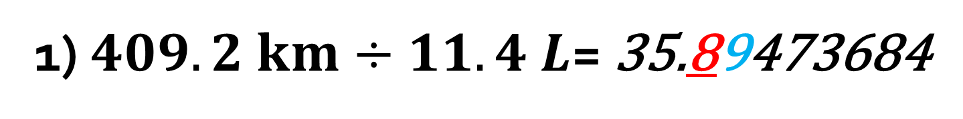
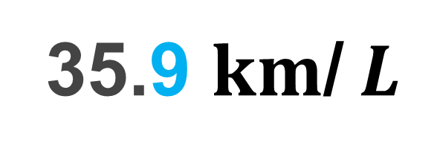
Arithmetic with Significant figures
To multiply or divide measurements , first perform the operation then ROUND OFF the result to the least number of significant figures.
4 SF
3 SF
If the digit immediate right of the last significant figure is:
greater than 5 – Round up the last sig. figure:
2.536
2.54

Slide 23
Solve the following problems , using the correct number of significant figures each time.
9.223
1) 5.74 + 0.832 + 2.651 =
2 Decimal Places
3 Decimal Places
2 Decimal Places
5 Mins
9.22
2) 4.8 + 3.965 =
8.765
In Groups
1 Decimal Place
3 Decimal Places
8.8
3) 5.02 x 89.665 x 0.10 =
45.0118
3 Significant
Figures
5 Significant Figures
2 Significant Figures
45
Notes:
https://slideplayer.com/slide/7365490/

Slide 24


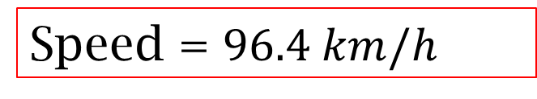
Example 1
Using Distance and Time To Find Speed. When a car travels 434 km in 4.5, what is the car’s average speed ?
Known
Distance = 434 km
Time = 4.5 h
Unknown
Speed = ? Km/h
The Problem
Analyze and Sketch the Problem
Solve for the Unknown
Evaluate the Answer
Distance = Speed x Time
Distance = speed x time
= 96.4 km/h x 4.5 h
= 434 km

Slide 25
Scientific Notation and Standard Notation

Slide 26
Learning Objectives
By the end of this lesson :
Students will be able to convert from scientific notation to standard notation
Students will be able to convert from standard notation to scientific notation
Students will be able to add and subtract numbers in scientific notation
Students will be able to multiply and divide numbers in scientific notation

Slide 27
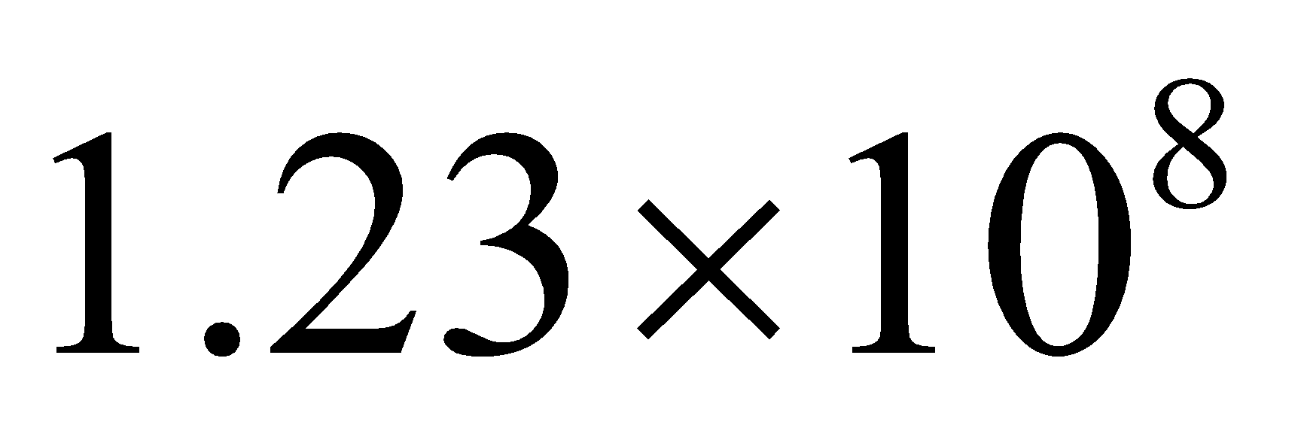
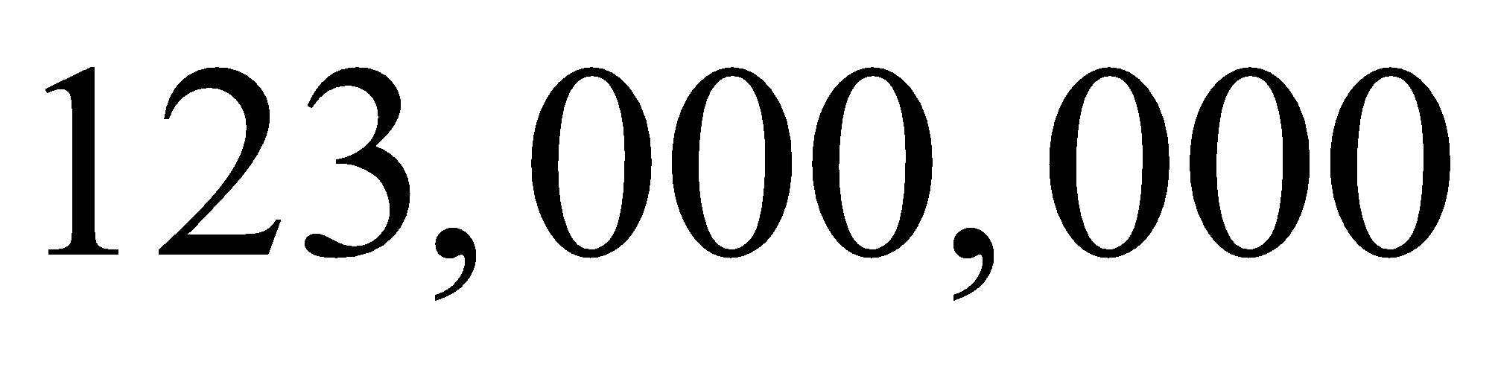
Key Vocabulary
Scientific Notation
Standard Notation

Slide 28
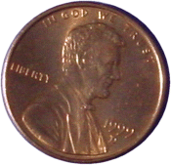
Scientific Notation
An ordinary penny contains about 20,000,000,000,000,000,000,000 atoms.
The average size of an atom is about 0.00000003 centimeters across.
In scientific notation the number of atoms in a penny is 2.0 × 10²², and the size of each atom is 3.0 × 10^{–8} centimeters across.
The length of these numbers in standard notation makes them awkward to work with.
Scientific Notation is a shorthand way of writing such numbers.

Slide 29
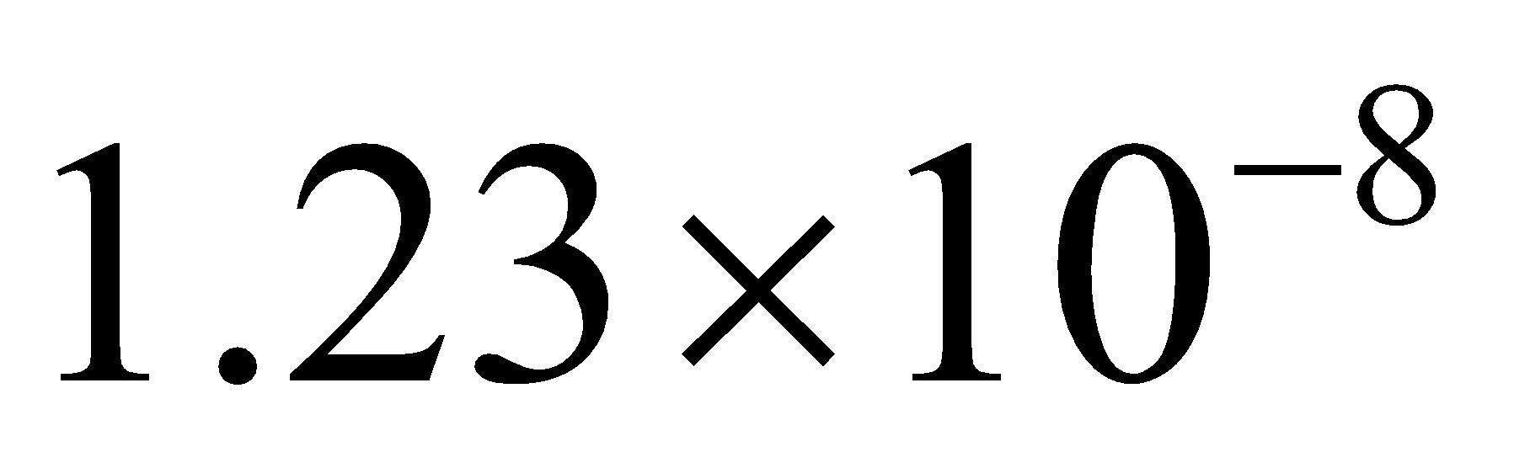
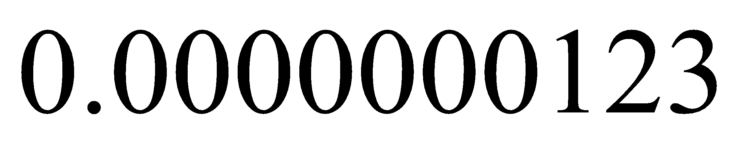
Translating Scientific Notation to standard notation
From Scientific Notation To Standard Notation
A Positive Exponent
A Negative Exponent
Helpful Hint
The sign of the exponent tells which direction to move the decimal. A positive exponent means move the decimal to the right, and A Negative exponent means move the decimal to the left.

Slide 30
Example 1
Write the numbers in Standard Notation.
A. 1.35 × 10⁵
5
10 = 100,000
From Scientific Notation To Standard Notation
1.35 × 10
5
Think: Move the decimal right 5 places.
1.35 × 100,000
135,000
–3
B. 2.7 × 10
0.0027
Think: Move the decimal left 3 places.

Slide 31
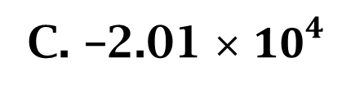
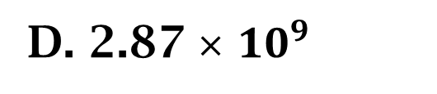
Write the numbers in Standard Notation.
Think: Move the decimal right 4 places.
–20,100
From Scientific Notation To Standard Notation
Think: Move the decimal right 9 places.
2,870,000,000
E. 1.9 × 10^{–5}
Think: Move the decimal left 5 places.
0.000019

Slide 32


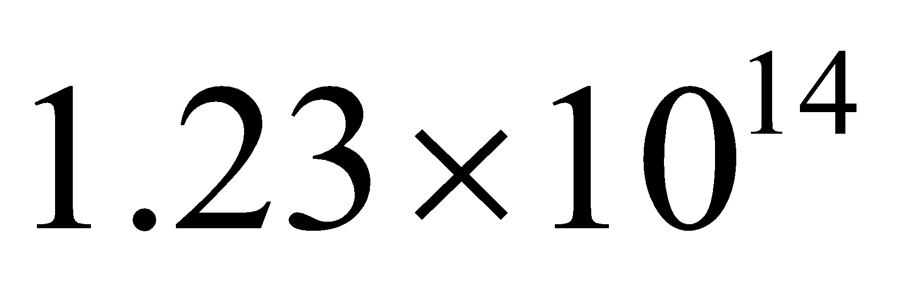
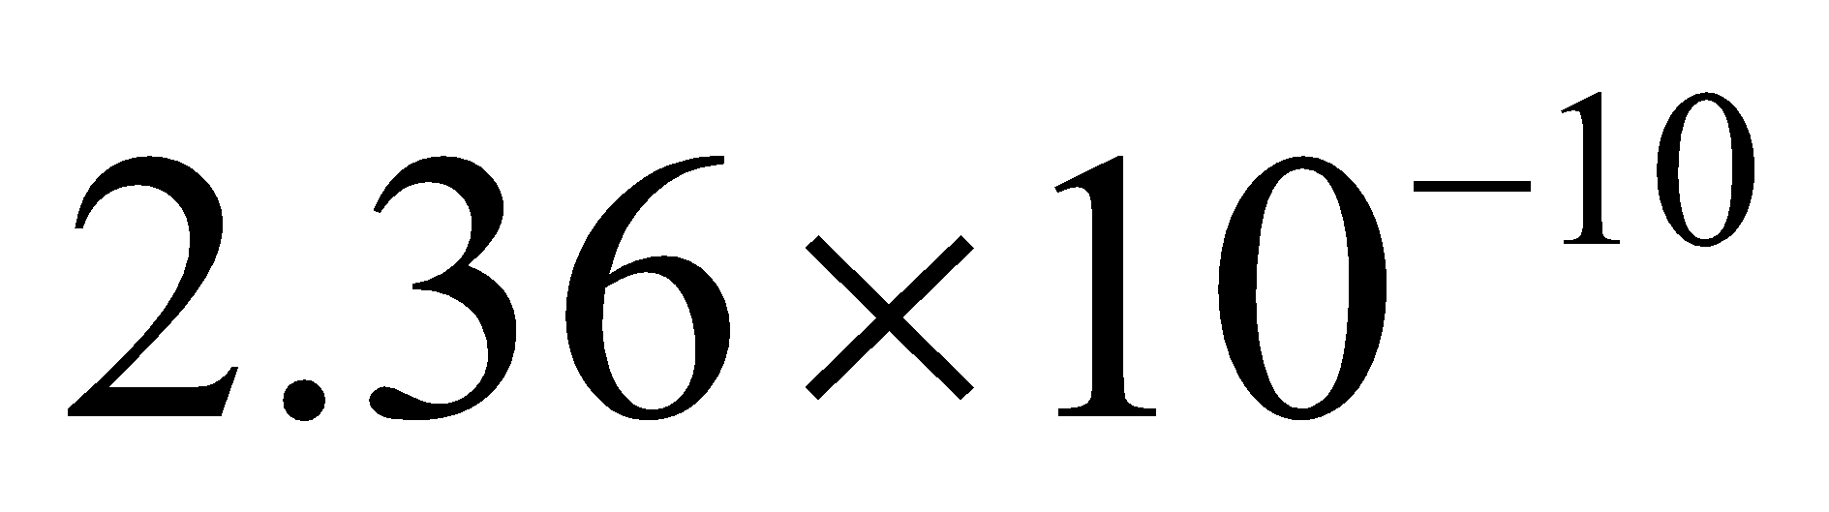
Translating standard notation
to scientific notation
Rules for converting Standard Notation to Scientific Notation
1. Move the decimal to get a number between 1 and 10.
2. Count the # of places the decimal moved (that is the exponent on 10)
A number in Scientific Notation is Expressed as :
Original number > 1 then positive exponent on the 10
Original number < 1 then negative exponent on the 10
A number between 1 and less than 10 times a power of 10
123,000,000,000,000
0.000000000236
K is an integer ( can be positive or negative )

Slide 33
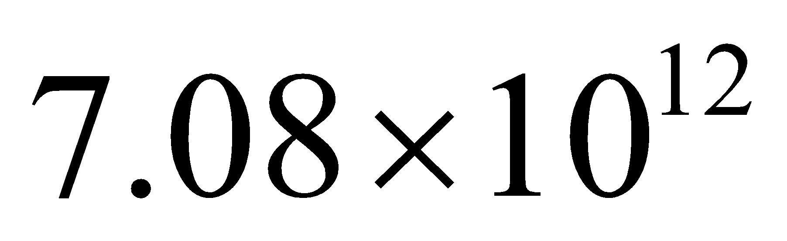
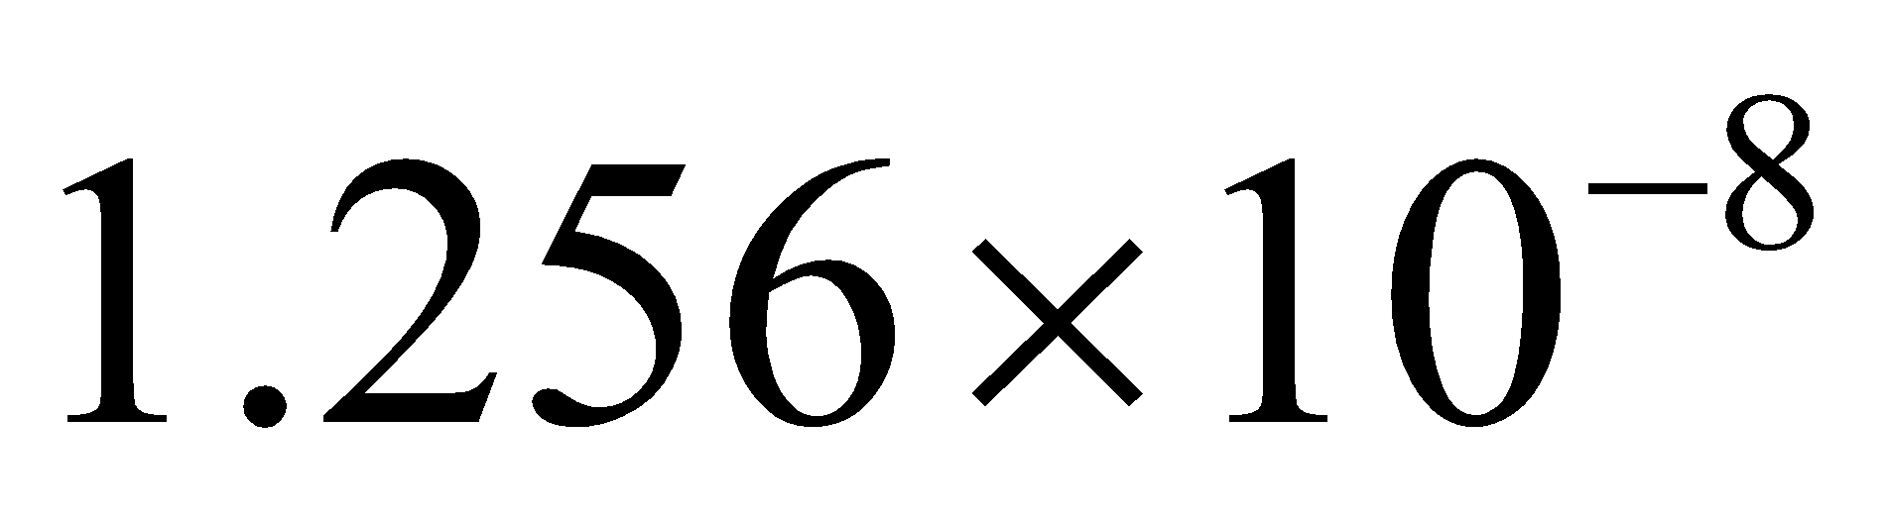
Example 2
Write the numbers in Scientific Notation.
A. 7,080,000,000,000
A number in Scientific Notation is Expressed as :
B. 0.00000001256
C. 57,000,000
5.7 × 10⁷
A number between 1 and less than 10 times a power of 10
D. 0.0053
5.3 × 10^{–3}
K is an integer ( can be positive or negative )
HINT :
Original number > 1 then positive exponent on the 10
Original number < 1 then negative exponent on the 10

Slide 34
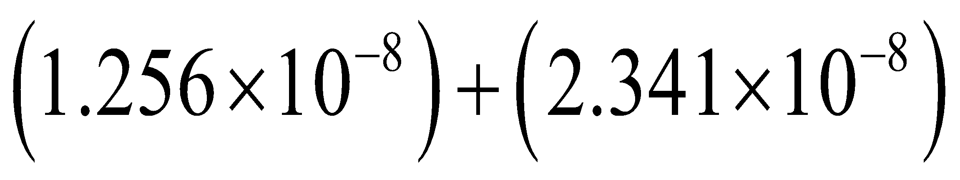
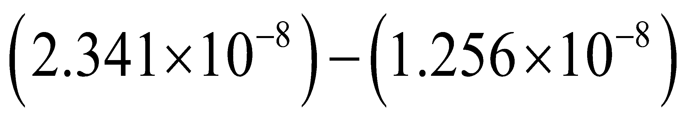
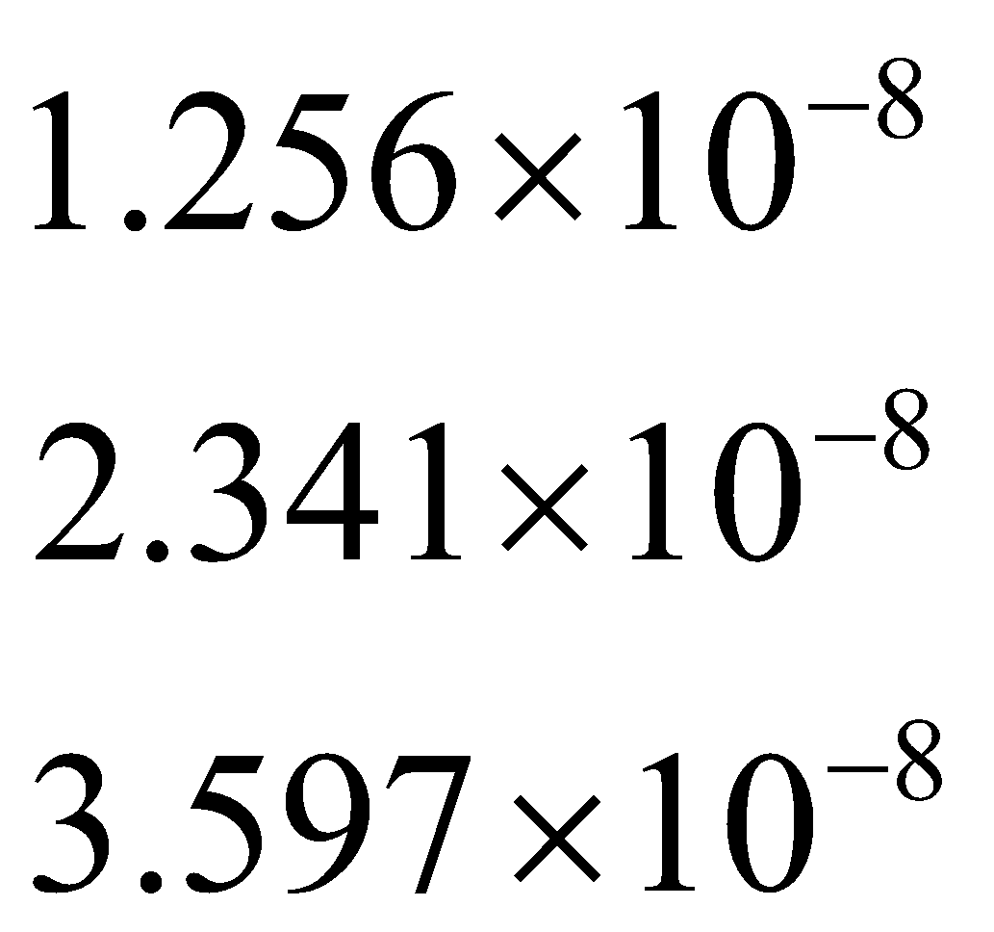
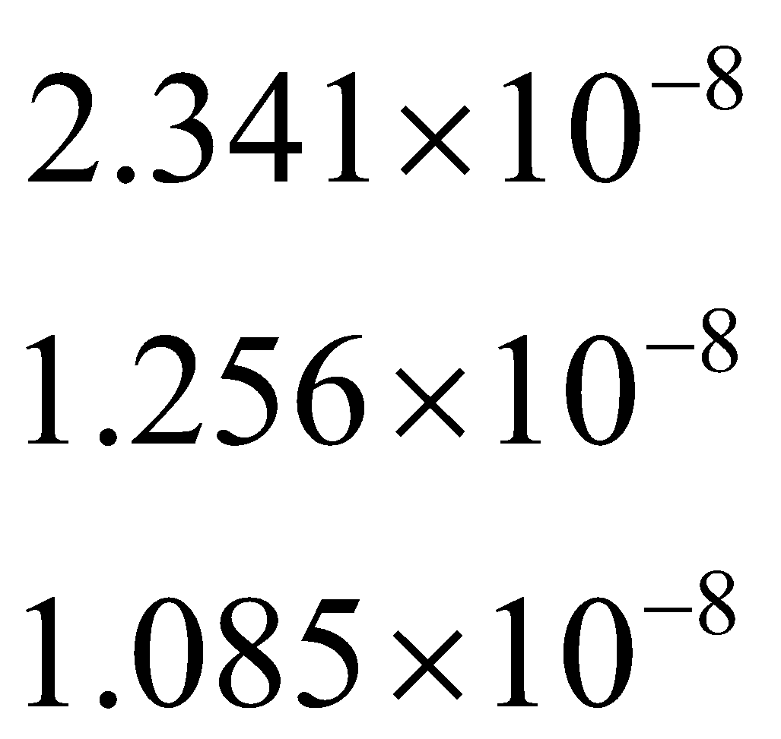
Adding and Subtracting numbers in Scientific Notation
To add or subtract numbers in scientific notation must have the same power of 10!
Add/Subtract the numbers. Remember to line the decimals up; the power of 10 will remain the same in your answer.
+

Slide 35
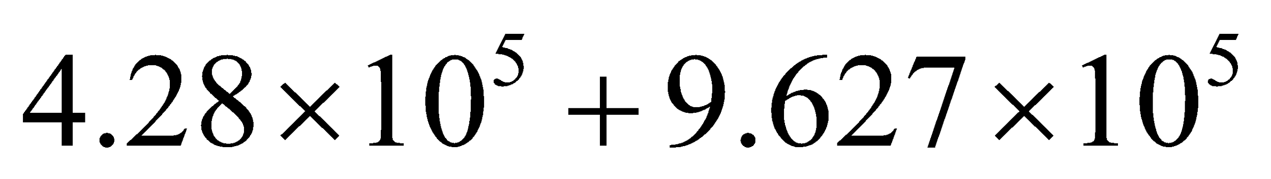
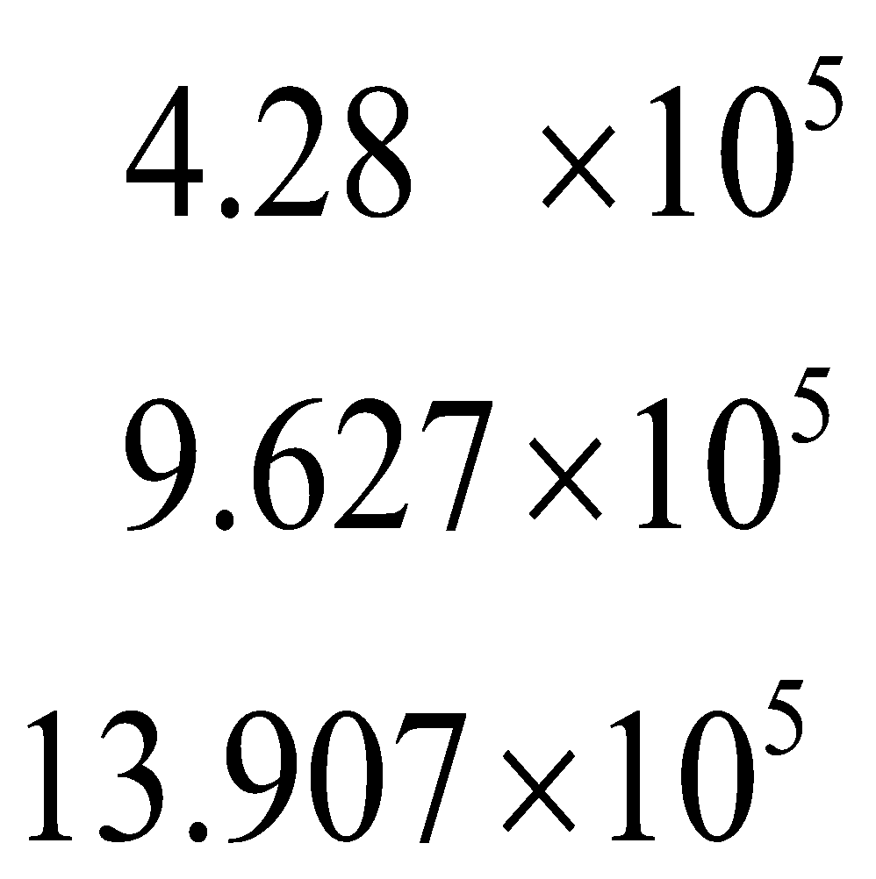
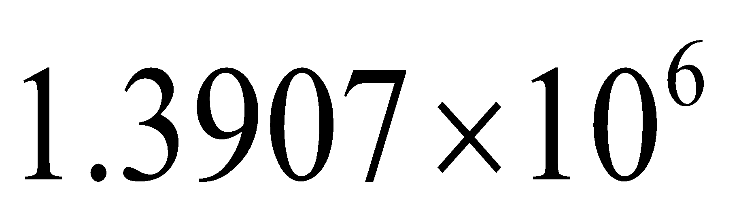
What happens when the number is greater than 10?
+
Make sure that you put your answer into scientific notation; that number must be at least 1 but less than 10
Remember to change the power of 10.

Slide 36
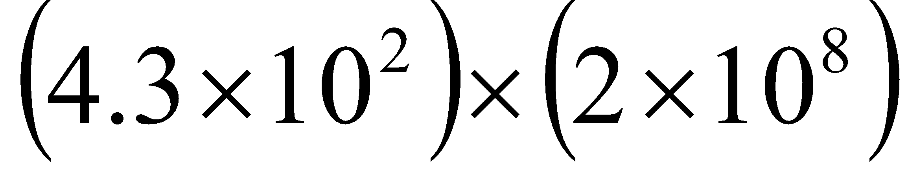
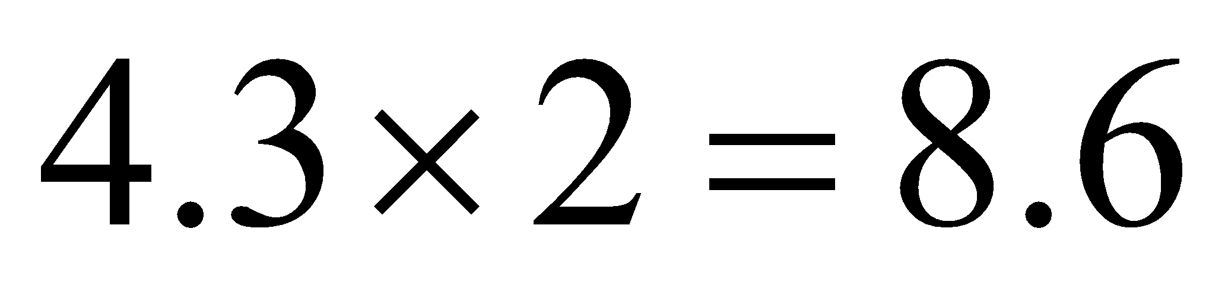
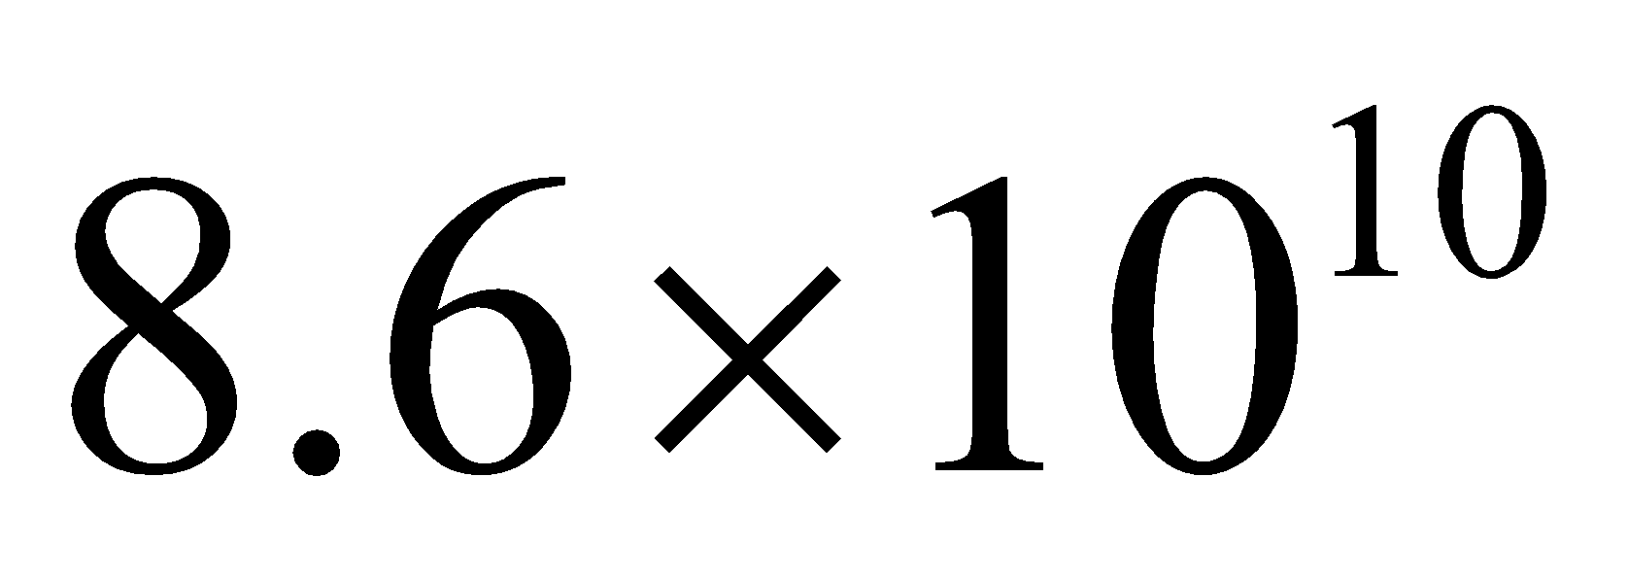
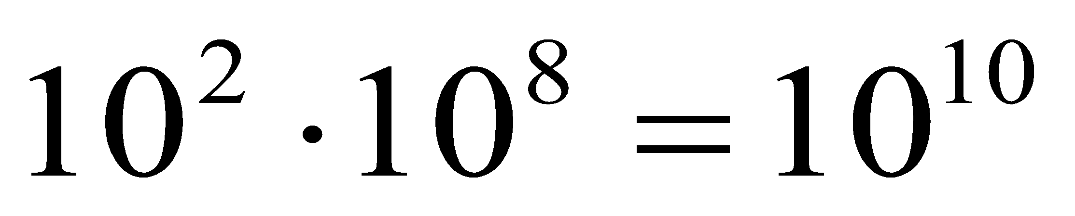
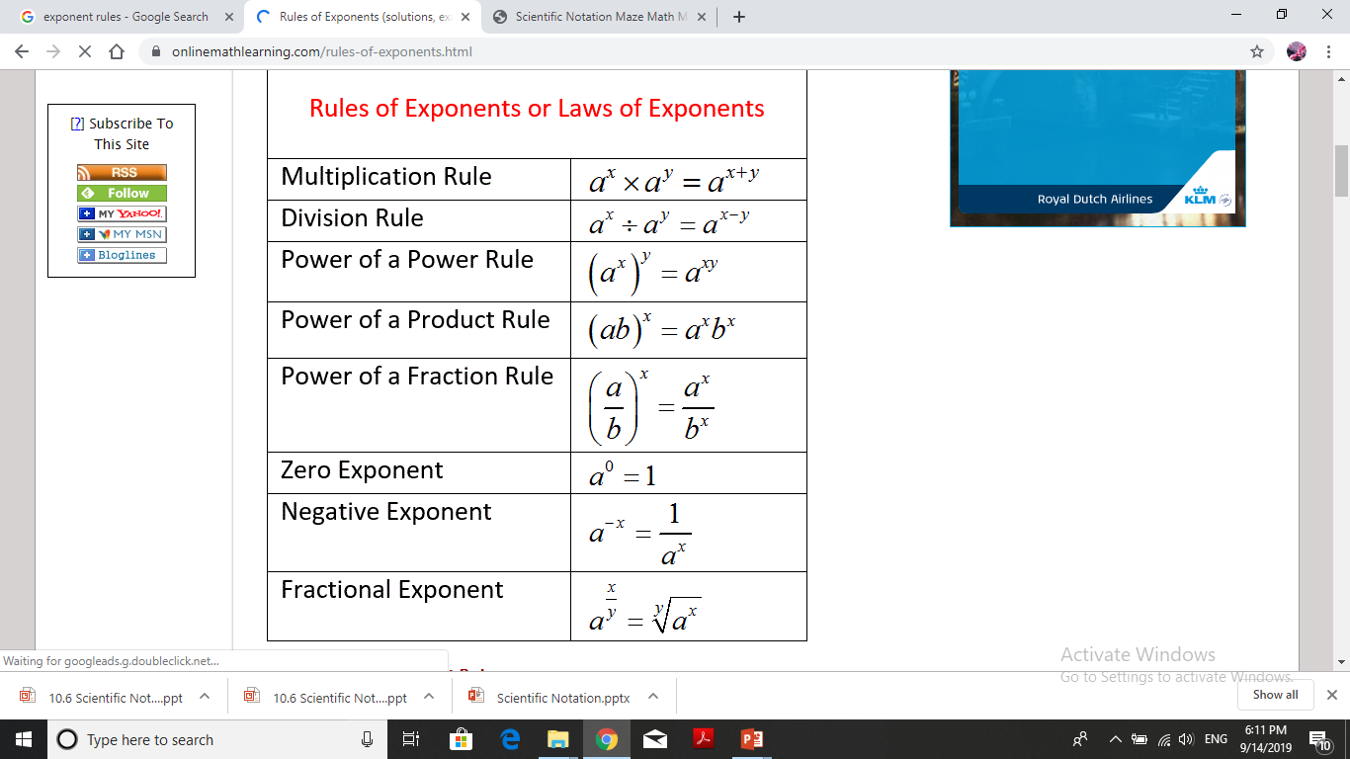
Multiplying numbers in Scientific Notation
Step 1
Step 3
Step 1: Multiply the numbers first.
Step 2: Multiply the powers of 10 using the exponent rules.
Step 3: Put your answer together as a product of a number and a power of 10.
Step 4: Check to make sure you don’t have to fix the answer.
Step 2
Step 4
Exponent Rule
Is the answer in Scientific Notation?
Yes

Slide 37
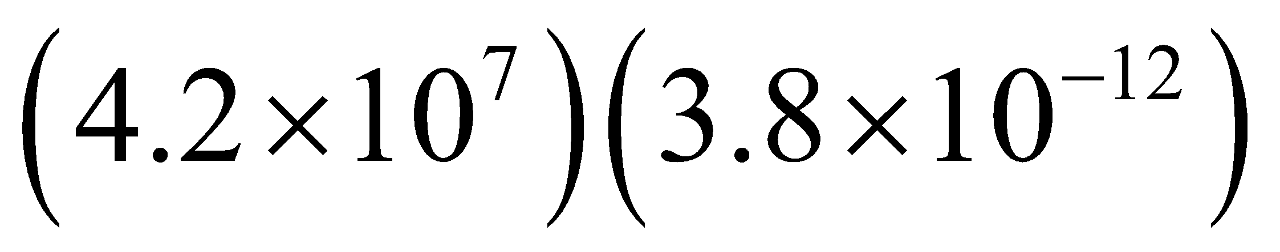
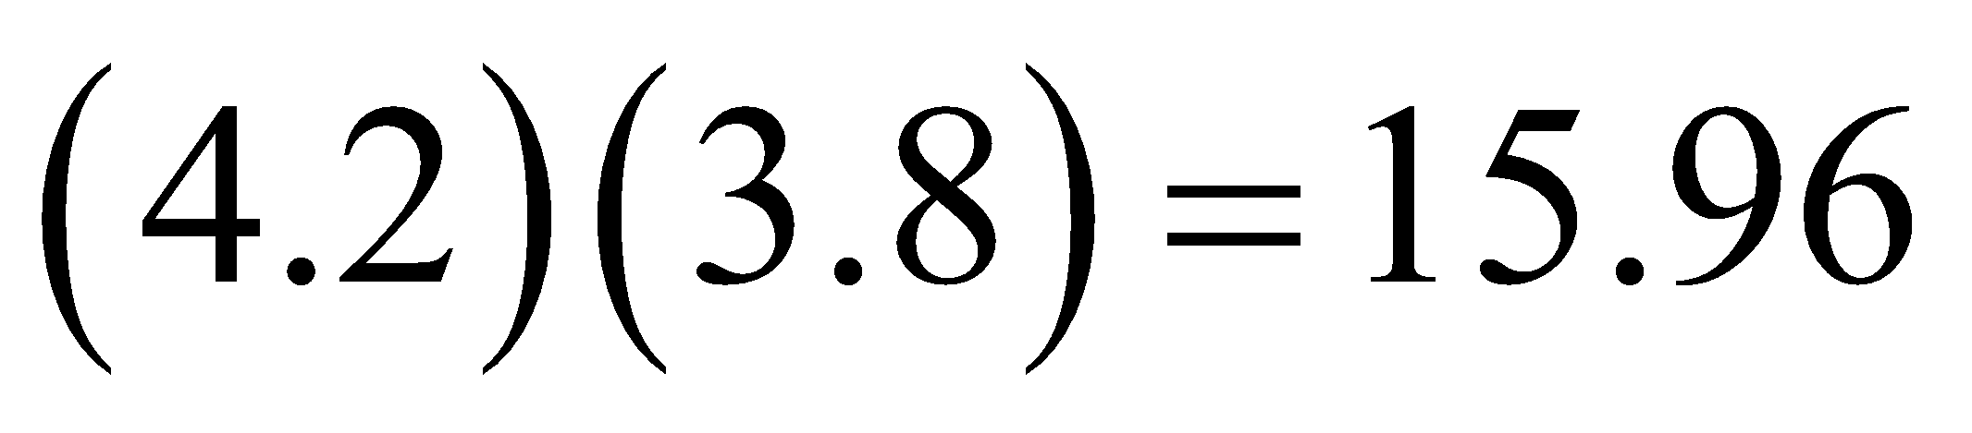
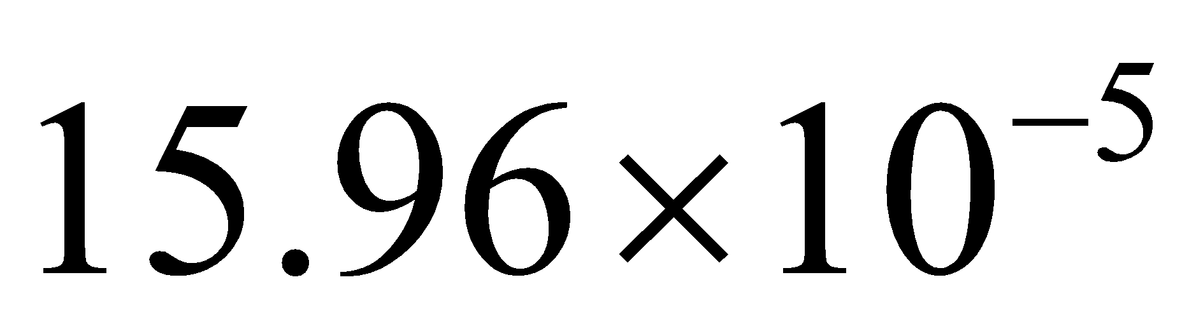
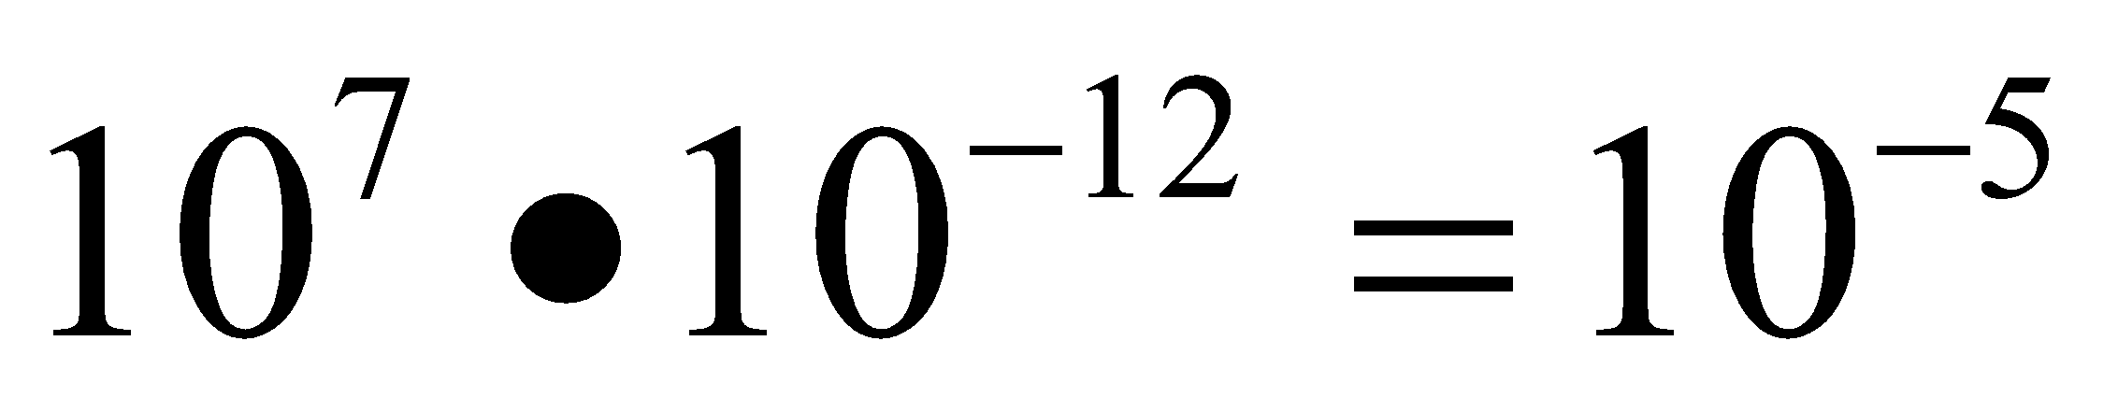
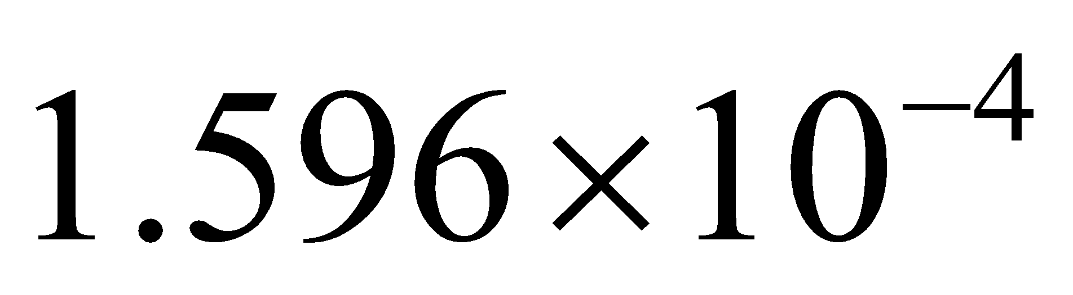

Multiplying numbers in Scientific Notation
Step 1
Step 3
Step 1: Multiply the numbers first.
Step 2: Multiply the powers of 10 using the exponent rules.
Step 3: Put your answer together as a product of a number and a power of 10.
Step 4: Check to make sure you don’t have to fix the answer.
Step 2
Step 4
Is the answer in Scientific Notation?
Exponent Rule
NO

Slide 38
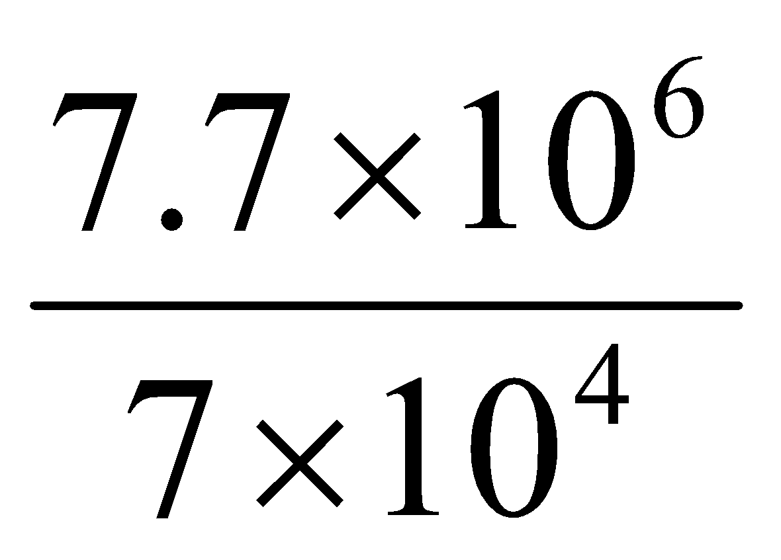
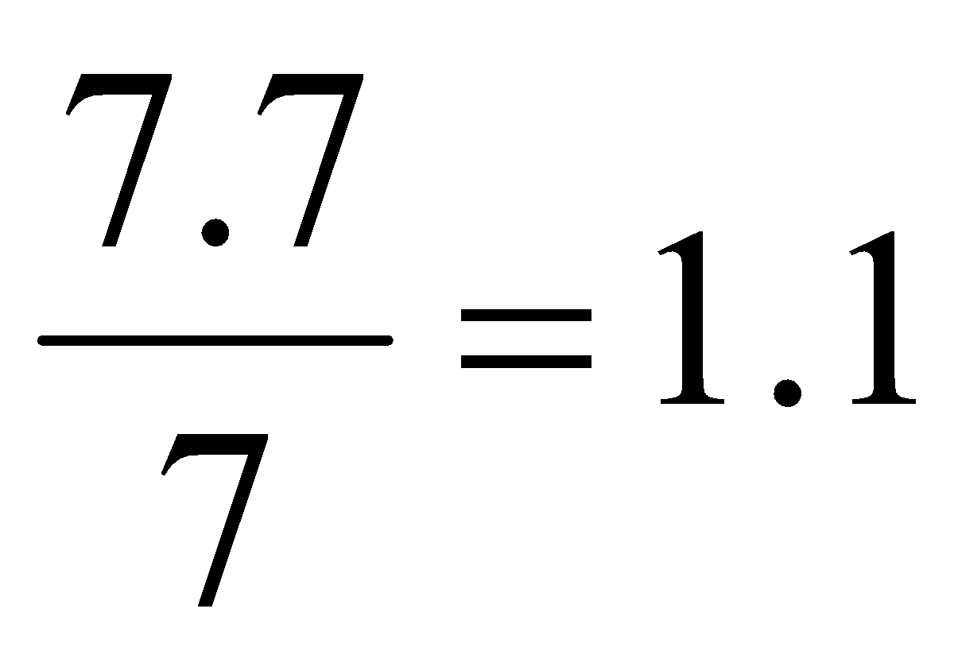


Dividing numbers in Scientific Notation
Step 1
Step 3
Step 1: Divide the numbers first
Step 2: Divide the powers of 10 using the exponent rules.
Step 3: Put your answer together as a product of a number and a power of 10.
Step 4: Check to make sure you don’t have to fix the answer.
Step 2
Step 4
Exponent Rule
Is the answer in Scientific Notation?
Yes

Slide 39
Most commonly used prefixes in Physics
Objective Learning
Prefix | Factor | Symbol
Mega | x 10⁶ | M
Kilo | x 10³ | K
Centi | x 10⁻² | c
Milli | x 10⁻³ | m
Micro | x 10⁻⁶ | μ
Nano | x 10⁻⁹ | n
Convert from scientific notation to standard notation
Convert from standard notation to scientific notation
Add and subtract numbers in scientific notation
Multiply and divide numbers in scientific notation

Slide 40

Section 2- Review
In Groups

Slide 41

Section 2- Review
In Groups

Slide 42
Section 2- Review Answer Key
8) It is one way of representing relationships between measurements.
9) Almost everyone uses it to communicate results and understand it.
10) 750,000 kilohertz
11) One calendar leap year has 366 days (occurs every 4 years):
1 leap year = 366 days = (366 days) × (24 hours/day) × (3600 seconds/hour) = 31,622,400 seconds

Slide 43

Section 2- Review Answer Key

