Slide 1



Welcome to Our Distance Learning Session

Slide 2




2 Mins
Once I call your name , just say
YES or comment in the chat

Slide 3

1
Warm up
What comes to your mind when you hear the word Science ?
3 Mins
https://www.menti.com/xzjnw2mxx4

Slide 4

Quote of the day

Slide 5

1-1 Methods of Science

Slide 6
Learning objectives
01
Define what is physics.
02
State characteristics of scientific methods.
1.1 Methods of Science
Textbook Page 04

Slide 7
Key vocabulary
Physics
Scientific Method
1.1 Methods of Science
Textbook Page 04

Slide 8


Learning Objectives
What is science
Define Physics.
State characteristics of scientific methods.
It is a method for studying the NATURAL WORLD
Latin Word Scientia : Knowledge
1.1 Methods of Science
Textbook Page 04

Slide 9
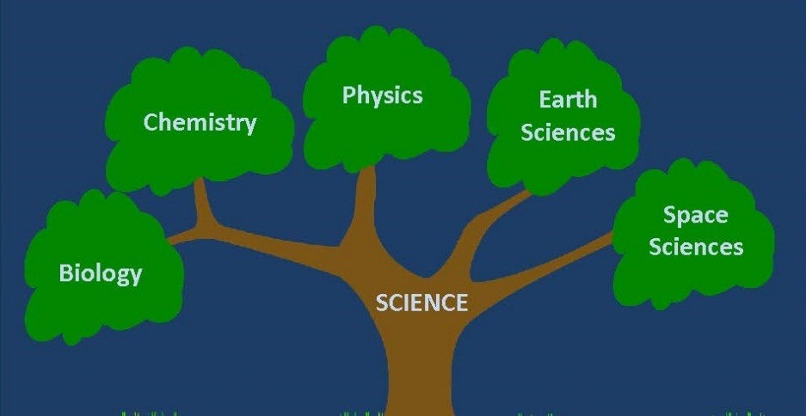
Learning Objectives
What is physics
Define Physics.
State characteristics of scientific methods.
Physics is a branch of science that includes the study of physical world like the relation between energy and matter.
1.1 Methods of Science
Textbook Page 04

Slide 10

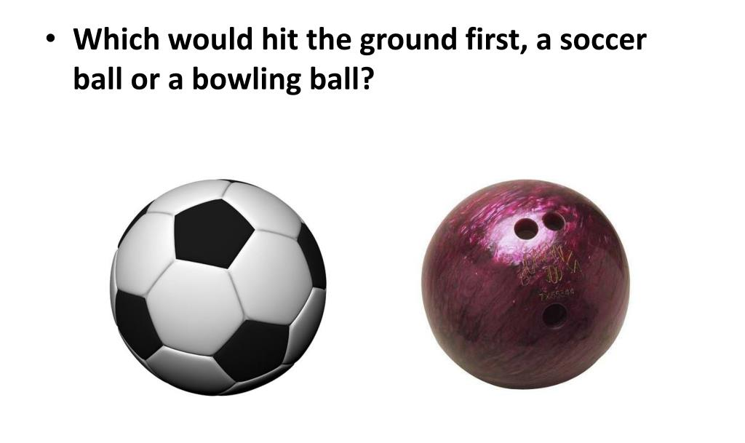
Learning Objectives
BRAIN GEAR
Define Physics.
State characteristics of scientific methods.
https://www.menti.com/r15vow4cyb
1.1 Methods of Science
Textbook Page 05

Slide 11


Search about ..
Learning Objectives
Define Physics.
State characteristics of scientific methods.
Now it’s time to search about which would hit the ground first the bowling ball or the soccer ball and share with us on the LMS Course Wall !
2 Mins
1.1 Methods of Science
Textbook Page 05

Slide 12
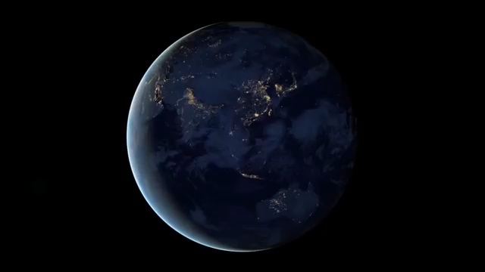
Learning Objectives
Scientific method
Define Physics.
State characteristics of scientific methods.
1.1 Methods of Science
Textbook Page 05

Slide 13
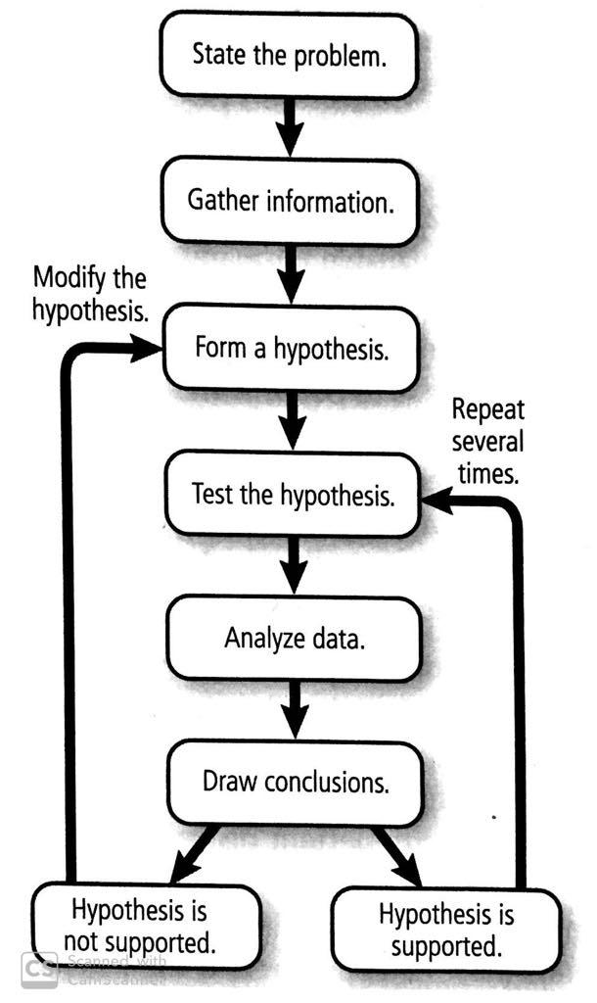

Learning Objectives
Scientific methods
Define Physics.
State characteristics of scientific methods.
Scientists do not always follow rigid steps.
1.1 Methods of Science
Textbook Page 05

Slide 14

Learning Objectives
Scientific methods
Define Physics.
State characteristics of scientific methods.
1) State the Problem
When you begin an investigation, you should state what you are going to investigate.
The question of “ Why “ or “ How “ is the problem.
Results leads to new questions !
1.1 Methods of Science
Textbook Page 05

Slide 15
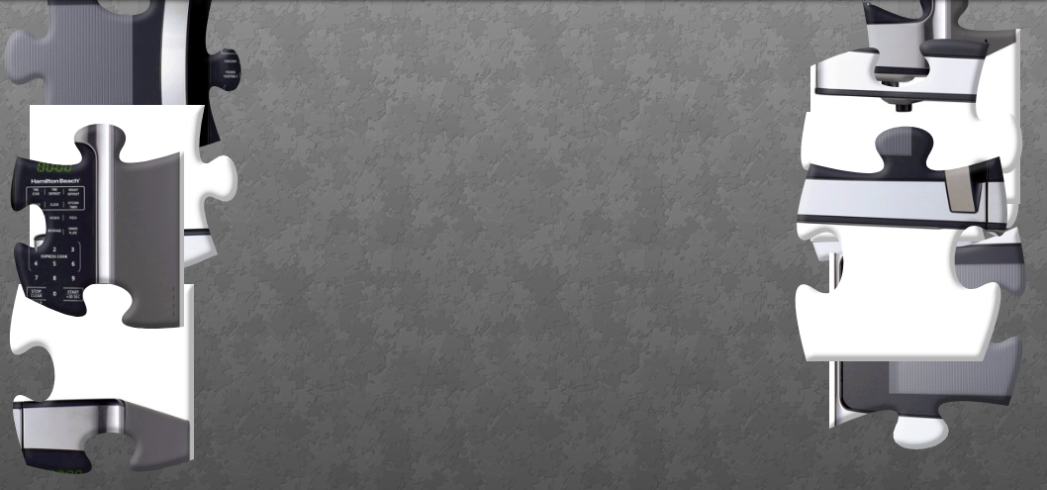
Learning Objectives
Guess the picture
Define Physics.
State characteristics of scientific methods.
https://www.jigsawplanet.com/?rc=play&pid=2d00f1b34725
1.1 Methods of Science
Textbook Page 05

Slide 16

Learning Objectives
Percy spencer
Define Physics.
State characteristics of scientific methods.
1.1 Methods of Science
Textbook Page 05

Slide 17
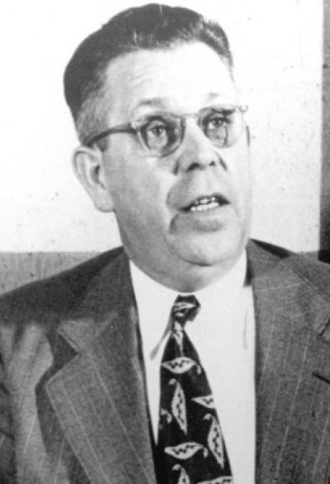
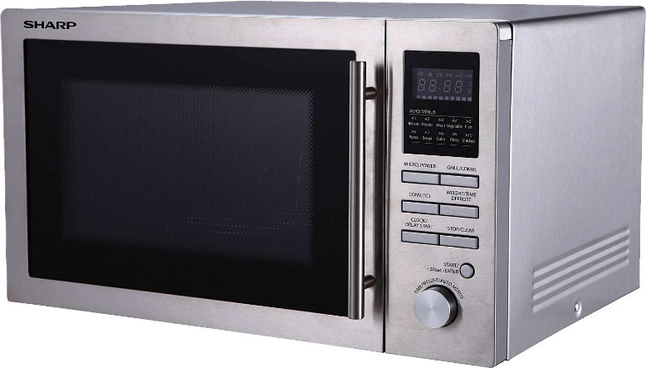
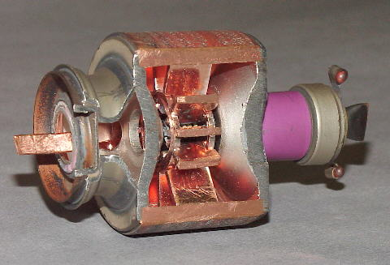

Learning Objectives
Percy spencer
Define Physics.
State characteristics of scientific methods.
Percy Lebaron Spencer
An American physicist and Inventor.
Q: How to mass-produce the magnetron tubes used in radar systems ?
1.1 Methods of Science
Textbook Page 05

Slide 18
Learning Objectives
Scientific methods
Define Physics.
State characteristics of scientific methods.
2) Research and Gather Information
Research what is already known about the problem.
Form into a hypothesis.
1.1 Methods of Science
Textbook Page 05

Slide 19
Learning Objectives
Scientific methods
Define Physics.
State characteristics of scientific methods.
3) Form and test a hypothesis
An Educated Guess
A proposed solution to a problem.
Not yet been supported by any measurable data.
Ways to test hypothesis :
Perform an experiment
Build a model and relate it to real life situations
Investigations ( if experiment is not possible )
Make observations
1.1 Methods of Science
Textbook Page 05

Slide 20
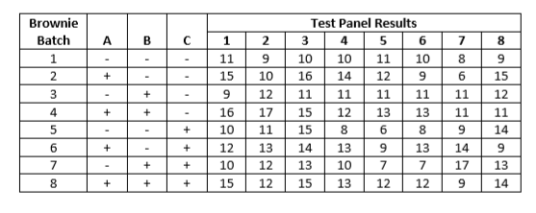
Learning Objectives
Scientific methods
Define Physics.
State characteristics of scientific methods.
4) Analyze Data
Organize data into easy to read tables and graphs.
Include all results
Organize in a logical manner.
1.1 Methods of Science
Textbook Page 05

Slide 21
Learning Objectives
Scientific methods
Define Physics.
State characteristics of scientific methods.
5) Draw Conclusions
Whether the hypothesis is supported or not
( Supported : Must be the same every time if repeated )
Revise and reconsider if experiment does not support hypothesis.
1.1 Methods of Science
Textbook Page 05

Slide 22

Learning Objectives
Scientific methods
Define Physics.
State characteristics of scientific methods.
6) Peer Review
Before it is made public
Reviewed by scientists same field of study
1.1 Methods of Science
Textbook Page 05

Slide 23
Learning Objectives
Scientific methods
Define Physics.
State characteristics of scientific methods.
7) Being Objective
Reduce bias in scientific investigations
Causes of bias :
Select a result from one trial over those from other trails.
Products used in promotion and obstacles are not presented.
1.1 Methods of Science
Textbook Page 05

Slide 24



Learning objectives
01
Define Physics.
02
State characteristics of scientific methods.
1.1 Methods of Science
Textbook Page 07

Slide 25
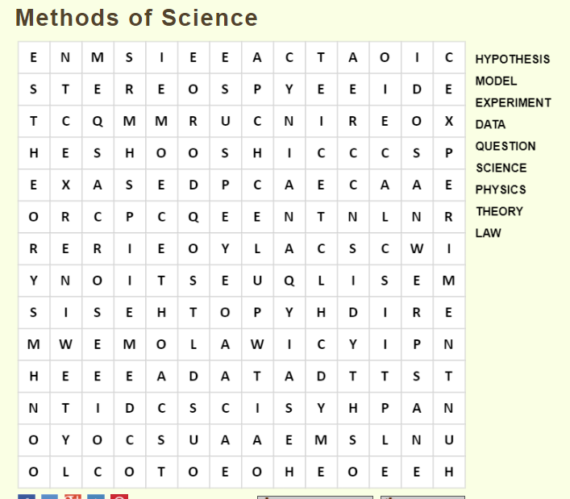
Learning Objectives
Word search
Define Physics.
State characteristics of scientific methods.
4 Mins
https://thewordsearch.com/puzzle/1400194/methods-of-science/
1.1 Methods of Science
Textbook Page 05

Slide 26
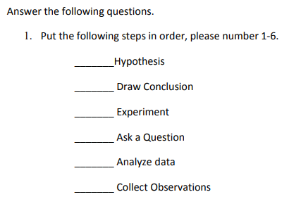

Learning Objectives
Check your understanding
Define Physics.
State characteristics of scientific methods.
1.1 Methods of Science
Textbook Page 05

Slide 27
Learning Objectives
Check your understanding
Define Physics.
State characteristics of scientific methods.
3
6
4
1
5
2
1.1 Methods of Science
Textbook Page 05

Slide 28
1-1 Methods of Science
Subject: Physics | Grade: 9 Advanced |Teacher: Dana Kamal Abdel Jabbar

Slide 29


Quote of the day

Slide 30
Learning objectives
01
Define what is a model.
02
State the difference between scientific theory and law
1.1 Methods of Science
Textbook Page 06

Slide 31
Key vocabulary
A Model
Scientific Theory
Scientific Law
1.1 Methods of Science
Textbook Page 06

Slide 32

CAN SCIENTISTS SEE EVERYTHING WITH THEIR EYES ?
Learning Objectives
Define Physics.
State characteristics of scientific methods.
1.1 Methods of Science
Textbook Page 05

Slide 33
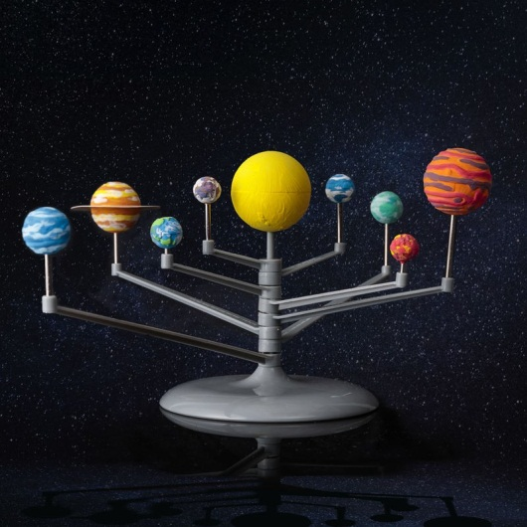
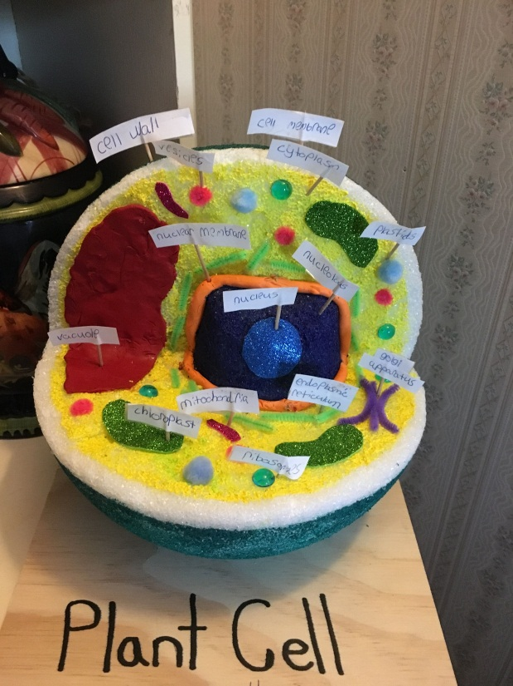
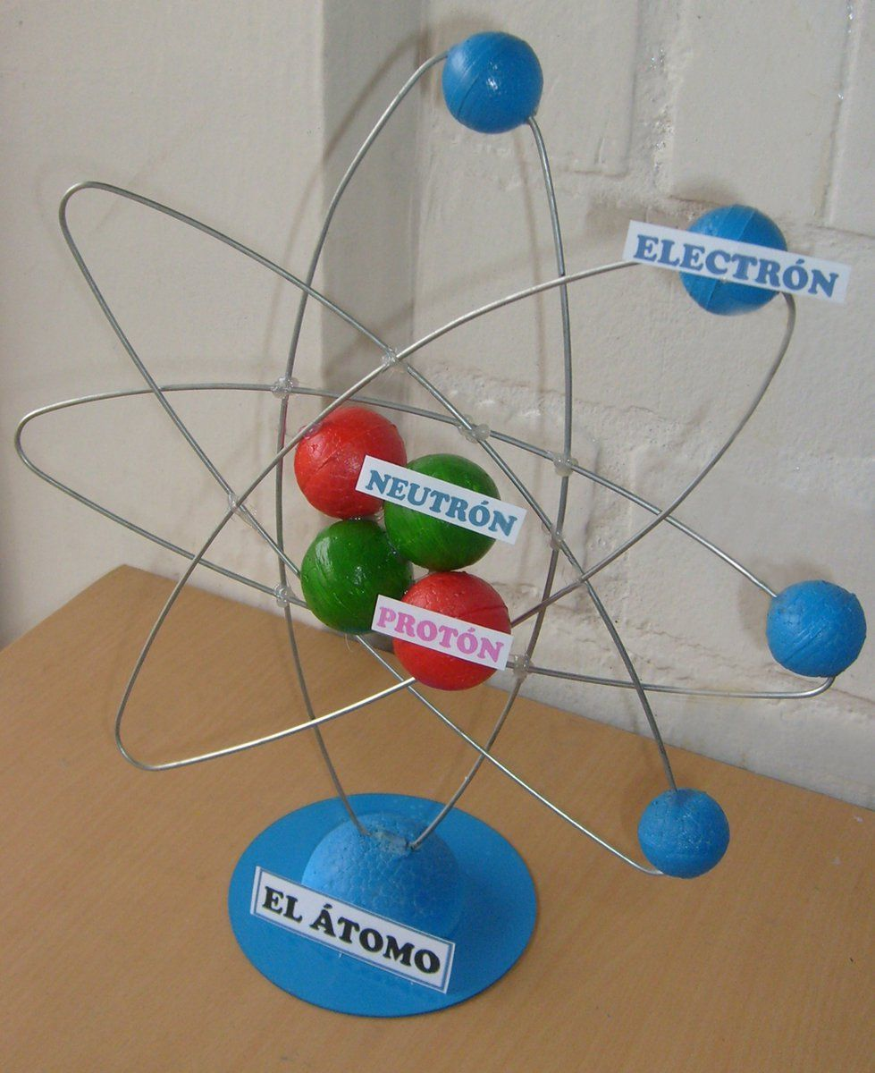
Why do we use models ?
Learning Objectives
Define A model.
State difference between scientific theory and law.
1.1 Methods of Science
Textbook Page 06

Slide 34
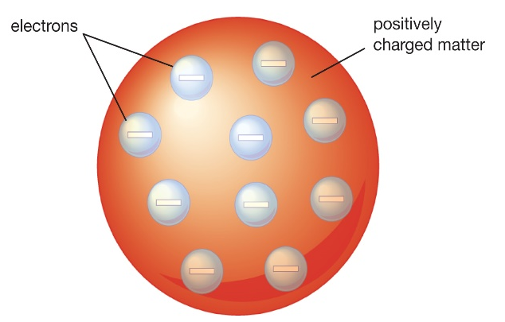
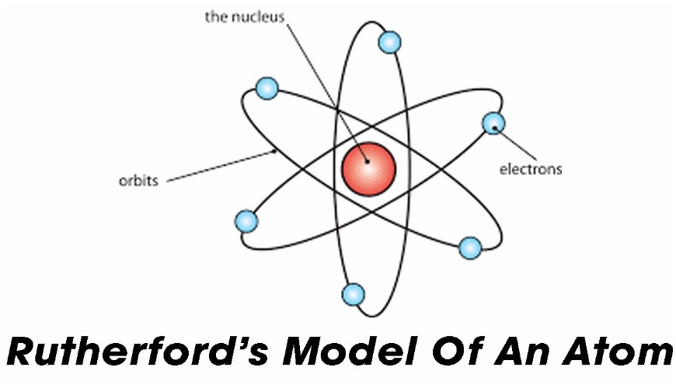
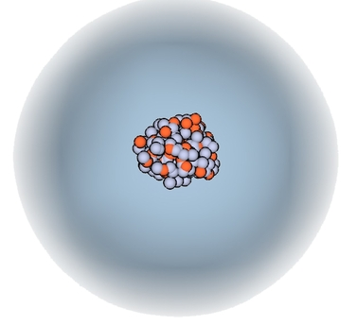
Learning Objectives
Models in history
Define A model.
State difference between scientific theory and law.
Thomson’s Model ( 1904 )
Rutherford’s Model ( 1911 )
model
Is a representation of an Idea , structure , or object that helps people better understand it
Electron Cloud Model ( Present Day )
Nucleus
( Made of protons and neutrons )
Electron Cloud
ATOM
1.1 Methods of Science
Textbook Page 05

Slide 35

Learning Objectives
High tech models
Define A model.
State difference between scientific theory and law.
COMPUTER SIMULATION
A computer simulation uses a computer to test process or procedure and to collect data.
  Computer software is designed to mimic the processes under study.
The purpose of the simulation is to predict the results of something. Such as Airplane test drive.
1.1 Methods of Science
Textbook Page 05

Slide 36


Slide 37
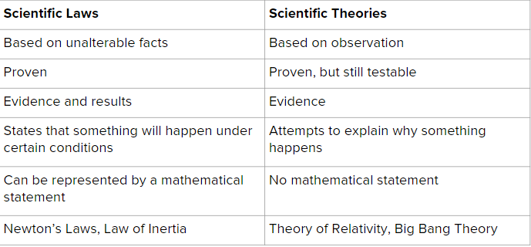
Learning Objectives
Scientific theory & Law
Define A model.
State difference between scientific theory and law.
Scientific Law
Scientific Theory
القانون العلمي
نظرية علمية
Is a statement about what happens in nature and seems to be true all the time.
( Predict what happens )
Is an explanation of things or events based on knowledge gained from many observations and investigations.
( Predict why it happens )
1.1 Methods of Science
Textbook Page 07

Slide 38
Learning Objectives
Important notes
Define A model.
State difference between scientific theory and law.
1. If many investigation and the results always support the hypothesis, the hypothesis can be called a theory.
2. Theories can change over time.
3. Laws don’t explain why or how something happens. Theories do.
4. A theory can be used to explain a law, but theories do not become laws.
1.1 Methods of Science
Textbook Page 07

Slide 39
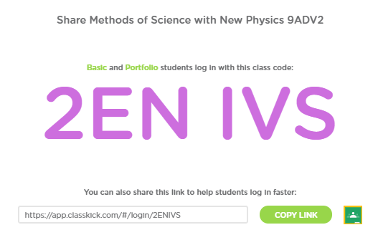

Learning Objectives
Check your understanding
Define A model.
State difference between scientific theory and law.
https://app.classkick.com/#/login/2ENIVS
1.1 Methods of Science
Textbook Page 07

Slide 40
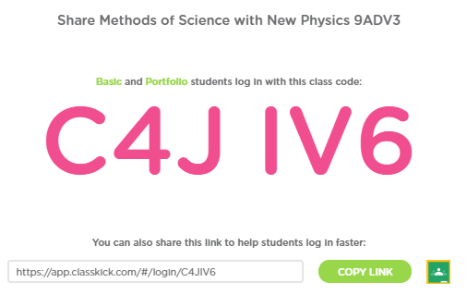
Learning Objectives
Check your understanding
Define A model.
State difference between scientific theory and law.
https://app.classkick.com/#/login/C4JIV6
1.1 Methods of Science
Textbook Page 07

Slide 41
Learning Objectives
Check your answer
Define A model.
State difference between scientific theory and law.
Term | Definition
Model | A representation of an idea, event, struc­ture, or object that helps people better understand it.
Theory | Is an explanation of things or events based on knowledge gained from many observations and investigations.
Law | A statement about what happens in nature and seems to be true all the time
Hypothesis | A possible explanation for a problem using what you know and have observed.
1.1 Methods of Science
Textbook Page 07

Slide 42


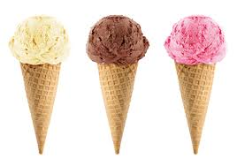
Learning Objectives
Limitations of science
Define A model.
State difference between scientific theory and law.
Science cannot explain or solve everything.
Questions about opinions, values, or emotions are not scientific because they cannot be tested.
1.1 Methods of Science
Textbook Page 07

Slide 43
Learning objectives
01
Define A model.
02
State difference between scientific method and law
1.1 Methods of Science
Textbook Page 07

Slide 44
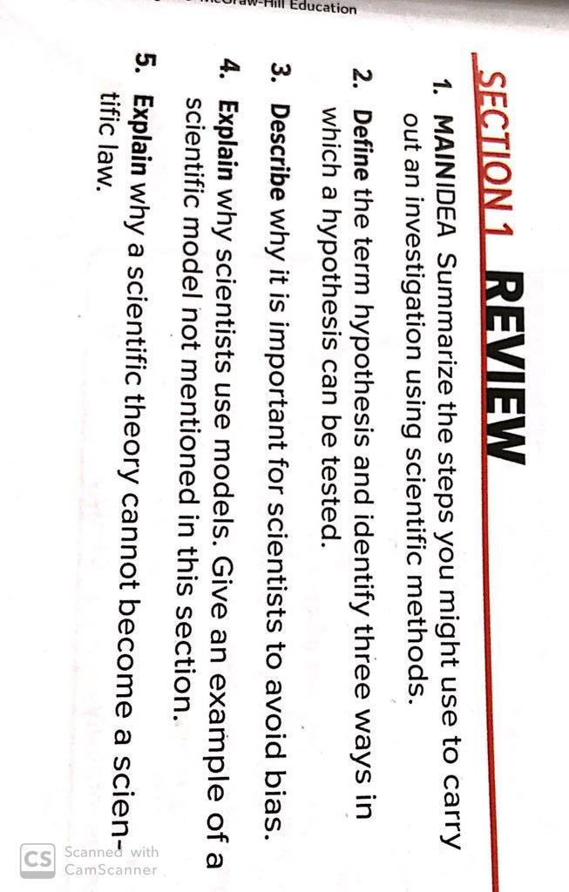
Section review

Slide 45
Answer key
1) Purpose, Research, Hypothesis, Experiment, Analysis, Conclusion, Repeat
2) A possible explanation for a problem using what you know and observed – Experiment , Making observations, building models, and relating it to real life situations
3) To insure that the information is not being persuaded to a certain answer.
4) To represent things that are too small/large, processes that take too much time or dangerous material
5) Scientific theories are based on knowledge gained from observations and investigations which a scientific law has been proven and is always true.

Slide 46

THANK YOU FOR Attending

