Slide 1
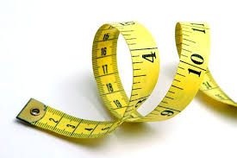
Measurement

Slide 2


Main idea:
Making careful measurements allows scientists to repeat experiments and compare results.

Slide 3
Essential Questions:
Why are the results of measurements often reported with an uncertainty?
What is the difference between precision and accuracy?
What is a common source of error when making a measurement?

Slide 4
Key words and expressions:
Review vocabulary
Parallax the apparent shift in the position of an object when it is viewed from different angles
New vocabulary
  Measurement
  Precision
  Accuracy

Slide 5



Students will be able to:
Learning Objectives
Define what a measurement is.
Recognize the difference between error and uncertainty.
State the difference between precision and accuracy.

Slide 6
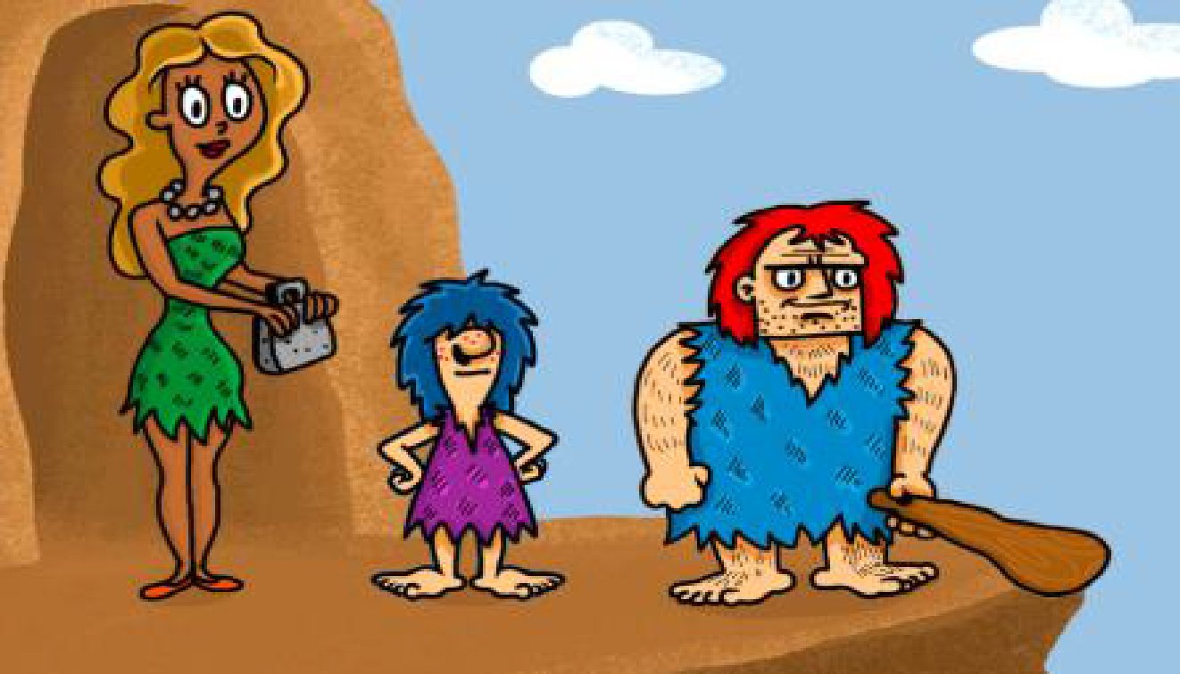
BRAIN GEAR
“Sam is taller than Dany. Dany is taller than Alex. Which one is Dany?”

Slide 7
What is a Measurement?
A measurement is a comparison between an unknown quantity and a standard.
  Ex. Measuring the mass of a rolling cart. The unknown quantity is the cart, the standard is the gram as defined the instrument being used.
Careful measurements enable you to derive the relationship between any two quantities.

Slide 8
Comparing Results
When a measurement is made, the results are often reported with uncertainty.
Therefore, before fully accepting new data, other scientists examine the experiment, looking for possible sources of errors, and try to reproduce the results.
Sometimes none of the measurements exactly matches but the uncertainties in all measurements should in all overlap, and the agree with each other.

Slide 9
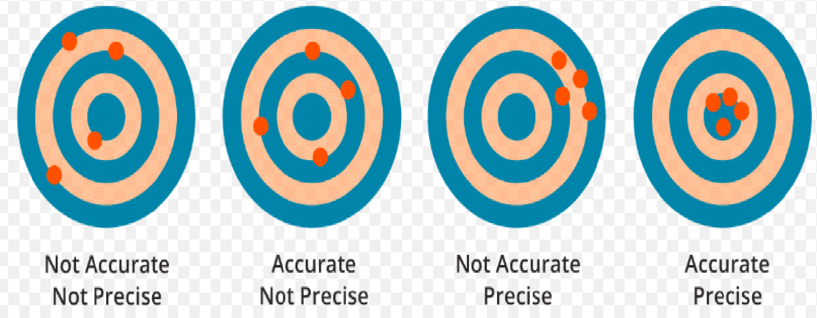
Precision Versus Accuracy

Slide 10
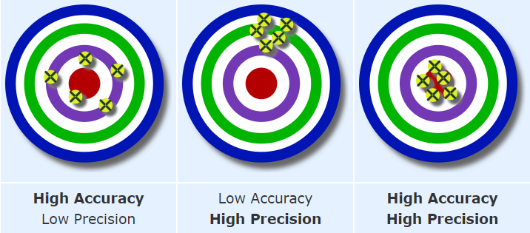
Precision Versus Accuracy
Look at the picture then try to answer the question
What is the difference between precision and Accuracy?

Slide 11
Precision Versus Accuracy
Precision
The degree of exactness of a measurement.
Accuracy
Describes how well the results of a measurement agree with the “real” value

Slide 12

https://www.youtube.com/watch?v=KEeSQvMCPLg&ab_channel=2MinuteClassroom
Lets watch this video

Slide 13
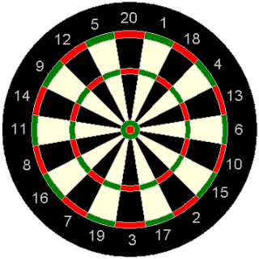
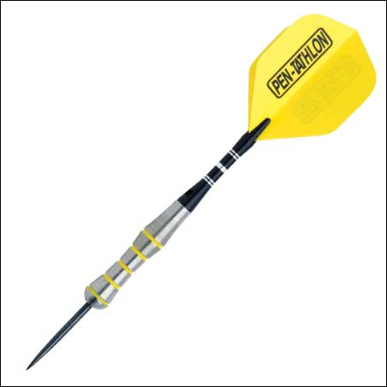


✔
✔

Slide 14
🗶
✔
Notes:
Teacher note:- Average of the three arrows would be on the bulls eye so is accurate.

Slide 15
✔
🗶

Slide 16
🗶
🗶

Slide 17
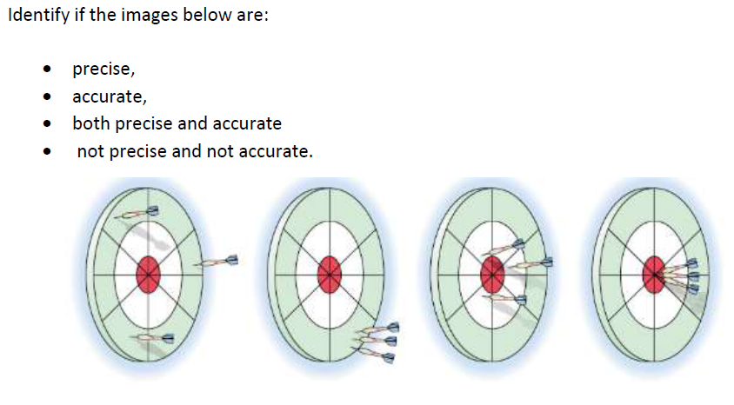
Activity 1

Slide 18
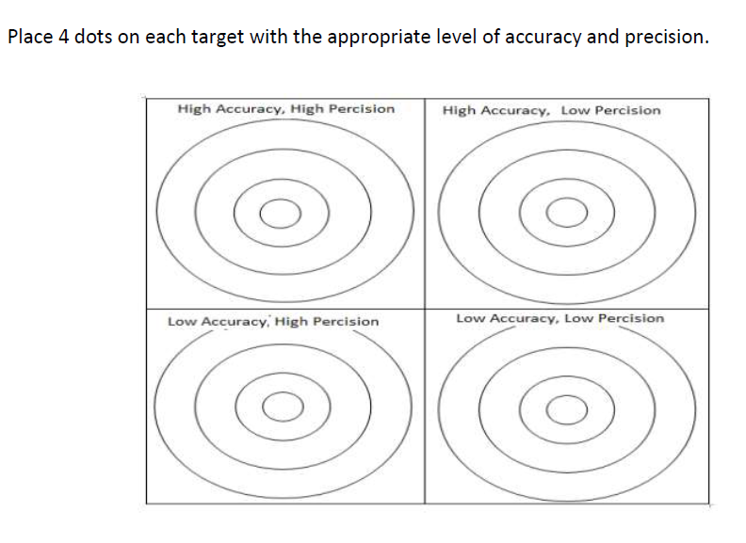
Activity 2

Slide 19


