Slide 1

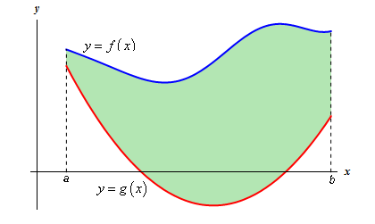
6-1Area Between Curves
Grade 12 advance

Slide 2
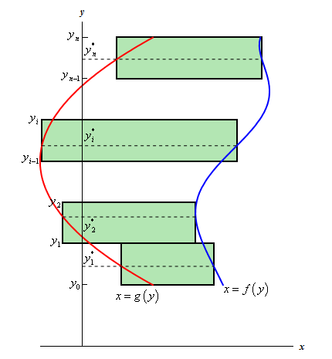
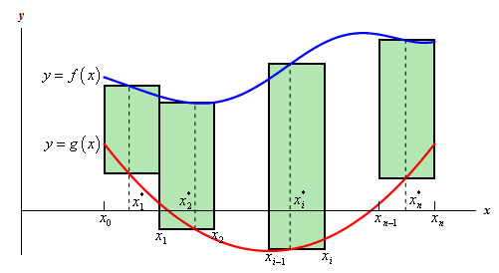
Learning Objectives:
1. Find the area between two curves using definite integrations.
2. Compute the area of a region using definite integration with y as a variable.

Slide 3
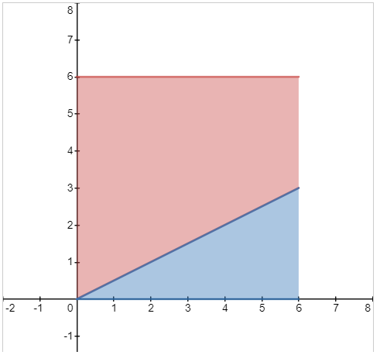
Lesson starter : what is the area of the red region (LMS)

Slide 4
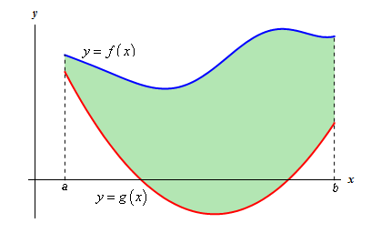

The area between two curves using definite integrations.

Slide 5
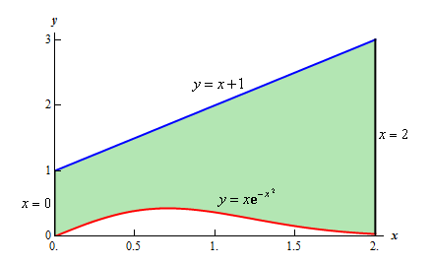




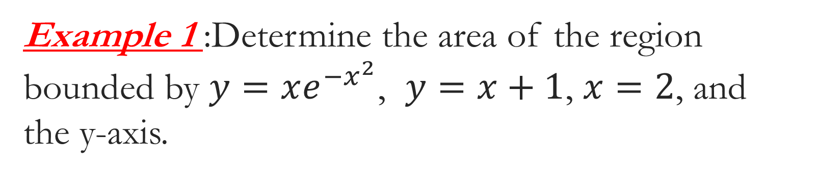
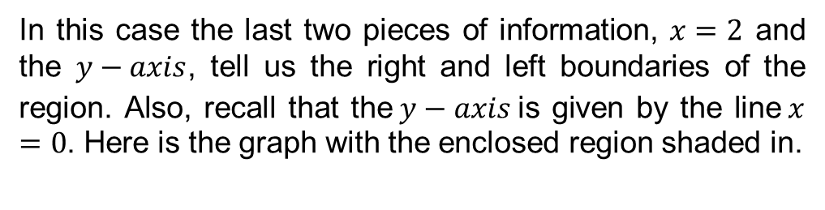
Example 1 :Determine the area of the region bounded by $y=xe^{−x^{2}}$, $y=x+1$, $x=2$, and the y-axis.
In this case the last two pieces of information, $x=2$ and the $y−axis$, tell us the right and left boundaries of the region. Also, recall that the$y−axis$is given by the line$x=0$. Here is the graph with the enclosed region shaded in.

Slide 6
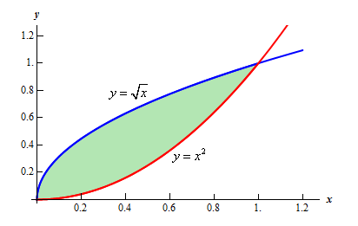



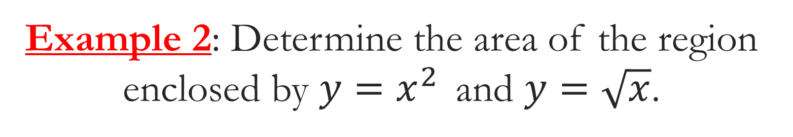
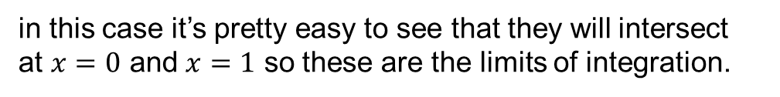
Example 2: Determine the area of the region enclosed by $y=x^{2 }$ and $y=\sqrt{x}$.
in this case it’s pretty easy to see that they will intersect at $x=0$ and $x=1$ so these are the limits of integration.

Slide 7
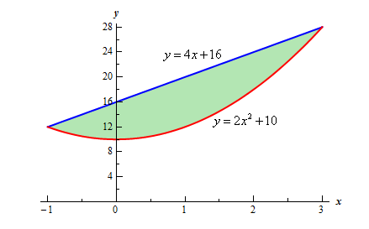

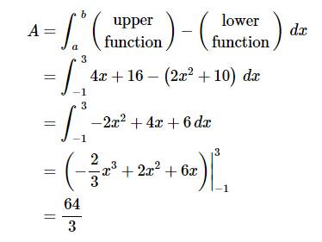
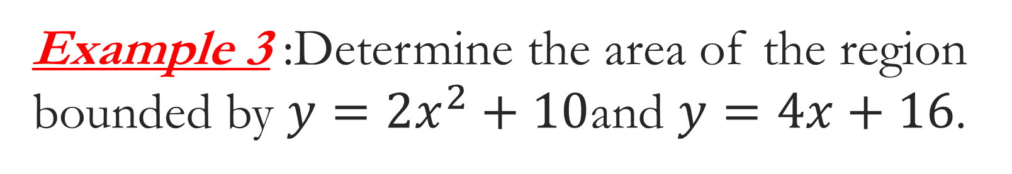
Example 3 :Determine the area of the region bounded by $y=2x^{2}+10$and $y=4x+16$.
In this case we can get the intersection points by setting the two equations equal.

Slide 8

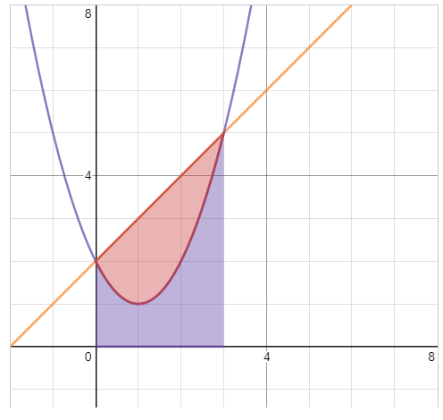
Formative assessment 1: (LMS)

Slide 9
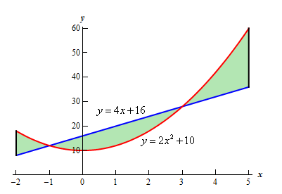
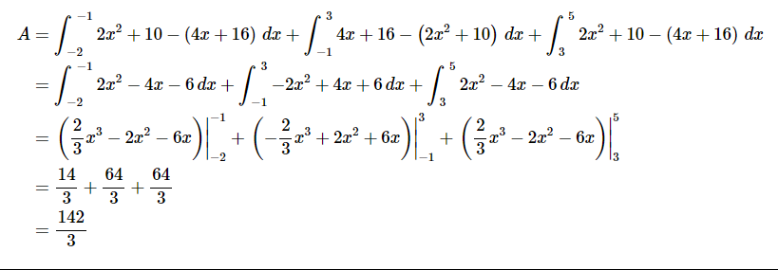
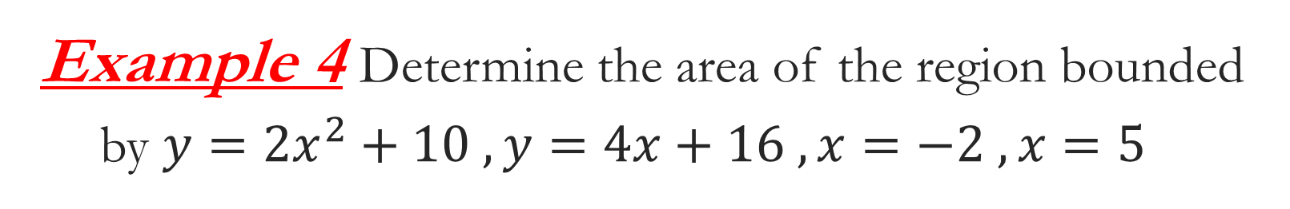
Example 4 Determine the area of the region bounded by $y=2x^{2}+10 , y=4x+16 , x=−2 , x=5$
There are three regions in which one function is always the upper function and the other is always the lower function. So, all that we need to do is find the area of each of the three regions, which we can do, and then add them all up.

Slide 10
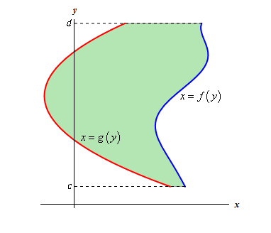

Compute the area of a region using definite integration with y as a variable.

Slide 11
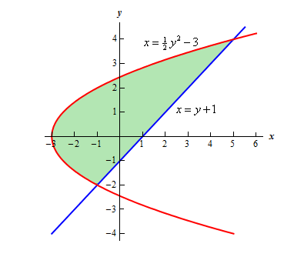
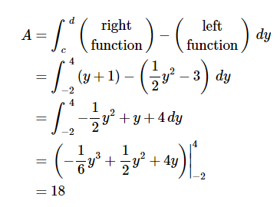
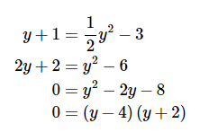
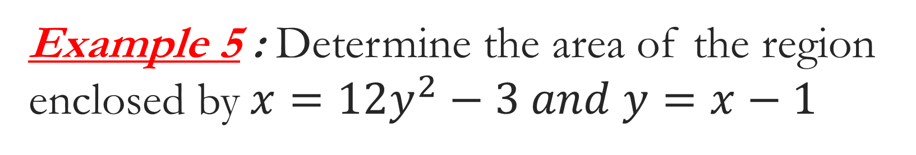
Example 5 : Determine the area of the region enclosed by$x=12y^{2}−3 and y=x−1$
In this case we’ll get the intersection points by solving the second equation for x and then setting them equal. Here is that work,

